Slide 1
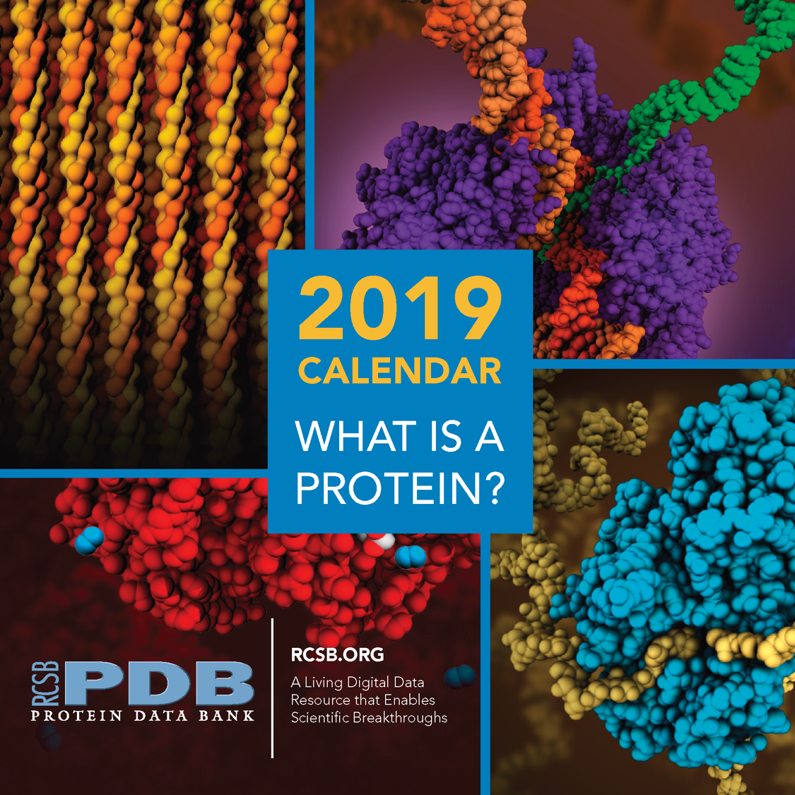
This presentation highlights the structure and function of proteins as presented in the RCSB PDB 2019 Calendar. The Calendar is available for download at pdb101.rcsb.org
Contents:
Protein Structure
Slides 2-5
Protein function:
Slides 6-17
About this calendar:
Slide 18
Note:
Click on the PDB Structure ID to explore each protein on the rcsb.org in 3D.
References can be found in the notes section.

Slide 2
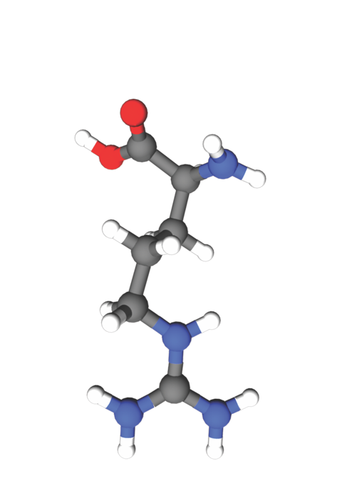
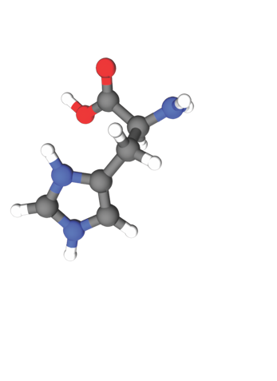
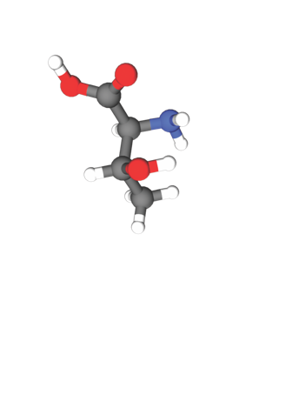
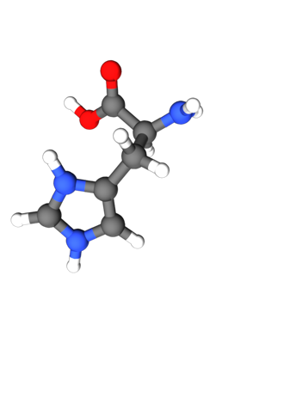
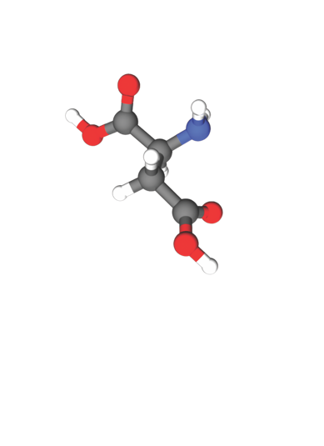
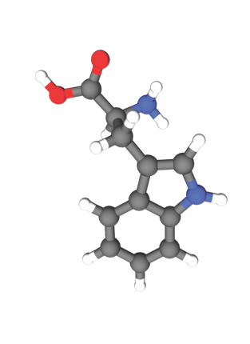
BUILDING BLOCKS
Proteins are large biomolecules built from twenty-one standard amino acids. Each amino acid contains amino and carboxyl groups, and an identifying side chain. These side chains determine the unique final shape of a protein. Some amino acids will hide away from the surrounding water, while others will interact
with water, each other, or other molecules.
Amino
Group
WHAT IS A PROTEIN?
Carboxyl
Group
Side Chain

Slide 3
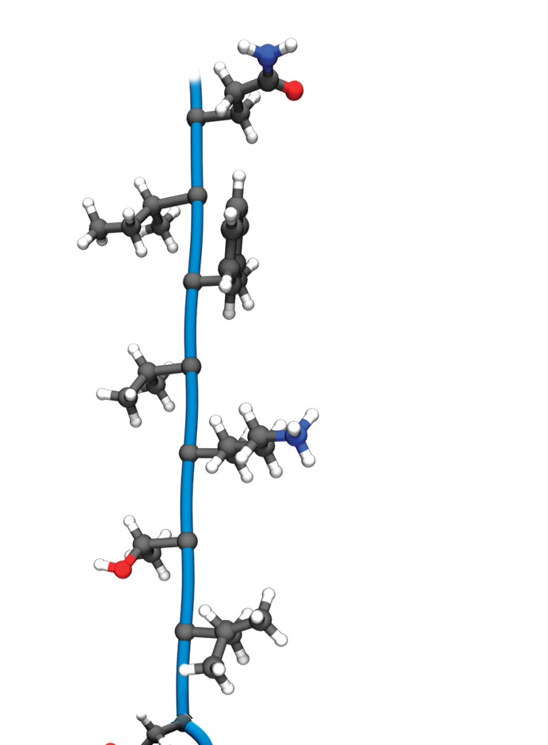
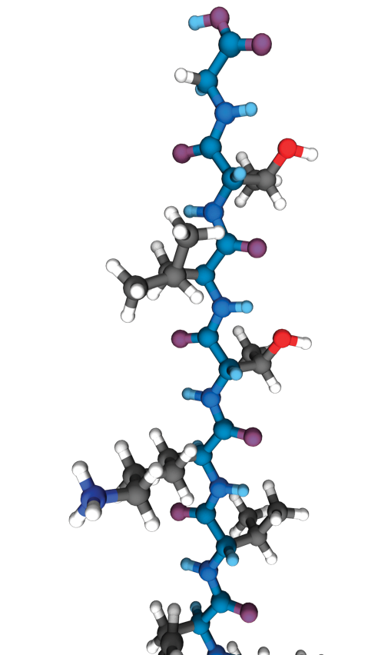
PRIMARY STRUCTURE
Primary structure is the linear sequence of amino acids as encoded by DNA. This sequence defines how the protein will fold and therefore how it will function.
The linked series of residual carboxyl and amino groups are known as the protein backbone (shown as atoms
on the right in blue and
as a pipe on the left).
WHAT IS A PROTEIN?
Protein Backbone
Side Chain

Slide 4
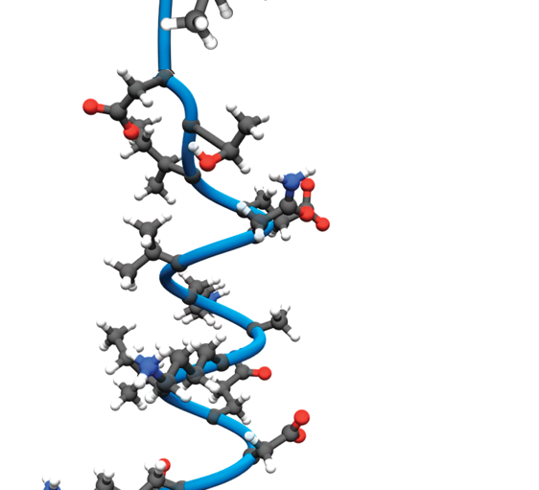
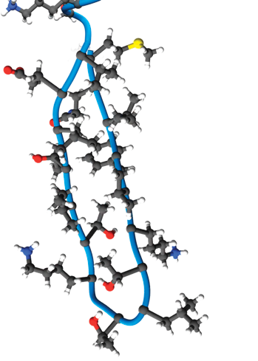
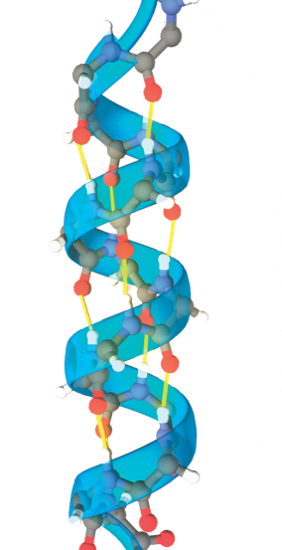
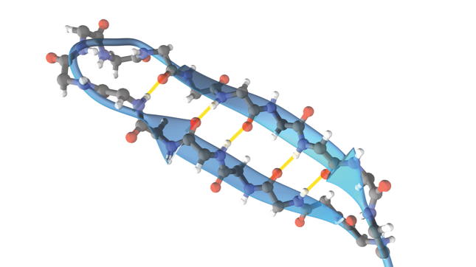
SECONDARY STRUCTURE
Hydrogen bonds between amino acids form two particularly stable structural elements in proteins: alpha helices and beta sheets. To illustrate these patterns, the side chain atoms are shown (top) and hidden (bottom).
WHAT IS A PROTEIN?
Alpha Helix
Beta-sheet
Hydrogen
bonds

Slide 5
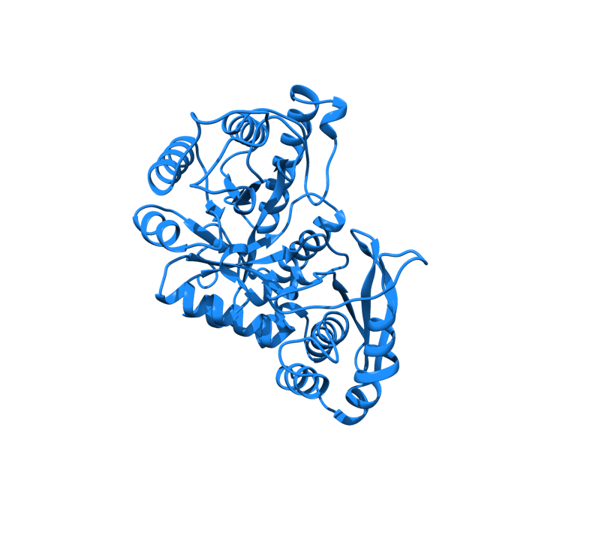
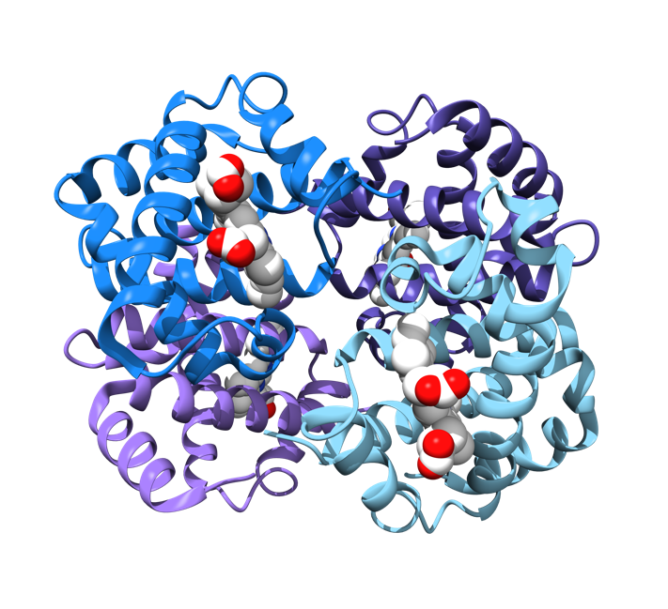
TERTIARY STRUCTURE
Protein chains fold into organized 3D structures (shapes) made up of secondary structural elements connected by random coil segments
as seen in enzyme EPSP Synthase.
WHAT IS A PROTEIN?
QUATERNARY STRUCTURE
Two or more polypeptide chains can come together to form one functional molecule with several subunits. The four subunits of hemoglobin cooperate so that the complex picks up and delivers more oxygen than is
possible with single subunits.

Slide 6
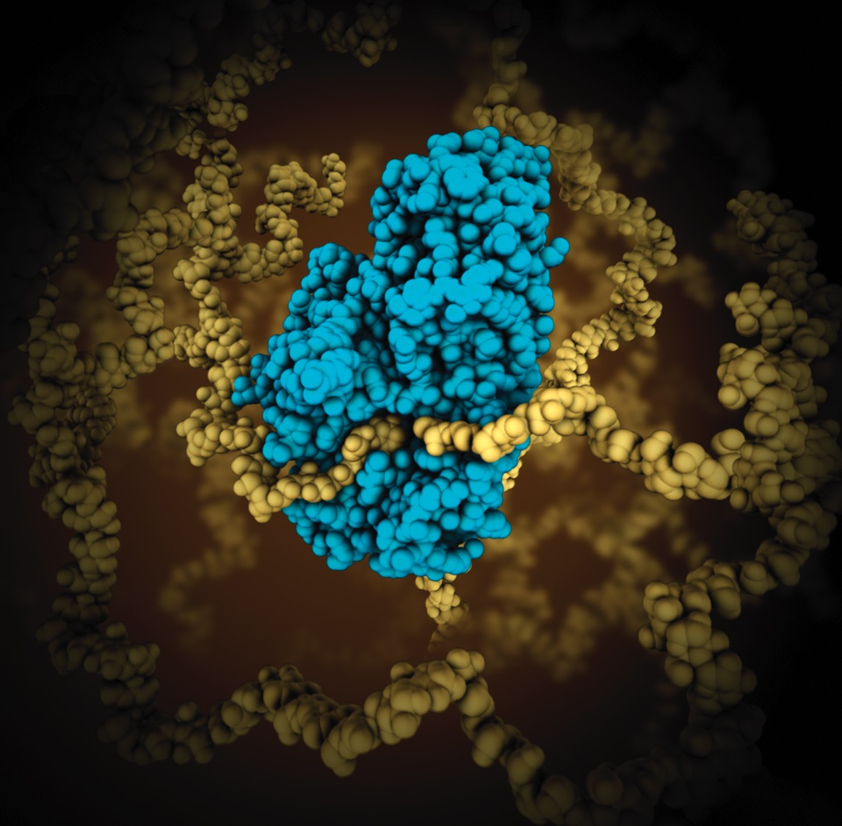
Enzymes have catalytic sites that perform the myriad reactions needed to sustain life. For example, alpha-amylase (turquoise) is found in saliva where it begins the breakdown of complex carbohydrates (yellow) into glucose and maltose. The food industry takes advantage of this
activity using the enzyme in large quantities in
the production of high fructose corn syrup.
Protein Function
ENZYMES
PDB Structure 1ppi
Notes:
PDB Structure 1ppi
M. Qian et al. (1994) The active center of a mammalian alpha-amylase. Structure of the complex of a pancreatic alpha-amylase with a carbohydrate inhibitor refined to 2.2-Å resolution. Biochemistry 33: 6284-6294

Slide 7
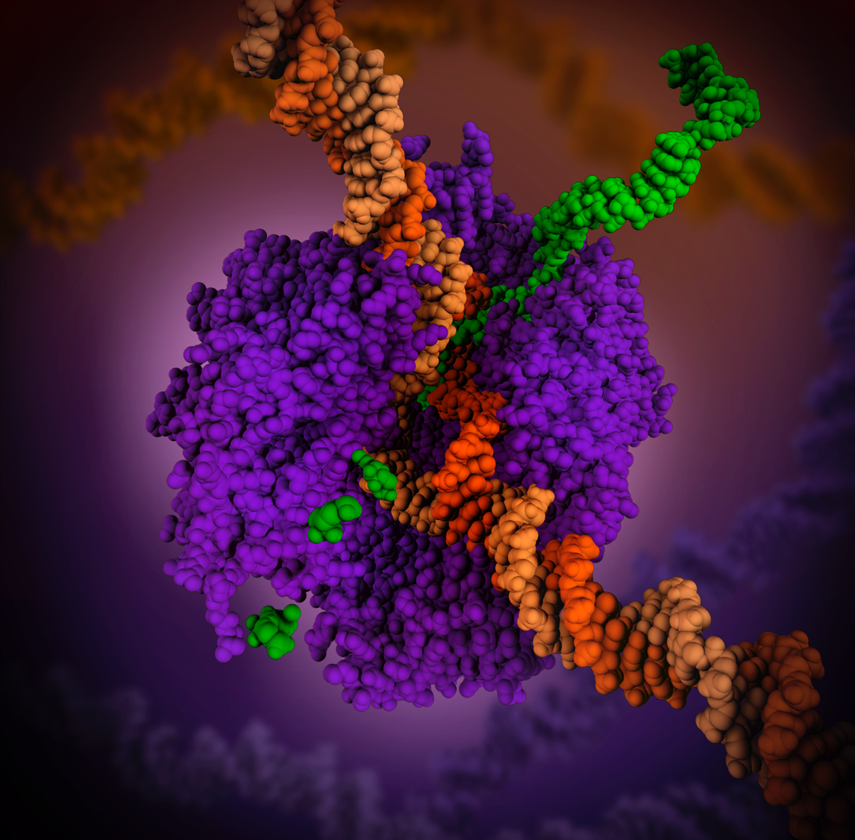
RNA polymerase is a complex enzyme at the heart of transcription. During this process, the enzyme unwinds the DNA double helix and uses one strand (darker orange) as a template to create the single-stranded
messenger RNA (green), later used by ribosomes for protein synthesis.
Protein Function
ENZYMES
PDB Structure 1i6h
Notes:
PDB Structure 1i6h
L. Gnatt et al. (2001) Structural basis of transcription: an RNA polymerase II elongation complex at 3.3 Å resolution. Science 292: 1876-1882
PDB Structure 1bna
H. R. Drew et al. (1981) Structure of a B-DNA dodecamer: conformation and dynamics.
Proc.Natl.Acad.Sci.USA 78: 2179-2183

Slide 8
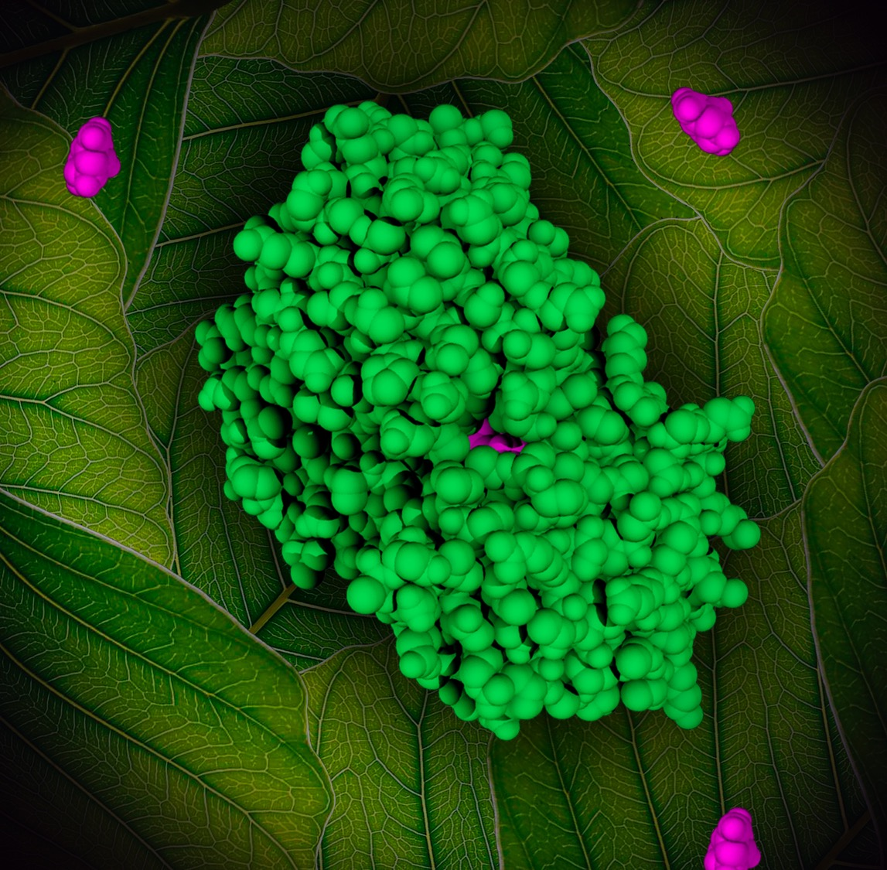
RoundUp (glyphosate, purple) ultimately kills
plants by attacking EPSP synthase (green), a key enzyme used by plants and bacteria to make the amino
acids phenylalanine, tyrosine, and tryptophan.
For effective use
of glyphosate in agriculture, plants have been engineered to use a version of the enzyme that is resistant to the herbicide. This means that glyphosate can be used to kill the weeds but not the crop.
Protein Function
ENZYMES
PDB Structure 2gga
Notes:
PDB Structure 2gga
T. Funke et al. (2006) Molecular basis for the herbicide resistance of Roundup Ready crops. Proc.Natl.Acad.Sci.Usa 103: 13010-13015
Background edited from A leaf with laminar structure and pinnate venation photo by Jon Sullivan (Public domain)

Slide 9
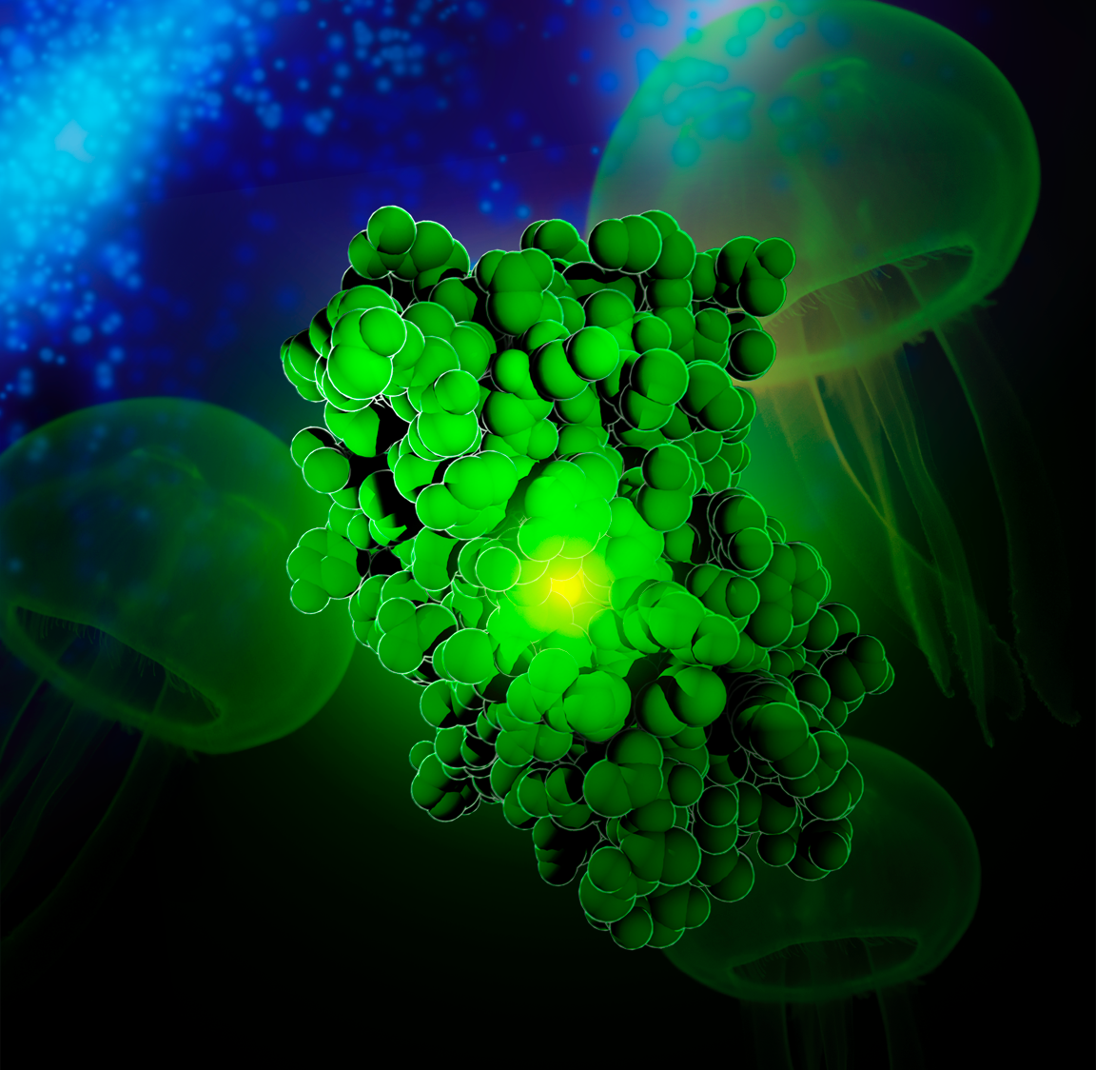
Green fluorescent protein (GFP) is
a small, stable, and brightly fluorescent
protein found in some marine organisms.
Although the biological purpose of the luminescence
is not known, biotechnology utilizes it as a marker of gene
expression and protein localization. When attached to a protein of interest,
the GFP’s glow allows visualization of the protein location inside the cell.
Protein Function
ENZYMES
PDB Structure 1gfl
Notes:
PDB Structure 1gfl
F. Yang et al. (1996) The molecular structure of green fluorescent protein. Nat.Biotechnol. 14: 1246-1251

Slide 10
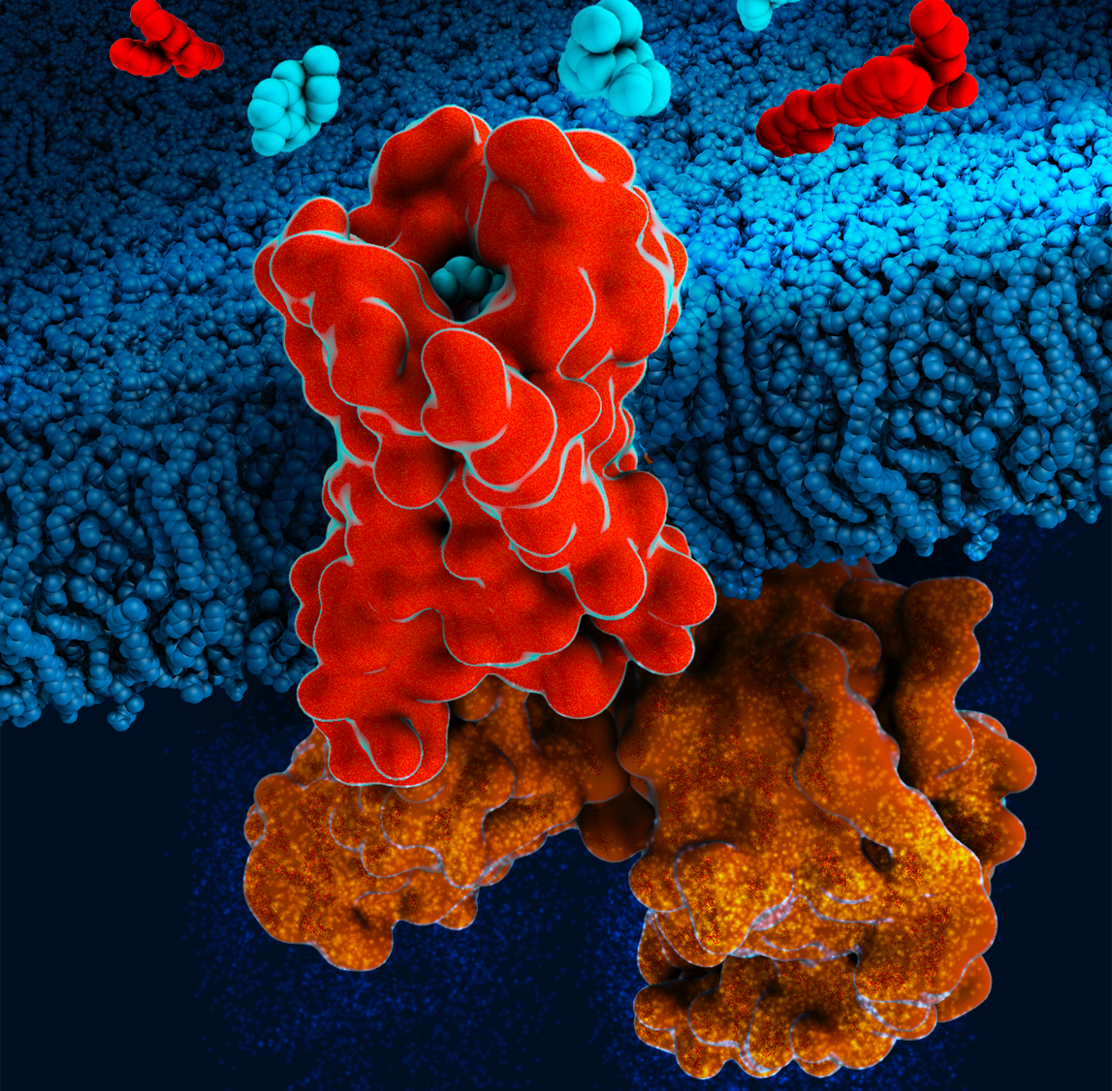
Our bodies synthesize small peptide neurotransmitters, enkephalins (shown
at top in red) and endorphins,
that bind to the opioid receptors (center) to mediate the pain signal. Opioids such as morphine (cyan)
mimic these neurotransmitters, but activate the nerve
cells in a different way, altering the pain response.
Protein Function
COMMUNICATION
PDB Structure 6dde
Notes:
PDB Structure 6dde
Koehl et al. (2018) Structure of the µ-opioid receptor–G_{i} protein complex. Nature 558: 547-552
Lipid bilayer model: Tieleman’s Biocomputing Group, University of Calgary

Slide 11
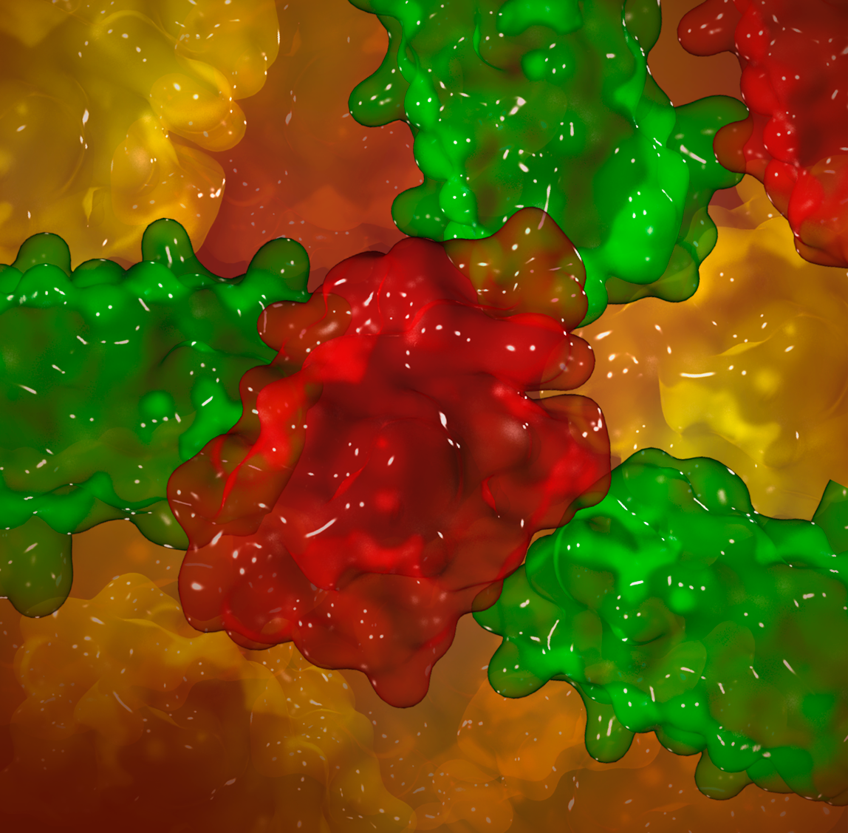
Signaling protein leptin is produced
by fat cells and sent through the blood to
special neurons in the brain to regulate the
appetite. Leptin amounts drop in starvation,
signaling the body to conserve energy by focusing only
on vital functions and simultaneously increasing appetite.
Protein Function
COMMUNICATION
PDB Structure 1ax8
Notes:
PDB Structure 1ax8
F. Zhang et al. (1997) Crystal structure of the obese protein leptin-E100. Nature 387: 206-209

Slide 12
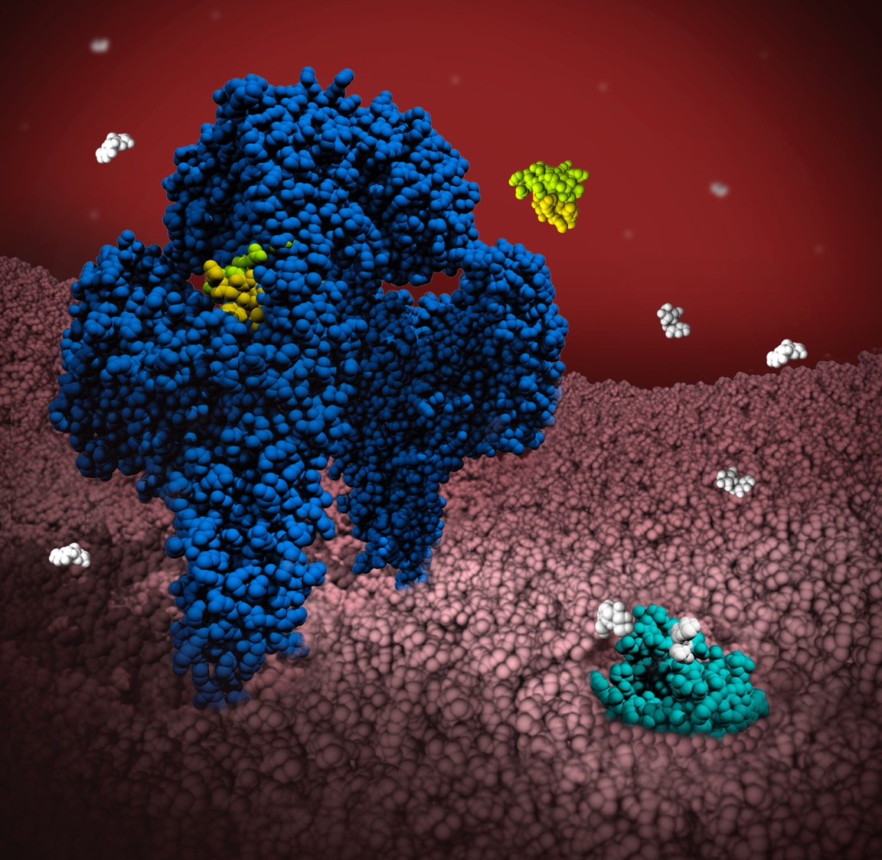
The hormone
insulin (yellow) communicates blood sugar levels.
Released by the pancreas when the glucose levels rise, insulin travels
through the blood until recognized by insulin receptors (navy) on the cellular
surface. Once the hormone and its receptor fuse, a complex intracellular signaling cascade is
triggered, causing glucose transporters (aqua) to come to the surface and uptake glucose (white).
Protein Function
COMMUNICATION
PDB Structures 3w14, 4zxb, 4zwc
Notes:
PDB Structure 3w14
J. G. Menting et al. (2013)
How insulin engages its primary binding site on the insulin receptor. Nature 493: 241-245
PDB Structure 4zxb
T. T. Croll et al. (2016) Higher-resolution structure of the human insulin receptor ectodomain: Multi-modal inclusion of the insert domain. Structure 24: 469-476
PDB Structure 4zwc
D. Deng et al. (2015) Molecular basis of ligand recognition and transport by glucose transporters. Nature 526: 391-396

Slide 13
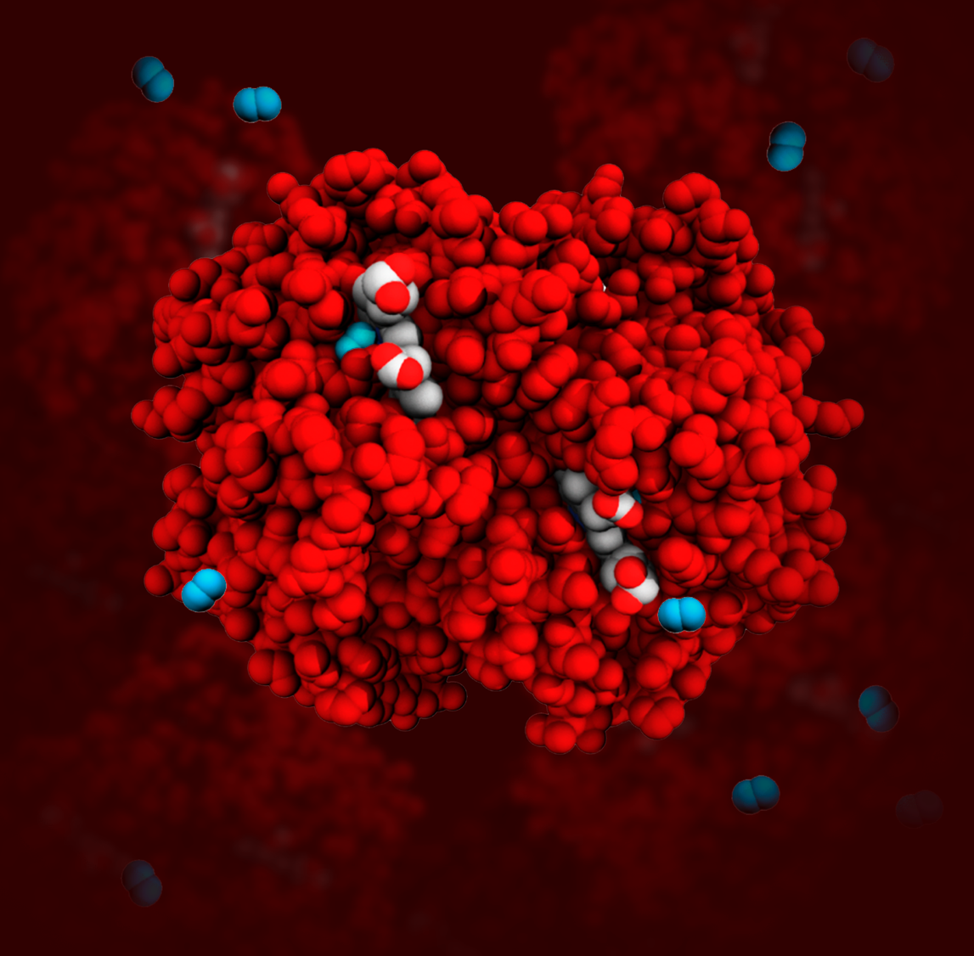
Cells need oxygen for
metabolism and maintenance.
Hemoglobin is the protein that transports oxygen.
It is composed of four chains, each
sheltering a ring-like heme group (white and red) containing
an iron atom. Oxygen (blue) binds reversibly
to these iron atoms and is transported through the blood
from our lungs to tissues throughout
the body.
Protein Function
TRANSPORT
PDB Structure 4hhb
Notes:
PDB Structure 4hhb
G. Fermi et al. (1984) The crystal structure of human deoxyhaemoglobin at 1.74 Å resolution. J.Mol.Biol. 175: 159-174

Slide 14
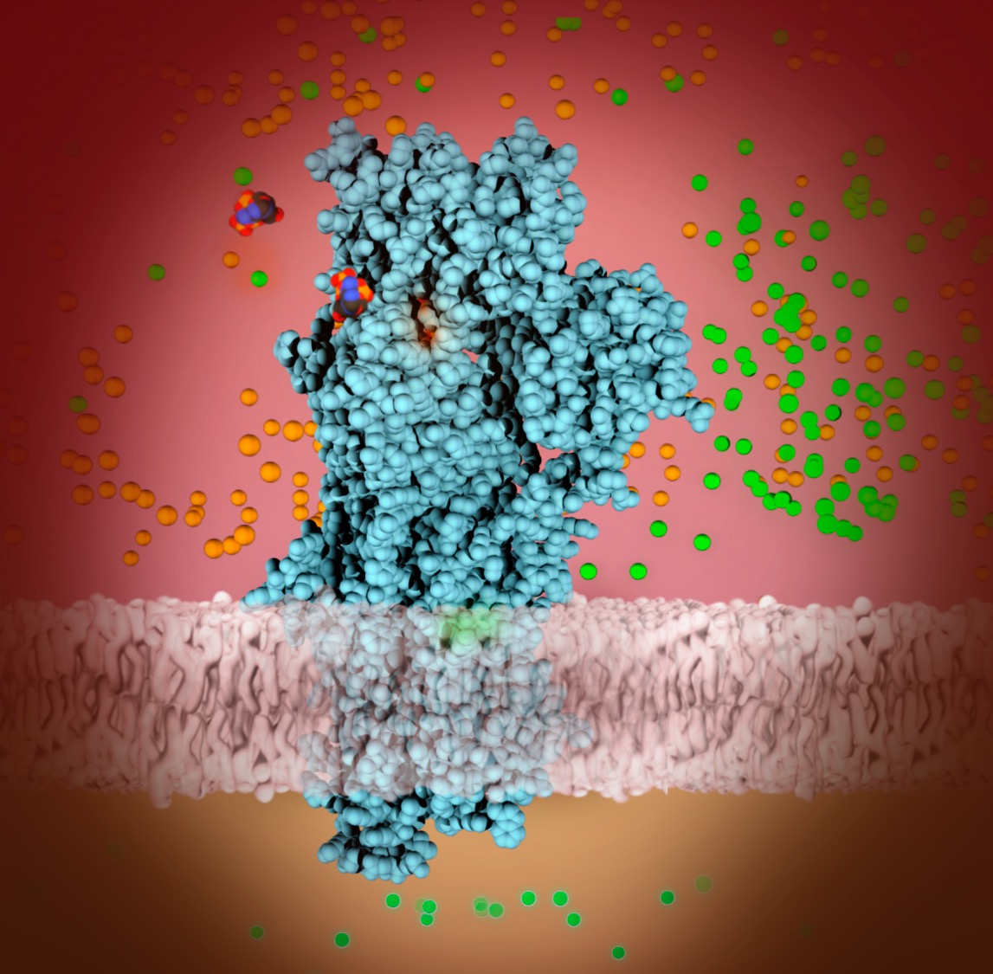
The calcium pump (blue) is a protein aided by magnesium (orange) and powered by ATP (colored by atom) to move calcium ions (green) back into the sarcoplasmic
reticulum after each
muscle contraction.
Protein Function
TRANSPORT
PDB Structure 2zbd
Notes:
PDB Structure 2zbd
C. Toyoshima et al. (2004) Lumenal gating mechanism revealed in calcium pump crystal structures with phosphate analogues. Nature 432: 361-368

Slide 15
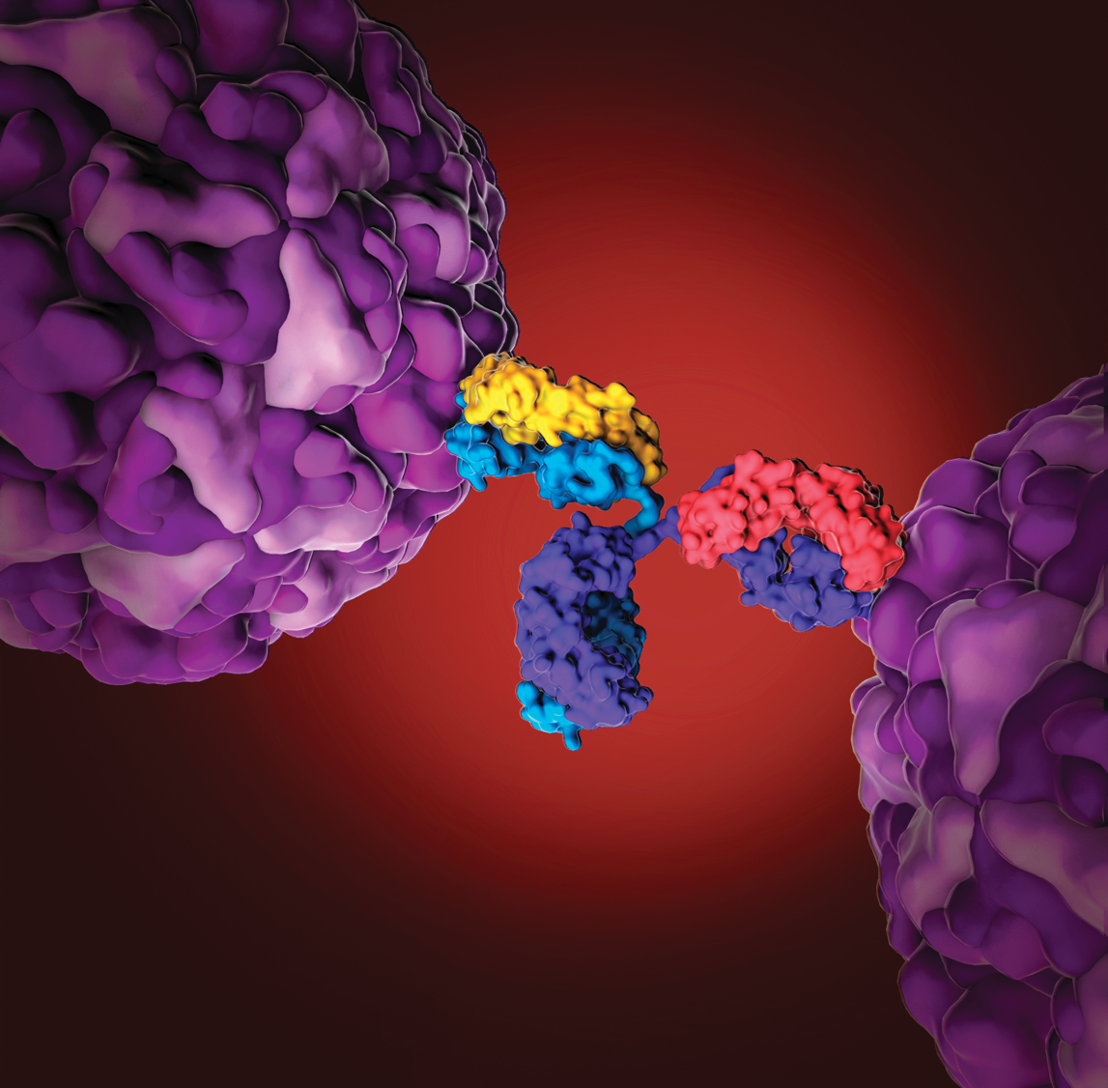
Antibodies (center) are central to the human immune system. Their flexible arms have binding sites that attach to foreign molecules such as viruses (purple) tagging them for destruction.
Protein Function
DEFENSE
PDB Structures 1igt and 4rhv
Notes:
PDB Structure 1igt
L. J. Harris et al. (1997) Refined structure of an intact IgG2a monoclonal antibody. Biochemistry 36: 1581-1597
PDB Structure 4rhv
E. Arnold et al. (1988) The use of molecular-replacement phases for the refinement of the human rhinovirus 14 structure. Acta Crystallogr., Sect.A 44: 270-282

Slide 16
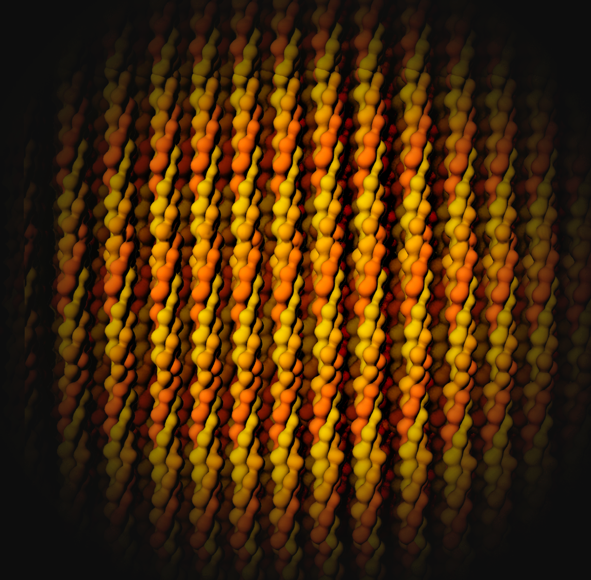
Collagen, the most abundant protein in our bodies, is used for structural support in fibrous tissues such as tendons, ligaments, and skin.
The three chains of collagen are wound into triple helices, which then form elongated fibrils.
Protein Function
STRUCTURE
PDB Structure 1cag
Notes:
PDB Structure 1cag
J. Bella et al. (1994) Crystal and molecular structure of a collagen-like peptide at 1.9 Å resolution. Science 266: 75-81

Slide 17
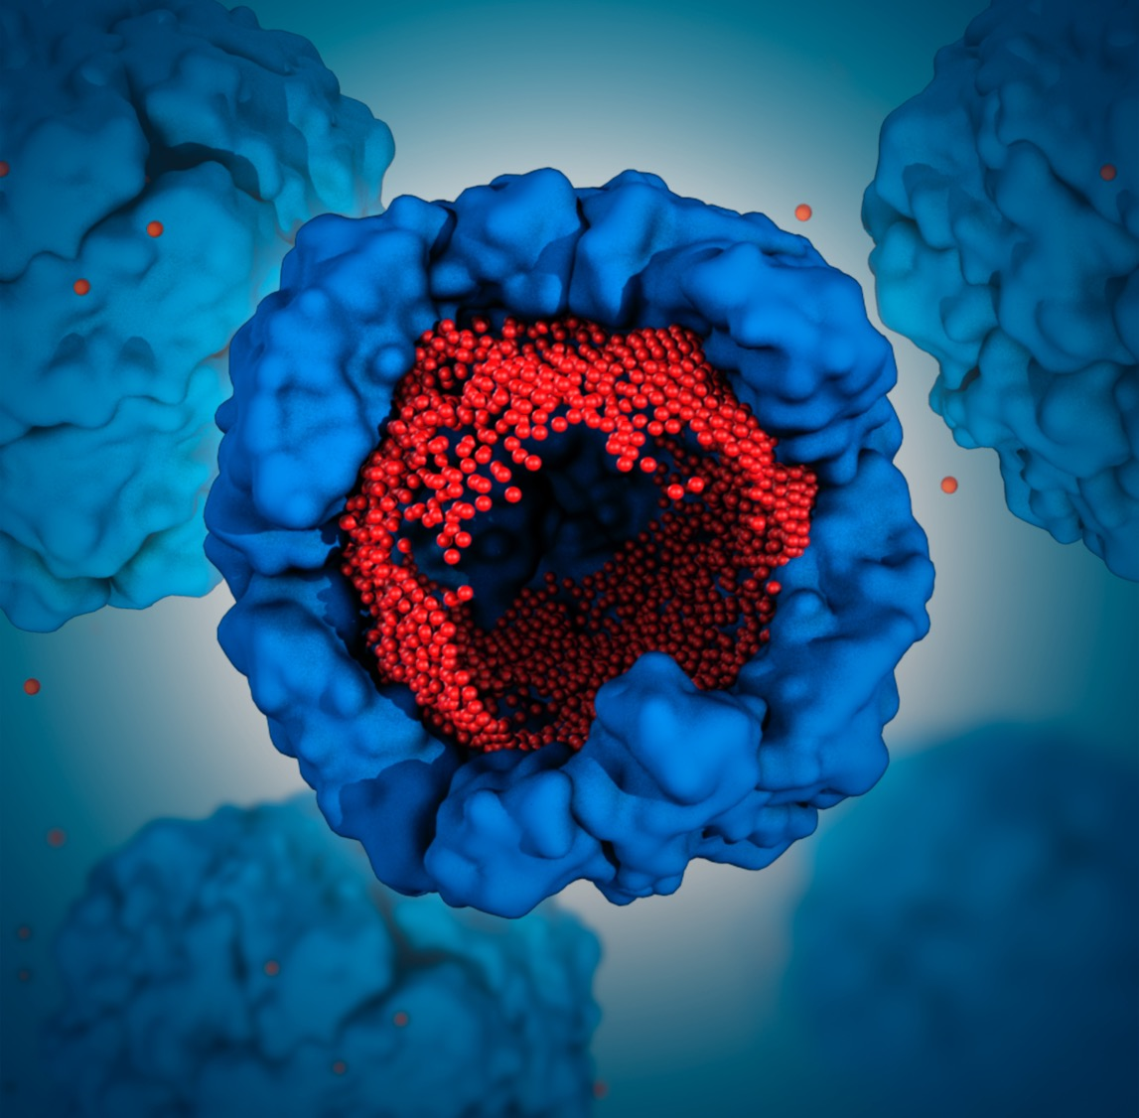
Ferritin helps balance iron levels within the human body. It is composed of 24 identical protein subunits that form a hollow shell. Pores within this shell allow iron (red) to enter for storage and exit as needed.
Protein Function
STORAGE
PDB Structure 1fha
Notes:
PDB Structure 1fha
D. M. Lawson et al. (1991) Solving the structure of human H ferritin by genetically engineering intermolecular crystal contacts. Nature 349: 541-544

Slide 18

The illustrations in this presentation/calendar were created by Maria Voigt.
Many of the visualizations are featured in the educational
video What is a Protein?
available on PDB-101.
rcsb.org
pdb101.rcsb.org
A Living Digital
Data Resource that
Enables Scientific Breakthroughs
Molecular Explorations through
Biology and Medicine
ABOUT THIS CALENDAR
Molecular images were created using UCSF Chimera (E. F. Pettersen et al. (2004) Chimera–a visualization system for exploratory research and analysis. J Comput Chem 25: 1605-1612) and Molecular Maya, a free plugin for Autodesk Maya that lets users import, model and animate molecular structures available at clarafi.com.
RCSB PDB is a member of the Worldwide PDB (wwpdb.org).
The RCSB PDB is managed by the members of the Research Collaboratory for Structural Bioinformatics:
Rutgers and UCSD/SDSC
PDB-101 is the educational portal of the RCSB PDB developed for teachers, students, and the general public to promote exploration in the 3D world of proteins and nucleic acids.
RCSB PDB is funded by a grant (DBI-1338415) from the National Science Foundation, the National Institutes of Health, and the US Department of Energy.

