Slide 1
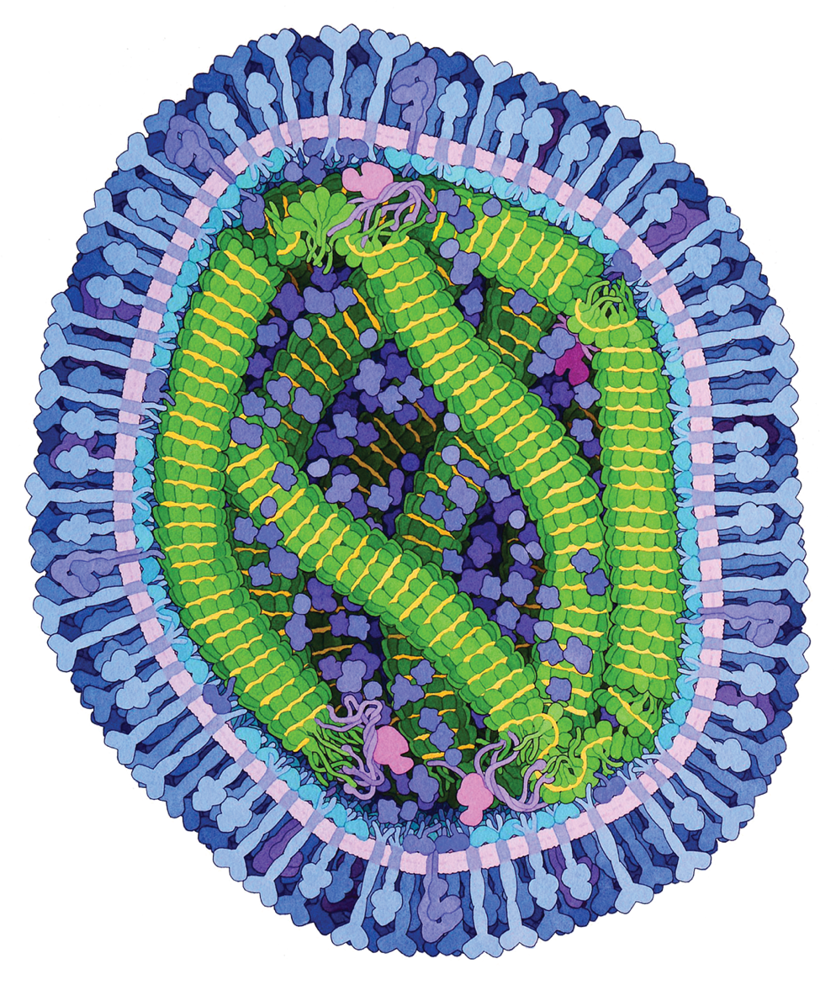


Measles Virus Proteins
March 2019

Slide 2
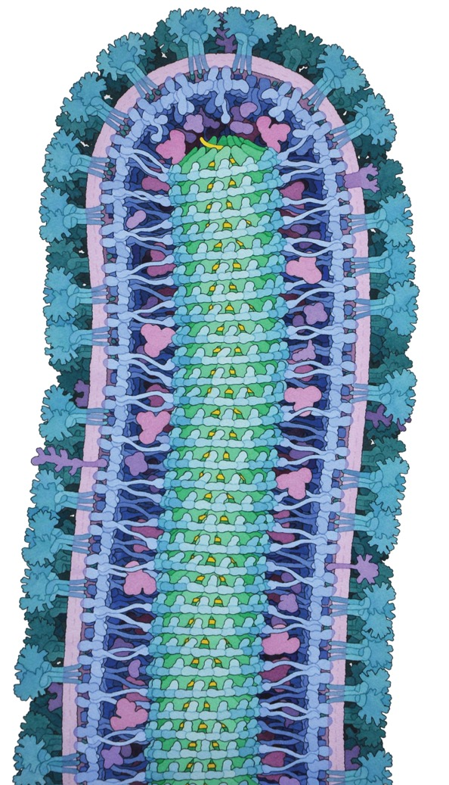
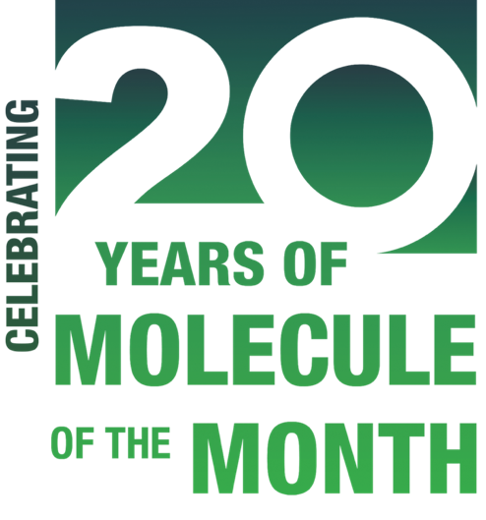
Since 2000, the RCSB PDB Molecule of the Month series has introduced millions of visitors to the shape and function of the 3D structures archived in the Protein Data Bank. The Molecule of the Month is presented as part of PDB-101, the education portal of the RCSB PDB.
Created and illustrated by David S. Goodsell (RCSB PDB-Rutgers and The Scripps Research Institute), this feature tells stories about molecular structure and function, their diverse roles within living cells, and the growing connections between biology and nanotechnology.
Ebola Virus Proteins, October 2014

Slide 3
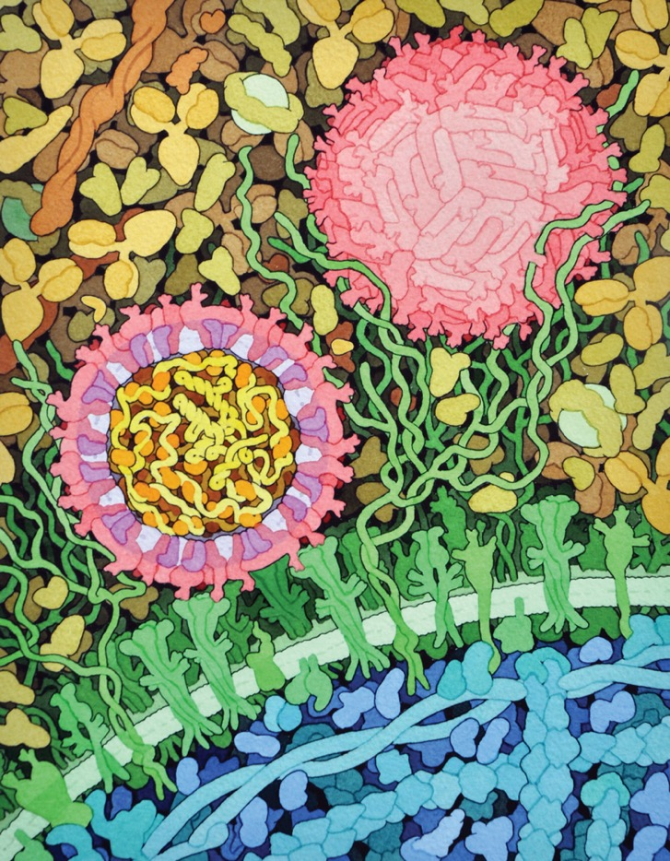
The top-accessed Molecule of the Month articles are highlighted in this presentation, culminating in the highest-ranked Hemoglobin (co-authored with Shuchismita Dutta) and Catalase.
Access the selected features using links provided on each of the following slides or access the whole collection on pdb101.rcsb.org.
References and PDB IDs for the structures shown in this presentation can be found in the notes section.
Zika Virus, May 2016

Slide 4
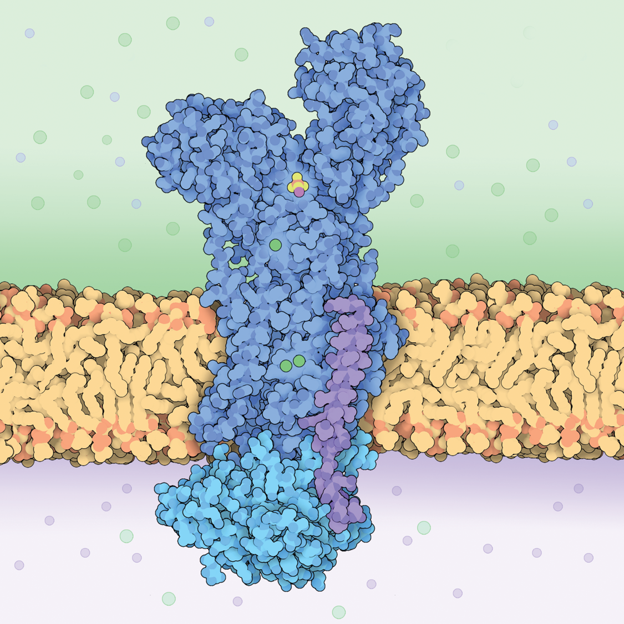
SODIUM-POTASSIUM PUMPS use the energy from ATP to pump ions across a membrane
Sodium-Potassium Pump October 2009
Notes:
PDB Structure 2zxe
Crystal structure of the sodium-potassium pump at 2.4 Å resolution.
T. Shinoda et al. (2009) Nature 459: 446-450

Slide 5
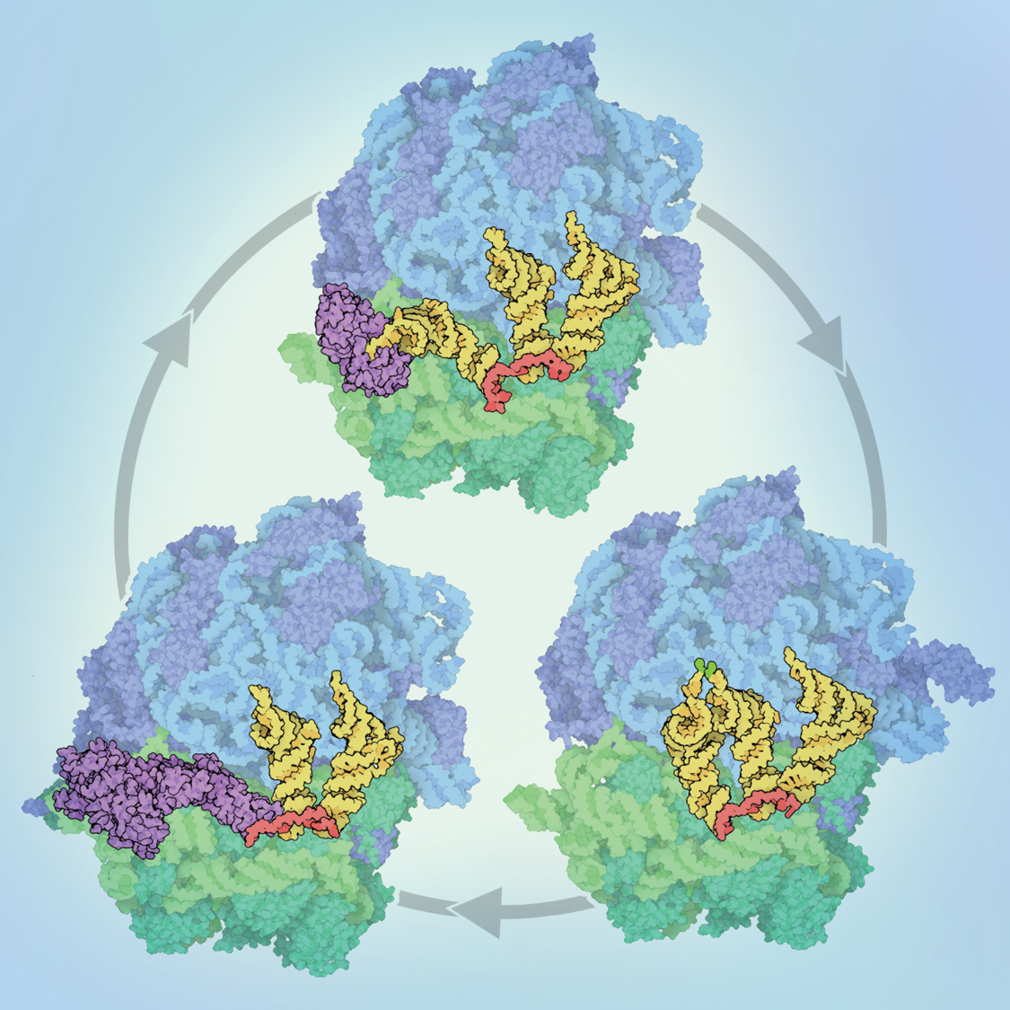
Three structures capture the basic steps of protein synthesis by RIBOSOMES
Ribosome January 2010
Ribosomal Subunits October 2000
Notes:
PDB Structure 4v5g, 4v5f
The structure of the ribosome with elongation factor G trapped in the posttranslocational state
Y.G. Gao et al. (2009) Science 326: 694-699
PDB Structure 4v5d
Insights into substrate stabilization from snapshots of the peptidyl transferase center of the intact 70S ribosome
R.M. Voorhees et al. (2009) Nat. Struct. Mol. Biol. 16: 528-533

Slide 6
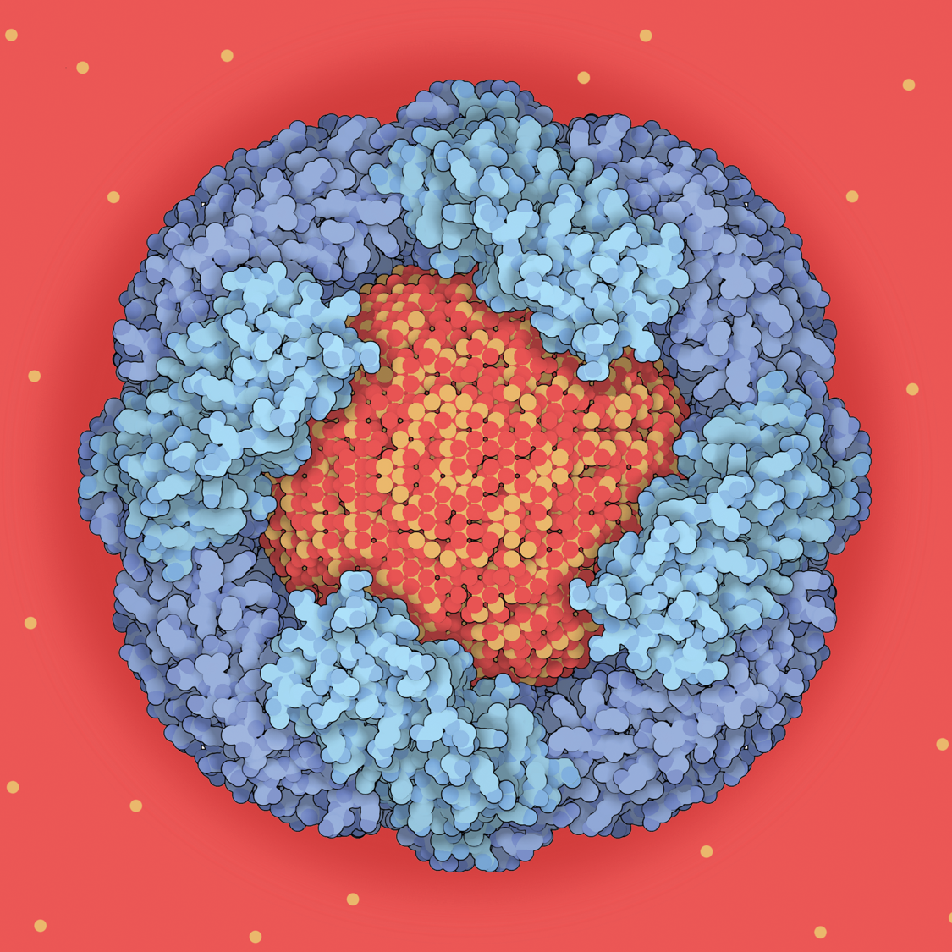
FERRITIN proteins form a shell that stores iron ions
Protein Function
ENZYMES
Ferritin and Transferrin November 2002
Notes:
PDB Structure 1hrs
A crystallographic study of haem binding to ferritin
G. Precigoux et al. (1994) Acta Cryst. D50: 739-743

Slide 7
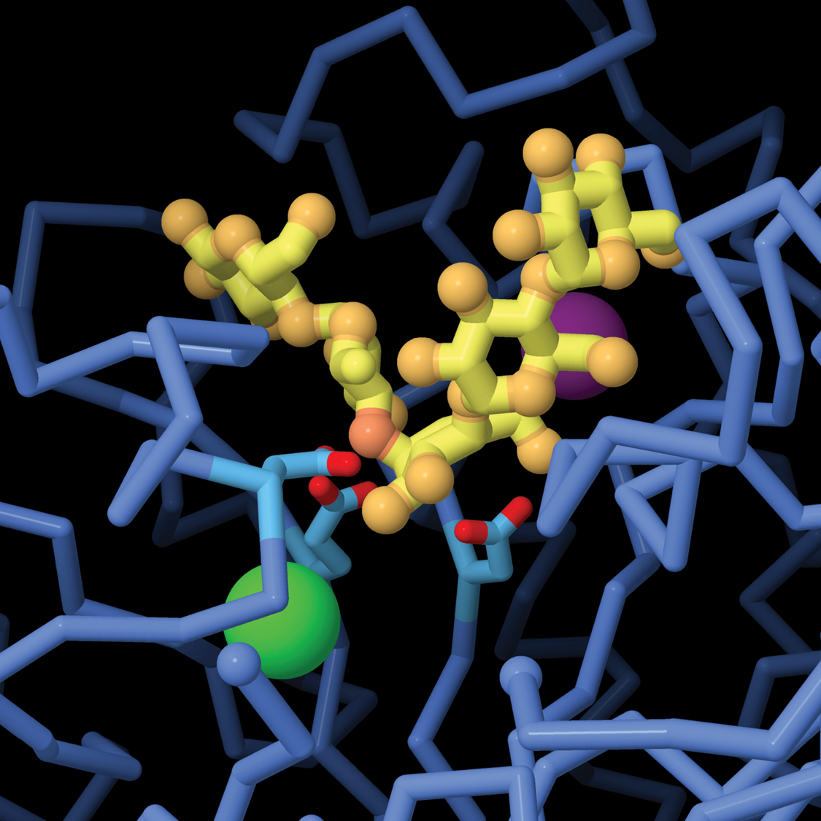
The enzyme
ALPHA-AMYLASE digests starch chains
Alpha-amylase February 2006
Notes:
PDB Structure 1PPI
The active center of a mammalian alpha-amylase. Structure of the complex of a pancreatic
alpha-amylase with a carbohydrate inhibitor refined to 2.2-Å resolution
M. Qian et al. (1994) Biochemistry 33: 6284-6294

Slide 8
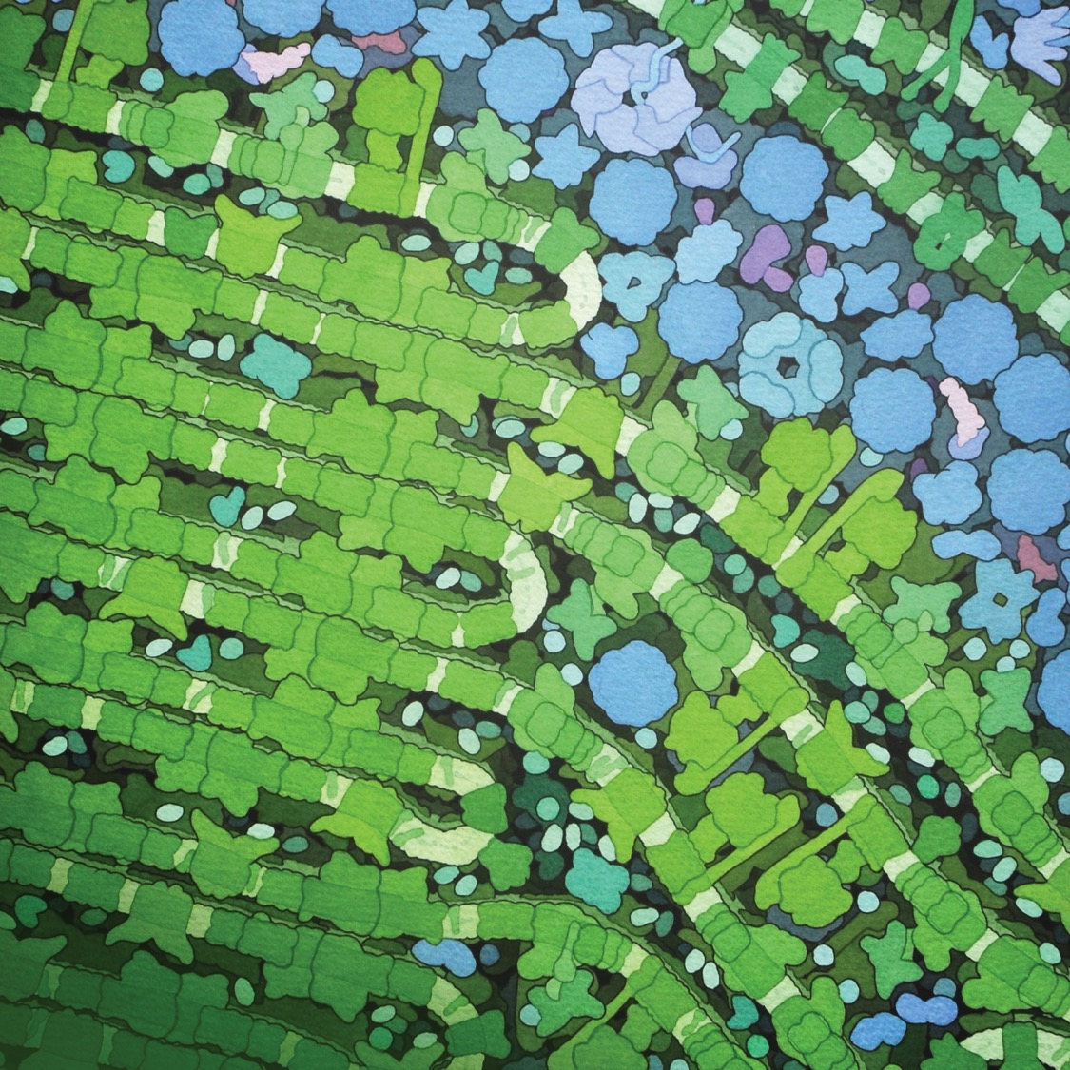
PHOTOSYSTEMS, ATP SYNTHASE
and other proteins work together to capture the energy in light
Photosystem I October 2001
Photosystem II November 2004
ATP Synthase December 2005

Slide 9
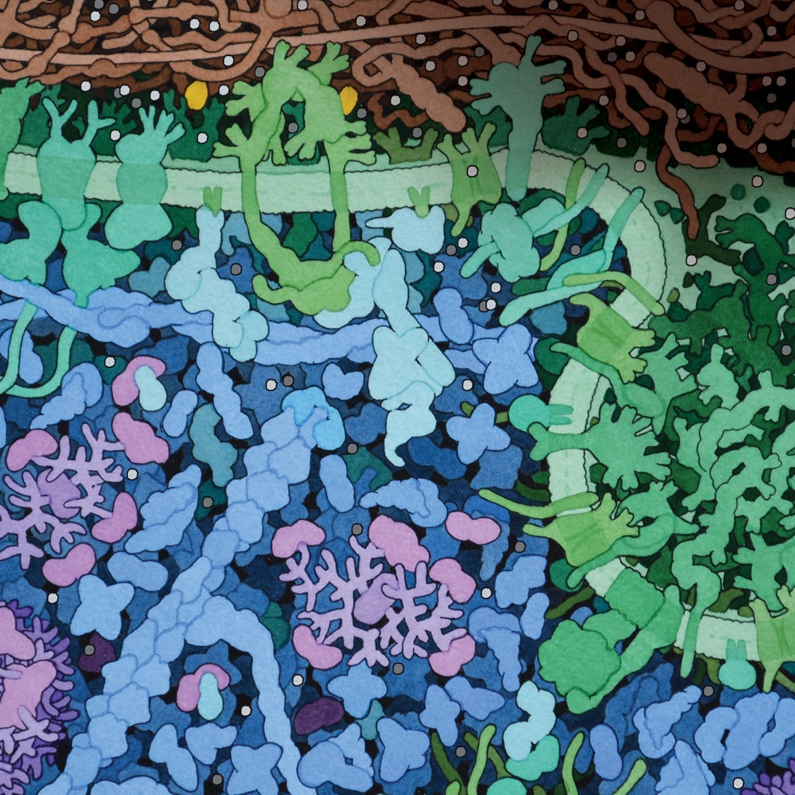
INSULIN binds to receptors
on cell surfaces and mobilizes
the machinery for storing glucose
Insulin
February 2001
PDB-101 Resources on Diabetes
Notes:
PDB Structure 1ax8
F. Zhang et al. (1997) Crystal structure of the obese protein leptin-E100. Nature 387: 206-209

Slide 10
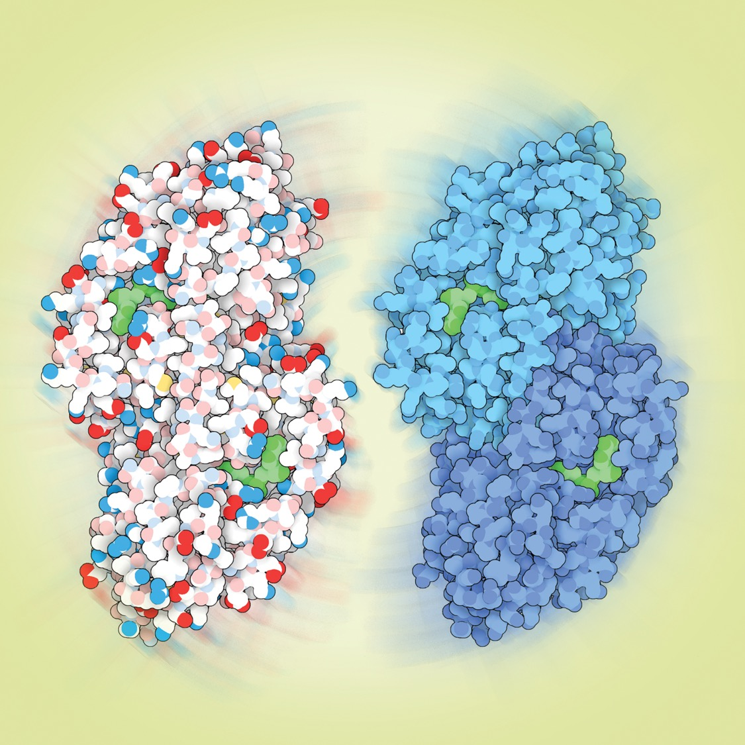
Seeing double?
ALCOHOL DEHYDROGENASE, shown with two different coloring schemes,
detoxifies the ethanol we drink
Protein Function
COMMUNICATION
Alcohol Dehydrogenase January 2001
Notes:
PDB Structure 1htb
X-ray structure of human β3β3 alcohol dehydrogenase.
The contribution of ionic interactions to coenzyme binding
G.J. Davis et al. (1996) J.Biol.Chem. 271: 17057-17061

Slide 11
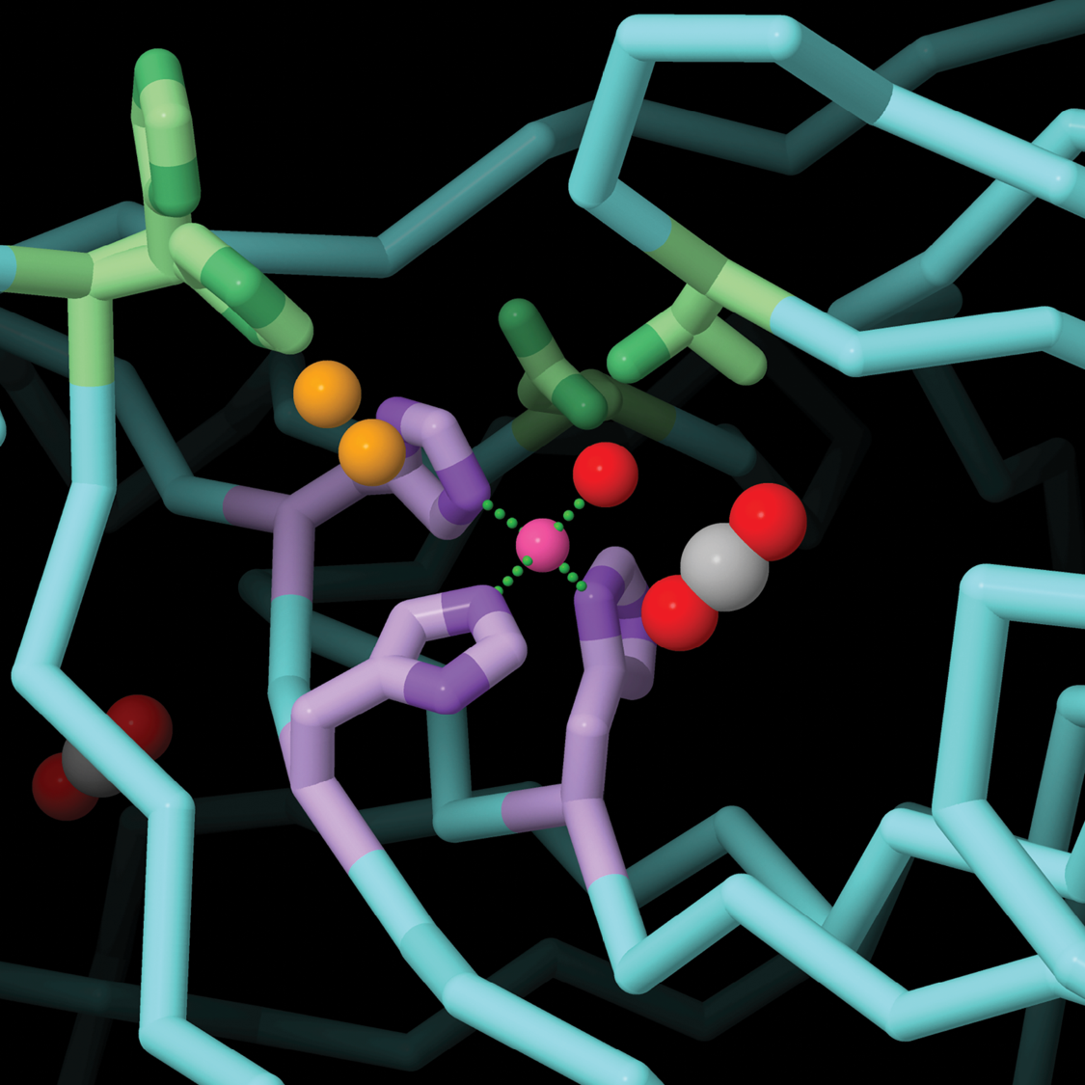
CARBONIC ANHYDRASE uses a zinc ion to solubilize carbon dioxide
Carbonic Anhydrase January 2004
Notes:
PDB Structure 5yui
Tracking solvent and protein movement during CO2 release in carbonic anhydrase II crystals
C.U. Kim et al. (2016) Proc. Natl. Acad. Sci. U.S.A. 113: 5257-5262
Image created by Belle Lin; article co-authored with Shuchismita Dutta

Slide 12
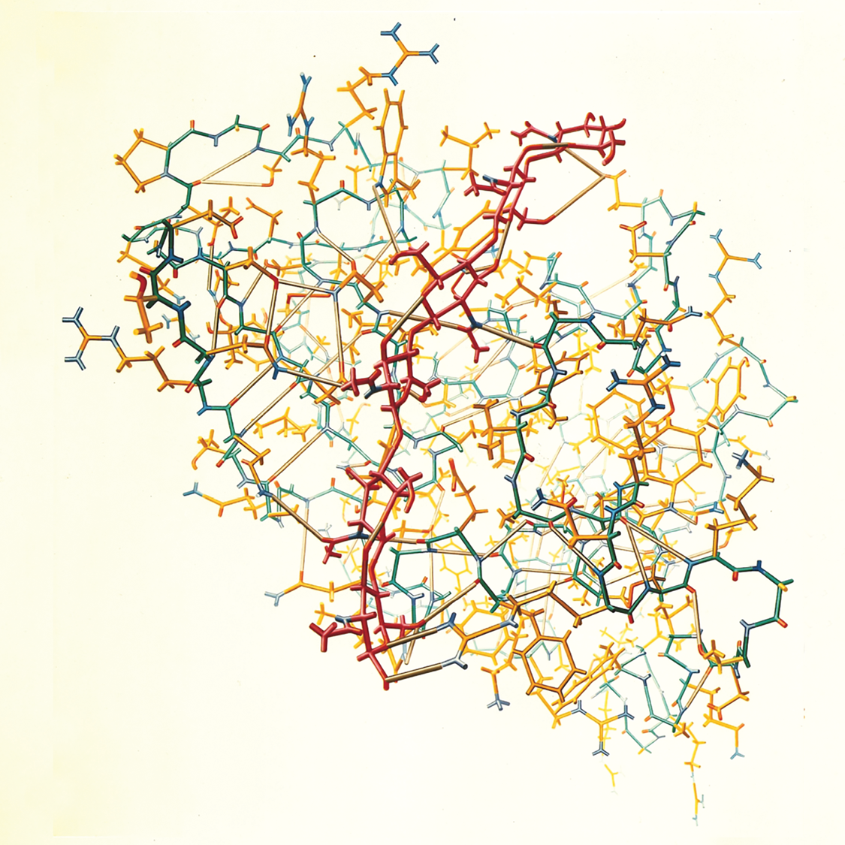
Irving Geis captures the amazing details
of the first enzyme structure solved by
X-ray crystallography, LYSOZYME
Lysozyme September 2000
PDB Pioneers October 2011
Notes:
Painting from D. Phillips (1966). The Three-Dimensional structure of an enzyme molecule. Sci. Am. 215: 78-90. doi: 10.1038/scientificamerican1166-78
Image used with permission from the Howard Hughes Medical Institute (www.hhmi.org). All rights reserved.

Slide 13
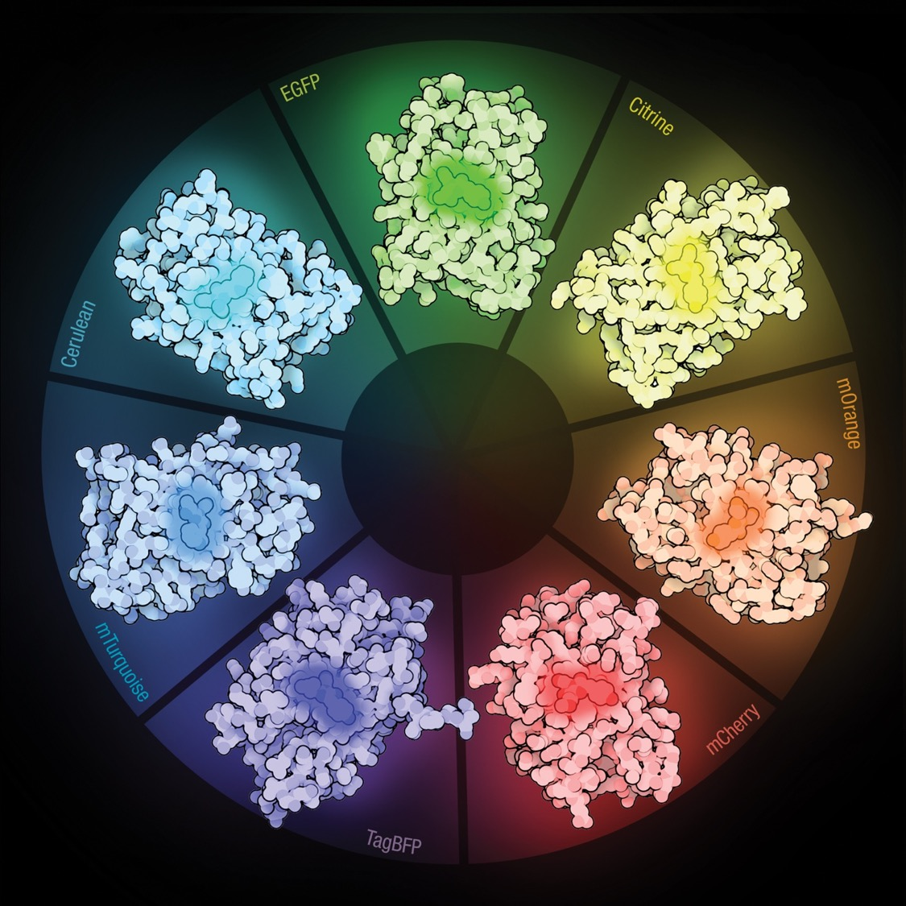
Fluorescent proteins in all colors have been engineered from
GREEN FLUORESCENT PROTEIN
Green Fluorescent Protein (GFP) June 2003
GFP-like Proteins June 2014
Notes:
PDB Structure 3m24
Structural characterization of acylimine-containing blue and red chromophores in mTagBFP and TagRFP fluorescent proteins O.M. Subach et al. (2010) Chem.Biol. 17: 333-341
PDB Structure 2q57
X-ray structure of Cerulean GFP: a tryptophan-based chromophore useful for fluorescence lifetime imaging G.D. Malo (2007) Biochemistry 46: 9865-9873
PDB Structure 4ar7
Structure of a Fluorescent Protein from Aequorea Victoria Bearing the Obligate-Monomer Mutation A206K D. von
Stetten et al. (2012) Acta Cryst. F68: 878-872
PDB Structure 2y0g
Stabilizing role of glutamic acid 222 in the structure of enhanced green fluorescent protein A. Royant, M. Noirclerc-Savoye (2011) J.Struct.Biol. 174: 385-390
PDB Structure 1huy
Reducing the environmental sensitivity of yellow fluorescent protein. Mechanism and applications O. Griesbeck et al. (2001) J.Biol.Chem. 276: 29188-29194
PDB Structure 2h5o, 2h5q
Novel chromophores and buried charges control color in mFruits X. Shu et al. (2006) Biochemistry 45: 9639-9647

Slide 14
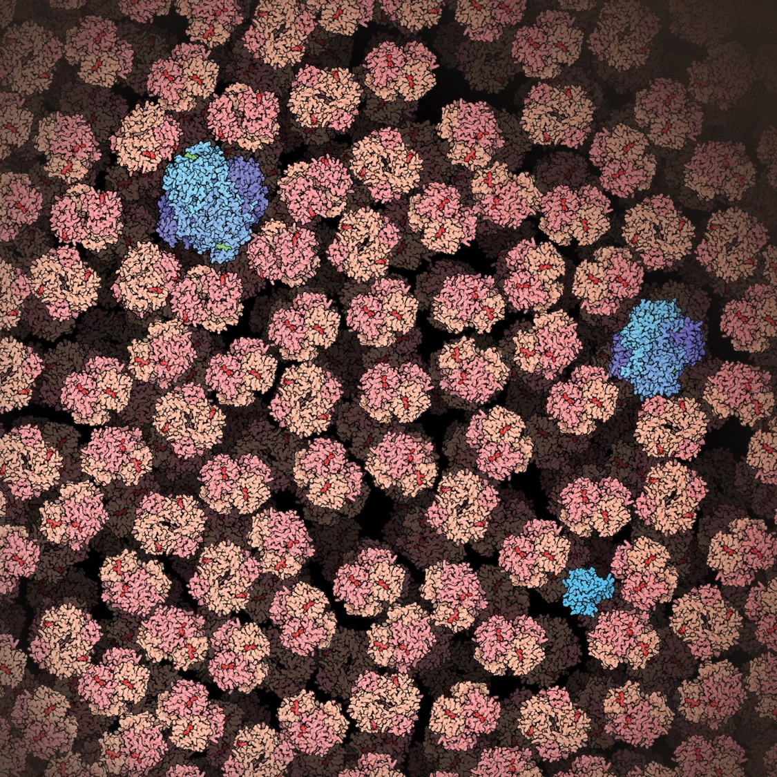
HEMOGLOBIN
is packed tightly into red blood cells
Hemoglobin
May 2003
N-nitrosylated Hemoglobin
May 2019
Notes:
PDB Structure 2hhb
Structure of hæmoglobin: a three-dimensional Fourier synthesis at 5.5-Å resolution, obtained by X-ray analysis.
M.F. Perutz et al. (1960) Nature, 185: 416-422.

Slide 15
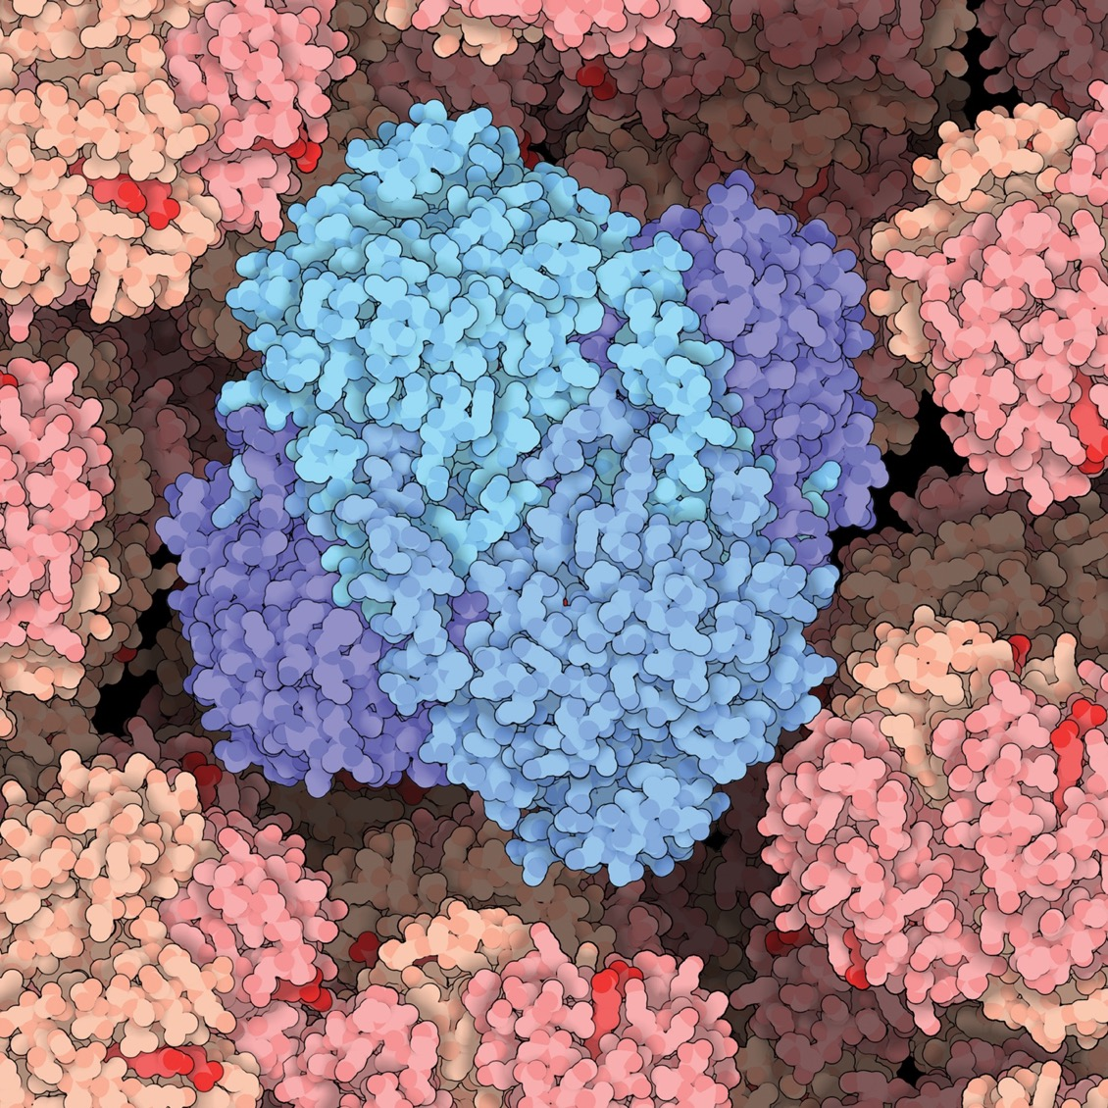
CATALASE protects our proteins from damage by dangerous oxygen radicals
Catalase September 2004
#1 accessed Molecule of the Month article
Notes:
PDB Structure 1QQW
Structure of human erythrocyte catalase
T.P. Ko et al. (2000) Acta Cryst. D56: 241-245

Slide 16


rcsb.org
pdb101.rcsb.org
A Living Digital
Data Resource that
Enables Scientific Breakthroughs
Molecular Explorations through
Biology and Medicine
PDB-101 is the educational portal of the RCSB PDB developed for teachers, students, and the general public to promote exploration in the 3D world of proteins and nucleic acids.
RCSB PDB is a member of the Worldwide PDB (wwpdb.org).
RCSB PDB is hosted by:
Rutgers, UCSD/SDSC and UCSF
RCSB PDB is funded by a grant from the
National Science Foundation (DBI-1832184),
the National Institutes of Health (R01GM133198),
and the US Department of Energy (DE-SC0019749).

