Slide 1
Introduction to Biological Databases and Data Archiving
Introduction

Slide 2
Outline for Module 1
History of the Protein Data Bank
Synergies of science, technology, community
Description of the data pipeline
PDB Usage
Sustainability

Slide 3
History

Slide 4
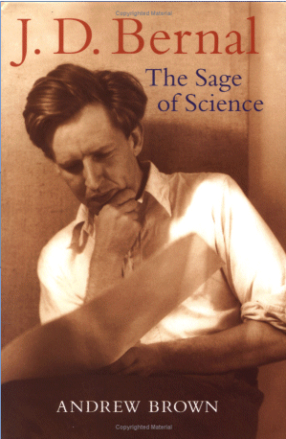
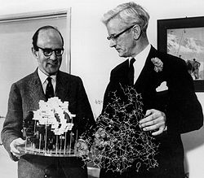

Pioneers
J.D. Bernal (1901-1971)
Dorothy Crowfoot Hodgkin
(1910-1994)
John Kendrew (1917-1997)
and Max Perutz (1914-2002)

Slide 5
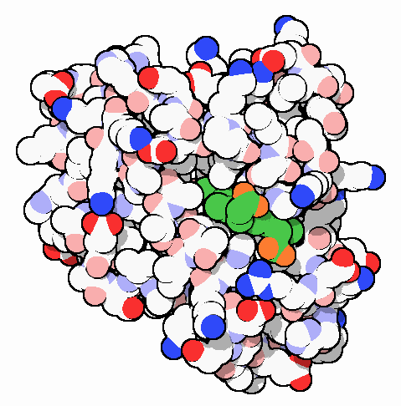
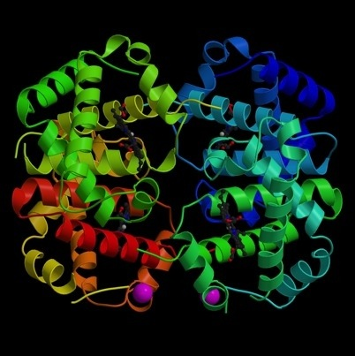
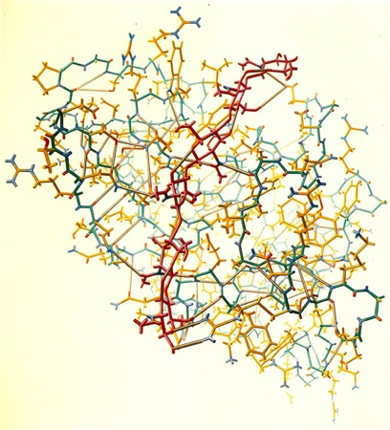
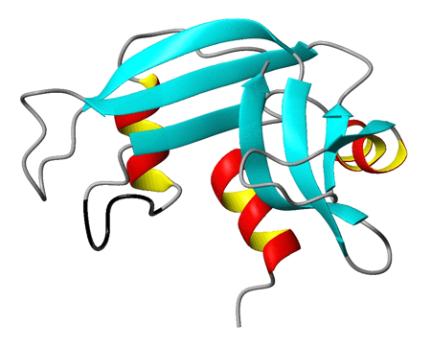
Early Structures – 1960s
Myoglobin
Kendrew, Bodo, Dintzis, Parrish, Wyckoff, Phillips (1958) Nature 181, 662-666
Hemoglobin
Perutz, Rossmann, Cullis, Muirhead, Will, North (1960) Nature 185, 416-422; Perutz (1962) Proc. R. Soc. A265, 161-187
Lysozyme (Painting by Irving Geis)
Blake, Koenig, Mair, North, Phillips, Sarma (1965) Nature 206, 757
Ribonuclease
Kartha, Bello, Harker (1967) Nature 213, 862-865; Wyckoff, Hardman, Allewell, Inagami, Johnson, Richards (1967) J. Biol. Chem. 242, 3753-3757.

Slide 6
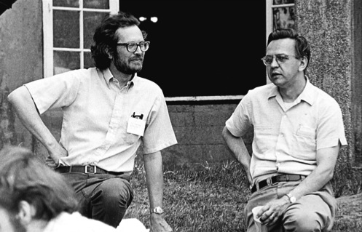
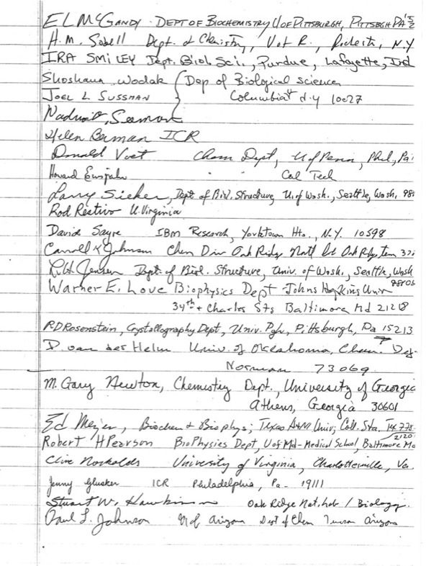
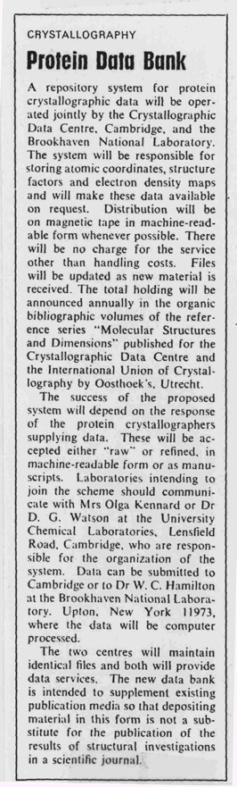
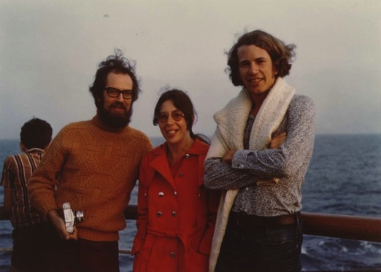
1971: Establish PDB archive

Slide 7
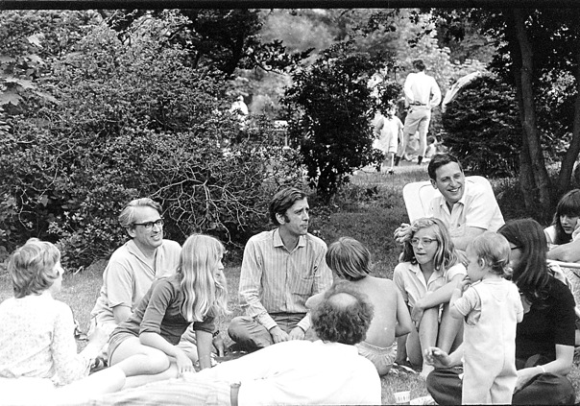
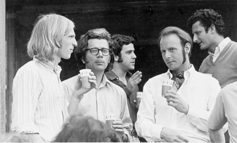
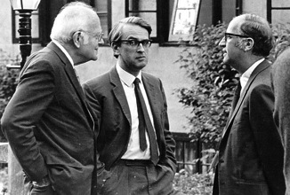
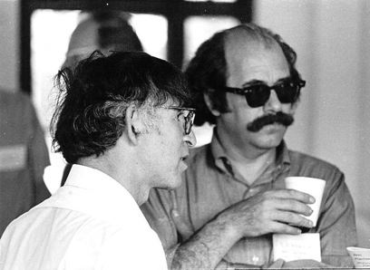
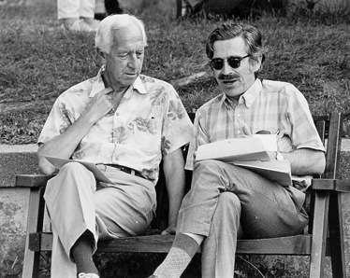
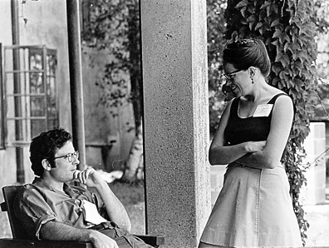
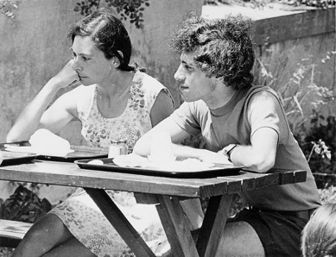
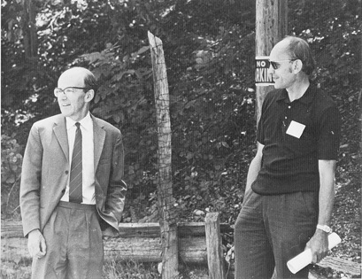
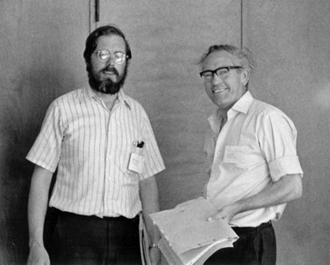
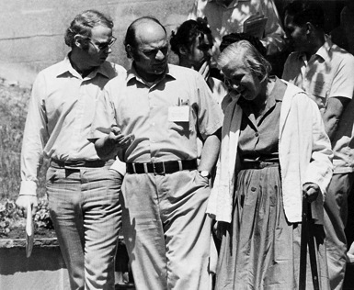
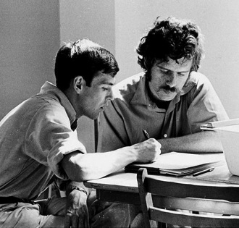

Slide 8
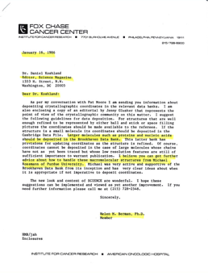
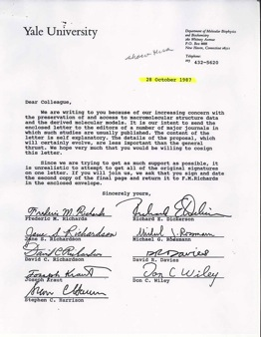
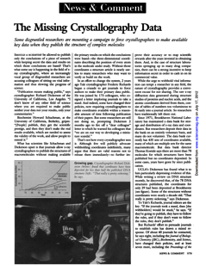
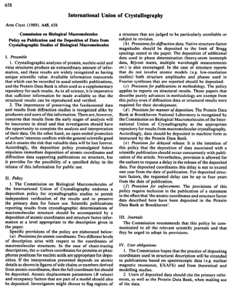
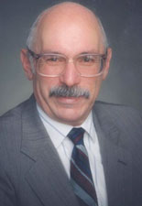
1980s: Cooperative Community Action
How do you encourage data sharing (before widespread open access)?
Contact editors of scientific journals
Professional Society Committees to get members to establish policies and standards
  IUCr commission on Biological Macromolecules
  ACA/USNCCr
  Richards committee
Funding agencies
Marvin Cassman

Slide 9
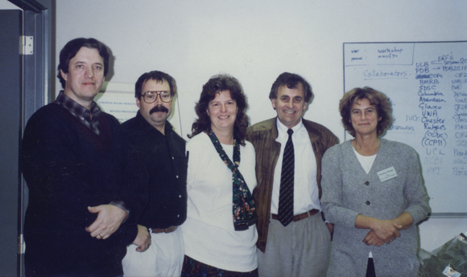
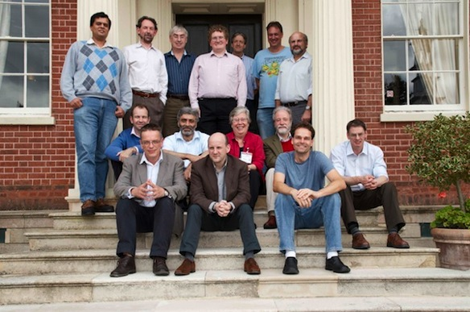
1990 onwards: Create data standards
Macromolecular Crystallographic Information format (mmCIF)
  Definitions for structure and experimental data from X-ray crystallographic experiments
PDBx adopted as master format for the PDB in 2011
  Definitions for X-ray, NMR, and 3DEM
mmCIF Working Group, 1993
PDBx/mmCIF Working Group, 2011

Slide 10
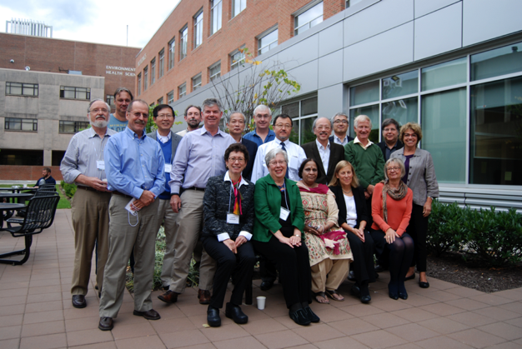

2003: Establish the wwPDB
Ensures data are freely & globally available
Collaborate on data processing and annotation
Each site provides different websites that offer different services and views of the data
wwPDB Advisory Committee Meeting, 2013

Slide 11
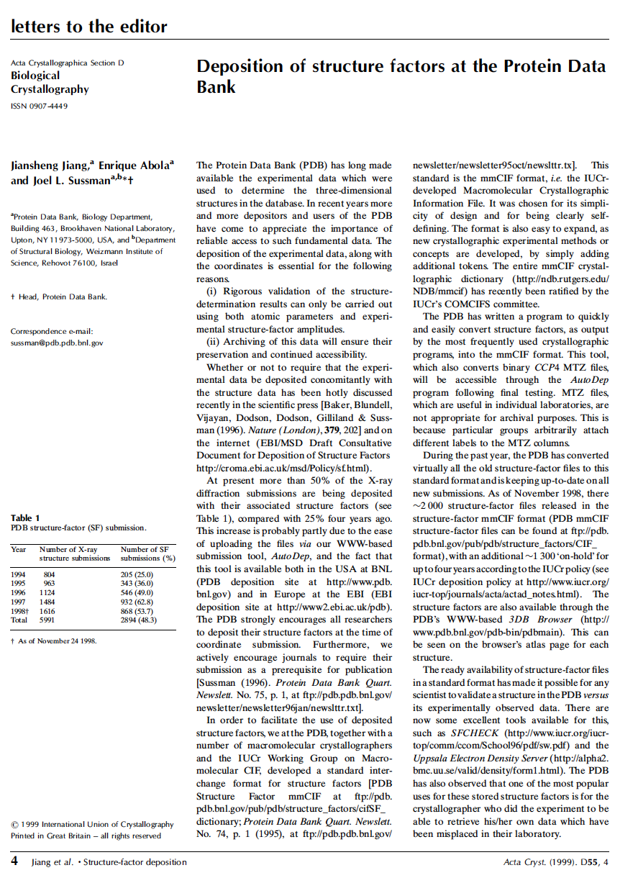
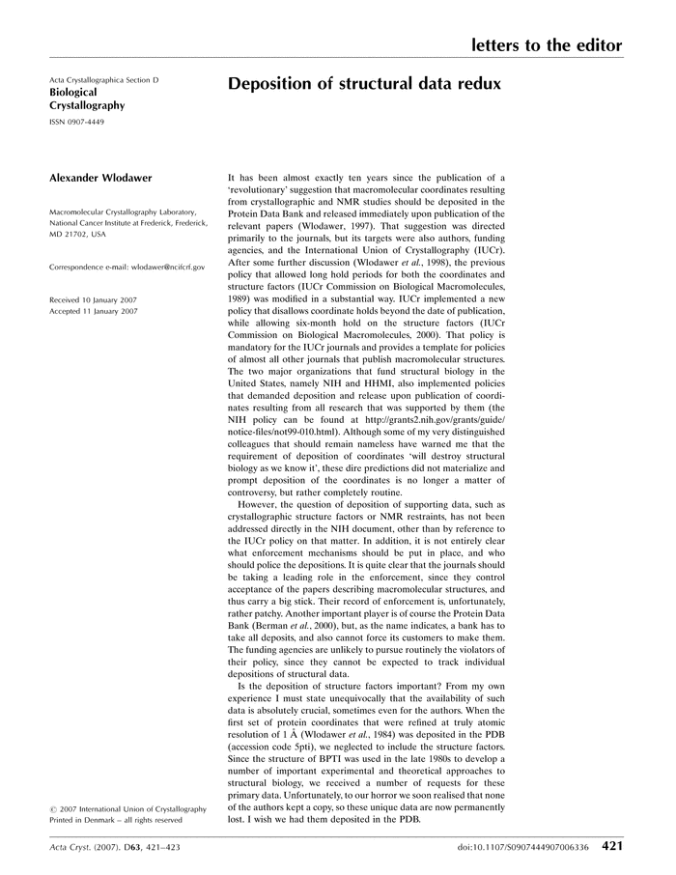
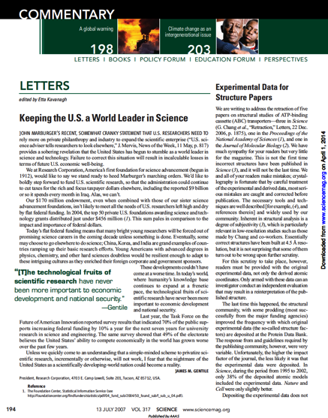
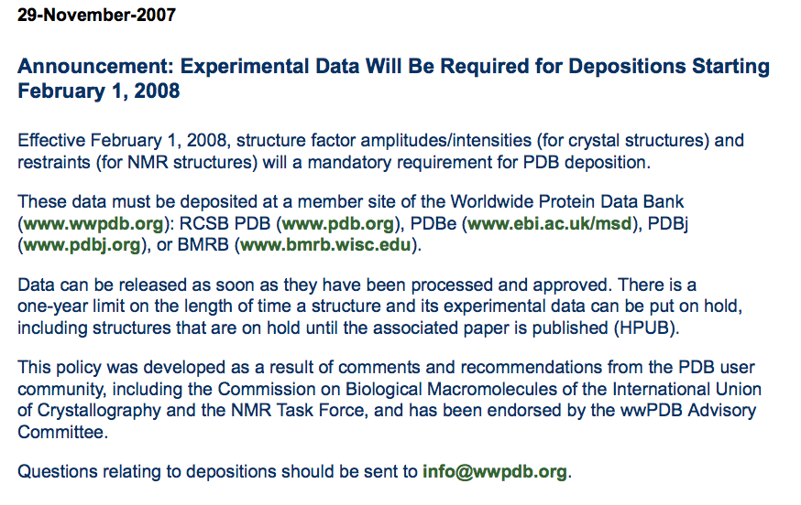
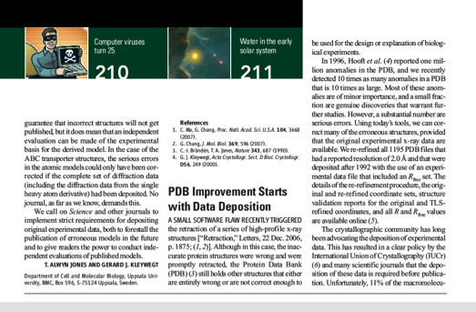
2008: Require Experimental Data
Structure factor amplitudes/intensities for crystal structures
1999
2007
Science, 2007

Slide 12
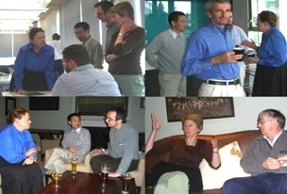
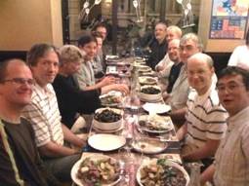
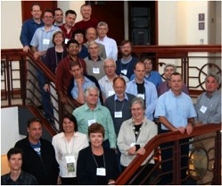
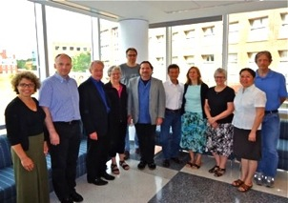
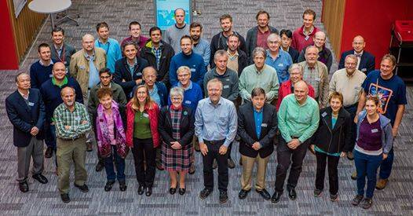
2008 Creation of Validation Task Forces
Task Force | Meeting/ Workshop | Chair(s)/Membership | Outcome
X-ray Validation Task Force | 2008 (2015) | Randy Read (Univ of Cambridge) 17 members | (2011) Structure 19: 1395-1412
NMR Validation Task Force | 2009, 2011, 2013 (x2), 2015 | Gaetano Montelione (Rutgers) Michael Nilges (Institut Pasteur) 10 members | (2013) Structure, 21: 1563-1570
3DEM Validation Task Force | 2010 | Richard Henderson (MRC-LMB) Andrej Sali (UCSF) 21 members | (2012) Structure 20: 205-214
Small-Angle Scattering Task Force | 2012, 2014 | Jill Trewhella (Univ Sydney) 6 members | (2013) Structure 21: 875-881
Hybrid Methods Workshop | 2014 | Andrej Sali (UCSF), Torsten Schwede (Univ Basel), Jill Trewhella (Univ Sydney) 27 members | (2015) Structure 23:1156-1167

Slide 13
Synergies
Science, technology, community

Slide 14
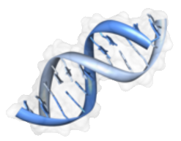
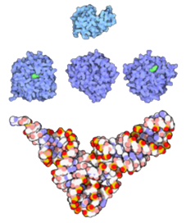
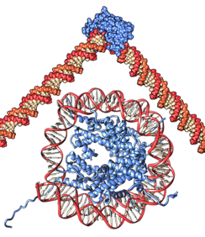
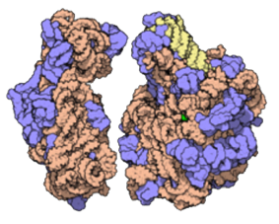
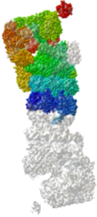
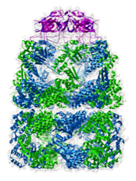
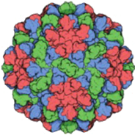
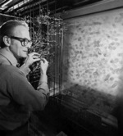
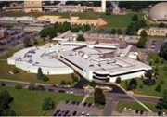
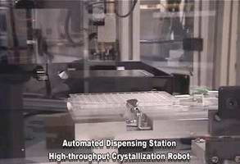
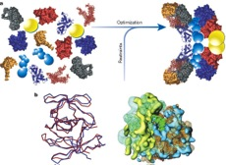
















 | 1970s | 1980s | 1990s | 2000s | 2010s
Science | Small enzymes, RNA | DNA, viruses | Protein-DNA complexes | Ribosomes | Large macromolecular machines
Technology | X-ray diffraction, diffractometers, punched cards | Synchrotron radiation, computer graphics, NMR | Electron microscopy, fast computers, fast detectors | High throughput structural genomics, robots | Hybrid methods
Community | PDB archive established | IUCr deposition guidelines | Standardization, RCSB | Experimental data required, wwPDB | Validation standards
Notes:
Hybrid image from http://www.nature.com/nature/journal/v422/n6928/fig_tab/nature01513_F5.html

Slide 15


J.D. Bernal
A key influence on how the crystallographic community works together
The Social Function of Science (1939)
Covers the organization of research to science and its social role
“Science is communism”

Slide 16


Elinor Ostrom (1933-2012)
2009 Nobel Memorial Prize in Economics
Bottom-up collective action can work better than top-down enforcement
Groups devise clear rules
  What actions are and are not allowed
  Based on local conditions and knowledge
  Adaptable to changing circumstances
  Include organized monitoring and enforcement
Text of talk by Avinash Dixit, Princeton University

Slide 17

This work is licensed under Creative Commons Attribution-NonCommercial-ShareAlike 4.0 International.
Funded by Grant R25 LM012286 from the National Library of Medicine of the National Institutes of Health.

