Slide 1
Introduction to Biological Databases and Data Archiving
Introduction

Slide 2
The data pipeline

Slide 3


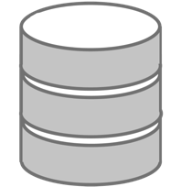
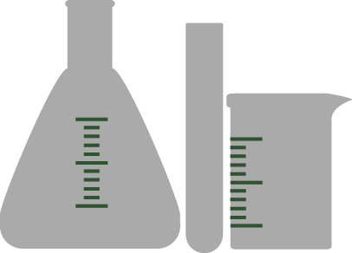

The Data Pipeline
Data
Creation
Deposition
Processing
Archiving
Distribution

Slide 4
Experimental Methods Used for
Structure Determination
First 500
1991
First 500
1995
First 500
2012
Year
Notes:
Update ALL EXCEPT FOR HYBRID

Slide 5
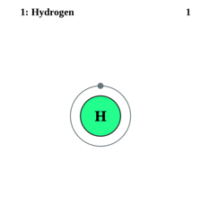
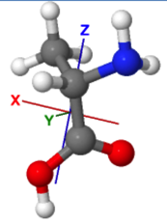
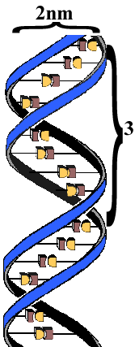
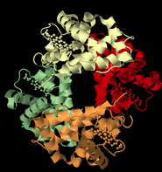
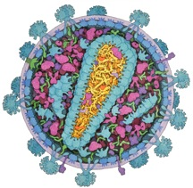
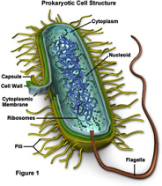
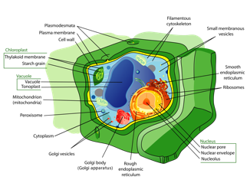
The Scale of Things
1Å
1nm
10nm
100nm
1μm
10μm
0.1mm
Optical resolution limit
chr22
unpacked:
10mm
PDB

Slide 6
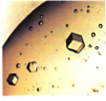
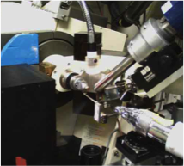
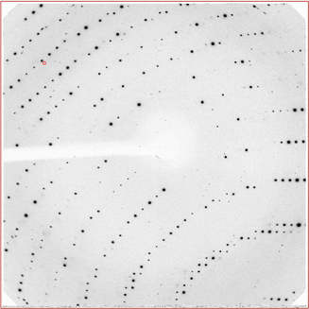
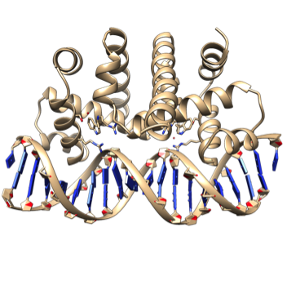
X-ray Experiment: What Data are Collected
Sample
  Source
  Sequence
  Crystallization
Experiment
  Sample Conditions
  X-ray Source
  Detector
  Collection Protocol
Experiment Data
  Structure Factors
  Processing Software
  Statistics (resolution, Rsym)
Final Model
  Structure Solution Method
  Refinement Software, Restraints
  Fit-to-Data Statistics

Slide 7
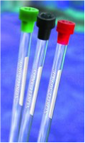
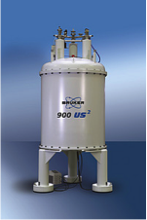
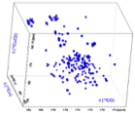
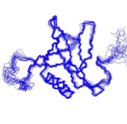
NMR Experiment: What Data are Collected
Sample
  Source
  Sequence
  Buffer Conditions
  Isotope Labeling
Experiment
  Sample Conditions
  Spectrometer
  Acquisition Parameters
Experiment Data
  Chemical Shifts
  Constraints
  Processing Protocol
  Resonance Assignment
Final Model
  Structure Calculation Method
  Refinement Software

Slide 8
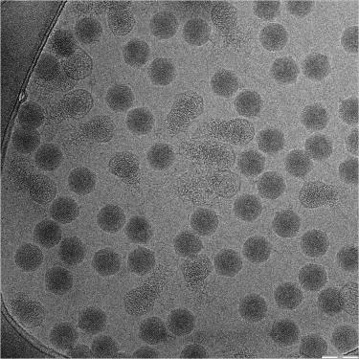
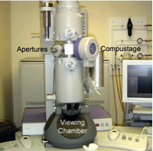
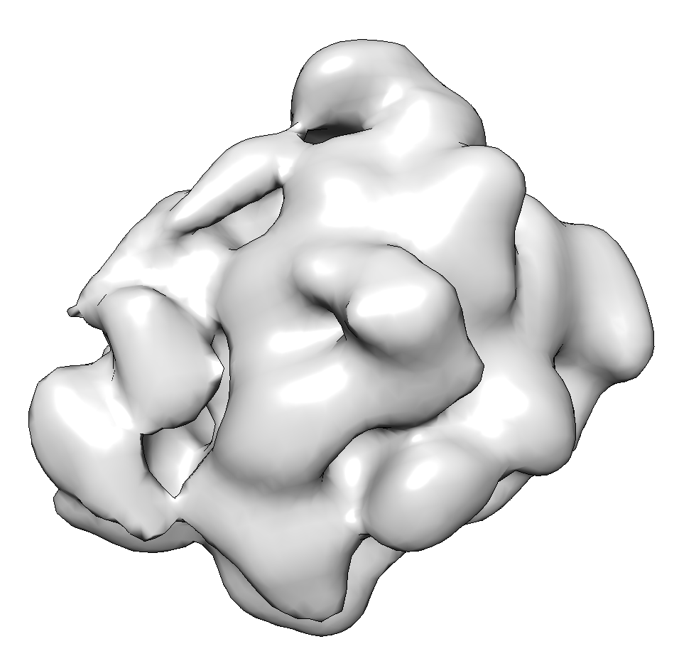
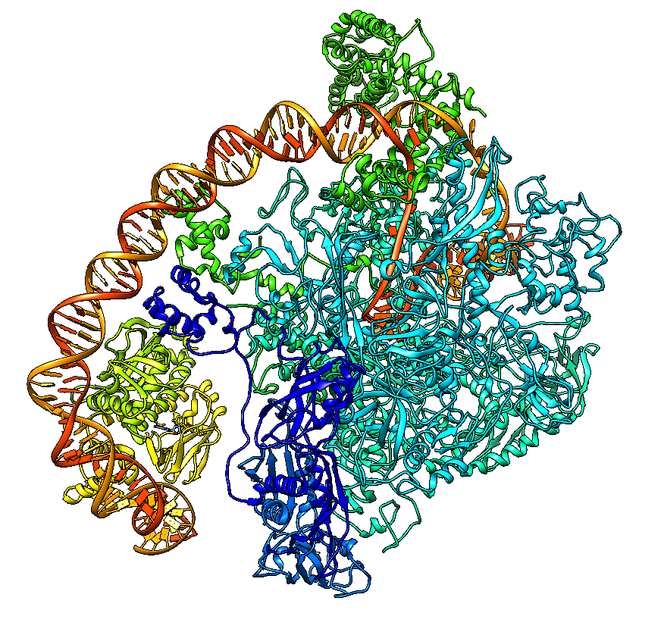
3DEM Experiment: What Data are Collected
Sample
  Source
  Sequence
  Buffer Conditions
  Sample Support
  Vitrification
Experiment
  Sample Conditions
  Electron Source
  Imaging Parameters
  Detector
Experiment Data
  Final 3D Map
  Processing Software
  Processing Protocol
  Resolution (FSC)
Final Model
  Modeling Method
  Model Source
  Fitting Software

Slide 9

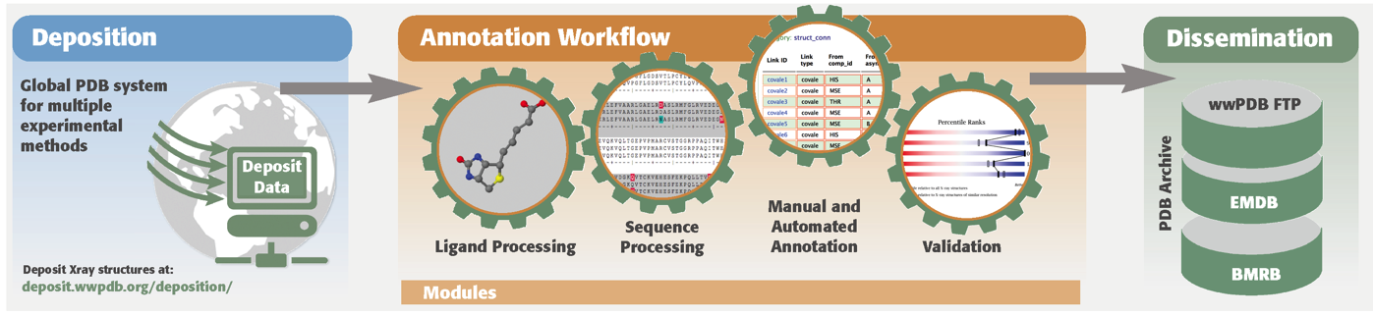
OneDep: The wwPDB
Deposition & Annotation System
Maximizes data quality
Standardizes file formats based on a controlled data dictionary
More complete data capture
Support for larger and more complex structures
Improved efficiency through automation and validation
Workload balancing based on resource capacity and location

Slide 10
Data Standardization
Clear definitions of all data items
Relationships of data items to one another
Well defined syntax

Slide 11
PDB Format
Advantages
  Human readable
  40 years history
  Fits majority of structures
  Adopted by most software
Disadvantages
  Relationships among data items are implicit
  Definitions not precise
  Does not work with large structures i.e. ribosome
  Difficult to extend

Slide 12
mmCIF/PDBx
Advantages
  Machine readable
  Extensible to new methods
  Works on large structures
  Relationships among data items are explicit
Disadvantages
  Not human readable
  Slow to be adopted

Slide 13
ATOM 1 N GLN A 39 24.690 -27.754 24.275 1.00 60.76 N
ATOM 2 CA GLN A 39 23.581 -26.768 24.416 1.00 60.98 C
ATOM 3 C GLN A 39 23.990 -25.379 23.905 1.00 59.98 C
ATOM 4 O GLN A 39 25.070 -25.209 23.330 1.00 60.25 O
ATOM 5 CB GLN A 39 23.136 -26.685 25.878 1.00 60.69 C
ATOM 6 N VAL A 40 23.115 -24.395 24.122 1.00 59.58 N
ATOM 7 CA VAL A 40 23.342 -23.010 23.690 1.00 57.26 C
ATOM 8 C VAL A 40 24.000 -22.152 24.778 1.00 56.00 C
ATOM 9 O VAL A 40 23.992 -20.920 24.692 1.00 55.53 O
ATOM 10 CB VAL A 40 22.015 -22.337 23.275 1.00 57.32 C
loop_
_atom_site.group_PDB
_atom_site.id
_atom_site.auth_atom_id
_atom_site.type_symbol
_atom_site.auth_comp_id
_atom_site.auth_asym_id
_atom_site.auth_seq_id
_atom_site.Cartn_x
_atom_site.Cartn_y
_atom_site.Cartn_z
_atom_site.pdbx_PDB_model_num
_atom_site.occupancy
_atom_site.pdbx_auth_alt_id
_atom_site.B_iso_or_equiv
ATOM 1 N N GLN A 39 24.690 -27.754 24.275 1 1.00 . 60.76
ATOM 2 CA C GLN A 39 23.581 -26.768 24.416 1 1.00 . 60.98
ATOM 3 C C GLN A 39 23.990 -25.379 23.905 1 1.00 . 59.98
ATOM 4 O O GLN A 39 25.070 -25.209 23.330 1 1.00 . 60.25
ATOM 5 CB C GLN A 39 23.136 -26.685 25.878 1 1.00 . 60.69
ATOM 6 N N VAL A 40 23.115 -24.395 24.122 1 1.00 . 59.58
ATOM 7 CA C VAL A 40 23.342 -23.010 23.690 1 1.00 . 57.26
ATOM 8 C C VAL A 40 24.000 -22.152 24.778 1 1.00 . 56.00
ATOM 9 O O VAL A 40 23.992 -20.920 24.692 1 1.00 . 55.53
ATOM 10 CB C VAL A 40 22.015 -22.337 23.275 1 1.00 . 57.32
ATOM 11 N N ALA A 41 24.560 -22.804 25.797 1 1.00 . 54.571
PDB
PDBx/mmCIF

Slide 14
Components of the OneDep System
Deposition Pipeline
Common Deposition Interface
Data Upload and Harvesting
Review & Client-side Editor
Submission
X-ray-specific
X-ray-specific
Validation
EM-specific
EM-specific
Progress Tracking/Status
NMR-specific
NMR-specific
Communication System
Workflow-Automation System
Annotation Pipeline
Ligand
Processing
ID, Edit, Build
Sequence
Processing
Validation
Calculated annotations
(PISA, SITE & LINK records, cross references, metal coordinates)
Release
Processing

Slide 15
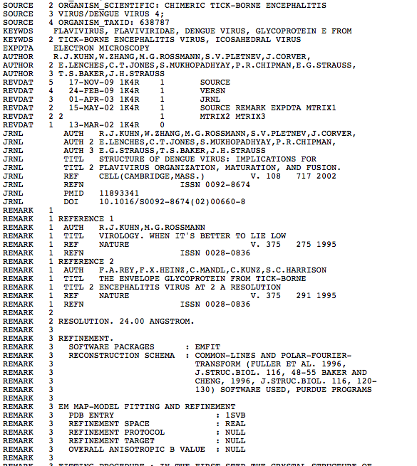
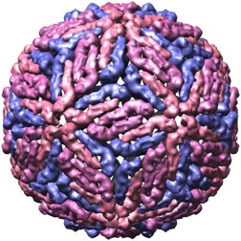
Annotation and Curation
Add meta data to put data in context with the science
Consistency
Standard vocabulary and terms
Notes:
MV: Picture of annotation summit

Slide 16
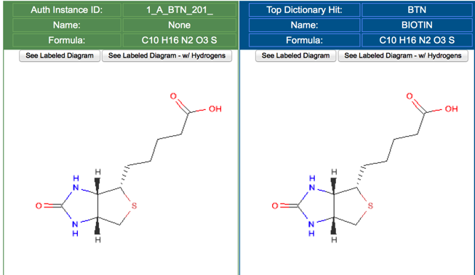
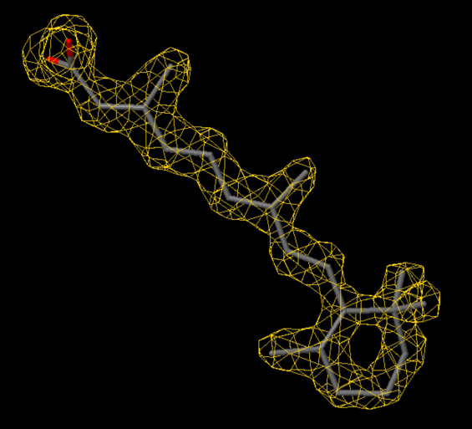
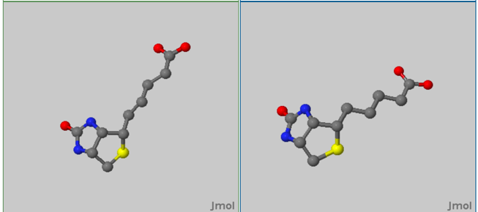
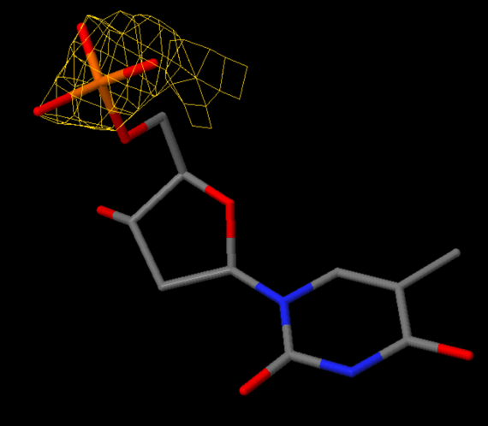
Ligand Annotation
REA in entry 1CBS with
LLDF=1.31 (RSR=0.10, CC=0.95)
Captures and displays author-provided chemical information
Comparison panel
  2D and 3D views of ligand for review
  ID assignment
Enhanced with display of local ligand electron density fit
Deposited instance from coordinates
Closest match in the dictionary
Local ligand density display (1.5 sigma
omit map)
TMP in entry 3HW4 with LLDF=6.77 (RSR=0.41, CC=0.70)

Slide 17
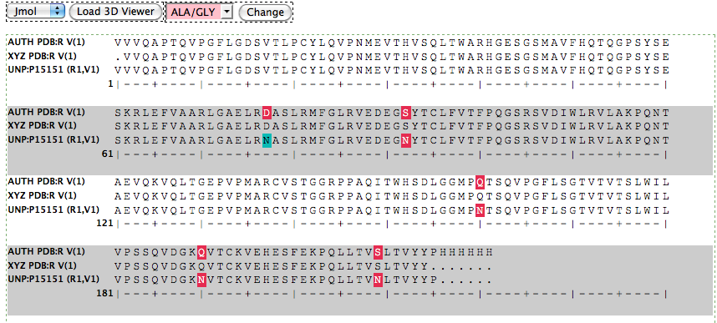
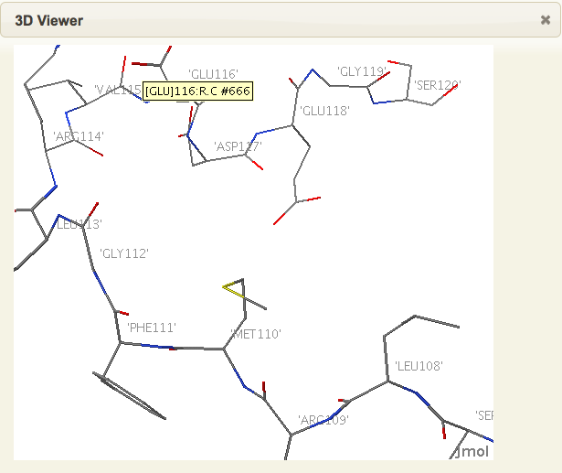
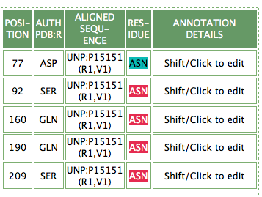
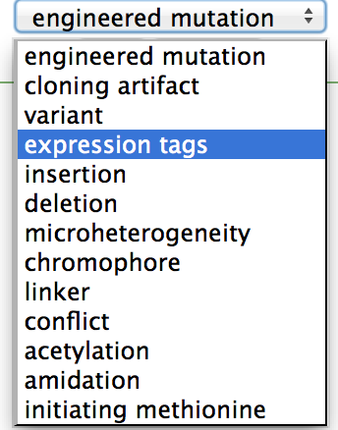
PDB Sequence Annotation
Biological sequence checked against atomic coordinate sequence
and cross-referenced to UniProt/GenBank
3D structure view
Sequence discrepancy annotation

Slide 18
Validation
“To support or corroborate on a sound or authoritative basis” Merriam-Webster
“Science is a way of trying not to fool yourself. The first principle is that you must not fool yourself, and you are the easiest person to fool.” (Richard Feynman)

Slide 19
Validation
Compare model to the experimental data and to the prior knowledge.
Types
  Model alone
  Data alone
  Fit of model and data

Slide 20
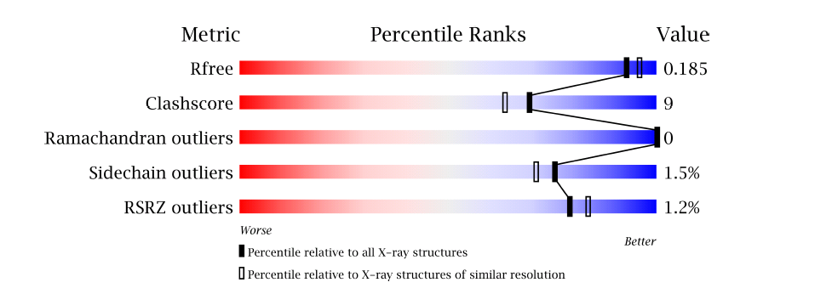
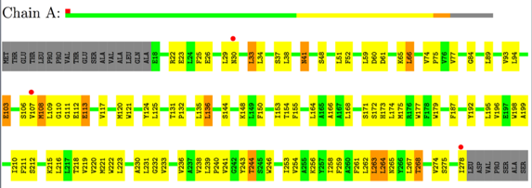
PDB Validation Report
Overall quality at-a-glance
“Table 1” with key data & refinement statistics
Component diagnostics for all macromolecules & ligands
Depositor also receives detailed XML report
PDF can be uploaded with manuscript submission to a journal
Overall Quality
Residue Plots
Grey – not modeled
Green, yellow, orange, red – 0,1,2, 3 or more issues
Red dot – poor fit to electron density

Slide 21
Data Quality
Data quality
Data standardization
Extended annotation
Improved query functionality
Extended query options
Notes:
21

Slide 22
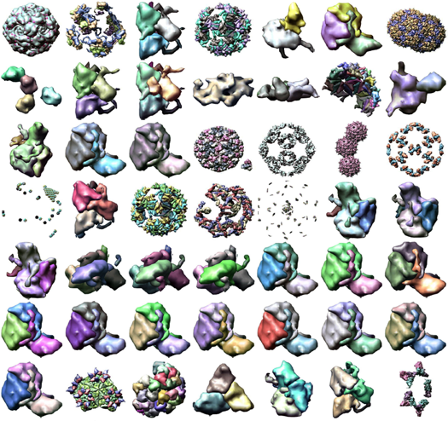
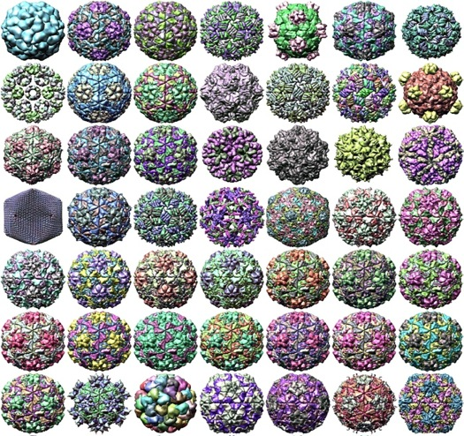
Ensuring Data Quality Across the Archive
before
after
Lawson, C.L., Dutta, S., Westbrook, J.D., Henrick, K., and Berman, H.M. (2008). Representation of viruses in the remediated PDB archive. Acta cryst. D64: 874-882

Slide 23
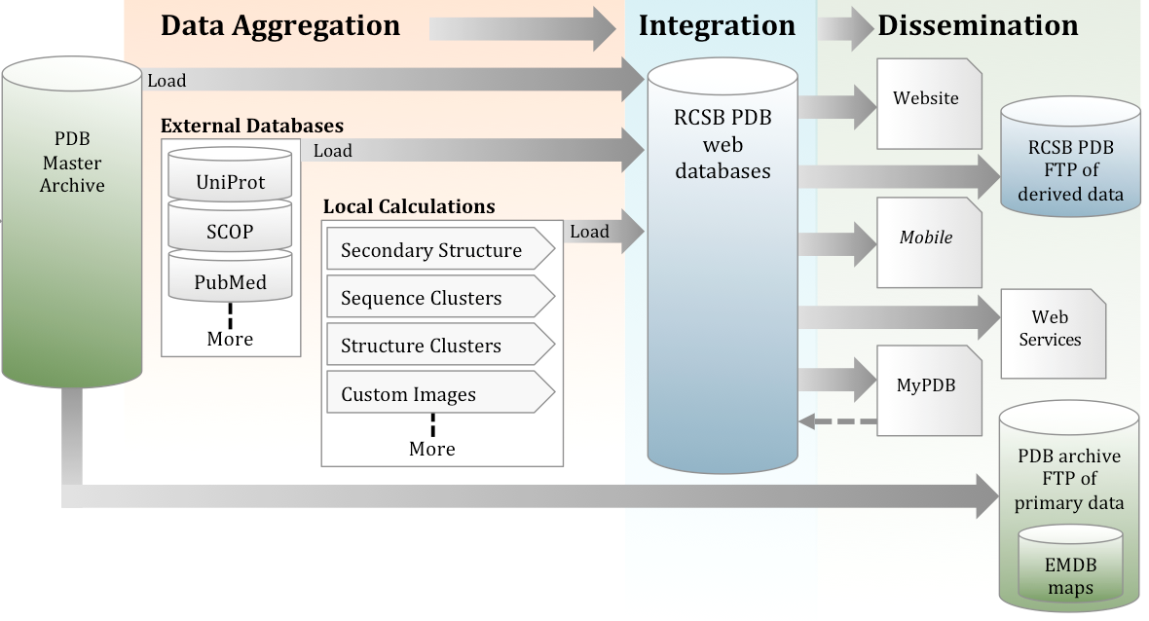
Data Distribution
Data In
Data are distributed to end users through
FTP site
Website and PDB-101
MyPDB (email notifications)
Mobile apps
Web services

Slide 24
The PDB Archive - FTP Site
Content of the PDB Archive
  Atomic coordinates and molecular description of macromolecules and ligands
  Metadata
  Experimental data
FTP File Transfer Protocol
  Protocol to download individual files to client computer
  Keep a synchronized copy of files on client computer using RSYNC

Slide 25
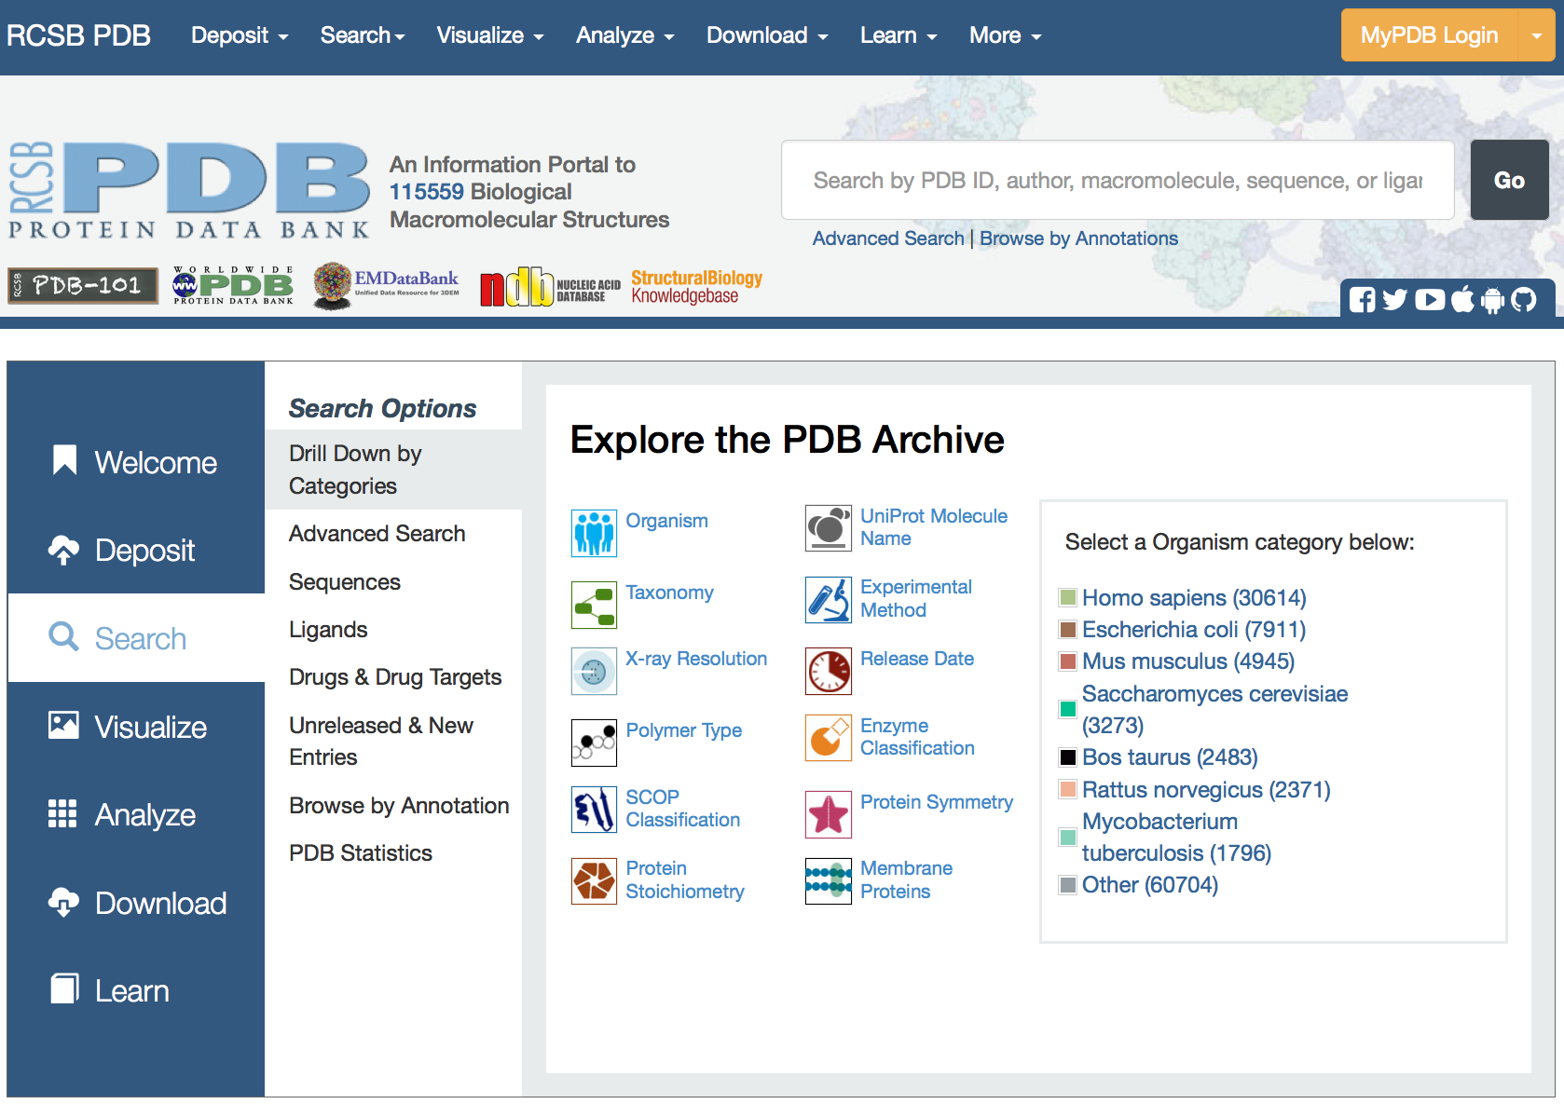
RCSB PDB Website
Portal for
many different functionalities:
Deposit
Search
Analyze
Visualize
Tabulate
Download data
rcsb.org
Notes:
Doesn’t illustrate the point –expand from left box

Slide 26

This work is licensed under Creative Commons Attribution-NonCommercial-ShareAlike 4.0 International.
Funded by Grant R25 LM012286 from the National Library of Medicine of the National Institutes of Health.

