Slide 1
Introduction to Biological Databases and Data Archiving
Introduction

Slide 2
PDB USAGE

Slide 3
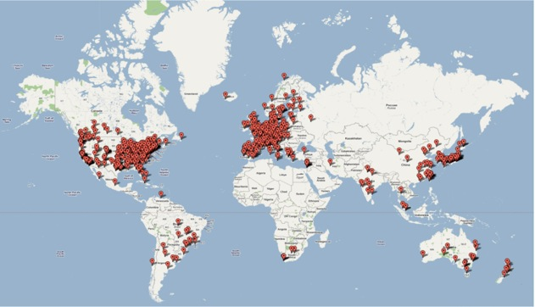
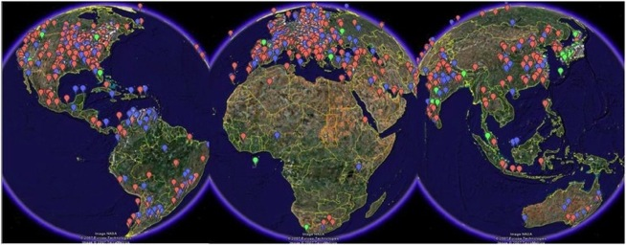
Growing number of
PDB Entries
PDB Depositors
>900 new entries/month
PDB Users
# of Entries
FTP and RSYNC Download Traffic in 2015:
535 million downloads
Year
The number of PDB entries doubled in only 6 years
(2010 – 65,000 to 2015 – 115, 000)
RCSB PDB
367 million
PDBe
90 million
PDBj
78 million
Notes:
update
3

Slide 4
What Has the PDB Enabled?
Safe storage of biomacromolecular data
Molecular replacement models for structure determination
“Parts list” for modeling
Structure-based drug design
Structure classification
Structure prediction

Slide 5
What is Important?
The science that is being archived must be important enough for people to want to access results
The technology for data archiving must be continually evaluated and changed as IT changes
The creation of an international organization recognizes the fact that science is global
Understanding the communities of the data users and the data producers

Slide 6
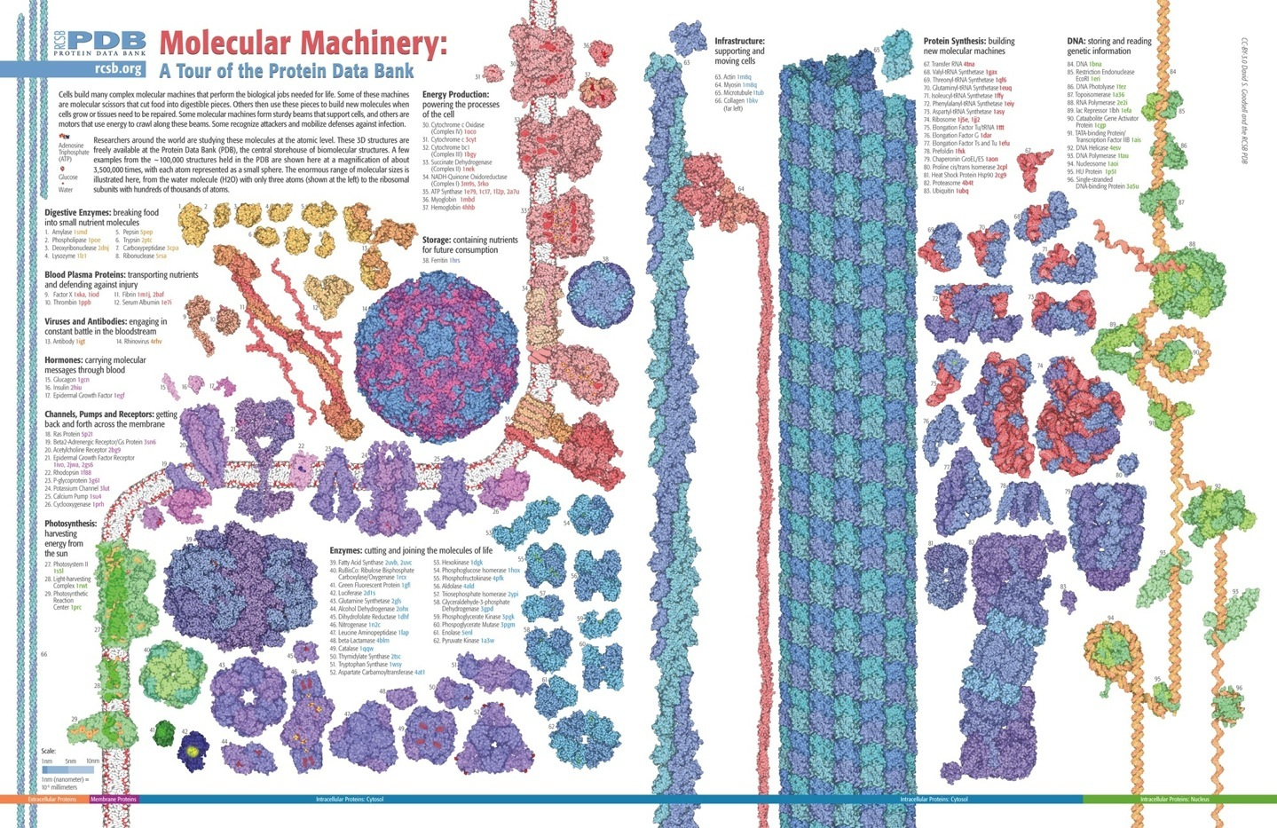
Notes:
6

Slide 7
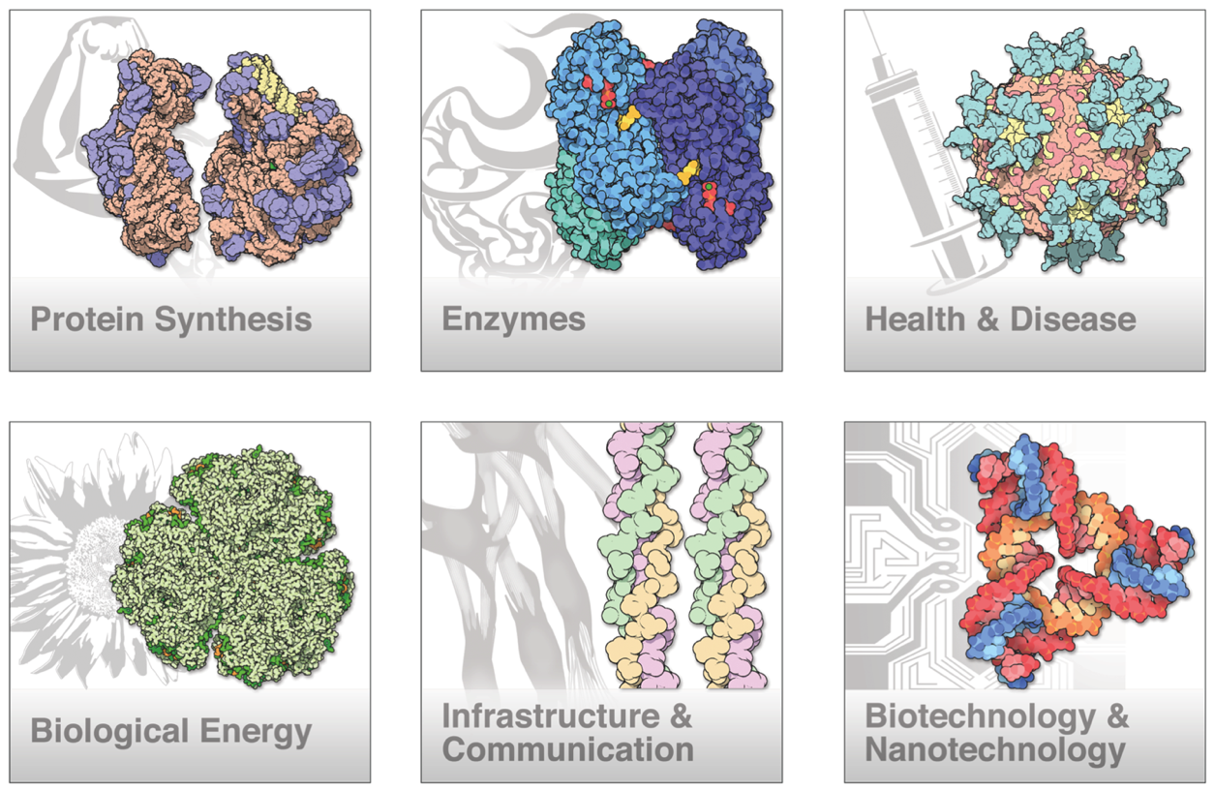
Some Areas of Interest

Slide 8
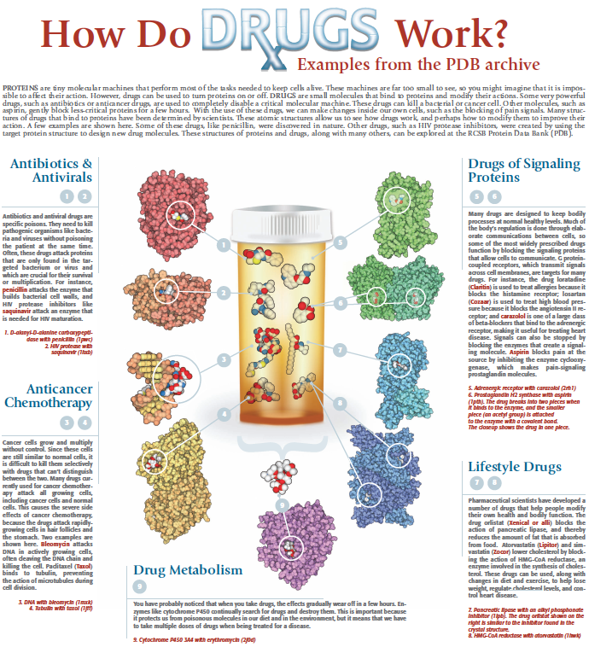

Slide 9
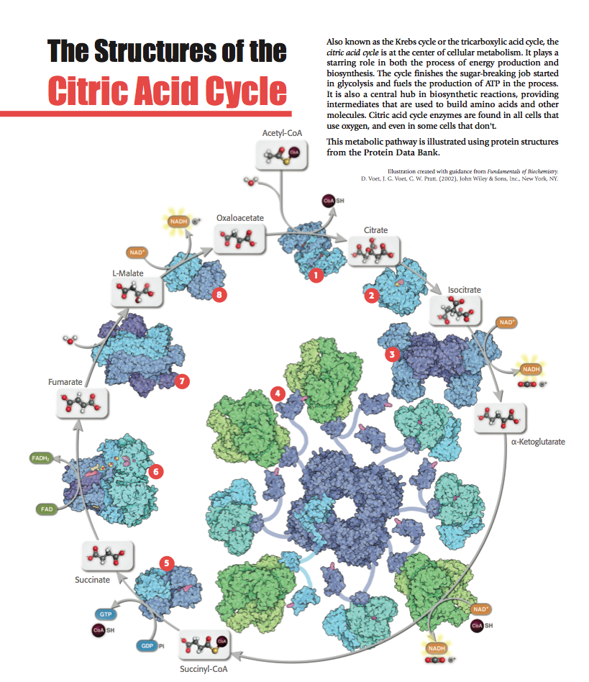
Pathways
A structural view
of the Krebs cycle
Notes:
Update CHANGED IT TO FLYER VERSION

Slide 10
Sustainability
How do we sustain a resource?

Slide 11
Funding Models for Domain Repositories
Inter-university Consortium for Political and Social Research published “Sustaining Domain Repositories for Digital Data Resources: A White Paper”
Chaired by George Alter, Director, ICPSR, UMichigan
Funded by the Alfred P. Sloan Foundation
Representation of 22 data resources from across the spectrum of scientific disciplines
Publication DOI:
DOI: 10.3886/SustainingDomainRepositoriesDigitalData

Slide 12
Evaluation of Funding Models
Evaluated 4 extant and 4 possible funding models
on basis of:
  Economic Stability/Long-term Sustainability
  Potential for
    Open Access to Research Data
    Equity for Data Deposition by Individuals
    Equity for Data Access by Institutions

Slide 13
Extant Resource Funding Models
Outcome of meeting organized by the Inter-university Consortium for Political and Social Research (ICPSR), supported by the Alfred P. Sloan Foundation, and attended by representatives of 22 data repositories from a wide spectrum of scientific disciplines.
Funding Models | Potential for Economic Stability Needed for Long-Term Sustainability | Potential for Open Access to Research Data | Potential for Equity for Deposits by Individual Researchers | Potential for Equity for Universities/ Institutions
Membership Dues | Moderate | Low | Moderate | Low
Submission Fees | Low to Moderate | High | Low | Low
Institutional support | Moderate | High | Low | Low
Federally-sponsored Special Projects | Low | High | Limited to designated research | High
From Sustaining Domain Repositories for Digital Data: A White Paper
Notes:
Would benefit from some notes on the different models. Reviewed with Stephen on 8/15/16, but would like to confirm understanding of these models in the PDB view.

Slide 14
Alternative Resource Funding Models
Outcome of meeting organized by the Inter-university Consortium for Political and Social Research (ICPSR), supported by the Alfred P. Sloan Foundation, and attended by representatives of 22 data repositories from a wide spectrum of scientific disciplines.
Funding Models | Potential for Economic Stability Needed for Long-Term Sustainability | Potential for Open Access to Research Data | Potential for Equity for Deposits by Individual Researchers | Potential for Equity for Universities/ Institutions
Commercial services | Low | Moderate | Low | Low
User fees | Low | Low | High | Low
Overhead | Moderate | High | Moderate | Low
Infrastructure | Moderate to High | High | High | High
From Sustaining Domain Repositories for Digital Data: A White Paper
Notes:
Would benefit from some notes on the different models. Reviewed with Stephen on 8/15/16, but would like to confirm understanding of these models in the PDB view.

Slide 15
The Infrastructure Model Fulfills Key Criteria
Funding agencies commit to direct payment of the costs of archiving experimental data/metadata generated with the research support they provide
Data Resource funding comes in the form of strategic,
long-term infrastructure investments (divorced from typical 3-5 year grant cycles)
Ensures Economic Stability/Sustainability for an
Open Access Data Resource Ecosystem with
Equity for Data Depositors and Consumers

Slide 16
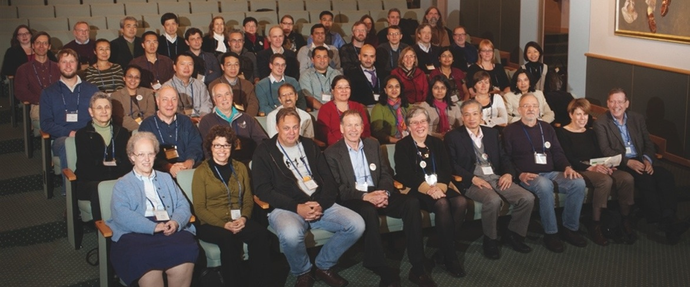



PDB Management
PDB members past and present at the PDB40 Anniversary Symposium, 2011
The Protein Data Bank Archive is managed by:
Worldwide Protein Data Bank
wwpdb.org
Members
rcsb.org
pdbe.org
pdbj.org
bmrb.wisc.edu
RCSB Protein Data Bank
proteindatabank
ja-jp.facebook.com/PDBjapan
@buildmodels
@PDBEurope
@PDB_ja
﻿Funding:
NSF, NIH, DOE
﻿Funding:
EMBL-EBI, Wellcome Trust, BBSRC, NIGMS, EU
﻿Funding: NBDC-JST
﻿Funding:
NLM

Slide 17

This work is licensed under Creative Commons Attribution-NonCommercial-ShareAlike 4.0 International.
Funded by Grant R25 LM012286 from the National Library of Medicine of the National Institutes of Health.

