Slide 1
Introduction to Biological Databases and Data Archiving
Creating Archive Requirements

Slide 2
Outline
Experimental data pipelines
Stakeholder involvement
Deposition, annotation, release policies

Slide 3
Experimental data pipelines:
Introduction

Slide 4
Experimental Methods Used for
Structure Determination
First 500
1991
First 500
1995
First 500
2012
Year
Notes:
Update ALL EXCEPT FOR HYBRID

Slide 5
Information Common to all Methods
Experimenter Information
  Name, ORCID id
Citation/Bibliography
  Author list, journal, volume, pages, year
Biological source
  Source type: natural, recombinant, or synthetic
  Natural source organism, e.g. Homo sapiens
  Recombinant source organism, e.g. E. coli BL21(DE3)
  Polymer sequence (protein, RNA, DNA)

Slide 6
Method-specific Information
Relevant information to archive can be divided into four broad classes
  sample description
  experimental setup and conditions
  experimental measurements produced
  interpretation of the data

Slide 7
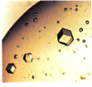
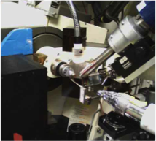
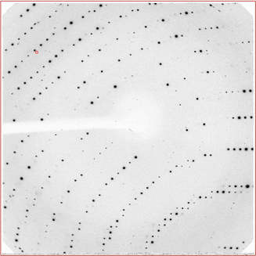
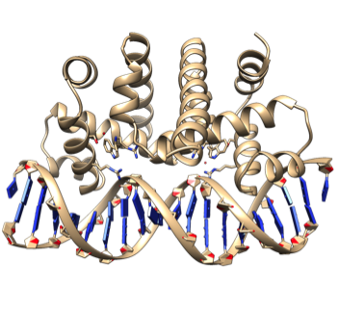
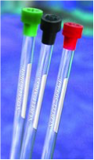
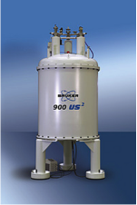
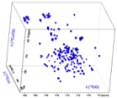
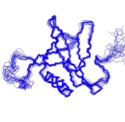
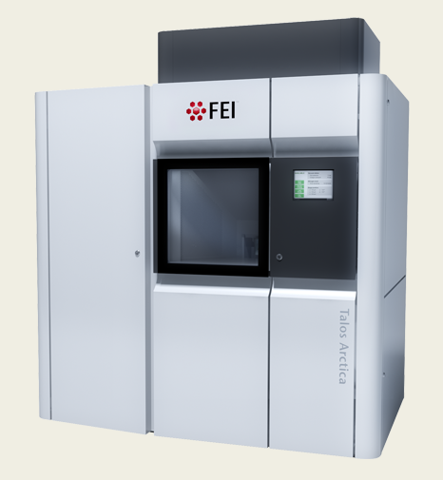
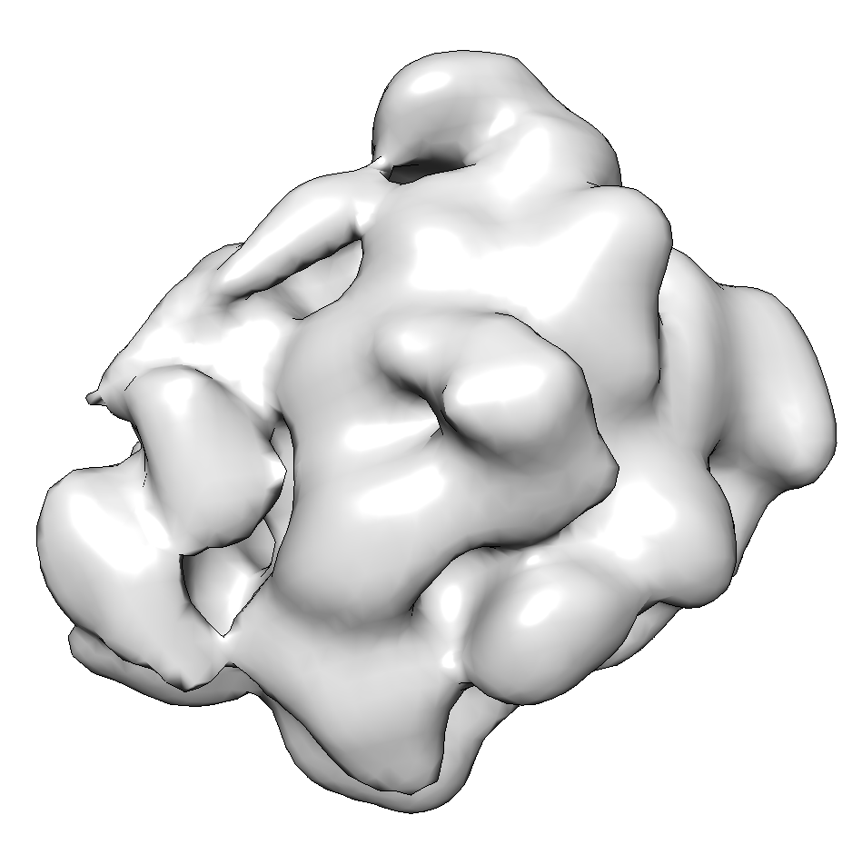
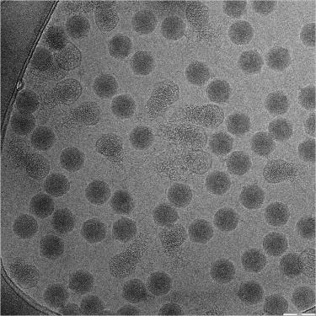
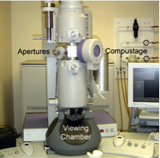
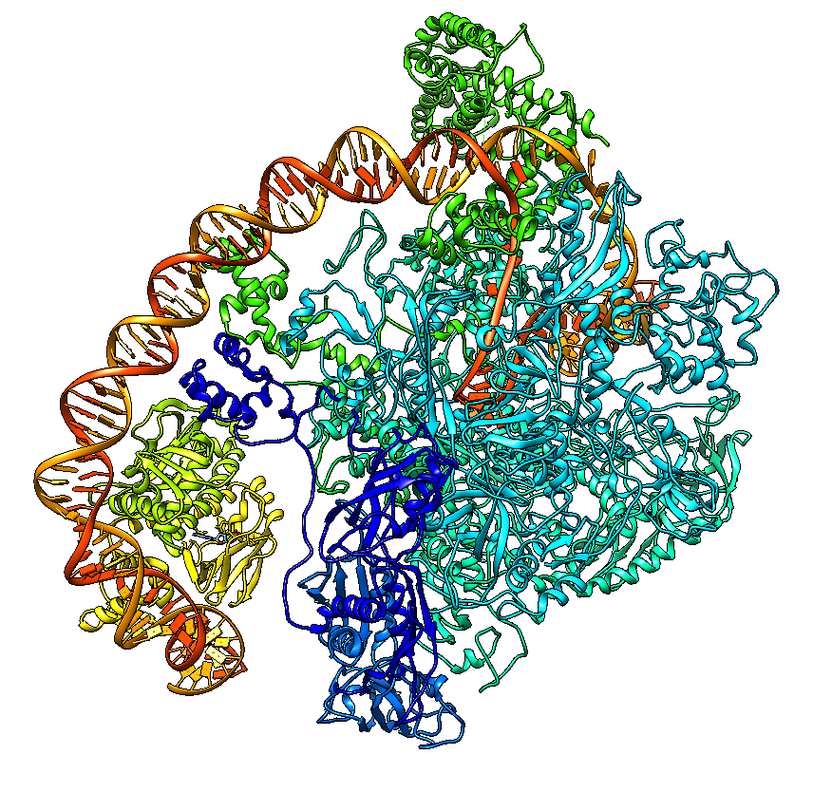
X-ray Crystallography
Nuclear Magnetic Resonance Spectroscopy (NMR)
Electron Microscopy (3DEM)

Slide 8
Sample
Xray | NMR | 3DEM
Buffer Crystallization Procedure | Buffer Isotope Labeling | Buffer Sample Support Vitrification
Notes:
In EM, referred to as specimen preparation

Slide 9
Experiment
X-ray | NMR | 3DEM
Sample Conditions X-ray Source Detector Collection Protocol | Sample Conditions Spectrometer Acquisition parameters | Sample conditions Electron Source Detector Imaging Parameters
Notes:
In EM, referred to as specimen preparation

Slide 10
Measurements/Data
Xray | NMR | 3DEM
Diffraction images Structure Factors Processing Software Statistics (resolution, Rsym) | Resonance Spectra Resonance Assignments Chemical Shifts Constraints Processing Protocol | Particle images Final 3D Map Processing Software Processing Protocol Resolution (FSC)
Notes:
the raw measured data is in red

Slide 11
Interpretation/Final Model
Xray | NMR | 3DEM
Structure solution method Refinement software, restraints fit-to-data statistics | Structure calculation method Refinement software | Modelling method Model source Fitting software
Notes:
In EM, referred to as specimen preparation

Slide 12

This work is licensed under Creative Commons Attribution-NonCommercial-ShareAlike 4.0 International.
Funded by Grant R25 LM012286 from the National Library of Medicine of the National Institutes of Health.

