Slide 1
Introduction to Biological Databases and Data Archiving
Creating Archive Requirements

Slide 2
Experimental data pipelines:
Cryo Electron Microscopy

Slide 3
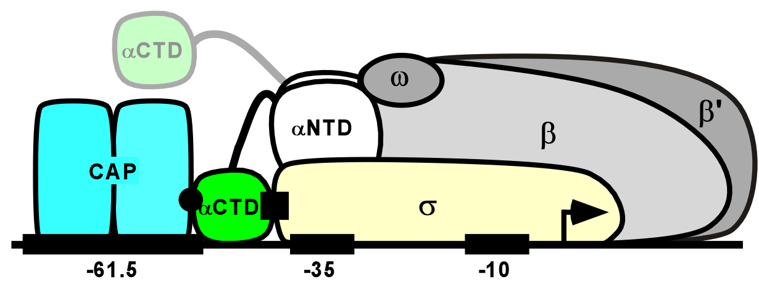
Example:
Bacterial Transcription Complex, 3DEM Method
3 components:
Catabolite Activator Protein (CAP) (50 kDa)
RNA polymerase (αCTD,αNTD,β,β’,ω) (300 kDa)
Promoter DNA (-61.5,-36,-10) (~100 base pairs)
Total: ~ 500 kDa

Slide 4
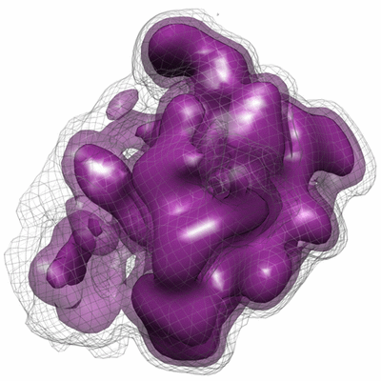
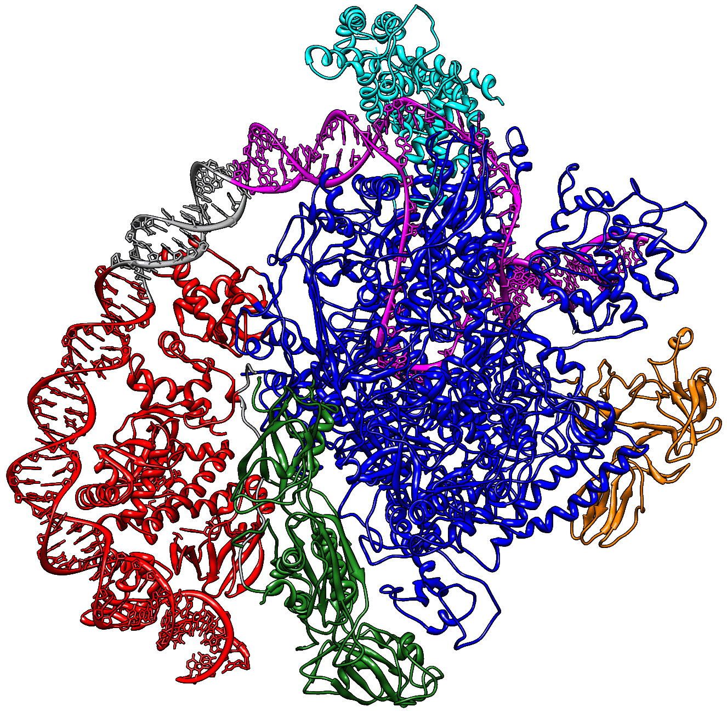
Depositions
Map: EMDB entry EMD-5127
Coordinate model: PDB entry 3IYD
Experimental Metadata:
EMDB and PDB

Slide 5
Citation
data item | value
type | primary
title | 'Three-dimensional EM structure of an intact activator-dependent transcription initiation complex’
journal (abbreviated) | Proc.Natl.Acad.Sci.USA
volume | 106
first page | 19830
last page | 19835
year | 2009
journal ISSN id | 0027-8424
PubMed id | 19903881
Digital Object Identifier (DOI) | 10.1073/pnas.0908782106
+ additional table for authors

Slide 6
Biological Source
id | type | source method | description | formula weight | #mole-cules
1 | polymer | genetically manipulated | DNA-directed RNA polymerase subunit alpha | 36559 | 2
2 | polymer | genetically manipulated | DNA-directed RNA polymerase subunit beta | 150821 | 1
3 | polymer | genetically manipulated | DNA-directed RNA polymerase subunit beta prime | 156196 | 1
4 | polymer | genetically manipulated | DNA-directed RNA polymerase subunit omega | 10118 | 1
5 | polymer | genetically manipulated | RNA polymerase sigma factor rpoD | 70327 | 1
6 | polymer | genetically manipulated | Catabolite gene activator | 23541 | 2
7 | polymer | synthetic | DNA (98-MER) | 30220 | 1
8 | polymer | synthetic | DNA (98-MER) | 30097 | 1
9 | non-polymer | synthetic | ADENOSINE-3',5'-CYCLIC-MONOPHOSPHATE | 329 | 2
Notes:
man = genetically manipulated
syn = synthetic

Slide 7
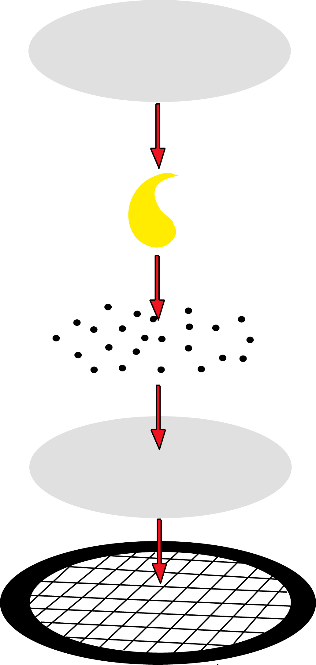
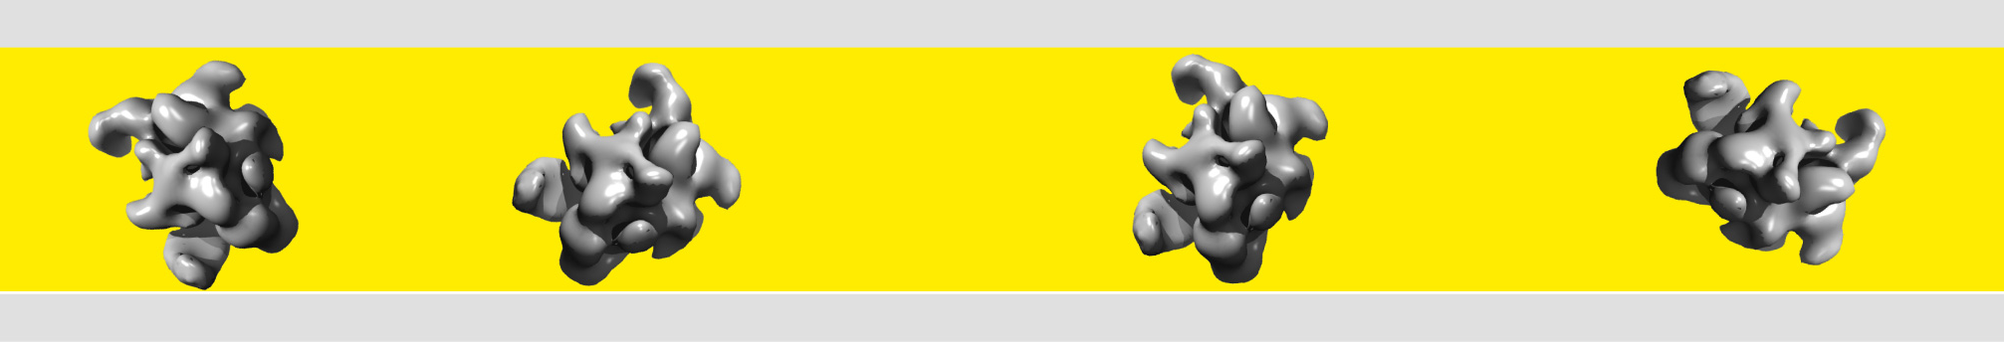
Sample/Specimen Preparation
item | value
staining | Sample and 2% uranyl formate stain were applied to the grid in rapid succession, with the last drop of stain remaining on the sample for 1 minute. The grid was then submerged in stain and brought up under thin carbon to form an upper sandwich layer. The grid was then blotted and dried for 10 minutes.
concentration (mg/ml) | 6.18
support details | 400-mesh copper 2.0x0.5 hole pattern C-flat grid covered with thin layer of continuous carbon
state | particle
buffer details | 25mM HEPES, 100mM KCl, 10mM MgCl2, 1mM DTT, 0.2mM cAMP
pH | 8.0
Carbon Film
Uranyl Formate Stain
Sample
Carbon Film
Grid

Slide 8
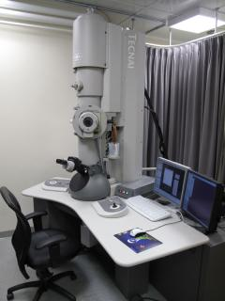
Imaging Experiment
data item | value
date | 4-NOV-2008
temperature (K) | 293
microscope model | FEI TECNAI F20
defocus min (nm) | 500
defocus max (nm) | 1500
nominal Cs (mm) | 2.0
mode | BRIGHT FIELD
electron dose (e⁻/Å²) | 16
illumination mode | FLOOD BEAM
nominal magnification | 5000
electron source | FIELD EMISSION GUN
accelerating voltage (kV) | 120
specimen holder model | SIDE ENTRY, EUCENTRIC
detector type | Teitz F415 4k x 4k pixel CCD

Slide 9
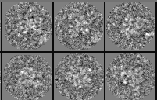
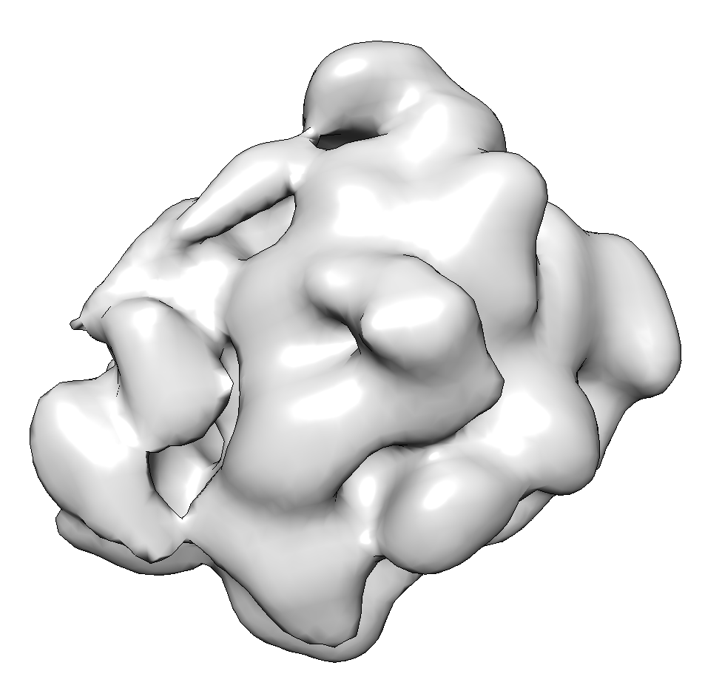
Measurements/Data
data item | value
map file name | emd_5127.map.gz
data type | image stored as Reals
dimensions col/row/sec | 80/80/80
spacing col/row/sec | 80/80/80
density minimum value | -3.3408
density maximum value | 14.3952
density average value | 0
density std deviation | 0.9027
pixel spacing x/y/z (Å) | 4.64/4.64/4.64
nominal magnification | 5000
recommended contour level | 2.8
contour level source | author
annotation details | E. coli Class I transcription activation complex

Slide 10
Interpretation/Final Model
Source Model PDB id | description
1LB2 | CAP/DNA complex
1BDF | RNAP alpha subunit N-terminal domain dimer
2AUK | RNAP beta’ subunit G/G’ insert
1SIG | sigma70 subunit fragment
3DXJ | RNAP holoenzyme

Slide 11

This work is licensed under Creative Commons Attribution-NonCommercial-ShareAlike 4.0 International.
Funded by Grant R25 LM012286 from the National Library of Medicine of the National Institutes of Health.

