Slide 1
Introduction to Biological Databases and Data Archiving
Designing the Infrastructure

Slide 2
Data Models

Slide 3
What is a data model?
A model describing the data items within a domain and how these data items relate to one another.

Slide 4
Early data models …

Slide 5

Early English Language Dictionary
circa 1582
Identified ~8000 words
In: The First Part of the Elementarie,
Richard Mulcaster, T. Vautroullier, London, 1582

Slide 6
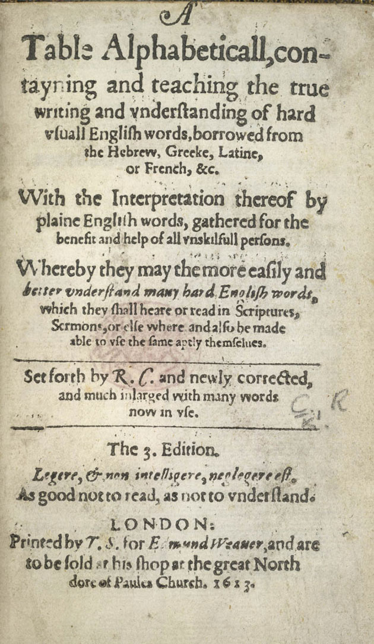
Early English Language Dictionary
circa 1613
3000 words
Including definitions
Organized alphabetically
In: Table Alphabeticall
Robert Cawdrey,
T. S. for Edmund Weauer, London, 1613

Slide 7
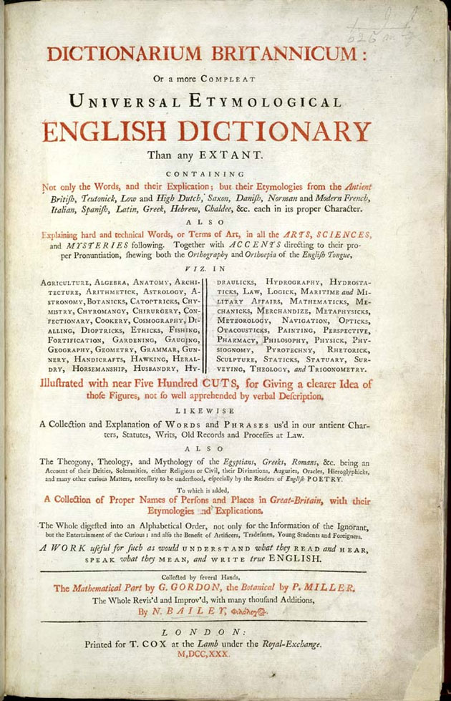
Early English Language Dictionary
circa 1730
48000 words including technical words and slang
Including definitions
Including pronunciation
In: Dictionarium Britannicum
Nathan Bailey,
T. Cox, London, 1730

Slide 8
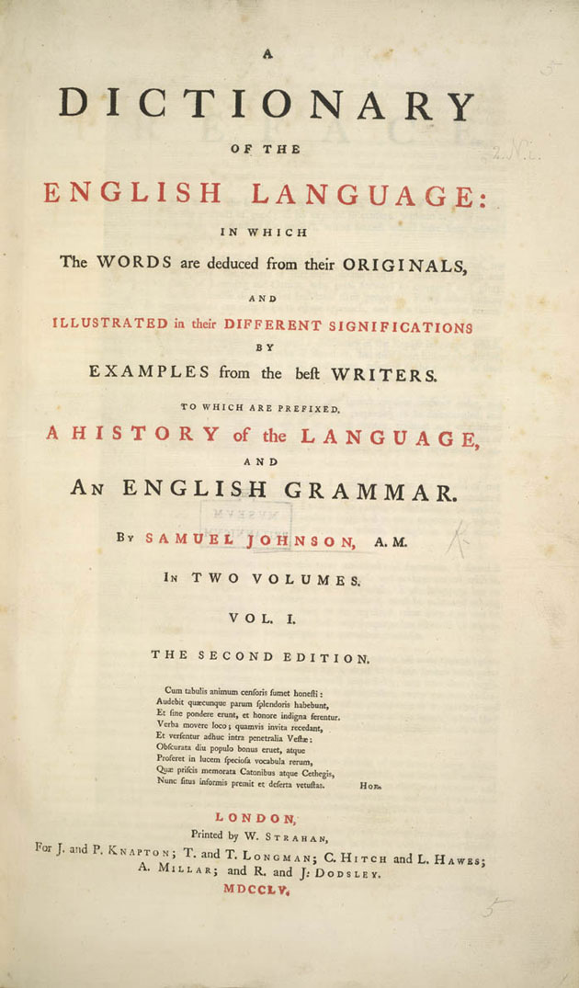
Early English Language Dictionary
circa 1755
~40,000 words
Origin
Type (e.g. noun, adjective)
Pronunciation
Definitions
Examples (e.g. quotations)
In: Dictionary of the English Language,
Samuel Johnson,
J. & P. Knapton, London, 1755

Slide 9
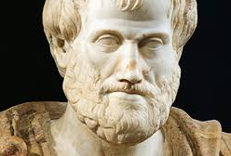
Early Biological Taxonomy circa 350 BC
LIFE
KINGDOM ANIMALIA
KINGDOM PLANTS
WHERE THEY LIFE
WHAT THEY EAT
IN THE WATER
IN THE LANDS
IN THE AIR
HERBIVORA
CARNIVORA
OMNIVORA
WHERE THEY LIFE
XEROFIT
HIGROFIT
HIDROFIT
PROPERTIES
TREES
BUSHES
HERBS
Aristotle (384-322 BC)

Slide 10
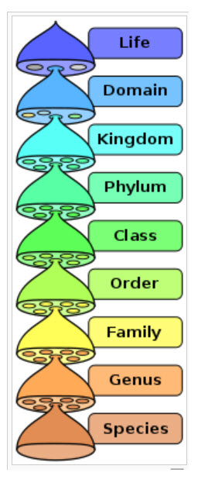

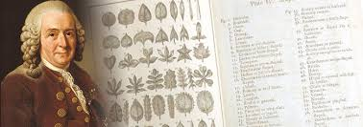
Biological Taxonomy circa 1758
4,400 animal species
7,700 plant species
Binomial nomenclature system
In: Systema Naturae (first edition)
Carl Linnaeus, Leiden, 1735
and final tenth edition in 1758

Slide 11
Data models in the computer age…

Slide 12
Conceptual Models
Entities, attributes
& relationships
High Level
Logical Models
Adds organization,
Record Structures
Physical Models
Record formats,
record orderings, access paths
Low Level
Commonly applied in modeling relational database model: Codd, E. F. 1970. A relational data model for large shared data banks. Communications of the ACM 13(6), 377-387. and Date, C.J (2004). An Introduction to Database Systems (8 ed.). Addison Wesley. pp. 592–97. ISBN 0-321-19784-4.
Notes:
23

Slide 13
A Spectrum of Data Models
Conceptual data models use concepts such as entities, attributes, and relationships
An entity represents a real-world object or concept
An attribute represents a property describing an entity.
A relationship represents an association among two or more entities
Logical or representational data models add organizational constructs to support requirements of a DBMS. These include the widely used relational data model, network and hierarchical models, object and object relational models, and many others.
Physical data models describe how data is stored as files on a computer by representing information such as record formats, record order, access paths or search indices.
Conceptual
Logical
Physical
More Abstract
Architecture Abstraction Continuum
More Concrete

Slide 14
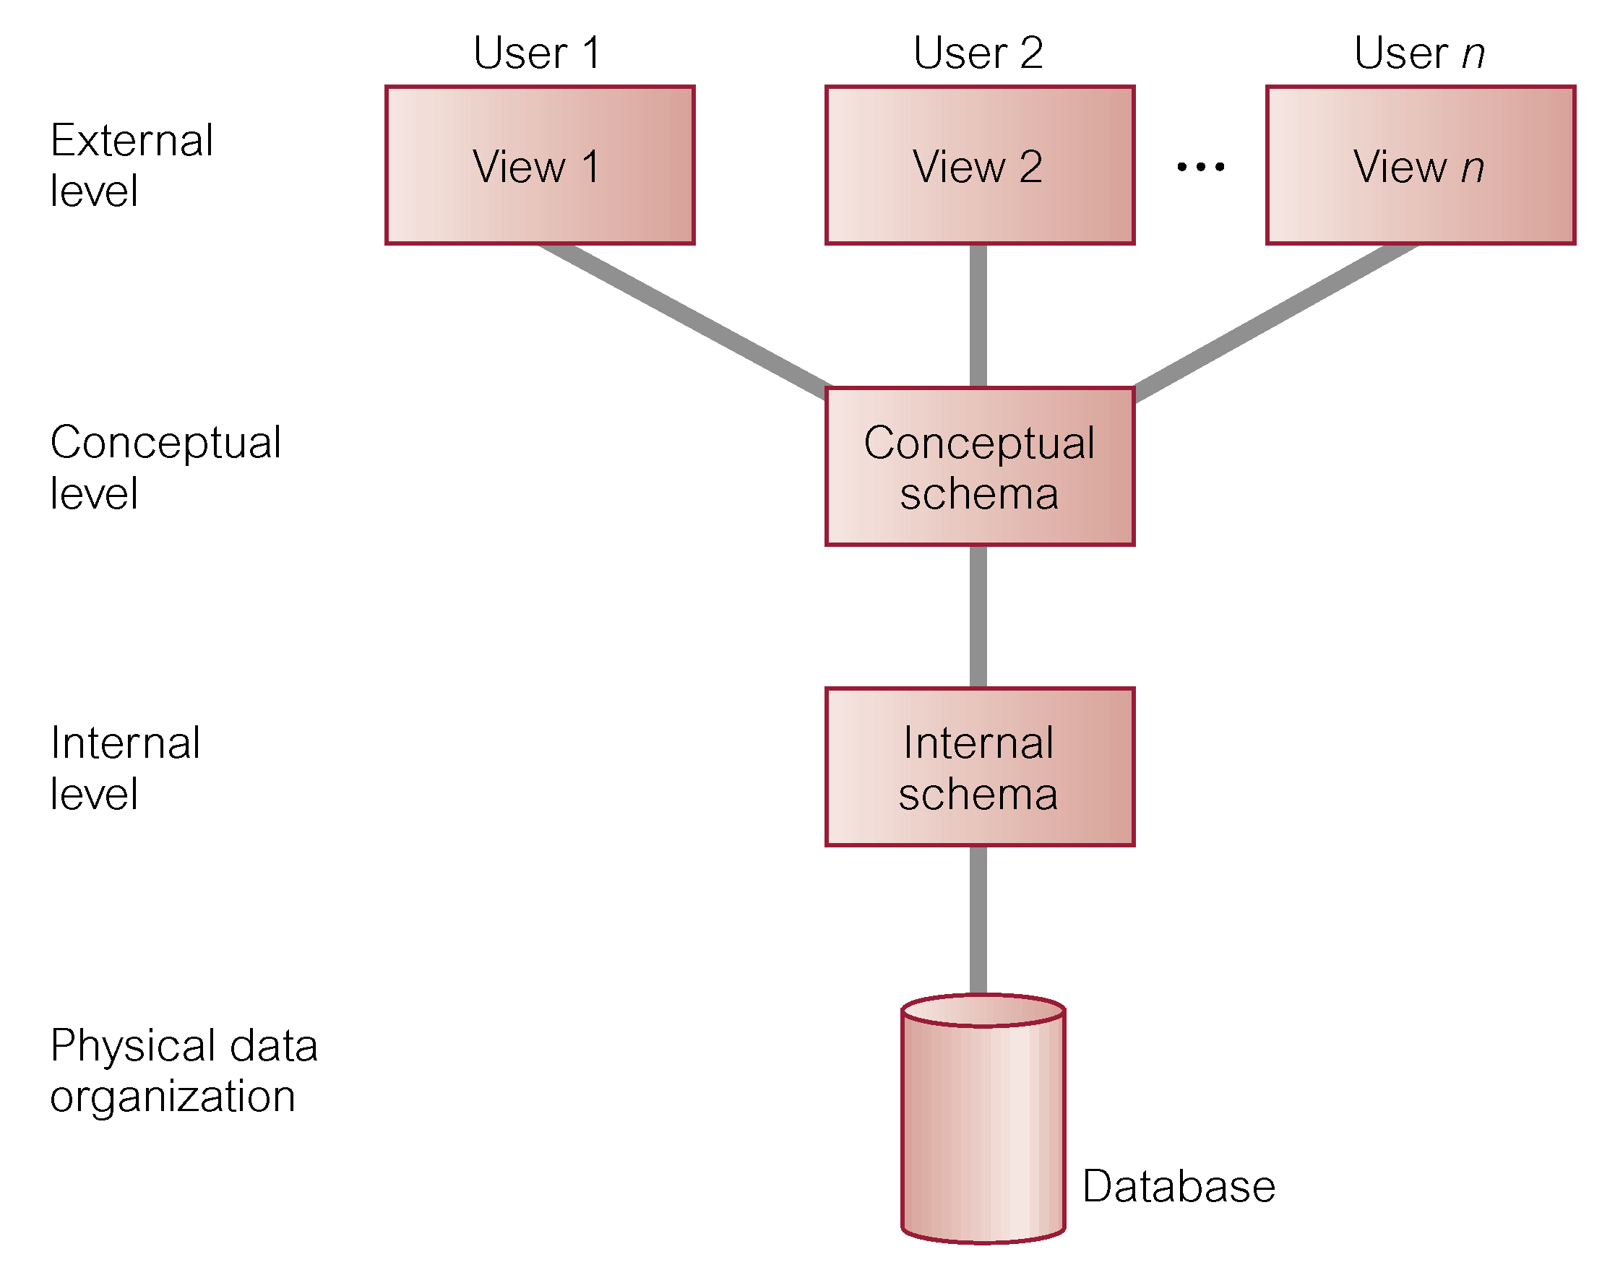
ANSI-SPARC Architecture
ANSI/X3/SPARC Study Group on Data Base Management Systems: (1975), Interim Report. FDT, ACM SIGMOD bulletin. Volume 7, No. 2

Slide 15
ANSI-SPARC Architecture
External Level
Users’ view of the data.
Describes a subset of data that is relevant to a particular user.
Conceptual Level
Community view of the data
The most data description including all of the relationships among the data.
Internal Level
Physical representation of the data in a database system.
Describes how the data is stored and accessed in the database.

Slide 16

This work is licensed under Creative Commons Attribution-NonCommercial-ShareAlike 4.0 International.
Funded by Grant R25 LM012286 from the National Library of Medicine of the National Institutes of Health.

