Slide 1
Introduction to Biological Databases and Data Archiving
Designing the Infrastructure

Slide 2
Structural Biology Data Model Example

Slide 3
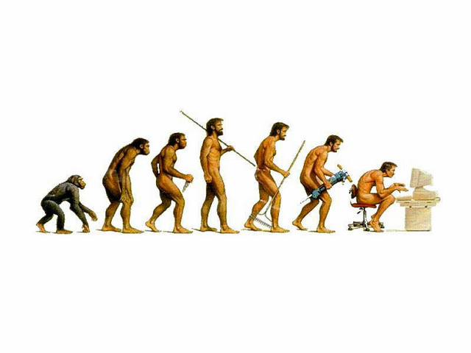

With a blink of an eye! PDBx/mmCIF Development Timeline
1991
1994
1997
2000
2003
2006
2009
2012
IUCr mmCIF Working Party
IUCr mmCIF Maintenance Group
Core CIF V1
mmCIF V1
mmCIF V2
mmCIF/Core sync’d
Workshops
York
Rutgers
CARB
Honolulu
Tarrytown
St. Louis
Glasgow
Orlando
Brussels
Seattle
Rutgers
EBI
DDL 1
DDL 2
mmCIF +Extensions
PDB Exchange Dictionary
wwPDB
One Archive – One Dictionary
wwPDB Common Deposition & Annotation System
Data
mmCIF
Notes:
Brian McMahon, IUCr

Slide 4
PDBx/mmCIF Architecture Dictionary of Dictionaries
Dictionary Definition Language (metadata definitions)
PDB Exchange Dictionary (domain definitions)
PDBx Data Files (instance data, PDB entries)
In addition to semantics, each layer provides the framework to validate and extend subsequent layers…
Dictionary Definition Language (DDL2)
Defines
PDBx Exchange Dictionary
Covers both conceptual plus logical traditional models and the conceptual model from the SPARC architecture.
Defines
PDBx Data files

Slide 5
Dictionary Metadata The elements of a domain definition
Features of data items
Definitions and examples
Data types (primitives & regular expression patterns)
Boundary values
Controlled vocabularies
Simple organization
Tables and columns (naming consistency)
Related data item sets (subcategories)
Chapters (category groups)
Associations
Referential integrity - parent-child relationships
Aliases and synoynms
Interdependencies/exclusivity
Methods
J. D. Westbrook, H. M. Berman, S. R. Hall. (2005). 2.6 Specification of a relational Dictionary Definition Language (DDL2). In International Tables for Crystallography (S. R. Hall & B. McMahon, eds.), Vol. G. Definition and exchange of crystallographic data, pp. 61-72. Springer, Dordrecht, The Netherlands.

Slide 6
PDBx/mmCIF Format Example
Name – value pairs (category ‘dot’ attribute)
Tables or loop_’s
_exptl.entry_id 1XBB
_exptl.method 'X-RAY DIFFRACTION'
_exptl.crystals_number 1
loop_
_database_PDB_rev.num
_database_PDB_rev.date
_database_PDB_rev.date_original
_database_PDB_rev.mod_type
_database_PDB_rev.replaces
_database_PDB_rev.status
1 2004-11-02 2004-08-30 0 1XBB ?
2 2005-03-22 ? 1 1XBB ?
3 2009-02-24 ? 1 1XBB ?

Slide 7
Dictionary Definition Example
Semantics
save__em_entity_assembly.symmetry_type
_item_description.description
; The type of symmetry of the assembly, component or superstructure.
;
_item.name '_em_entity_assembly.symmetry_type'
_item.category_id em_entity_assembly
_item.mandatory_code no
_item_type.code line
loop_
_item_enumeration.value
_item_enumeration.detail
asymmetric 'object with no internal symmetry'
point 'point symmetry object'
helical 'helix/filament'
2D '2D crystal'
3D '3D crystal'
save_
Schema
Data type
Controlled
vocabulary

Slide 8
Dictionary Definition Example
save__atom_site.Cartn_x
_item_description.description
; The x atom-site coordinate in angstroms specified according to
a set of orthogonal Cartesian axes related to the cell axes as
specified by the description given in
_atom_sites.Cartn_transform_axes.
;
_item.name '_atom_site.Cartn_x'
_item.category_id atom_site
_item.mandatory_code no
_item_aliases.alias_name '_atom_site_Cartn_x'
_item_aliases.dictionary cif_core.dic
_item_aliases.version 2.0.1
loop_
_item_dependent.dependent_name
'_atom_site.Cartn_y'
'_atom_site.Cartn_z'
_item_related.related_name '_atom_site.Cartn_x_esd'
_item_related.function_code associated_esd
_item_sub_category.id cartesian_coordinate
_item_type.code float
_item_type_conditions.code esd
_item_units.code angstroms
Aliases
Related items
Precision

Slide 9
Dictionary Definition Example
save__em_sample_preparation.experiment_id
_item_description.description
; The value of _em_sample_preparation.id must
uniquely identify the sample preparation.
;
_item.name '_em_sample_preparation.experiment_id'
_item.category_id em_sample_preparation
_item.mandatory_code yes
_item_type.code code
_item_linked.child_name '_em_sample_preparation.experiment_id'
_item_linked.parent_name '_em_experiment.id'
save_
Parent-Child
relationships

Slide 10
A Portion of the
PDBx/mmCIF Data Model
Each box represents a data category –
Key items yellow
Arrow represent parent-child relationships
Current data dictionary contains: 380 categories & 4400 data items

Slide 11
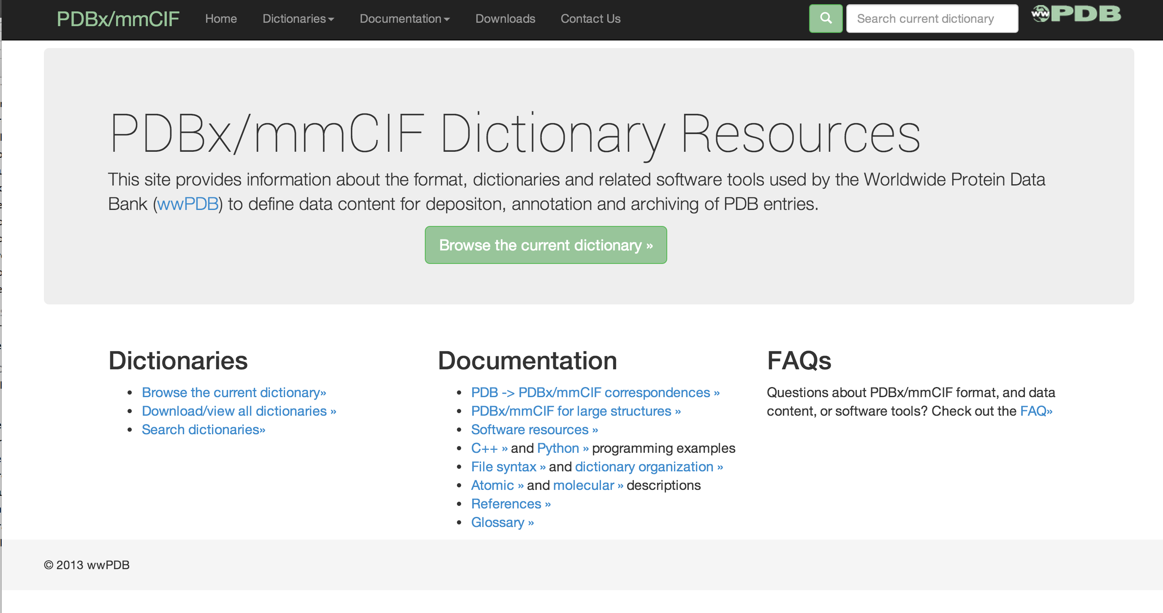
PDBx/mmCIF Resource Site mmcif.wwpdb.org
J. Westbrook, H. Yang, Z. Feng, H. M. Berman. (2005). 5.5 The use of mmCIF architecture for PDB data management. In International Tables for Crystallography (S. R. Hall & B. McMahon, eds.), Vol. G. Definition and exchange of crystallographic data, pp. 539-543. Springer, Dordrecht, The Netherlands.

Slide 12

This work is licensed under Creative Commons Attribution-NonCommercial-ShareAlike 4.0 International.
Funded by Grant R25 LM012286 from the National Library of Medicine of the National Institutes of Health.

