Slide 1
Introduction to Biological Databases and Data Archiving
Designing the Infrastructure

Slide 2
Creating descriptive metadata

Slide 3
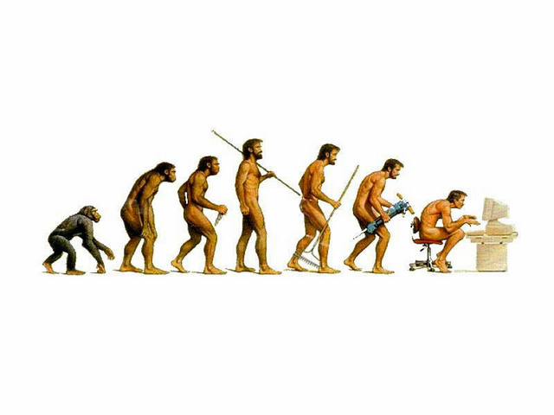
Dictionary Development is an Evolutionary Process
Data
mmCIF
Notes:
Brian McMahon, IUCr

Slide 4
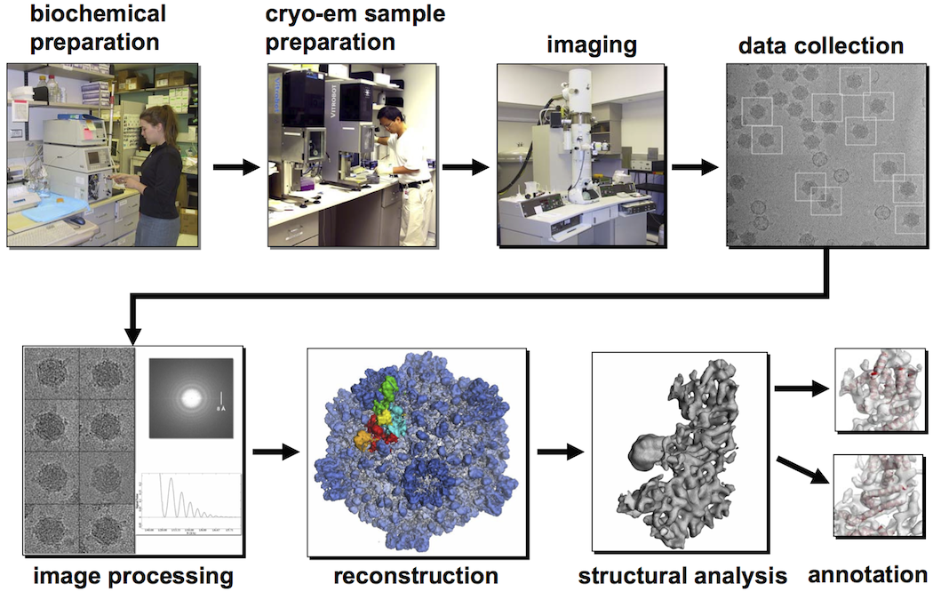
Metadata Development
Goal: Create a data dictionary that captures the key information (parameters) for each of the steps in an experiment
EM EXPERIMENT

Slide 5
Community Input is Essential
Who
expert data producers (scientists)
software developers
database experts
journals
funding agencies
How
Workshops to focus community discussion on data dictionary development

Slide 6
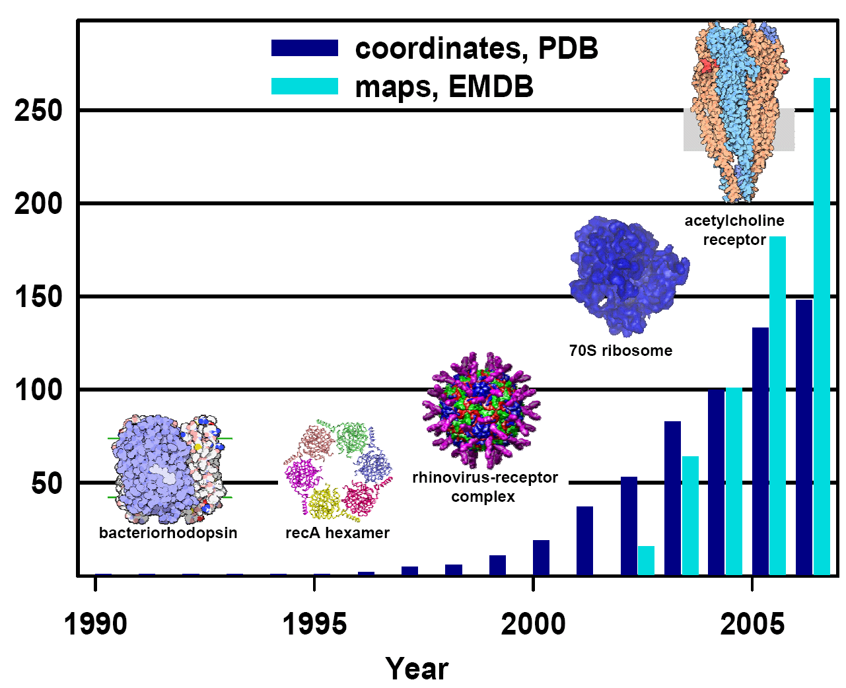
EM Archiving: Early Days
1990s: First EM structures deposited to PDB
2002: EM map archive est. at EBI
2002-5: Handful of entries in each archive

Slide 7
Early Development Workshops
EM Software Development Workshops
Nov 2002, May 2004, Oct 2005 @ EBI (UK)
CryoEM Structure Deposition Workshop
Oct 2004 @ Rutgers (USA)
All workshops co-organized by database developers + experts in the scientific field
emdatabank.org/outreach_history.html
DataBase developers: Kim Henrick (EBI), Helen Berman (Rutgers)
Experts: Stephen Fuller, Jose Maria Carazo, Wah Chiu, Michael Rossmann

Slide 8
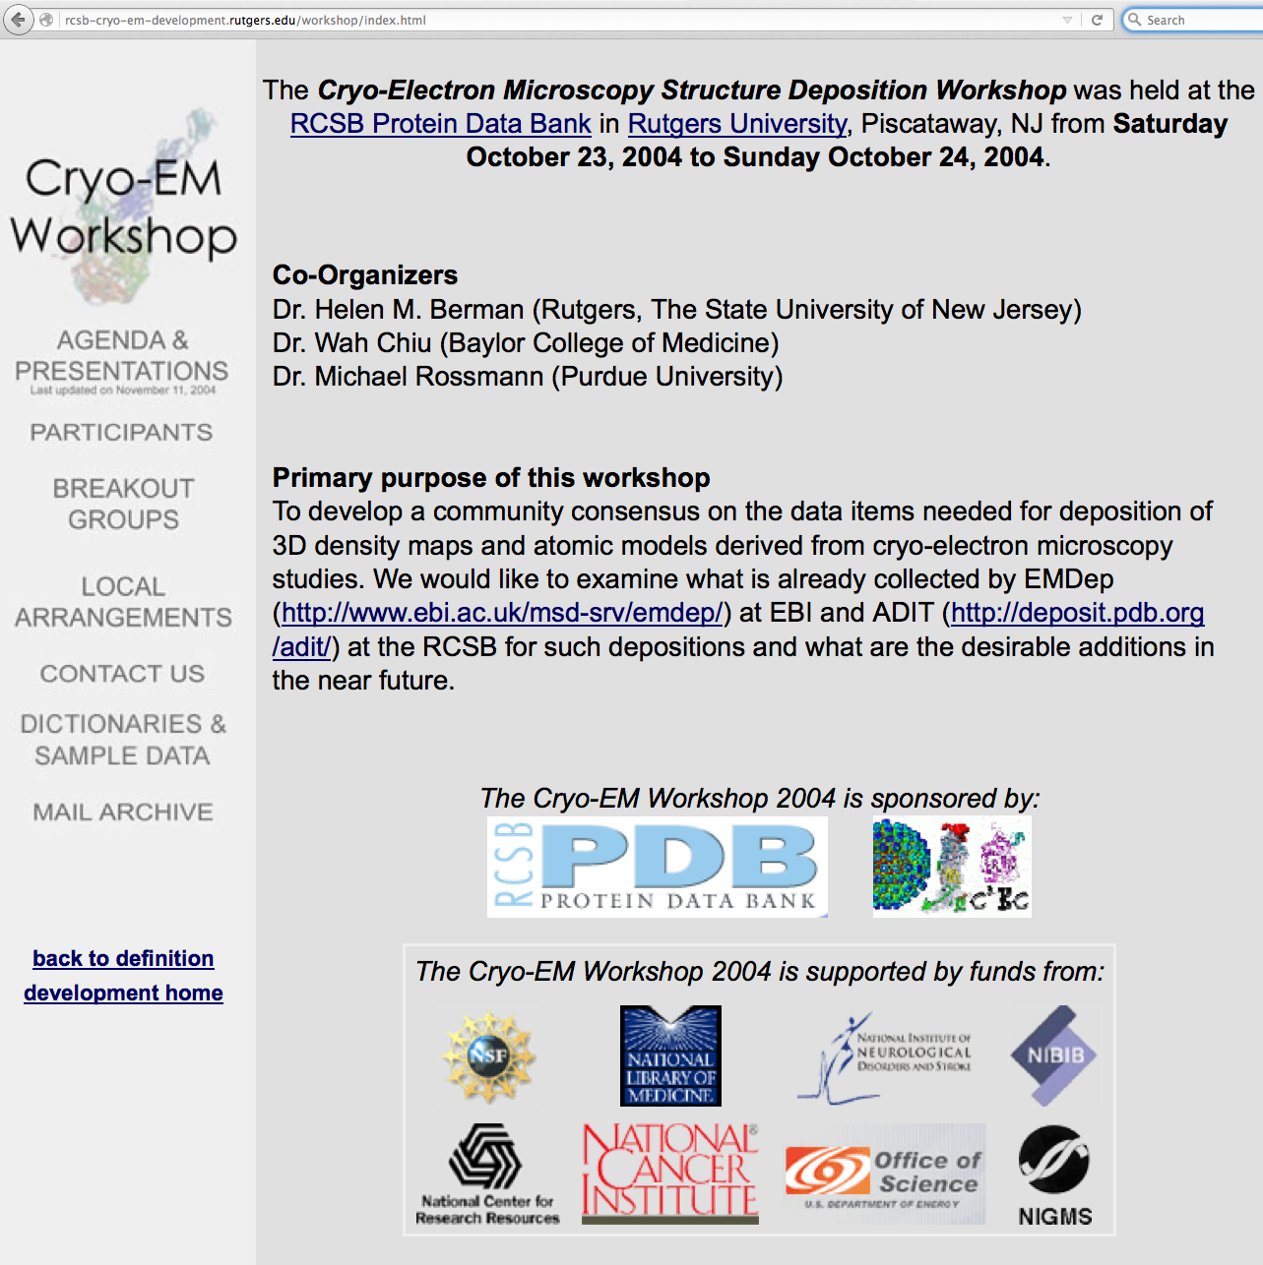
2004 Cryo-EM Workshop

Slide 9
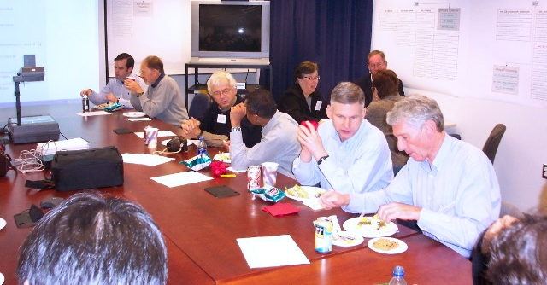
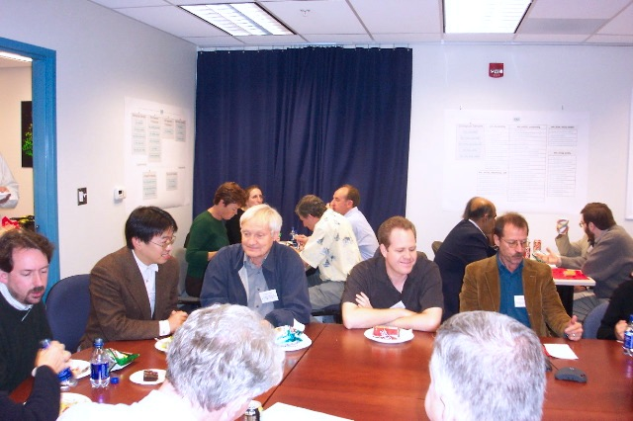
2004 CryoEM Workshop Overview
30 Attendees including cryo-EM, programming and database experts, funding agency and journal representatives
The current EM dictionary was reviewed in two focus groups and recommendations for revisions were obtained
Notes:
Make handout notebook for Greg Farber that has specifics of workshop—agenda, attendee list, ppt files with group 1 and group 2 recommendations, wrap up document.

Slide 10
Key Recommendation:
one-stop shop for EM data deposition
this recommendation lead to creation of a unified dictionary
dictionary was basis for NIH-funded international partnership: EMDataBank Unified Data Resource for 3DEM
Notes:
Make handout notebook for Greg Farber that has specifics of workshop—agenda, attendee list, ppt files with group 1 and group 2 recommendations, wrap up document.

Slide 11
Workshop Follow-up
rcsb-cryo-em-development.rutgers.edu
Dictionary development team was created
Matt Baker (Baylor College of Medicine)
Kim Henrick (EBI)
Cathy Lawson, John Westbrook (Rutgers)
Data Items collected in EMDB and PDB were reviewed
Workshop-recommended revisions to the EM dictionary were incorporated
Example experiments identified, mocked up
Revised dictionary reviewed by workshop attendees

Slide 12
Review of EM Meta Data Items
22
collected
by
EMDB
only
33
collected by
Both EMDB and PDB
23
collected
by
PDB
only
Review enabled harmonization (single dictionary)
for both deposition systems
(total of 78 items)

Slide 13
Proposed Cryo-EM Dictionary Expansion
Sample
Description
Biochemical
Preparation
EM Specimen
Preparation
EM Data Collection
em_imaging
em_assembly
em_sample_preparation
em_vitrification
em_detector
em_sample_support
em_stain
em_entity_assembly
em_image_scans
em_array_formation
em_cryo_stain
em_entity_assembly_list
em_microscope
em_solution_composition
em_embedding_agent
em_virus_entity
em_micrographs
em_icos_virus_shells
em_electron_diffraction
em_single_particle
Image Processing
Structure
Analysis
em_electron_diffraction_phase
em_filaments
em_singleparticle_selection
em_electron_diffraction_pattern
em_3d_fitting
em_3d_reconstruction
em_2d_crystal
em_3d_fitting_list
em_particle_picking
New categories
recommended at
the Oct 2004 workshop
are in orange
em_classes
em_particle_picking_list
em_refinement
em_filament_selection
em_fsc_curve
em_filament_reconstruction

Slide 14
EM Dictionary Development Examples
Experiment (imaging, microscope model)
Sample Representation (assemblies)

Slide 15
Experiment: EM Imaging
Parent/Child Relationships
entry_id*
specimen_id*
Parameters (Units, with value limits)
accelerating_voltage (kV)*
c2_aperture_diameter (mm)
nominal_cs (mm)
nominal_defocus_max (nm)
nominal_defocus_min (nm)
nominal_magnification (fold x)
recording_temperature_maximum (ºK)
recording_temperature_minimum (ºK)
tilt_angle_max (º)
tilt_angle_min (º)
Equipment & Basic
Settings (enumerations)
cryogen
electron_source*
illumination_mode*
microscope_model*
mode*
specimen_holder_model
*mandatory data item

Slide 16
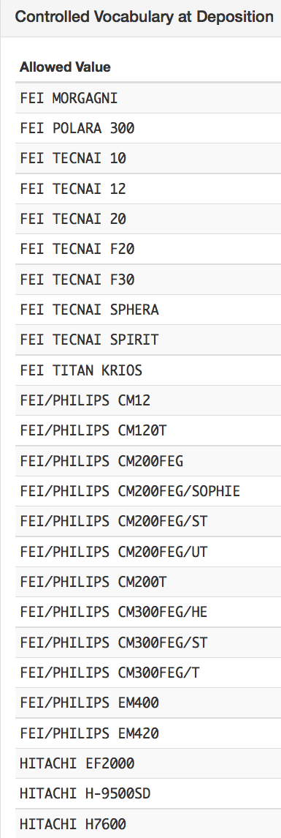
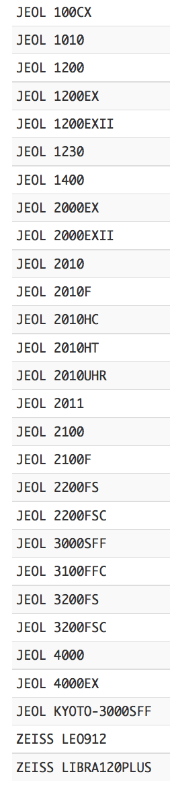
Experiment: Microscope Model
mandatory data item
controlled vocabulary
input from
3DEM experts
microscope manufacturers
Notes:
remediation covered in more detail in lecture 6

Slide 17
Sample Representation: Assemblies
Worked Examples: as suggested by workshop participants
Single Particle | Helical | Tomogram | 2D crystal
GroEL and GroEL/ES chaperones | acetylcholine receptor | embedded mouse skin slice | aquaporin
Rice Dwarf Virus | HIV capsid helical crystal | spirochete whole cell
Poliovirus-Receptor Complex | Tobacco Mosaic Virus
Pneumolysin-liposome complex
T4 bacteriophage

Slide 18
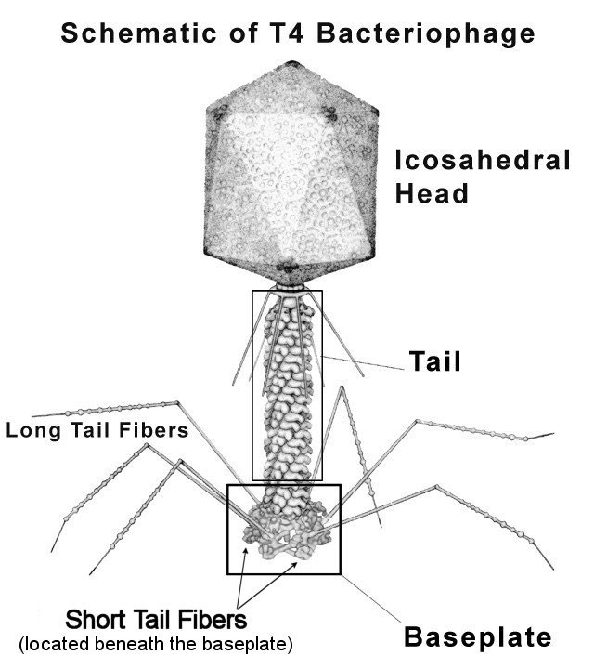
T4 Bacteriophage Assembly
Complex anatomy: 4 major regions, many types of symmetry.
flexible, hierarchical representation needed!
head
capsid
genomic DNA
portal assembly
neck
neck base
collar fibers
whisker fibers
tail
sheath
tail tube
tail terminator
cell puncturing device
baseplate
baseplate base
short tail fibers
long tail fibers
5-fold
symmetry
helical
symmetry
6-fold
symmetry
--based on review of T4 anatomy by Yap & Rossmann (2014) Future Microbiol 12, 1319-27

Slide 19
Assembly Hierarchy
_em_entity.assembly.id
_em_entity.assembly.parent_id
T4 virus (id= 0)
...
baseplate (id=4, parent=0)
baseplate base (id=15, parent=4)
short tail fibers (id=16, parent=4)
long tail fibers (id=17, parent=4)
--based on review of T4 anatomy by Yap & Rossmann (2014) Future Microbiol 12, 1319-27
Notes:
allow for hierarchical representation in a flat file

Slide 20
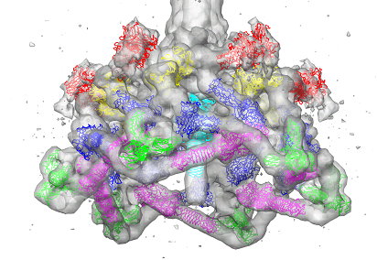
Assembly-Polymer Linkage
T4 has ~30 distinct polymer entities
head
capsid: gp23, gp24, Soc, Hoc
genomic DNA: 2 strands
portal assembly: gp20
neck
neck base: gp13, gp14
collar fibers: gpWac
whisker fibers: gpWac
tail
sheath: gp18
tail tube: gp19
tail terminator: gp3, gp15
cell puncturing device: gp5, gp27, gp5.4
baseplate
baseplate base: gp11, gp10, gp8, gp6, gp25, gp9, gp5, gp27
short tail fibers: gp12
long tail fibers: gp34, gp35, gp36, gp37

Slide 21
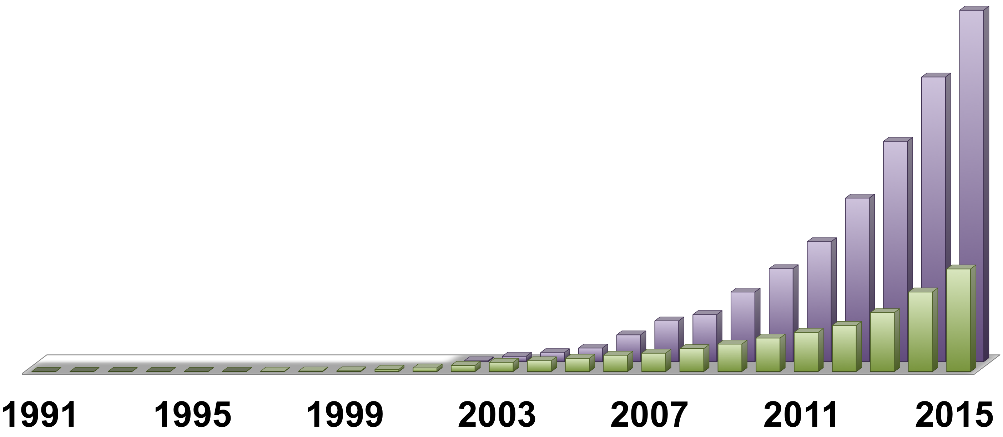
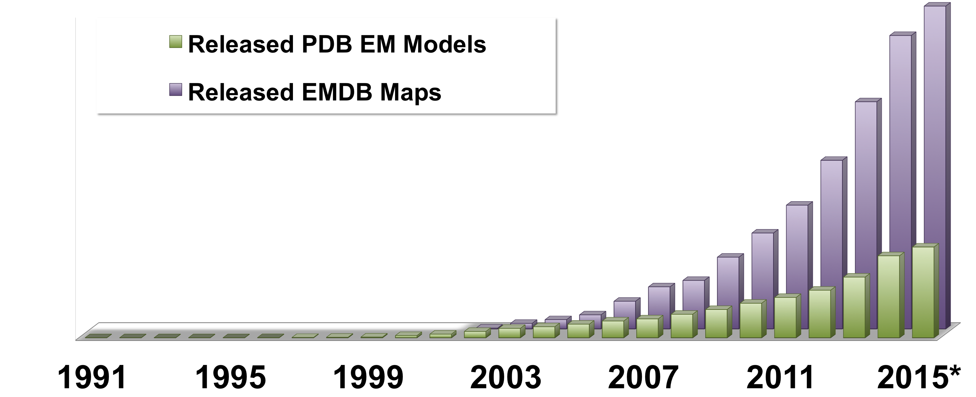
EM Archiving to Present Day
2007: EMDataBank Unified Data Resource funded by NIH
2010: EM Validation Task Force and 1st Model Challenge
2013: NIH funding of EMDataBank renewed
2014: EMPIAR-Raw image data pilot archive est. at EBI
2015-6: New EMDataBank Map and Model Challenges
2016: EM deposition integrated with wwPDB system
3367
983

Slide 22



EMDataBank (.org)
Unified global portal for deposition and retrieval of 3DEM density maps, atomic models, and associated metadata
Resource for news, events, software tools, data standards, validation methods for the 3DEM community

Slide 23
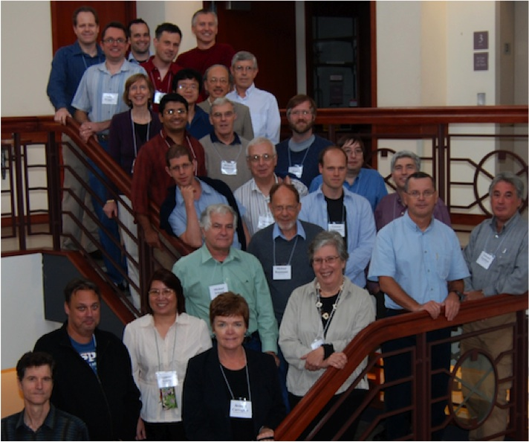
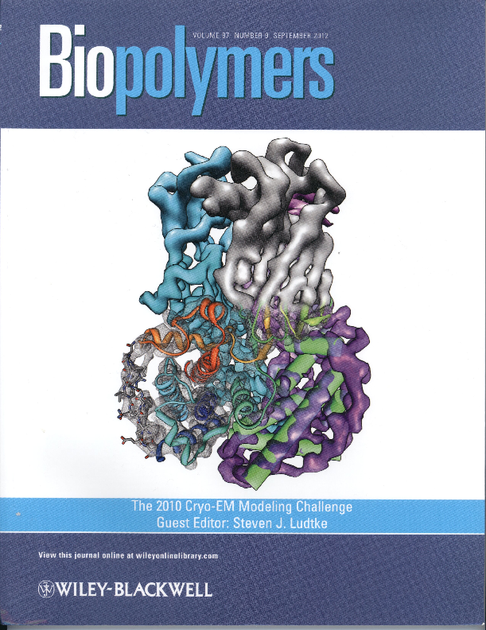
Validation for Cryo EM Data/Structures
EM Validation Task Force Henderson et al. (2012) Structure 20, 205-214
Maps: Standards for assessing resolution and accuracy need to be developed
Models: Criteria needed for model only, fit to map, and fit to additional structural data
2010
EM-VTF
2010 CryoEM Modeling Challenge
Collected papers in a special issue of Biopolymers September 2012
13 target maps
58 participants
10 research groups
136 submitted models
13 software packages

Slide 24
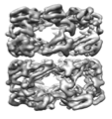
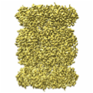
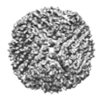
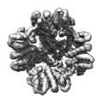
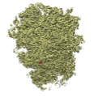
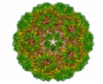
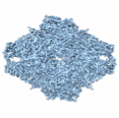
2015-6 Cryo EM Map and Model Challenges
Goals: Develop benchmarks, encourage development of best practices in 3DEM reconstruction and model fitting, evolve criteria for validation, compare and contrast different approaches
Targets are EMPIAR raw image datasets, EM maps
GroEL
T20S
Proteasome
Apo-
Ferritin
TrpV1
channel
80S
Ribosome
Brome
Mosaic Virus
β-galacto-
sidase
More info: challenges.emdatabank.org

Slide 25
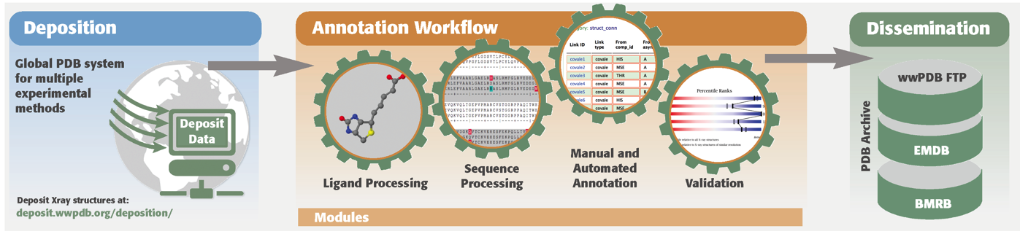
wwPDB OneDep System
Maximizes data quality
Standardizes file formats based on a controlled data dictionary
More complete data capture
Support for larger and more complex structures
Improved efficiency through automation and validation
Workload balancing based on resource capacity and location
Significantly expanded EM dictionary

Slide 26
EM Categories 2016
 | Legacy | D&A
# categories | 26 | 65
# items | 228 | 563
^{High Level}
^{em_experiment}
^{em_software}
^{Sample}
^{em_entity_assembly}
^{em_entity_assembly_molwt}
em_entity_assembly_naturalsource em_entity_assembly_recombinant
^{em_virus_entity}
^{em_virus_natural_host}
^{em_virus_shell}
^{Imaging}
^{em_diffraction}
^{em_diffraction_shell}
^{em_diffraction_stats}
^{em_image_recording}
^{em_image_scans em_imaging}
^{em_imaging_optics}
^{Reconstruction}
^{em_3d_reconstruction}
^{em_image_processing}
^{em_particle_selection}
^{em_volume_selection}
^{em_ctf_correction}
^{em_euler_angle_assignment}
^{em_final_classifiation}
^{em_start_model}
^{Symmetry}
^{em_2d_crystal_entity}
^{em_3d_crystal_entity}
^{em_helical_entity}
^{em_single_particle_entity}
^{Fitting}
^{em_3d_fitting}
^{em_3d_fitting_list}
^{Specimen}
^{em_buffer}
^{em_buffer_component}
^{em_crystal_formation}
^{em_embedding}
^{em_sample_support}
^{em_specimen}
^{em_staining}
^{em_vitrification}
^{em_fiducial_markers}
^{em_focused_ion_beam}
^{em_grid_pretreatment}
^{em_high_pressure_freezing}
^{em_shadowing}
^{em_support_film}
^{em_tomography}
^{em_tomography_specimen}
^{em_ultramicrotomy}
Notes:
-extension of previous dictionary

Slide 27

This work is licensed under Creative Commons Attribution-NonCommercial-ShareAlike 4.0 International.
Funded by Grant R25 LM012286 from the National Library of Medicine of the National Institutes of Health.

