Slide 1
Introduction to Biological Databases and Data Archiving
Data Deposition

Slide 2
EXAMPLE Data Deposition Systems, PART I

Slide 3
Example Deposition Systems
Archive | Deposition System | Deposition Host(s) | Content | Founded | Archive size as of 2017-02-02
Genbank | Bankit* | NCBI | Nucleic acid sequences | 1982 | 198,565,475
Protein Data Bank (PDB) | OneDep | wwPDB partners | 3D structures of macromolecules solved using crystallography, NMR, or 3DEM | 1971 | 126,447
Cambridge Structural Database (CSD) | CIF deposition & validation service | CCDC | 3D structures of small molecules determined using crystallography | 1965 | 874,577
Model Archive | Model Archive | Protein Model Portal / SIB | Theoretical 3D models of macromolecules | 2013 | 1,426
Notes:
Numerous online databases exist, each collecting specific data on their special focus, each with its own standards and formats. Deposition systems have been designed for these databases with the specific needs of the related communities in mind. These are examples of deposition systems for a few selected biological and chemical databases.

Slide 4
Genbank
https://www.ncbi.nlm.nih.gov/genbank/submit/
Collects DNA sequences; mature archive
Curated
  Contains redundant data from multiple sources
  Further curation isolates non-redundant data (RefSeq)
Several deposition options are available

Slide 5
Genbank Deposition Systems
Bankit
  Web-based submission tool
  Useful for simple sequences or sets of sequences
Sequin
  Downloadable, standalone application
  Provides alignment and analysis tools
  Useful for complex sequences requiring complex annotation
tbl2asn
  Command line application
  Highly automated
  Useful for large numbers of sequences
Submission Portal
  Unified next-generation web-based submission tool
  Currently limited to specific sequence types
Barcode Submission Tool
  Specific for the “Barcode of Life” project
Notes:
Choice of deposition system depends on the needs of the Depositor, be it an individual researcher or a government initiative.

Slide 6
Genbank: Bankit
Requires user account registration
Manual information entry
  Contact
  Release Date
  Reference
  Submission category (original vs. Third Party)
  Sequence features
Primary data: Nucleotide sequence
  Cut-and-paste
  Upload FASTA format:
Source organism information
  Some or all may be provided as part of FASTA input
Notes:
ADD EXAMPLE OF FASTA FILE

Slide 7
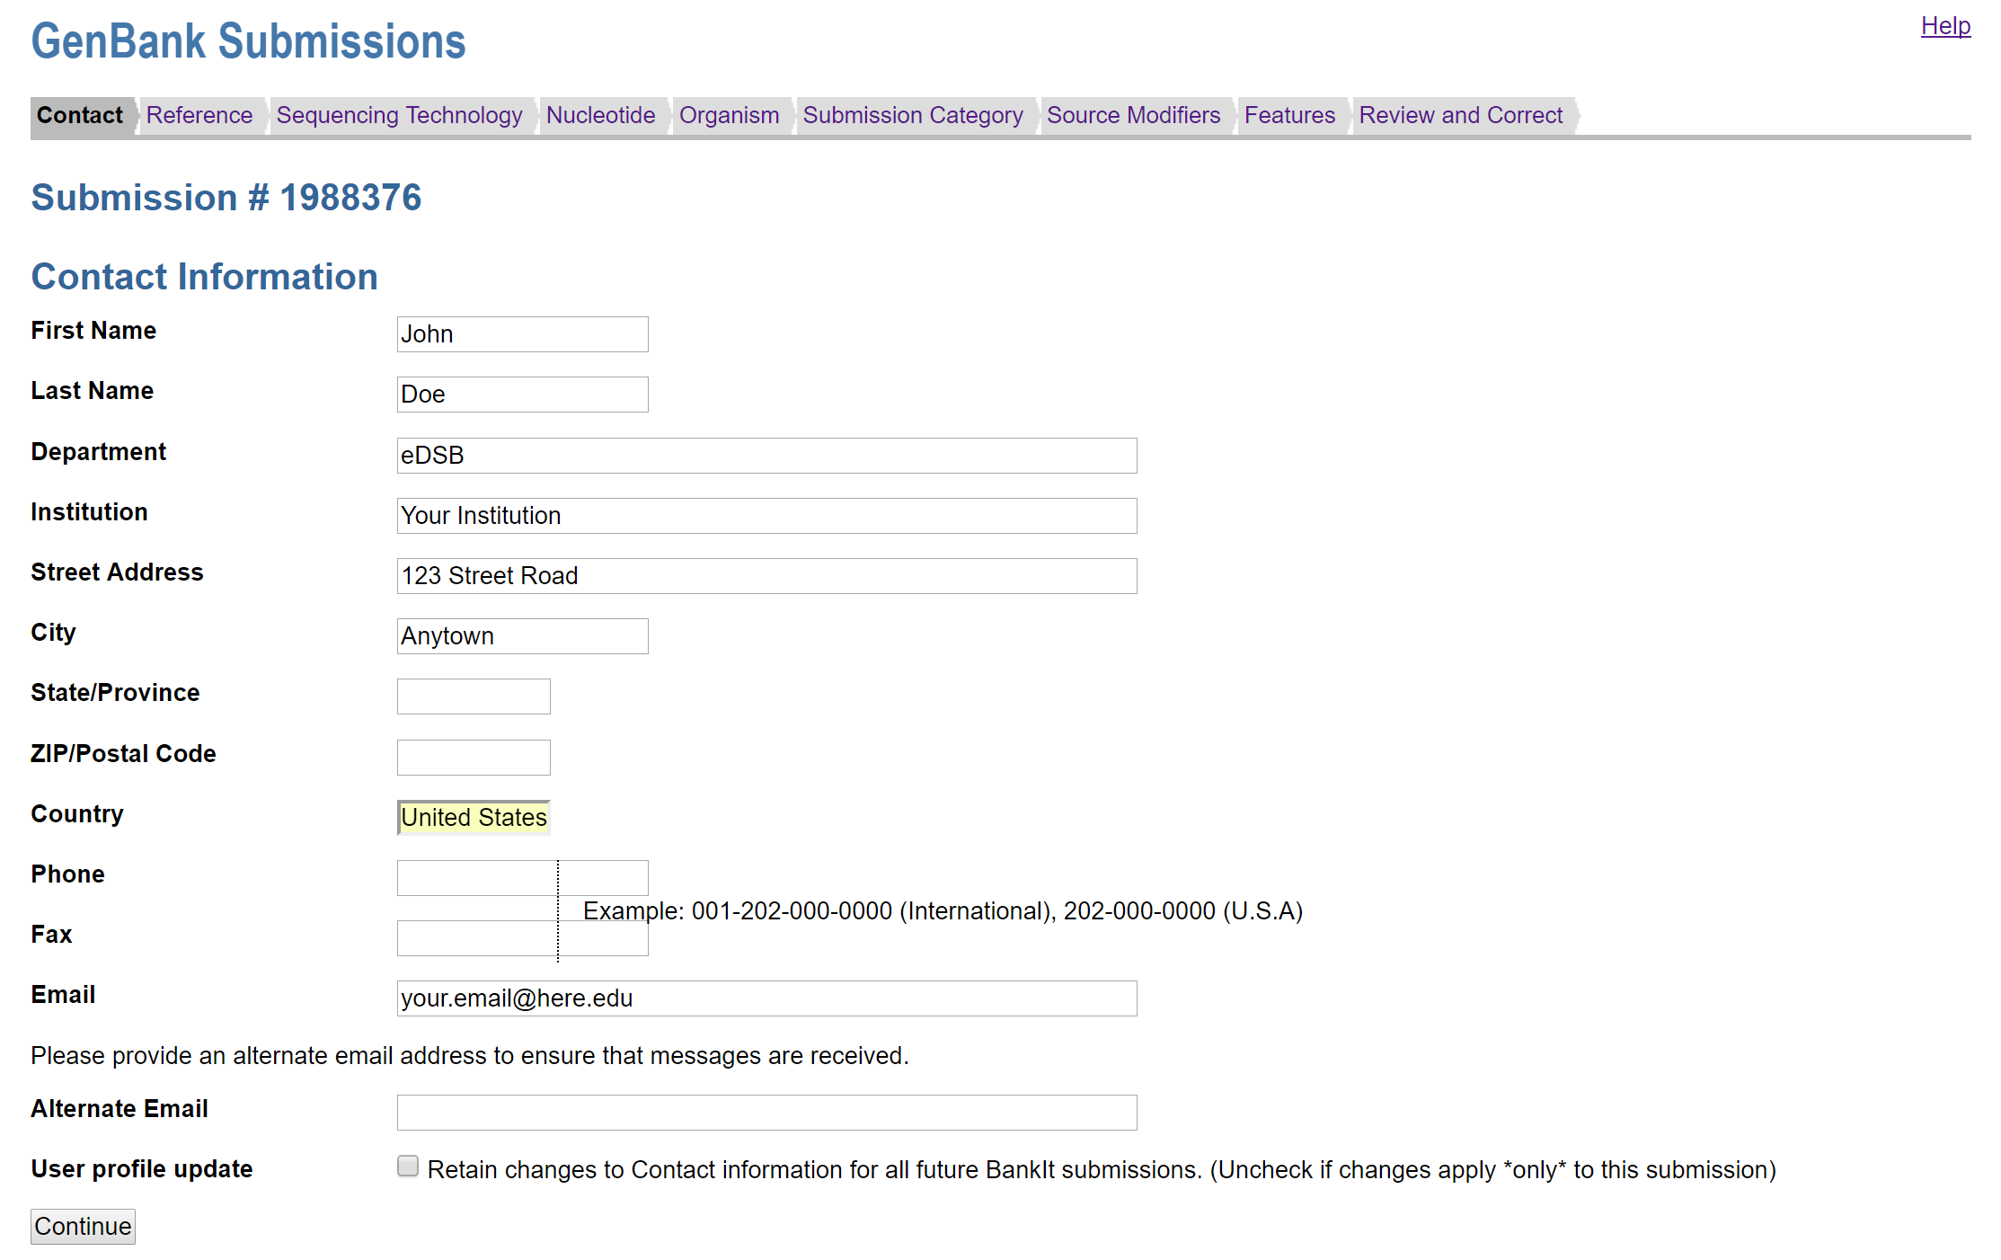
Genbank (Bankit) - Data Entry

Slide 8
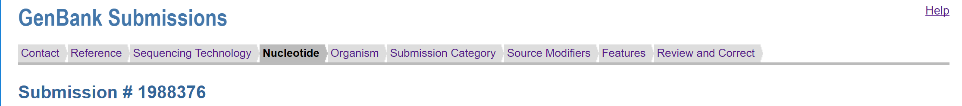
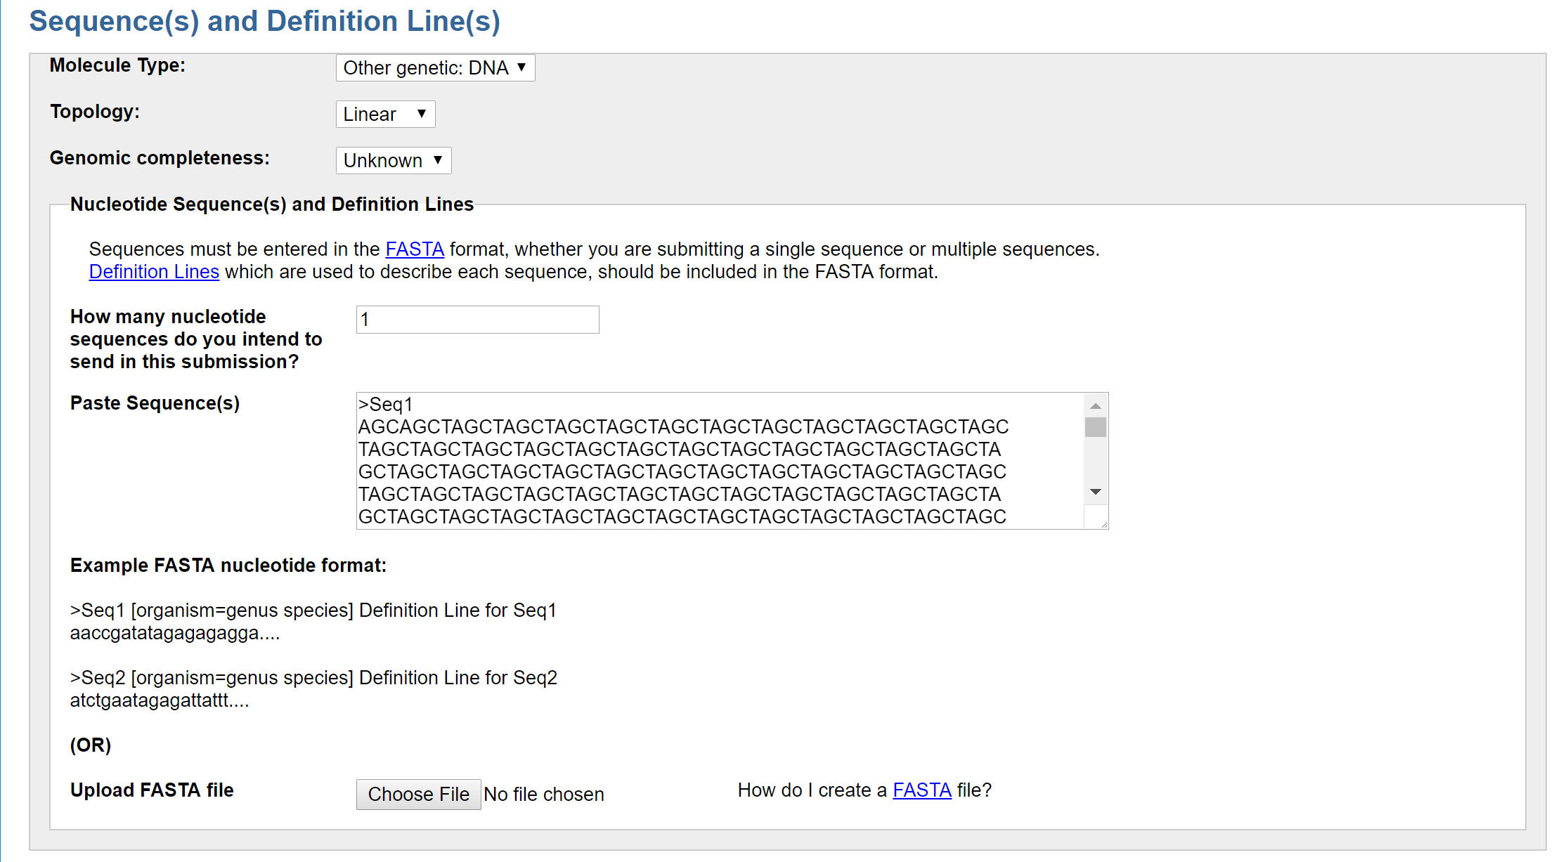
Genbank (Bankit) - Data Entry, File Upload

Slide 9
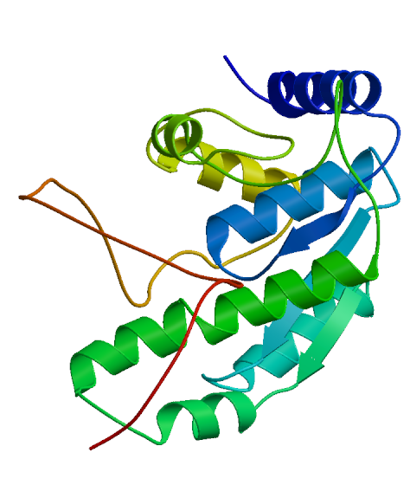

Model Archive
http://www.modelarchive.org/project/step1
Established as part of the Protein Model Portal and the SIB - Swiss Institute of Bioinformatics
Used to collect three-dimensional atomic models of proteins, DNA, and RNA determined using theoretical methods
Young archive; standards under development
File upload and validation available prior to registration

Slide 10
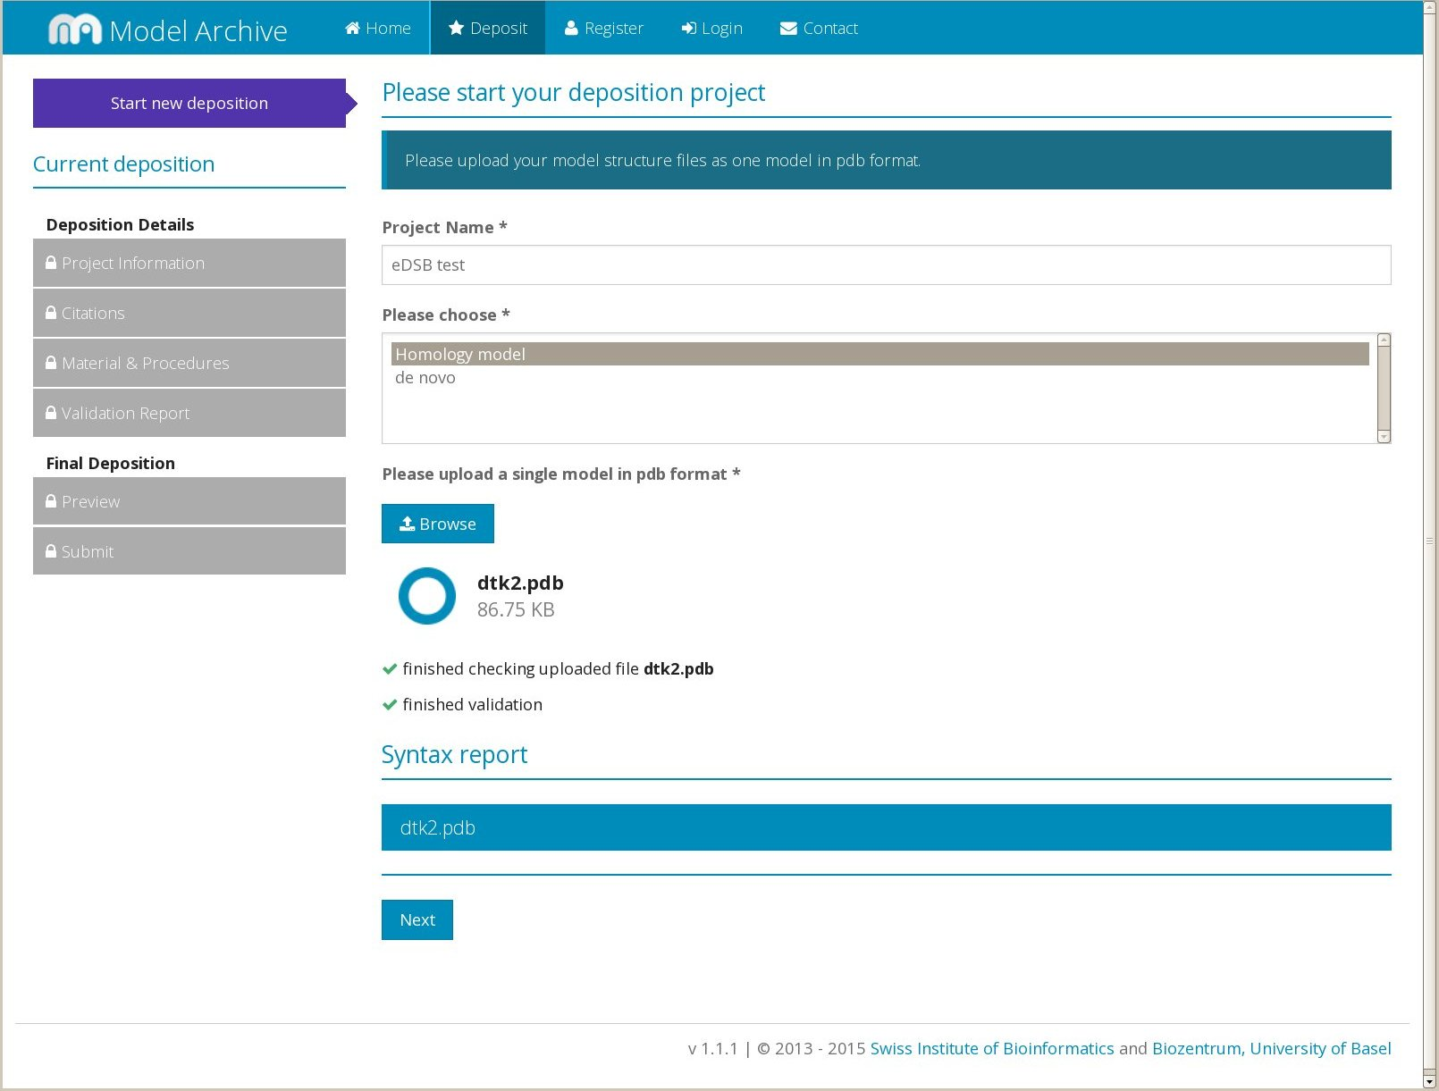
Model Archive – File Upload and Validation

Slide 11
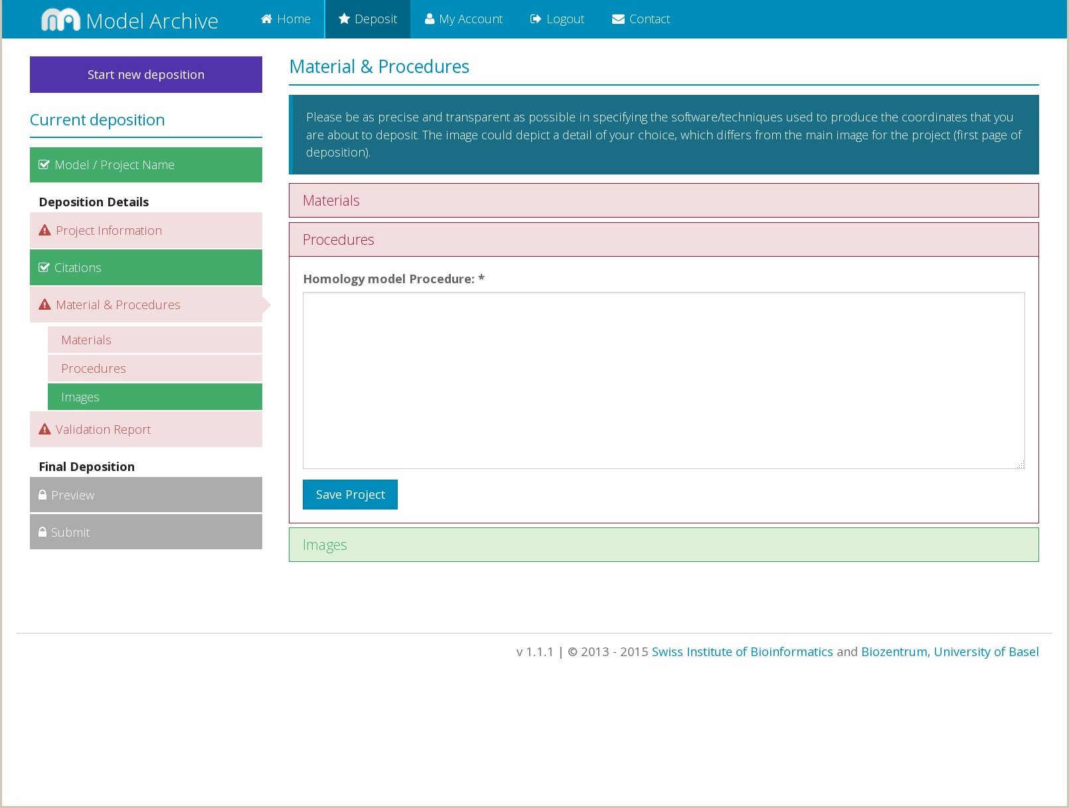
Model Archive – Data Entry
Notes:
Start with free text input; move on to enumeration lists, more structured data entry. Free text input allows the depositor to provide information without restriction, at the cost of being more difficult to datamine afterward.

Slide 12
wwPDB OneDep System
https://deposit-1.wwpdb.org/deposition/
Collects 3D atomic coordinates for proteins, DNA, and RNA, from which chemical bonding and properties are derived.
Data collected using X-ray crystallography, nuclear magnetic resonance (NMR) spectroscopy, and/or electron microscopy (3DEM)
Covers fields that range from young (3DEM) to mature (X-ray crystallography)
Depositions are entry-centric; each deposition is individually password-protected

Slide 13
Features of the OneDep System
All communication managed within the deposition system – no external e-mail sent
Input of coordinates and experimental data via file upload
  Strict rules for file formats (structural biology is a well-established field)
Form-based input of metadata, with allowed input of some metadata via file upload
All corrections and file uploads tracked by the system

Slide 14
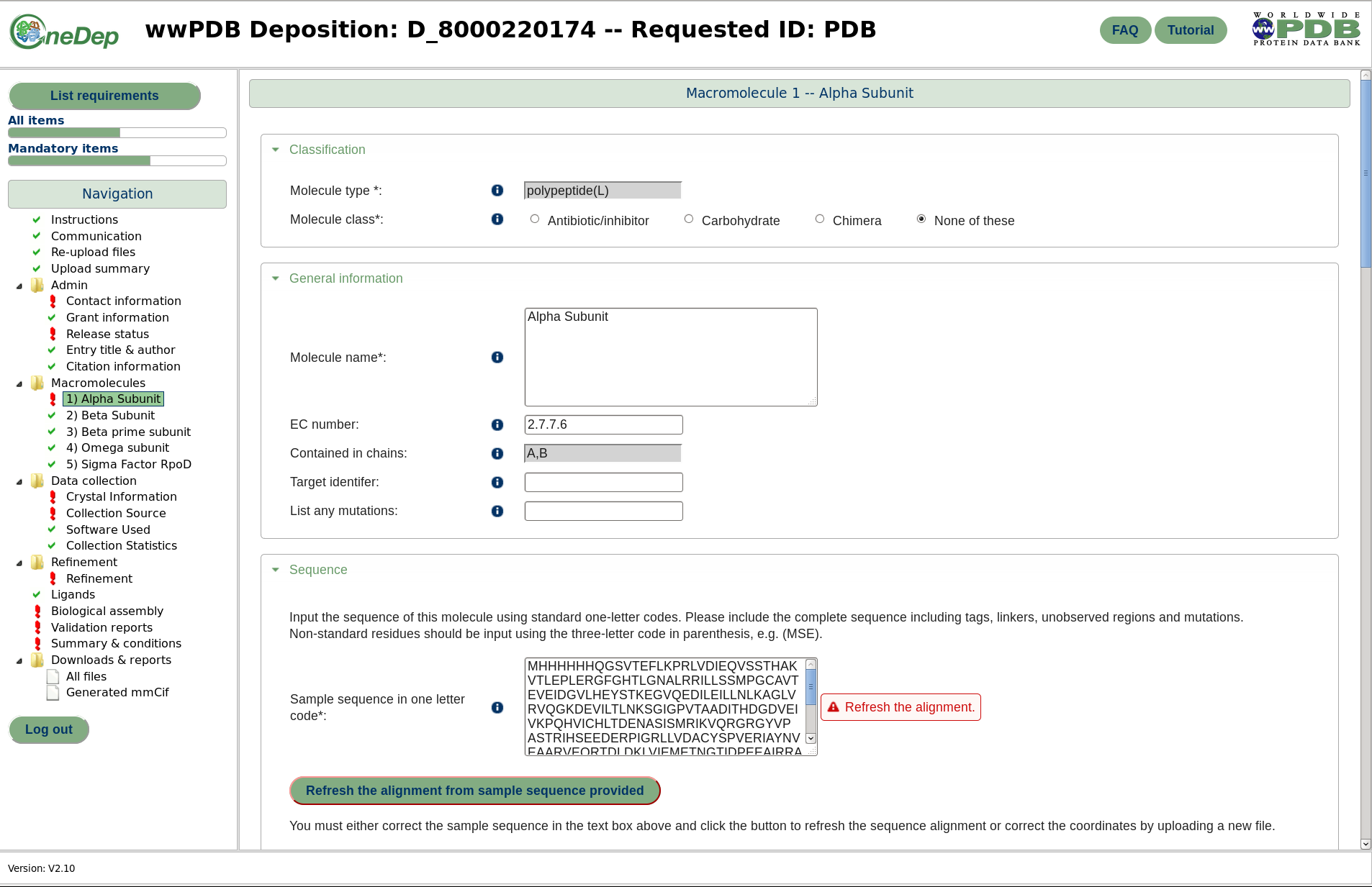
OneDep: Data Entry
Notes:
Slides for macromolecules page(s). Reference to image of molecule. Focus on sequence, move on to sequence DB reference.

Slide 15
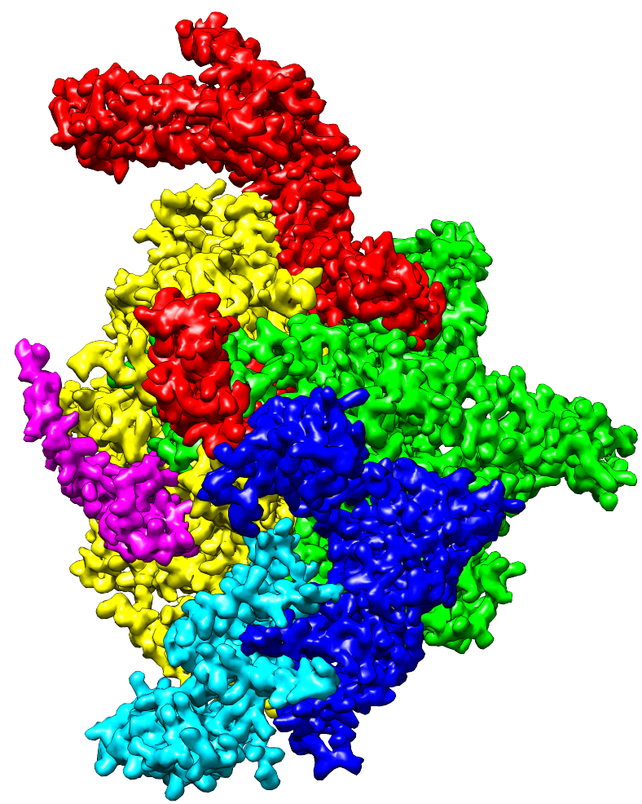
OneDep: Data Entry
Notes:
Slides for macromolecules page(s). Reference to image of molecule. Focus on sequence, move on to sequence DB reference.

Slide 16
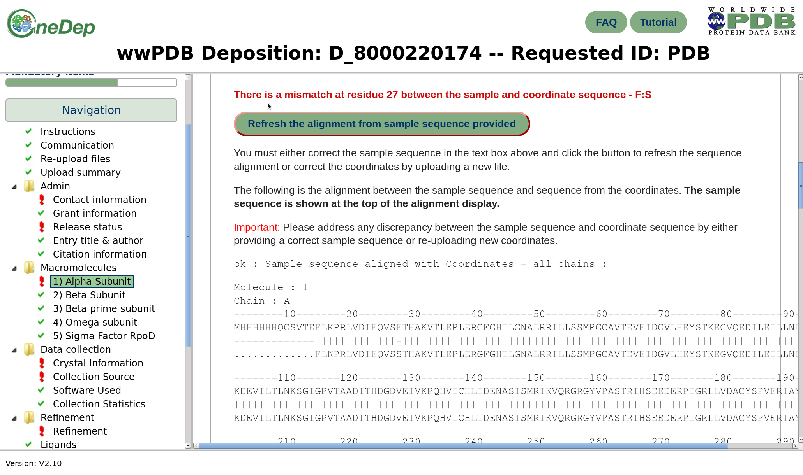
OneDep: Data Entry
Notes:
Slides for macromolecules page(s). Reference to image of molecule. Focus on sequence, move on to sequence DB reference.

Slide 17
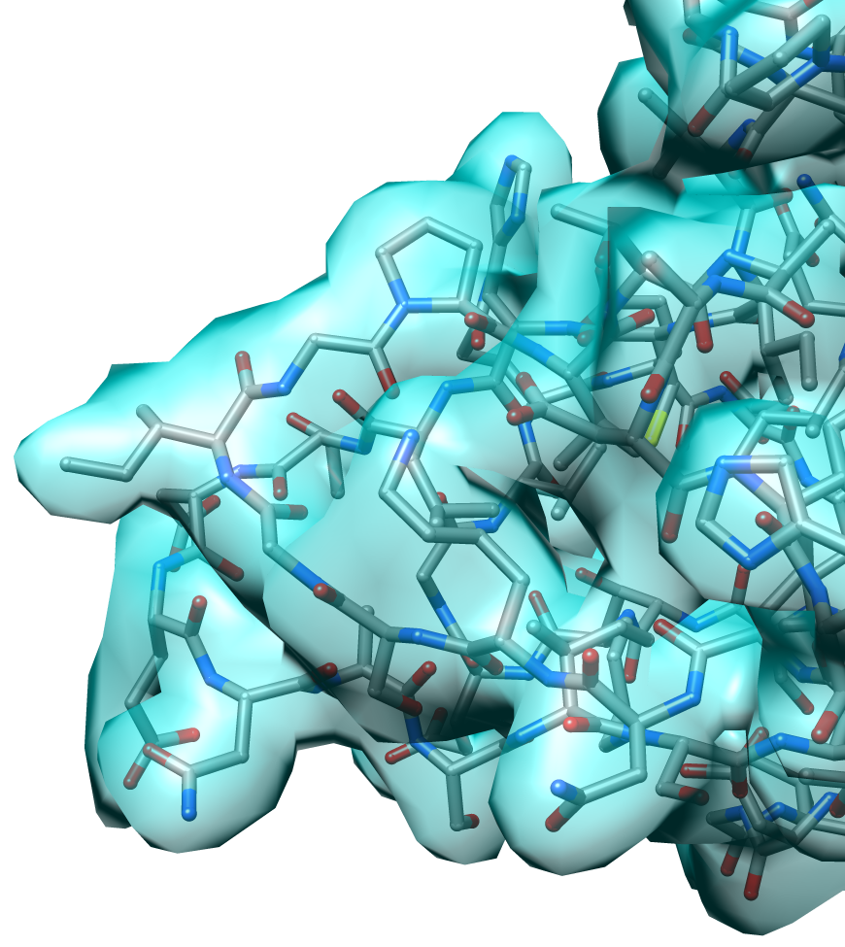
OneDep: Data Entry
P109
G108
I107
Notes:
Slides for macromolecules page(s). Reference to image of molecule. Focus on sequence, move on to sequence DB reference.

Slide 18
OneDep: Data Entry
“On the Fly” Data Validation
Notes:
Slides for macromolecules page(s). Reference to image of molecule. Focus on sequence, move on to sequence DB reference.

Slide 19
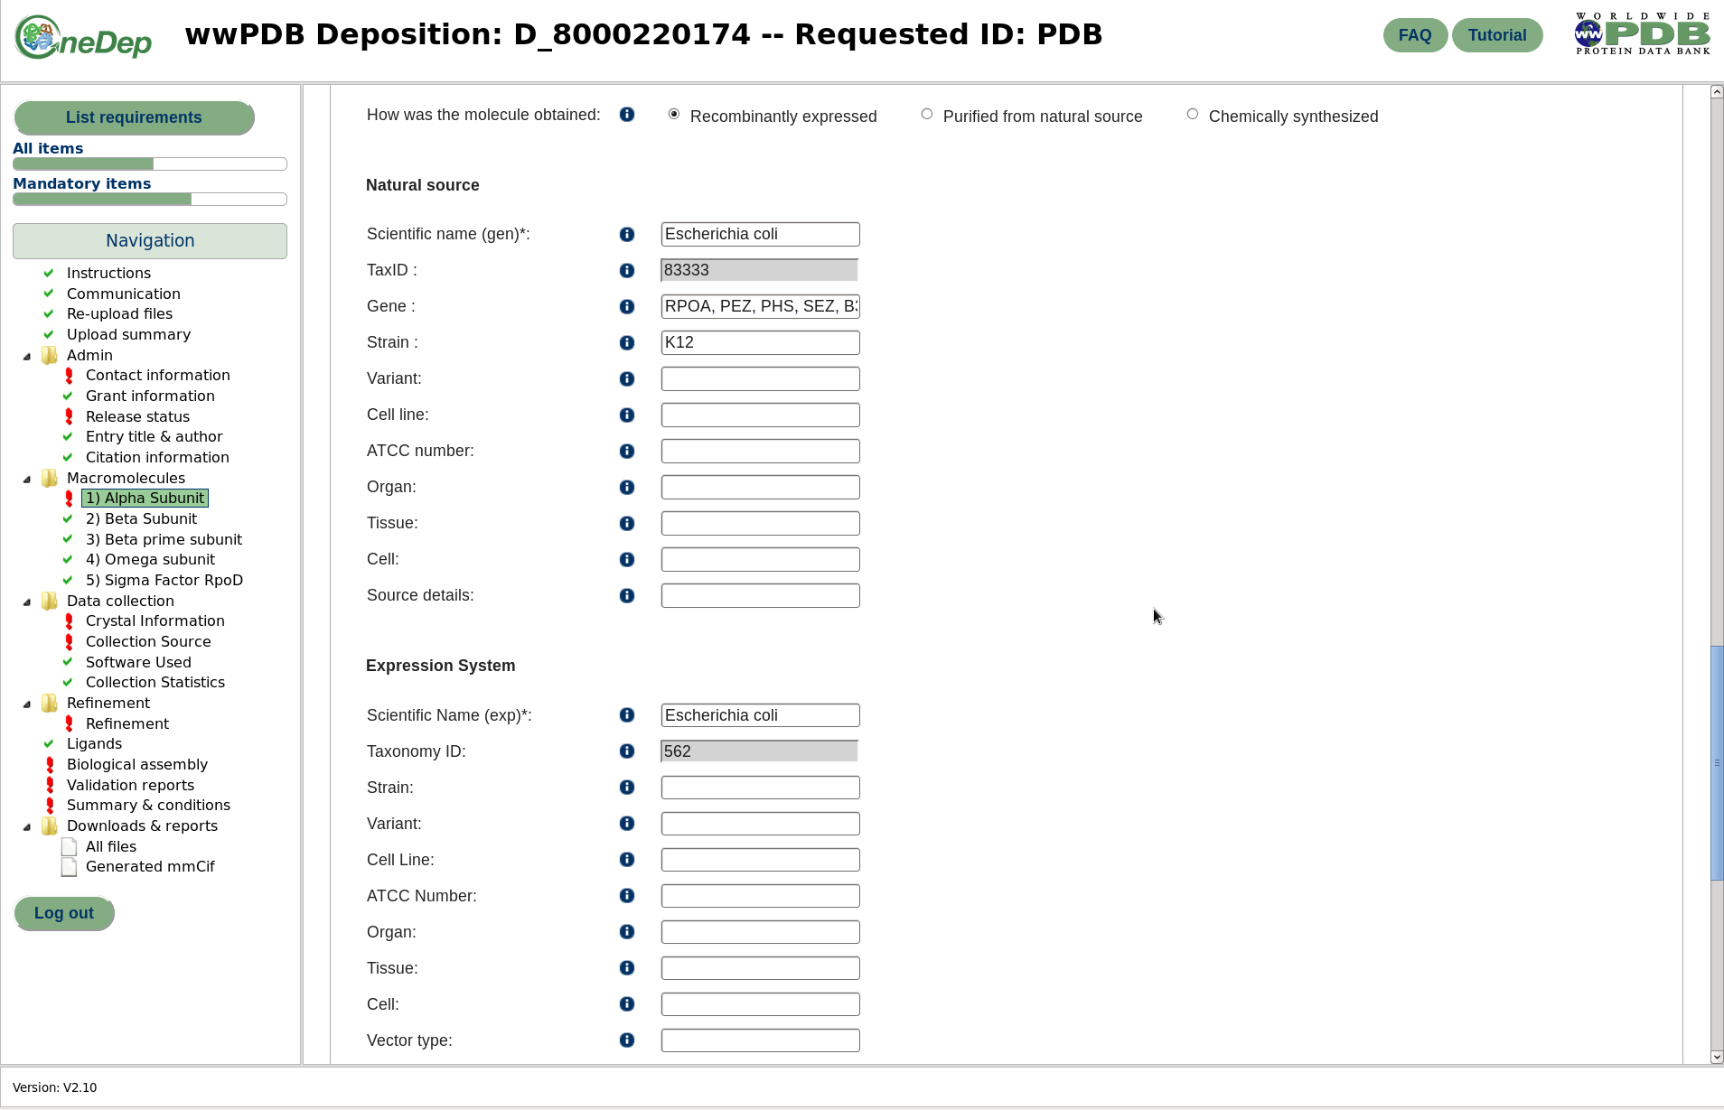
OneDep: Data Entry
Notes:
Slides for macromolecules page(s). Reference to image of molecule. Focus on sequence, move on to sequence DB reference.

Slide 20
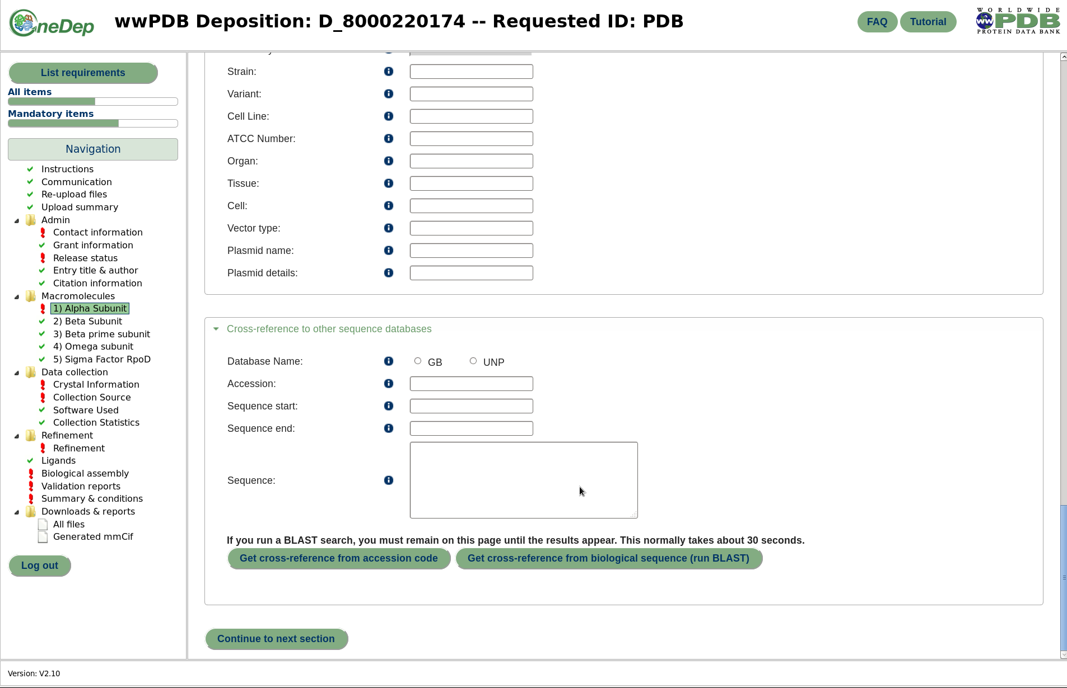
OneDep: Data Entry

Slide 21
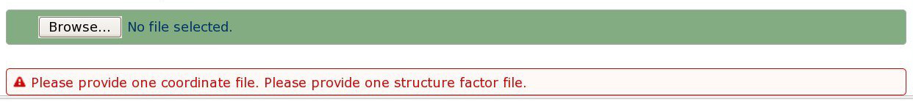
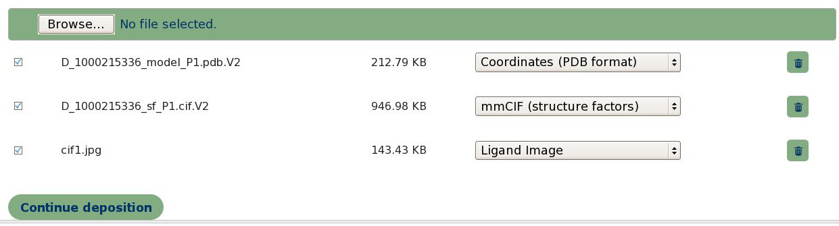
OneDep: File Upload

Slide 22
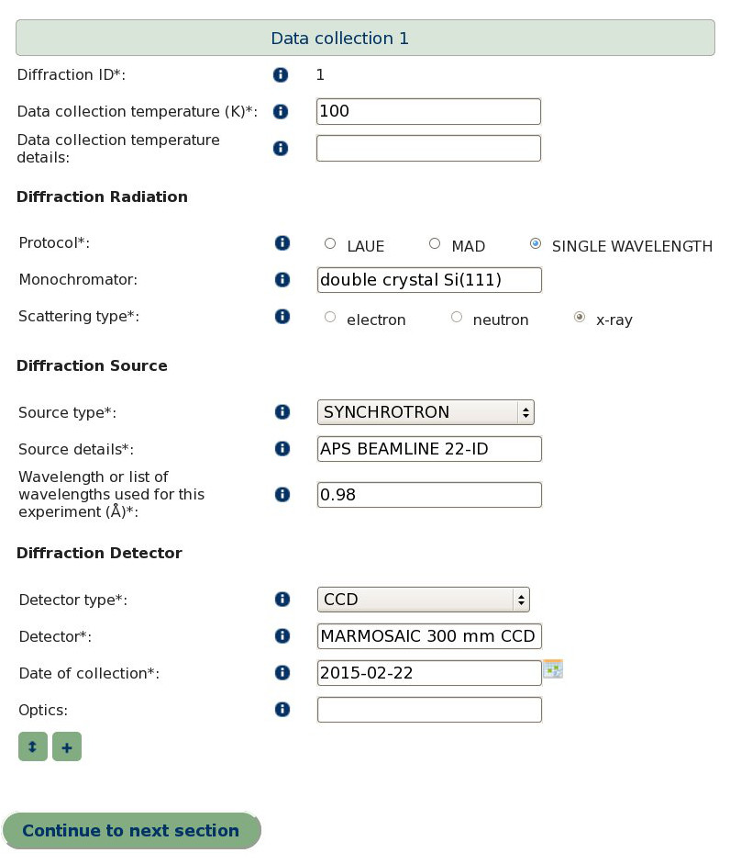
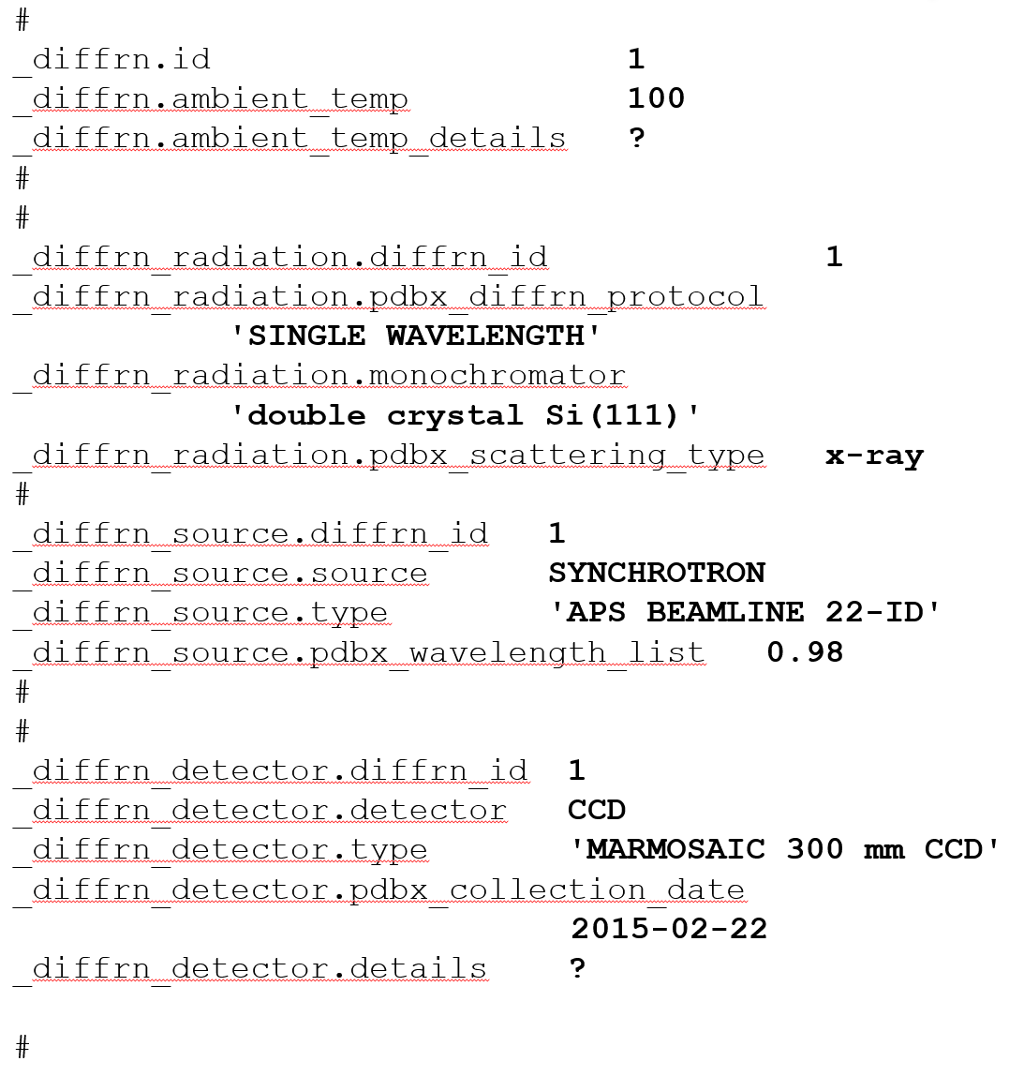
OneDep: Data Harvesting
Uploaded mmCIF file

Slide 23
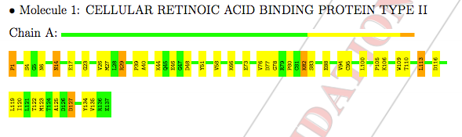
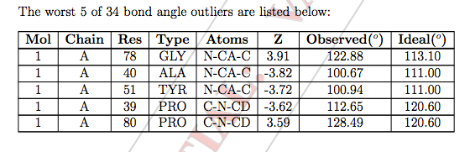
Validation Report
Validation calculations and content are recommended by expert wwPDB Task Forces
Validation report format and content are developed by wwPDB staff
Generation of a validation report is initiated for every structure upon file upload.
Validation reports allow Depositors to review their structures prior to submission
Review of validation report is required for submission.
Notes:
This will be discussed in more detail later in this course.
SAY: Explain at a high level that these depictions are generated by software that we made. How did we make it? We made it! This is what database people do! Emphasize usability if possible.

Slide 24
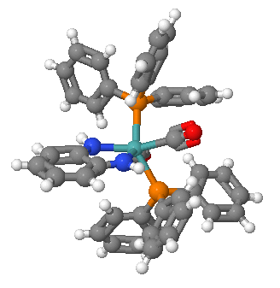
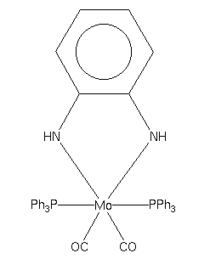
CCDC: CSD Deposition and
Validation Service
PEPCES : cis-Dicarbonyl-1,2-diamidobenzene-
bis(triphenylphosphine)-molybdenum(ii)
Cambridge Crystallographic Data Centre – Cambridge Structural Database
Model coordinates and experimental data files are expected to strictly follow community-developed format (CIF)
Incorporates an extensive, community-developed file validation process (checkCIF, IUCr)
Mature field; narrow focus
Data pipeline for deposition starts at data collection

Slide 25
In Summary
Deposition systems are a controlled interface for outside users to add data to an archive
Deposition systems are designed to optimize usability.
Deposition systems have some commonalities
Maturity of archive/field affects data collected
After deposition, data are checked either automatically or by hand
Data input via a deposition system will eventually be released to the full archive
Notes:
Usability is key! Add a point about the design of the system. USABILITY USABILITY USABILITY

Slide 26

This work is licensed under Creative Commons Attribution-NonCommercial-ShareAlike 4.0 International.
Funded by Grant R25 LM012286 from the National Library of Medicine of the National Institutes of Health.

