Slide 1
Introduction to Biological Databases and Data Archiving
Data Curation

Slide 2
Designing an annotation Workflow

Slide 3
Annotation and Curation
What authors provide:
  atomic coordinates
  polymer sequences
  experimental descriptions
  structure determination information
What PDB biocurators provide:
  Format standardization
  Annotation consistency
  Standard vocabulary and terms
  Added annotation
    Derived data to put data in context with the science
Notes:
MV: Picture of annotation summit

Slide 4
Designing an Annotation Workflow
The goals
  regular review for the consistent and highly accurate data
  maximize quality of individual datasets and quality across the archive
Employ procedures and data handling tools to achieve the goals
  accept, organize and encode deposited data in a standard form
  add annotation in the form of classifications
  validate the experimental and structural content
Manage the incoming data stream efficiently
Place the least possible burden on both Annotator and Depositor
Engage the Depositor during the annotation process enables efficient resolution of issues that may arise during validation
Leverage the Depositor's expertise in vetting any added annotations.

Slide 5
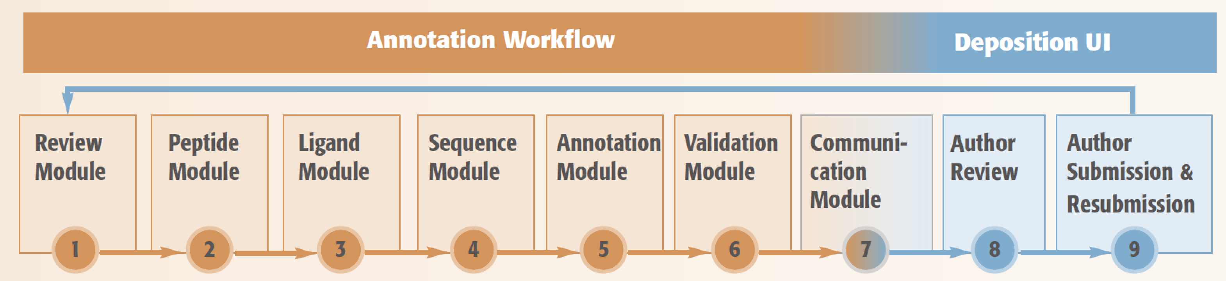
Annotation Workflows at PDB
Workflow manager tracks all tasks and their corresponding status
Review data content & possible issues
Annotate peptide-like molecule representation
Assign and define chemistry for small molecules
Provide database cross reference for sequence and taxonomy
Add derived annotation (secondary structure, binding sites, and biological assemblies)
Generate validation reports (geometric check and fit to the experimental data)
Reports communicated back to depositors

Slide 6
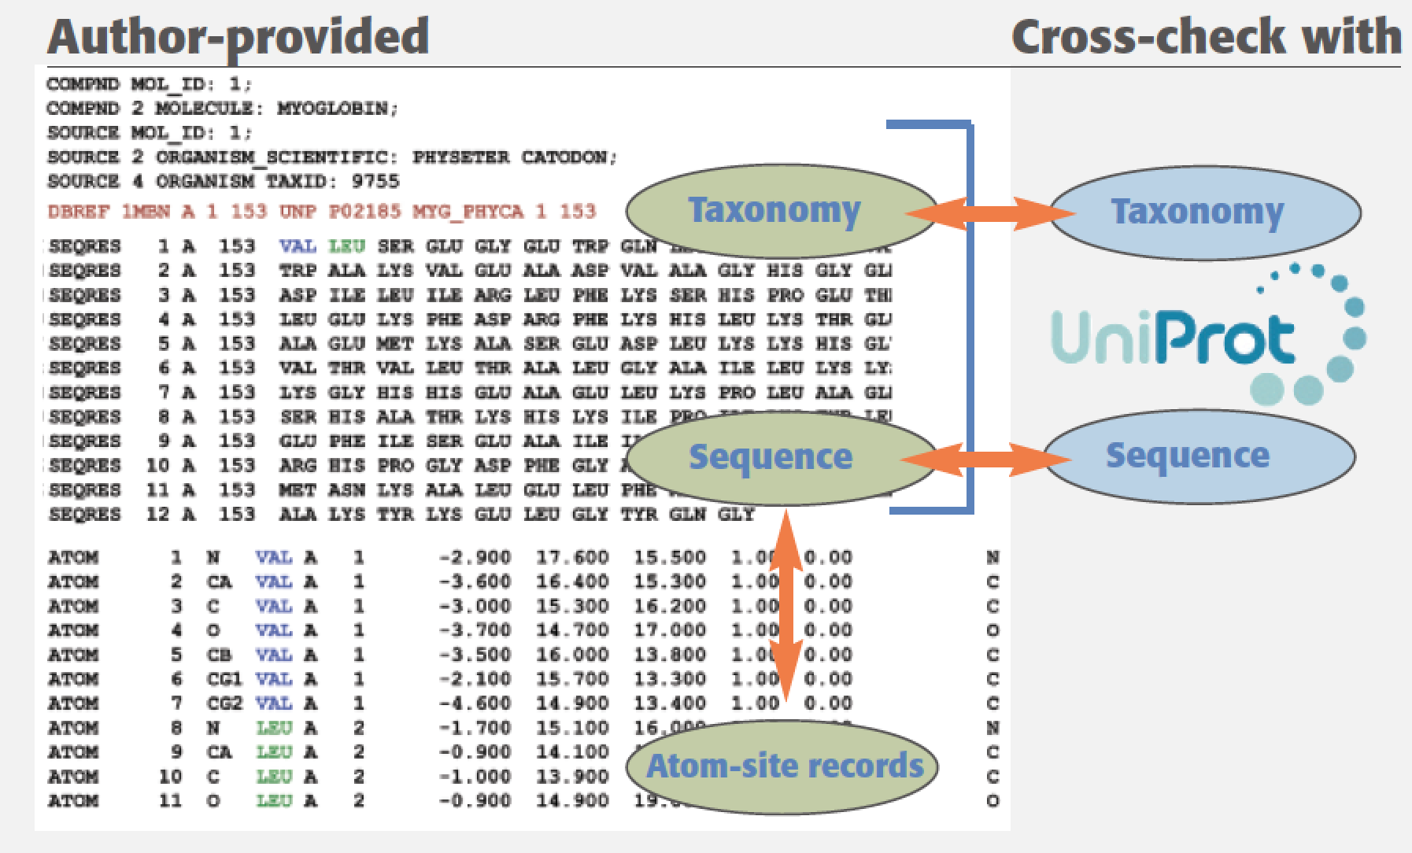
PDB Sequence Annotation
Cross checks author-provided sample sequence and coordinate sequence versus the sequence database
Cross checks author-provided source organism versus the taxonomy database
Assigns database references and taxonomy identifiers to modeled protein polymer entities
Annotate sequence discrepancies between sample sequence and database reference

Slide 7
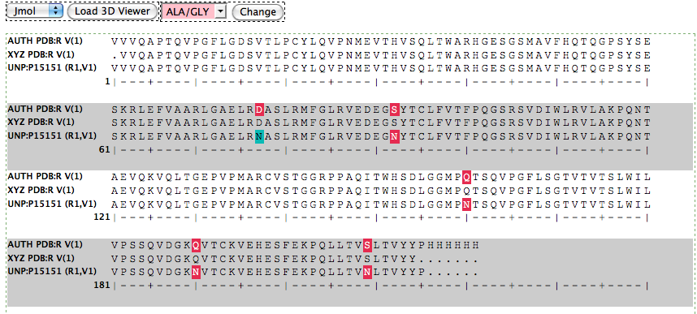
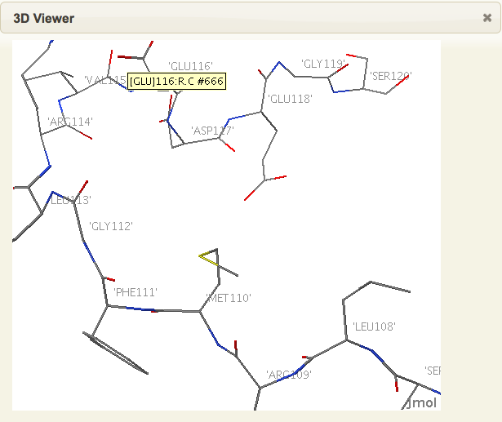
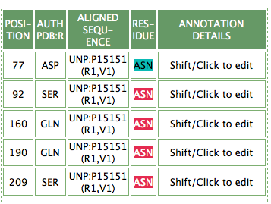
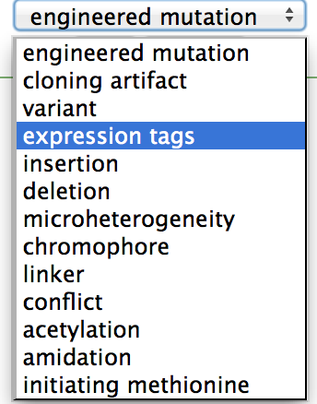
Sequence Module Tool
Multiple sequence alignment view: Biological sequence checked against atomic coordinate sequence
and cross-referenced to UniProt/GenBank
3D structure view: examining backbone connectivity
Tabular form for sequence discrepancy annotation

Slide 8
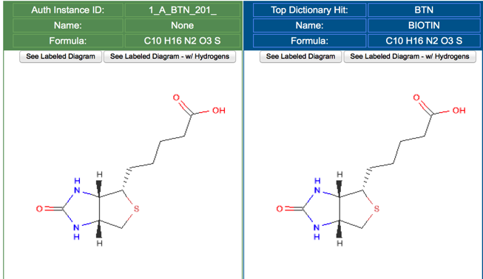
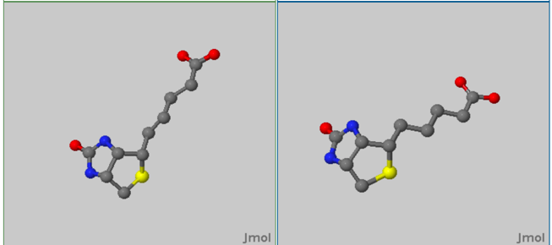
Ligand Annotation
Batch search against Chemical Component Dictionary & return best matches
Captures and displays author-provided chemical information
Review chemistry correctness
  2D and 3D comparison view
  Ligand ID assignment
Deposited instance from coordinates
Closest match in the dictionary

Slide 9
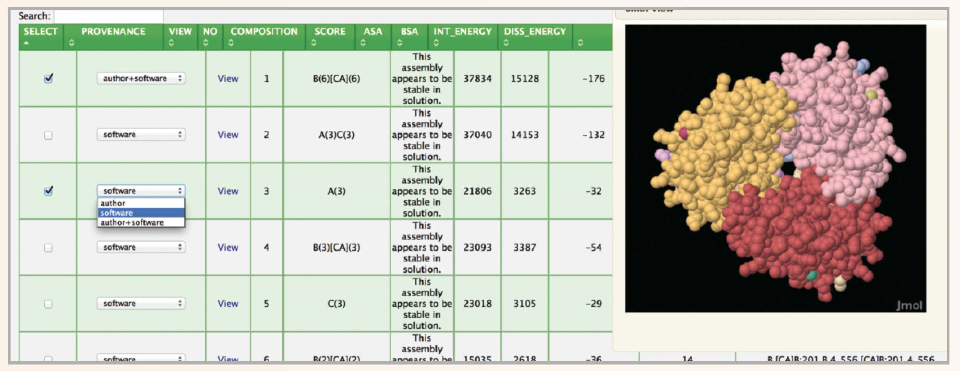
Added Annotation Module
Biological Assembly
Annotators assign biological assembly information to an entry after visualizing the structure in 3D and reviewing software suggestion.

Slide 10

This work is licensed under Creative Commons Attribution-NonCommercial-ShareAlike 4.0 International.
Funded by Grant R25 LM012286 from the National Library of Medicine of the National Institutes of Health.

