Slide 1
Introduction to Biological Databases and Data Archiving
Data Curation

Slide 2
VALIDATION

Slide 3
Validation
Establishing or checking the truth or accuracy of something
“Science is a way of trying not to fool yourself. The first principle is that you must not fool yourself, and you are the easiest person to fool.” (Richard Feynman)

Slide 4
Validation
Compare your model to the experimental data and to the prior knowledge. It should:
  Reproduce knowledge/information/data used in the construction of the model
  Predict knowledge/information/data not used in the construction of the model
Global and local
  Model alone, data alone, fit of model and data

Slide 5
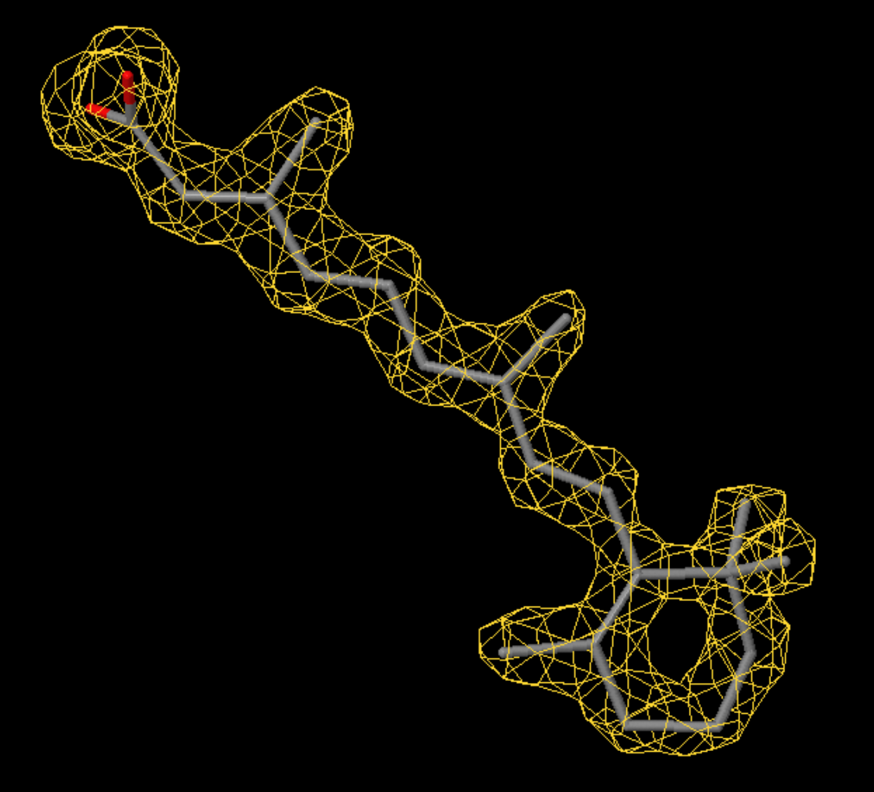
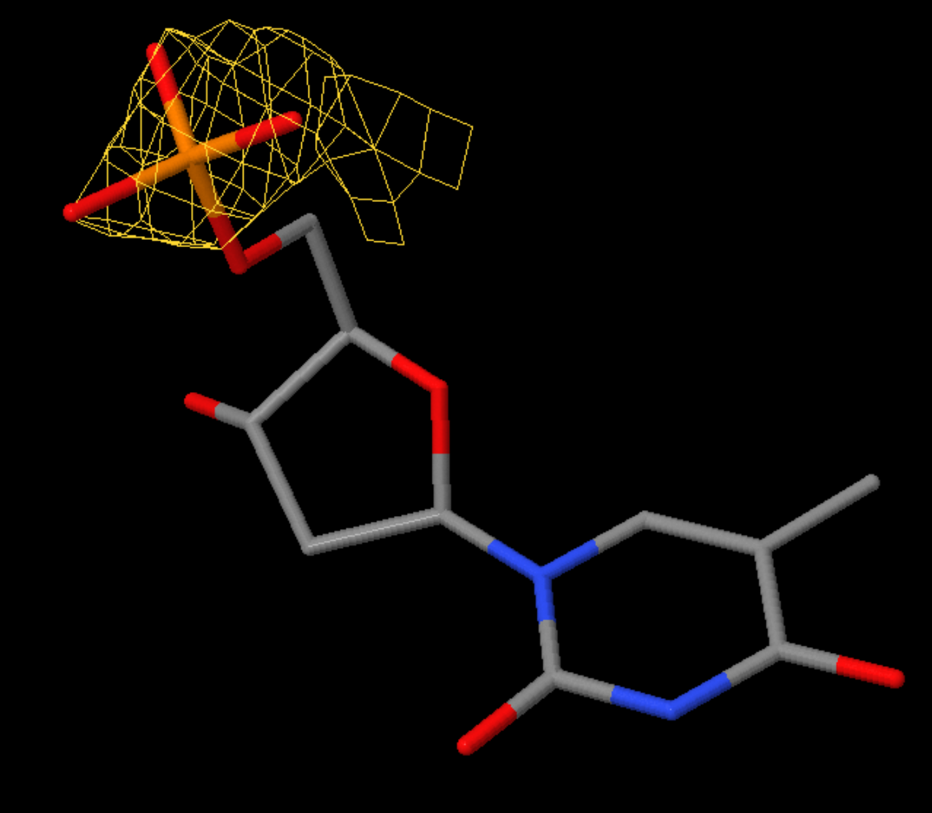
Inspection of Electron Density
Ligand density display (2Fo-Fc map)
Left: REA in entry 1CBS with
LLDF=1.31 (RSR=0.10, CC=0.95)
Right: TMP in entry 3HW4 with LLDF=6.77 (RSR=0.41, CC=0.70)
Notes:
JY
1.5 sigma Omit map
1CBS REA
3HW4 TMP

Slide 6
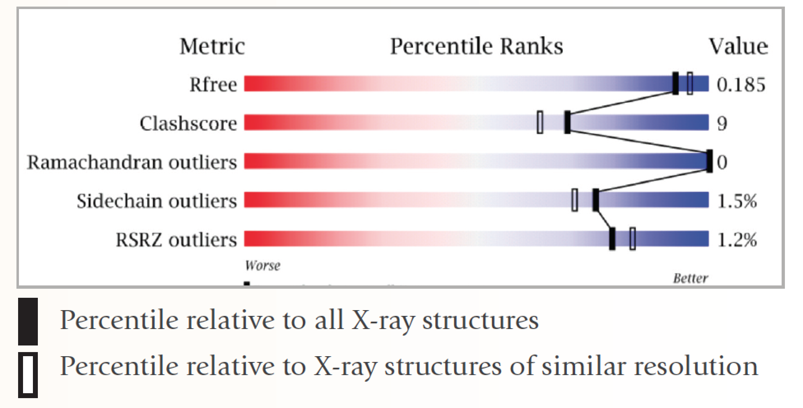
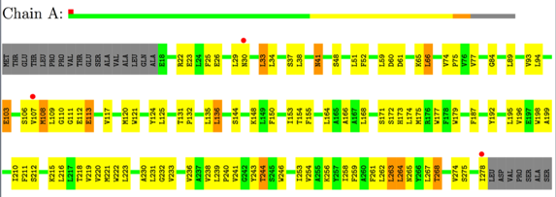
PDB Validation Report
Summarizes key issues in PDF file
  All details in XML file
  Supporting help details
Overall quality at-a-glance
  Slider plots of key statistics
Summary table
  Key data and refinement statistics
Tabulations of diagnostics for entry components
  Macromolecules
  Ligands
PDF can be uploaded with manuscript submission to a journal
Overall Quality
Residue Plots
Grey – not modeled
Green, yellow, orange, red – 0,1,2, 3 or more issues
Red dot – poor fit to electron density

Slide 7

This work is licensed under Creative Commons Attribution-NonCommercial-ShareAlike 4.0 International.
Funded by Grant R25 LM012286 from the National Library of Medicine of the National Institutes of Health.

