Slide 1
Introduction to Biological Databases and Data Archiving
Ensuring Data Consistency

Slide 2
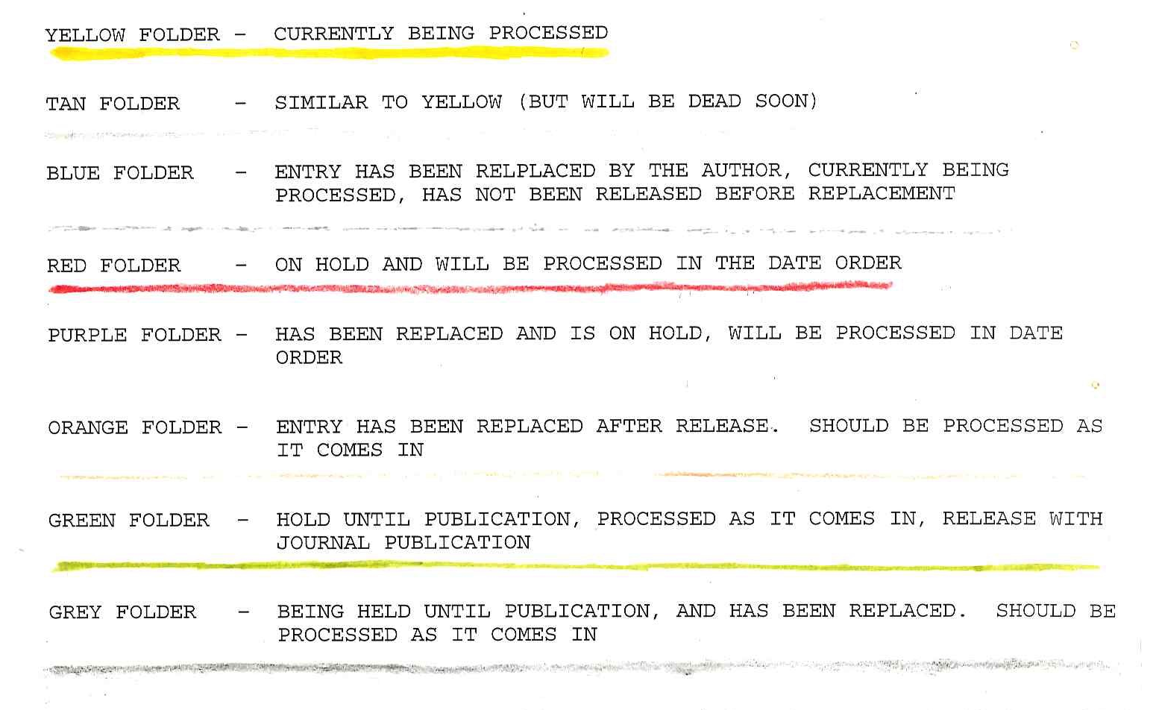
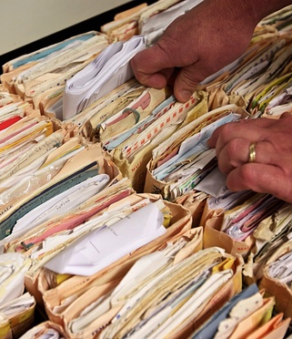
Databases Change Over Time
NHS identity details are to be shared on a central register under Scottish government plans. Photograph: Christopher Thomond/for the Guardian

Slide 3
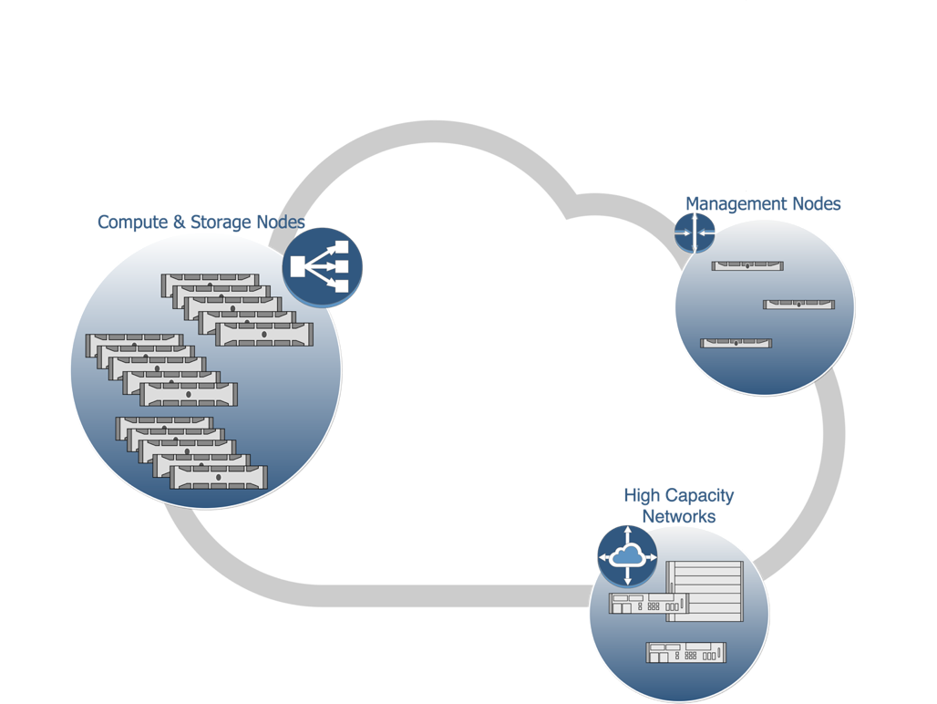
Databases Change Over Time
PDBx/mmCIF File
loop_
_atom_site.group_PDB
_atom_site.id
_atom_site.auth_atom_id
_atom_site.type_symbol
_atom_site.auth_comp_id
_atom_site.auth_asym_id
_atom_site.auth_seq_id
_atom_site.Cartn_x
_atom_site.Cartn_y
_atom_site.Cartn_z
_atom_site.pdbx_PDB_model_num
_atom_site.occupancy
_atom_site.pdbx_auth_alt_id
_atom_site.B_iso_or_equiv
ATOM 1 N N GLN A 39 24.690 -27.754 24.275 1 1.00 . 60.76
ATOM 2 CA C GLN A 39 23.581 -26.768 24.416 1 1.00 . 60.98
ATOM 3 C C GLN A 39 23.990 -25.379 23.905 1 1.00 . 59.98
ATOM 4 O O GLN A 39 25.070 -25.209 23.330 1 1.00 . 60.25
ATOM 5 CB C GLN A 39 23.136 -26.685 25.878 1 1.00 . 60.69
ATOM 6 N N VAL A 40 23.115 -24.395 24.122 1 1.00 . 59.58
ATOM 7 CA C VAL A 40 23.342 -23.010 23.690 1 1.00 . 57.26
ATOM 8 C C VAL A 40 24.000 -22.152 24.778 1 1.00 . 56.00
ATOM 9 O O VAL A 40 23.992 -20.920 24.692 1 1.00 . 55.53
ATOM 10 CB C VAL A 40 22.015 -22.337 23.275 1 1.00 . 57.32
ATOM 11 N N ALA A 41 24.560 -22.804 25.797 1 1.00 . 54.571

Slide 4
Why do Databases Change?
To accommodate
New types of data
New relationships between various data in archive
To enable/support
New types of queries (consistent annotation)
New organizations/presentations for browsing
To integrate
With various data resources

Slide 5
Over Time Errors May be Introduced
Lack of clear definitions
Misunderstandings
Human error
Machine error
Bloody mindedness
Errors need to be fixed to improve data quality-remediation

Slide 6
Relationship Between Data In and Data Out
Data quality
Data standardization
Extended annotation
Improved query functionality
Extended query options
Notes:
6

Slide 7
Types of Inconsistencies/Errors
Nomenclature (atom names)
Coordinate frame (viruses)
Data harvesting (B factor)
Representation (peptide-like molecules, carbohydrates)

Slide 8
Considerations For Remediation
Disruption caused by changes of large numbers of entries
Must have discussions with users and give ample notice
People have built scripts to correct known errors
Not everyone will agree with decisions made about the remediated data

Slide 9
What is the Process?
Identify inconsistencies/errors
Develop methods to correct
Implement corrections
Change curation process so as to prevent new entries from having those errors
Work with structure determination software developers so as to produce correct data
Communicate with all stakeholders about the corrections and any amendment of the processing procedures

Slide 10

This work is licensed under Creative Commons Attribution-NonCommercial-ShareAlike 4.0 International.
Funded by Grant R25 LM012286 from the National Library of Medicine of the National Institutes of Health.

