Slide 1
Introduction to Biological Databases and Data Archiving
Ensuring Data Consistency

Slide 2
Data Remediation Case Study: Peptide-Like Molecules

Slide 3
Learning Objectives
Understanding the Molecules:
  Building blocks, Polymers, and Peptide-like Molecules
Problem: Representing Peptide-like Molecules
Solution: Dual Representation
Remediation:
  Improving infrastructure, and updating files
  New Dictionaries

Slide 4
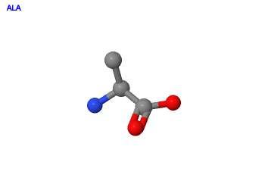
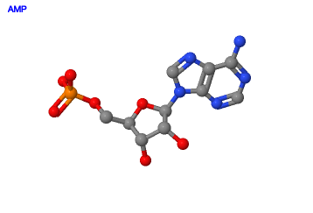
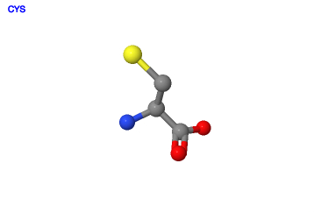
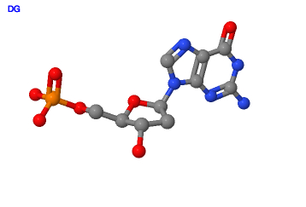
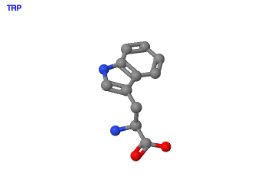
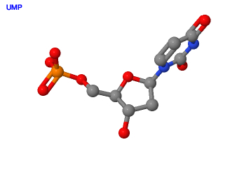
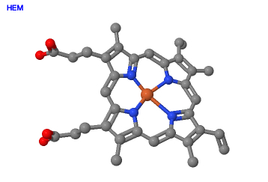
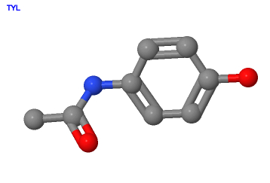
Building Blocks, Chemical Groups
Polymer building blocks:
    Amino acids (proteins/peptides)
    Nucleotides (nucleic acids)
    monosaccharides (Sugars)
Ligands/groups:
    Ions, metals
    Cofactors
    Inhibitors, drugs

Slide 5
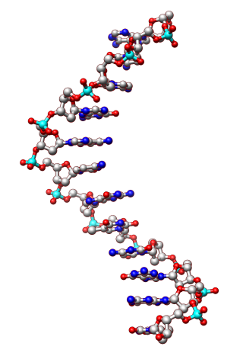
Biological Polymers
Peptides and Proteins
Nucleic Acid Polymers
Peptide bond between amino acids
Phosphodiester linkages between nucleotides
Base
Sugar
Phosphate

Slide 6
Representing Regular Polymers
Name: List as name protein, e.g. Myoglobin
Source: Organism name (for naturally derived polymer)
Composition and linkage: Sequence of amino acids listed; Linkage between amino acids implied
Reference: Polymer sequence database reference, where available (UniProt)
Structure: Regular regions of 3D structure (such as helices/sheets) described, where appropriate
Binding environment: n/a
Function: Described for polymer

Slide 7
Representing Components (Ligands)
Name: List for component(s)
Source: N/A; since usually designed
Composition and linkage: n/a
Reference: CCD
Structure: n/a
Binding environment: Residues interacting with or surrounding component
Function: Described for component

Slide 8
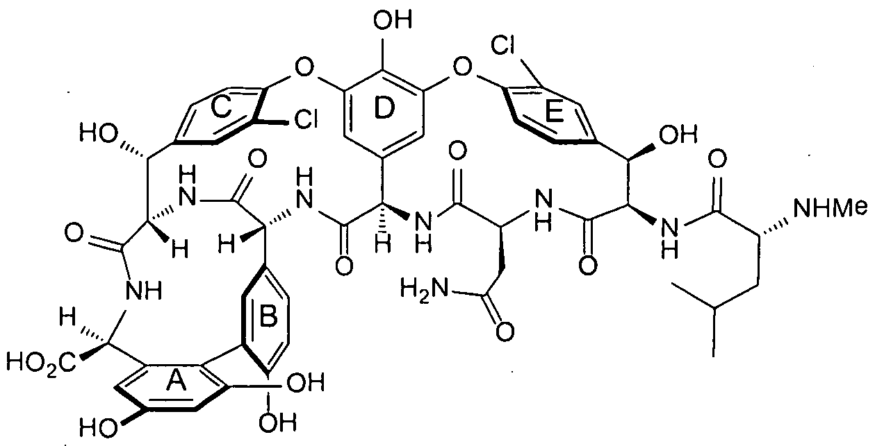
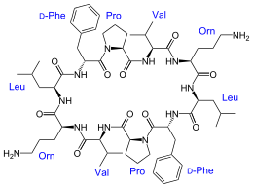
Peptide-Like Molecules
Biological Significance
Chemical Interest
Antibiotics:
Inhibitors of key enzyme/processes in Biology
Non-linear polymers
Interesting chemistry in molecule biosynthesis
Interesting chemistry in interaction with target
Ribosomal: Thiostrepton
Vancomycin aglycon
thiozole ring from Thiostrepton
Non-Ribosomal: Gramicidin S

Slide 9
The Problem
Representation:
  Inclusion of non-standard amino acids, sugars or other chemical groups in polymer sequence
  Non-linear (cyclic or branched) sequences
Interactions (Chemistry):
  Formation of covalent links
Annotation:
  Incomplete/incorrect linkages
  Microheterogeneity
  Missing/inconsistent information about source and function of molecules

Slide 10
Case of Thiostrepton
Pre-remediation representation
1e9w SEQRES THR ILE ALA DHA ALA DHA PYT
2jq7 SEQRES ILE ALA DHA ALA
1oln LINKed HETs ROP incorrectly used
3cf5 is single molecule TXX
Current sequence

Slide 11
Solution: Dual Representation
Keep track of molecule’s detailed composition
    To facilitate understanding its synthesis/design
    To allow grouping of related molecules
Keep the peptide-like molecule together
    To facilitate query, visualization and analysis
Thiostrepton

Slide 12

This work is licensed under Creative Commons Attribution-NonCommercial-ShareAlike 4.0 International.
Funded by Grant R25 LM012286 from the National Library of Medicine of the National Institutes of Health.

