Slide 1
Introduction to Biological Databases and Data Archiving
Ensuring Data Consistency

Slide 2
Data Remediation Case Study: Peptide-Like Molecules, part II

Slide 3
Learning Objectives
Understanding the Molecules:
  Building blocks, Polymers, and Peptide-like Molecules
Problem: Representing Peptide-like Molecules
Solution: Dual Representation
Remediation:
  Improving infrastructure, and updating files
  New Dictionaries

Slide 4
Solution: Dual Representation
Keep track of molecule’s detailed composition
    To facilitate understanding its synthesis/design
    To allow grouping of related molecules
Keep the peptide-like molecule together
    To facilitate query, visualization and analysis
Thiostrepton

Slide 5
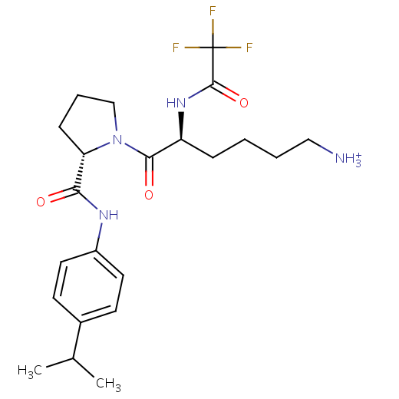
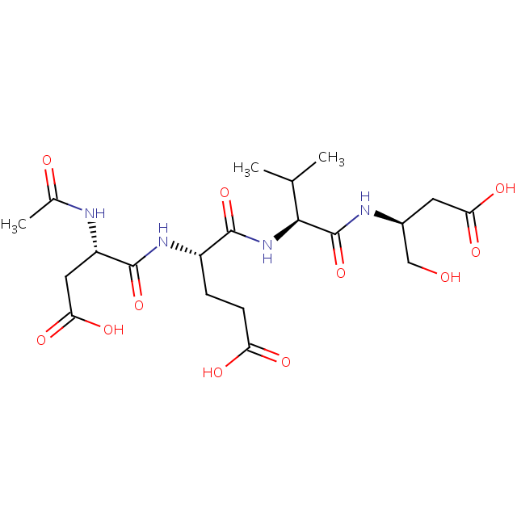
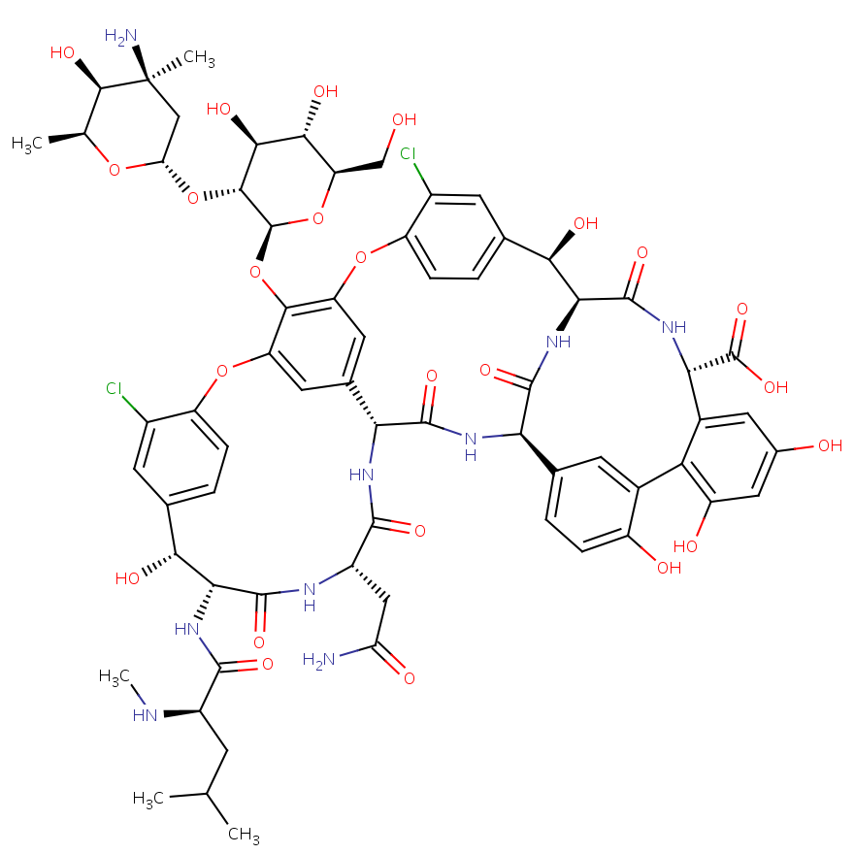
Flavors of Dual Representation
Component with subcomponents
Polymers
Grouped molecules
1.
2.
3.
PRD_000365
PRD_000422
PRD_000204

Slide 6
1: Component with Subcomponents
Peptide-like inhibitor
  2 consecutive amino acids
  2 other non-amino acid components
Linkage
  Single component
  Too small to be represented as a peptide/polymer
  Subcomponent sequence captured within component definition
0Z1: TFA LYS PRO ISO
Subcomponents:
LYS, PRO, are standard aa,
TFA is trifluoroacetic acid and
ISO is isopropylanilide.

Slide 7
Representing 1.
Name: List with other components
Source: N/A; since usually designed
Composition and linkage: Apparent “sequence” listed in subcomponent sequence; Explicit links between subcomponents listed in PRD files; All links between atoms listed in CCD
Reference: n/a
Structure: n/a
Binding environment: Residues interacting with or surrounding component
Function: Described for component

Slide 8
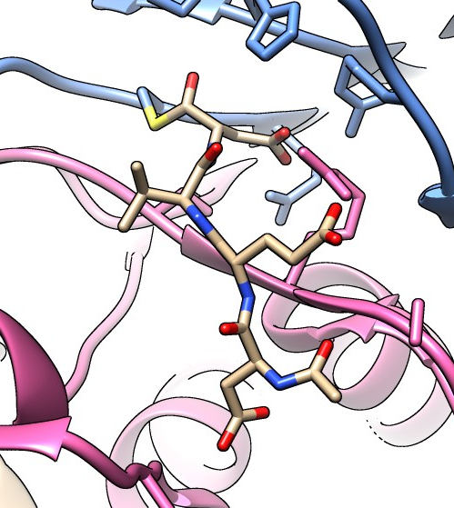
2: Polymers
Peptide-like inhibitor
  Targets Caspase 3
  Polymer sequence
    ACE-ASP-GLU-VAL-ASJ
    Carbonyl carbon of C-terminal residue is in bound hemithioacetal form (ASJ).
      The unbound inhibitor’s hybridization at this C is sp² (component ASA).
Linkage implied
  Standard peptide bonds
sp³ C
ACE-ASP-GLU-VAL-ASJ to its target, caspase 3, in PDB entry 4dcp, Chung et al., 2012

Slide 9
Representing 2.
Name: List as names of other proteins etc.
Source: Organism name included for naturally derived polymers
Composition and linkage: Sequence listed along with other polymers in entry; Standard peptide linkages implied; All non-standard links explicitly defined in PDB entry and PRD file.
Reference: Sequence database reference for polymer, where available
Structure: Regular regions of 3D structure (such as helices/sheets) described, where appropriate
Binding environment: Residues interacting with or surrounding polymer
Function: Described for polymer

Slide 10
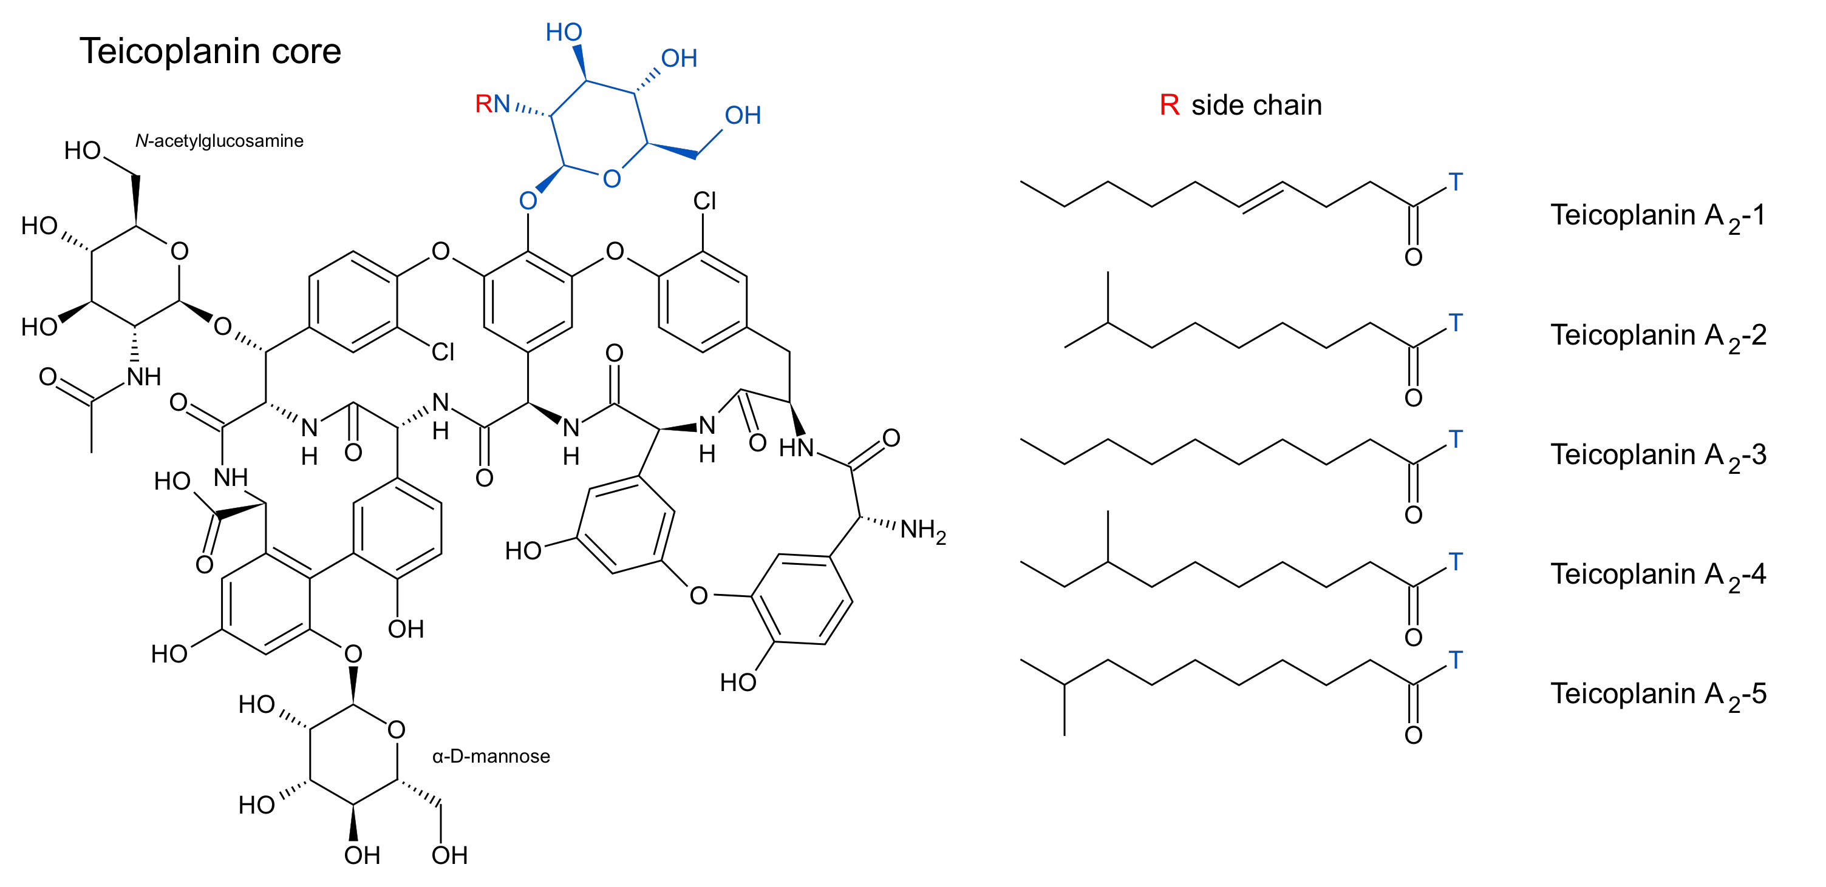
3. Grouped Molecule
Glycopeptide antibiotic:
  Peptide core (black, polymer)
  Decorated with nonpolymers
    3 saccharides (blue, green and orange)
    fatty acid (red).
Linkage representation:
  Intrachain bonds:
    Peptide bonds in core (green halo)
    Covalent links between side chains (purple)
  polymer:non-polymer linkages
R is T55
5
3
2
6
4
7
1
    T55
|
GCS NAG MAN
| | |
GHP 3MY 3FG GHP GHP OMX 3FG
1 2 3 4 5 6 7
Teicoplanin

Slide 11
Representing 3.
Name: List for complete molecule – including all polymer and non-polymer components
Source: Organism name included for polymeric part(s)
Composition and linkage: All constituents of molecule group defined in PDB entry; Sequence(s)of polymer components described as for other polymers; Links between polymer and non-polymer constituents explicitly defined in PDB and PRD.
Reference: Sequence database reference for polymeric components, where available
Structure: Regular regions of 3D structure (such as helices/sheets) described for polymeric components, as appropriate
Binding environment: Residues interacting with or surrounding grouped molecule
Function: Described for grouped molecule

Slide 12
Deciding Representation
Used in annotation of new peptide-like molecules in the PDB (and Remediation)

Slide 13
Remediation of Pre-2012 Entries
Identify PDB entries with peptide-like molecules (~1000)
  Antibiotics: ~150 PDB entries (with ~60 different types)
  Inhibitors: ~850 PDB entries (with ~310 different types)
Analyze status of identified PDB structures
Decide representation of peptide-like molecule
  Peptides with polymer sequence
  Single components with subcomponent sequence
  Grouped Molecules
Dictionary updates:
  Build/remove relevant components and subcomponents
  Develop categories/tokens for representing peptide-like molecules
  Build new Dictionaries

Slide 14
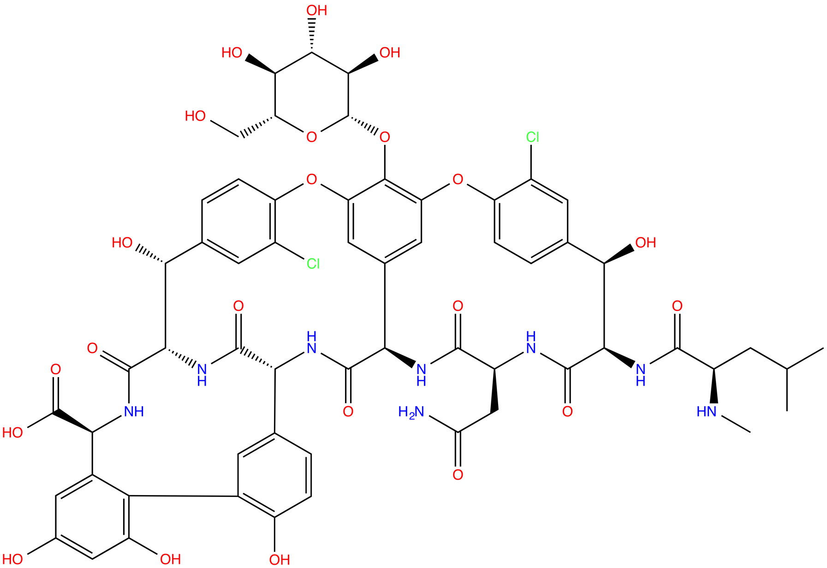
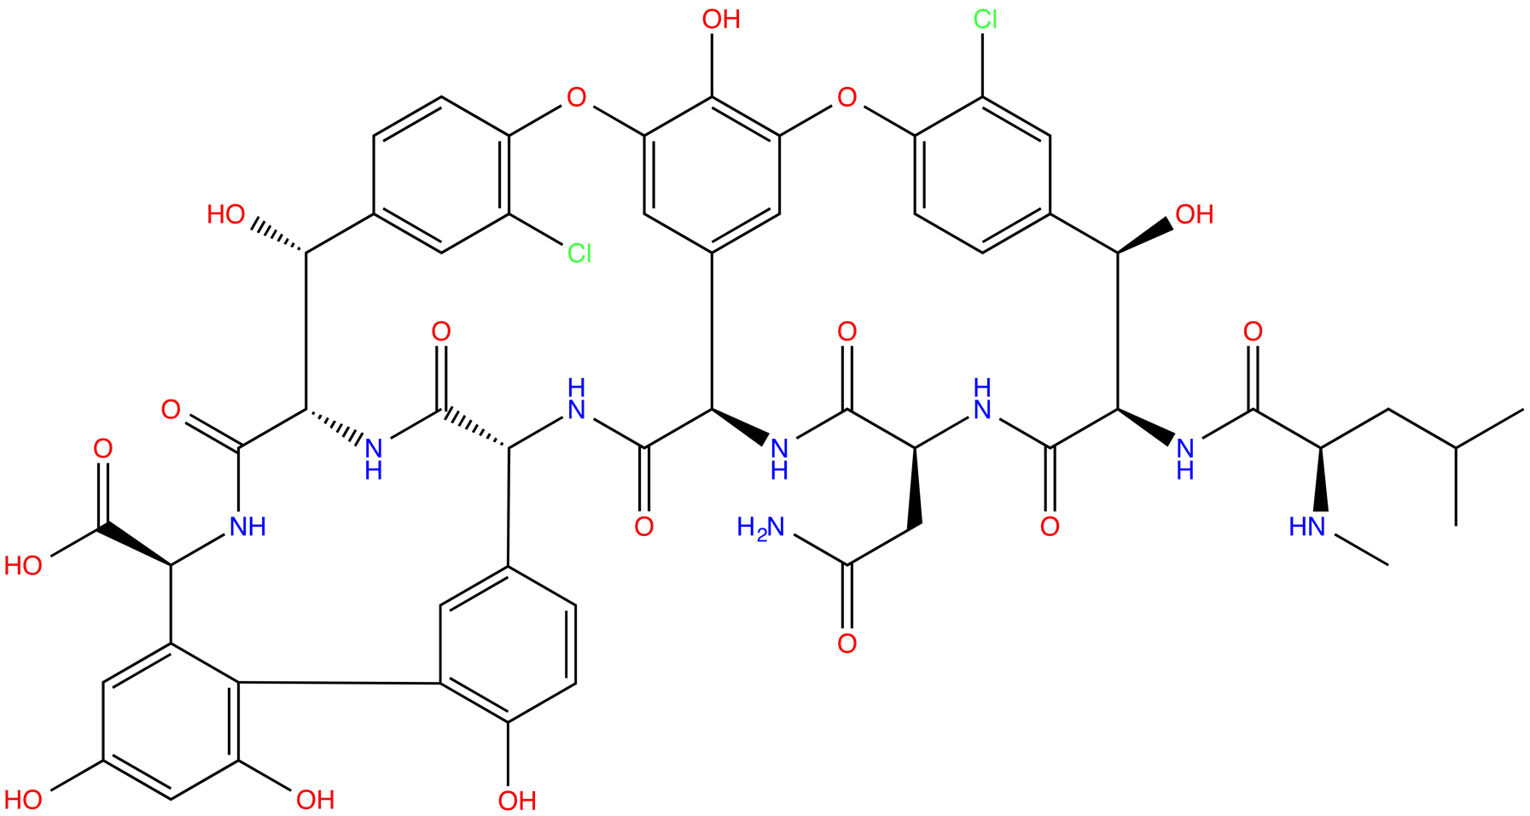
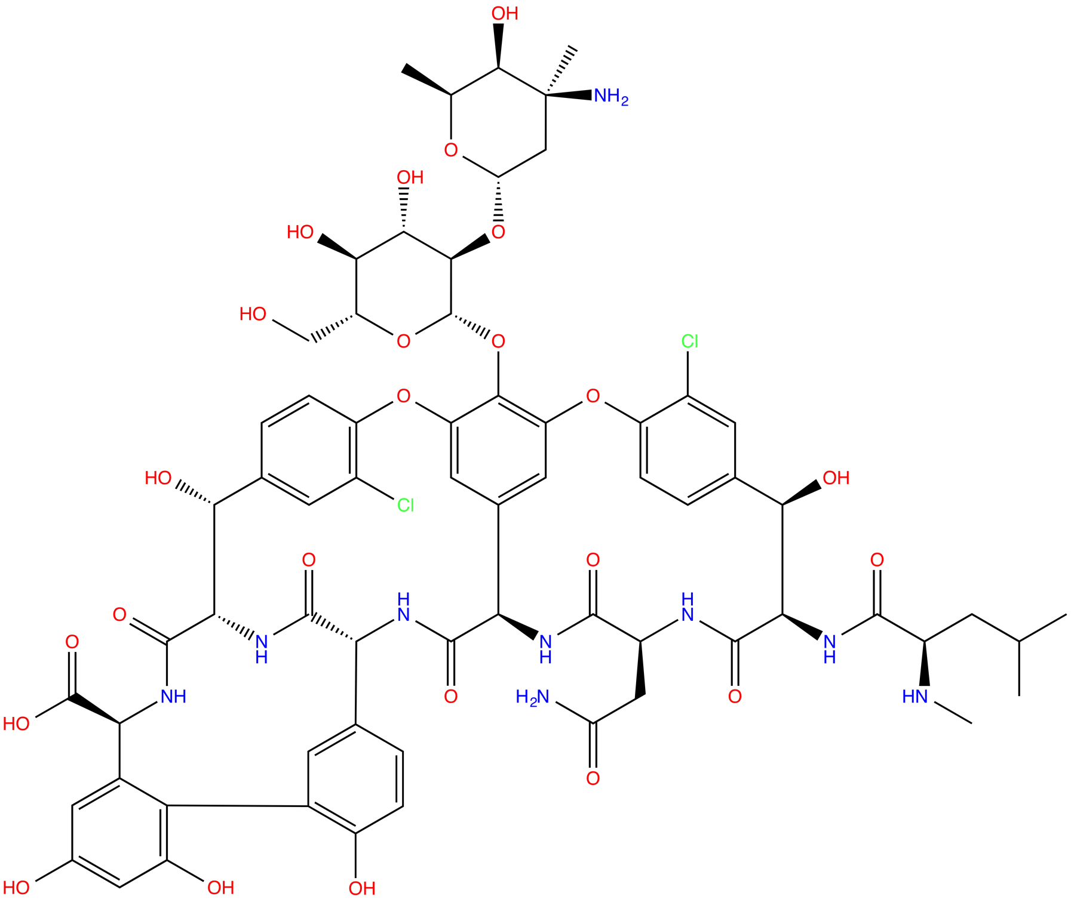
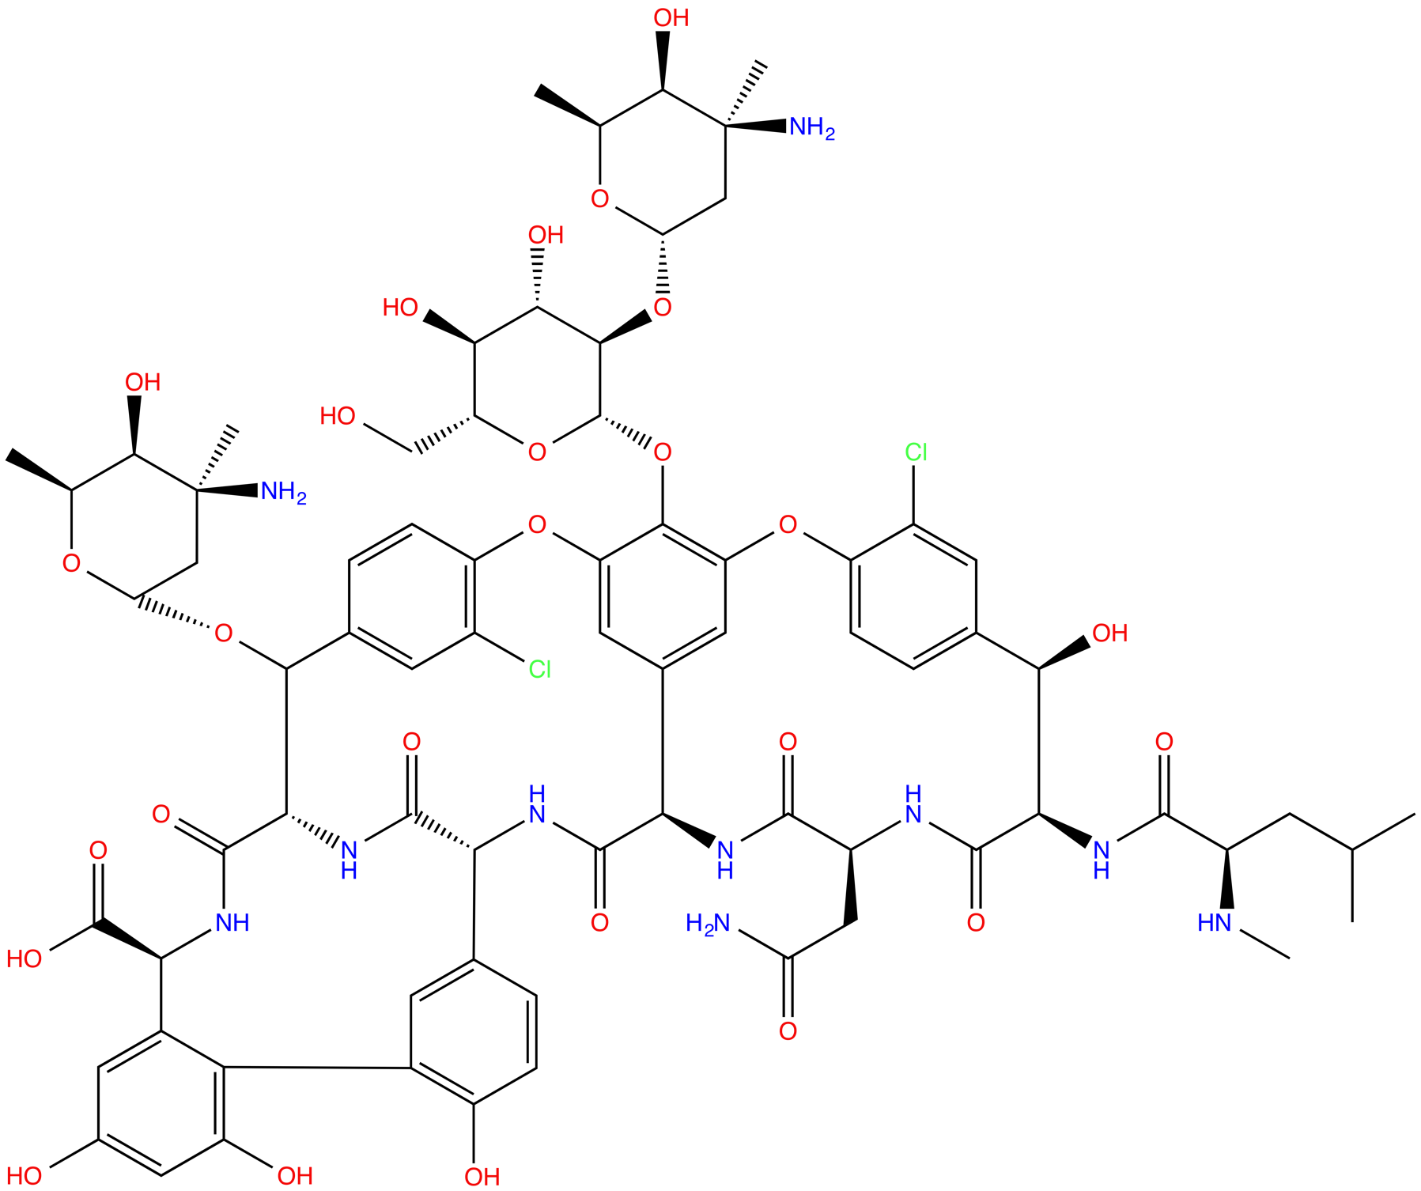
Vancomycin Family Members
A.
B.
Vancomycin aglycon
Desvancosaminyl vancomycin
C.
D.
Vancomycin
Chloroorienticin A
Notes:
Figure 5

Slide 15
New Dictionaries
Property | PRD file | FAM file
Identifier | PRD_######, e.g. PRD_000001 | FAM_######, e.g. FAM_000001
Name | Molecule name | Family name
Description | Molecular formula and weight Specific function (class) Structural details (type) | List of member PRD identifiers Literature references
Chemical details | List polymer and non-polymer entities Polymer or subcomponent sequence Intra-entity linkages between components in polymer entities Inter-entity linkages between polymer segments and non-polymer components (for grouped molecules) Description of how all components in the molecule are linked | Synonyms for PRD family members from various resources including the PDB and primary citations Reference database IDs and links to resources with information about family members Family specific annotations – IDs and information about related entries in CSD Corresponding literature references
Biological details | Source organism (for naturally produced molecules) and Source of source information (e.g. database, author or literature) | Annotations about Structural, functional and mechanistic details Pharmacological action (where appropriate)

Slide 16
Summary
The challenges presented by peptide-like molecules
Our solution to the representation challenges
Rationale for remediating PDB entries containing peptide-like molecules
Remediation:
  Improving infrastructure, and updating files
  New Dictionaries

Slide 17

This work is licensed under Creative Commons Attribution-NonCommercial-ShareAlike 4.0 International.
Funded by Grant R25 LM012286 from the National Library of Medicine of the National Institutes of Health.

