Slide 1
Introduction to Biological Databases and Data Archiving
Ensuring Data Consistency

Slide 2
Data Remediation Case Study: Viruses

Slide 3
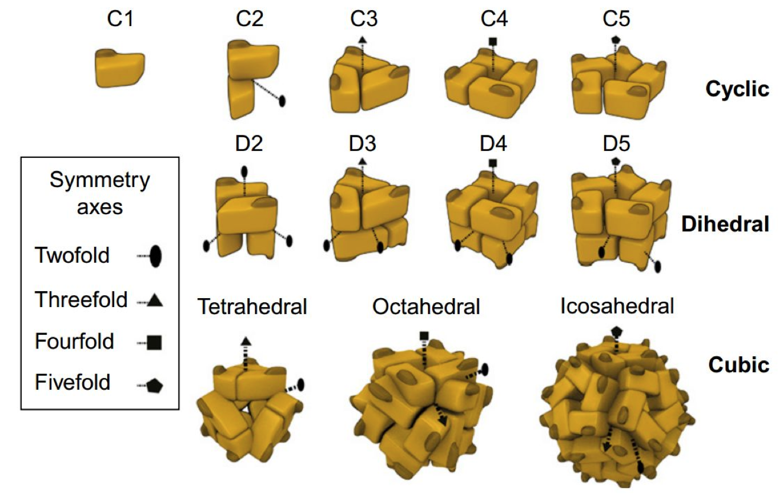
Point Symmetries
Levy & Teichmann 2013

Slide 4
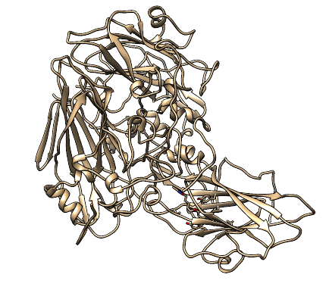
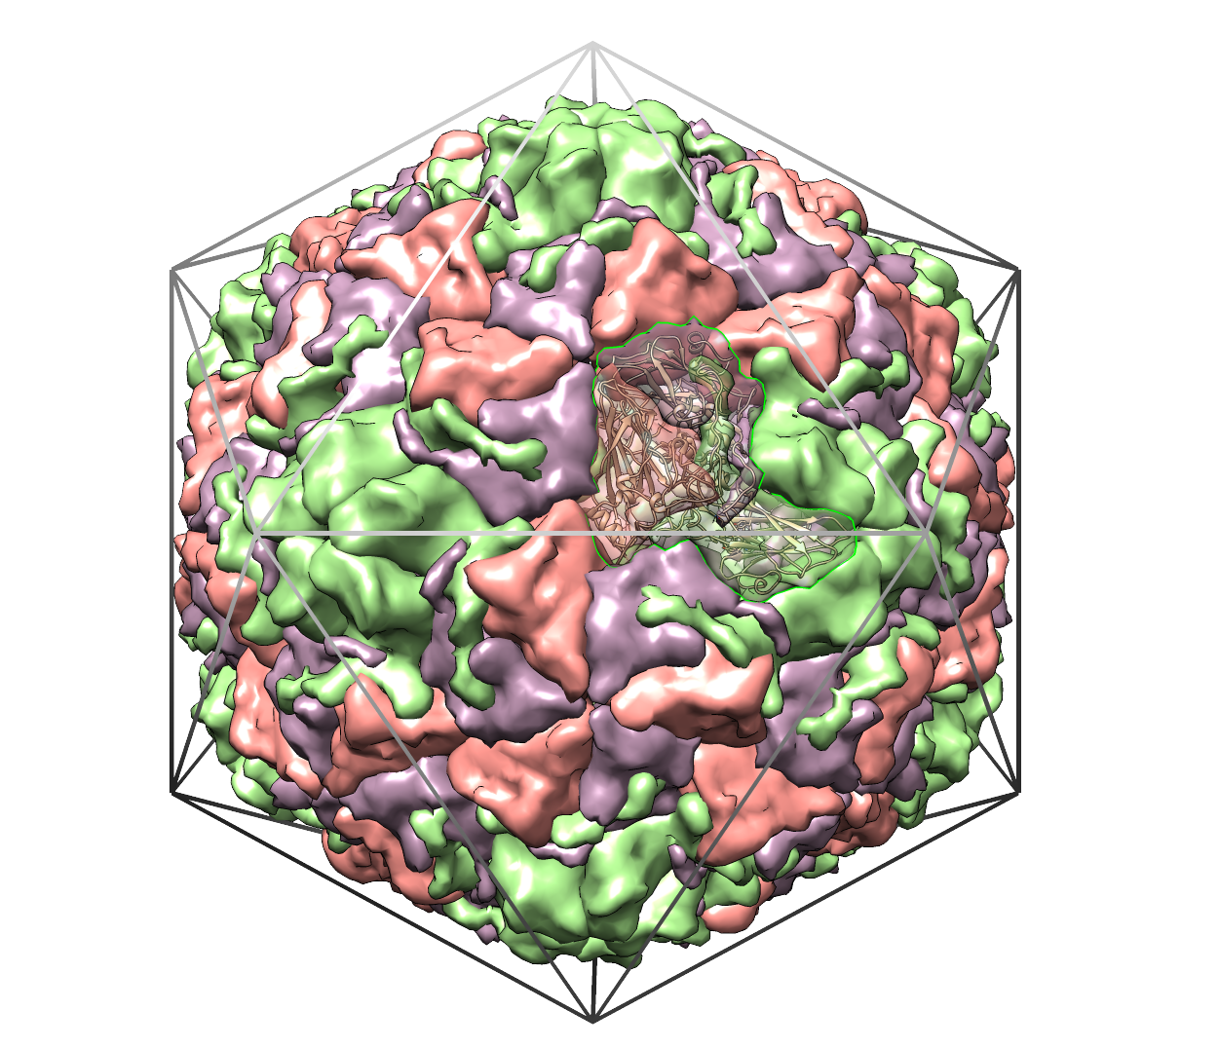
Icosahedral Viruses
Virus coat is composed of 60 identical copies of a single repeating unit
Rhinovirus
(1RUG)
Hadfield, A.T. et al (1995)

Slide 5
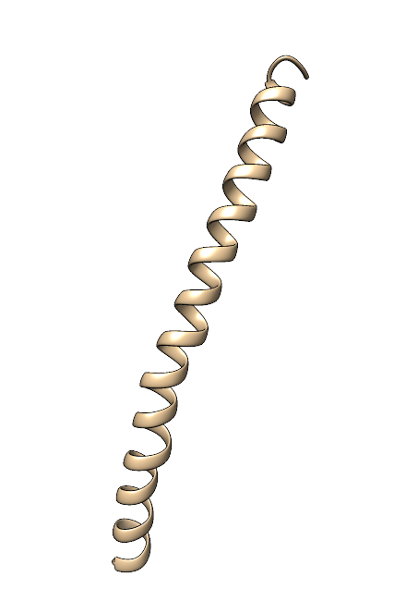
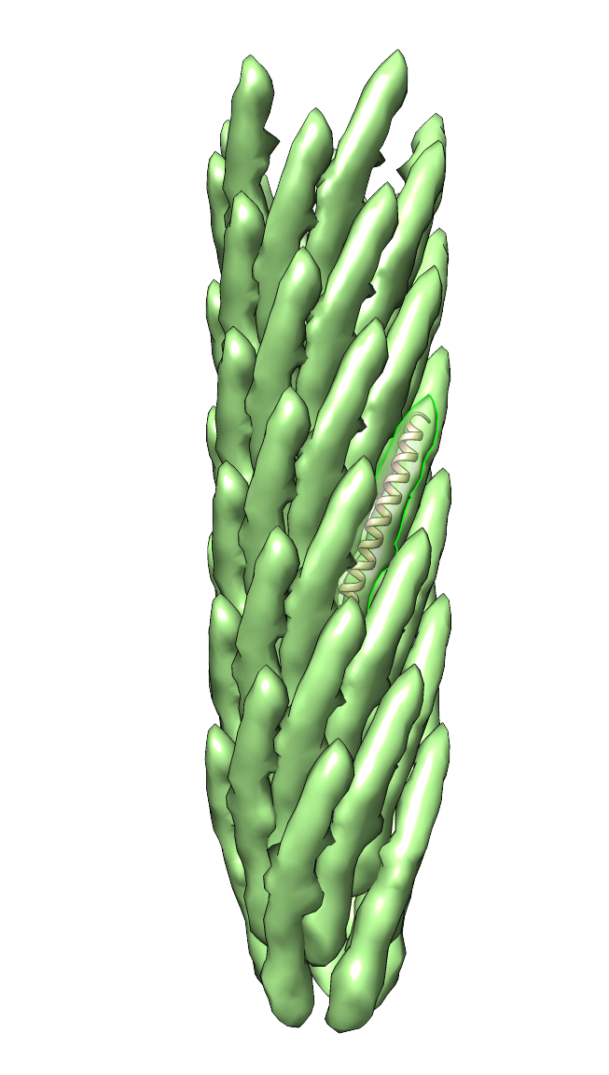
Helical Viruses
Virus coat is similarly composed identical copies of a single repeating unit
Filamentous
Inovirus
(1IFD)
Marvin, D.A. (1990)

Slide 6
The Problem
Growing number of large macromolecular assemblies—mostly virus structures—were being deposited
No standard for representing assemblies with regular (point, helical) symmetry
No annotation process for checking/validating depositor-provided symmetry information

Slide 7
Evaluation
~280 existing entries reviewed, 3 major issues identified:
missing or erroneous transformation operations, identified by inspection of automatically generated images
inconsistent “deposition frame,” identified by checking crystal packing
overly complex building instructions, identified from depositor remarks
Lawson et al. (2008)

Slide 8
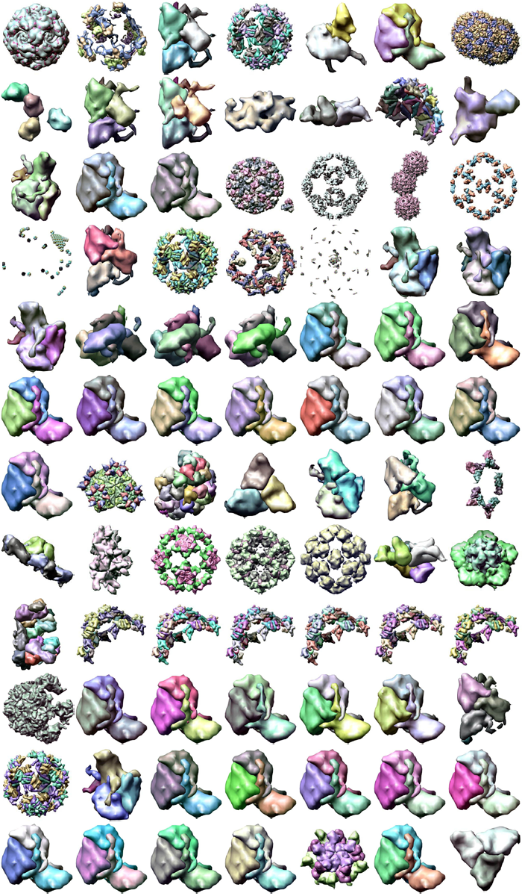
Erroneous Building Instructions
REMARK 350 BIOMT1 1 1.000001 0.000000 0.000000 0.00000
REMARK 350 BIOMT2 1 0.000000 1.000000 0.000000 0.00000
REMARK 350 BIOMT3 1 0.000000 0.000000 1.000000 0.00000
REMARK 350 BIOMT1 2 0.990681 0.110665 -0.079075 0.00000
REMARK 350 BIOMT2 2 -0.109930 0.309000 -0.944669 0.00000
REMARK 350 BIOMT3 2 -0.080095 0.944581 0.318319 0.00000
REMARK 350 BIOMT1 3 0.975662 0.069109 -0.208049 0.00000
REMARK 350 BIOMT2 3 -0.067185 -0.808999 -0.583925 0.00000
REMARK 350 BIOMT3 3 -0.208678 0.583701 -0.784664 0.00000
REMARK 350 BIOMT1 4 0.975662 -0.067185 -0.208678 0.00000
REMARK 350 BIOMT2 4 0.069109 -0.808999 0.583701 0.00000
REMARK 350 BIOMT3 4 -0.208049 -0.583925 -0.784664 0.00000
REMARK 350 BIOMT1 5 0.990681 -0.109930 -0.080094 0.00000
REMARK 350 BIOMT2 5 0.110665 0.309000 0.944581 0.00000
REMARK 350 BIOMT3 5 -0.079076 -0.944669 0.318319 0.00000
REMARK 350 BIOMT1 6 0.266264 -0.490051 -0.830002 0.00000
REMARK 350 BIOMT2 6 -0.490051 -0.810322 0.321234 0.00000
REMARK 350 BIOMT3 6 -0.830002 0.321234 -0.455944 0.00000
REMARK 350 BIOMT1 7 0.384158 -0.906006 0.177697 0.00000
REMARK 350 BIOMT2 7 -0.422168 -0.001207 0.906516 0.00000
REMARK 350 BIOMT3 7 -0.821095 -0.423264 -0.382951 0.00000
REMARK 350 BIOMT1 8 0.465941 -0.069594 0.882062 0.00000
REMARK 350 BIOMT2 8 -0.490707 0.809187 0.323085 0.00000
REMARK 350 BIOMT3 8 -0.736241 -0.583382 0.342873 0.00000
REMARK 350 BIOMT1 9 0.398597 0.863229 0.309685 0.00000
REMARK 350 BIOMT2 9 -0.600983 0.500935 -0.622774 0.00000
REMARK 350 BIOMT3 9 -0.692761 0.062146 0.718469 0.00000

Slide 9
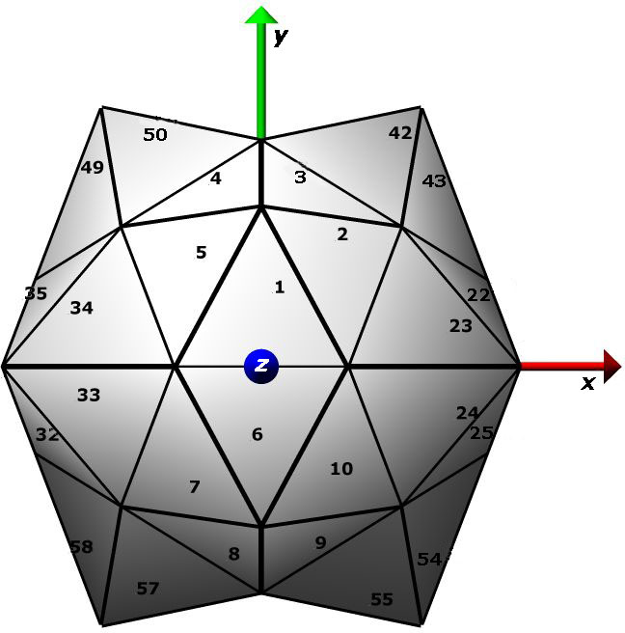
Crystal Frame vs Icosahedral Frame
Not unique: multiple ways
to place symmetry axis with respect to XYZ axes

Slide 10
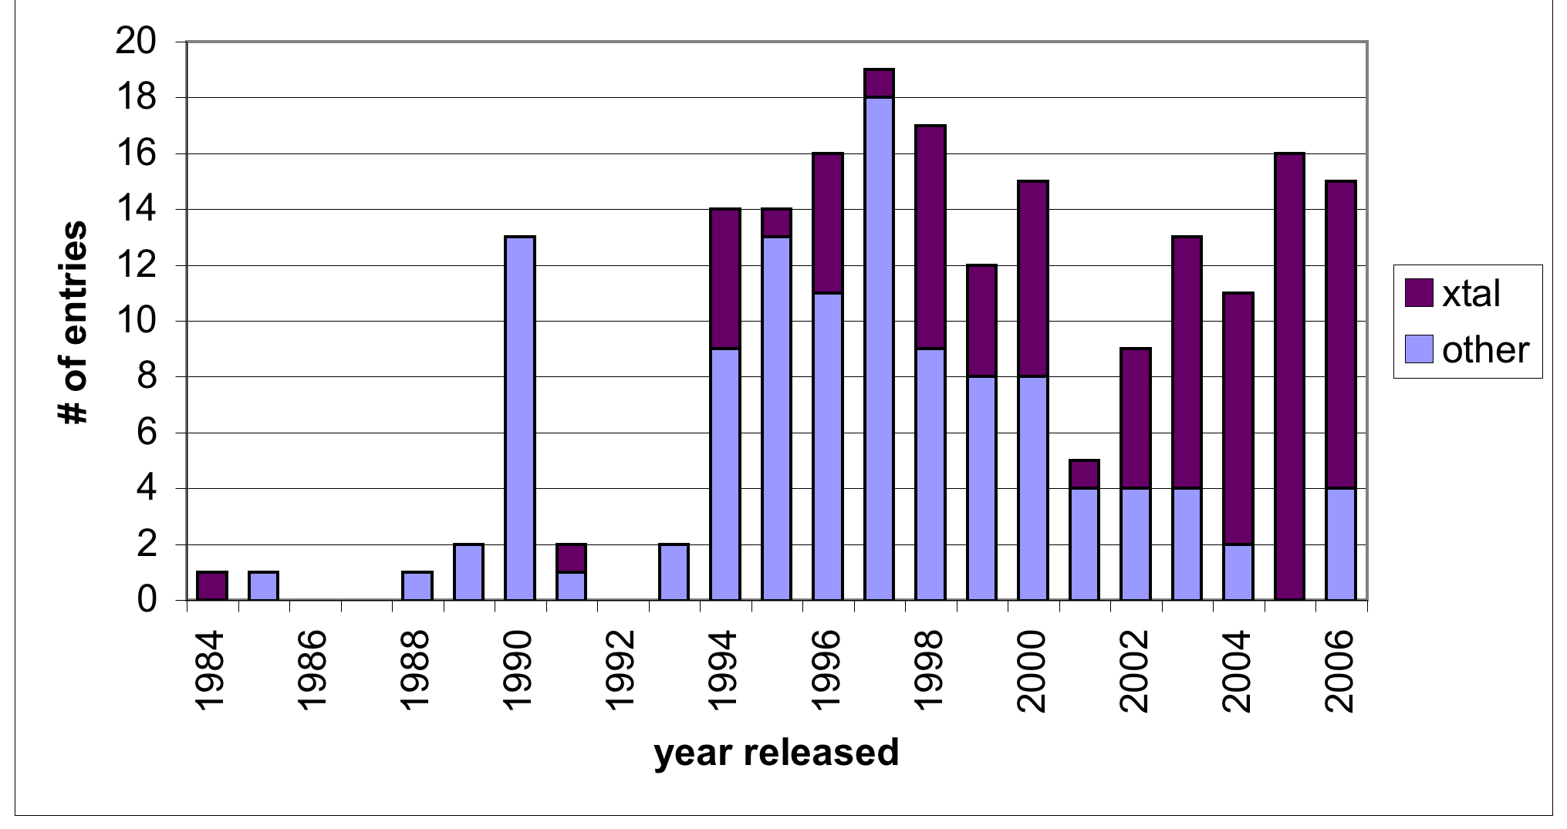
Crystal Frame vs. Icosahedral Frame Deposition
Other ➔ one of the icosahedral frame definitions
Lawson et al. (2008)

Slide 11
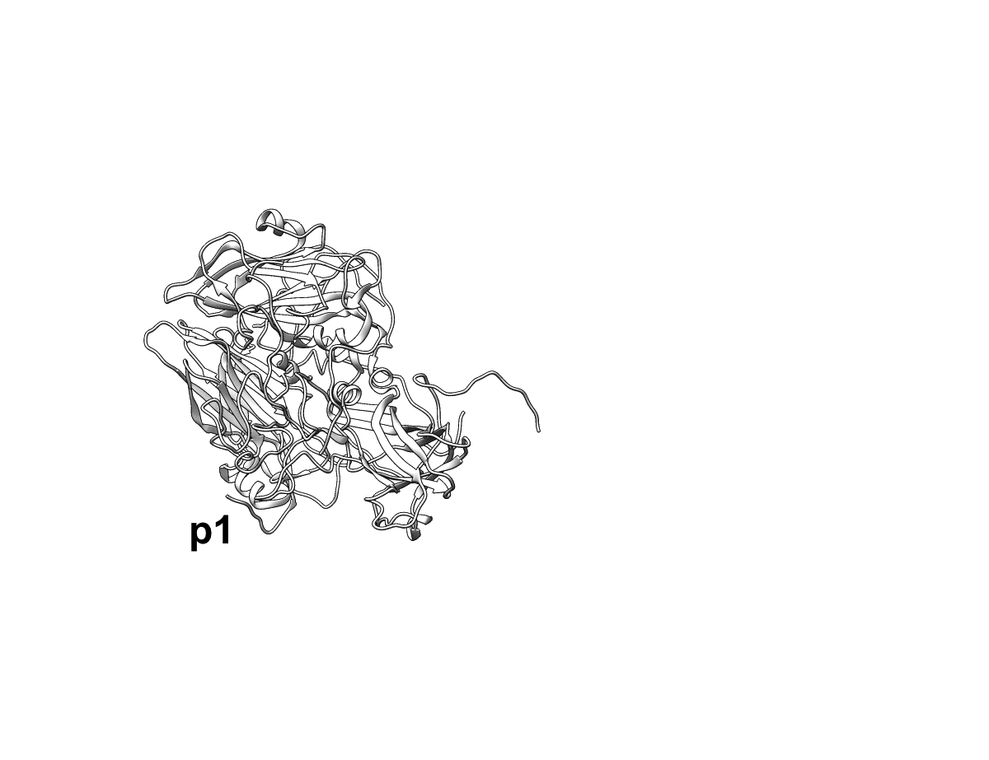
Complex building instructions Example 1: Rhinovirus (4rhv)
“To generate a viral shell from the coordinates ... apply the 532 point group symmetry elements in the specific order 5x2x2x3 about specific axes whose transformations are given below.”
Let p1 = coordinates of the entry.
Apply trnsf1 four times to create an entire pentamer:
p2 = trnsf1*p1; p3 = trnsf1*p2; p4 = trnsf1*p3; p5 = trnsf1*p4
[...additional instructions are given to build full virus shell with 60 copies]
trnsf1=
.500000 -.809017 .309017
.809017 .309017 -.500000
.309017 .500000 .809017
Arnold, E. & Rossmann, M.G. (1988)

Slide 12
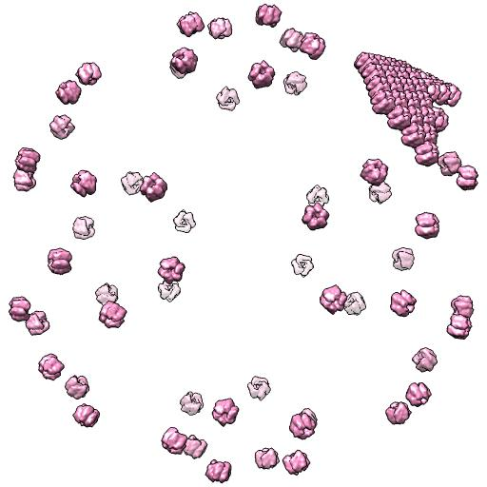
Complex building instructions: Example 2 PBCV-1 Virus (1m4x)
Incorrect: apply all 88 supplied transformations to 3 deposited chains
Nandhagopal, N. et al (2002)

Slide 13
Improving the Infrastructure
New Representation Requirements:
Symmetry parameter information
Instructions for building assemblies (standard order)
Instructions for moving assemblies between different frames: deposited, standard, crystal
PDBx/mmCIF dictionary categories/items created to hold the new instructions
Software suite (Pointsuite) created to automate production of the new representation

Slide 14
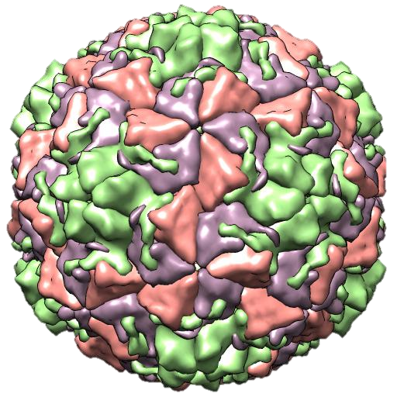
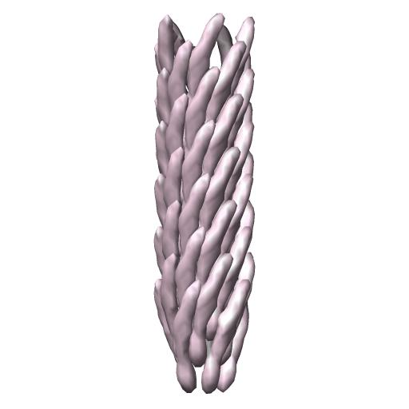
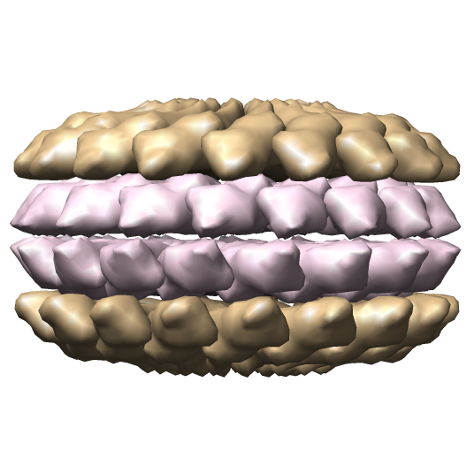
Symmetry Parameters Defined
Rhinovirus (1RUG)
Icosahedral point symmetry
Schoenflies symbol I
Filamentous Inovirus (1IFD)
Helical symmetry
number of operations 55
rotation per n subunits -33.230100
rise per n subunits 16.000000
n subunits (divisor) 1
dyad axis no
cyclic symmetry 5
TMV coat aggregate (1EI7)
Dihedral point symmetry
Schoenflies symbol D
cyclic symmetry 17
TMV: Bhyravbhatla, B., et al (1998)

Slide 15
Standard Frame/ Standard Order of Transformations
1= position of the deposited coordinates
(1-5) = first
pentamer

Slide 16
From “Deposited Frame” to “Any Frame”
Lawson et al. (2008)
Notes:
REQUIRED INPUT INFO is shaded orange. Standard input info is shaded blue. Dotted path implies coordinate/matrix selection.

Slide 17
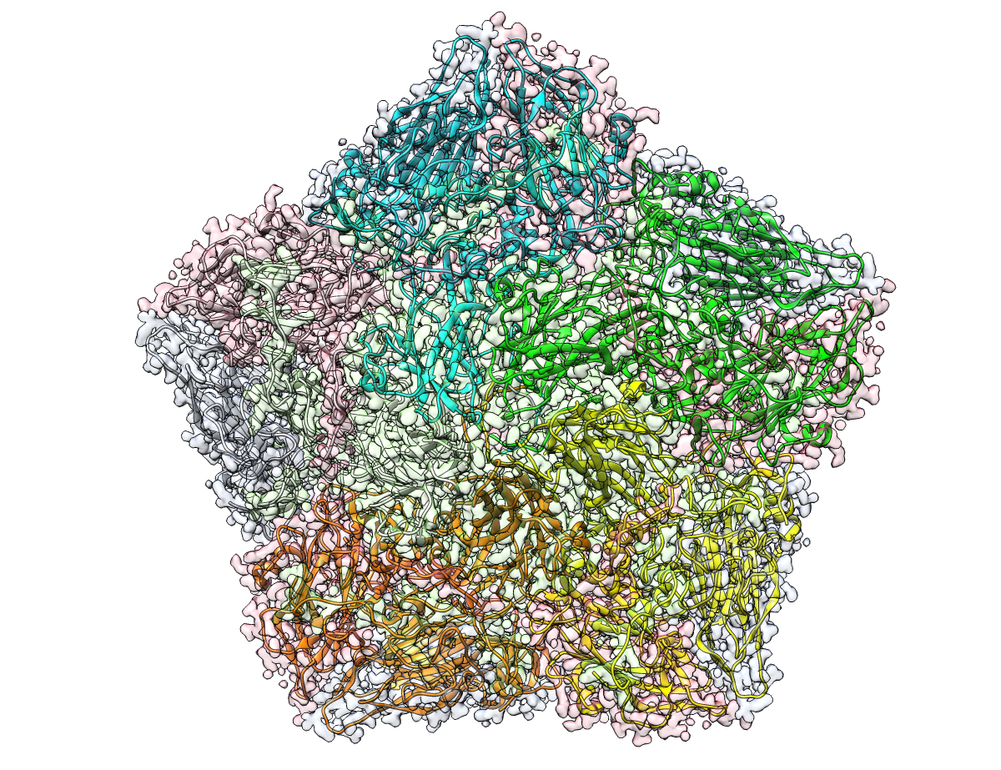
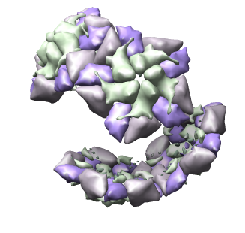
Computer-readable Instructions
assembly | transformation expression | chain id list
pentamer | (1-5) | 1,2,3,4
'complete icosahedral assembly’ | (1-60) | 1,2,3,4
‘point asymmetric unit in point frame’ | P | 1,2,3,4
‘crystal asymmetric unit’ | (X0)(1-5,11-15,21-25,36-40) | 1,2,3,4
pentamer
complete
icosahedral
assembly
Crystal
asymmetric
unit

Slide 18
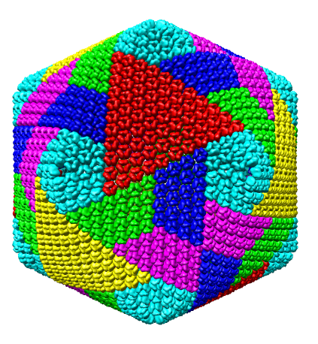
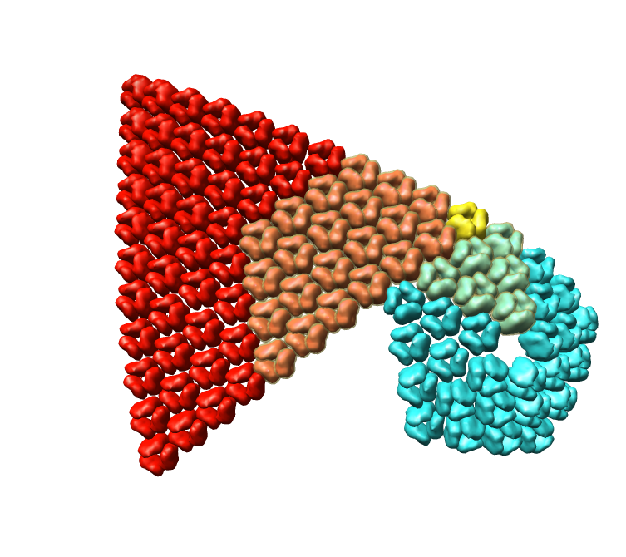
Complex Assembly Example 1M4X
loop_ _pdbx_struct_assembly.id _pdbx_struct_assembly.details
1 'Complete virus capsid'
2 'Point asymmetric unit' 3 'Trisymmetron capsid element’
4 ‘Pentasymmetron capsid element’
loop_ _pdbx_struct_assembly_gen.assembly_id _pdbx_struct_assembly_gen.oper_expression _pdbx_struct_assembly_gen.asym_id_list 1 (1-60)(61-88) A,B,C 2 (61-88) A,B,C 3 (1,10,23)(61,68-88) A,B,C
4 (1-5)(63-68) A,B,C
Nandhagopal, N. et al (2002)

Slide 19
Remediation Process
Errors were identified through visual inspection of auto-generated images (UCSF Chimera script)
Corrections obtained from other public databases where assembly information was being carefully curated: VIPERdb, PQS
Some transformations were extracted from PDB files or (when desperate) from primary citation text
Provisional corrections were checked in multiple ways:
assembly images, symmetry contacts, validation against experimental data (structure factors)

Slide 20

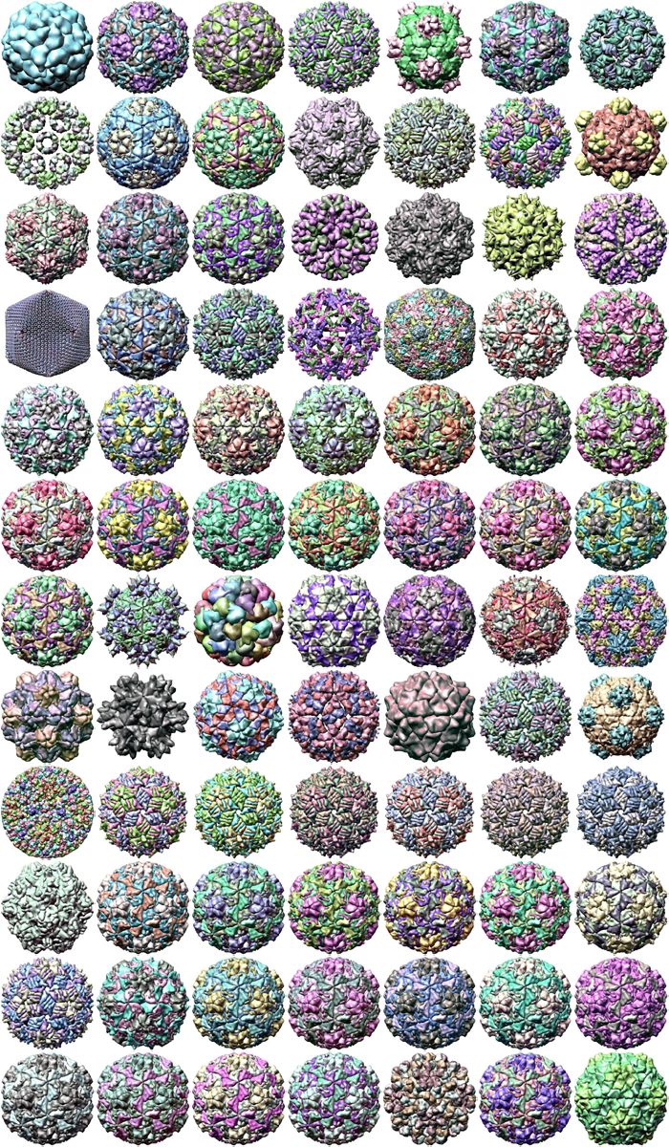
Fixing Virus Structures: from Rogues Gallery to Regular Icosahedra
before
after

Slide 21
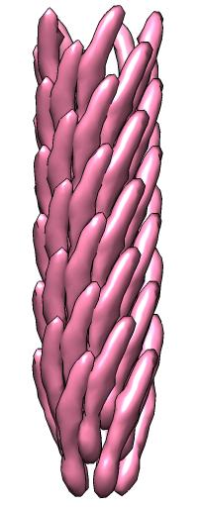
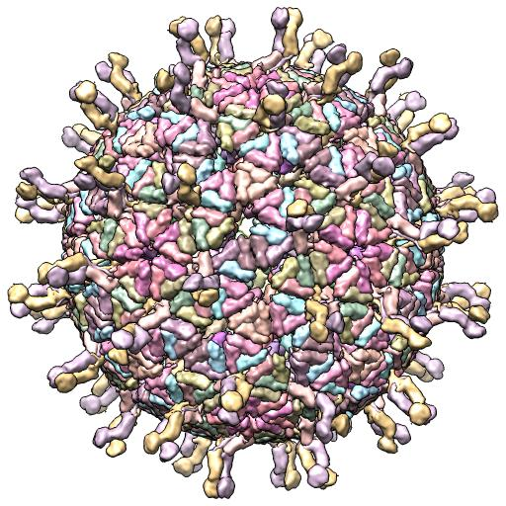
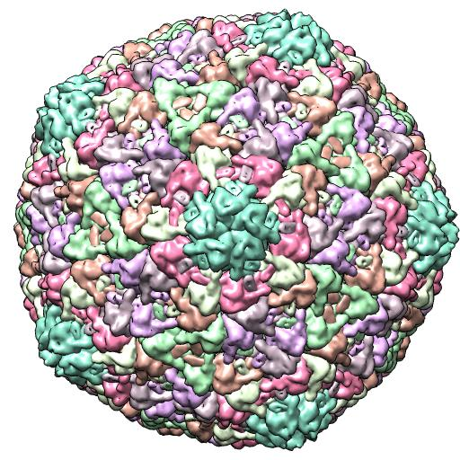
Preventing Future Errors
Annotation process created
Pointsuite software generates the standard CIF representation from depositor-supplied transformations
annotators build/inspect the full assemblies

Slide 22

This work is licensed under Creative Commons Attribution-NonCommercial-ShareAlike 4.0 International.
Funded by Grant R25 LM012286 from the National Library of Medicine of the National Institutes of Health.

