Slide 1
Introduction to Biological Databases and Data Archiving
Creating and Maintaining a Data Archive

Slide 2
Choosing formats

Slide 3
Archival Data Formats Considerations
Expressivity – represents all relevant data
Content extensibility – change is not disruptive
Portability – platform independence
Compatibility with typical user access patterns
Software support – well supported by existing tools
Documentation – well described
Web service delivery – compatible with Internet data exchange formats
Variations or the above – supporting multiple data formats

Slide 4
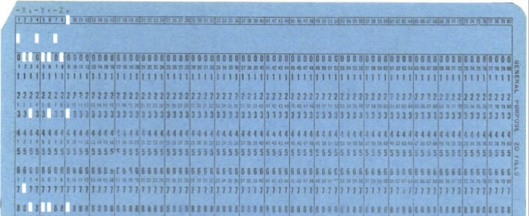
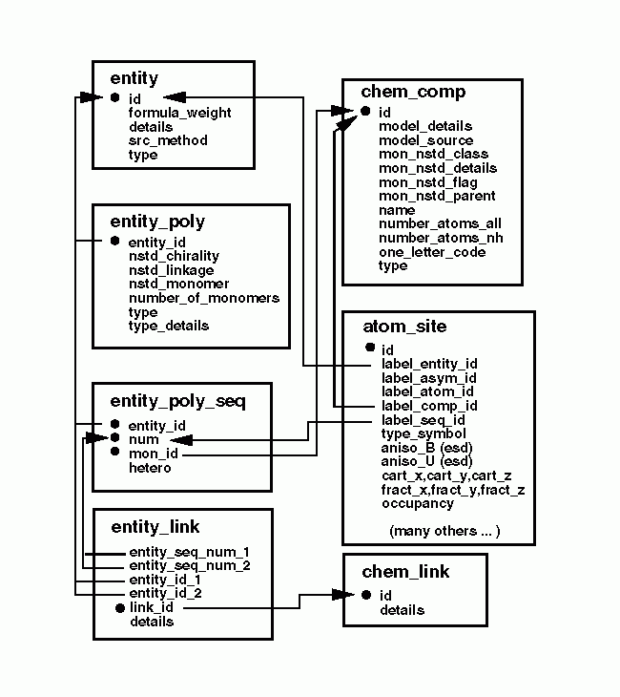
PDB Supported Archival Formats
PDB (ca. 1974)
PDBx/mmCIF (ca. 1997)
PDBML (ca. 2005)
RDF (ca. 2011)
PDB
PDBx/
mmCIF
PDBML & RDF
In managing the formats, PDBx is the master format.

Slide 5
PDB Format Example
REMARK 3 DATA USED IN REFINEMENT.
REMARK 3 RESOLUTION RANGE HIGH (ANGSTROMS) : 1.57
REMARK 3 RESOLUTION RANGE LOW (ANGSTROMS) : 23.00
REMARK 3 DATA CUTOFF (SIGMA(F)) : 0.000
REMARK 3 COMPLETENESS FOR RANGE (%) : NULL
REMARK 3 NUMBER OF REFLECTIONS : 43316
REMARK 3
REMARK 3 FIT TO DATA USED IN REFINEMENT.
REMARK 3 CROSS-VALIDATION METHOD : NULL
REMARK 3 FREE R VALUE TEST SET SELECTION : NULL
REMARK 3 R VALUE (WORKING + TEST SET) : NULL
REMARK 3 R VALUE (WORKING SET) : 0.191
REMARK 3 FREE R VALUE : 0.221
REMARK 3 FREE R VALUE TEST SET SIZE (%) : NULL
REMARK 3 FREE R VALUE TEST SET COUNT : 2189
REMARK 3
ATOM 1 N VAL A 363 22.741 -1.397 11.729 1.00 33.32 N
ATOM 2 CA VAL A 363 21.557 -0.831 11.024 1.00 32.13 C
ATOM 3 C VAL A 363 20.954 -1.757 9.943 1.00 31.73 C
ATOM 4 O VAL A 363 19.737 -1.906 9.845 1.00 30.94 O
ATOM 5 CB VAL A 363 21.883 0.552 10.391 1.00 33.45 C
Record-oriented with fixed column format
Metadata in semi-structured remarks
Documentation by example
Most widely used and supported archival format
Compatibility, Portability, Software Support, Text Documentation

Slide 6
PDBx/mmCIF Format Example
Name – value pairs
Tables or loop_’s
_exptl.entry_id 1XBB
_exptl.method 'X-RAY DIFFRACTION'
_exptl.crystals_number 1
Simple syntax
Named data items
Data semantics defined in the PDBx data dictionary
Software support in most popular languages
Expressivity, Content Extensibility, Compatibility, Portability, Growing Software Support, Electronic Documentation
✔
loop_
_database_PDB_rev.num
_database_PDB_rev.date
_database_PDB_rev.date_original
_database_PDB_rev.mod_type
_database_PDB_rev.replaces
_database_PDB_rev.status
1 2004-11-02 2004-08-30 0 1XBB ?
2 2005-03-22 ? 1 1XBB ?
3 2009-02-24 ? 1 1XBB ?

Slide 7
PDBML Example
<PDBx:entity_polyCategory>
<PDBx:entity_poly entity_id="1">
<PDBx:type>polypeptide(L)</PDBx:type>
<PDBx:nstd_linkage>no</PDBx:nstd_linkage>
<PDBx:nstd_monomer>no</PDBx:nstd_monomer>
<PDBx:pdbx_seq_one_letter_code>
DIVLTQSPASLSASVGETVTITCRASGNIHNYLAWYQQKQGKSPQLLVYYTTTLADG
VPSRFSGSGSGTQYSLKINSLQPEDFGSYYCQHFWSTPRTFGGGTKLEIK
</PDBx:pdbx_seq_one_letter_code>
<PDBx:pdbx_seq_one_letter_code_can>
DIVLTQSPASLSASVGETVTITCRASGNIHNYLAWYQQKQGKSPQLLVYYTTTLADG
VPSRFSGSGSGTQYSLKINSLQPEDFGSYYCQHFWSTPRTFGGGTKLEIK
</PDBx:pdbx_seq_one_letter_code_can>
</PDBx:entity_poly>
</PDBx:entity_polyCategory>
Three flavors of PDBML files:
fully marked-up files
files without atom records
files with a more space efficient encoding of atom records
Follows naming and semantics of the PDBx data dictionary
Expressivity, Content extensibility, Portability, Software support, Electronic documentation, Web service delivery friendly

Slide 8
RDF Example
<?xml version="1.0" encoding="UTF-8"?>
<?xml-stylesheet type="text/xml" href="http://pdbj.org/rdf-supp/pdbj-rdf.xsl" ?>
<rdf:RDF xmlns:PDBo="http://pdbj.org/schema/pdbx-v40.owl#"
xmlns:rdfs="http://www.w3.org/2000/01/rdf-schema#"
xmlns:rdf="http://www.w3.org/1999/02/22-rdf-syntax-ns#">
<PDBo:PDBID rdf:about="http://pdbj.org/pdb/1GOF">
<rdfs:label>1GOF</rdfs:label>
</PDBo:PDBID>
<rdf:Description rdf:about="http://pdbj.org/rdf/1GOF/entity/1">
<PDBo:entity.formula_weight>68579.250</PDBo:entity.formula_weight>
<PDBo:entity.id>1</PDBo:entity.id>
<PDBo:entity.pdbx_description>GALACTOSE OXIDASE</PDBo:entity.pdbx_description>
<PDBo:entity.pdbx_ec>1.1.3.9</PDBo:entity.pdbx_ec>
<PDBo:entity.pdbx_number_of_molecules>1</PDBo:entity.pdbx_number_of_molecules>
<PDBo:entity.src_method>man</PDBo:entity.src_method>
<PDBo:entity.type>polymer</PDBo:entity.type>
<PDBo:link_to_enzyme rdf:resource="http://purl.uniprot.org/enzyme/1.1.3.9"/>
<PDBo:of_datablock rdf:resource="http://pdbj.org/rdf/1GOF"/>
<PDBo:referenced_by_entity_keywords rdf:resource="http://pdbj.org/rdf/1GOF/entity_keywords/1"/>
<PDBo:referenced_by_entity_poly rdf:resource="http://pdbj.org/rdf/1GOF/entity_poly/1"/>
<PDBo:referenced_by_entity_src_gen rdf:resource="http://pdbj.org/rdf/1GOF/entity_src_gen/1"/>
<PDBo:referenced_by_struct_asym rdf:resource="http://pdbj.org/rdf/1GOF/struct_asym/A"/>
<PDBo:referenced_by_struct_ref rdf:resource="http://pdbj.org/rdf/1GOF/struct_ref/1"/>
<rdf:type rdf:resource="http://pdbj.org/schema/pdbx-v40.owl#entity"/>
</rdf:Description>
</rdf:RDF>
A format for Web-based resource discovery and query applications
Translates data items in PDBx/mmCIF schema into triples with URL identifiers
Follows naming and semantics of the PDBx data dictionary
http://pdbj.org/rdf/<pdbID>/<categoryName>/<pkey1>,…
For example, http://pdbj.org/rdf/1GOF/entity/1
Expressivity, Content extensibility, Portability, Software support, Electronic documentation, Web service delivery friendly

Slide 9
Summary of Formats and their Applications
Property | PDB | PDBx/mmCIF | PDBML | RDF
Expressivity |  | ✔ | ✔ | ✔
Content extensibility |  | ✔ | ✔ | ✔
Portability | ✔ | ✔ | ✔ | ✔
Compatibility | ✔ | ✔
Software support | ✔ | ✔ | ✔ | ✔
Documentation | ✔ | ✔ | ✔ | ✔
Web service delivery |  |  | ✔ | ✔

Slide 10
This work is licensed under Creative Commons Attribution-NonCommercial-ShareAlike 4.0 International.
Funded by Grant R25 LM012286 from the National Library of Medicine of the National Institutes of Health.

