Slide 1
Introduction to Biological Databases and Data Archiving
Data Distribution

Slide 2
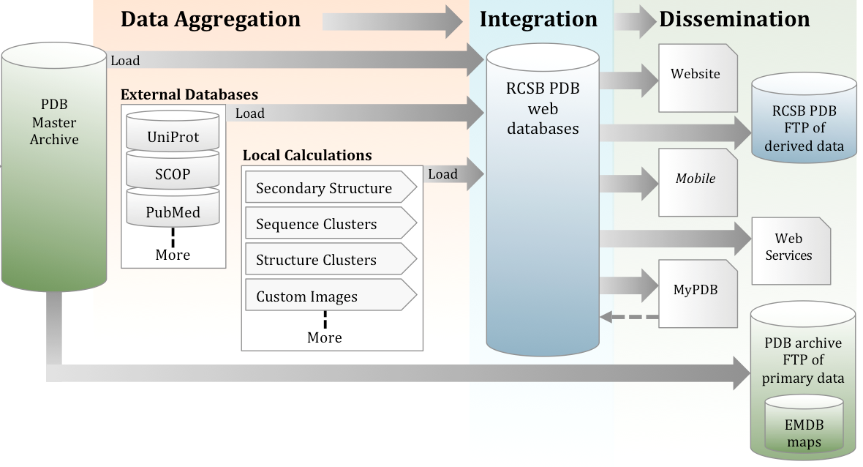
Data Distribution
Data In
Data are distributed to end users through
FTP site
Website and PDB-101
MyPDB (email notifications)
Mobile apps
Web services

Slide 3
The PDB Archive - FTP Site
Content of the PDB Archive (Flat Files)
Atomic coordinates and molecular description of macromolecules and ligands
Metadata
Experimental data
FTP File Transfer Protocol
Protocol to download individual files to client computer
Keep a synchronized copy of files on client computer using RSYNC

Slide 4
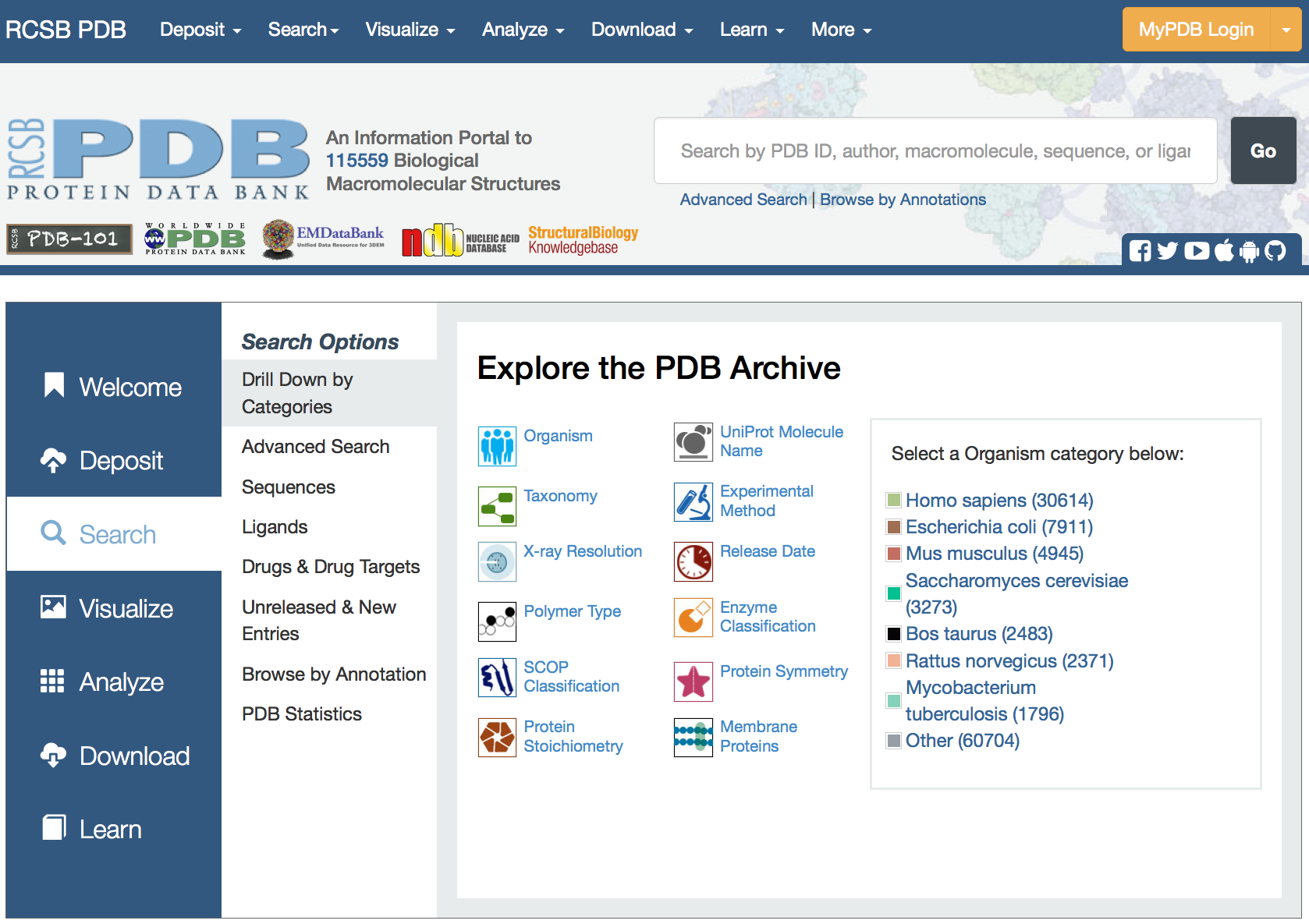
RCSB PDB Website (rcsb.org)
Portal for many different functionalities:
Deposit
Search
Analyze
Visualize
Tabulate
Download
Notes:
Doesn’t illustrate the point –expand from left box

Slide 5
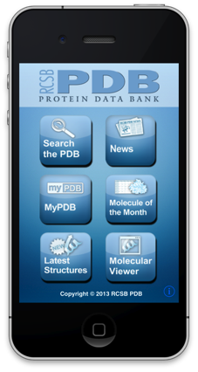
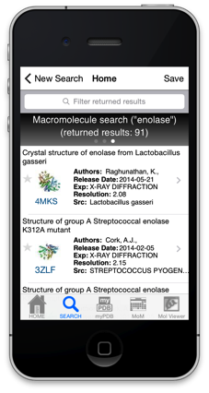
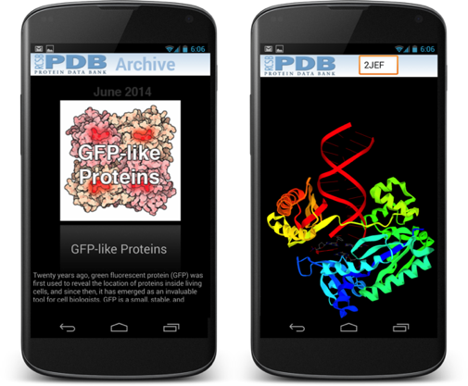
RCSB PDB Mobile Apps
Quick access to PDB on the go with minimal feature set
Exposes PDB to new users, e.g., students and general public
Support for iPhone, iPod, iPad, Android
Browse, simple search, interactive 3D viewer

Slide 6
Web Services (RESTful APIs)
Programmatic access to data : application-to-application communication
Required by power users that do automated analysis on big chunks of data
They write their own programs and scripts in a diversity of computer languages

Slide 7
Web Services (RESTful APIs)
Query encoded in URL
Machine-readable response (XML, JSON)
http://www.rcsb.org/pdb/rest/sequenceCluster?cluster=40&structureId=4hhb.A
Function/service requested
Parameters
PDB web server
Internal API
<sequenceCluster clusterNr="7" clusterPercID="40">
<pdbChain name="2W72.A" rank="1"/>
<pdbChain name="2W72.B" rank="2"/>
<pdbChain name="2W72.D" rank="2"/>
<pdbChain name="2W72.C" rank="3"/>
</sequenceCluster>
PDB

Slide 8
LICENSING

Slide 9
PDB Usage Policies
Data Files
Data files in the PDB archive (ftp://ftp.wwpdb.org) are free of all copyright restrictions and made fully and freely available for both non-commercial and commercial use. Users of the data should attribute the original authors of that structural data.
Molecular Images
Molecular images from RCSB PDB Structure Summary pages are available under the same conditions. The authors of the structural data producing the image and the RCSB PDB should be cited.
Molecule of the Month Illustrations
Molecule of the Month illustrations are available under a CC-BY-4.0 license.
Molecule of the Month Text
Molecule of the Month articles are copyrighted by the RCSB PDB and the authors of the article. Text can only be reprinted with permission, with attribution, and without the right to manipulate or change its content.

Slide 10
Copyright vs Copyleft
Copyright
Protect authors of documentation or software from unauthorized copying or selling of their work
Copyleft
Others may freely distribute, modify, and distribute modified versions
Novel use of existing copyright law to ensure a work remains freely available
Notes:
Fix format

Slide 11
Popular Open Software Licenses
GPL (GNU Public License): Copyleft ensures users rights to distribute the software and future changes to the software. Derived works can only be distributed under the same license terms
BSD (Berkeley Software Distribution): Fewer restrictions on distribution compared to other free software licenses such as the GPL. Allows the redistribution with out the source. You can keep your changes to yourself
MIT (Massachusetts Institute of Technology): Requires attribution and inclusion of the MIT license document. MIT licensed code stays under the license but can be used in proprietary software
choosealicense.com

Slide 12
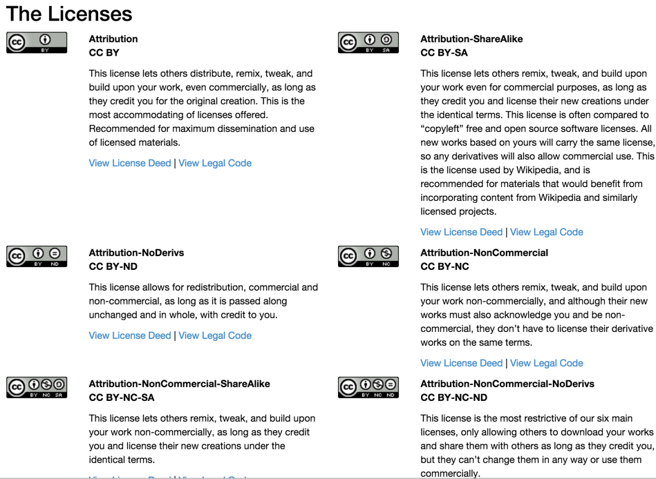
Creative Commons - Data Licenses
https://creativecommons.org/licenses/

Slide 13

This work is licensed under Creative Commons Attribution-NonCommercial-ShareAlike 4.0 International.
Funded by Grant R25 LM012286 from the National Library of Medicine of the National Institutes of Health.

