Slide 1
Introduction to Biological Databases and Data Archiving
Data Distribution

Slide 2
Matching Delivery and Query Services to Data Organization

Slide 3
Relational databases
Represent the data and its relationships as tables
Facilitate querying: SQL language
Relationships between tables ensure referential integrity
One-to-one
One-to-many
Many-to-many
Structure
pdb_id
StructureDesc
pdb_id
Chain
chain_id
length
type
Residue
chain_id
residue_code
residue_num
Structure
pdb_id
Structure_Classification
pdb_id
class_id
Classification
class_id
1
1
∞
∞
∞
1

Slide 4
Popular Relational Database Systems
Open source:
  MySQL - used at the PDB
  PostgreSQL
Commercial:
  Oracle

Slide 5
Mapping mmCIF to relational database
mmCIF dictionary categories are automatically mapped into a relational database tables
Data from other resources (e.g, Uniprot, Gene Ontology) are also mapped to the relational database
Part of the mmCIF dictionary schema
for Chemical Composition

Slide 6
How to Query a Relational Database: SQL
A standard querying language used in all relational database systems
Long history: development started in 1970s
SELECT *
FROM Structure
WHERE numChains >=4 AND releaseDate>2015-01-01;

Slide 7
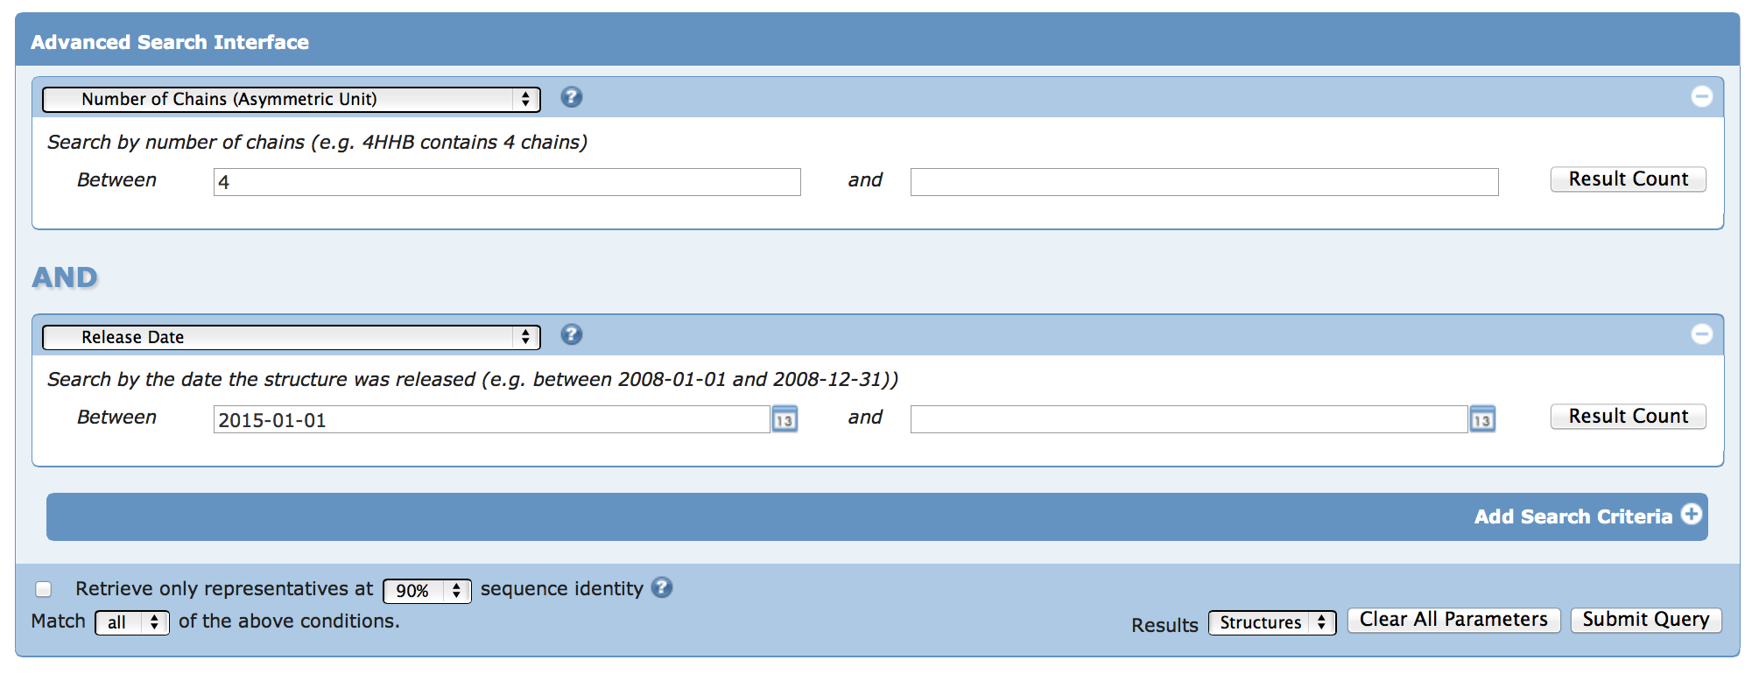
User Interface (UI) for SQL
SELECT *
FROM Structure
WHERE numChains >=4 AND releaseDate>2015-01-01;
Notes:
Screen shots need to be higher resolution

Slide 8
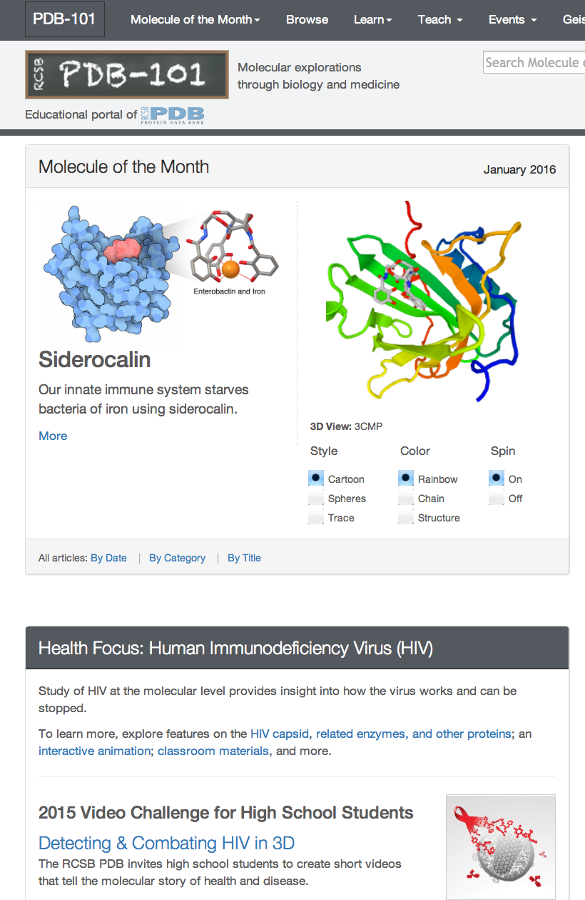
NoSQL
Recent alternative to relational databases (~2010)
Increasingly used in Big Data
Compromises some consistency in favor of availability and speed
Example: MongoDB, now used for PDB-101 website
Some types of NoSQL databases:
  Key-value stores
  Triple stores
  Graph databases

Slide 9
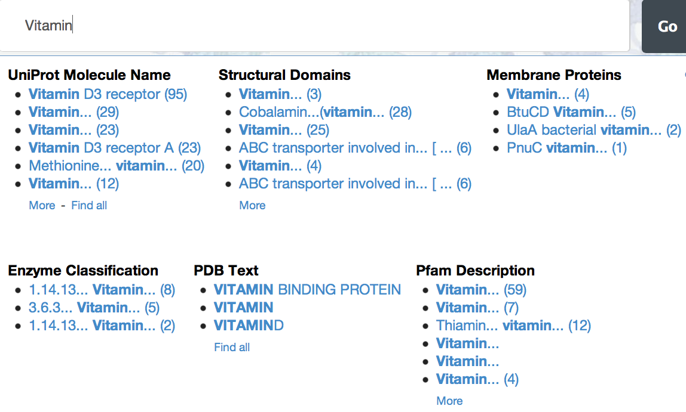
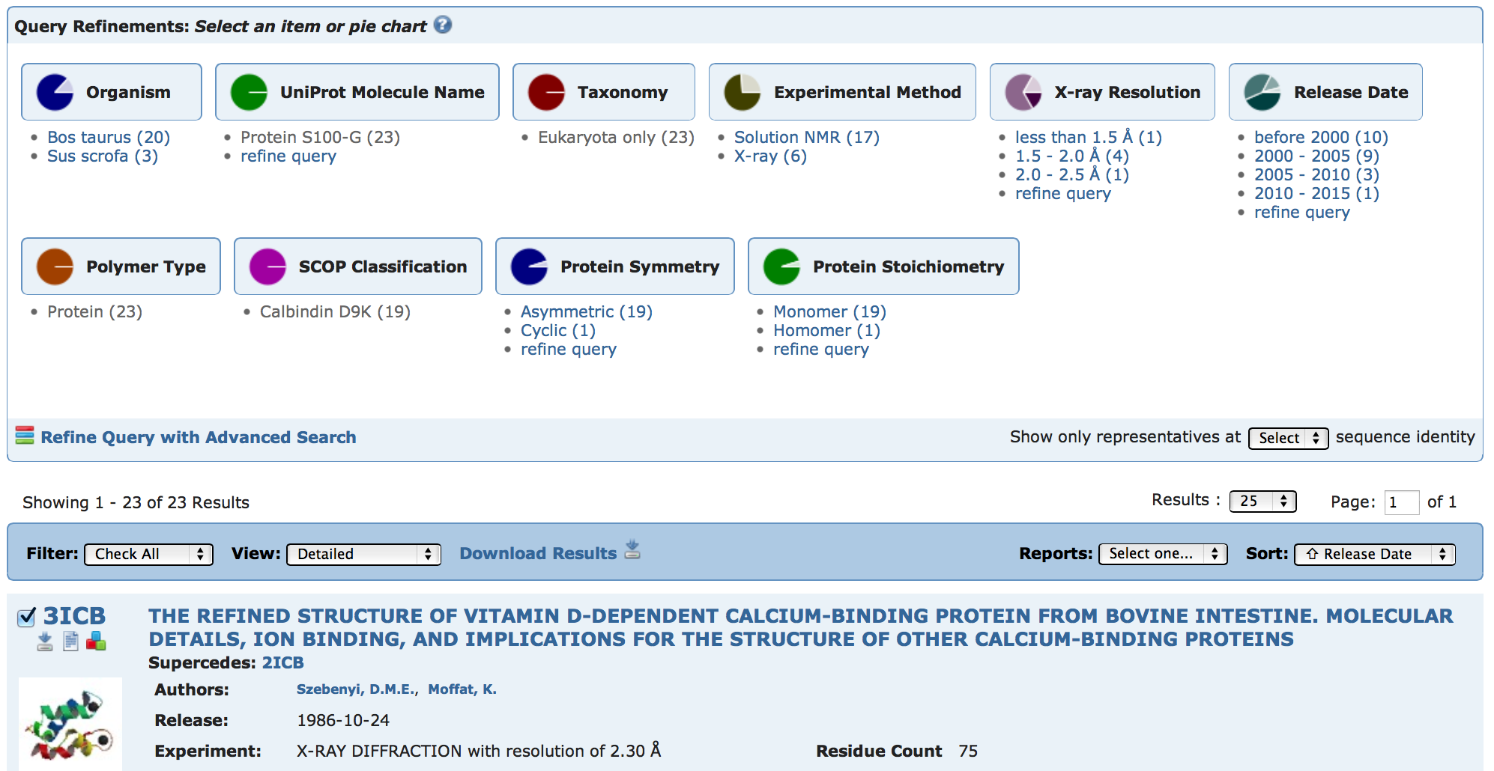
Other User Interface Features
Auto-suggest
Drill-down lists
Dynamic searches
Filtering
Indexing software (e.g. Lucene, Solr)
Parallelisation to improve search speed (MapReduce)
Notes:
Fix image

Slide 10
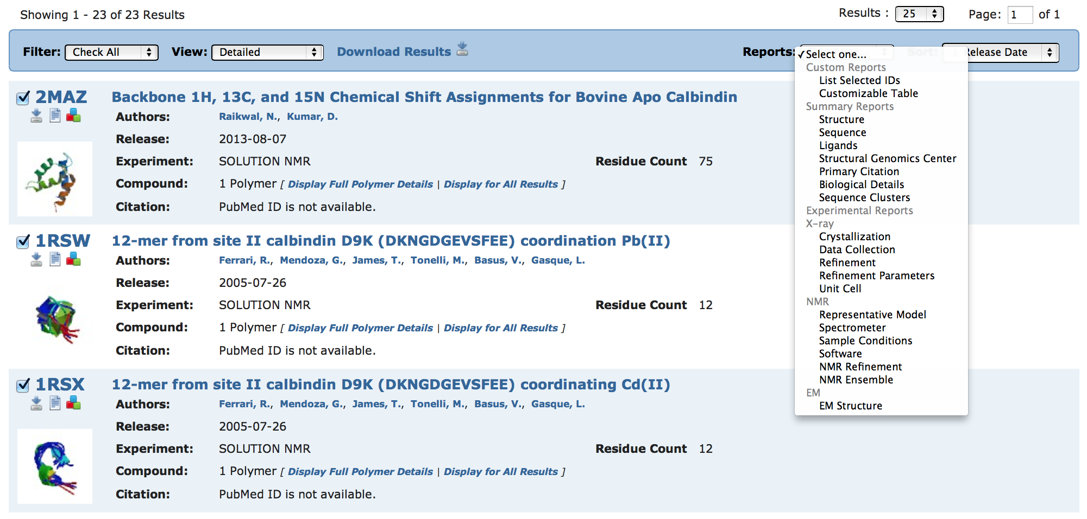
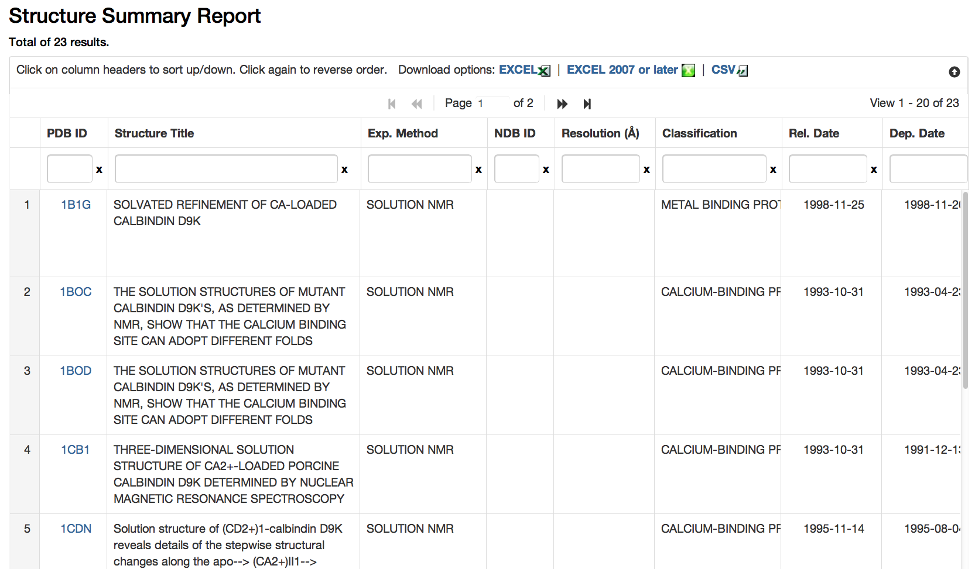
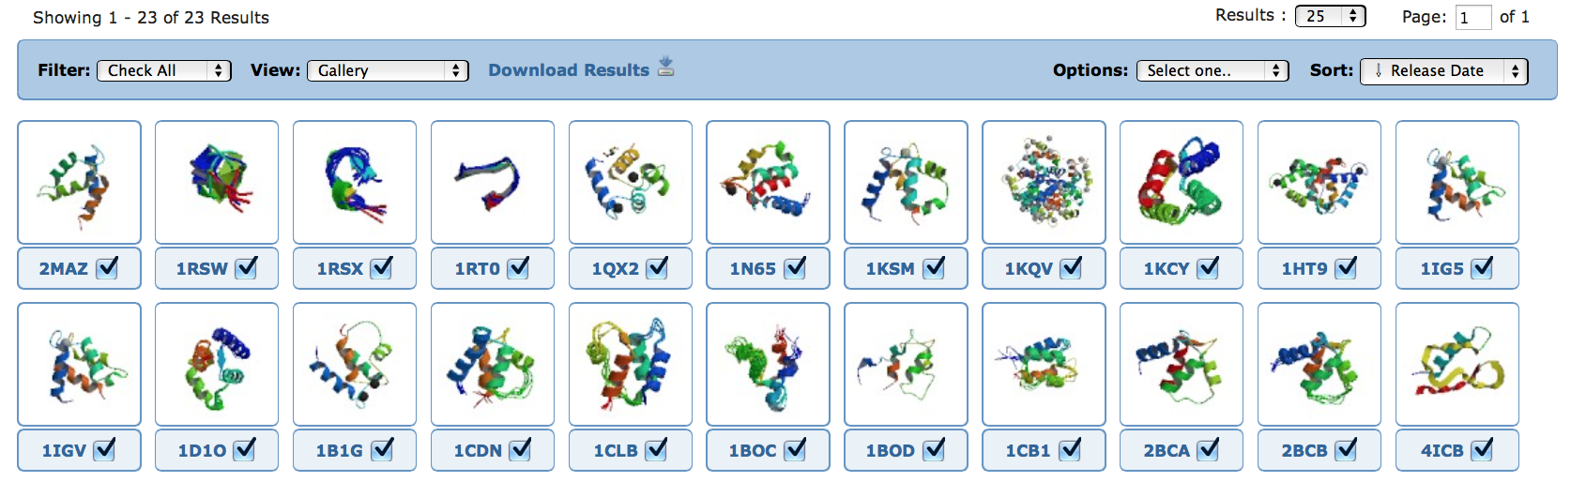
Reports
Notes:
Screen shots need to be higher resolution
Show other report examples

Slide 11

This work is licensed under Creative Commons Attribution-NonCommercial-ShareAlike 4.0 International.
Funded by Grant R25 LM012286 from the National Library of Medicine of the National Institutes of Health.

