Slide 1
Introduction to Biological Databases and Data Archiving
Data Distribution

Slide 2
Linking and Integrating Services with other Resources

Slide 3
Linking and Integrating other Resources with PDB
New query capabilities are gained by integrating data from complementary biomedical data resources
RCSB PDB integrates data from ~70 external database resources

Slide 4
Linking and Integrating other Resources with PDB
PDB
Common
Identifiers
Other Data
Resources
Integrated Data
Expanded query capabilities
PDB
Queries limited to PDB data
Example:
Get all X-ray structures with a resolution < 1.5A AND are kinases
Example:
Get all X-ray structures with a resolution < 1.5A

Slide 5
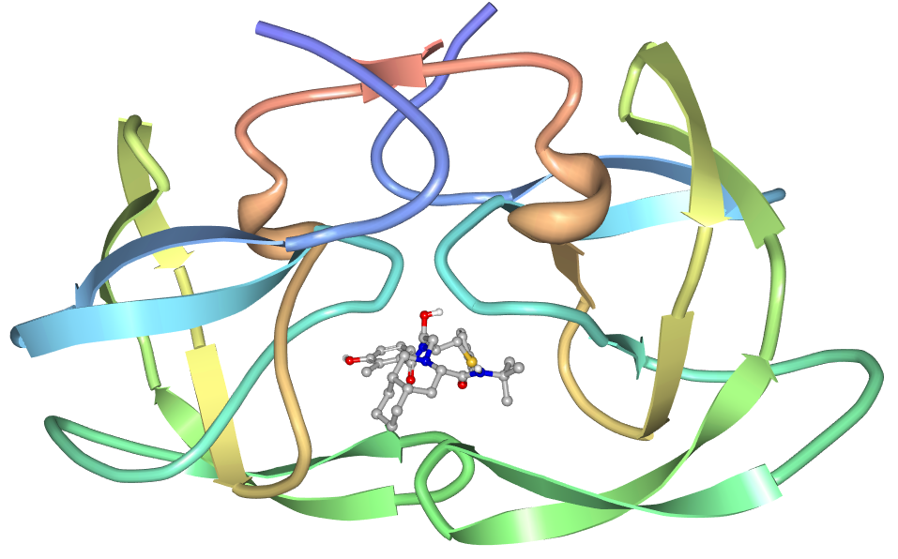
Common Identifiers used for Data Linking
PDB
3D Protein Structure
Drug
Molecule
Identifier | Example
PDB Id | 1OHR
InChI Key | QAGYKUNXZHXKMR-HKWSIXNMSA-N
UniProt Id | Q9Q288
Taxonomy Id (NCBI) | 11676
Protein Sequence: PQITL...
Organism: HIV 1

Slide 6
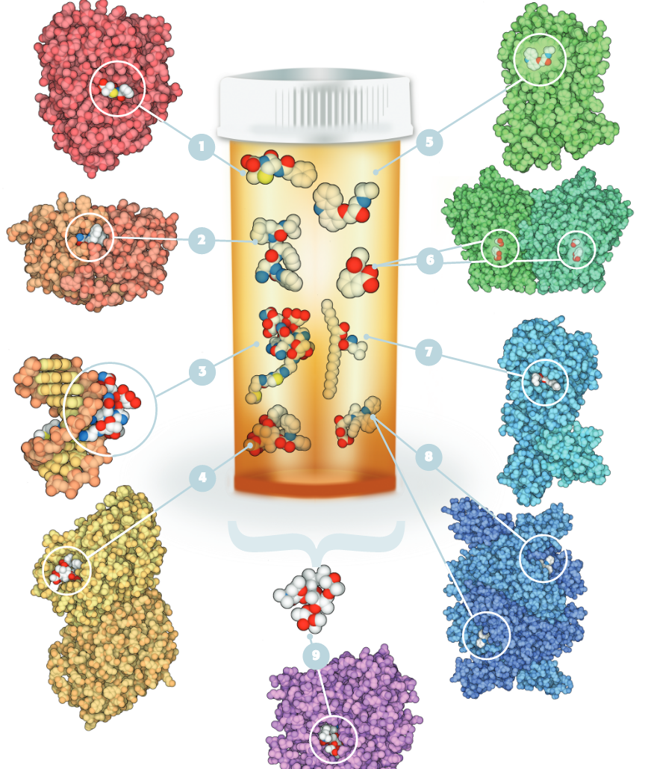
Drugs & Drug Target Annotation from DrugBank
PDB
Chemical structures
Protein sequences
3D Coordinates
DrugBank (www.drugbank.ca)
Chemical structures (Drugs)
Protein sequences (Drug Targets)
Drug names
generic
brand
Indication
Pharmacology
Mechanism of action
Route of administration
...
Drugs
3D Drug - Macromolecule Complexes in the PDB

Slide 7
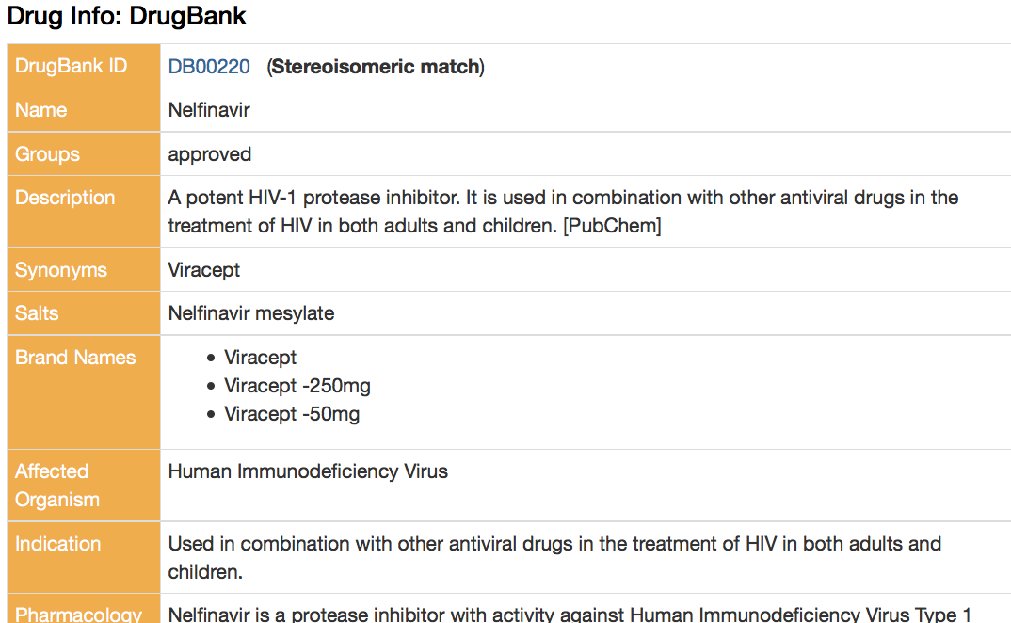
Example: Linking Drugs in PDB to Drug Bank
Identifier | Example
InChI Key | QAGYKUNXZHXKMR-HKWSIXNMSA-N
PDB
3D Protein Structure
Drug
Molecule
(Nelfinavir)
Drug Bank
Protein Sequence: PQITL...
Organism: HIV 1

Slide 8
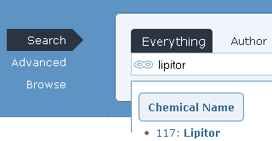
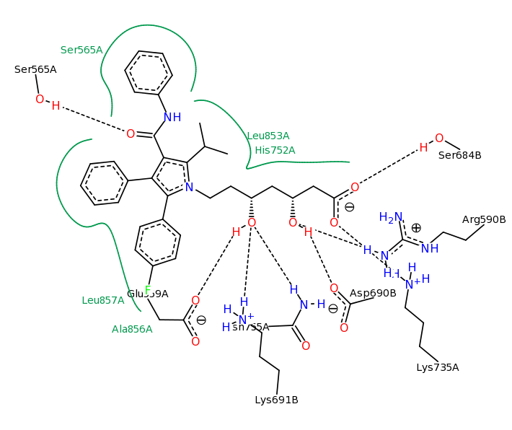
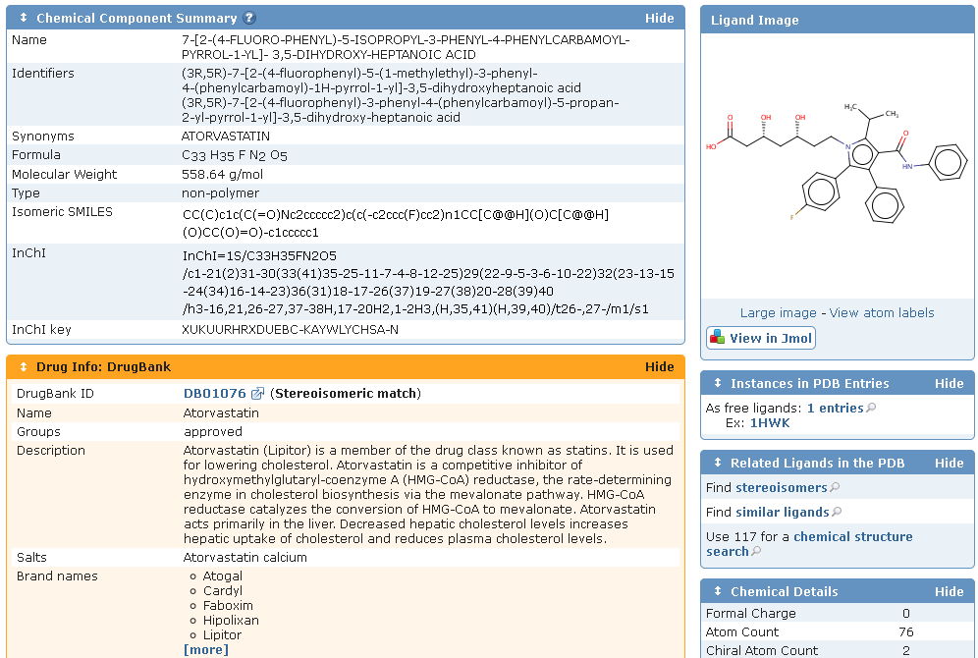
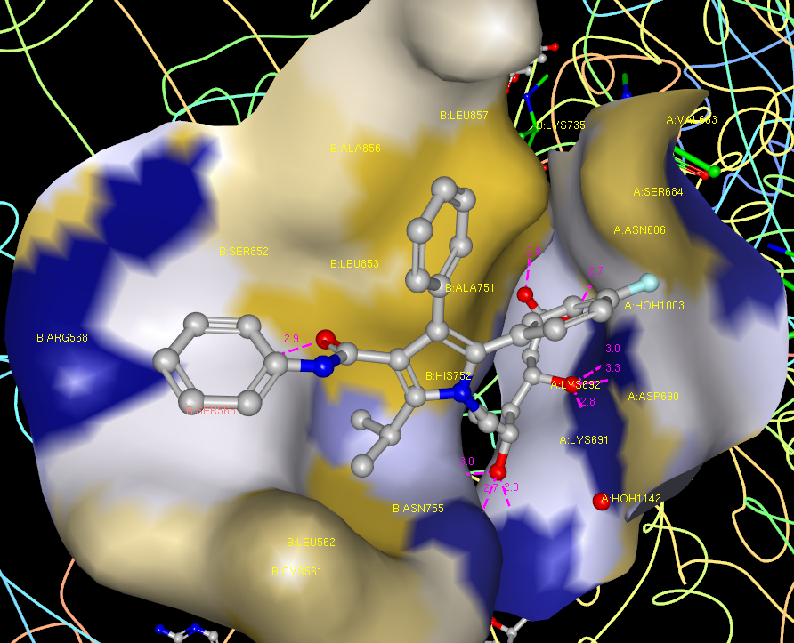
Drug View Enabled Through Data Integration
Search by Generic and Brand Name
Visualize Binding Site in 2D & 3D
Integration with DrugBank
Created by Poseview, Univ. of Hamburg, Germany

Slide 9
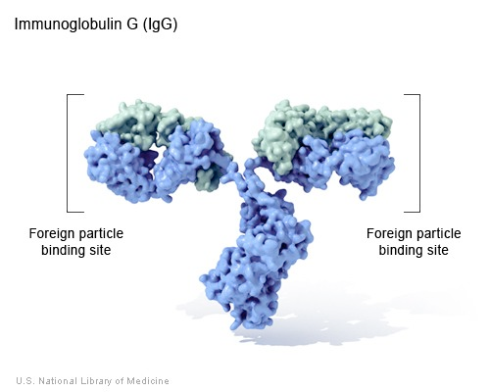
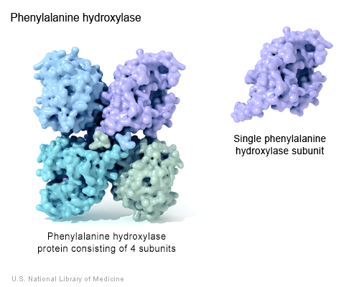
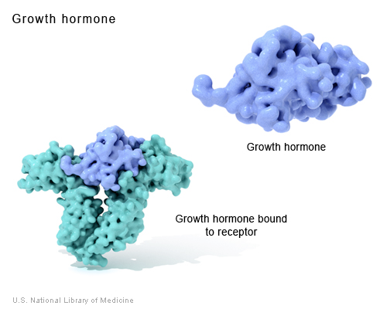
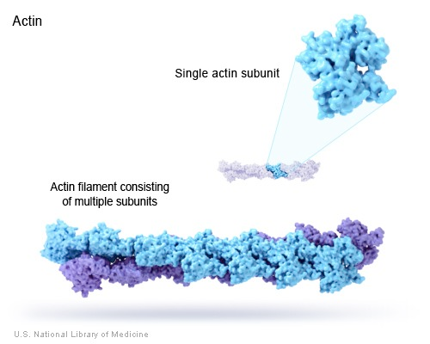
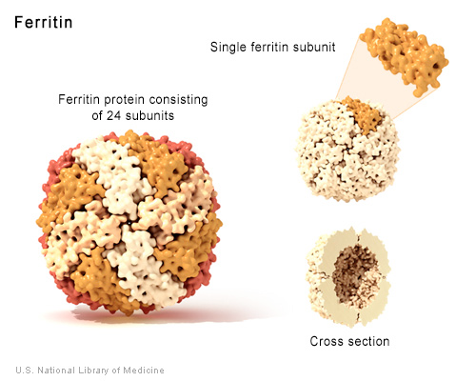
Protein Functional Annotation Examples
Function | Description | Example
Antibody | Antibodies bind to specific foreign particles, such as viruses and bacteria, to help protect the body.
Enzyme | Enzymes carry out almost all of the thousands of chemical reactions that take place in cells. They also assist with the formation of new molecules by reading the genetic information stored in DNA.
Messenger | Messenger proteins, such as some types of hormones, transmit signals to coordinate biological processes between different cells, tissues, and organs.
Structural component | These proteins provide structure and support for cells. On a larger scale, they also allow the body to move.
Transport/storage | These proteins bind and carry atoms and small molecules within cells and throughout the body.
http://ghr.nlm.nih.gov/handbook/howgeneswork/protein

Slide 10
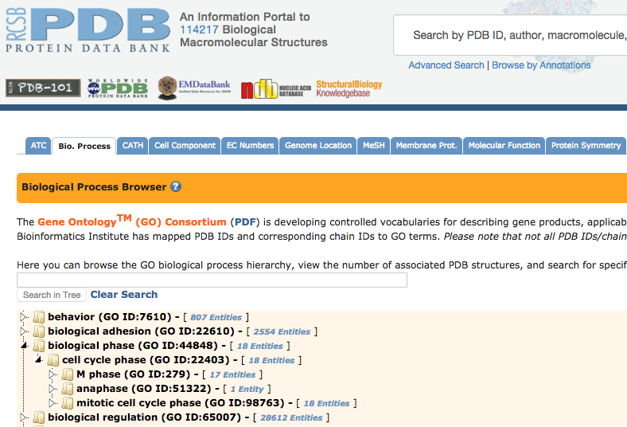
How do we Expose Function Annotation?
Use community standards: Ontologies or Classification Schemes
Provide hierarchical browsers to explore protein function annotation

Slide 11
Challenges with Protein Naming
Multiple names for protein and gene cause confusion in literature and databases
UniProt provides a recommended name to minimize confusion
Best practice: use UniProt Names/Ids or protein sequence to unambiguously refer to a specific protein
Design search to give same result for any name/alternative
Placental anticoagulant protein 4 Short name: PP4 Placental anticoagulant protein I Short name: PAP-I Thromboplastin inhibitor Vascular anticoagulant-alpha; Short name: VAC-alpha
Recommended name: Annexin A5 Alternative names: Anchorin CII Annexin V Annexin-5 Calphobindin I Short name: CBP-I Endonexin II Lipocortin V
http://www.uniprot.org/help/different_protein_gene_names

Slide 12
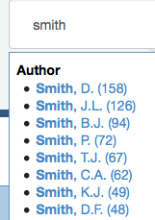
Challenges with Author Names
ORCID (Open Researcher and Contributor id) universal author identifier
Open, non-proprietary
Began in 2010, use is spreading rapidly, almost 2 million registered ORCIDs
Several journal require ORCID for manuscript submission
Example from PDB:
Are there several authors with the same name “Smith, D”?
Are some “Smith, D.” the same as “Smith, D.F.”?

Slide 13

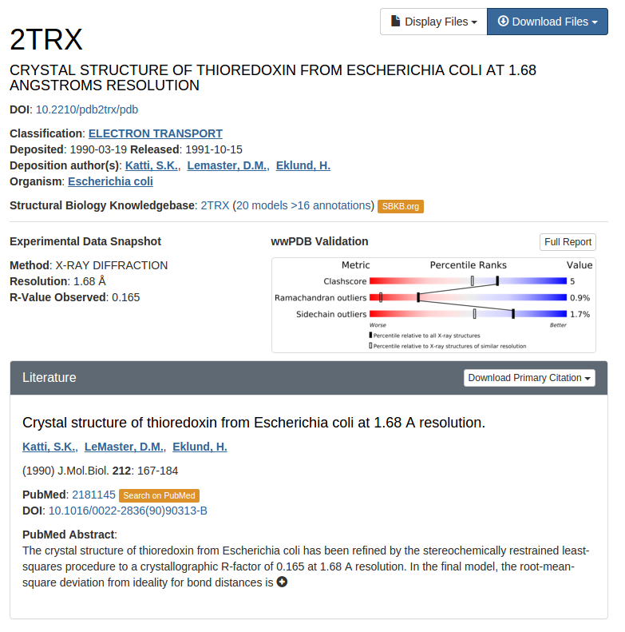
Digital Object Identifier (DOI)
Unique identifier for a digital object: single system for citations
Mostly used for electronic documents: journal articles and books
Can be used for datasets, e.g. PDB entries have DOIs
Member organizations pay a registration fee to assign DOI’s
Zenodo repository in Europe offers free archiving/DOI assignment for datasets as well as software (via gitHub).

Slide 14
Common Data formats for Interoperability
must be machine readable
humans should also be able to read them without too much difficulty
CSV (or TSV) | XML | JSON
simple | tagged, relationships | tagged, relationships
PDBID,Alpha,Beta,Gamma,A,B,C,Space Group "1C0F","90.00","90.00","90.00","57.00","69.55","184.62","P 21 21 21" "1C0G","90.00","90.00","90.00","56.86","69.03","181.50","P 21 21 21” | <?xml version="1.0"?> <STRUCTURES> <PDB_STRUCTURE> <PDB_ID>1C0F</PDB_ID> <Alpha>90.00</Alpha> <Beta>90.00</Beta> <Gamma>90.00</Gamma> <A>57.00</A> <B>69.55</B> <C>184.62</C> <Space_Group>P 21 21 21</Space_Group> </PDB_STRUCTURE> <PDB_STRUCTURE> <PDB_ID>1C0G</PDB_ID> <Alpha>90.00</Alpha> <Beta>90.00</Beta> <Gamma>90.00</Gamma> <A>56.86</A> <B>69.03</B> <C>181.50</C> <Space_Group>P 21 21 21</Space_Group> </PDB_STRUCTURE> </STRUCTURES> | { "STRUCTURES": { "PDB_STRUCTURE": [ { "PDB_ID": "1C0F", "Alpha": "90.00", "Beta": "90.00", "Gamma": "90.00", "A": "57.00", "B": "69.55", "C": "184.62", "Space_Group": "P 21 21 21" }, { "PDB_ID": "1C0G", "Alpha": "90.00", "Beta": "90.00", "Gamma": "90.00", "A": "56.86", "B": "69.03", "C": "181.50", "Space_Group": "P 21 21 21" }, ] } }
Notes:
Confusing given earlier discussions re mmCIF

Slide 15
mmCIF Tools for Interoperability
Software built by RCSB PDB and by others enable PDBx/mmCIF to be converted to other formats (such as XML) and to be loaded into a database
mmcif.wwpdb.org/docs/software-resources.html

Slide 16
Enabling New Science By Linking to Genomic Data

Slide 17
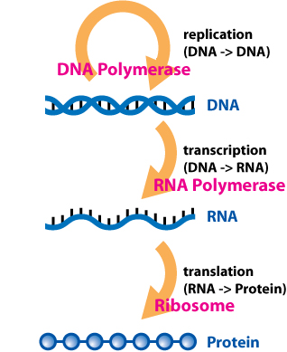
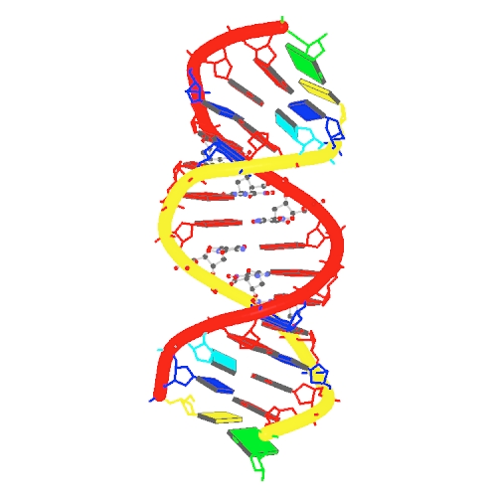
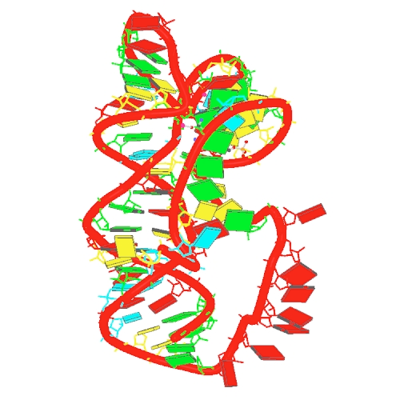
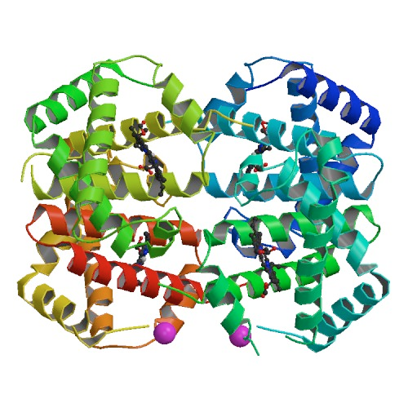
PDB in the Context of Biology
determines
determines
Sequence
Structure
Function
4XNO
DNA
Enzyme
Transporter
Messenger
Structural component
Antibody
...
4ZNP
RNA
4HHB
Protein

Slide 18
Analysis Tools for Genetic Variation Data in PDB
Pipeline created to map human genome coordinates onto PDB entries, through UniProt
UniProt
curated protein sequence data
PDB
curated protein structure data
HGNC
curated human gene variants
SIFTS
PDB->UniProt
Mapping
Identify correct Isoform
Notes:
HGNC stands for HUGO gene nomenclature committee/ HUGO is “the Human Genome Organization”

Slide 19
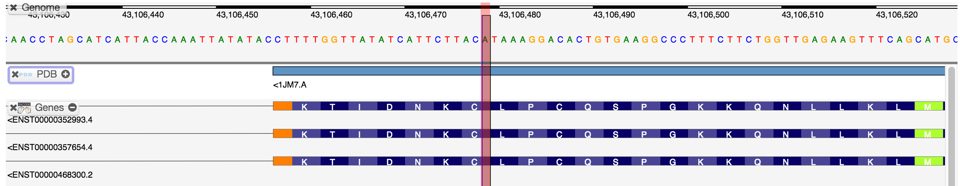
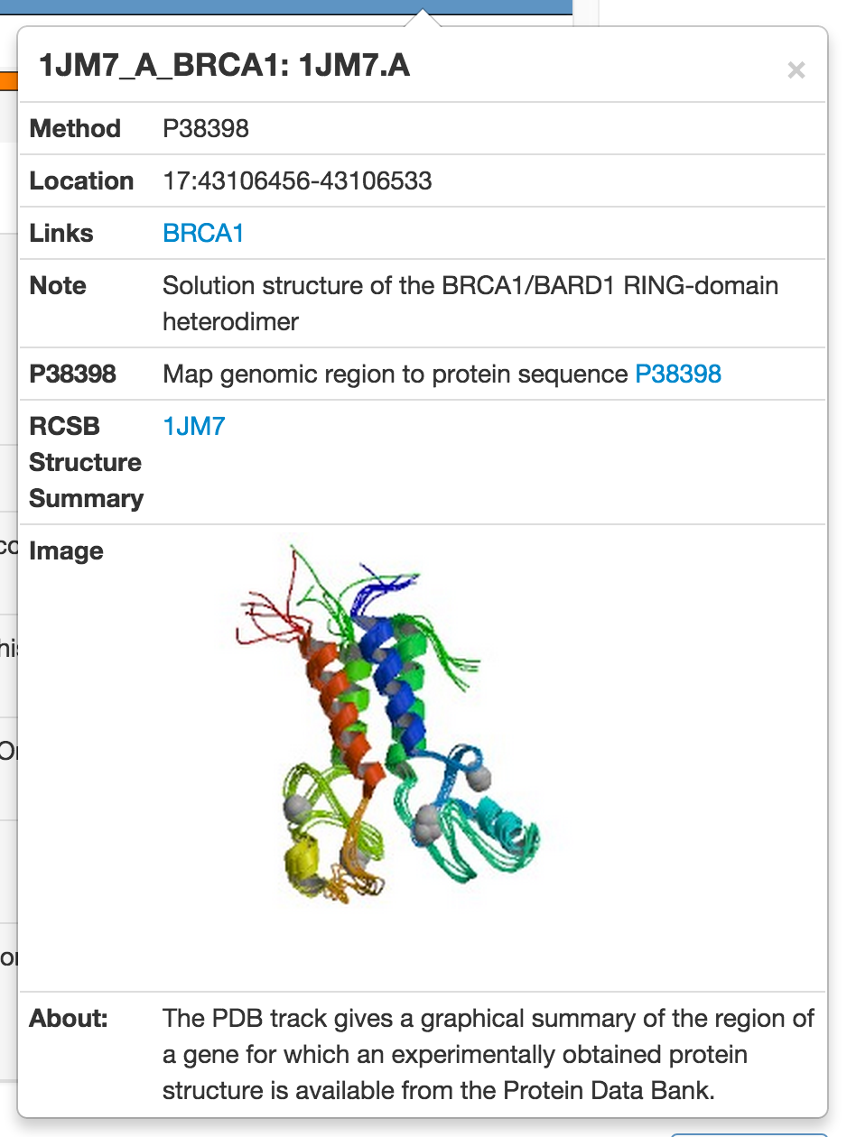
Gene View
Supports zooming in/out, scrolling, interaction
Based on http://www.biodalliance.org

Slide 20
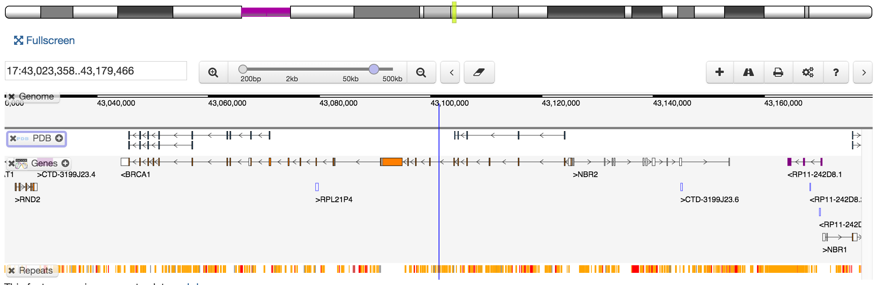
Gene View

Slide 21
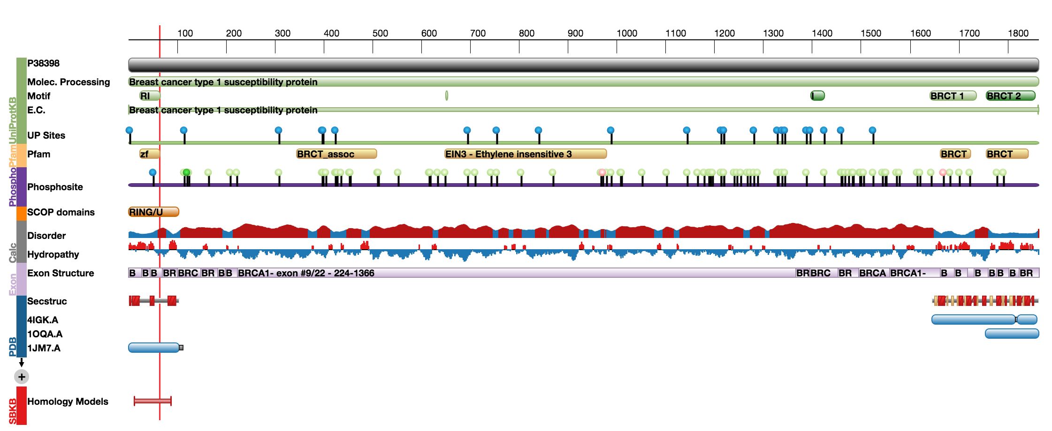
Protein Feature View
Notes:
Explain carefully

Slide 22
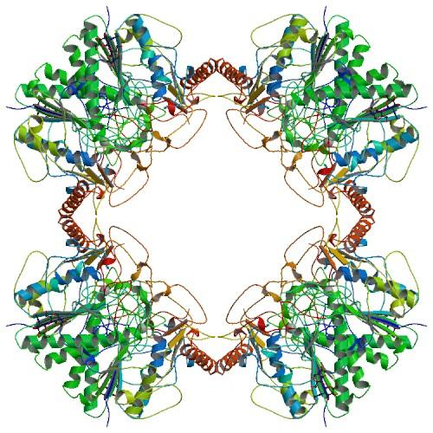
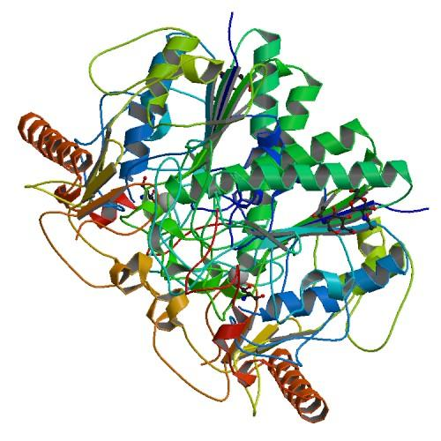
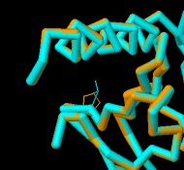
Visualization
dbSNP:rs28940893 P426L causes metachromatic leukodystrophy
PDB ID: 1AUK
PDB ID: 1E33
Variant: dimer
… the exchange of leucine for proline at position 426 increases the susceptibility of arylsulfatase A to lysosomal cysteine proteinases and results in a severe reduction in the half-life of the mutant polypeptides.
WT: octamer
Notes:
Explain this slide

Slide 23

This work is licensed under Creative Commons Attribution-NonCommercial-ShareAlike 4.0 International.
Funded by Grant R25 LM012286 from the National Library of Medicine of the National Institutes of Health.

