Slide 1
Enabling Data Science in
Structural Biology
Module 1 Class Exercise
Learn to Search/Browse PDB
Please Note: The Protein Data Bank archive is updated weekly.
Your search/browse results may differ from examples shown.

Slide 2
Exercise 1.1
Learn how to search the PDB by protein name and by protein (amino-acid) sequence

Slide 3
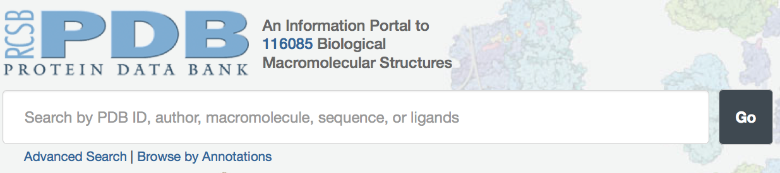
Exercise Start Point
We will use the RCSB PDB’s website:
  http://rcsb.org
Main Search Box
Advanced Search
Browse by Annotations

Slide 4
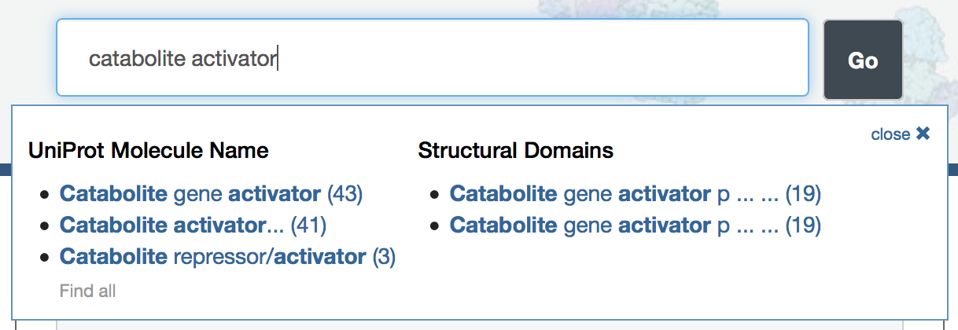
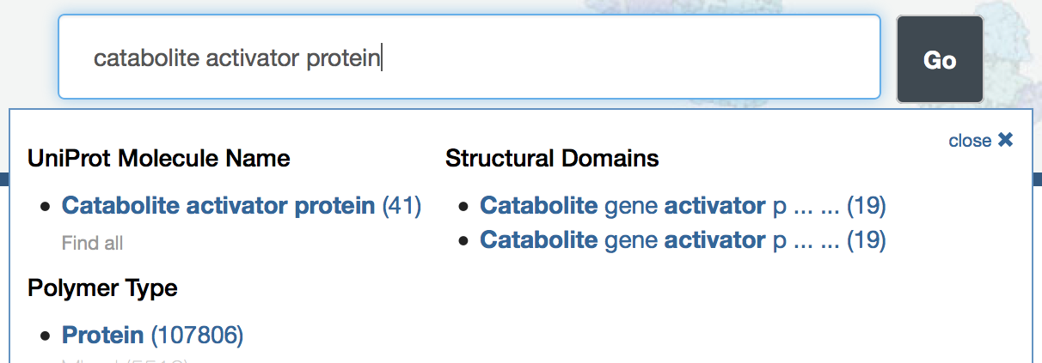
Search by Protein Name
Look for catabolite activator protein by entering this text in the main search box
As you are typing, suggestions appear below
UniProt Molecule Name is almost always the correct choice

Slide 5
Search by Protein Name (2)
Click on the UniProt Molecule name with the largest number of results (catabolite gene activator)

Slide 6
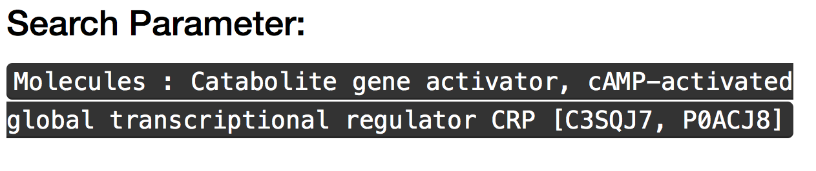
Search by Protein Name (3)
The Search Results page shows the query actually used
UniProt IDs

Slide 7
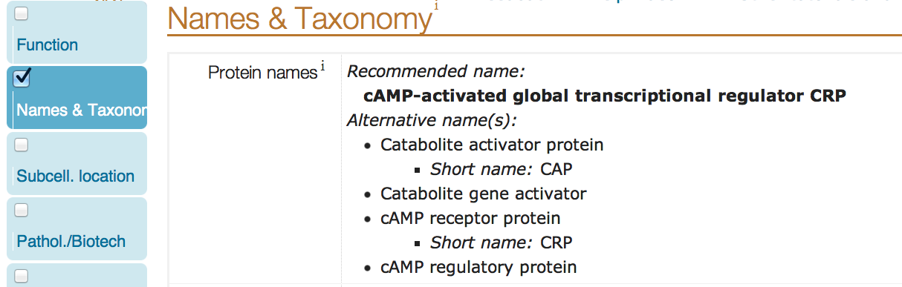
UniProt Protein Naming (1)
Look at protein naming for catabolite activator protein in Uniprot
  Go to http://www.uniprot.org/uniprot/P0ACJ8
  Look at the names & taxonomy section
original search string
suggested search string

Slide 8
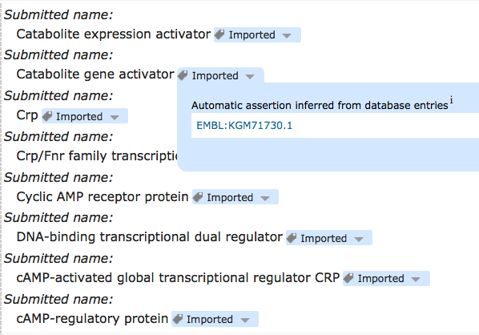
UniProt Protein Naming (2)
What about the other UniProt ID?
  http://www.uniprot.org/uniprot/C3SQJ7
suggested
search string
original search string
is not present

Slide 9
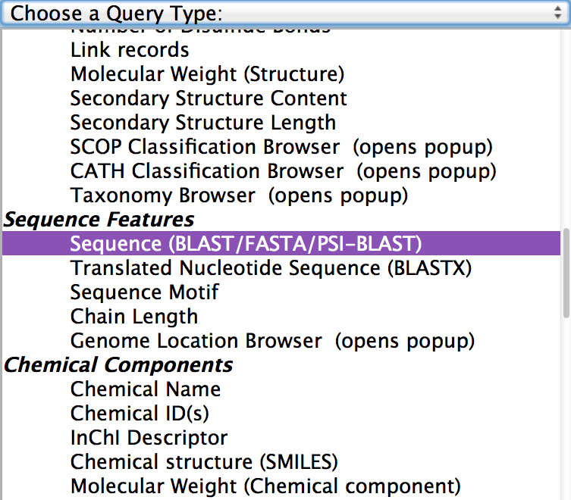
Search by Sequence
Go to Advanced Search
  clear your search history first
Scroll through Query options to “Sequence Features” section
Select “Sequence (BLAST/FASTA/PSI-BLAST)”

Slide 10
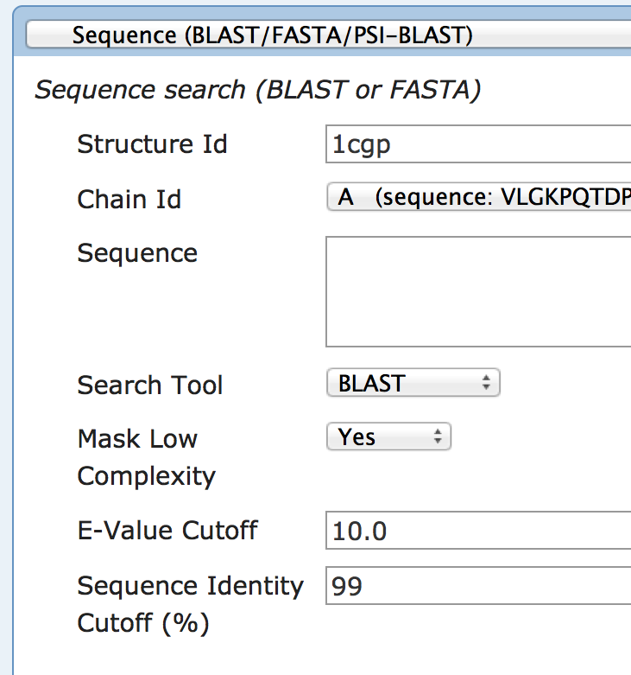
Search by Sequence (2)
Enter 1cgp in the Structure Id box*
Select Chain Id A
Enter 99 for Sequence Identity Cutoff (%)
Use default values for other options (BLAST, mask low complexity, 10.0 E-Value cutoff)
*1cgp is one of the catabolite gene activator entries from the previous exercise

Slide 11
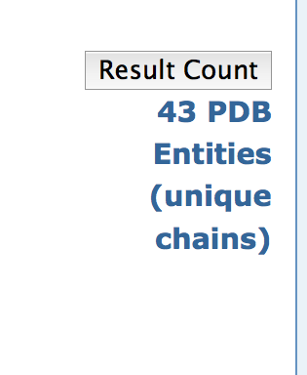
Search by Sequence (3)
Click on “result count”
Q: If you submit this query will you get the same set of structures as the earlier query to search by name?
Notes:
yes

Slide 12
Exercise 1.2
Learn how to browse the PDB and search by example

Slide 13
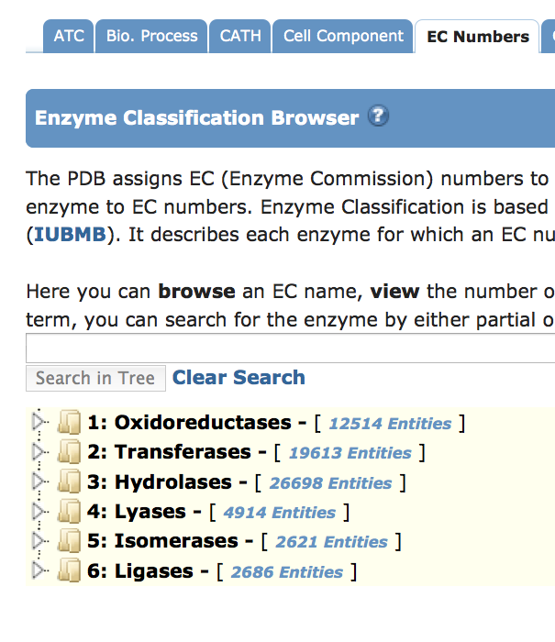
Browse the PDB
Goal: find all of the protease enzyme structures in the PDB. A protease is a type of hydrolase that acts on protein peptide bonds.
Click on "browse by annotation" under the main search box, select the "EC numbers" tab.

Slide 14
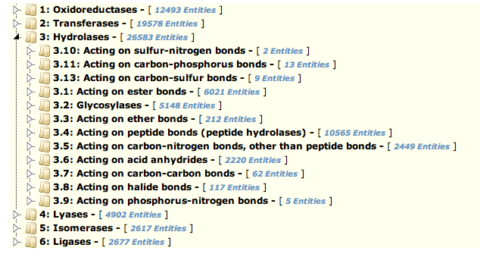
Browse the PDB (2)
Click on the triangle to the left of "hydrolases" to expose a more detailed level of annotation, that includes "acting on peptide bonds"

Slide 15
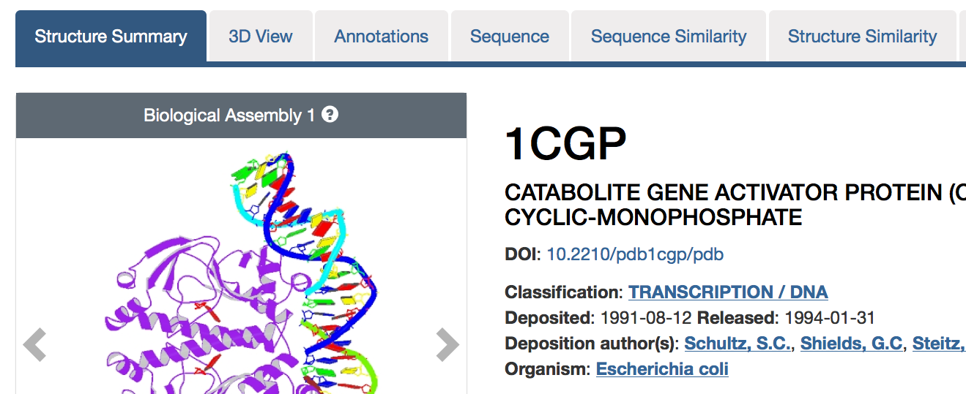
Search by Example
We will find one DNA-binding transcription factor and then use this to search for others.
Enter 1cgp in the main search box
Select the Annotations tab

Slide 16
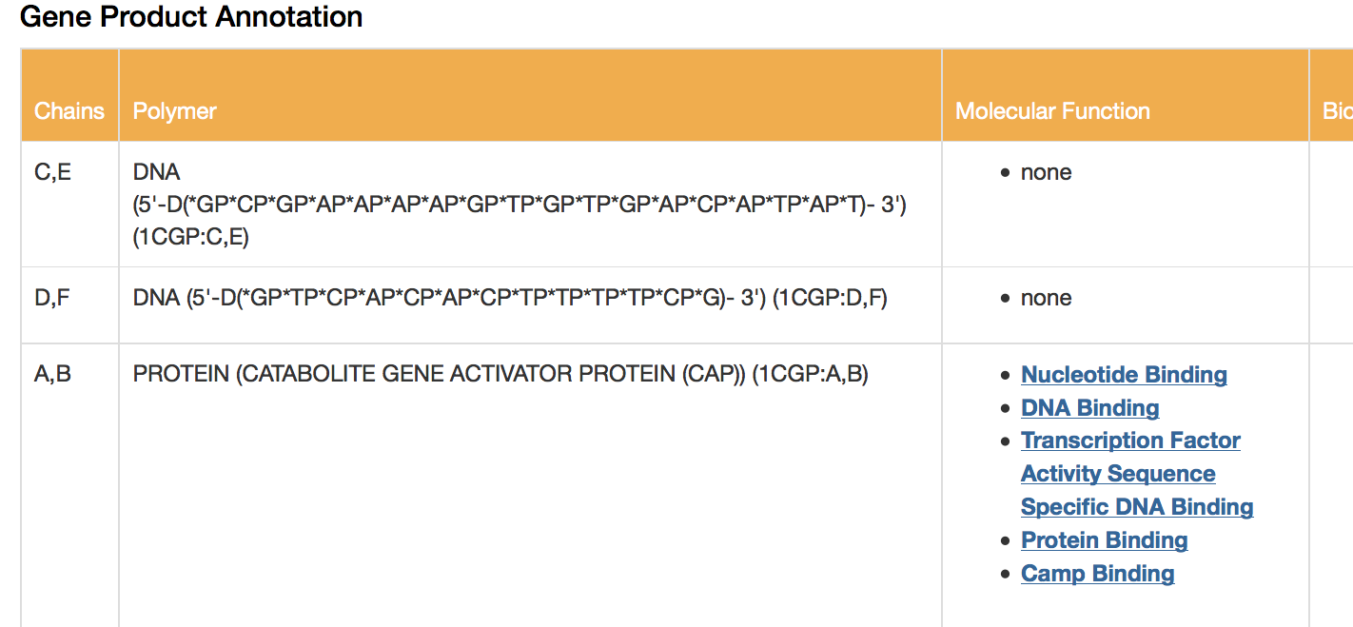
Search by Example (2)
Scroll down to the “Gene Product Annotation” table (towards bottom of annotations tab). This table is built based on the Gene Ontology terms available for 1cgp.
Click on the term “Transcription Factor Activity Sequence Specific DNA Binding”

Slide 17
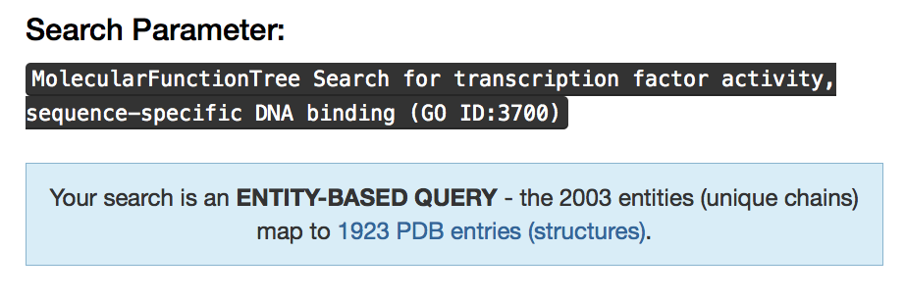
Search by Example (3)
On the result page you will see the Gene Ontology (GO) term associated with the molecular function selected (3700), with the set of entries associated with this term.

Slide 18
Exercise 1.3
Obtain list of PDB ids from search

Slide 19
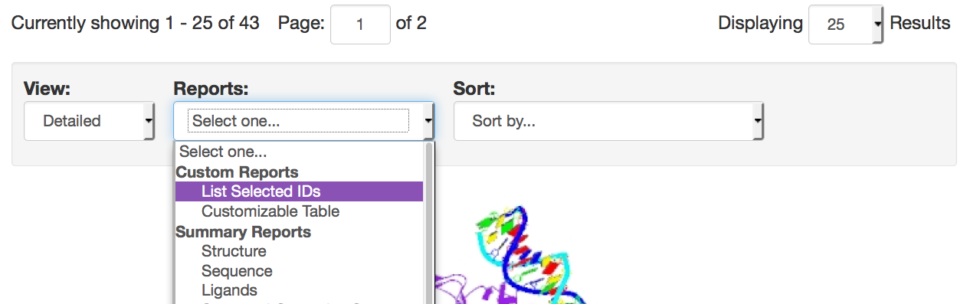
List PDB IDs from a Search
To record/save a list of PDB ids:
On a search by name result page, select “List Selected IDs” from the Reports Menu.

Slide 20
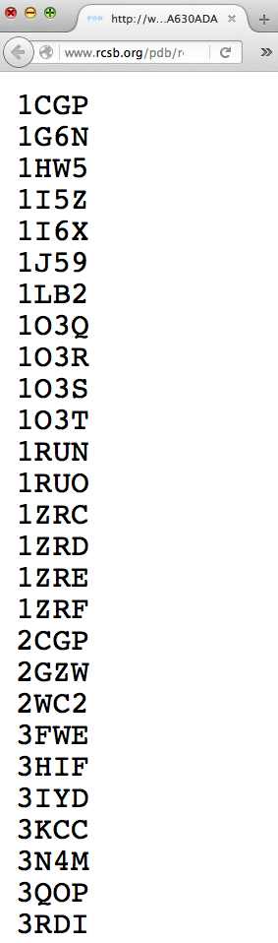
Find/Save ID list
Look for the id list in a new browser tab.
Use your browser menu to save the list as a file, or select all/copy/paste the ids into a simple text application

Slide 21
Additional Data Resources
UniProt http://uniprot.org
  protein sequence database with extensive annotation and cross-referencing to other data resources
Gene Ontology http://geneontology.org
  descriptors for gene products: biological process, molecular function, cellular components
Enzyme Classification http://expasy.ch/enzyme
  numerical classification for enzymes
Notes:
all major bioinformatics initiatives
integration/SIFTS further discussed in Session 8!

Slide 22

This work is licensed under Creative Commons Attribution-NonCommercial-ShareAlike 4.0 International.
Funded by Grant R25 LM012286 from the National Library of Medicine of the National Institutes of Health.

