Slide 1
Enabling Data Science in
Structural Biology
Module 2 Class Exercise
Create PDB reports, obtain Citation Abstracts

Slide 2
Exercise 2.1
Learn how to create standard and custom reports of PDB data

Slide 3
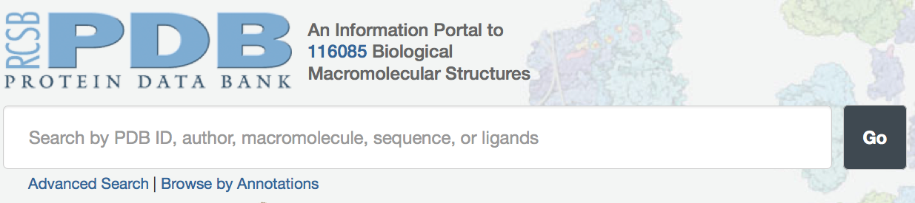
Exercise Start Point
RCSB PDB’s website:
  http://rcsb.org
Main Search Box
Advanced Search
Browse by Annotations

Slide 4
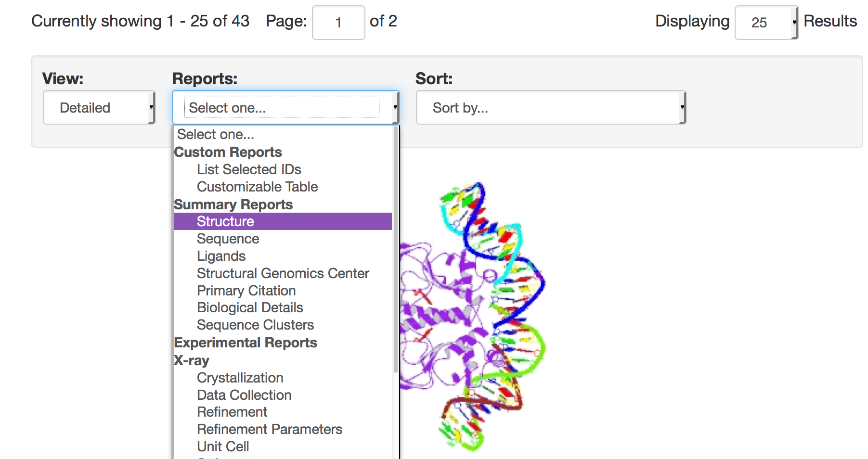
Create a Structure Summary Report
Carry out a query (e.g., catabolite activator protein), or enter a set of ids in Advanced Search➔PDB id(s)
On the results page, select the "Summary Reports ➔ Structure" option in the "Reports" pulldown menu.

Slide 5
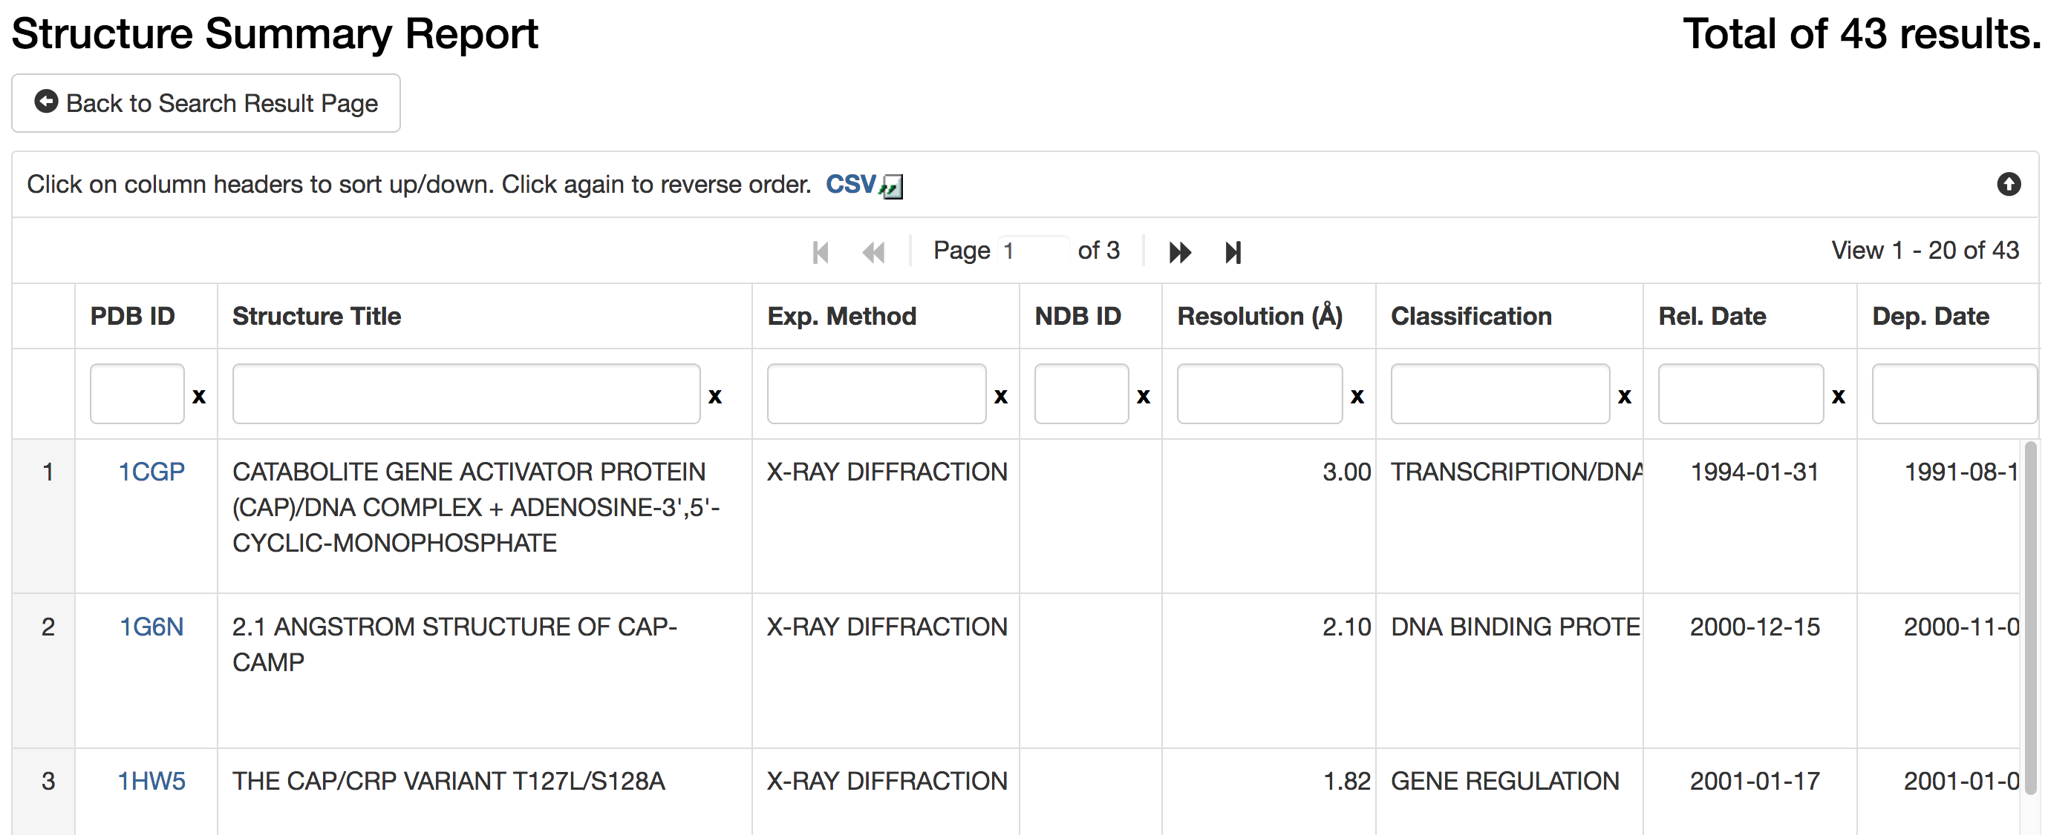
Structure Summary Report (2)
This report type provides a standard set of data items for each entry in the query result list.
Save the data on your local machine by clicking on the “CSV” link.

Slide 6
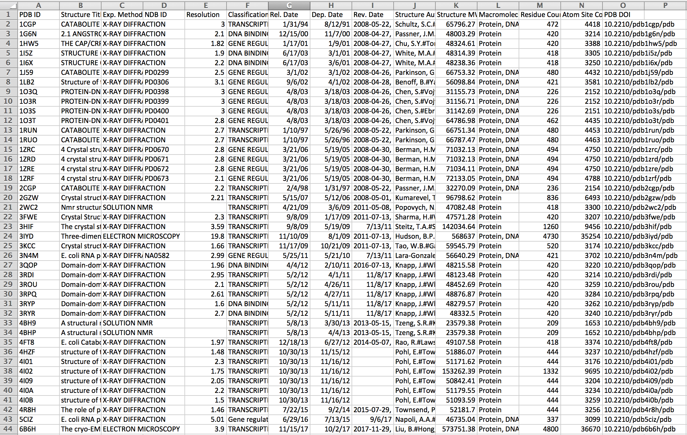
Report opened in Excel

Slide 7
Create a Custom Report (1)
go back to the search results page
select the "Custom Reports ==> Customizable Table" option in the "Reports" pulldown menu From the Custom Tabular Report menu

Slide 8
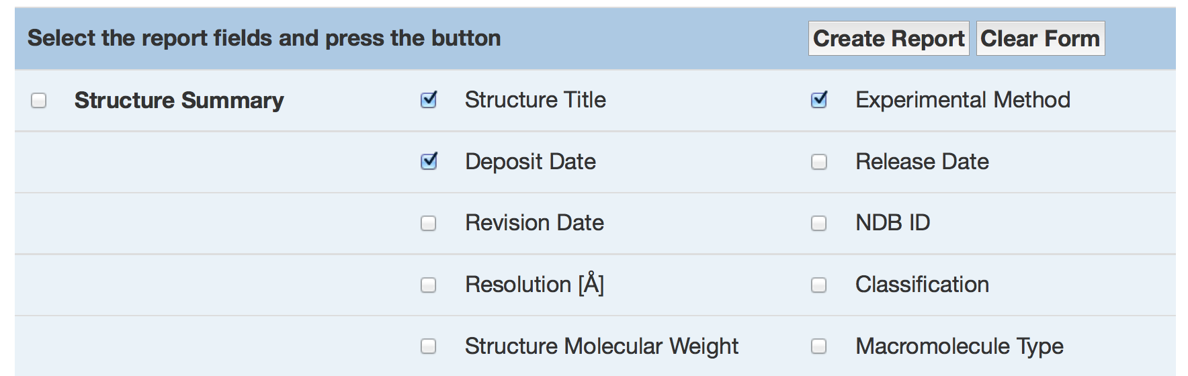
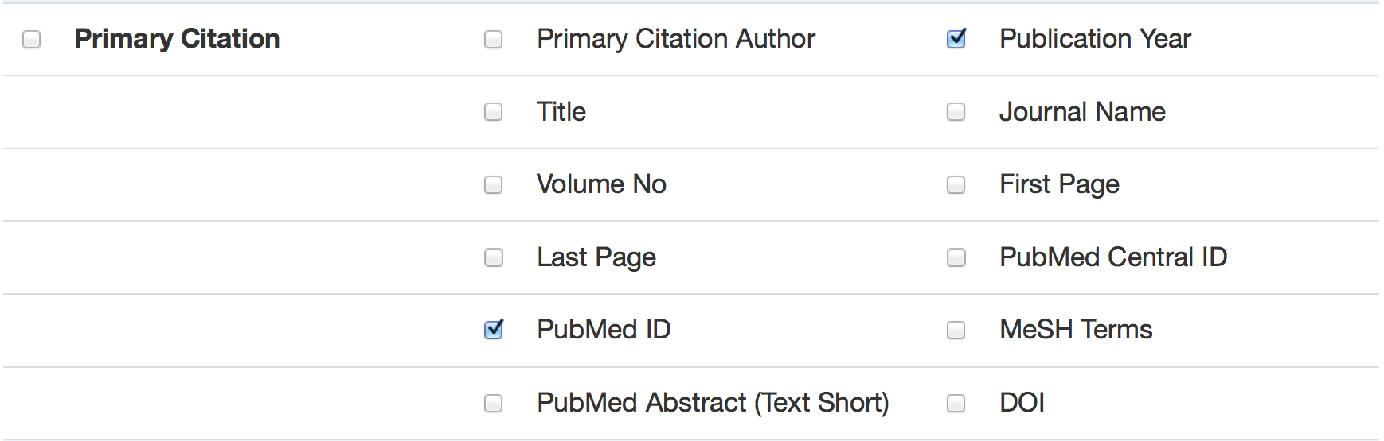
Create a Custom Report (2)
You can select multiple items to include in the report
...

Slide 9
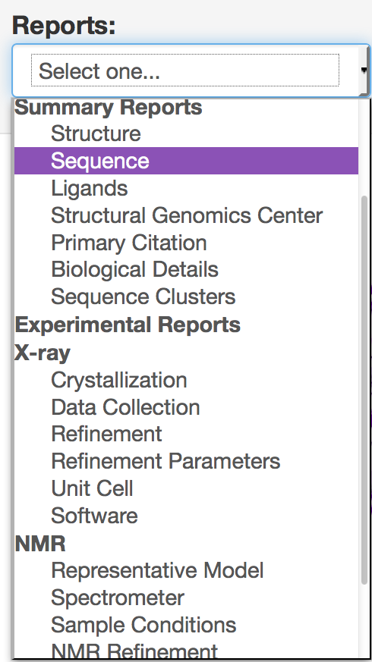
On your Own
Explore the other report types available, e.g. “Sequence”, “Ligands”

Slide 10
Exercise 2.2
Obtain a set of citation abstracts from PubMed

Slide 11
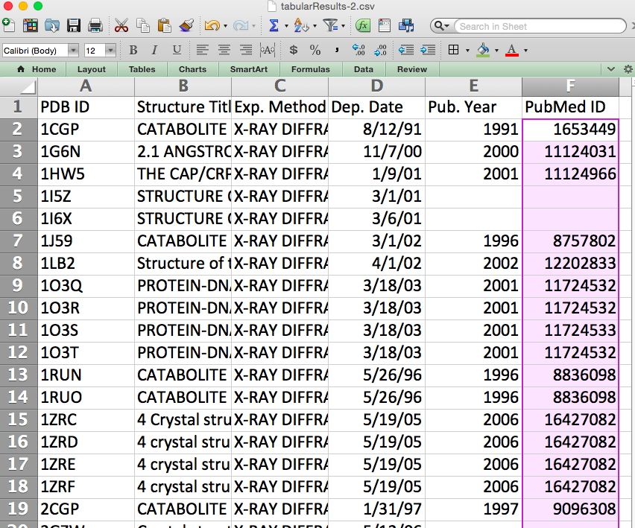
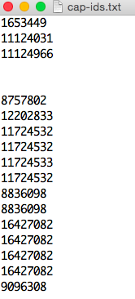
Obtain Citation Abstracts from PubMed
Save a custom report that includes primary citation PubMed ids (PMIDs)
Select the column of cells with PMIDs, cut/paste them into a file using a text editor (e.g., TextEdit, Notepad). Don’t worry about blanks/duplicates.

Slide 12
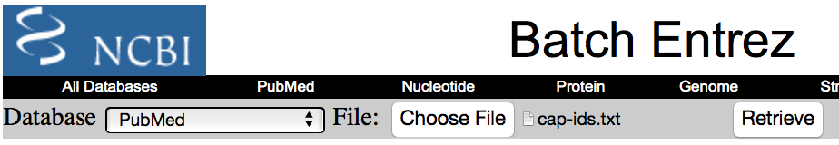
Citation Abstracts (2)
Go to NCBI Batch Entrez: http://www.ncbi.nlm.nih.gov/sites/batchentrez
Select PubMed in the left pulldown menu, choose the id file for upload, and click on “Retrieve”

Slide 13
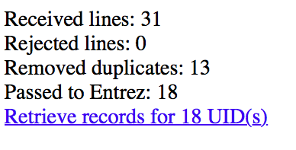
Citation Abstracts (3)
You should next see a brief report about your uploaded ids. [This example had many duplicates].
Click on the link to retrieve the records.

Slide 14
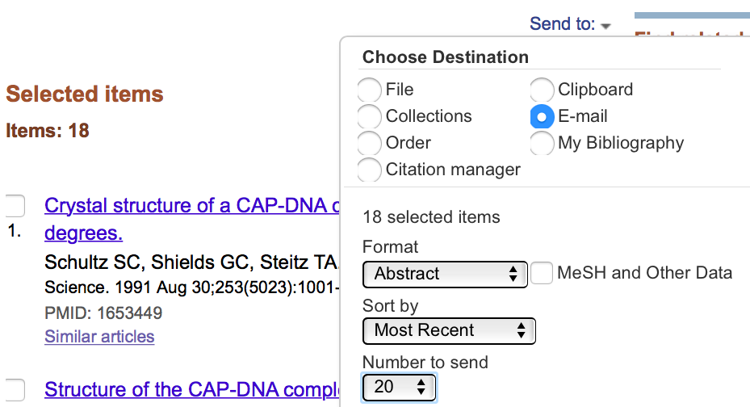
Citation Abstracts (4)
Save the results list through the “Send to:” menu.
Recommended: email destination with shown options

Slide 15
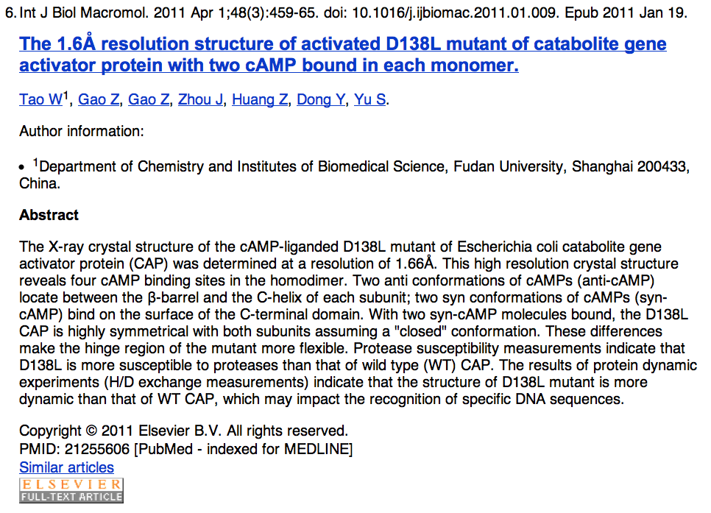
Citation Abstracts (5)
email will include full abstract + hyperlinks
pubmed
entry
article
link

Slide 16

This work is licensed under Creative Commons Attribution-NonCommercial-ShareAlike 4.0 International.
Funded by Grant R25 LM012286 from the National Library of Medicine of the National Institutes of Health.

