Slide 1
Enabling Data Science in Structural Biology
Module 3 Class Exercise
Review PDBx/mmCIF Dictionary

Slide 2
Exercise 3.1
Exploring the PDBx/mmCIF Data Dictionary

Slide 3

A Copernican View of the PDBx/mmCIF Data Dictionary
Validation Tools
PDB Exchange
Dictionary
PDBx/mmCIF
XML Schema
Deposition Tools
RDF/OWL
Harvesting Tools
SQL Schema
Format Tools
PDB
RDF
mmCIF
XML

Slide 4
PDBx/mmCIF Architecture Dictionary of Dictionaries
Dictionary Definition Language (metadata definitions)
PDB Exchange Dictionary (domain definitions)
PDBx Data Files (instance data, PDB entries)
Dictionary Definition Language (DDL2)
Defines
PDBx Exchange Dictionary
In addition to semantics, each layer provides the framework to validate and extend subsequent layers…
Defines
PDBx Data files

Slide 5
Dictionary Metadata The elements of a domain definition
Features of data items
Definitions and examples
Data types (primitives & regular expression patterns)
Boundary values
Controlled vocabularies
Simple organization
Tables and columns (naming consistency)
Related data item sets (subcategories)
Chapters (category groups)
Associations
Referential integrity - parent-child relationships
Interdependencies/exclusivity
Methods

Slide 6
PDBx/mmCIF Format Example
Name – value pairs (category ‘dot’ attribute)
Tables or loop_’s
_exptl.entry_id 1XBB
_exptl.method 'X-RAY DIFFRACTION'
_exptl.crystals_number 1
loop_
_database_PDB_rev.num
_database_PDB_rev.date
_database_PDB_rev.date_original
_database_PDB_rev.mod_type
_database_PDB_rev.replaces
_database_PDB_rev.status
1 2004-11-02 2004-08-30 0 1XBB ?
2 2005-03-22 ? 1 1XBB ?
3 2009-02-24 ? 1 1XBB ?

Slide 7
Dictionary Definition Example
Semantics
save__em_entity_assembly.symmetry_type
_item_description.description
; The type of symmetry of the assembly, component or superstructure.
;
_item.name '_em_entity_assembly.symmetry_type'
_item.category_id em_entity_assembly
_item.mandatory_code no
_item_type.code line
loop_
_item_enumeration.value
_item_enumeration.detail
asymmetric 'object with no internal symmetry'
point 'point symmetry object'
helical 'helix/filament'
2D '2D crystal'
3D '3D crystal'
save_
Schema
Data type
Controlled
vocabulary

Slide 8
Dictionary Definition Example
save__atom_site.Cartn_x
_item_description.description
; The x atom-site coordinate in angstroms specified according to
a set of orthogonal Cartesian axes related to the cell axes as
specified by the description given in
_atom_sites.Cartn_transform_axes.
;
_item.name '_atom_site.Cartn_x'
_item.category_id atom_site
_item.mandatory_code no
_item_aliases.alias_name '_atom_site_Cartn_x'
_item_aliases.dictionary cif_core.dic
_item_aliases.version 2.0.1
loop_
_item_dependent.dependent_name
'_atom_site.Cartn_y'
'_atom_site.Cartn_z'
_item_related.related_name '_atom_site.Cartn_x_esd'
_item_related.function_code associated_esd
_item_sub_category.id cartesian_coordinate
_item_type.code float
_item_type_conditions.code esd
_item_units.code angstroms
Aliases
Related items
Precision

Slide 9
Dictionary Definition Example
save__em_sample_preparation.experiment_id
_item_description.description
; The value of _em_sample_preparation.id must
uniquely identify the sample preparation.
;
_item.name '_em_sample_preparation.experiment_id'
_item.category_id em_sample_preparation
_item.mandatory_code yes
_item_type.code code
_item_linked.child_name '_em_sample_preparation.experiment_id'
_item_linked.parent_name '_em_experiment.id'
save_
Parent-Child
relationships

Slide 10
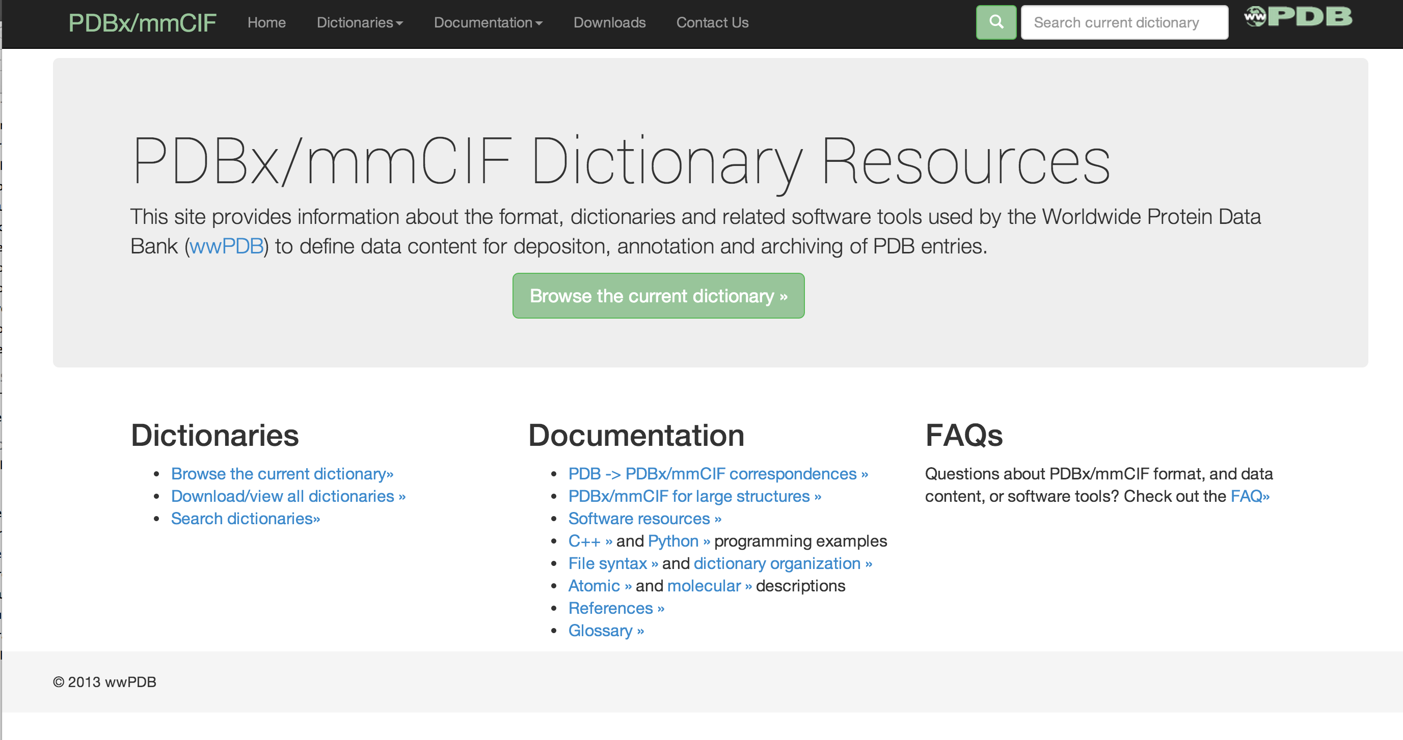
PDBx/mmCIF Resource Site mmcif.wwpdb.org

Slide 11
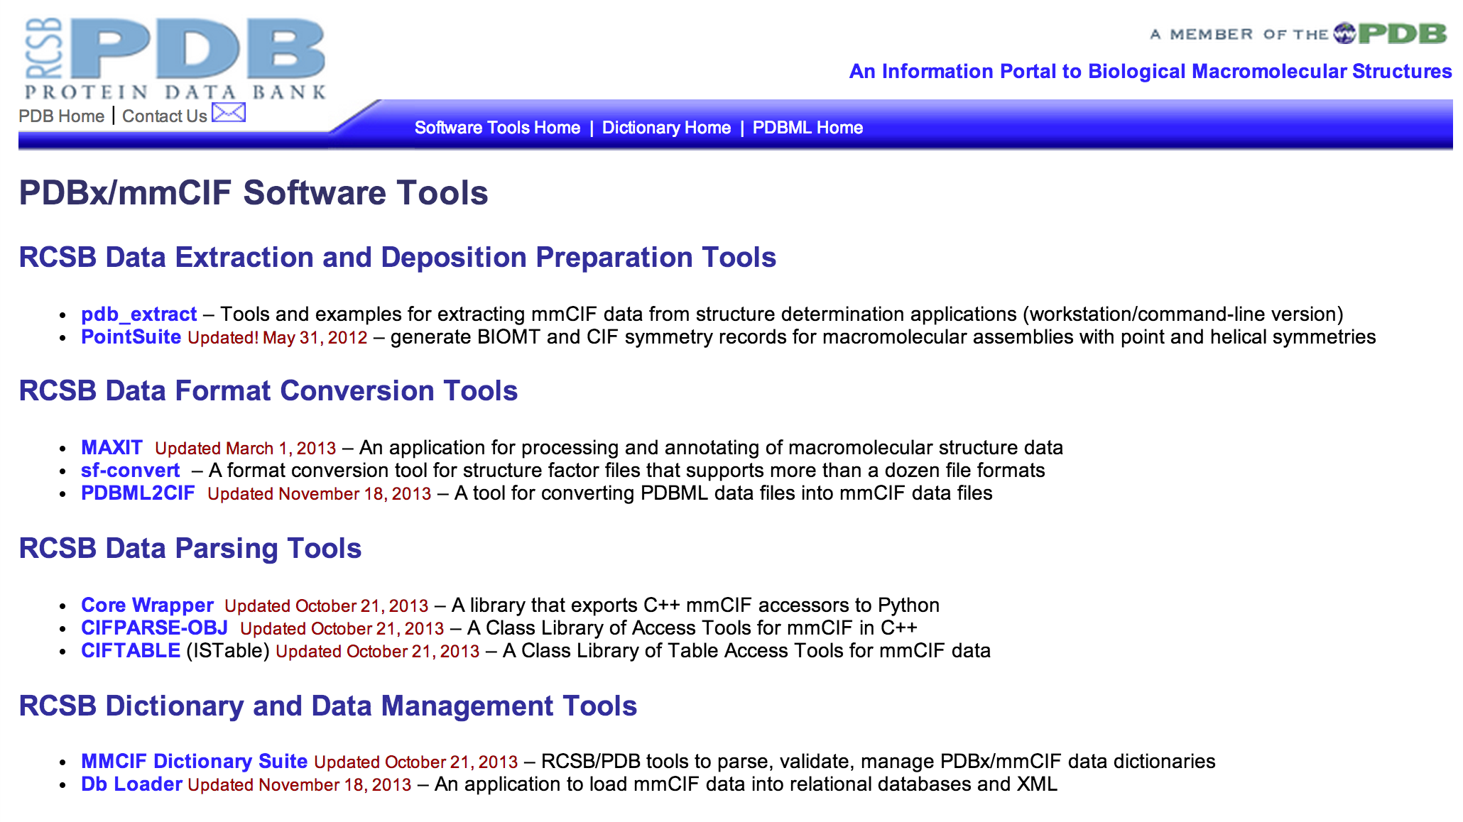
RCSB PDBx/mmCIF Tools Site sw-tools.pdb.org

Slide 12
Additional PDBx/mmCIF Resources
(1) File Syntax
http://mmcif.wwpdb.org/docs/tutorials/mechanics/pdbx-mmcif-syntax.html
(2) Dictionary organization
http://mmcif.wwpdb.org/docs/tutorials/mechanics/pdbx-mmcif-dict-struct.html
(3) Atomic description
http://mmcif.wwpdb.org/docs/tutorials/content/atomic-description.html
(4) Molecular description
http://mmcif.wwpdb.org/docs/tutorials/content/molecular-entities.html
(5) glossary
http://mmcif.wwpdb.org/docs/tutorials/glossary/pdbx-mmcif-glossary.html

Slide 13

This work is licensed under Creative Commons Attribution-NonCommercial-ShareAlike 4.0 International.
Funded by Grant R25 LM012286 from the National Library of Medicine of the National Institutes of Health.

