Slide 1
Enabling Data Science in
Structural Biology
Module 5 Class Exercise
Understanding Validation Reports, Viewing Electron Density

Slide 2
Exercise 5.1
Learn how obtain validation reports for structures of interest

Slide 3
Exercise Start Point
RCSB PDB’s website:
  http://rcsb.org
Search

Slide 4
Find Report for Single Structure
Carry out a query (e.g., putative haloacid dehalogenase)
Select

Slide 5
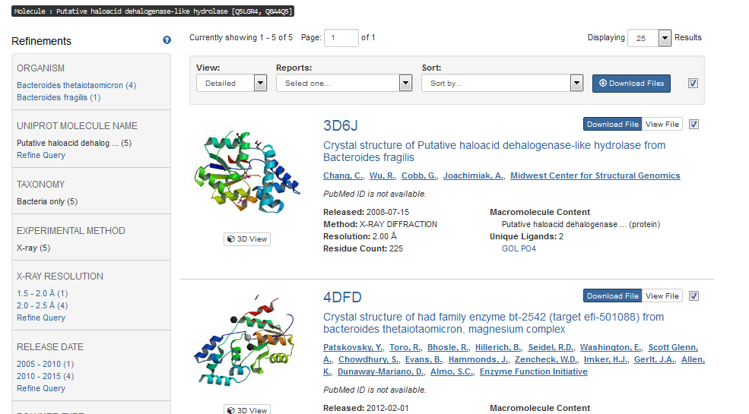
Structure Summary Report (2)
Retrieve individual report for a single entry
Click here to view the structure summary page

Slide 6
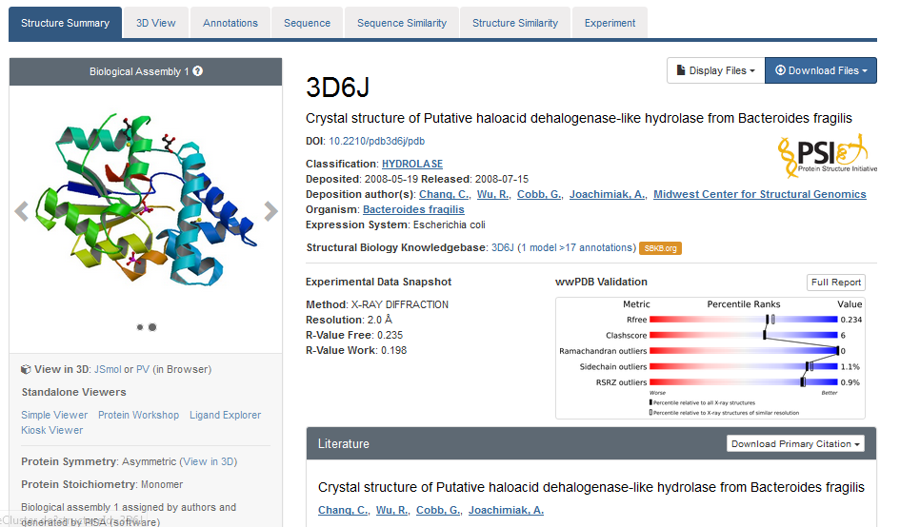
Structure Summary Page
High level detailed view of the structure
Summary of much of the meta-data
Download the validation report (“full report”)

Slide 7
Download the Validation Report
Contains an abundance of information
Will focus on some highlights

Slide 8
Exercise 5.2
Learn how to interpret validation reports

Slide 9
Walk Through the Validation Report
Contains an abundance of information
Many different sections
Some highlights

Slide 10
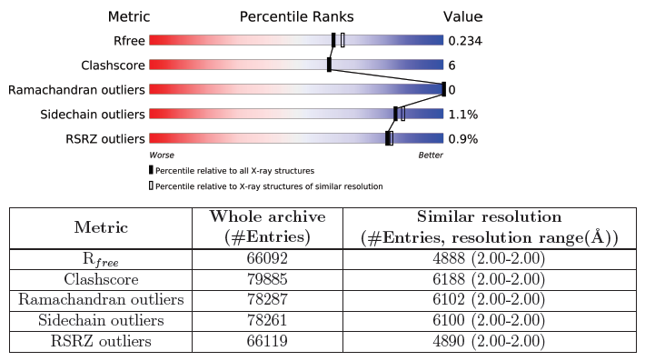
The Slider
Summarizes the structure and compares it to the archive (updated annually)

Slide 11
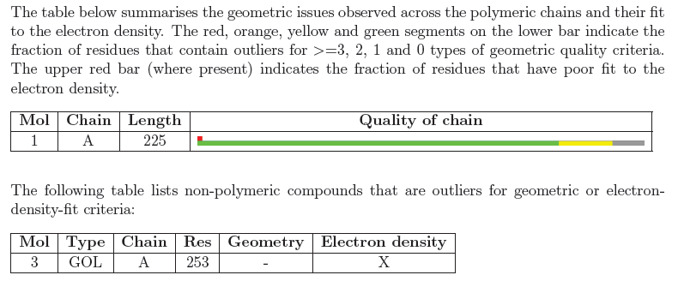
Overall Summary of Polymers and Ligands
Graphical overview of issues

Slide 12
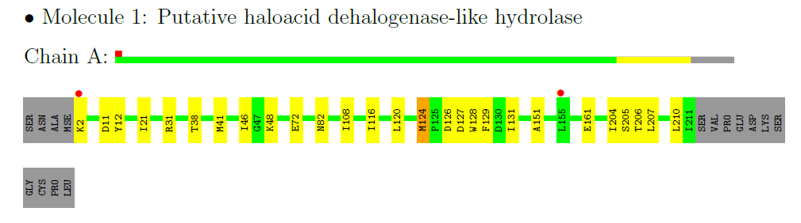
Residue Property Plots (Section 3)
Provides a per residue overview showing the problematic regions
Red dots are poor fits to electron density
Gray regions are missing and likely disordered residues

Slide 13
Model Quality (Section 5)
Many values, providing detailed information
High Z-scores indicate problems
A few outliers in a long polymer is not unexpected

Slide 14
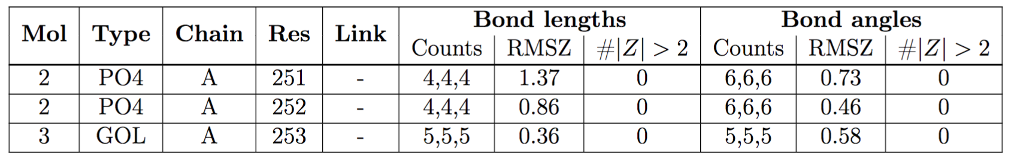
Ligand Geometry (section 5.6)
Indicates whether ligands are built correctly
Ideal geometry is obtained from similar fragments in Cambridge Structural Database
Individual bond lengths or angles with a Z-score less than -2 or greater than 2 merit inspection.

Slide 15
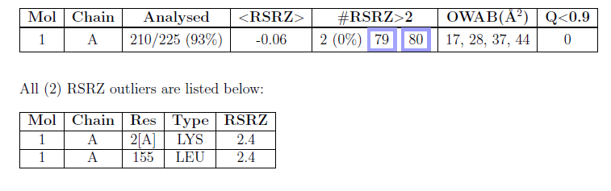
Examine Fit of Model to Data (Sect. 6)
Only available if experimental data is deposited
For polymers, look at the # outliers
Residues with Real space R factor Z-score (RSRZ) above 2 are flagged.
Compared to all structures
Compared to similar resolution

Slide 16
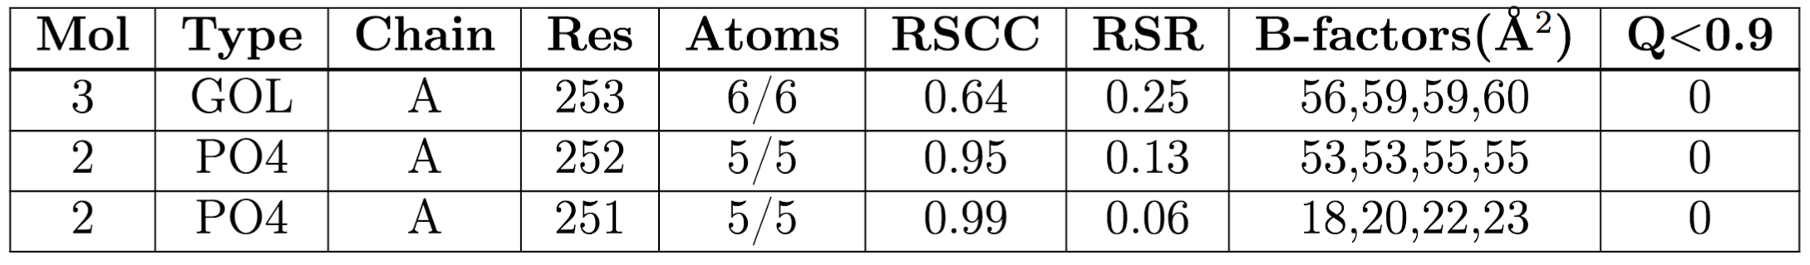
Examine Ligand Model Fit to Data
For ligands a similar table exists
RSCC < 0.8 or RSR > ~0.4 may indicate poor fit
High B-factors (>80 Å²) indicate disorder (atom positions are widely distributed)

Slide 17
Exercise 5.3
Learn how to visualize electron density of ligands

Slide 18
Ligand Electron Density Maps
It is useful to verify the quality of the electron density maps of ligands
Especially important if validation report indicates a problem

Slide 19
How to Find and Visualize the Maps
Example: PDB ID: 4EUF, 2.7Å structure containing NAD
NAD: Nicotinamide adenine dinucleotide
  Coenzyme found in all living cells
  Used in metabolism
  Very flexible ligand

Slide 20
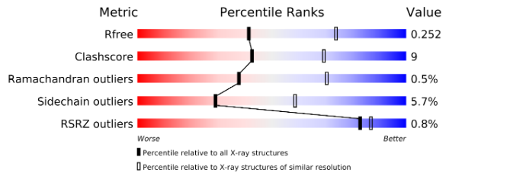
4EUF Validation Report
Sliders not as good as previous structure

Slide 21
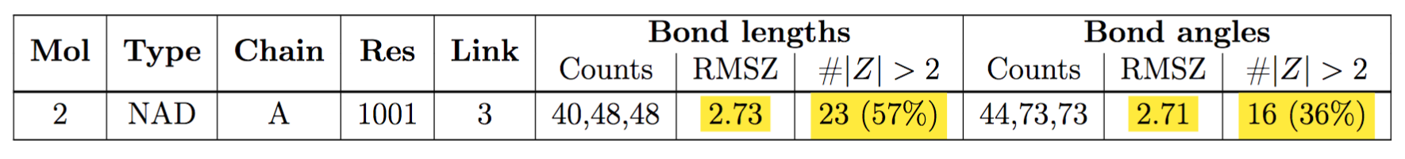
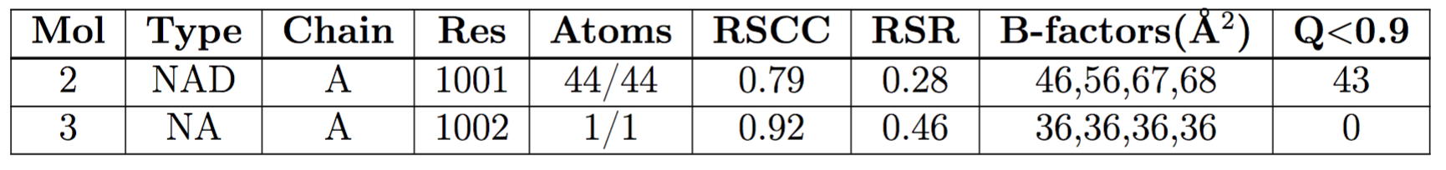
Ligand Quality
There are issues reported on ligand geometry
The reported fit of NAD to electron density is questionable RSCC < 0.8 or RSR > ~0.4 may indicate poor fit

Slide 22
Examine the Electron Density Maps
Navigate to the structure summary page for 4EUF

Slide 23
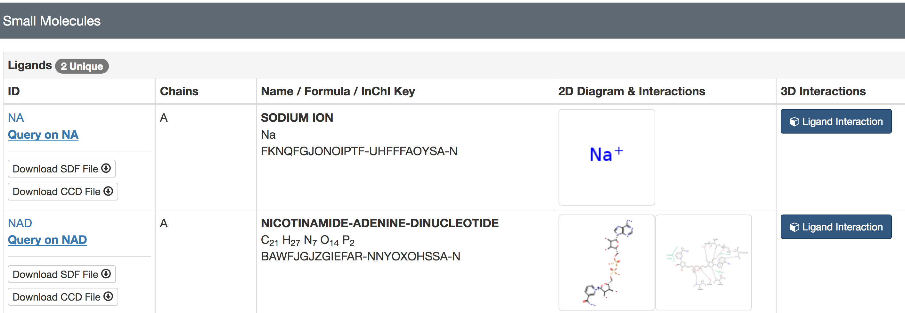
Small Molecule Section of Page
Scroll down to bottom of page
Select Ligand Interaction for NAD

Slide 24
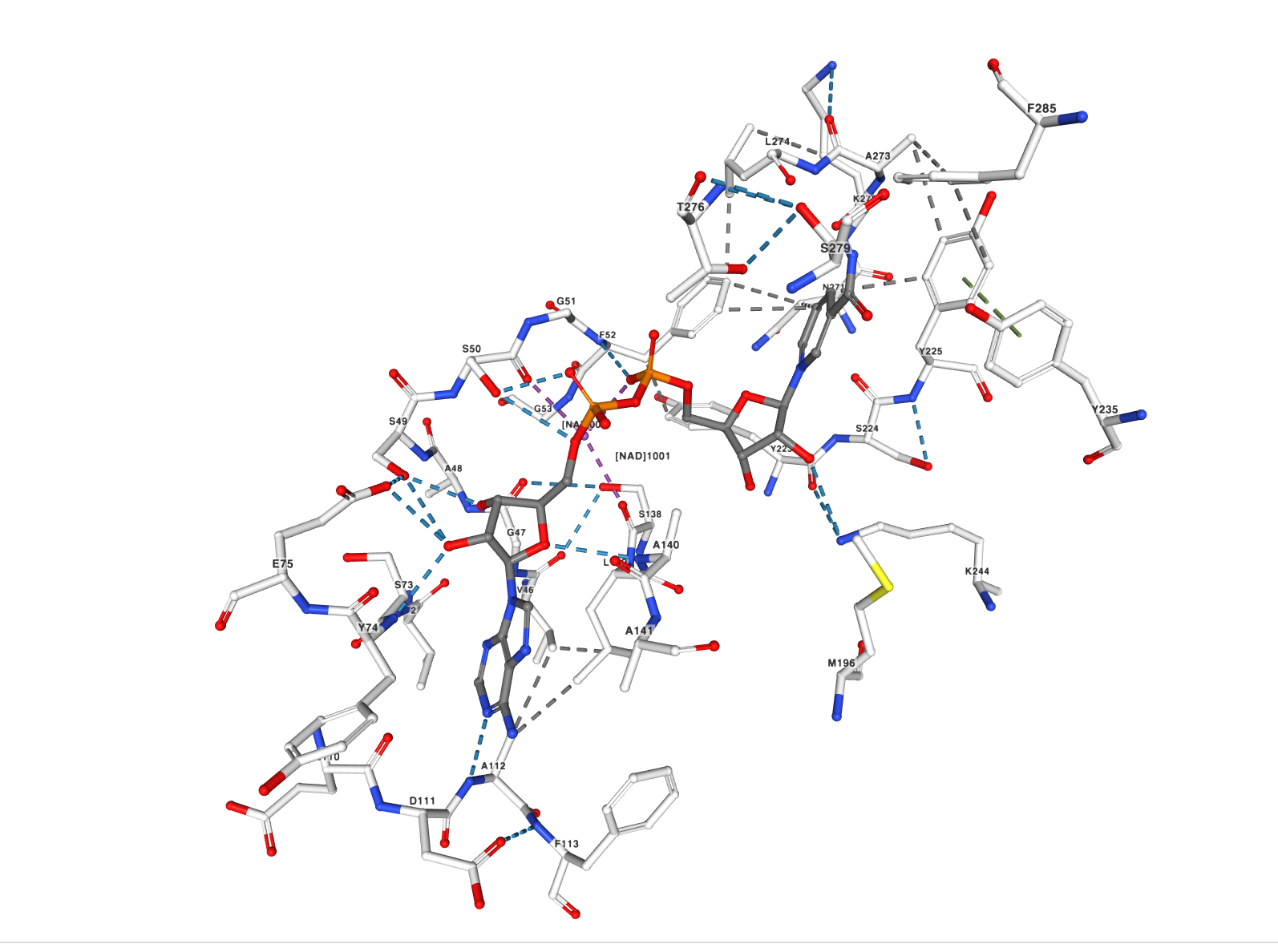
Default Ligand View
View can be rotated/zoomed using mouse

Slide 25
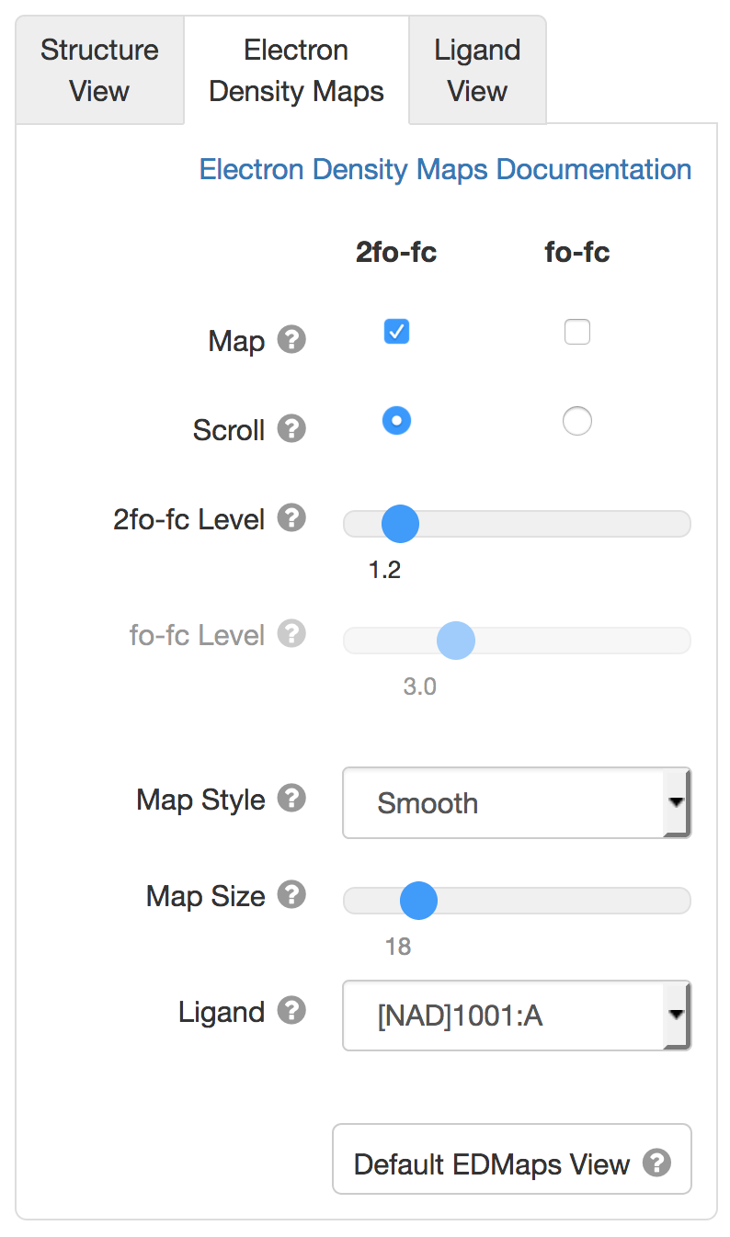
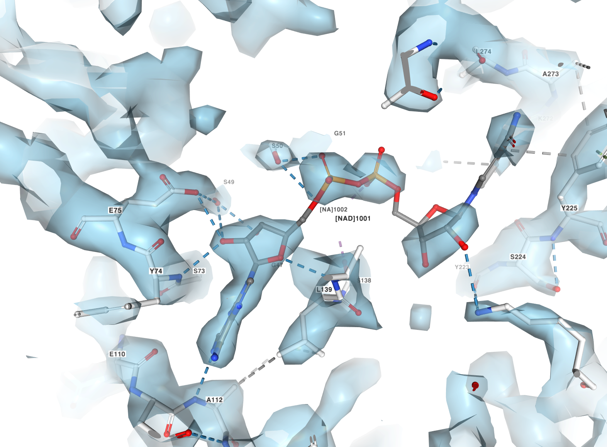
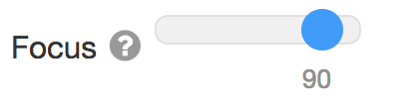
View with Electron Density: 2fo-fc
Focus adjusts clipping planes, high values make it easier to see close up.
2fo-fc map for NAD ligand is ok, electron density is just a bit weak at some positions.

Slide 26
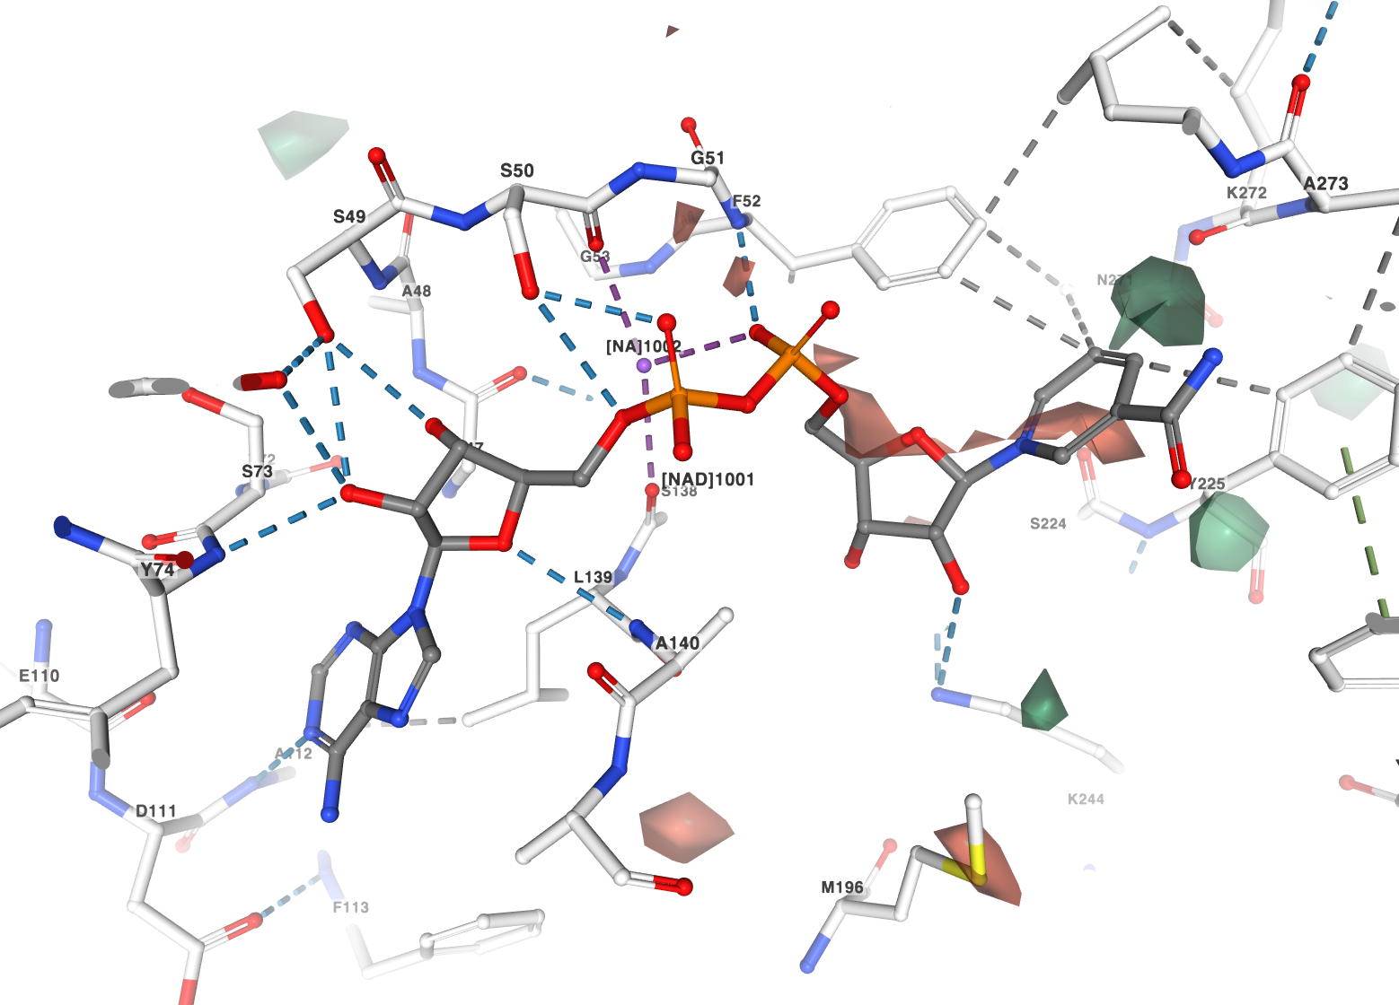
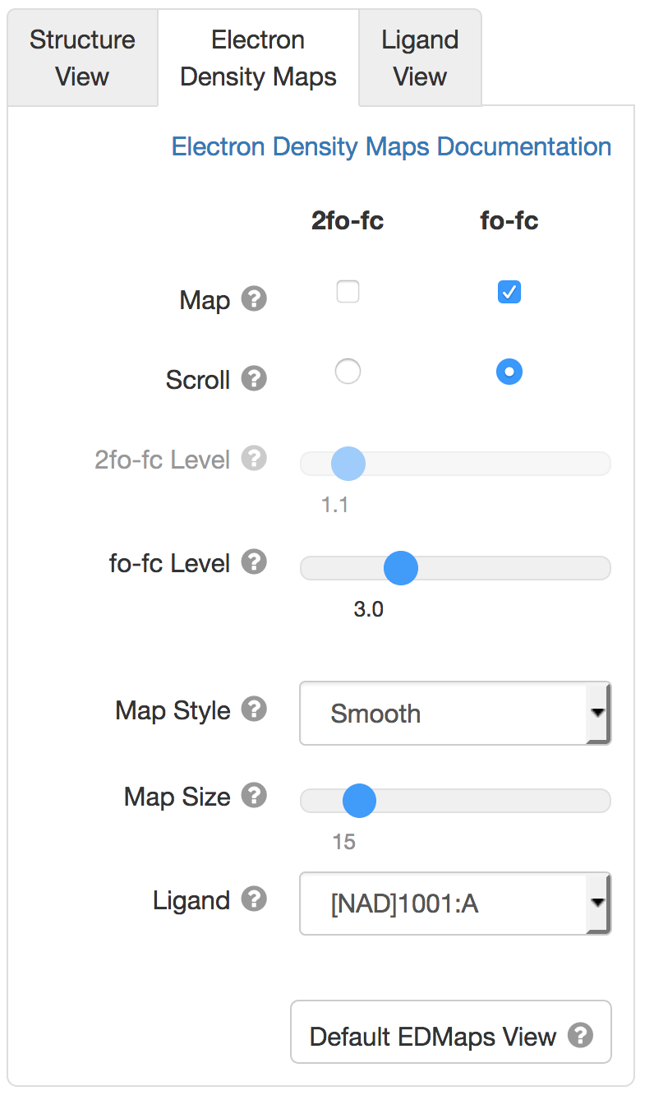
View with Electron Density: fo-fc
fo-fc difference map for NAD ligand is also ok: no atoms sit in strong negative (red) density.

Slide 27

This work is licensed under Creative Commons Attribution-NonCommercial-ShareAlike 4.0 International.
Funded by Grant R25 LM012286 from the National Library of Medicine of the National Institutes of Health.

