Slide 1
Enabling Data Science in
Structural Biology
Module 6 Class Exercise
Investigate Data Representation for a Large Inhibitor Ligand

Slide 2
Exercise 5.1
Recognizing Peptides

Slide 3
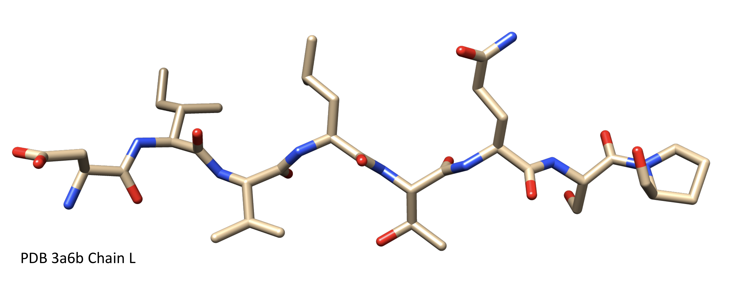
How many amino acids/peptide bonds?

Slide 4
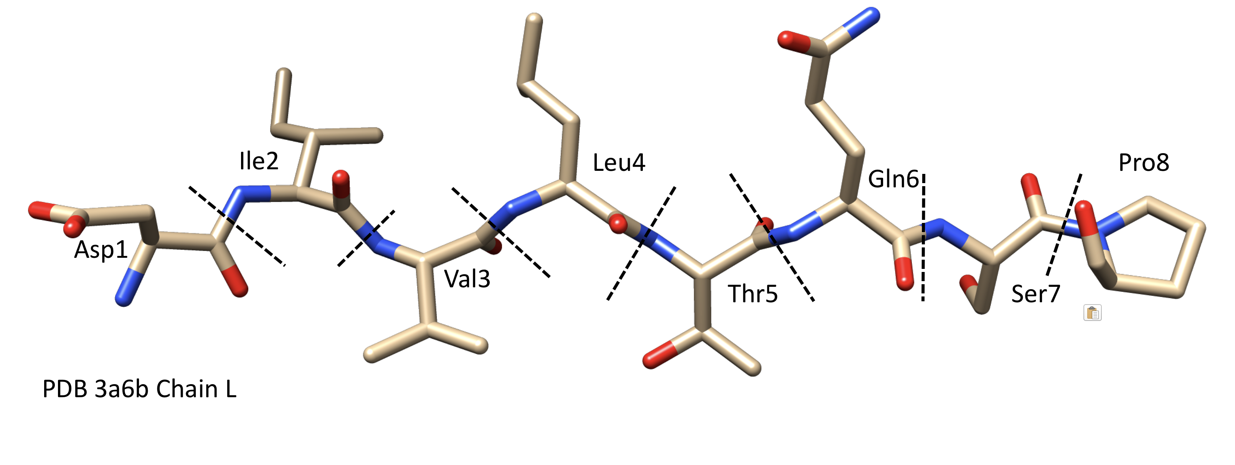
How many amino acids/peptide bonds?
Answer: 8 amino acids and 7 peptide bonds

Slide 5
Exercise 5.2
Remediating a Simple Peptide Inhibitor

Slide 6
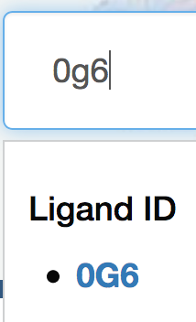
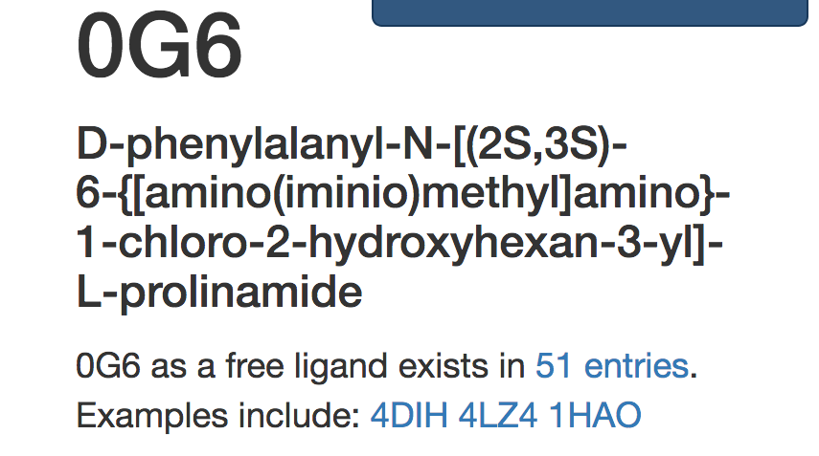
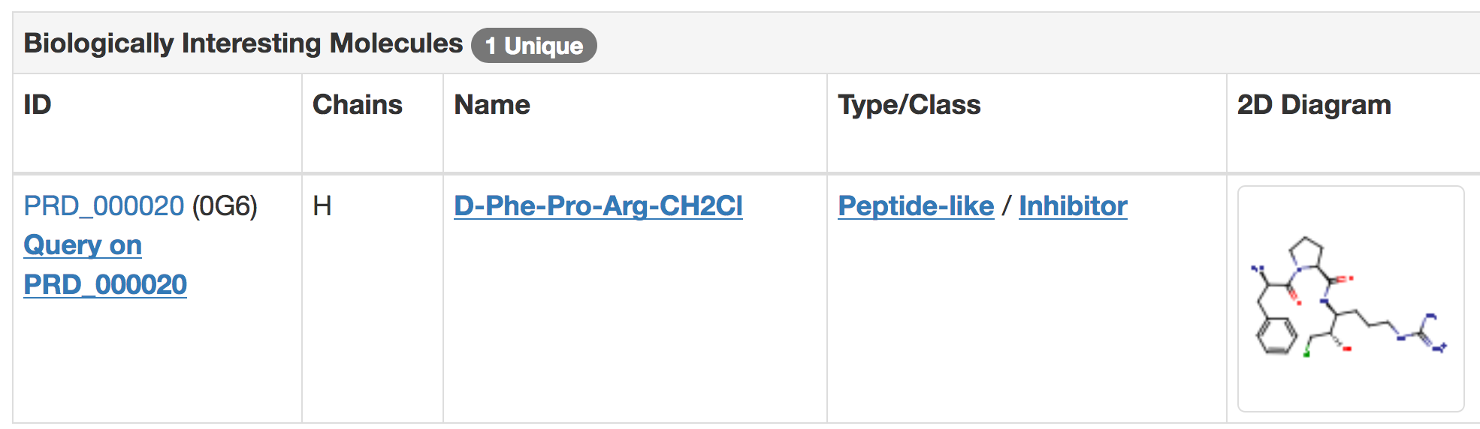
PPACK: ligand id 0g6
What are the polymer subcomponents of this inhibitor? (hint: look at PPACK’s Biologically Interesting Reference Dictionary (BIRD) entry).
1. Enter the ligand id 0g6 into search box
2. Pick any example ⬅entry
3. Scroll down to find link to BIRD entry id = PRD_00020

Slide 7
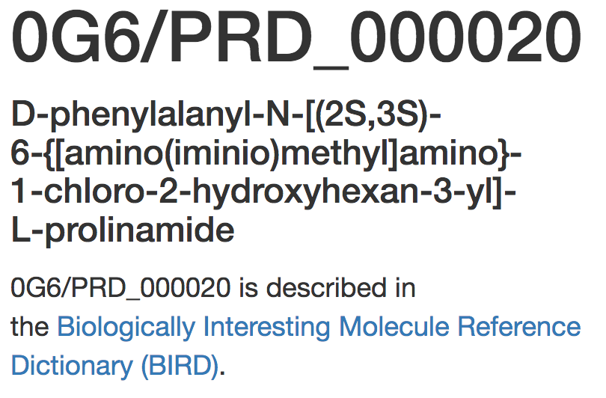
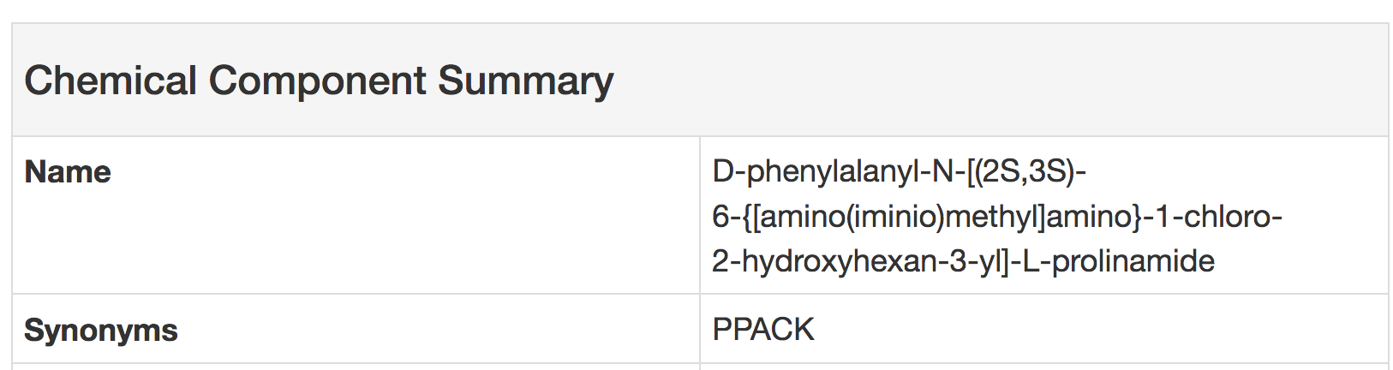
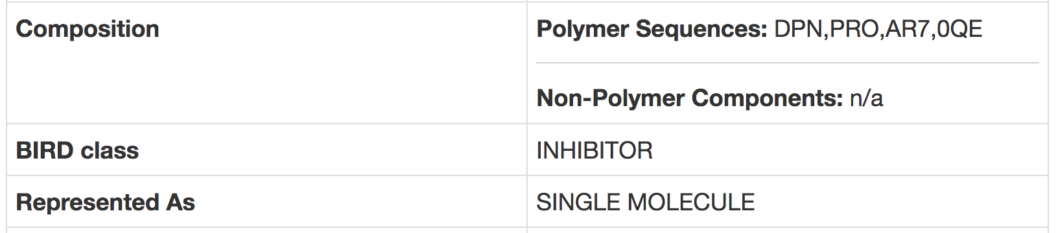
PPACK: BIRD id PRD_00020
Answer: Subcomponents of PPACK are (DPN PRO AR7 0QE). Search for 0G6 in RCSB PDB and open any entry with this inhibitor. Click on the BIRD ID to find this information.

Slide 8
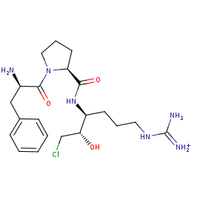
PPACK: Polymer Components
How many standard amino acids and peptide bonds between standard amino acids can you see?

Slide 9
PPACK: Polymer Components
Answer: There are 2 standard amino acids (DPN, PRO) and 1 peptide bond.
There is also a modified Arginine (AR7) and leaving group (OQE, chloromethane (CH2Cl)).
PRO
Standard
Peptide
linkage
Non-Standard
linkage
DPN
AR7
OQE

Slide 10
PPACK: Related Ligands
What is the BIRD Family identifier for this inhibitor?
Name other inhibitors in this family.

Slide 11
PPACK: Related Ligands
From https://www.wwpdb.org/data/bird, Click on the ftp link and open the family_all.cif.gz file in the directory family. Open the file and search for the PRD identifier for PPACK.
There you will see that the Family identifier for PPACK is FAM_000003 and other inhibitors include Phe-Pro-Arg-Chloromethylketone, ATA-PPACK

Slide 12

This work is licensed under Creative Commons Attribution-NonCommercial-ShareAlike 4.0 International.
Funded by Grant R25 LM012286 from the National Library of Medicine of the National Institutes of Health.

