Slide 1
Enabling Data Science in
Structural Biology
Module 7 Class Exercise
Install Database Software and Create a Database

Slide 2
Objectives
Brief introduction to relational database management systems (RDBMS) and Structured Query Language (SQL)
Install a Open Source RDBMS and supporting graphical user interface (GUI)
Using the database GUI:
  create a database
  load example data sets
  explore some data retrieval features of SQL

Slide 3
Exercise 7.1
Relational Databases Overview

Slide 4
Who does what?
Relational Database Management System (RDBMS)
  Provides the storage and access services for data stored as a set of relations (tables).
Structured Query Language (SQL)
  A portable language used to interact with the RDBMS
Send SQL Instructions & data
RDBMS
Receive Reports & Data

Slide 5
A bit of history
Relational database technology was originally described by Edgar Codd in the 1970s, and developed at IBM San Jose Research Laboratory as System R.
Donald Chamberlin and Raymond Boyce of IBM subsequently created the Structured English Query Language (SEQUEL) to manipulate and manage data stored in System R.
The first SQL language standard was published in 1986. The most recent update is 2011.
Codd, E. F. (1970). “A relational model of data for large shared data banks”, Communications of the ACM 13 (6): 377-387.
SQL:2011 (ISO/IEC 9075:2011) - Zemke, F. (2012). "What's new in SQL:2011”, ACM SIGMOD Record 41.1, 67-73.

Slide 6
The database server part
RDBMS systems have been widely used in data management applications for 40+ years
Many commercial providers (e.g. Oracle, IBM, Microsoft, SAP Sybase,…)
A variety of Open Source implementations (e.g. MySQL, PostgreSQL, SQLite and MariaDB)

Slide 7
The query language part
SQL at a glance
SQL provides functions in three broad categories:
  Data definition
    Includes commands to create databases composed of collections of tables, indexes, and views
  Data manipulation
    Includes commands to insert, update, delete, and retrieve data within database tables
  Data control
    Includes commands to set access permissions

Slide 8
Tables in SQL
Attribute (column)
names
Table name
SLOWBASE_STATUS
IdCode | ReleaseYear | DepositYear | ExpMethod
100 | 2014 | 2007 | X-ray
101 | 2015 | 2008 | X-ray
102 | 2015 | 2008 | 3DEM
103 | 2016 | 2009 | NMR
Primary
Key
Tuples or rows

Slide 9
Listing table rows
The SELECT command can be used to list the contents of a table
  Syntax:
    SELECT columnlist
    FROM tablename;
Columnlist represents one or more attributes, separated by commas
Asterisk can be used as wildcard character to list all attributes
SELECT IdCode, DepositYear FROM SLOWBASE_STATUS
SELECT * FROM SLOWBASE_STATUS

Slide 10
Selecting rows with conditions
Select partial table contents by placing restrictions on rows to be included in an output report using a WHERE clause
  Syntax:
    SELECT columnlist
    FROM tablelist
    [ WHERE conditionlist ] ;
SELECT IdCode, DepositYear FROM SLOWBASE_STATUS
WHERE DepositYear > 2008
SELECT * FROM SLOWBASE_STATUS
WHERE ExpMethod = “X-ray”

Slide 11
Other selection features
SQL provides useful functions that can:
  Count records
  Find minimum, maximum and average values
  Find distinct values
SQL allows recording ordering grouping by common values
SELECT COUNT(IdCode) FROM SLOWBASE_STATUS
SELECT MIN(DepositYear) FROM SLOWBASE_STATUS
SELECT * FROM SLOWBASE_STATUS
ORDER BY DepositYear GROUP BY ExpMethod

Slide 12
Selecting records from multiple tables
Ability to combine tables via common attributes is a distinguishing feature of relational database systems
Table JOINS are performed when data are retrieved from more than one table at a time
A JOIN is generally composed of a comparison (e.g. equality) between common or key attributes of related tables

Slide 13
Table JOIN example
SLOWBASE_STATUS
IdCode | Release Year | Deposit Year | Exp Method
100 | 2014 | 2007 | X-ray
101 | 2015 | 2008 | X-ray
102 | 2015 | 2008 | 3DEM
103 | 2016 | 2009 | NMR
USER_COMMENTS
IdCode | Comment
100 | You are slow!
101 | You are very slow!
102 | You are a model of slowness!
103 | You are still very slow!
SELECT SLOWBASE_STATUS.IdCode, DepositYear, ReleaseYear, Comment
FROM
SLOWBASE_STATUS INNER JOIN USER_COMMENTS
ON
SLOWBASE_STATUS.IdCode = USER_COMMENT.IdCode

Slide 14

THERE’S LOTS MORE TO SQL
Scratching the Surface

Slide 15
SQL On-line Resources
W3Schools Home
  http://www.w3schools.com/sql/
SQL Zoo - Interactive -
  http://sqlzoo.net/wiki/SQL_Tutorial
Tutorials Point --
  http://www.tutorialspoint.com/sql/

Slide 16
Exercise 7.2
MySQL Community Server and MySQL Workbench Installation

Slide 17
Software Downloads
MySQL Community Server
  http://dev.mysql.com/downloads/mysql/
MySQL Workbench
  http://dev.mysql.com/downloads/workbench/

Slide 18
MySQL Server Installation
Mac OSX
  Follow native package instructions
    https://dev.mysql.com/doc/refman/5.7/en/osx-installation-pkg.html
  Server control (startup/shutdown)
    https://dev.mysql.com/doc/refman/5.7/en/osx-installation-prefpane.html
Microsoft Windows
  Follow simple method instructions –
    https://dev.mysql.com/doc/refman/5.7/en/windows-installation.html
  Server control (startup/shutdown)
    https://dev.mysql.com/doc/refman/5.7/en/windows-notifier.html
Notes:
Need a connection between this section and next section

Slide 19
MySQL Workbench Installation
Mac OSX Instructions
  http://dev.mysql.com/doc/workbench/en/wb-mac.html
Microsoft Windows Instructions
  http://dev.mysql.com/doc/workbench/en/wb-windows.html

Slide 20
Verify your MySQL server is running

Slide 21
CREATE a DataBase

Slide 22
Prepare Files for Upload
In homework_tables.xlsx, find the three tabs with “-HW7” extensions and save each table as a comma-separated value file:
  citations2015.csv
  biodetails2015.csv
  struct2015.csv

Slide 23
Launch MySQL Workbench
Click here to begin

Slide 24
Create a new database schema
Select the schema tool

Slide 25
Name your database
Enter database name and character set type

Slide 26
Database creation dialog
Review the SQL instructions to create the database

Slide 27
Exercise 7.3
Create Tables and Import Data

Slide 28
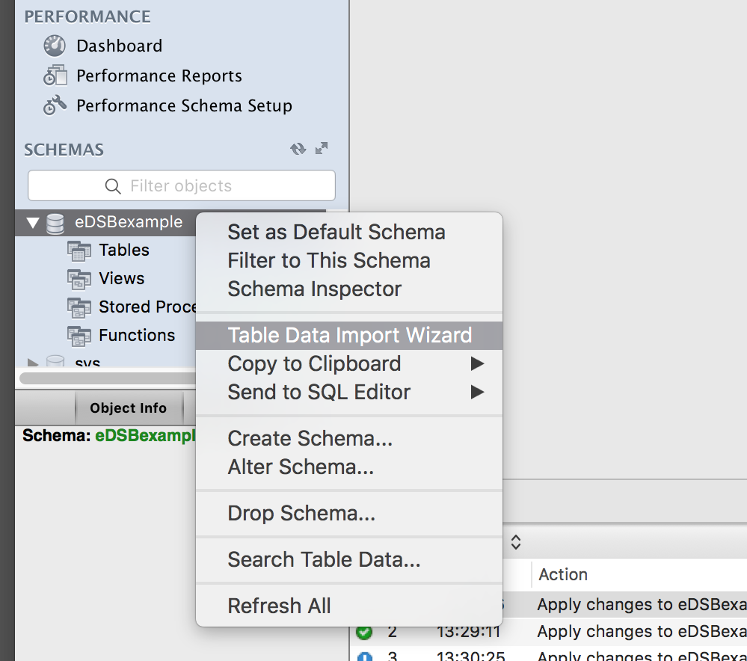
Launch the table data Import Wizard
Select the Table Import Wizard
(right click or <cntrl>click)

Slide 29
Select data file to import
Example file: citation2015.csv
Select Browse to select the example data file citation2015.csv [contains citations for PDB entries after Jan, 2015]
then select “next”

Slide 30
Assign a table name
Select the database name and table name (e.g. citation2015)

Slide 31
Verify column data types
Review the perceived column data types for the imported data set

Slide 32
Import the sample data

Slide 33
Review data import summary
Review imported data statistics

Slide 34
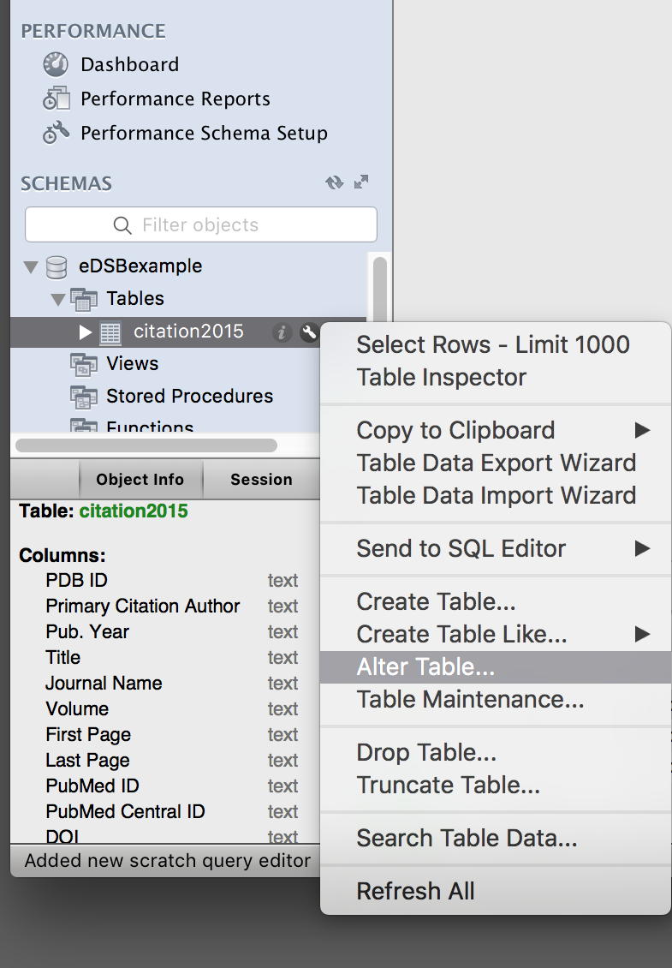
Launch the Alter Table widget
1. Refresh the menu
2. Right click or <cntrl> click on the citation2015 table name
3. Launch the Alter Table widget to edit column features

Slide 35
Replace ‘space’s with underscores (‘_’)s
Edit every column name, replacing all ‘spaces’ with ‘underscores’
Notes:
Need to explain why this step is needed.

Slide 36
Column rename SQL dialog
SQL instructions for column rename operations

Slide 37
Import additional tables
Follow the previous steps to import the other two example files, biodetails2015.csv and struct2015.csv for PDB entries released in 2015. These will be used in Exercise 8.

Slide 38

This work is licensed under Creative Commons Attribution-NonCommercial-ShareAlike 4.0 International.
Funded by Grant R25 LM012286 from the National Library of Medicine of the National Institutes of Health.

