Slide 1
Enabling Data Science in Structural Biology
Module 3 Homework:
Identify Your Research Topic

Slide 2
Homework Assignments Overview
Module | Goal
1 | Select set of PDB entries on topic of interest (50-100)
2 | Create PDB data reports, get primary citations
3 | Define questions about your topic, create new data terms
4 | Create a deposition form for your new terms and fill it in
5 | Review validation reports for your PDB entries
6 | Check your filled data for errors
7 | Create a database combining PDB data and your new data
8 | Perform queries to answer the questions about your topic

Slide 3
Homework
Devise Questions, Create New Data Items for your Structures

Slide 4
Devise Questions
Review the primary citation abstracts obtained in HW2 to develop a set of questions about your selected structures.
A good question is one that can be answered with a combination of information from PDB plus additional information you can obtain by research (e.g. from reading primary citations or from analyzing PDB structures).

Slide 5
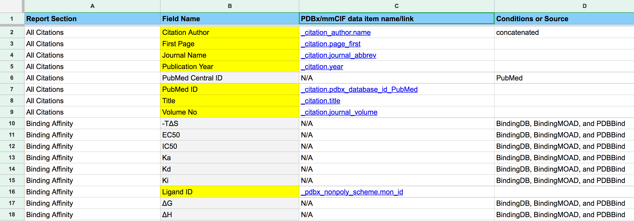
Select mmCIF Data Items
Review “PDB Report mmCIF-HW3” (homework_tables)
select at least five (5) data yellow-highlighted data items that are defined in the PDBx/mmCIF dictionary to include in your database.

Slide 6
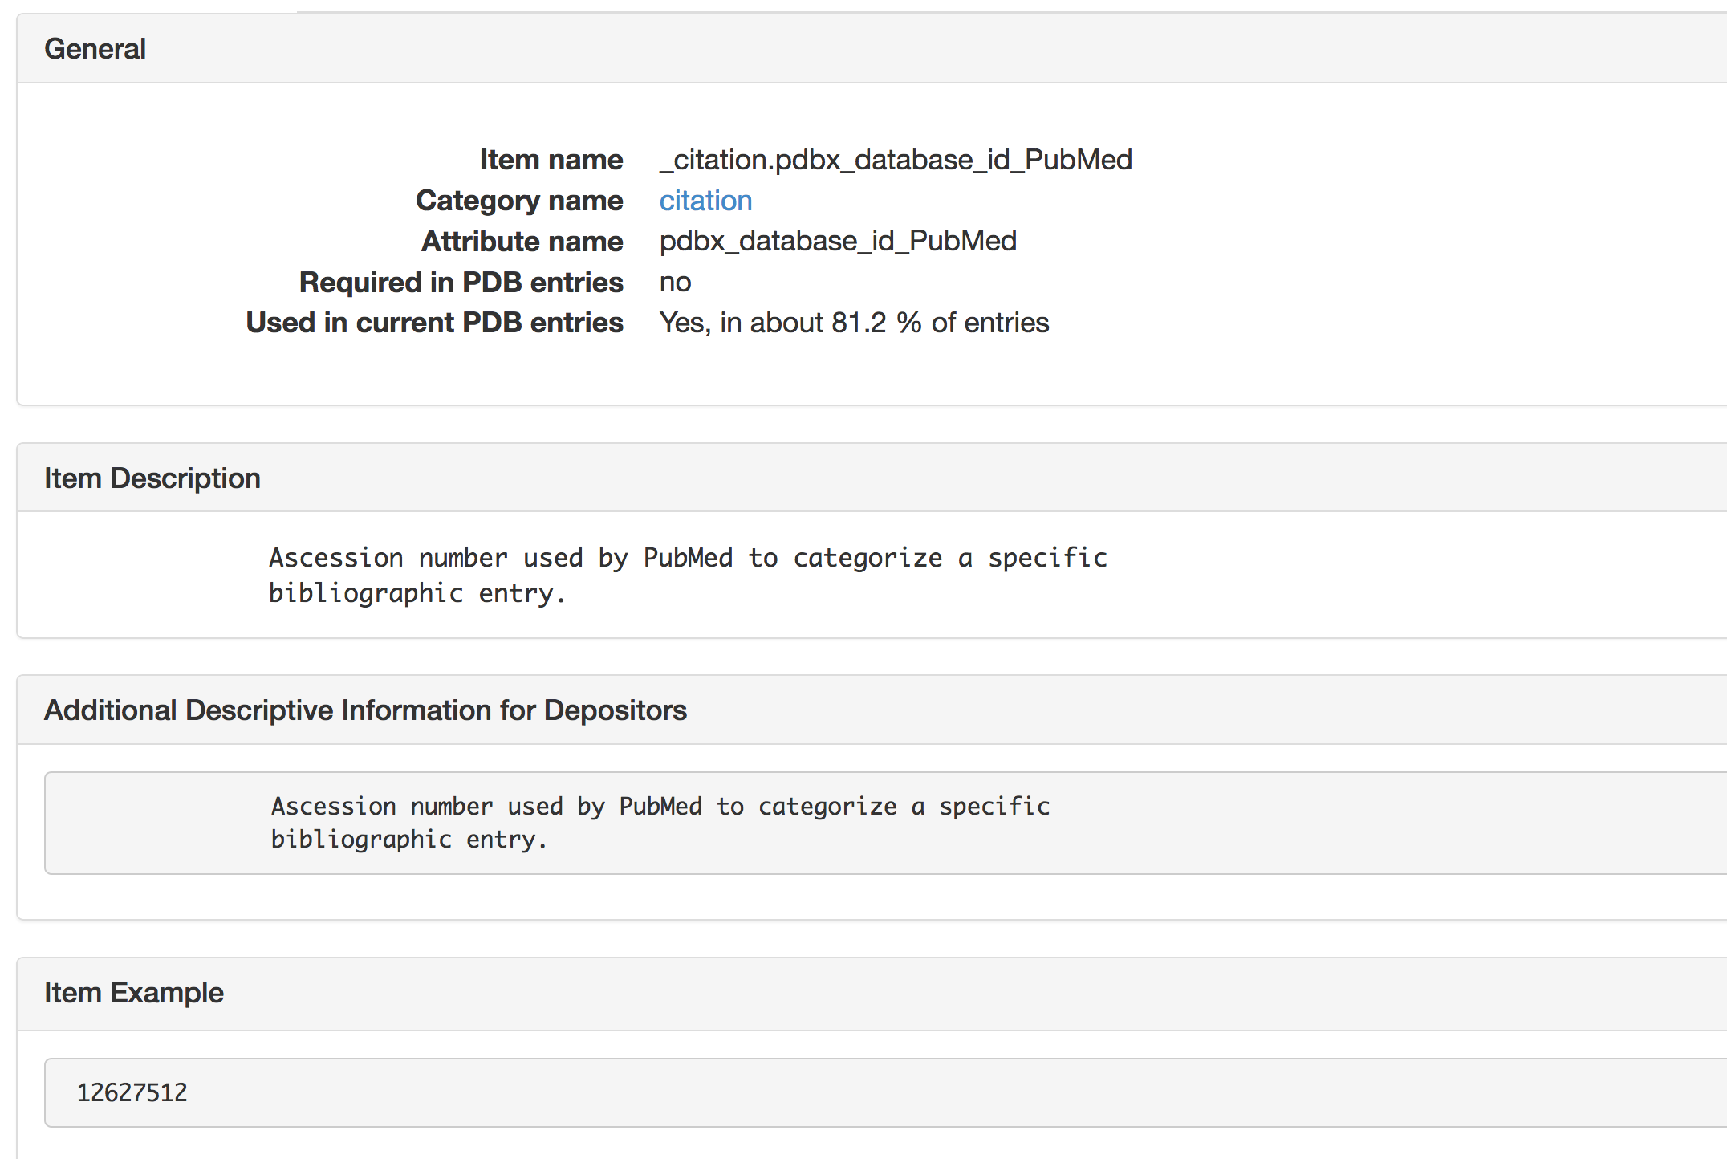
Select mmCIF Data Items (2)
View candidate data item definitions by following the links in column C.
Click on the Category name link to see more details about the citation category. For example, you can find the reference key for the citation category:
_citation.id

Slide 7
Additional Data Items
Identify four (4) additional data items. These will either be:
Non-highlighted (greyed) fieldnames from the PDB report mmCIF correspondence table (choose <=2 items).
Completely new items for which you will need to do research to find the values, e.g., from reading primary citations or from analyzing PDB structures. (create 2-4 items).

Slide 8
Worked ExAMPLE
E. coli Ribosomes determined using CryoEM

Slide 9
Research Topic Questions
How many structures have just one ribosomal subunit?
Which structures have antibiotic ligands?
Which structures have messenger RNA?
What type of tRNA is bound in the P (peptidyl) site? A (acceptor) site? E (exit) site?
Which structure has the highest EM Resolution?
How many structures were deposited by Nobel Laureate author Joachim Frank?

Slide 10
mmCIF Data Items to include in database
Structure Title: _struct.title
Structure Authors: _audit_author.name
Primary Citation Authors: _citation_author.name
EM Resolution: _em_3d_reconstruction.resolution
Deposit date: _database_PDB_rev.date_original

Slide 11
New Data Category/Items
New data items for ribosomes will be part of a new category that we will call “_ribosome_features”

Slide 12
PDB Report Data Item: Ribosome Complex Molecular Weight
Item | _ribosome_features.molecular_weight
Key | _ribosome_features.pdb_id
Description | Molecular weight of the ribosome complex
Item Type | real
Units | Daltons
Example | 2166424.50 | (PDB entry 3JBU)
Enumeration | LSU | Large Subunit
 | SSU | Small Subunit
 | LSU+SSU | Large and Small Subunits
Research Method | Take value directly from PDB Custom Report

Slide 13
New Data Item: Ribosome Subunit Content
Item | _ribosome_features.subunit_content
Key | _ribosome_features.pdb_id
Description | Structure content, in terms of presence of ribosomal large and/or small subunits
Item Type | short text
Example | SSU
Enumeration | LSU | Large Subunit
 | SSU | Small Subunit
 | LSU+SSU | Large and Small Subunits (full ribosome)
Research Method | Review primary citations, entry titles, and entry images

Slide 14
New Data Item: Messenger RNA
Item | _ribosome_features.contains_messenger_RNA
Key | _ribosome_features.pdb_id
Description | Indicates whether the structure contains messenger RNA
Item Type | short text
Example | YES
Enumeration | YES, NO
Research Method | Review primary citations, author defined RNA polymer names

Slide 15
New Data Item: P Site tRNA
Item | _ribosome_features.p_site_trna_aa_type
Key | _ribosome_features.pdb_id
Description | Amino acid (aa) type of the tRNA in the P (peptidyl) site
Item Type | short text
Example | Initiator Methionine
Enumeration | Alanine | Cysteine | Aspartate | Glutamate | Phenylalanine
 | Glycine | Histidine | Isoleucine | Lysine | Leucine
 | Methionine | Asparagine | Proline | Glutamine | Arginine
 | Serine | Threonine | Valine | Tryptophan | Tyrosine
 | Initiator Methionine | PyroLysine | Seleno Cysteine | None (no tRNA) | Unknown (aa type)
Research Method | Review structure titles, author-defined RNA polymer names, and primary citations

Slide 16
New Data Item: Ribosome Antibiotic
Item | _ribosome_features.antibiotic
Key | _ribosome_features.pdb_id
Description | Name of antibiotic in the ribosome complex
Item Type | short text
Examples | Chloramphenicol, Erythromycin A, Kirromycin
Research Method | Extract data from PDB report containing Ligand Names (not all ligands are antibiotics).

Slide 17

This work is licensed under Creative Commons Attribution-NonCommercial-ShareAlike 4.0 International.
Funded by Grant R25 LM012286 from the National Library of Medicine of the National Institutes of Health.

