Slide 1
Enabling Data Science in
Structural Biology
Module 5 Class Exercise
Review Validation Reports
Important Note:
The Protein Data Bank is a continuously growing archive.
Validation reports may differ somewhat from the examples shown.

Slide 2
Homework Assignments Overview
Module | Goal
1 | Select set of PDB entries on topic of interest (50-100)
2 | Create PDB data reports, get primary citations
3 | Define questions about your topic, create new data terms
4 | Create a deposition form for your new terms and fill it in
5 | Review validation reports for your PDB entries
6 | Check your filled data for errors
7 | Create a database combining PDB data and your new data
8 | Perform queries to answer the questions about your topic

Slide 3
Homework 5.1
Review Hemoglobin Structure Validation Data

Slide 4
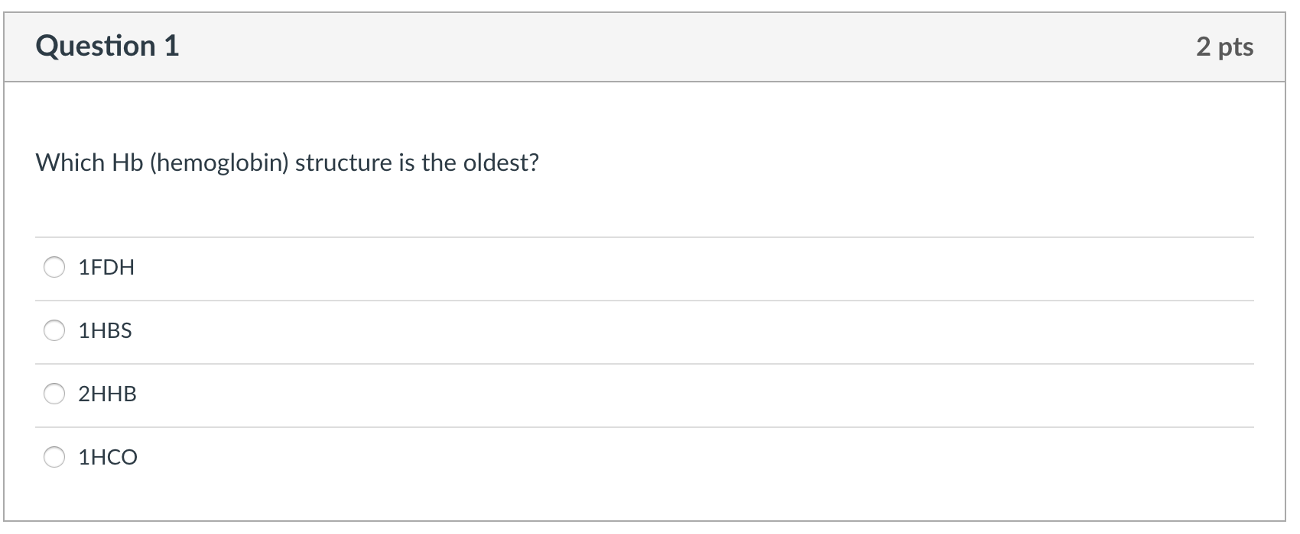
Hemoglobin Structures: Questions (1)
Review Hemoglobin structure validation statistics (homework-tables.xslx: “Hemoglobin Val Stats-HW5” tab) and answer the following questions:

Slide 5
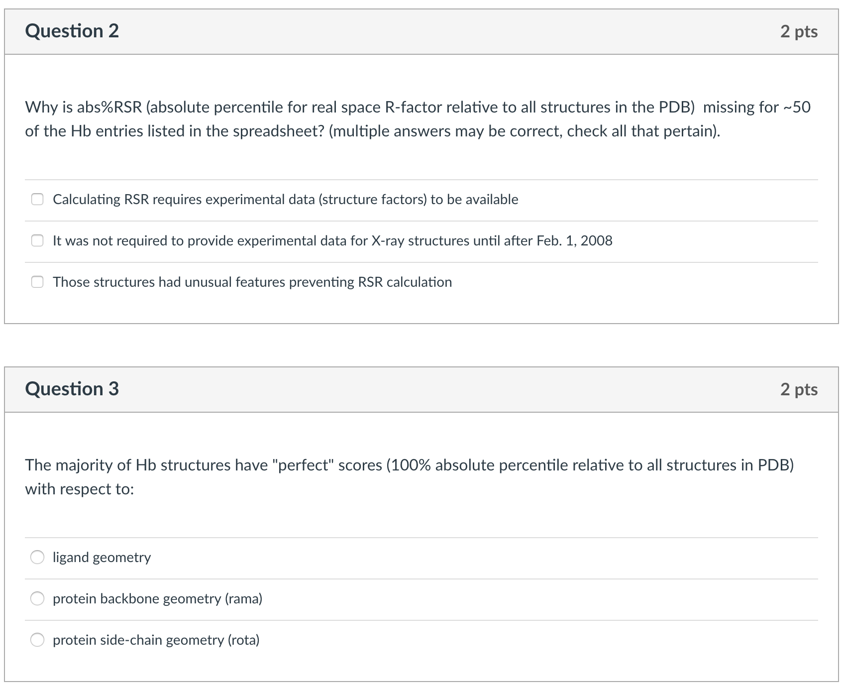
Hemoblobin Structures: Questions (2-3)

Slide 6
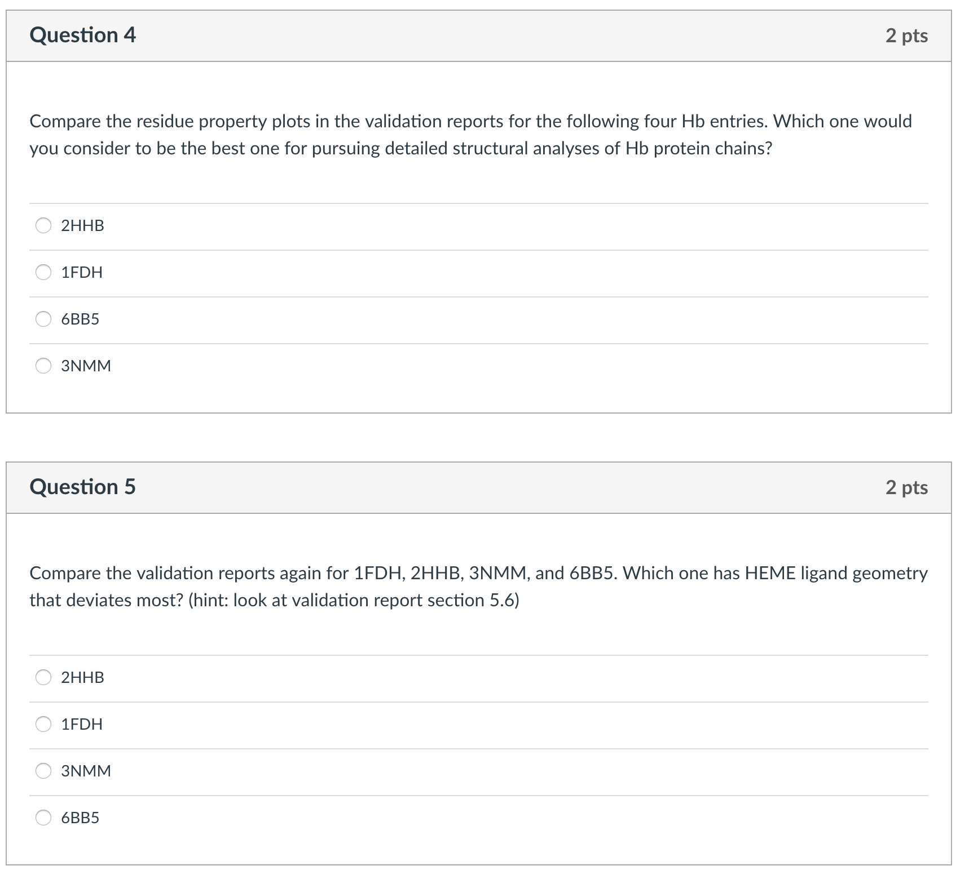
Hemoblobin Structures: Questions (4-5)

Slide 7
Answer Key
1: 1FDH
2: two answers are correct: Calculating RSR requires experimental data (structure factors) to be available, and it was not required to provide experimental data for X-ray structures until after Feb. 1, 2008.
3: protein backbone geometry (rama).
4: 3NMM. This is a fairly recently determined structure and was determined to somewhat higher resolution than the others.
5: 3NMM. Even though 3NMM is the highest resolution structure, its hemes deviate more than the others in terms of bond distances, bond angles from the chemical component dictionary definitions. However, none of the deviations are extreme. Given the high resolution of the crystallographic determination, the deviations may be structurally meaningful.

Slide 8
Homework 5.2
Review Validation Data for Your Structures

Slide 9
View Validation Reports
Download/review validation reports for your set of structures from the Structure Summary pages, as shown in Exercise 5.
(Optional) To create a validation statistics table like the one provided for the hemoglobin example, follow the instructions on the following page.

Slide 10
Extract Data from Validation Reports
Create the three files shown on the following page in a fresh directory (copy/paste text).
Create a 4th file with your PDB ids named “pdbid.list”.
Execute “getstats.csh” on the command line.*
Open the file validation-table.html using a web browser
The html table can be copy/pasted into a spreadsheet
*wget and xsltproc commands must be available for the script to run successfully

Slide 11
Files to Extract Validation Report Data
getstats.csh | PDB-validation-summary.xsl | header.html
Script retrieves validation report xml files from server (wget), extracts summary statistics (xsltproc), and writes the result for each pdb id to validation-table.html. Make this file executable by issuing command “chmod +x getstats.csh” | Template file for xsltproc: indicates where to find desired data items in validation xml, embeds found values into html table row. | html code for the first line of the validation table.
#!/bin/csh -f cat header.html > validation-table.html #loop over all pdb entry ids foreach entry (`cat pdbid.list`) set entrylc = `echo ${entry} | tr '[:upper:]' '[:lower:]' ` set twolett = `echo ${entrylc} | cut -c 2-3 ` echo ${entry} # get wwPDB validation xml wget ftp://ftp.wwpdb.org/pub/pdb/validation_reports/${twolett}/${entrylc}/${entrylc}_validation.xml.gz gunzip ${entry}_validation.xml.gz xsltproc PDB-validation-summary.xsl ${entry}_validation.xml >> validation-table.html end echo " </table> </body> </html>" >> validation-table.html | <?xml version="1.0" encoding="utf-8"?> <xsl:stylesheet xmlns:xsl="http://www.w3.org/1999/XSL/Transform" version="1.0"> <xsl:template match="/"> <xsl:variable name="PDB" select="wwPDB-validation-information/Entry/@pdbid"> </xsl:variable> <xsl:for-each select="wwPDB-validation-information/Entry"> <tr> <td><xsl:value-of select="@pdbid"/></td> <td><xsl:value-of select="@EDS_R"/></td> <td><xsl:value-of select="@EDS_resolution"/></td> <td><xsl:value-of select="@absolute-percentile-DCC_Rfree"/></td> <td><xsl:value-of select="@absolute-percentile-clashscore"/></td> <td><xsl:value-of select="@absolute-percentile-percent-rama-outliers"/></td> <td><xsl:value-of select="@absolute-percentile-percent-rota-outliers"/></td> <td><xsl:value-of select="@absolute-percentile-percent-RSRZ-outliers"/></td> </tr> </xsl:for-each> </xsl:template> </xsl:stylesheet> | <html><body> <h2>PDB validation report statistics</h2> <table border="1"> <tr> <th>PDBid</th> <th>R</th> <th>Resolution</th> <th>abs-percentile-R-free</th> <th>abs-percentile-clashscore</th> <th>abs-percentile-rama-outliers</th> <th>abs-percentile-rota-outliers</th> <th>abs-percentile-RSRZ</th> </tr>

Slide 12
Worked ExAMPLE
E. coli Ribosomes determined using CryoEM

Slide 13
Ribosome Validation Statistics
Ribosome structure validation statistics can be viewed under homework-tables.xslx: “Ribosome Val Stats-HW5”
Because our structures were determined using cryo-EM, three columns are obtained:
  absolute percentile clashscore
  absolute percentile Ramachandran outliers
  absolute percentile rotamer outliers

Slide 14

This work is licensed under Creative Commons Attribution-NonCommercial-ShareAlike 4.0 International.
Funded by Grant R25 LM012286 from the National Library of Medicine of the National Institutes of Health.

