Slide 1
Enabling Data Science in
Structural Biology
Module 7 Homework:
Create Your Own Database

Slide 2
Homework Assignments Overview
Module | Goal
1 | Select set of PDB entries on topic of interest (50-100)
2 | Create PDB data reports, get primary citations
3 | Define questions about your topic, create new data terms
4 | Create a deposition form for your new terms and fill it in
5 | Review validation reports for your PDB entries
6 | Check your filled data for errors
7 | Create a database combining PDB data and your new data
8 | Perform queries to answer the questions about your topic

Slide 3
Homework
Create Your Database

Slide 4
Instructions
Following the instructions provided in Exercise 7, load two or more data tables from previous HW assignments* into a new Database.
Include at least one table containing data from PDB (either custom or standard report), and at least one table containing your research data collected using your deposition form.
*For CSV files downloaded from Google spreadsheets, you may need to add quotes around the data items in the 1st row in order to successfully load to MySQL Workbench, e.g."citation.pubmed_id"

Slide 5
Worked ExAMPLE
E. coli Ribosomes determined using CryoEM

Slide 6
MySQL Database “Ribosomes”
4 tables will be created for the 61 structures:
  structures : standard PDB Structure Report (HW2)
  custom: custom report with EM resolution, PubMed ID, and primary citation author list (HW2)
  deposition: data collected via the deposition form (HW4)
  validation: data extracted from PDB validation reports (HW6)

Slide 7
Prepare Files for Upload
In homework_tables.xlsx, find the four tabs with Ribosome data and save each as a comma-separated value file:
  Ribosome_structures.csv
  Ribosome_custom.csv
  Ribosome_deposition.csv
  Ribosome_validation.csv

Slide 8
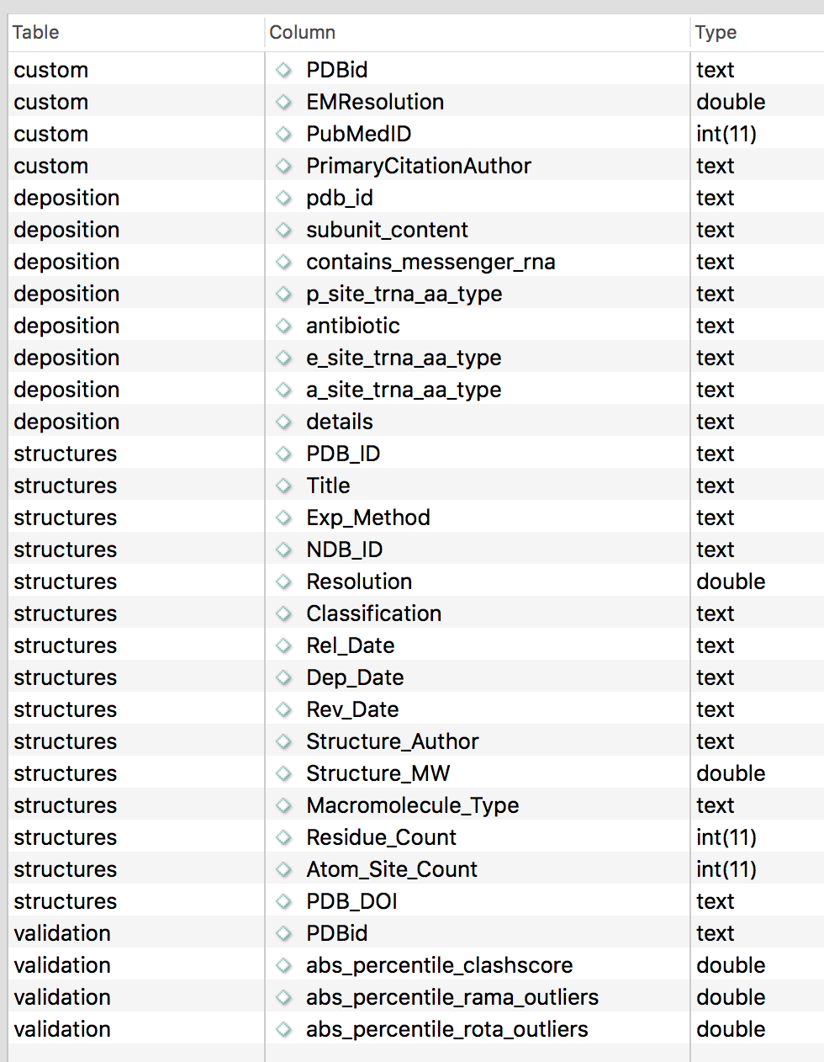
Database Columns

Slide 9

This work is licensed under Creative Commons Attribution-NonCommercial-ShareAlike 4.0 International.
Funded by Grant R25 LM012286 from the National Library of Medicine of the National Institutes of Health.

