Slide 1
Enabling Data Science in
Structural Biology
Module 8 Homework:
Perform Queries to Answer Questions About Your Topic

Slide 2
Homework Assignments Overview
Module | Goal
1 | Select set of PDB entries on topic of interest (50-100)
2 | Create PDB data reports, get primary citations
3 | Define questions about your topic, create new data terms
4 | Create a deposition form for your new terms and fill it in
5 | Review validation reports for your PDB entries
6 | Check your filled data for errors
7 | Create a database combining PDB data and your new data
8 | Perform queries to answer the questions about your topic

Slide 3
Homework
Develop queries to answer questions about your structures

Slide 4
Instructions
Review previous assignments to help you identify 5 questions that your database can address.
Devise one question corresponding to each category described on the following three slides.
Categories 2 and 4 use “group by” SQL queries.
Category 5 uses a “join” SQL query, joining data spanning two or more tables.

Slide 5
Categories 1,2 Example Questions
PDB Data/Simple Answer
  How many structures are Human?
  What is the most common experimental method used?
  How many structures have a resolution of 2.5 Å or better?
PDB Data/Table Answer
  What ligands exist in my set of structures and what is their distribution?
  What is the distribution of deposit dates; is there a steady increment or have there been bursts of discovery?

Slide 6
Categories 3-4 Example Questions
Research Data/Simple Answer
  How many structures reflect the conformation corresponding to the active state?
Research/Table
  I found two major conformations for my structures, what is the distribution?
  How many structures are connected to disease states and what are those diseases?
  Which (~research defined feature~) is most highly represented?
  Do structures of wildtype and mutant forms differ in terms of (~research defined feature~)?

Slide 7
Category 5 Example Questions
Research+PDB Data/Join (query joining two tables)
  What is the distribution of (~research defined feature~) for structures determined using different experimental methods?
  How many publications are associated with each (~research defined feature~)?

Slide 8
Worked ExAMPLE
E. coli Ribosomes determined using CryoEM

Slide 9
Research Topic Questions (from HW3)
How many structures have just one ribosomal subunit?
Which structures have antibiotic ligands?
Which structures have messenger RNA?
What type of tRNA is bound in the P (peptidyl) site? A (acceptor) site? E (exit) site?
Which structure has the highest EM Resolution?
How many structures were deposited by Nobel Laureate author Joachim Frank?

Slide 10
MySQL Database “Ribosomes”
In HW7, 4 tables were created for the 61 structures:
  structures : standard PDB Structure Report (HW2)
  custom: custom report with EM resolution, PubMed ID, and primary citation author list (HW2)
  deposition: data collected via the deposition form (HW4)
  validation: data extracted from PDB validation reports (HW6)

Slide 11
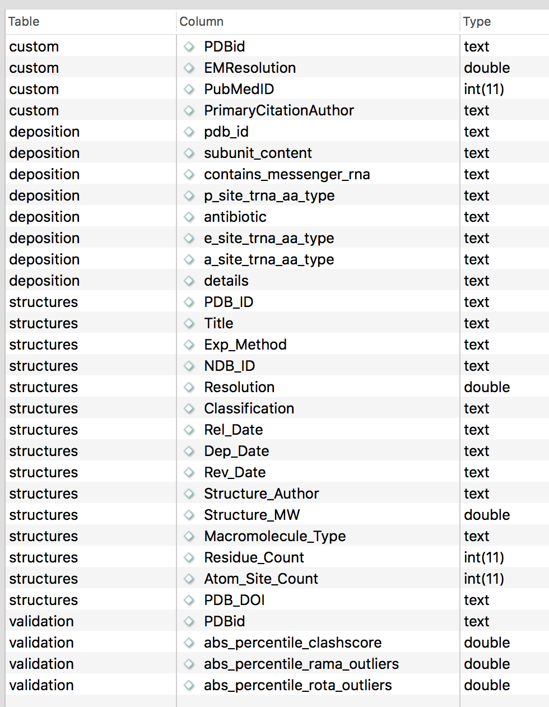
Database Columns

Slide 12
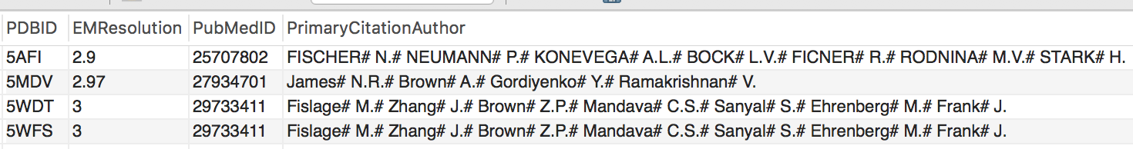
PDB Data/Simple
Question: Which cryoEM E. coli ribosome structures have the highest reported EM resolution?
Query: SELECT * FROM ribosomes.custom where EMResolution<="3.0";
Result:

Slide 13

PDB Data/Simple
Question: How many structures were deposited by by Joachim Frank?
Query: SELECT PDB_ID FROM structures where Structure_author LIKE "%Frank%" ;
Result (6 total):

Slide 14
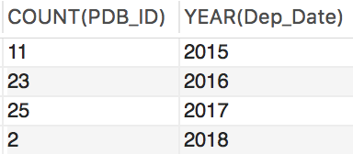
PDB Data/Table
Question: What is the distribution of structure deposition dates; is there a steady increment or have there been bursts of discovery?
Query: SELECT COUNT(PDB_ID), YEAR(Dep_Date) FROM structures group by YEAR(Dep_Date) order by YEAR(Dep_Date);
Result: discovery picked up between 2015 and 2017 (data for 2018 is not complete in this case)

Slide 15

Research Data/Simple
How many structures have just one ribosomal subunit?
Query: SELECT COUNT(pdb_id) FROM deposition where subunit_content = "LSU" or subunit_content="SSU" ;
Result : 16 of the 61 structures

Slide 16
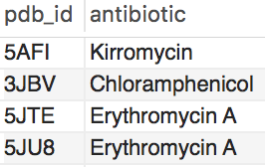
Research Data/Simple
Which Structures have antibiotics?
Query: SELECT pdb_id, antibiotic FROM deposition where antibiotic != " " ;
Results:

Slide 17
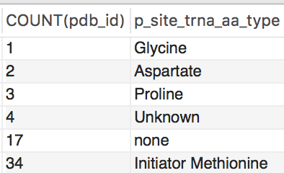
Research Data/Table
What is the distribution of tRNA’s in the P site?
Query: SELECT COUNT(pdb_id), p_site_trna_aa_type FROM deposition group by p_site_trna_aa_type order by COUNT(pdb_id) ;
Result :

Slide 18
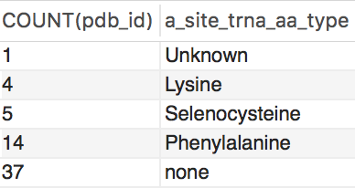
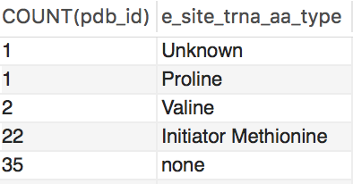
Research Data/Table
What is the distribution of tRNA’s in the A and E sites? (same query as before using the other columns)
Results :
A Site
E Site

Slide 19
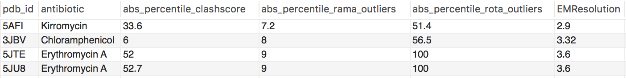
Research+PDB Data/Join
What are the validation statistics for the ribosome structures containing antibiotics?
Query: SELECT pdb_id, antibiotic, abs_percentile_clashscore, abs_percentile_rama_outliers, abs_percentile_rota_outliers, EMResolution FROM deposition JOIN validation on deposition.pdb_id = validation.PDBid JOIN custom on deposition.pdb_id = custom.PDBid where antibiotic != " " ;
Result :

Slide 20

This work is licensed under Creative Commons Attribution-NonCommercial-ShareAlike 4.0 International.
Funded by Grant R25 LM012286 from the National Library of Medicine of the National Institutes of Health.

