Slide 1
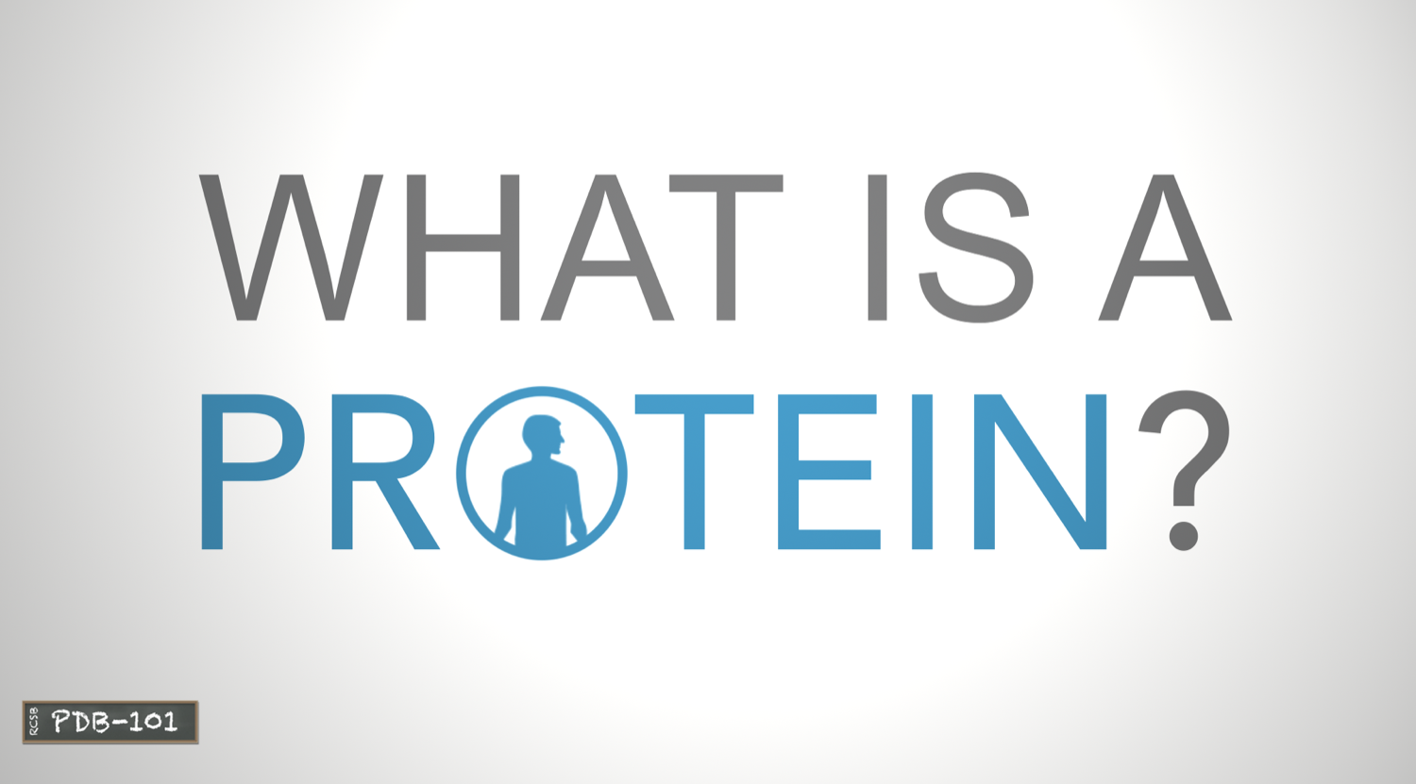
This presentation accompanies a video available at pdb101.rcsb.org > Learn > Videos

Slide 2
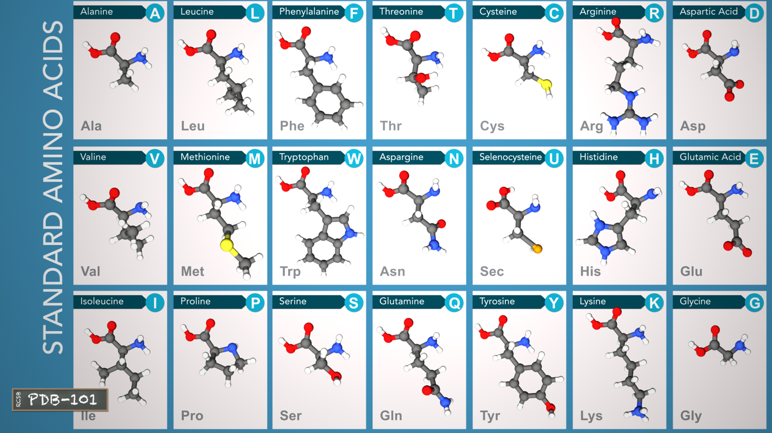
The Building Blocks of Proteins
All proteins are made out of 21 building blocks, called amino acids.

Slide 3
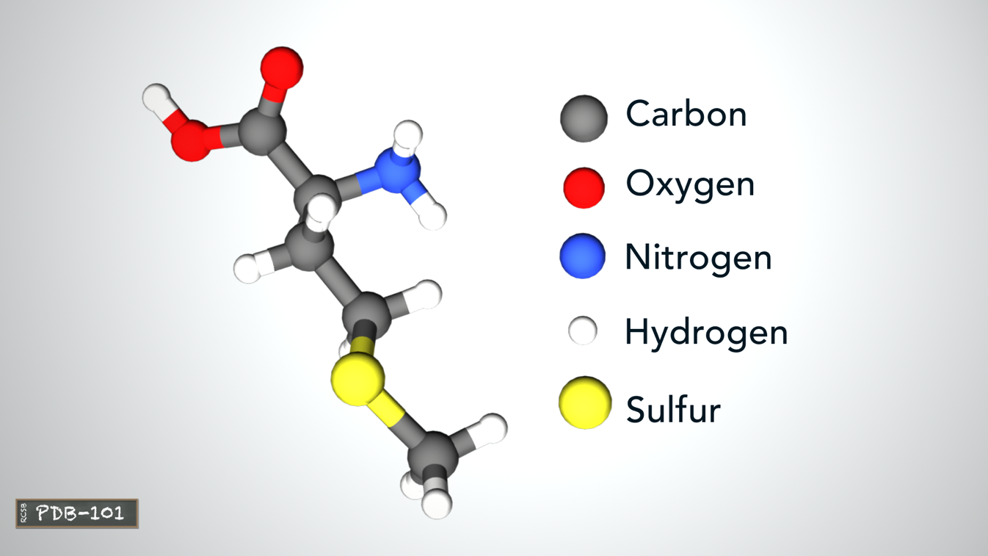
The Building Blocks of Proteins
Amino acids are made of carbon, oxygen, nitrogen, and hydrogen, and some contain sulfur atoms. Selenocysteine is the only standard amino acid that contains a selenium atom.

Slide 4
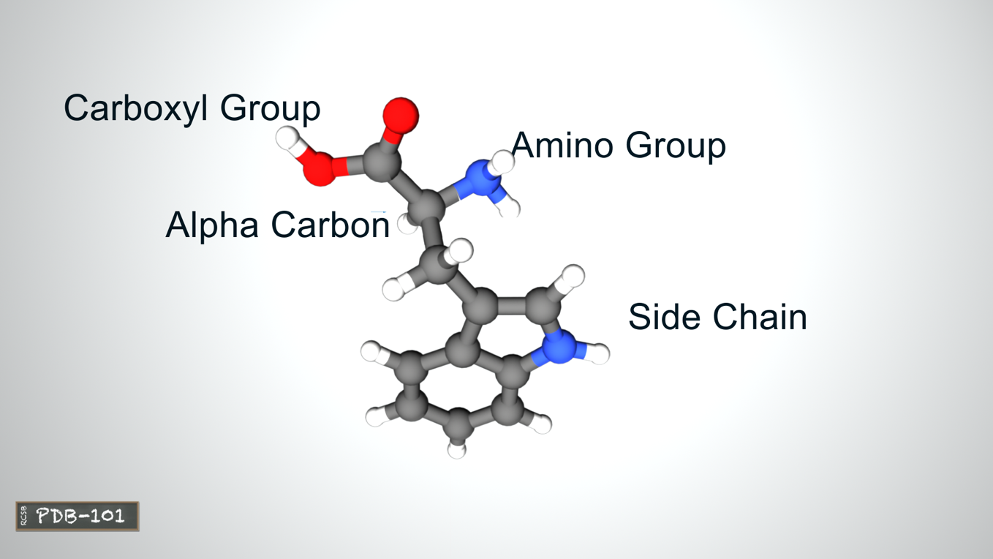
The Building Blocks of Proteins
The atoms of each amino acid form an amino group, a carboxyl group, and a side chain attached to a central carbon atom.

Slide 5
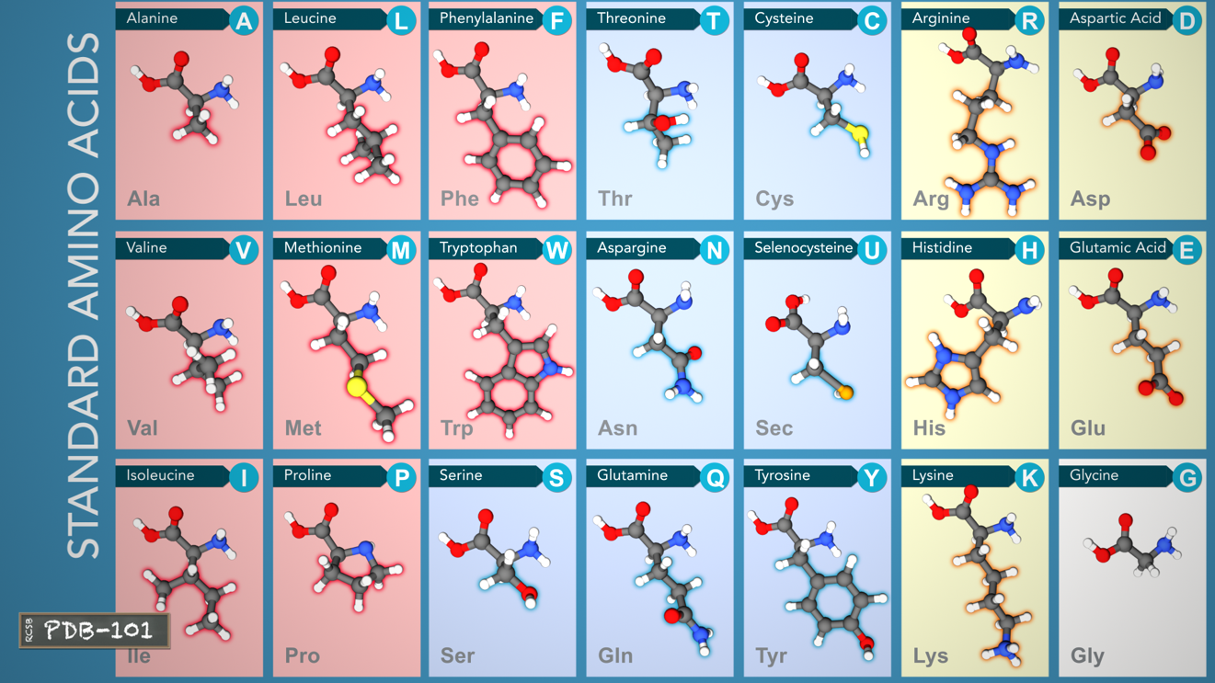
The Building Blocks of Proteins
Hydrophobic
Hydrophilic or polar
No side chain
Charged
The side chain is the only part that varies from amino acid to amino acid and determines its properties.

Slide 6
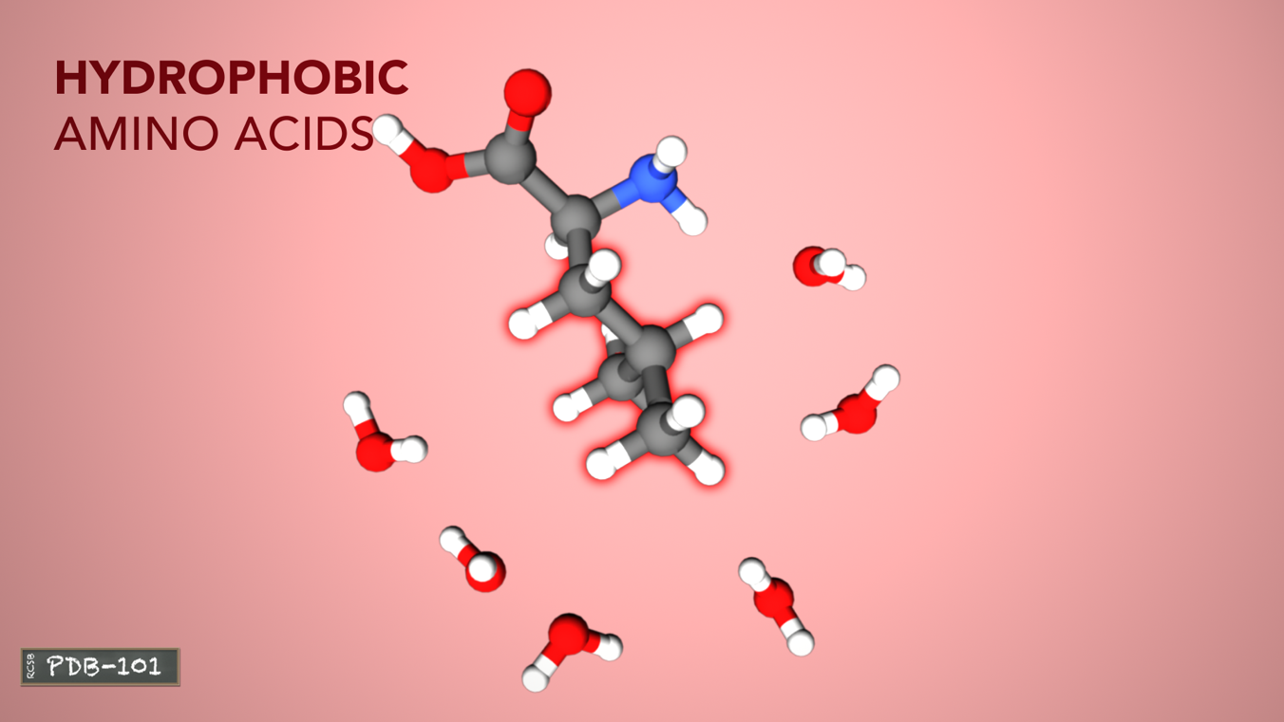
The Building Blocks of Proteins
Hydrophobic amino acids have carbon-rich side chains, which don’t interact well with water.

Slide 7
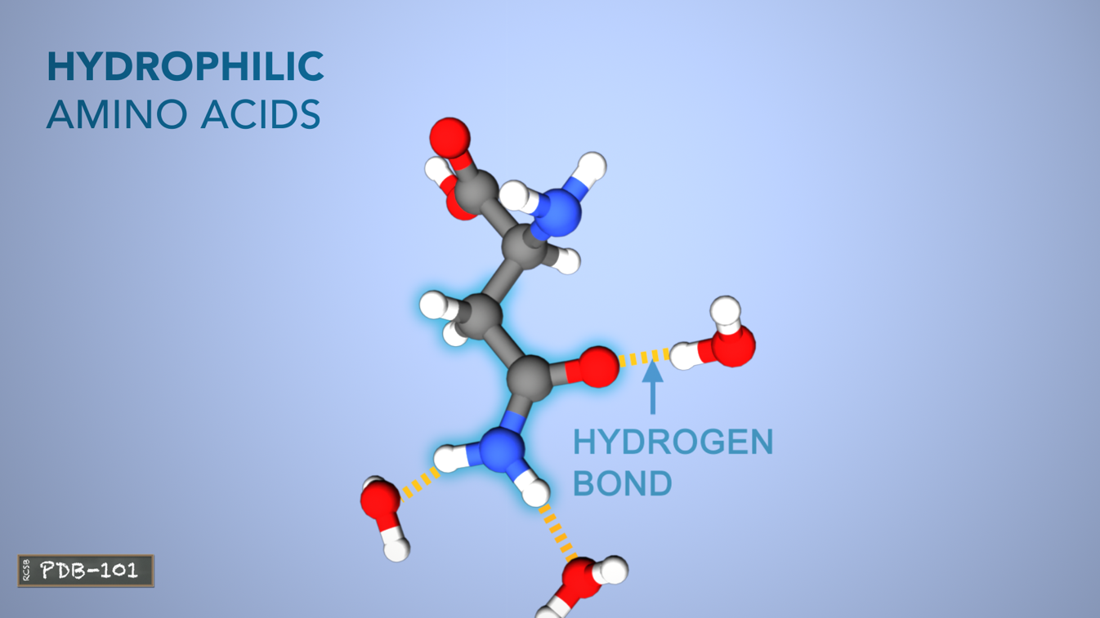
The Building Blocks of Proteins
Hydrophilic or polar amino acids interact well with water.

Slide 8
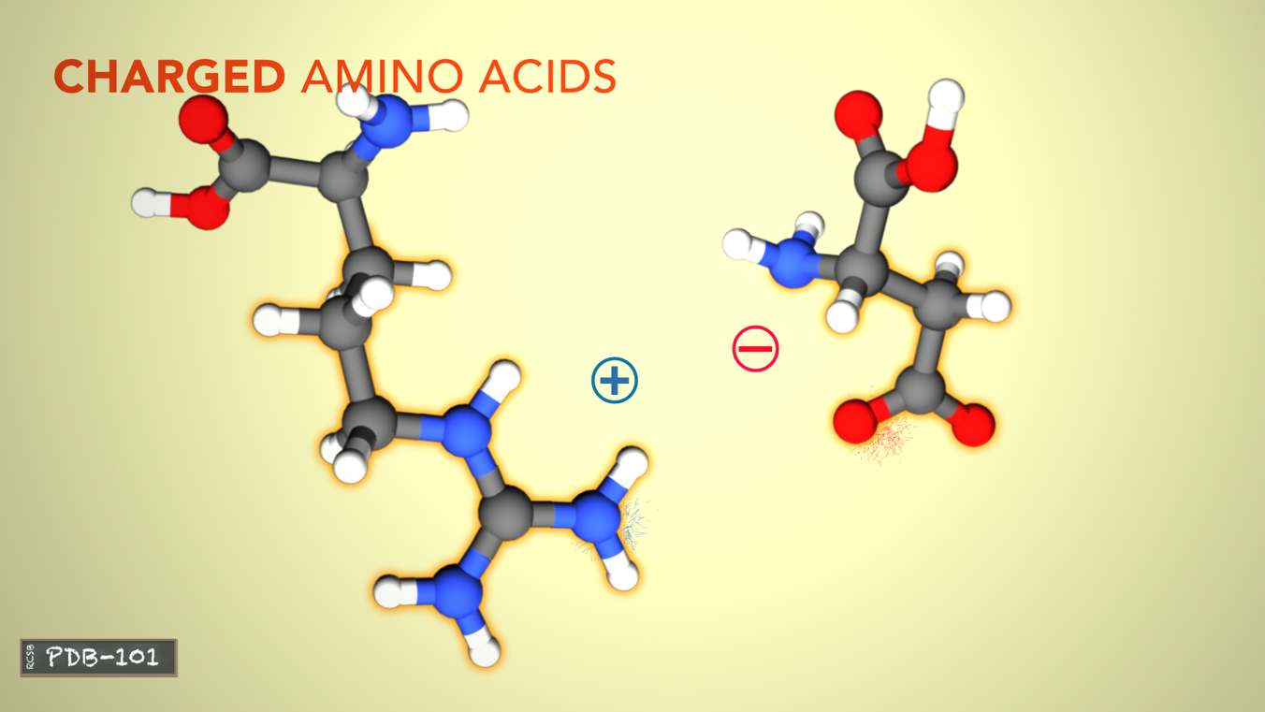
The Building Blocks of Proteins
Charged amino acids interact with oppositely charged amino acids or other molecules.

Slide 9
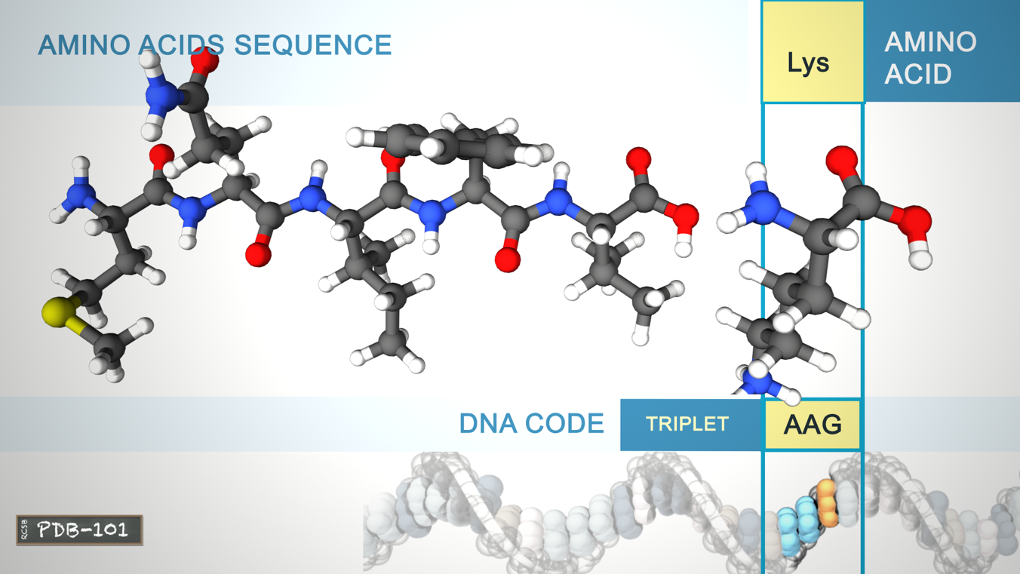
Protein Structure: Primary Structure
The primary structure of a protein is the linear sequence of amino acids as encoded by DNA.

Slide 10
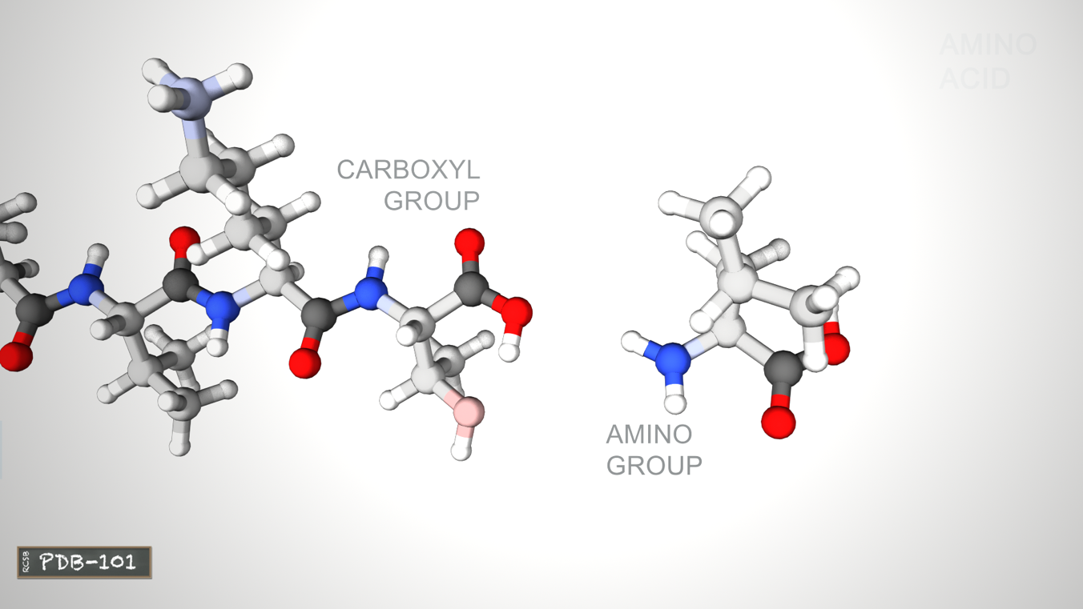
Protein Structure: Primary Structure
PEPTIDE BOND
The amino acids are joined by peptide bonds, which link an amino group and a carboxyl group. A water molecule is released each time a bond is formed.

Slide 11
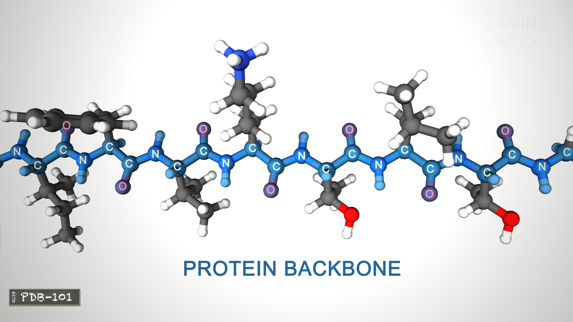
Protein Structure: Primary Structure
The linked series of carbon, nitrogen, and oxygen atoms make up the protein backbone.

Slide 12
Protein Structure: Secondary Structure
The protein chains often fold into two types of secondary structures: alpha helices, or beta sheets.

Slide 13
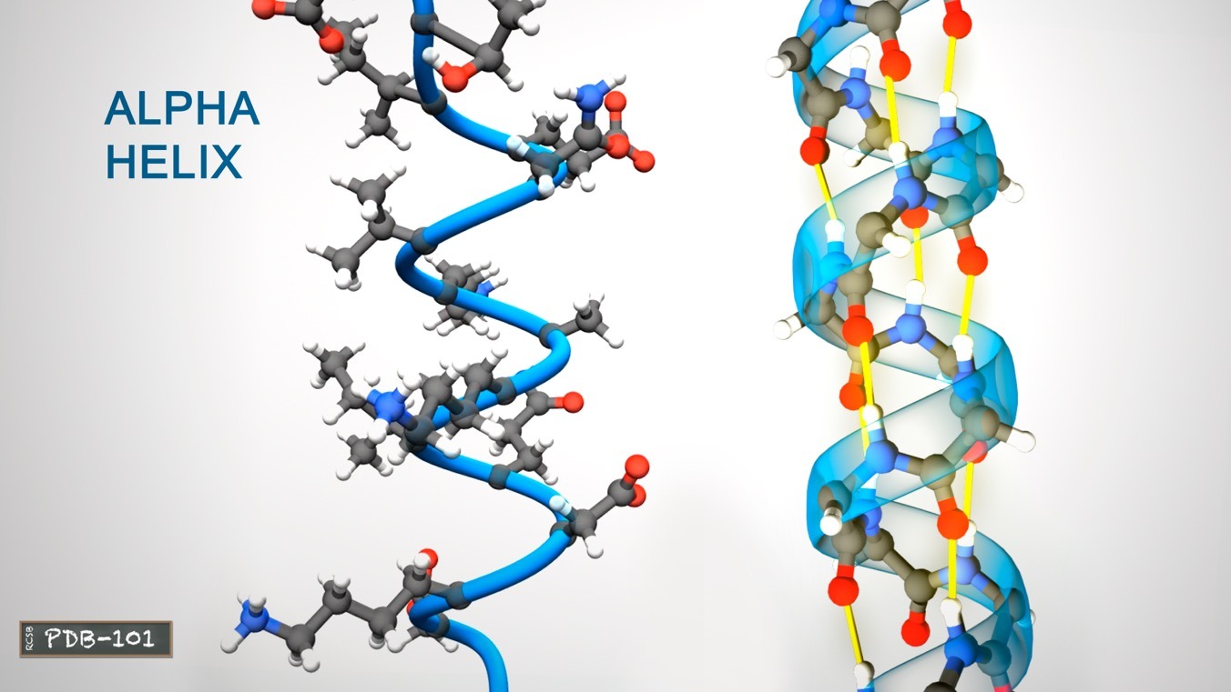
Protein Structure: Secondary Structure
Hydrogen
Bond
An alpha helix is a right-handed coil stabilized by hydrogen bonds between the amine and carboxyl groups of nearby amino acids

Slide 14
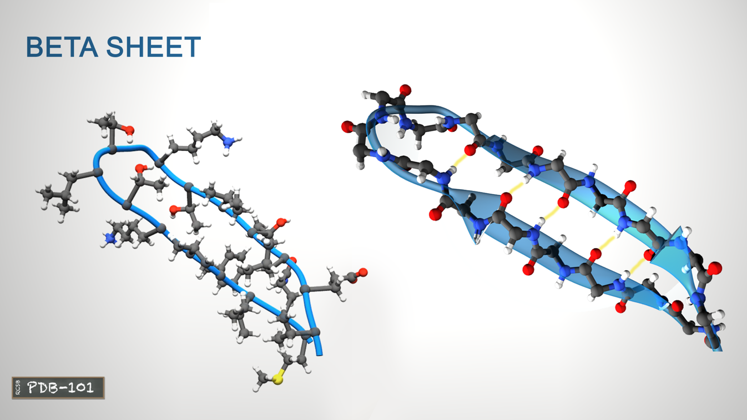
Protein Structure: Secondary Structure
Hydrogen
Bond
Beta-sheets are formed when hydrogen bonds stabilize two or more adjacent strands.

Slide 15
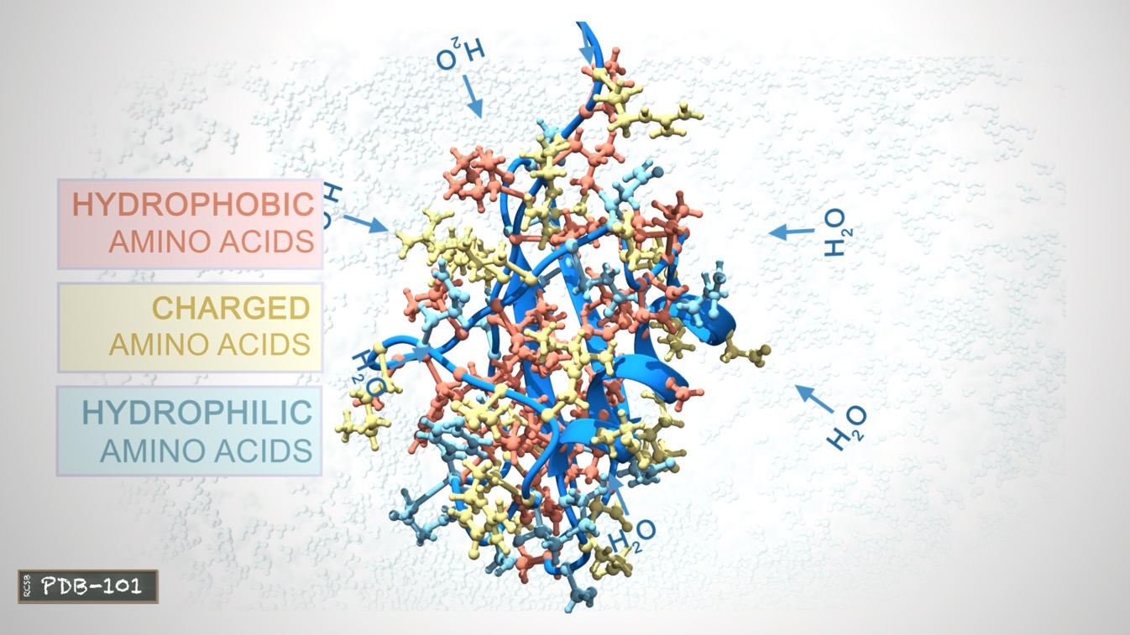
Protein Structure: Tertiary Structure
The tertiary structure of a protein is the three-dimensional shape of the protein chain. This shape is determined by the characteristics of the amino acids making up the chain.

Slide 16
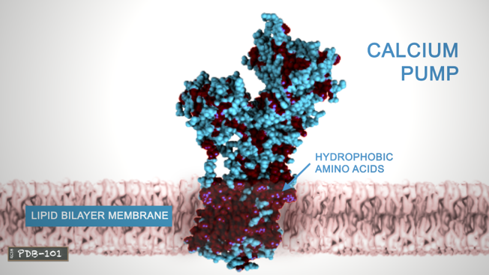
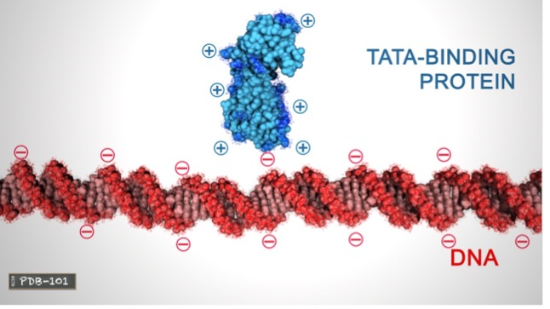
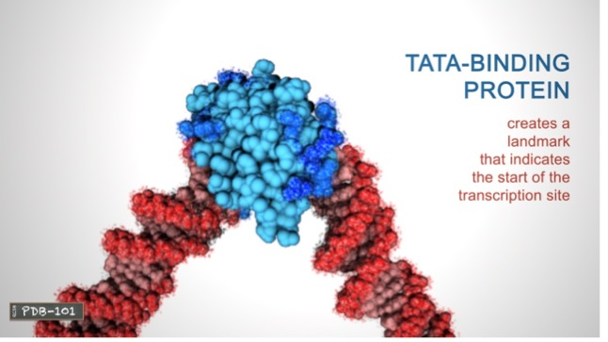
Protein Structure: Tertiary Structure
Many proteins form globular shapes with hydrophobic side chains sheltered inside, away from the surrounding water.
Membrane-bound proteins have hydrophobic residues clustered together on the outside, so that they can interact with the lipids in the membrane.
Charged amino acids allow proteins to interact with molecules that have complementary charges.

Slide 17
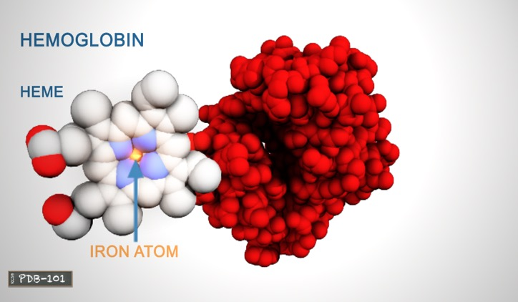
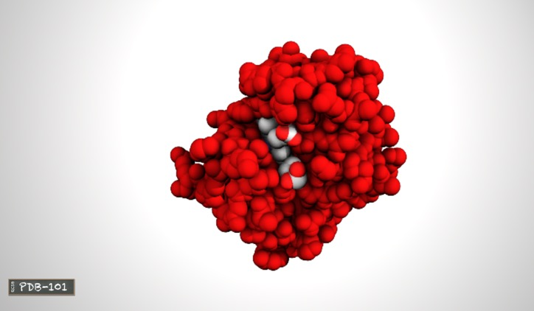
Protein Structure: Tertiary Structure
The functions of many proteins rely on their three-dimensional shapes. For example, hemoglobin forms a pocket to hold heme, a small molecule with an iron atom in the center that binds oxygen.

Slide 18
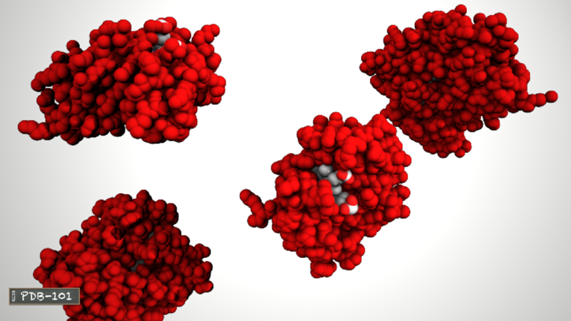
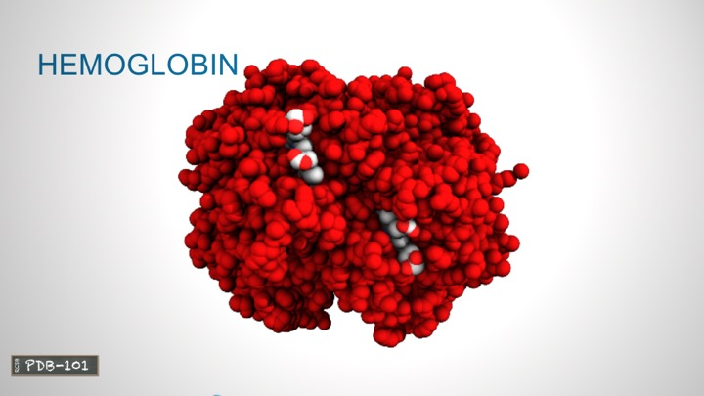
Protein Structure: Quaternary Structure
Two or more polypeptide chains can come together to form one functional molecule with several subunits.
For example, the four subunits of hemoglobin cooperate so that the complex can pick up more oxygen in the lungs and release it in the body.

Slide 19
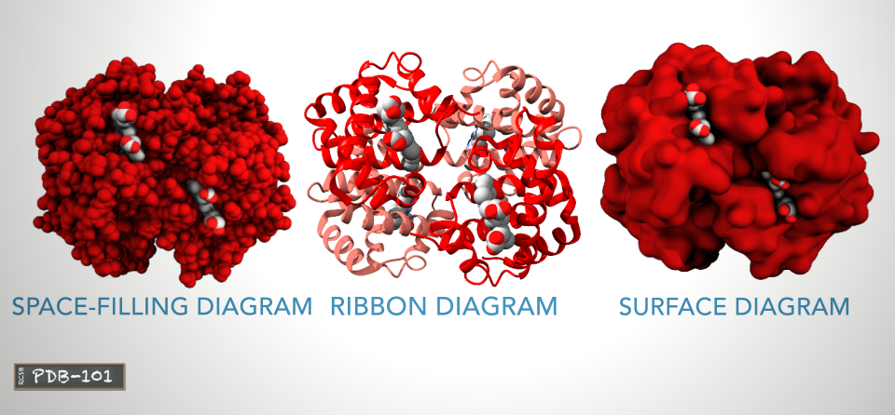
Protein Representation
Different visual representations of proteins can give us visual clues about the protein structure and function. The space filling diagram shows all atoms that are making up this protein. The ribbon or cartoon diagram shows the organization of the protein backbone and highlights the alpha helices. The surface representation shows the areas that are accessible to water molecules.

Slide 20
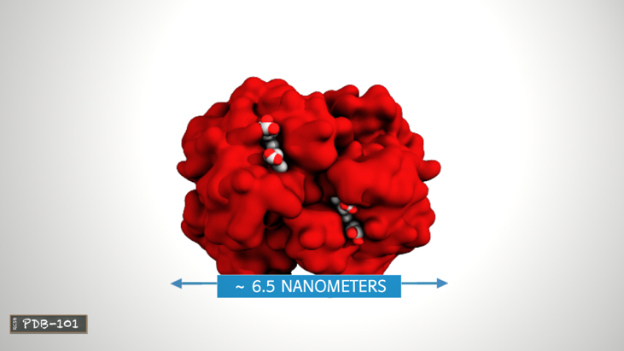
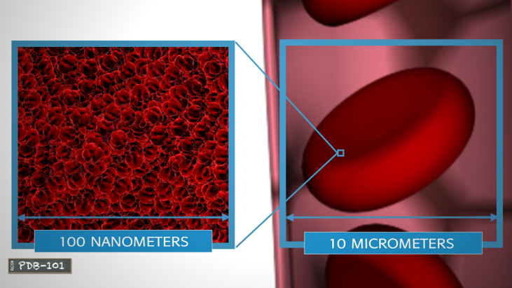
Protein Size
Most proteins are smaller than the wavelength of light. For example, the hemoglobin molecule is about 6.5 nanometers in size.
Hemoglobin is found in high concentration in red blood cells.
A typical red blood cell contains about 280 million hemoglobin molecules.

Slide 21
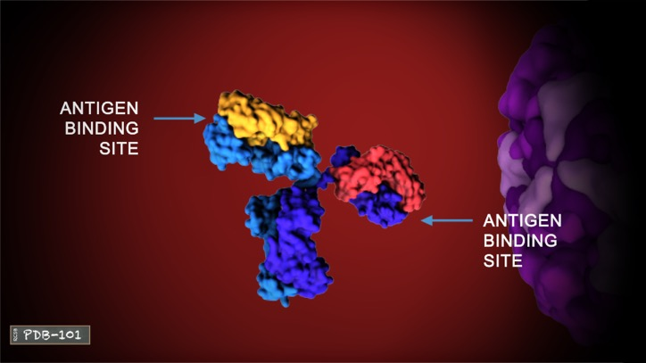
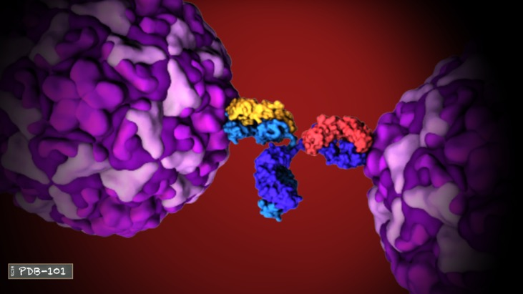
Shape and Function: DEFENSE
The flexible arms of antibodies protect us from disease by recognizing and binding to pathogens such as viruses, and targeting them for destruction by the immune system.

Slide 22
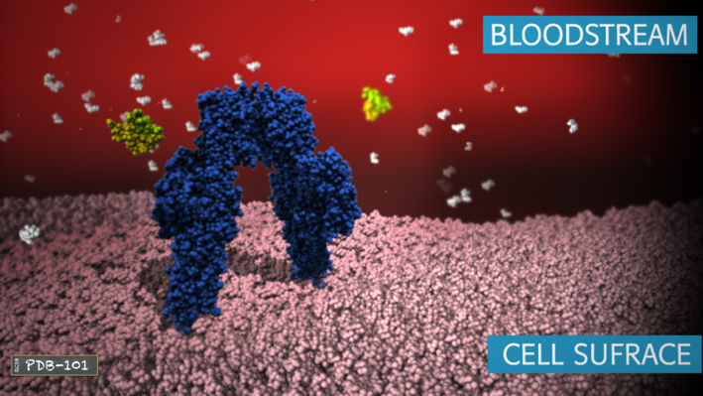
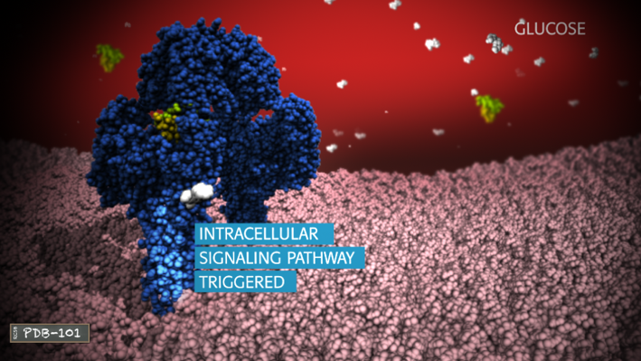
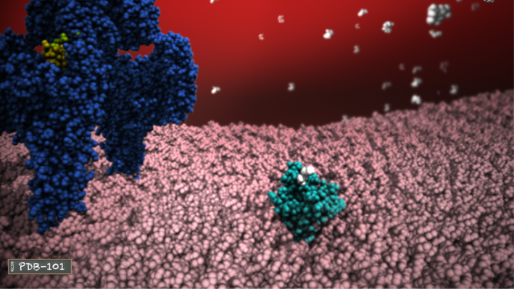
Shape and Function: COMMUNICATION
1
The hormone insulin (yellow) is a small, stable protein that can easily maintain its shape while traveling through the blood to regulate the blood glucose level.
2
3
Insulin binds to the insulin receptor (navy blue) and triggers an intracellular signaling pathway.
As a result, the glucose transporter (aqua) comes to the cell surface creating a channel for glucose (white) to enter the cell.

Slide 23
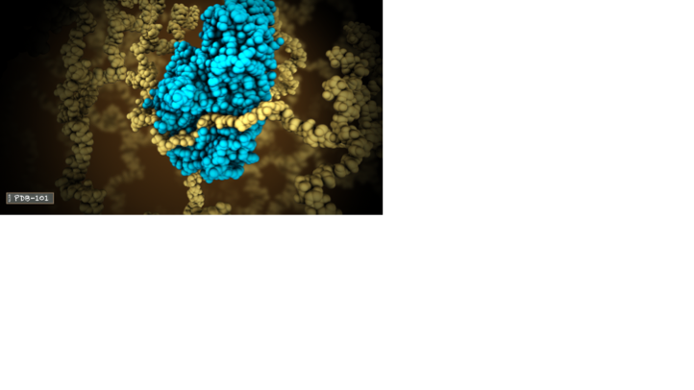
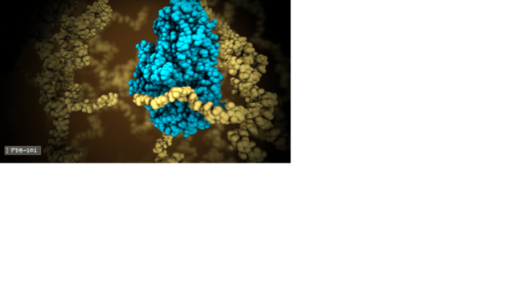
Shape and Function: ENZYMES
Alpha Amylase (turquoise) is an enzyme that begins digestion of starches in our saliva.
It binds to a carbohydrate chain (yellow) and breaks it into smaller pieces with two or three glucose units.

Slide 24
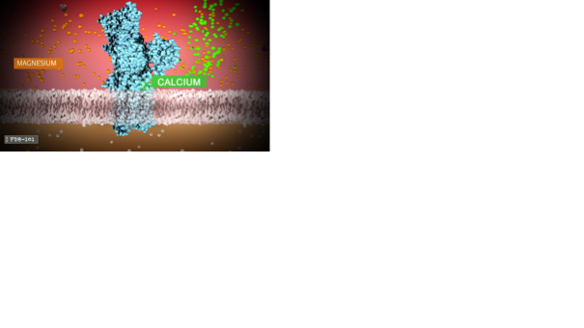
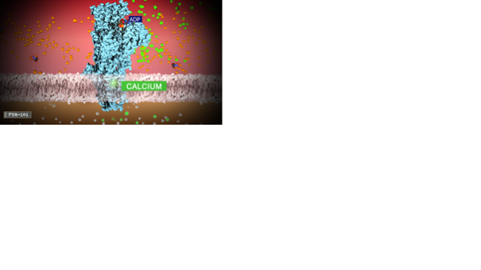
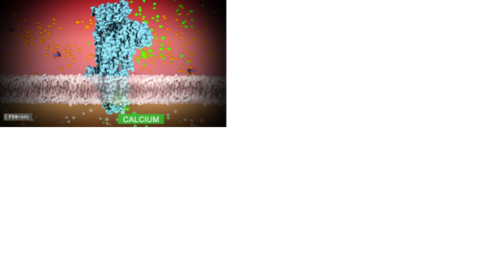
Shape and Function: TTRANSPORT
1
The calcium pump reduces the calcium level in the muscle cell by transporting calcium ions back to the sarcoplasmic reticulum after each muscle contraction.
Magnesium primes the pump for calcium intake and two atoms enter the pump.
2
3
The ATP causes a change in shape of the transmembrane part of the pump, allowing the calcium atoms to be pushed further down the channel.
After the calcium atoms are released to the lumen of the sarcoplasmic reticulum, the whole cycle begins again.

Slide 25
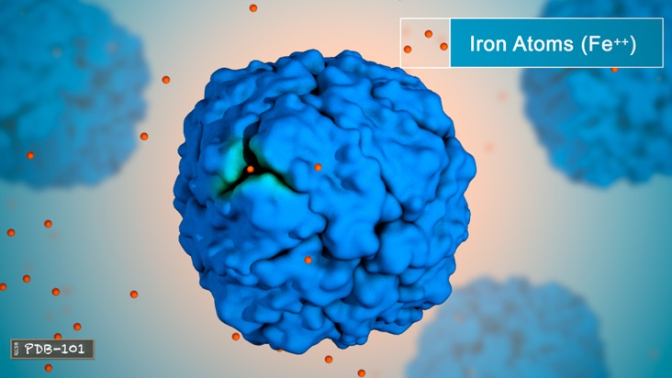
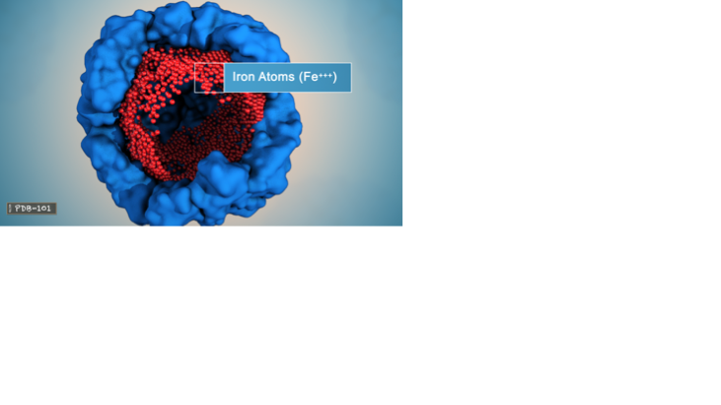
Shape and Function: STORAGE
Ferritin stores iron. It is a spherical protein with channels that allow the iron atoms to enter and exit depending on the organism’s needs.
On the inside, ferritin forms a hollow space with the iron atoms attached to the inner wall.
Ferritin stores iron in the non-toxic form.

Slide 26
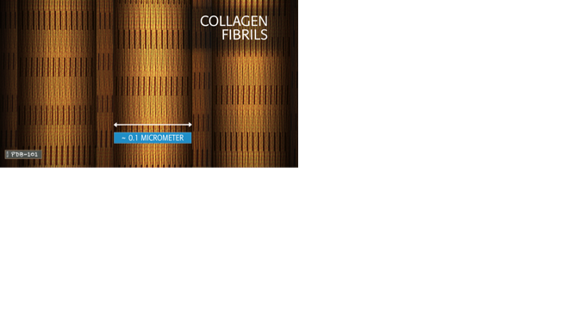
Shape and Function: STRUCTURE
Collagen forms a strong triple helix that is used throughout the body for structural support.
1
2
3
Collagen molecules can form elongated fibrils.
The fibrils aggregate to form collagen fibers. This type of collagen is found in skin and tendons.

