Slide 1
Adolescents/Young Adults and HIV
John Nelson, PhD, CPNP
July 31, 2014

Slide 2
Learning Objectives
Identify factors leading to “high-risk” for HIV infection in adolescents and young adults.
Identify barriers to HIV-related health care services for adolescents and young adults

Slide 3
History of Adolescent HIV Infections
Blood transfusion
Hemophiliacs and other children/adolescents receiving blood transfusions before 1985
Sexual practices
Gay, bisexual, and transgender adolescents
Heterosexual adolescents
Sexually abused children/adolescents
Injection drug use (IDU) and other needle-sharing (steroids, hormones) adolescents
Perinatally infected individuals
Notes:
Introduce some of the ways in which adolescents and young adults are exposed to HIV infection

Slide 4
Risk Factors 1
Education (low health literacy - ability to navigate health care system and understand health terminology)
Motivation and Self-Esteem (“Am I worth protecting?”)
Mental Health (i.e. anxiety, depression, PTSD are associated with increased risk behaviors)
Social Networking/Social Determinants (living or socializing in high HIV prevalence areas/neighborhoods); incarceration
Social Injustice: racism, sexism, classism, age-ism, heterosexism, able-ism (all are associated with stigma, anxiety, depression)
Notes:
Primary Infection (HIV) makes people more susceptible to Secondary Infection (bacteria, parasite, etc.)

Slide 5
Risk Factors 2
Substance use - Non-Injection Drug Use as well as IDU
E.g. Alcohol, marijuana, cocaine, heroin, meth
Mucosal Conditions
Presence of another STI – many STIs may be asymptomatic
Use of hyperosmolar douches/lubricants etc.
Male Circumcision
Studies show that uncircumcised males can become infected more easily
Availability of protective measures
Condoms, Dental Dams, Clean Needles, PrEP/PEP
PrEP – Pre-Exposure Prophylaxis medication
PEP – Post-Exposure Prophylaxis medication
Notes:
Talk about how there are needle exchange programs as well as the PrEP and PEP medications. This is especially critical for individuals in high risk groups and/or who may have been exposed to infection due to risky behavior

Slide 6
Risk Factors 3
Cognitive abilities of the adolescent
concrete vs. abstract thinking ability;
living for the moment vs. thinking about the future
Developmental Issues related to adolescence
“We’re in love - since (s)he’s positive, I don’t care if I become positive.”
Adolescent’s who perceive an early mortality for themselves
Notes:
Individuals <25 years of age are still developing their ability to think about the big picture – c.f. driving insurances reduce after age 25
Adolescents often think that their behavior and their body is their business and they should be able to do what they “want”. They fail to see the potential consequences of their choices

Slide 7
Risk Factors 4
Motivation for sex
(i.e. survival sex, pleasure, “to feel loved,” reproduction, comfort, or abusive/forced)
Relationship power
(unequal power in a relationship is associated with greater risk behaviors)
Health Belief
Family history - Adolescents who have a parent or grandparent who died of HIV/AIDS related disease

Slide 8
Subpopulations at Greatest Risk
“Street” youth (homeless, runaway, throw-away, abandoned, foster care, familial/parental drug abuse, incarceration, mental illness or death)
Sexually active Gay, Bisexual and Transgender youth
Sexually active heterosexual youth (primarily with an STI)
Substance users (IDU and non-IDU)

Slide 9
Diagnoses of HIV/AIDS
Age (Years) | Estimated Number of Diagnoses of HIV Infection, 2011
Under 13 | 192
Ages 13-14 | 53
Ages 15-19 | 2,240
Ages 20-24 | 8,054
Ages 25-29 | 7,484
Ages 30-34 | 6,209
Ages 35-39 | 5,285
Ages 40-44 | 5,753
Ages 45-49 | 5,564
Ages 50-54 | 3,951
Ages 55-59 | 2,312
Ages 60-64 | 1,229
Ages 65 or older | 948
CDC. HIV Surveillance Report: Diagnoses of HIV Infection and AIDS in the United States and Dependent Areas, 2011; Vol. 23.
Notes:
The population shown in red are those that are considered in the adolescents and young adults discussion
Visit the Aidsvu.org for more stats and details

Slide 10
HIV Treatment Cascade
Notes:
HARRT (highly active antiretroviral therapy) is now CART (combined antiretroviral therapy)
Window testing – picks up antibody AND antigen (can detect sooner)
Have to have a certain number of bands on the Western Blot test to confirm HIV
Currently the treatment cascade shows that there is a rapid drop in the percentage of individuals who are diagnosed with HIV infection and those that stay in care (taking medications to check viral replication and manage HIV related morbidity and mortality)

Slide 11
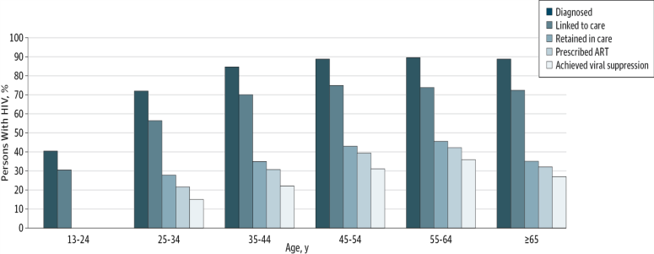
Treatment Cascade by Age group
JAMA Intern Med. 2013;173(14):1337-1344. doi:10.1001/jamainternmed.2013.6841
From: Differences in Human Immunodeficiency Virus Care and Treatment Among Subpopulations in the United States
Figure Legend:
Percentage of Persons With Human Immunodeficiency Virus (HIV) Infection Percentages are shown for US individuals engaged in selected stages of the continuum of care by age. ART indicates antiretroviral therapy.
Date of download: 9/13/2013
Copyright © 2012 American Medical Association. All rights reserved.
Notes:
Younger than 24 yr olds with HIV infection often either do not have the means to get to the care facilities/clinics or are too embarrassed/scared to go to the clinics. There are still many stigmas associated with HIV/AIDS

Slide 12
Public Health Implications
Routine care: persons living with HIV/AIDS (PLWHA) need risk assessments & counseling to reduce transmission of STIs and HIV.
Health care providers should (ASI):
ASK about behavioral risks
SCREEN for sexually transmitted infections
INTERVENE by
delivering tailored harm reduction interventions.
Focus on beliefs, attitudes, norms, skills, self-efficacy, environmental circumstances,
Motivate change while setting concrete and realistic behavioral goals.
MMWR Recommendations and Reports. 2003;52(RR-12):1–24.
Notes:
This is what currently is being promoted in all health care facilities (not just specialized HIV clinics)

Slide 13
Barriers to Health Care Services
Concerns for HIV+ and HIV at-risk Adolescents in the U.S.
Payment: (no insurance, parental insurance and confidentiality, no money for co-payment)
Transportation: (may not want to be tested in home neighborhood; how do they get to another site without money or without parents finding out?)
Confidentiality: (“Will my parents find out?” “What if someone I know is at that clinic or works at that hospital/clinic?”)
Legal: (deportation, DOH notification, DFYS notification, “street” minors)
Social: Fear of disapproval from a provider when reveals personal information regarding sexuality, sexual behaviors, substance use, problems at home . . .

Slide 14
For additional information and details visit http://aidsetc.org/ and explore the Resource Library

