Slide 1
COVID-19:
Infection and Disease
Collaborative Curriculum Development Program 2020

Slide 2
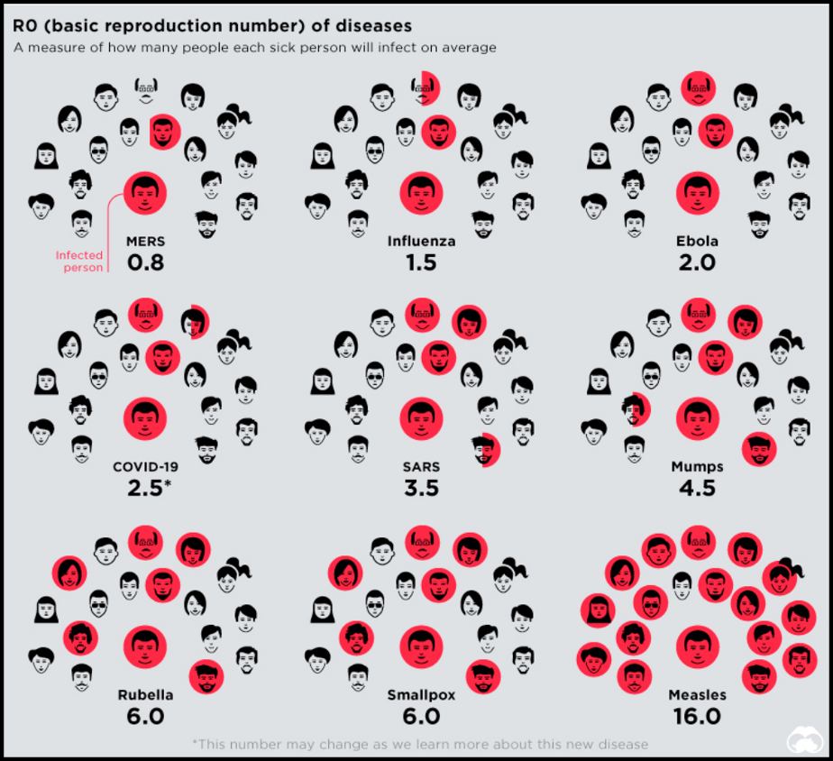
Transmission of Infection
Basic Reproduction Number = number of cases transmitted by a single infected person
https://theo10.com/wp-content/uploads/2020/03/History-of-Pandemics-Deadliest-1-820x675.jpg
Notes:
The basic reproduction number is calculated by looking at the number of cases transmitted by a single infected person. This occurs at the start of an epidemic when there is no widespread immunity or vaccination. For example, if one person infects 2 other people then the Ro (R naught) would = 2.
If the Ro is >1 in a population then the infection will spread exponentially. Infections with an Ro < 1 would spread slowly and die out.
The above graphic compares the Ro of several infectious diseases. An important note is that SARS has a higher Ro as compared to COVID-19. This number may change as more data and information is recorded.
The infectivity of the SARS-CoV-2 is an ongoing story and studying why SARS-COV-2 is less pathogenic than SARS-COV-1 is an interesting area of research.
Could continued adaptation to humans have played an impact on the immune response? Is SARS-CoV-2 less efficient at the suppression of antiviral responses? The molecular mechanism for these effects will be extremely important research.

Slide 3
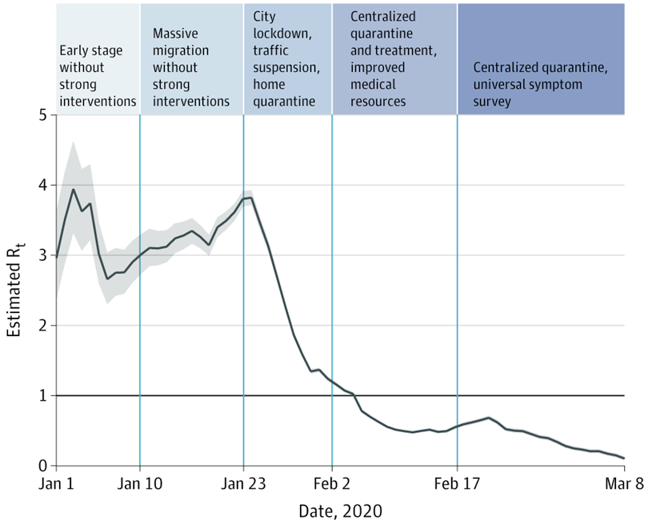
Controlling Infection
Effective Reproduction Number (Rt)
https://jamanetwork.com/journals/jama/fullarticle/2765665
Notes:
The Rt is the number of people in a population that can be infected by an individual at any specific time. This number can change due to many factors such as immunization and social distancing measures. If the Rt decreases below 1, then the viral infection is an epidemic and can be controlled in that region.
Many measures can be taken to reduce the Rt during an epidemic. The above plot shows how the Rt for COVID-19 was reduced in Wuhan China.

Slide 4
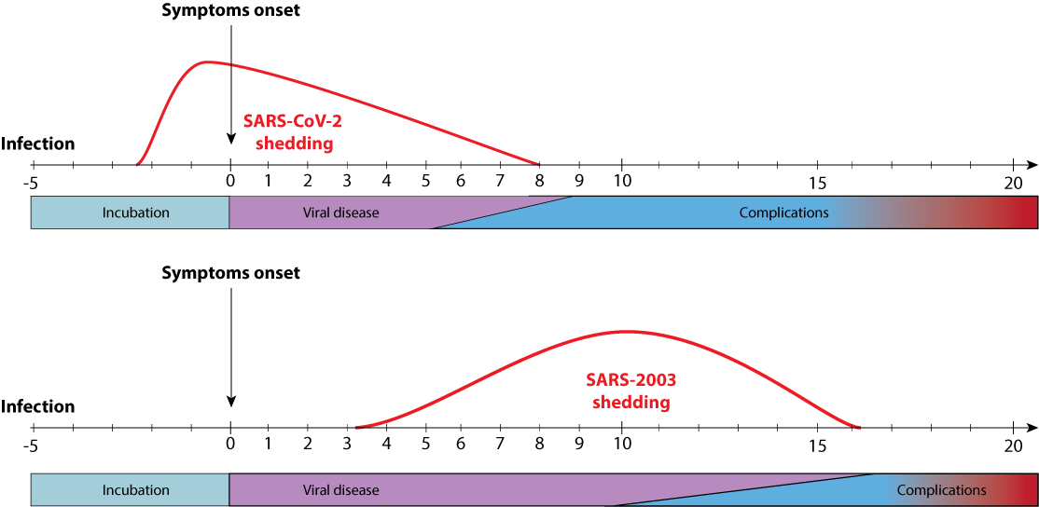
Why is SARS-CoV-2 Harder to Manage?
https://viralzone.expasy.org/resources/COVID-19_SARS2003.png
Notes:
Note that in the SARS-CoV-1 which happened in 2002-2003, the phase when the infected person can infect others is 5-15 days after they start showing symptoms. Isolating the individual after onset of symptoms can prevent further spread of the disease.
In contrast, individuals who are infected with SARS-CoV-2 may be completely asymptomatic and spread the infection to others. By the time they show the first symptoms they may have already infected many others. This is making it really hard to control the spread of infection.

Slide 5
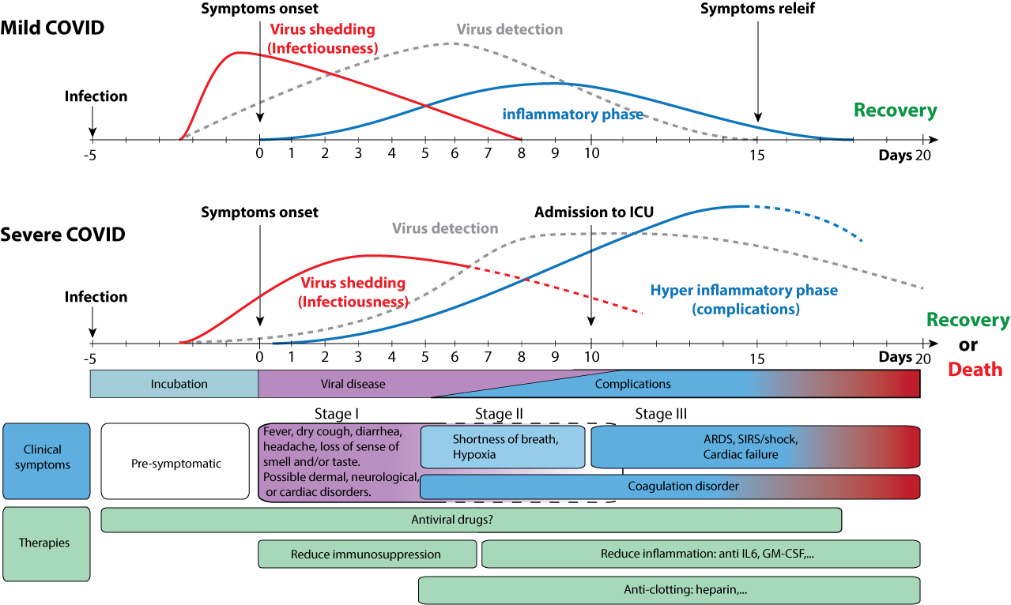
SARS-CoV-2 Infection and Disease Progression
https://viralzone.expasy.org/resources/COVID-19-stages.png
Notes:
Although the primary function of Cytokines is to help mount an immune response to rid the body of the pathogen, when the response is uncontrolled it can cause the individual harm
Mild cases of COVID-19 has a smaller cytokine response and within 14-18 days the individual can recover
Individuals who have a severe response to infection have an uncontrolled cytokine response which can lead to many complications, organ damage and even death. In such cases, it is important to carefully manage the cytokine storm to help the individual recover.

Slide 6
What Happens Upon SARS-CoV-2 Infection?
Stage | Clinical | Biological | Treatment
I (early infection) | Incubation >> mild symptoms (e.g. malaise, fever, dry cough) | Viral replication; innate immune response; some interferons | Antiviral therapies; Immunosuppression at this stage could be dangerous
II (pulmonary phase) | Can progress rapidly to Acute Respiratory Distress Syndrome (ARDS), may require intubation | Adaptive immune response occurs; viral titers decrease but increased levels of inflammation and tissue damage. | Antiviral-therapy and some immunosuppression could be beneficial esp. patients with severe manifestations
III (hyperinflammation phase / cytokine storm) | develop high levels of inflammation; leads to clinical deterioration | Dysregulated adaptive immune response leads to cytokine storm | Continue immunosuppression; steroids may be added
https://emcrit.org/ibcc/covid19/#signs_and_symptoms

Slide 7
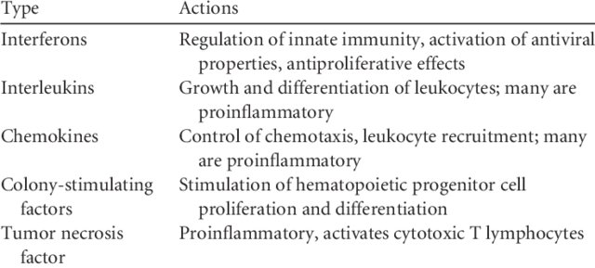
What are Cytokines?
Group of small proteins, secreted by specific immune cells that function as signaling molecules, mediate and regulate immunity and inflammation
https://www.researchgate.net/figure/Major-types-and-actions-of-cytokines_tbl1_22188
Notes:
They have autocrine, paracrine, and endocrine function. A major function is the regulation of immune and inflammatory responses.

Slide 8
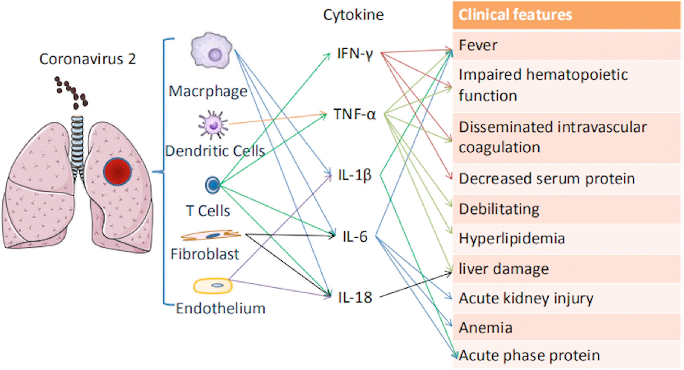
Cytokine Storm
https://doi.org/10.1016/j.cytogfr.2020.04.002
Notes:
The term Cytokine Storm appeared in infectious disease research in the year 2000.
It has been associated with infectious and noninfectious diseases.
One of the major problems with SARS-CoV-2 is its ability to trigger an aggressive cytokine storm in many patients.
Cytokine storm can cause lung and other organ damage.

Slide 9
Managing the Storm by Blocking IL-6 function
https://www.nature.com/articles/s41584-020-0419-z/figures/2
Notes:
IL-6 receptor antagonists (monoclonal antibodies)
Tocilizumab (Actemra), sarilumab (Kevzara) approved to treat rheumatoid arthritis
Siltuximab (Sylvant), used for the treatment of patients with Castleman’s disease
IL-6 binding monoclonal antibodies
Olokizumab
Sirukumab
Clazakizumab
Inhibitors of intracellular kinases involved in IL-6 signaling
Baricitinib
See https://www.nature.com/articles/s41584-020-0419-z

