Slide 1
Developing a Vaccine Against SARS-CoV-2
Collaborative Curriculum Development Program
2020

Slide 2
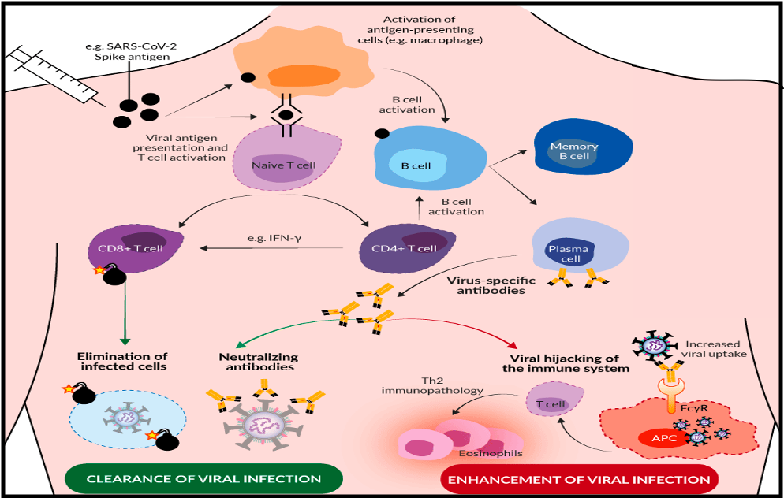
Rationale for Vaccine Design
https://www.invivogen.com/spotlight-covid-19-vaccine-development
Notes:
Stimulating the immune system to a particular antigen involves activating multiple cells.
Innate immune cells will respond to the SARS-COV-2 virus and then activate the adaptive immune response.
The antigen presenting cells will activate specific B and T cells.
T cells once presented with the antigen will directly attack virus infected cells.
Some of those T cells will remain as memory T cells and will be able to respond to reinfection of the Virus.
B cells will produce Antibodies specific to a viral protein (e.g. SARS-COV-2 Spike Protein).
Antibodies will travel through the blood-stream to the site of infection and bind to that protein, thus blocking the virus from infecting cells. These neutralizing antibodies are very effective at preventing infection.
Some antibodies are made in response to other parts of the virus and do not effectively block viral entry.
Once the infection has cleared some of the B cells will live on as memory B Cells. They will continue to make antibodies and protect a person from reinfection. This protection from Antibodies is the key strategy to vaccine development and success. Vaccines must stimulate neutralizing antibodies and block viruses from infecting a host cell.

Slide 3
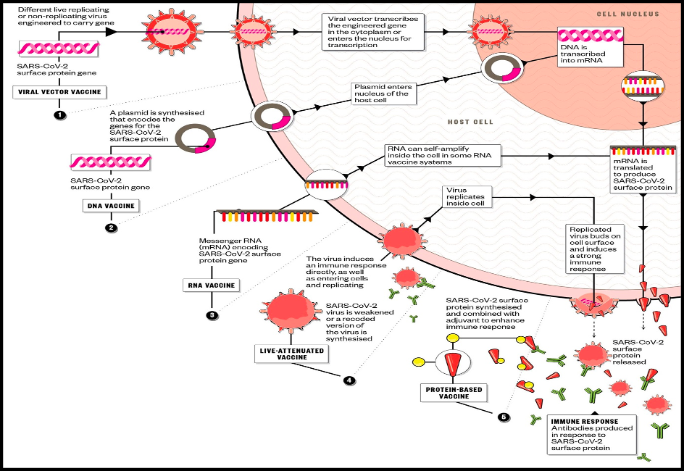
Vaccine Development Approaches
https://www.pharmaceutical-journal.com/download?ac=1079940
Notes:
There are 4 strategies used to develop a vaccine:
1.Protein Based
a. Subunit
b. Virus Like Particle
2. Virus Based
a. Inactivated or
b. Live Attenuated Virus
3. Nucleic Acid Based
a. mRNA
-Replicating
-Non-replicating
b. DNA
4. Viral Vectors
a. Replicating
b. Non-replicating

Slide 4
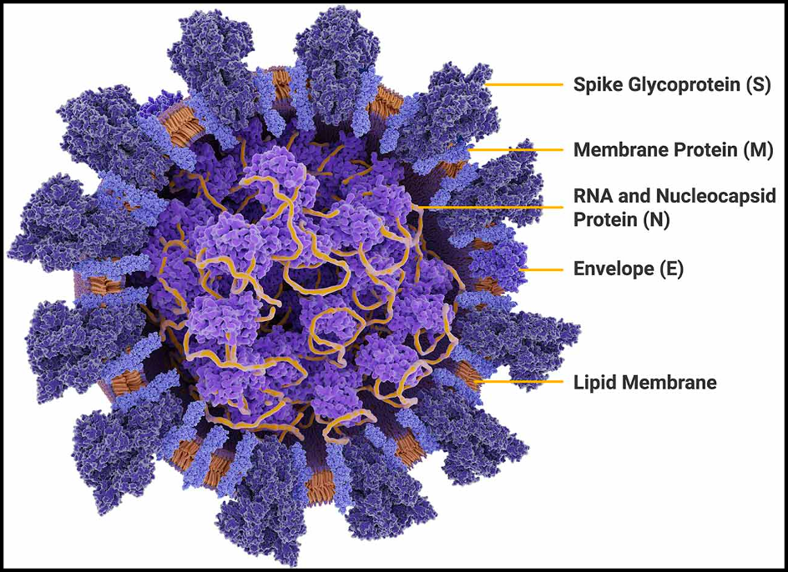
Vaccine Target
https://promega.media/-/media/images/products-and-services/coronavirus-detection/coronavirus-labeled2.jpg
Notes:
The main target of the COVID-19 vaccine is the SARS-COV-2 spike protein. Stimulating the production of neutralizing antibodies that will bind to this protein can prevent viral infection of the host cell.

Slide 5
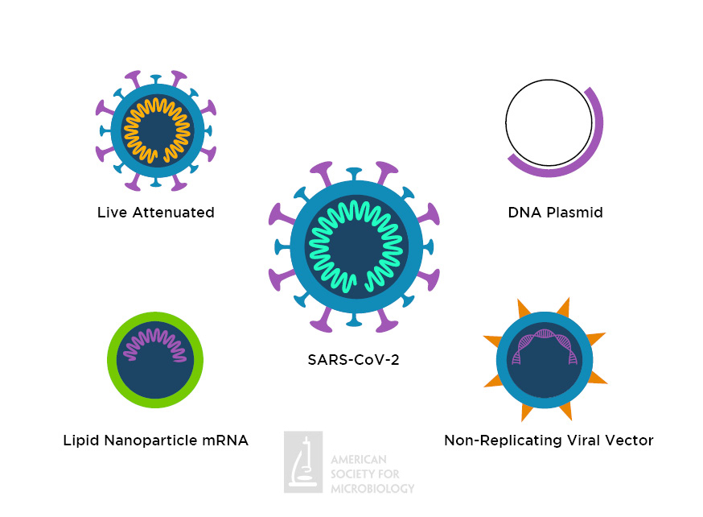
Types of SARS-CoV-2 Vaccines in Clinical Trials
https://asm.org/ASM/media/Article-Images/2020/May/COVID-Vaccine-Infographic-874x642.jpg?ext=.jpg

Slide 6
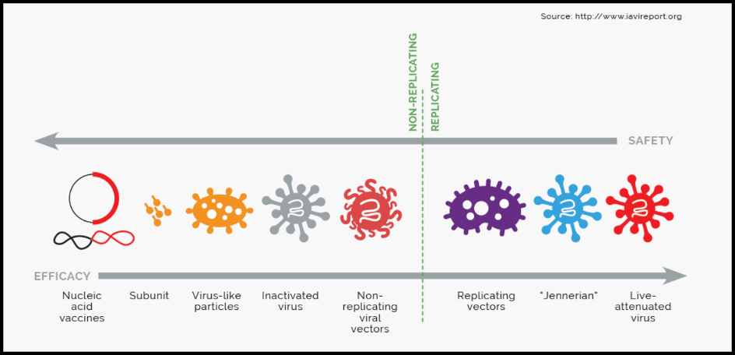
Efficacy and Safety
Notes:
Many vaccines are currently in clinical trials and will continue to be in the near future.
Many companies have developed vaccines using all 4 strategies.
Major concerns with all vaccines are efficacy and safety.
Depending on the strategy used that can vary. Some of the very effective vaccines can have more side effects and vice versa.
Clinical trials a performed to determine the safety and efficacy of all vaccines.

