Slide 1
Endocrinology: A Molecular View
Shuchismita Dutta, Ph.D.

Slide 2
Learning Objectives
Hormones: Types and Functions
Feedback loops
Balancing Insulin and Glucagon

Slide 3
Learning Objectives
Hormones: Types and Functions
Feedback loops
Balancing Insulin and Glucagon

Slide 4
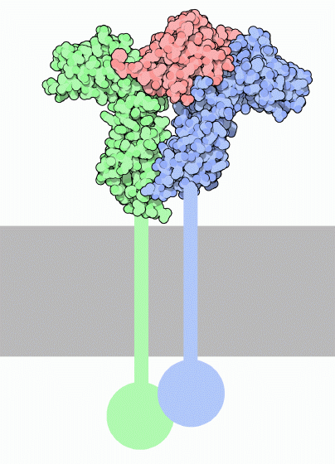
Hormones: What Are They?
Growth hormone (GH)
Small molecules, peptides or proteins to signal cells and regulate their functions
Secreted by specific cells in the body but usually act on other and remote cells
Transport from source to target via blood
Specific: i.e. have unique chemical structures bind to specific receptors on/in target cells
GH Receptor
http://pdb101.rcsb.org/motm/52
Notes:
Learn more about Growth Hormone at http://pdb101.rcsb.org/motm/52

Slide 5
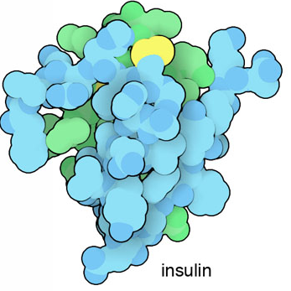
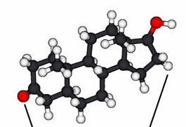
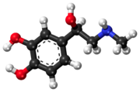
Hormone Types
Peptide/protein
Small Molecule derivatives
Usually short peptide or a small protein
  Insulin
  Glucagon
Binds to surface receptors
Derived from lipids:
  Steroids
  Binds nuclear receptors
Derived from amino acids:
  Adrenaline
  Binds to surface receptors
Insulin
Testosterone
Adrenaline
Notes:
Learn more about insulin at http://pdb101.rcsb.org/motm/14
Learn more about testosterone binding at http://pdb101.rcsb.org/motm/92
Learn more about adrenaline at http://pdb101.rcsb.org/motm/100

Slide 6
Hormone Functions
Broad Group | Example
Reproduction and sexual differentiation | Testosterone
 | Estrogen
Development and growth | Insulin
 | Cytokines
Maintenance of the internal environment | Thyroid
Regulation of metabolism and nutrient supply | Glucocorticoids
 | Mineralocorticoid

Slide 7
Hormones: General Properties
A single hormone may affect multiple effects on same or different cells
  e.g. Thyroid hormone
    essential in development
    essential for many aspects of homeostasis and metabolism
  Glucocorticoids (such as cortisol)
    important both in growth and nutrient supply and
    modulators of immune function.
Multiple hormones may regulate a single specific function in the organism
  e.g. Insulin, Glucagon, Cortisol, Growth Hormone and Epinephrine
    all are involved in maintaining blood glucose concentrations

Slide 8
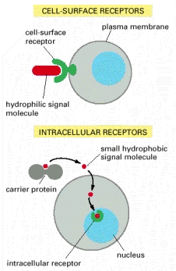
Hormone Receptors
Receptor specifically binds signal molecule (sometimes called ligand)
Cell surface receptors
  Embedded in plasma membrane
  Bind water-soluble ligands
Intracellular receptors
  Present in cytoplasm or nucleus
  Binds small and hydrophobic ligands
  (that can pass through the cell membrane)
http://www.ncbi.nlm.nih.gov/books/NBK21059/figure/A2741/

Slide 9
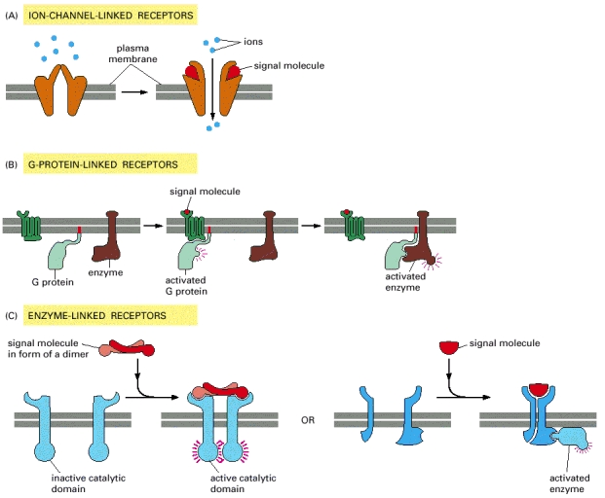
Types of Cell-Surface Receptors
Linked to ion channel
    e.g., ligand gated Ca2+ channels
Linked to G-Protein
    e.g., Glucagon receptor
Linked to Enzymes
    e.g., Insulin receptor
    (Tyr Kinase is part of the receptor)
http://www.ncbi.nlm.nih.gov/books/NBK21059/figure/A2741/

Slide 10
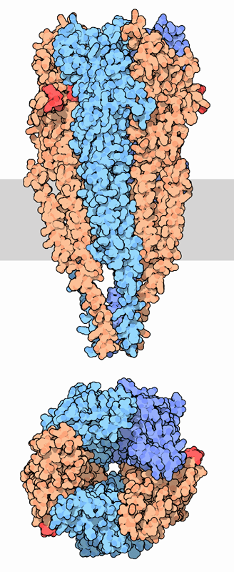
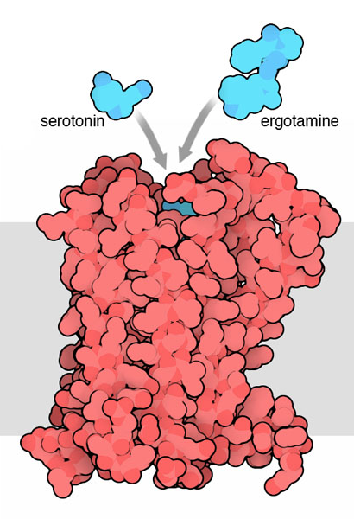
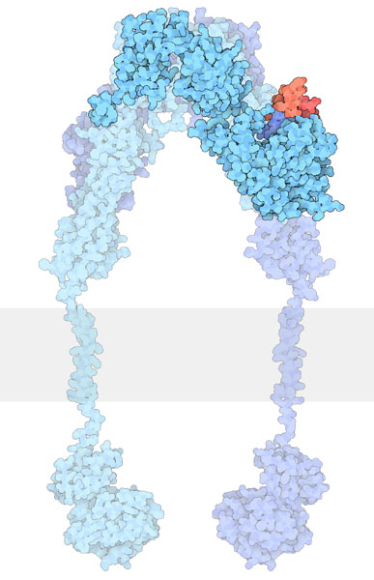
Examples of Cell Surface Receptors
Ion channel linked
G-Protein linked
Enzyme linked
Ion channel
Kinase (enzyme) domain
G-Protein binding
Acetylcholine receptor
Acetylcholine (red)
Serotonin receptor
Serotonin (blue)
Insulin receptor
Insulin (red)
In all these figures the membrane is schematically shown in gray
Notes:
Learn more about:
Acetylcholine Receptors at http://pdb101.rcsb.org/motm/71
Serotonin Receptors at http://pdb101.rcsb.org/motm/164
Insulin Receptors at http://pdb101.rcsb.org/motm/182

Slide 11
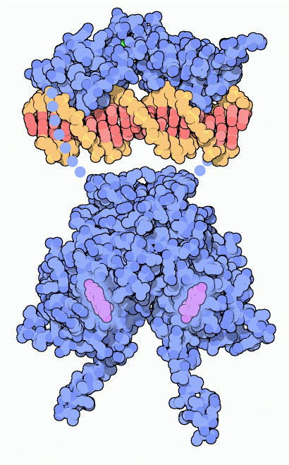
Example of Nuclear Receptor
DNA Binding Domain
Estrogen binds to receptors in nucleus → affects key genes in development
Ligand binding domain and DNA binding domains linked by connectors
DNA
Connector, not shown
Ligand Binding Domain
Estrogen
Estrogen Receptor
Notes:
Learn more about Estrogen Receptors at http://pdb101.rcsb.org/motm/45

Slide 12
Learning Objectives
Hormones: Types and Functions
Feedback loops
Balancing Insulin and Glucagon

Slide 13
Feedback Regulation
Why?
  To turn off signal and return to basal level
  To fine-tune response to external stimuli
What/How?
  Metabolite/effect of hormone action or another hormone regulates further release of hormone and/or its signaling
  May be positive (⬆hormone production) or negative (⬇ hormone production)

Slide 14
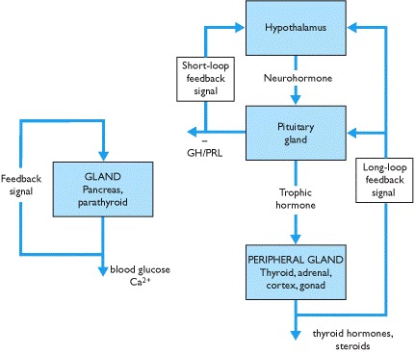
Feedback Regulation Examples
Hypothalamic-pituitary axis
  Regulates secretory activity of the thyroid gland, adrenal cortex and gonads
Small molecule metabolites (e.g. glucose and calcium)
  Regulate secretion of endocrine pancreas and parathyroid gland secretions
http://www.ncbi.nlm.nih.gov/books/NBK20/box/A13

Slide 15
Learning Objectives
Hormones: Types and Functions
Feedback loops
Balancing Insulin and Glucagon

Slide 16
Glucose Homeostasis
Starch in food
Digestion
Undigested/unabsorbed glucose to Feces
Excess glucose to Urine
Glucose in Intestine
Absorption
Low Blood Sugar
Reabsorption
Filtration
Glucose in Blood
Glucose in Kidney
-
-
Glucagon
Glycogen breakdown
Glucose uptake
Insulin
Pancreatic β-cells
High Blood Sugar
Pancreatic α-cells
+
+
Intestinal cells
Glucose in Cells
Incretins
(GLP-1, GIP)
DPP-4
Store as Glycogen
Provide energy
-
Proteolysis
Notes:
Try the Glucose Homeostasis Puzzle activity

Slide 17
Hormones in Glucose Homeostasis
Insulin
  Produced by pancreatic β cells
  Promotes uptake of glucose from plasma
  Reduces Glucagon production
Glucagon
  Produced by pancreatic α cells
  Promotes processes to release glucose into plasma
  Increases insulin production

Slide 18
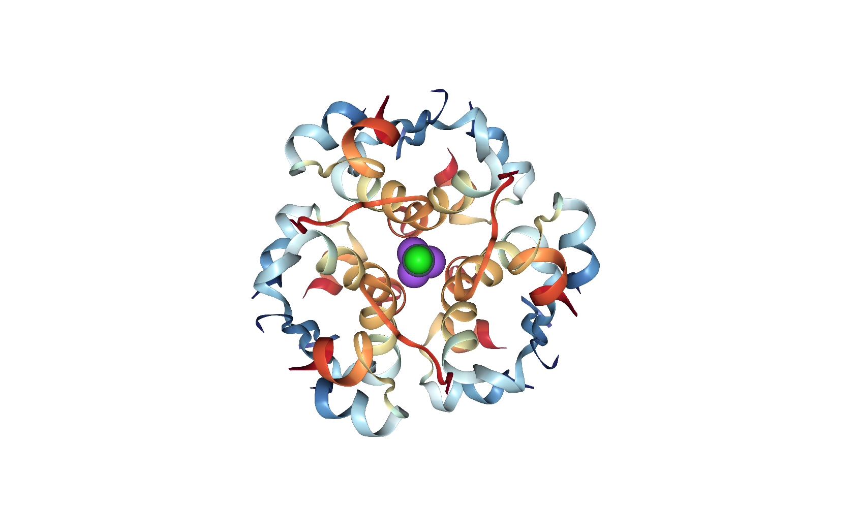
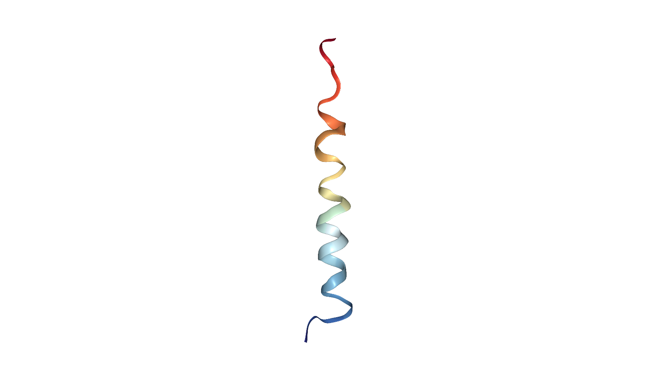
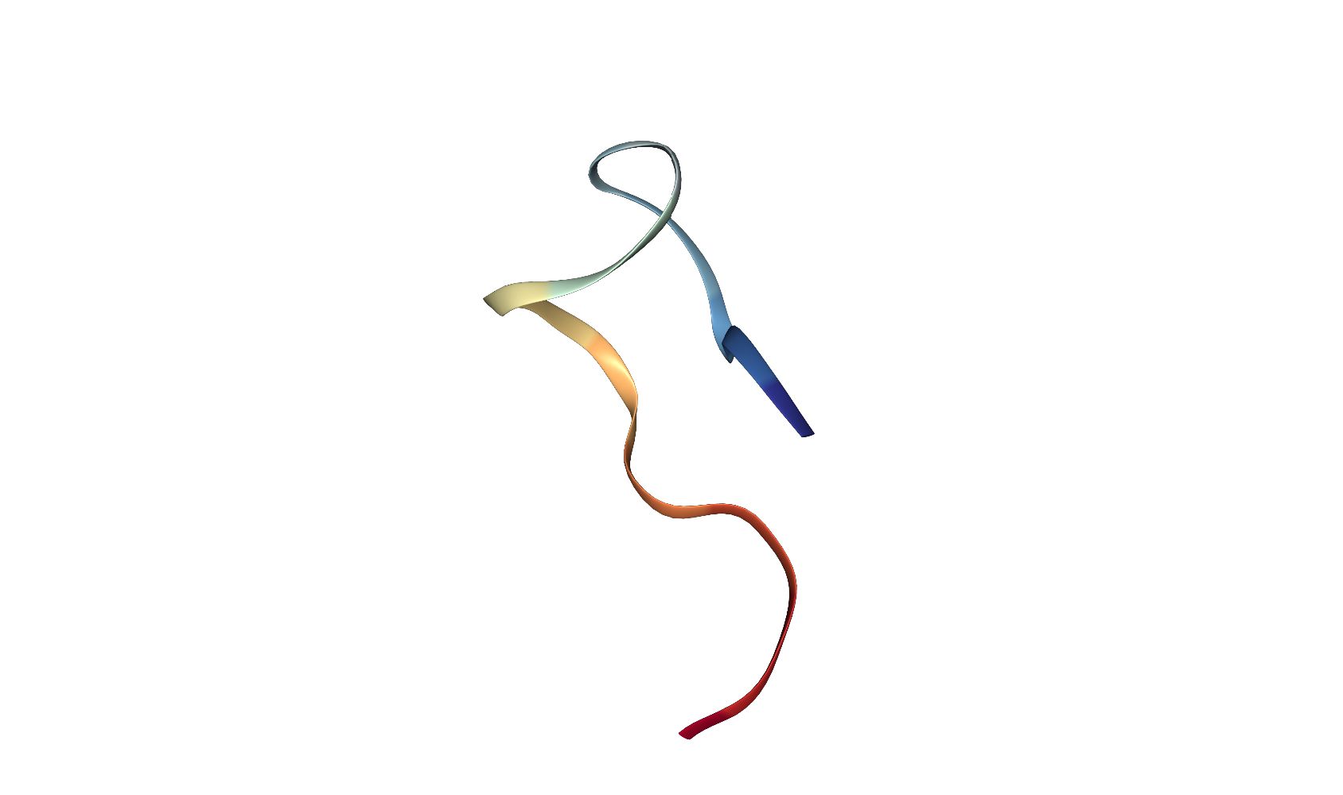
Balancing Insulin and Glucagon
Incretins
GLP-1; GIP
(Gut cells)
⬆Insulin production
  High blood glucose
  Glucagon
  Incretin hormones
    Glucose-dependent insulinotropic peptide (GIP)
    Glucagon-like-peptide 1 (GLP-1)
⬆Glucagon production
  Low blood glucose
  Insulin
Insulin
(β cells)
Glucagon
(α cells)
Somatostatin(δ cells)

Slide 19
Summary
Hormones: Types and Functions
    Protein/peptide, small molecule
Feedback loops
    Examples of positive and negative feedback
Balancing Insulin and Glucagon
    Role of Glucose and Incretins

