Slide 1
Evolution of RNA Viruses
Collaborative Curriculum Development Program
2020

Slide 2
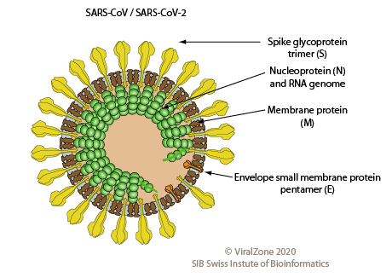
What does SARS-CoV-2 look like?
Severe acute Respiratory Syndrome -Coronavirus-2
Large (~30Kb)
+RNA genome
https://viralzone.expasy.org/764?outline=all_by_species
Notes:
Notes: Virus genetic material come in two main forms, DNA or RNA but never both. DNA viruses can be single (ex. Canine parvovirus) or double stranded (Ex. Chicken pox and Mono). RNA viruses can be double stranded RNA (ex. Rotaviruses causing gastroenteritis) single stranded negative RNA (some obscure diseases) , single stranded RNA (Coronaviruses) and retroviruses (HIV)

Slide 3
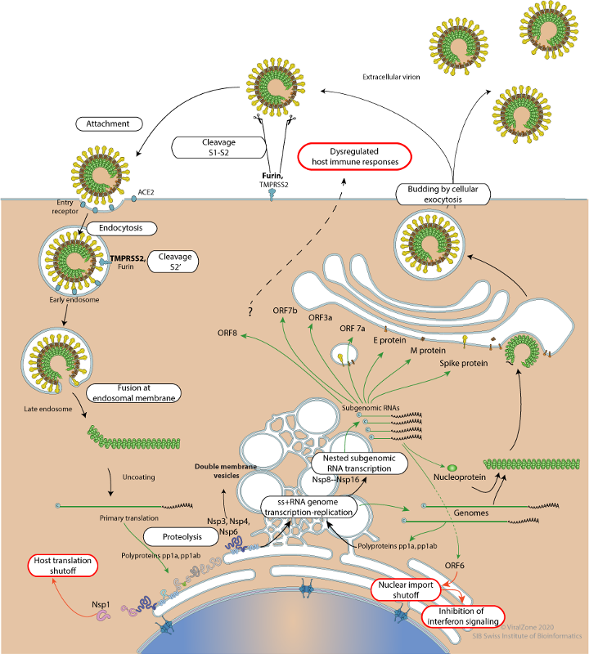
July 2020
Life Cycle of SARS-CoV-2
LYTIC
1. Attachment and
Entry
3. Viral Assembly and
Release
2. Replication and Synthesis
https://viralzone.expasy.org/resources/Coronavirus_cycle.png
Notes:
Viral Attachment and Entry
Viral Spike protein attaches to host protein ACE2 on the human epithelial mucosa cell (e.g., lungs, digestive system)
The virus can now enter the host cell in one of two different ways: The fusion machinery of the spike allows the virus and host cell membranes to come close enough so that they fuse together forming a channel that allows the virus genetic material to enter the host cell.
After viral and host cell membranes fuse Genomic RNA enters host cell
Replication and Synthesis
The viral RNA is an mRNA and can immediately begin translation to make the viral proteins. Polyproteins are translated which produced enzymes including proteases and RNA dependent RNA polymerase (RdRP)
RdRP makes copies of genomic and subgenomic RNA
The replication occurs in double membrane vesicles
Translation products of subgenomic RNA produce cytosolic and membrane proteins that are needed for viral assembly
Viral Assembly and Release
The genomic RNA and various proteins are assembled in the cytoplasm and membrane
Fully formed viral particles are released

Slide 4
SARS-CoV-2 Life Cycle
Viral Attachment and Entry
Virus spike protein interacts with cell surface protein to enter the host (Human) cell
The viral genomic RNA acts like an mRNA - it can directly make proteins.
Replication and Synthesis
The genomic RNA produces proteins and new RNA necessary for viral reproduction, hijack the host cell machinery and prevent it from carrying out it own functions
Three important proteins produced by the virus are PL Proteinase, 3CL protease and RdRP.
Much of the RNA synthesis occurs in the double membrane vesicles budding off from the ER
Viral Assembly and Release
The structural proteins (Spike, Envelope, Matrix, and Nucleocapsid) and newly formed RNA are modified and packaged and assembled in the Golgi apparatus before release from the host cell by exocytosis

Slide 5
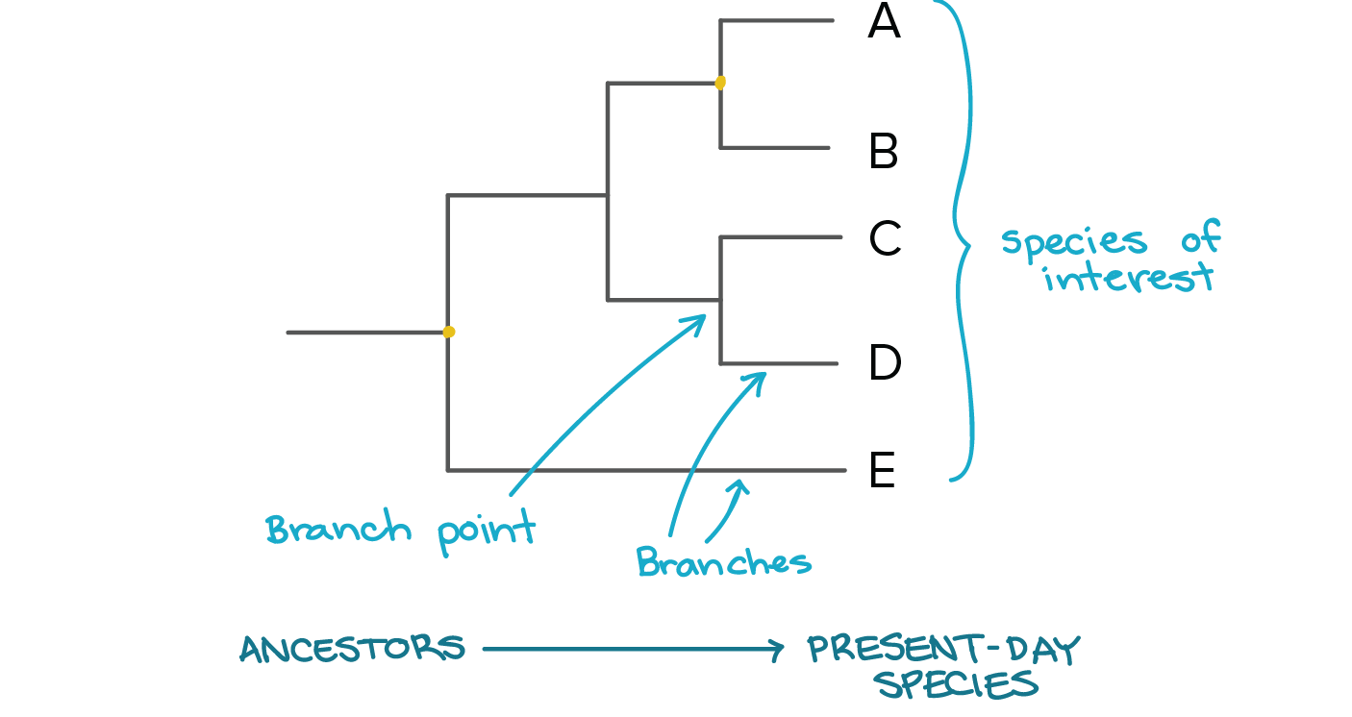
Are All RNA Viruses Related?
All RNA viruses have some proteins in common and unique to them
RNA dependent RNA Polymerases (RdRP)
+ strand RNA virus translate RdRP following infection
- strand RNA virus brings RdRP in virus particle
Proteases to separate the individual proteins from polyproteins
PL Proteinase
3C-Like protease
Can trace RNA virus ancestry
Phylogeny: representation of evolutionary relationships
Notes:
RdRp is needed for RNA-to-RNA copying. This violates the Central Dogma of information transfer from DNA to RNA to Proteins. There are some RdRps in eukaryotes to produce RNA interference (RNAi) for gene regulation. Many of the animal host have no RdRps so the virus has to produce this enzyme in order to complete its life cycle.

Slide 6
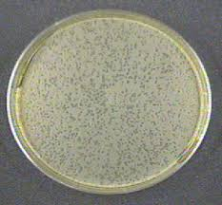
How Does Evolution Happen?
Genetic variation from mutation and recombination
Mutations:
Are Random
Most are deleterious
Necessary for adaptation
Recombinations (in viruses): when 2 or more viruses with different genotypes infect the same host. Can happen by
Template switching
Reassortment of segmented viruses
Changes in allele frequencies through natural selection and genetic drift
Natural selection - some individuals leaving more descendents than others
Bottlenecks occur - so reproductive success may not necessarily be due to selection
Founder Effects: Genetic Drift
Notes:
See the next slide for Recombination approaches.

Slide 7
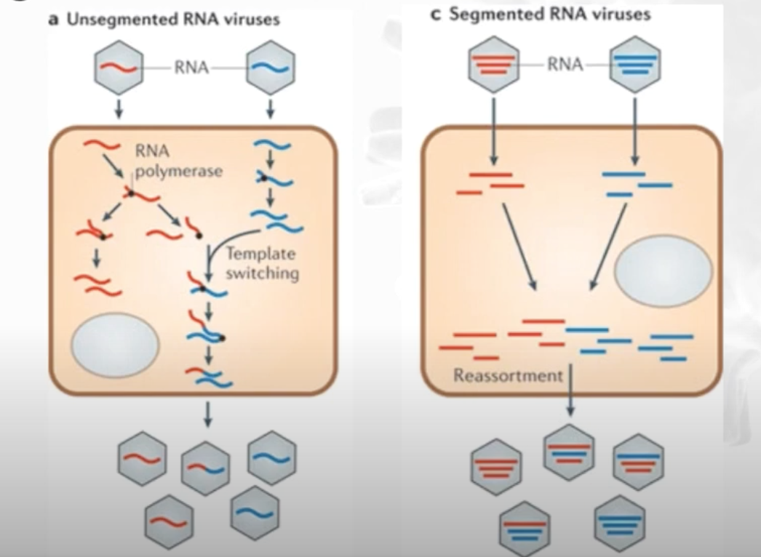
Template switching and Reassortment
Template switching
Reassortment

Slide 8
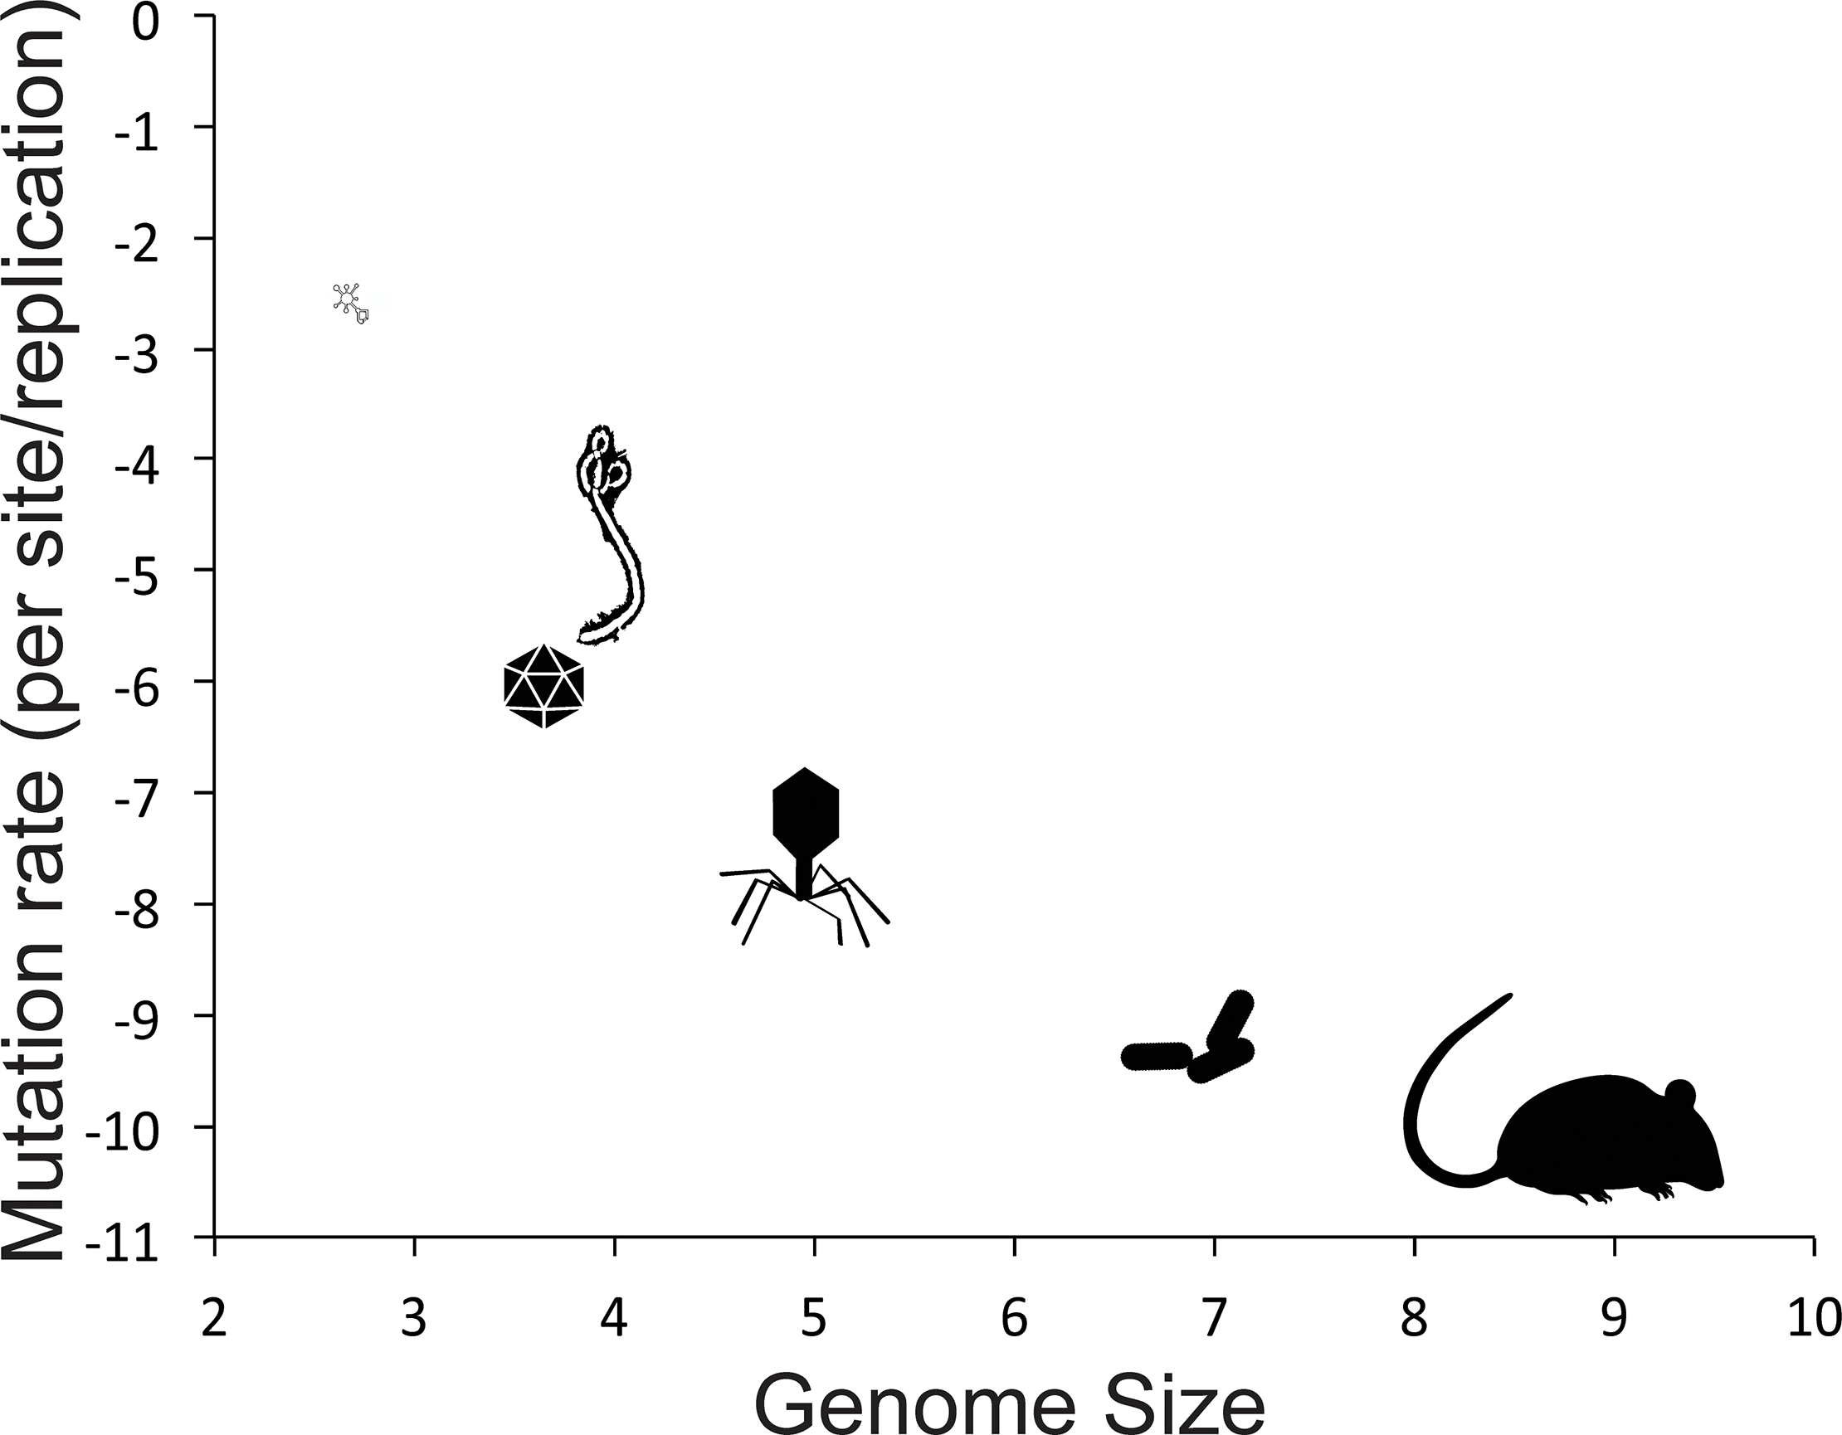
RNA viruses have high mutation rates
Ebola
Notes:
Biological mutation rates summarized from fastest to slowest: Viroid (RNA elements that cause some plant disease without encoding any genes), viruses (RNA shown as Ebola, single-stranded DNA shown as an icosohedron, and double-stranded DNA shown as a myophage), prokaryotes (rod-shaped bacteria), and eukaryotes (rodent). Axes are log-transformed. The Corona viruses have the largest genome among the RNA viruses
Duffy, 2018 PLOS https://doi.org/10.1371/journal.pbio.3000003

Slide 9
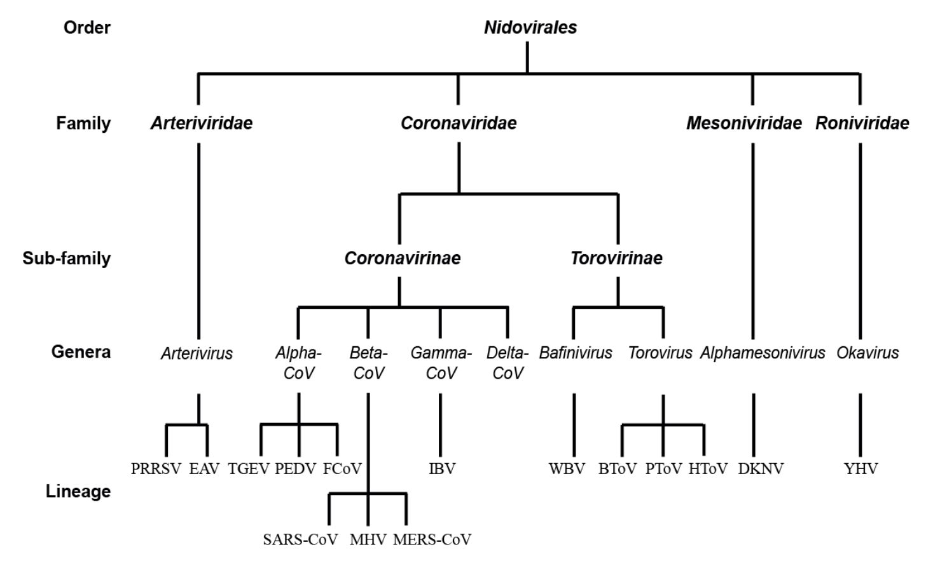
Evolutionary tree of the RNA viruses
All these viruses infect animals
SARS -CoV-2
Cong et al., 2017, doi: 10.3390/v9070182

Slide 10
Phylogeny of Coronaviruses
Beta-CoV Lin B
Gorbalenya et al., 2020, Nature Microbiology, 5, 536–544
Beta-CoV Lin C
Beta-CoV Lin A
Alpha-CoV
Notes:
Note that there are 7 coronaviruses that infect humans - colored orange (seasonal and endemic) or red (epidemic or pandemic).
2 of the human disease causing ones are Alpha coronavirus while the others are in different lineages (A, B, and C) of betacoronavirus.
Note that many of the beta coronaviruses also infect bats. They are likely a reservoir for these viruses. From time to time these viruses mutate and/or recombine and jump to various animal hosts (including humans).

Slide 11
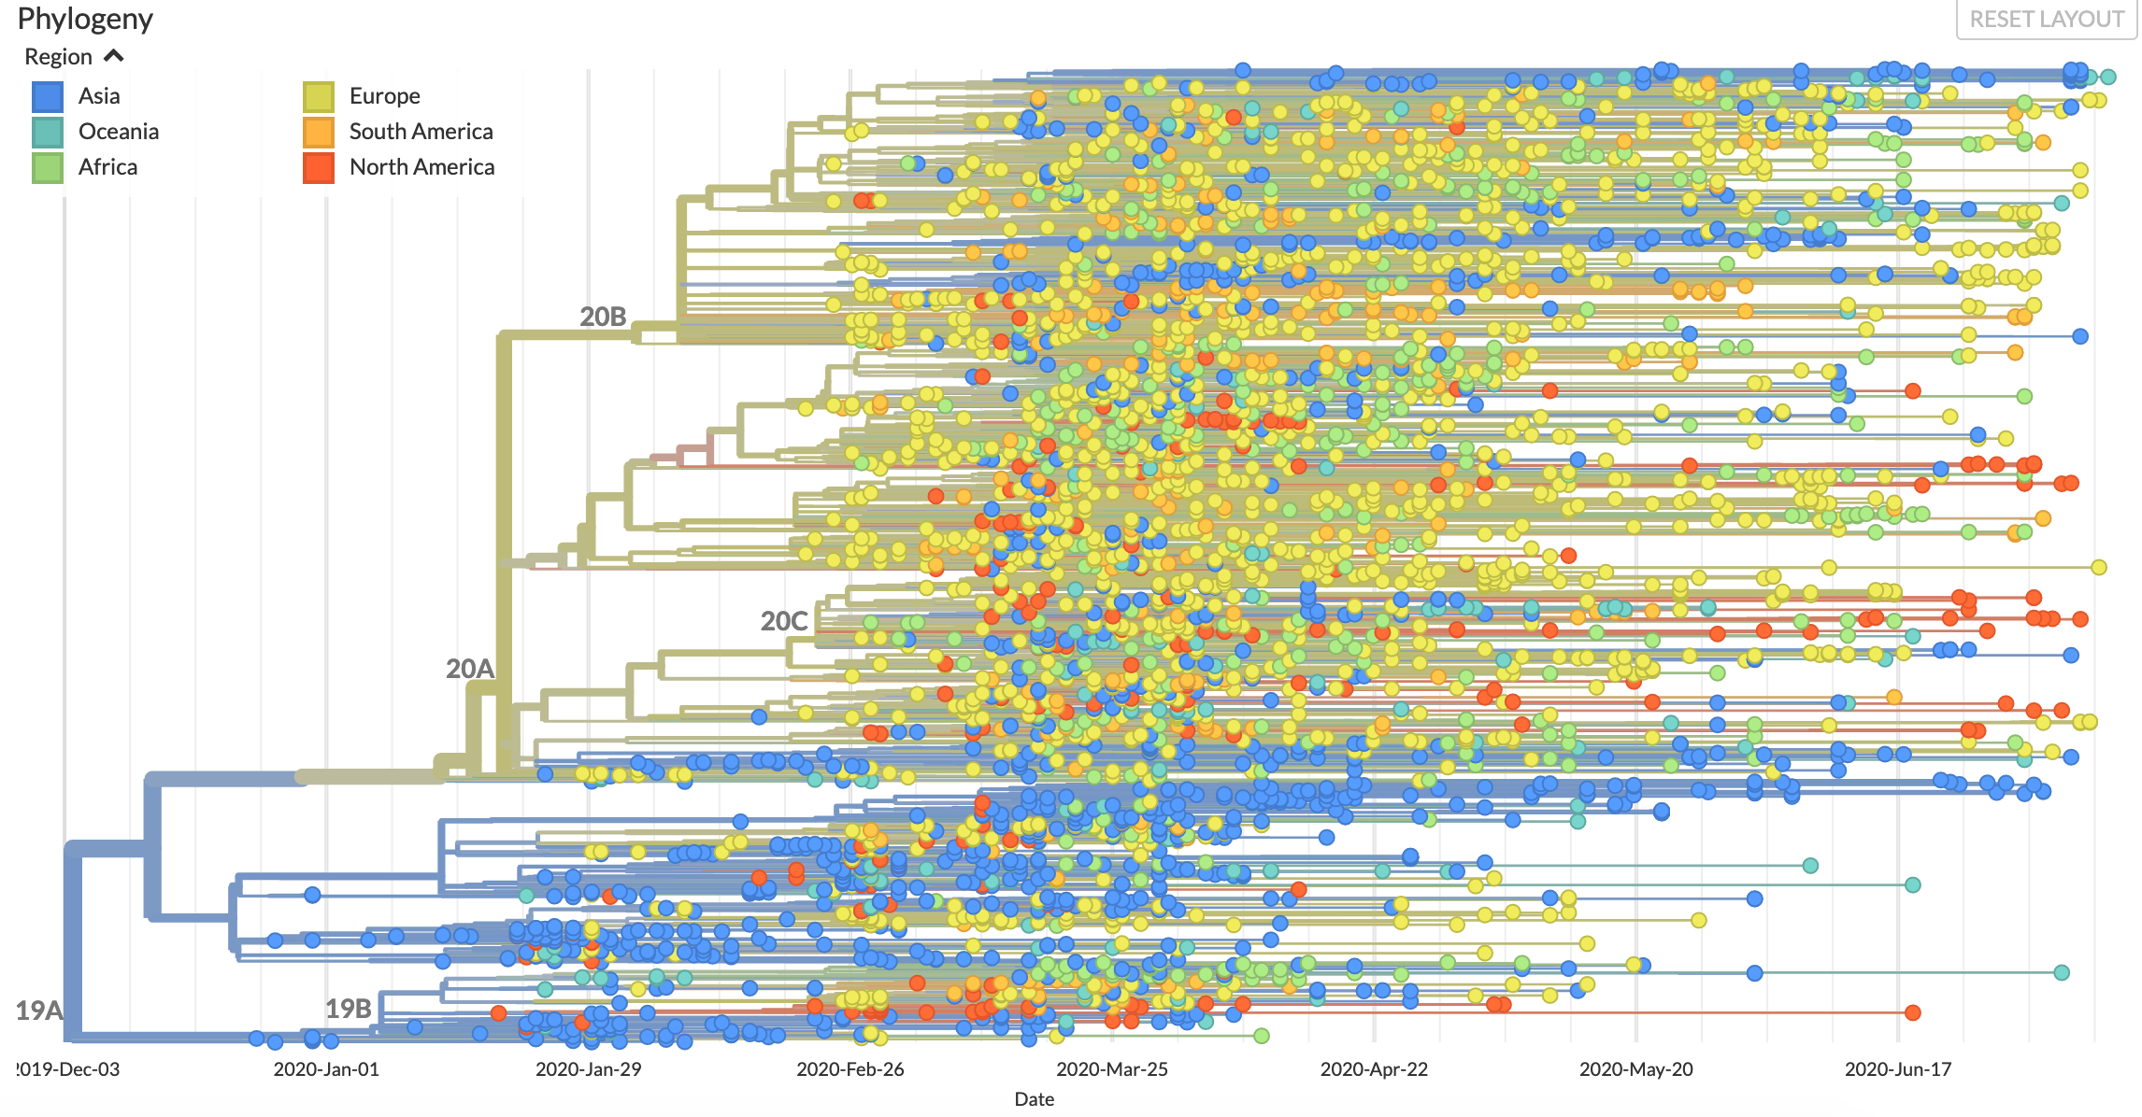
Is SARS-CoV-2 Evolving?
https://nextstrain.org/ncov/global?c=region
Notes:
Yes. The virus is evolving but it is still the same strain.
Differences in sequences of the corona virus infection from the whole world. The blue lines/dots indicate Asian lineage, brown is Europe, Red is Americas. This colors show which strain spread where.
Multiple lines of the same color show multiple infections that shows the virus travelled independently multiple times. It was not one infection that spread in the entire country. It also shows that some variations rose independently after travelling from Asia.

Slide 12
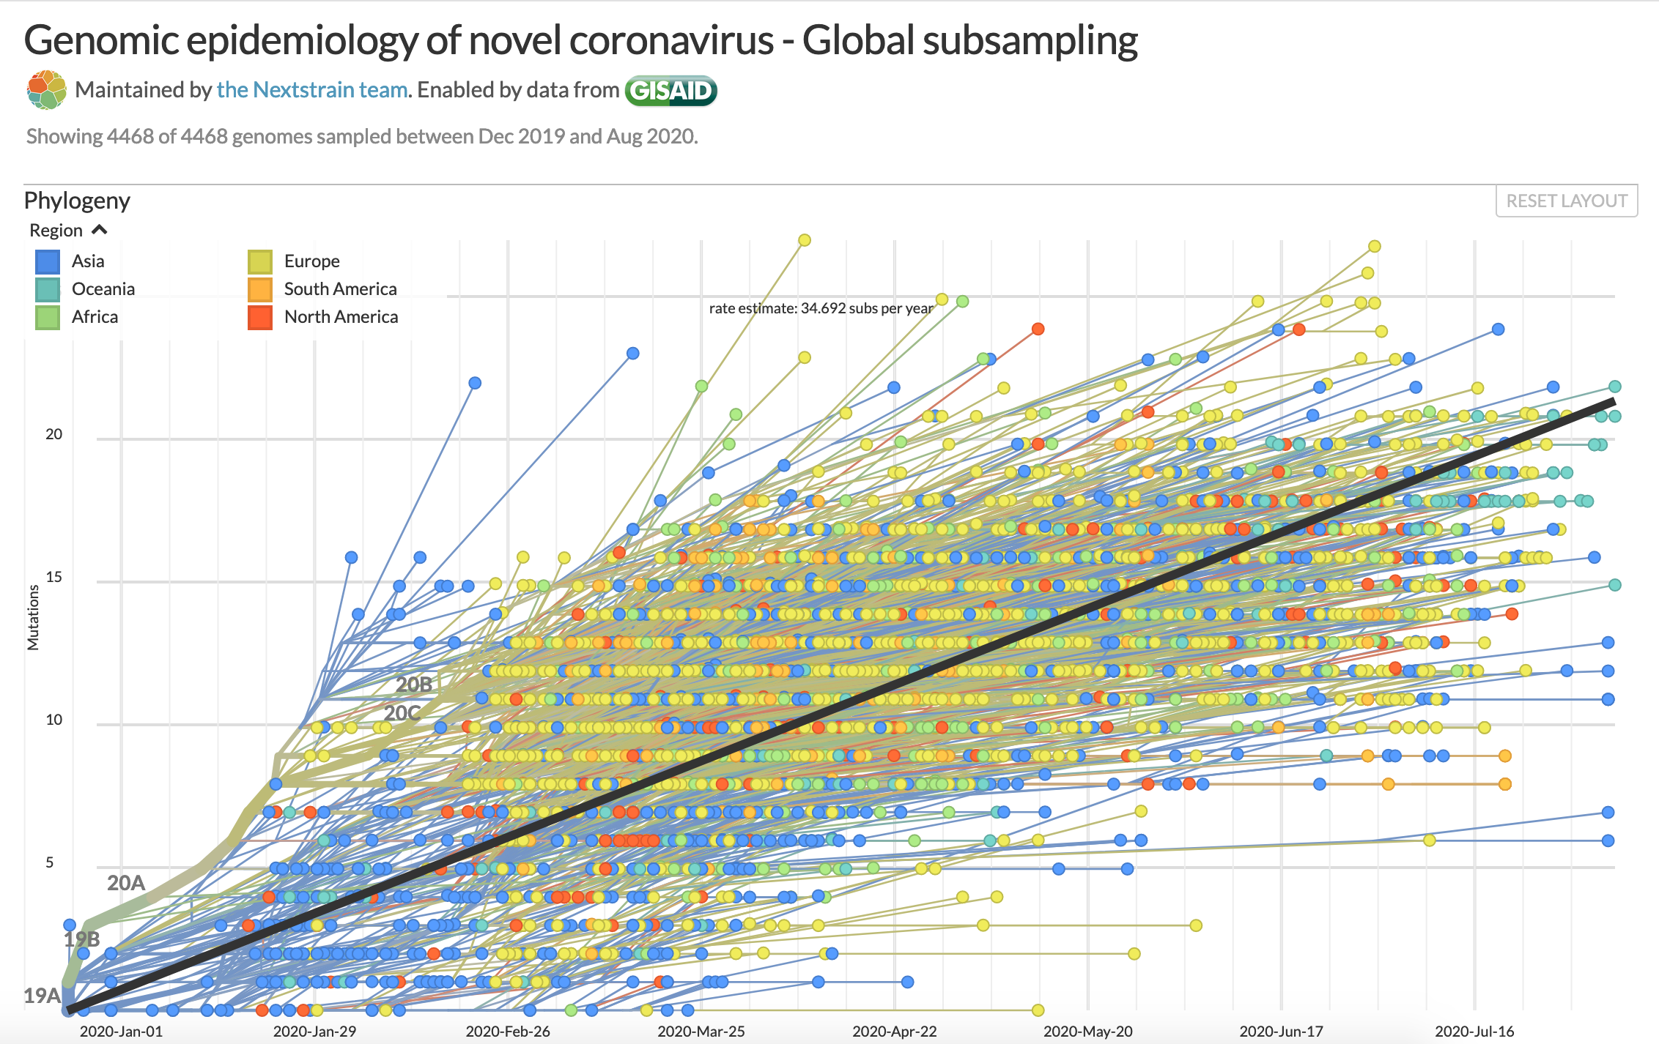
SARS-Cov-2 rate of evolution - SLOW
https://nextstrain.org/ncov/global?l=clock
Notes:
Still the same strain. The proof reading capacity of the virus shows a slower rate of change.

Slide 13
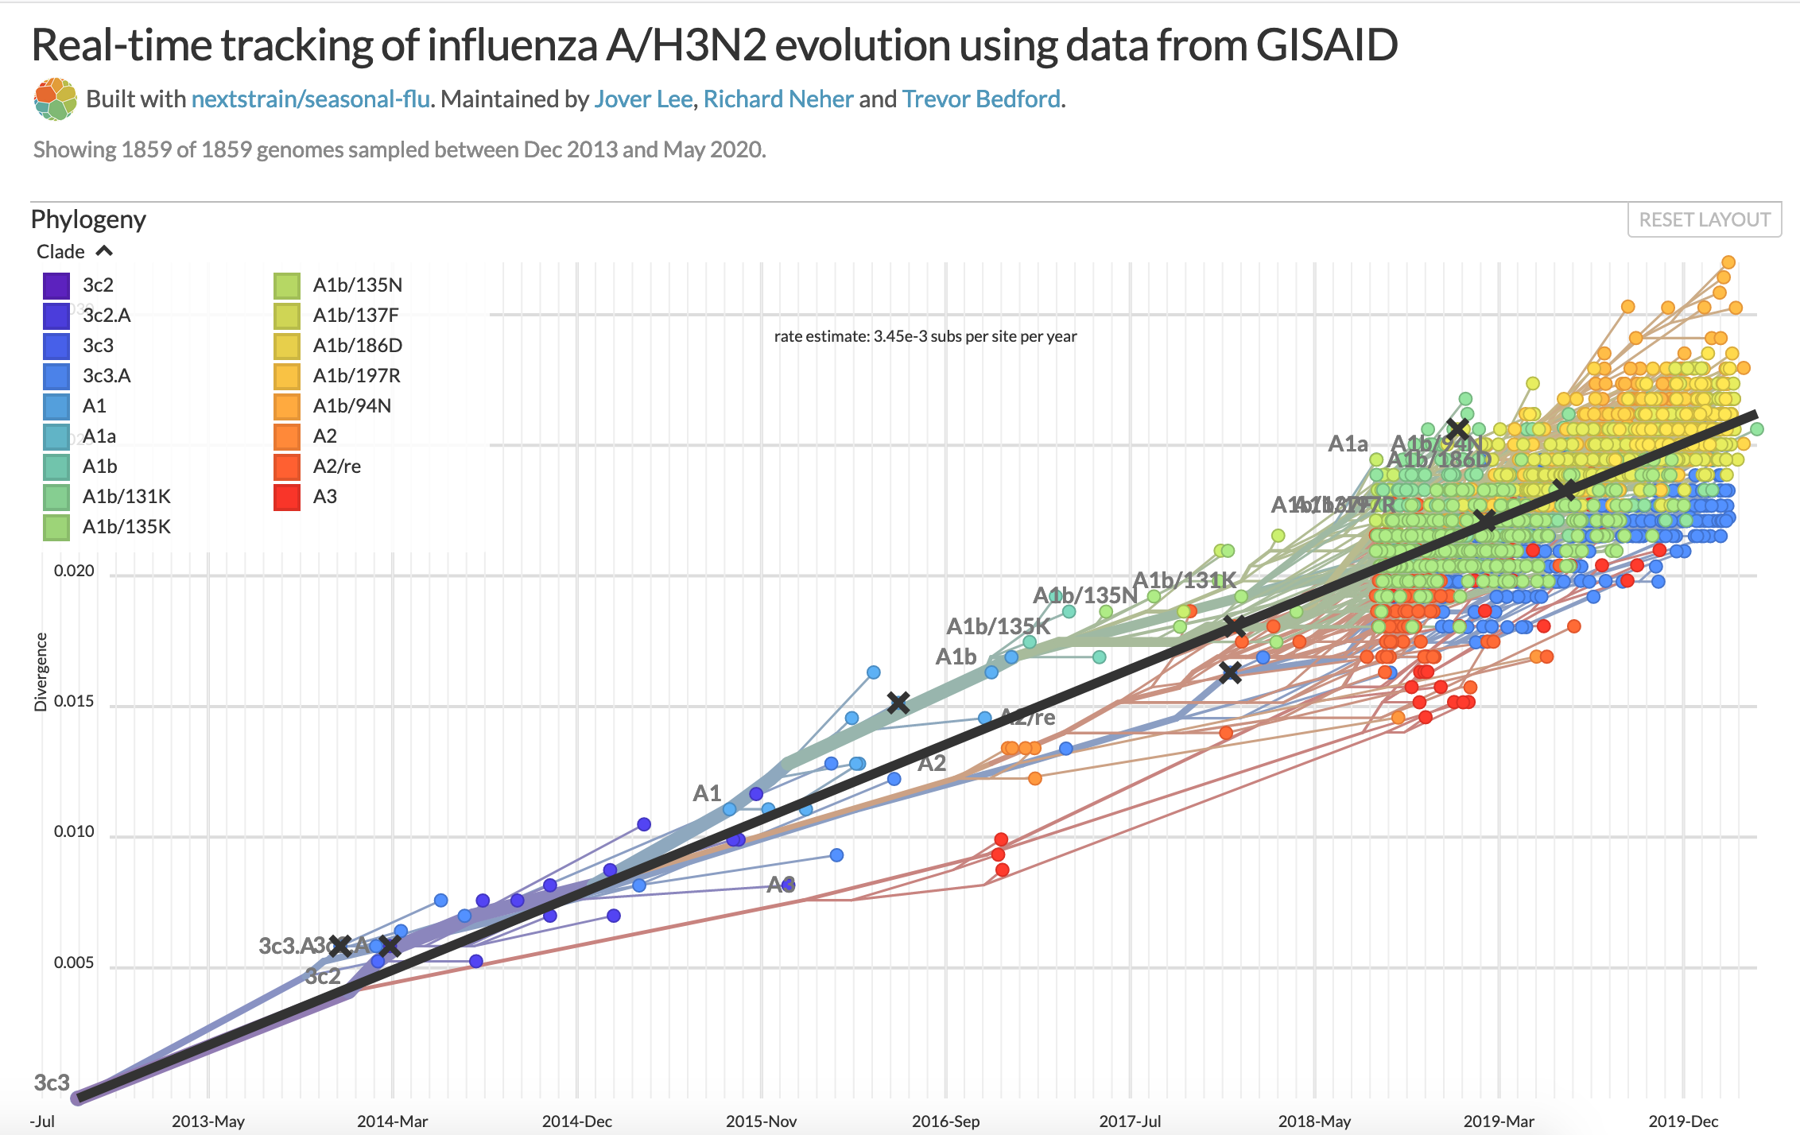
Influenza rate of evolution - FAST
https://nextstrain.org/flu/seasonal/h3n2/ha/2y?l=clock
Notes:
The steepness of the line indicates that the flu virus mutates more rapidly and shows higher rates of variation over a shorter period of time. Reason: Flu virus does not have the proof reading capacity that the SARS-Cov viruses have.

