Slide 1
A Molecular View of Genetics
Shuchismita Dutta, Ph.D.

Slide 2
Learning Objectives
DNA to Genome
Gene to Protein
Mutations and Variations
Genetic Engineering

Slide 3
Learning Objectives
DNA to Genome
Gene to Protein
Mutations and Variations
Genetic Engineering

Slide 4
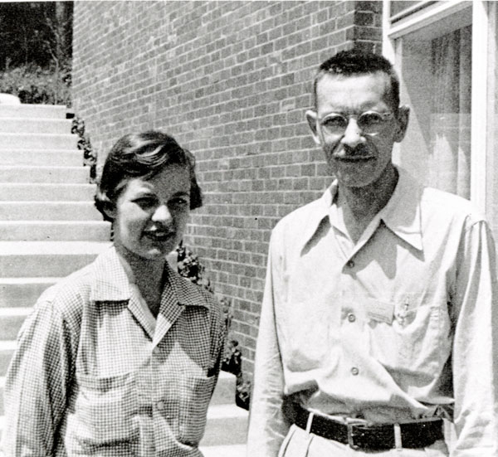
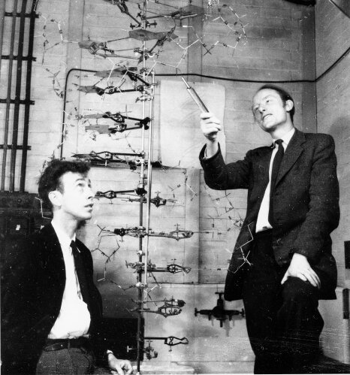
Genetic Timeline
http://library.cshl.edu/Buildings/images/hersh/hersh4.jpg
http://library.cshl.edu/DNAinNY/Case5/p35caption.htm
Notes:
Learn more about the genetics timeline at https://www.genome.gov/pages/education/genetictimeline.pdf and http://www.dnai.org/timeline/

Slide 5
DNA: Deoxyribose Nucleic Acid
Most commonly used genetic material
Inherited from parents
Stored inside cells (nucleus, mitochondria)
Read-only memory
Duplicated by DNA polymerase
Deoxyribose in backbone
DNA
http://pdb101.rcsb.org/motm/23
Notes:
Learn more about DNA at http://pdb101.rcsb.org/motm/23

Slide 6
RNA: Ribonucleic Acid
Ribose sugar in backbone
Produced by transcription (RNA polymerase)
Different types in cell
mRNA
tRNA
rRNA
snRNA
May acts as enzymes
May be carrier of genetic information too (some virus)
tRNA
http://pdb101.rcsb.org/motm/15
Notes:
Learn more about tRNA at http://pdb101.rcsb.org/motm/15

Slide 7
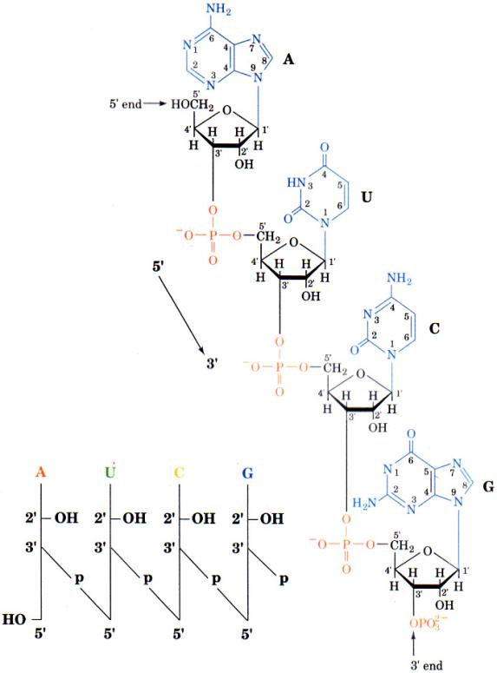
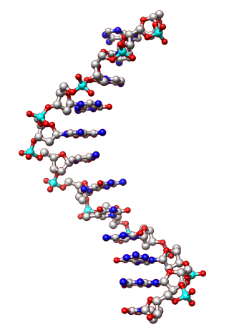
Components of Nucleic Acid
Base
Sugar
Phosphate

Slide 8
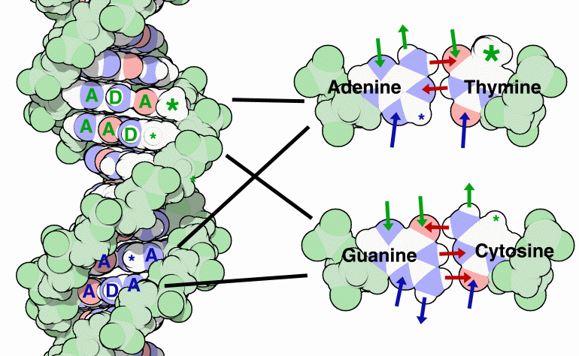
Basis of Biology and Inheritance
Base-pairing
A-T
G-C
Replication
Both strands make complementary DNA
Transcription
Coding strand makes mRNA
Translation
tRNA recognizes specific codon on mRNA
A: denotes hydrogen bond acceptor
D: denotes hydrogen bond donor
http://pdb101.rcsb.org/motm/23
Notes:
Learn more about nucleic acid base pairing at http://pdb101.rcsb.org/motm/23

Slide 9
The Packing Problem
Nucleosome
Single human cell → pack 6ft of DNA
DNA condensed by wrapping on special proteins (histones) → nucleosomes
Nucleosomes pack further to make a chromosome
http://pdb101.rcsb.org/motm/7
Notes:
Learn more about Nucleosomes at http://pdb101.rcsb.org/motm/7

Slide 10
Gene, Chromosome and Genome
Gene
Unit of DNA that carries the instructions for making a specific protein or set of proteins
Chromosome
Made of protein and a single molecule of DNA.
Genome
An organism's complete set of DNA
Human genome has ~3 billion DNA base pairs
https://www.genome.gov/images/content/chromosome_1_factsheet.jpg
Notes:
Learn more about Chromosomes at https://www.genome.gov/26524120/
Learn more about genomics at https://www.genome.gov/18016863/a-brief-guide-to-genomics/

Slide 11
Learning Objectives
DNA to Genome
Gene to Protein
Mutations and Variations
Genetic Engineering

Slide 12
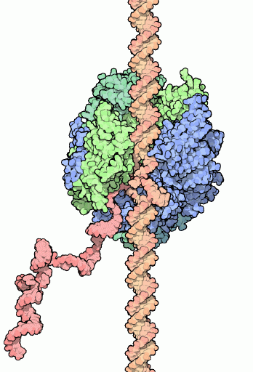
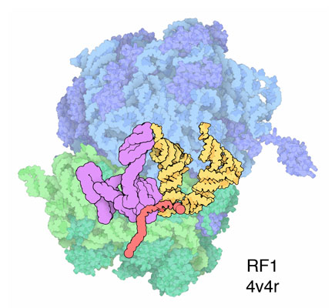
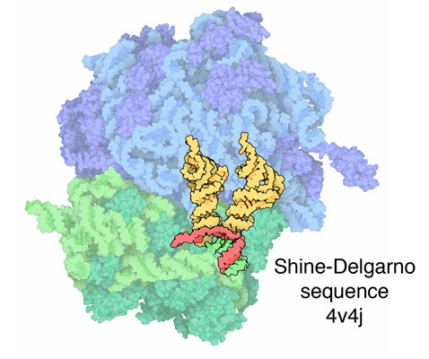
From Gene to Protein
3. Peptide bond formation
Transcription
2. Delivery of tRNA-aa
4. Push peptide bound tRNA
Repeat
1. Initiate Translation
Translation
Protein
Post translational processing
End. Terminate Protein Synthesis
Notes:
Learn more about RNA Polymerase at http://pdb101.rcsb.org/motm/40
Learn more about Ribosomes and Protein Synthesis at http://pdb101.rcsb.org/motm/121

Slide 13
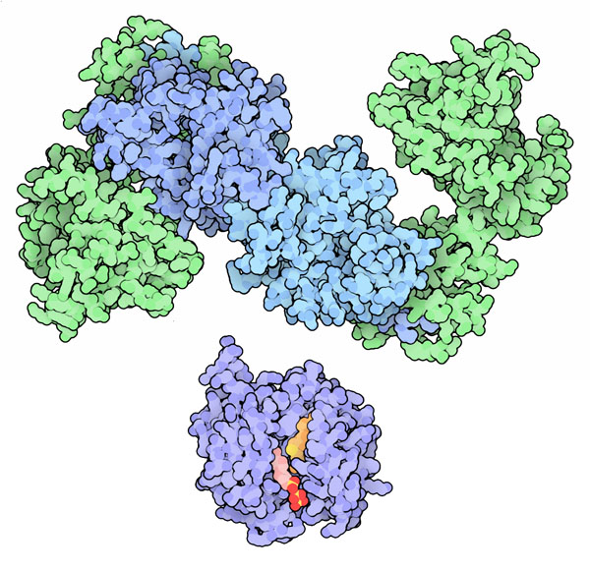
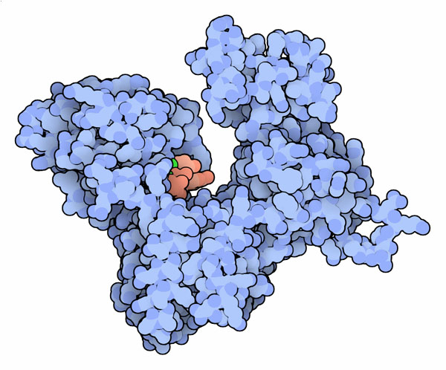
Post-Transcriptional Processing – 1
http://pdb101.rcsb.org/motm/145
7 methyl Guanosine -Cap
To protect RNA from cleavage
To recognize beginning of mRNA (5’)
3 steps and 3 enzymes involved
Poly A Tail
Binds polyA binding protein to protect from cleavage
Long tail of adenine nucleotides at end of mRNA (3’)
1.Phosphatase
2. guanosyl transferase
3. (guanine-N7-)-methyltransferase
Poly(A) polymerase
http://pdb101.rcsb.org/motm/106
Notes:
Learn more about the mRNA Cap at http://pdb101.rcsb.org/motm/145
Learn more about Poly A Polymerase at http://pdb101.rcsb.org/motm/106

Slide 14
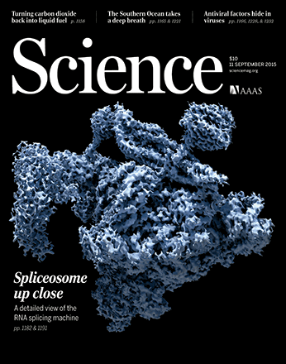
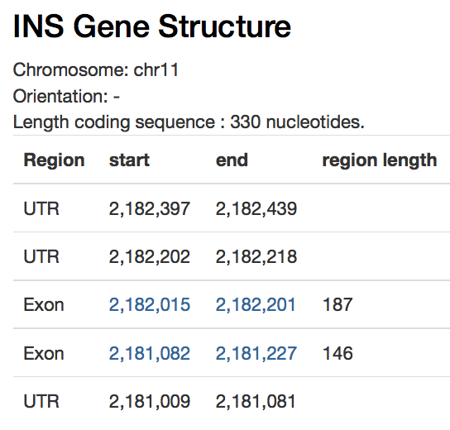
Post-Transcriptional Processing - 2
EM structure of yeast Spliceosome, Sept. 2016
Splicing
Processing by spliceosome (snRNA + proteins)
introns removed from pre-mRNA
Example of insulin gene on human Chromosone 11 shown below.
Chromosome 11
INS Gene

Slide 15
Learning Objectives
DNA to Genome
Gene to Protein
Mutations and Variations
Genetic Engineering

Slide 16
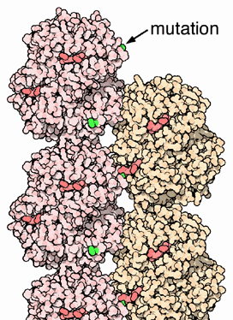
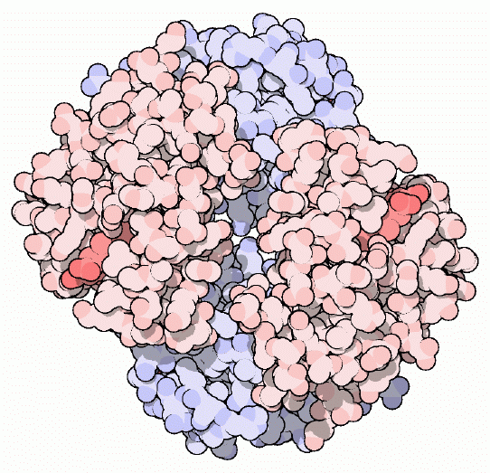
Mutations
Normal
DNA TGA … GGA … CTC … CTC …
mRNA ACU … CCU … GAG … GAG …
Prot Thr Pro Glu Glu
Mutant
DNA TGA … GGA … CAC … CTC …
mRNA ACU … CCU … GUG … GAG …
Prot Thr Pro Val Glu
Permanent change in gene → altered protein structure and function
Mutation in gene
Transition
(A←→G or C←→T)
Transversion
(A/G ←→C/T)
Deletion/Insertion
Change in protein
Synonymous - sequence same
Missense – sequence altered
Non-sense – insert stop codon
http://pdb101.rcsb.org/motm/41
Hemoglobin
Sickle Cell Hemoglobin
Notes:
Learn more about hemoglobin and sickle cell anemia at http://pdb101.rcsb.org/motm/41

Slide 17
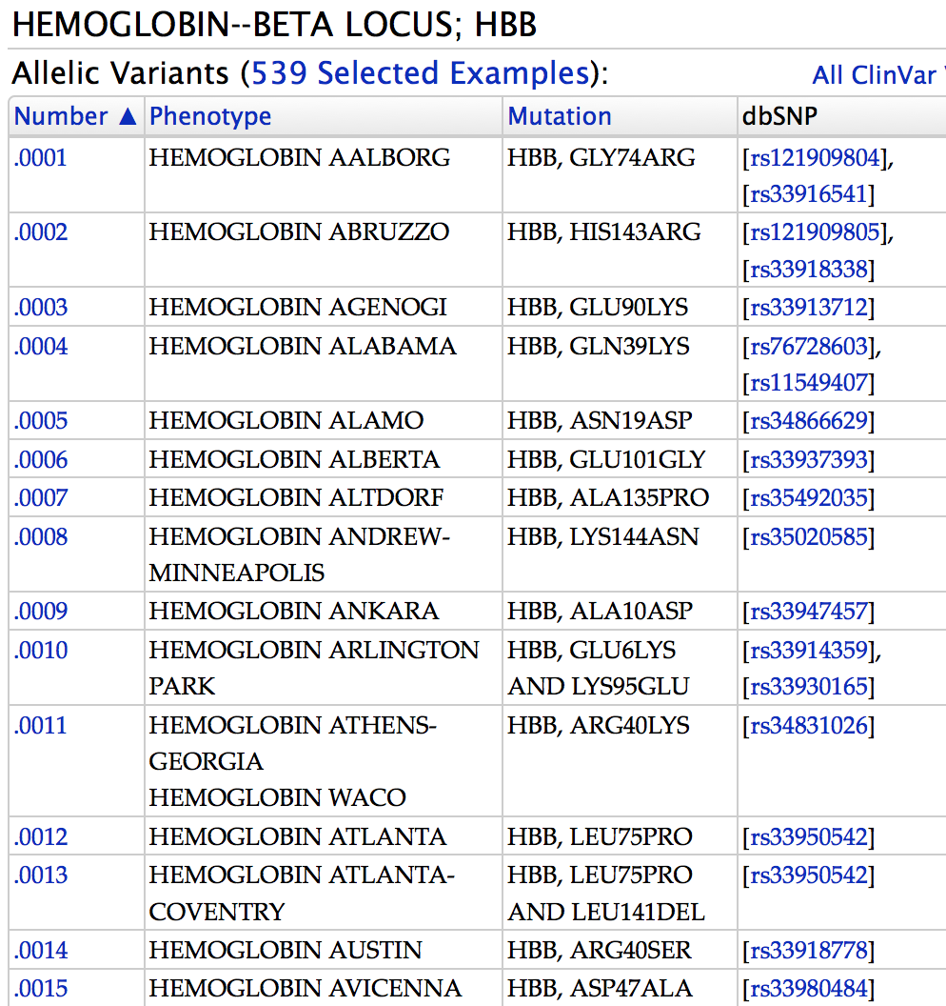
Human Genetic Variations
All humans are genetically unique (except identical twins)
Polymorphisms or genetic differences
Single nucleotide polymorphisms (SNP)
Indels ( insertions, deletions), duplications, and rearrangements occur less frequently
https://omim.org/allelicVariant/141900
Notes:
Learn more about Human Genetic Variations at https://www.ncbi.nlm.nih.gov/books/NBK20363/

Slide 18
Learning Objectives
DNA to Genome
Gene to Protein
Mutations and Variations
Genetic Engineering

Slide 19
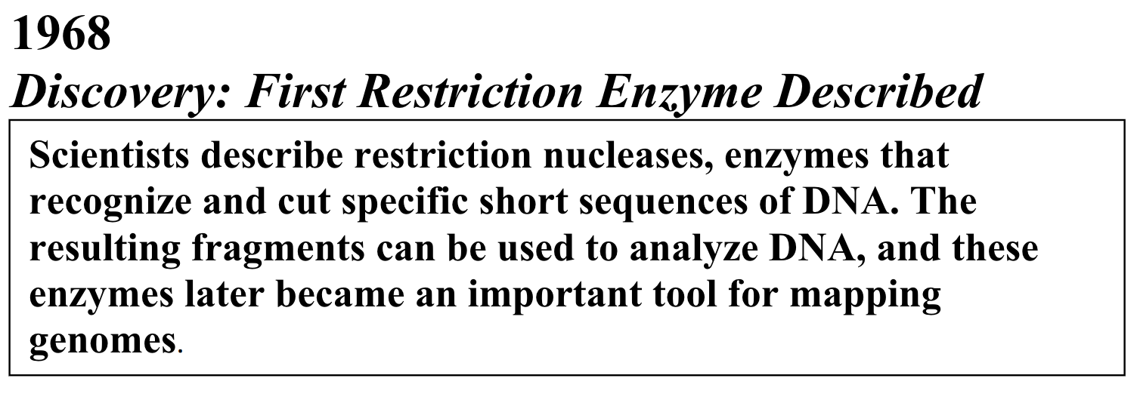
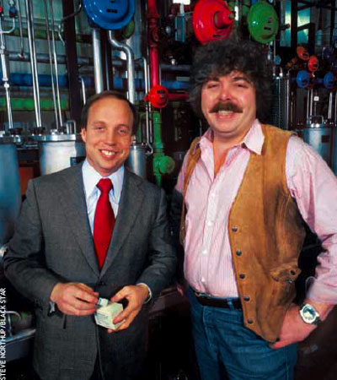
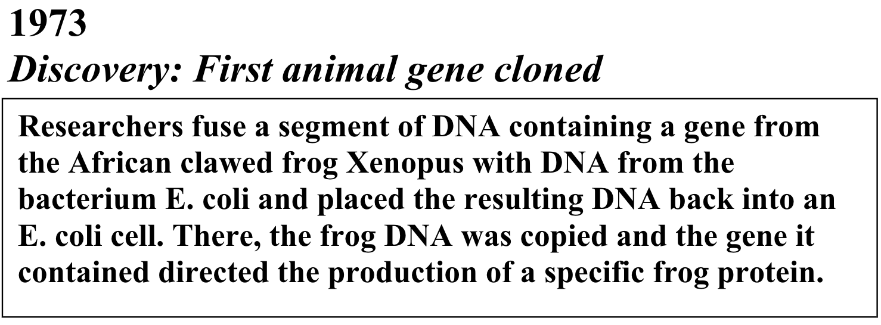
Genetic Timeline
Robert Swanson and Herbert Boyer
http://www.bloomberg.com/news/articles/2004-10-17/robert-swanson-and-herbert-boyer-giving-birth-to-biotech
Notes:
Learn more about the genetic timeline at https://www.genome.gov/pages/education/genetictimeline.pdf

Slide 20
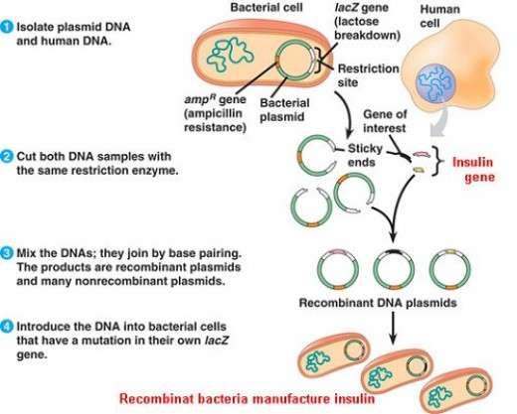
Making Recombinant Insulin
http://americanhistory.si.edu/collections/search/object/nmah_1000967
http://labiotech.eu/genentechs-beginning-the-origins-of-biotechnology/

Slide 21
Genetic Engineering Today
Genetics Tools
Applications
For Cutting:
Restriction endonucleases (RE)
Zinc finger nucleases (ZFN)
Transcription Activator Like Effector Nucleases (TALEN)
Clustered Regularly Interspaced Short Palindromic Repeat (CRISPR)
For amplification:
Polymerase chain reactions
For exploring and archiving:
cDNA libraries
Research: Protein production; Tracking function
Agriculture: Disease resistance; increased production
Industry: Production of large quantities of various proteins
Medicine: Diagnose details of diseased states; change genomic DNA to treat diseases (Trials ongoing)
Environment: Engineer special enzymes that can process environmental pollutants/contaminants

Slide 22
Summary
DNA to Genome
DNA Structure
Nucleosomes and Chromosomes
Gene to Protein
Transcription and mRNA processing
Translation
Mutations and Variations
Synonymous, missense and non-sense mutations
Genetic Engineering
Making Humulin

