Slide 1
HIV Testing and Treatment:
Current and Upcoming
Stephen K. Burley, M.D., D.Phil. Shuchismita Dutta, Ph.D.

Slide 2
Overview
About HIV
  HIV Proteins
  HIV Life cycle
  HIV Infection with no intervention
Testing for HIV infection
Treating HIV Infection
    HIV's Achilles' Heels: Current Treatment Approaches
    Drug Resistance
Current areas of research
    HIV Vaccine: A Status Report
    Upcoming Treatment Strategies

Slide 3
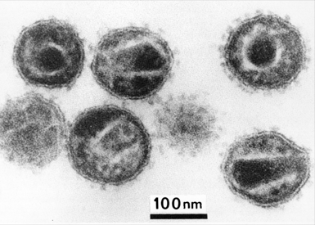
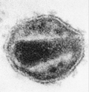
What is HIV?
Came from a virus that infects African Chimpanzees
Genetic material, RNA, stored in protein capsid
HIV capsid enveloped by a membrane
Membrane spikes for attachment to host cells
http://histology.leeds.ac.uk/what-is-histology/The_electron_microscope.php
Electron Micrograph of HIV
Protein
spikes
Envelope
Capsid
Notes:
What does the HIV look like and where does it come from? Describe the overall architecture of the enveloped virus

Slide 4
Architecture of HIV
Enveloped Virus
  Surrounding Capsid
Viral Enzymes
  Anti-retroviral Rx targets
Structural Proteins
  Some are targets for anti-retroviral treatment
Viral RNA
  Integrated permanently in host cells
Accessory Proteins
  Manipulates host cell machinery
Notes:
Continue thinking about the EM images seen in the previous slide and now discuss the various protein/RNA components of the virus. Feel free to go to the animation link http://www.rcsb.org/pdb/static.do?p=education_discussion/educational_resources/hiv-animation.html
to explore further

Slide 5
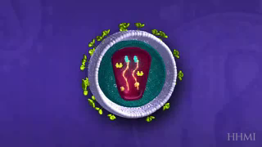
HIV Life Cycle
http://www.hhmi.org/biointeractive/hiv-life-cycle
Notes:
View the video to learn about the life cycle of HIV. Note that the proteins are shown as schematics – the actual shape and structure is not shown.

Slide 6
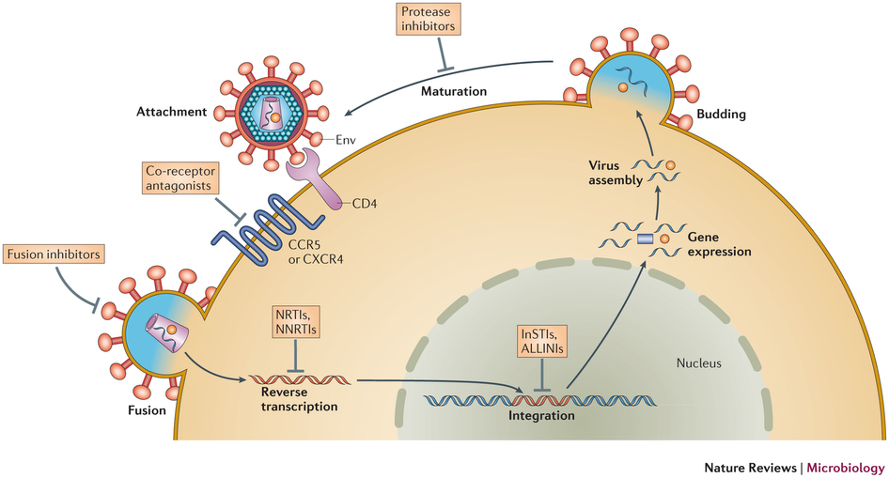
HIV Life Cycle
Adapted from http://www.nature.com/nrmicro/journal/v12/n11/fig_tab/nrmicro3351_F1.html
Notes:
2D Schematic of the HIV life cycle. Start discussion with the attachment …

Slide 7
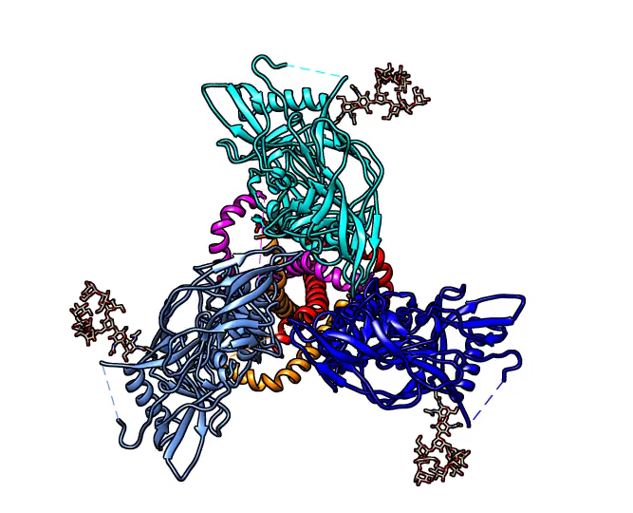
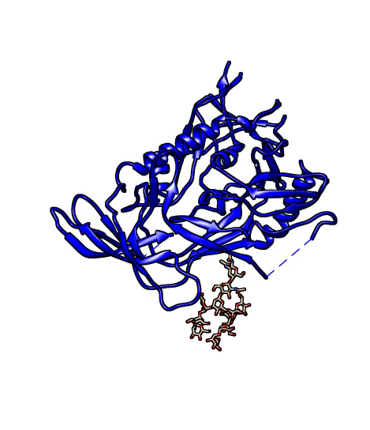
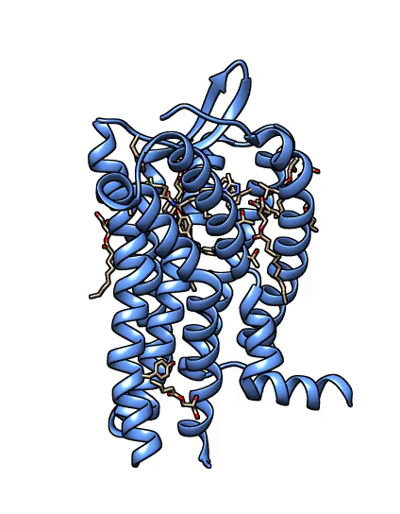
Entry
gp41
Env Spike: View from CD4+ cell, PDB ID 4nco
gp120
gp120:CD4 complex, PDB ID 1gc1
Interaction of gp120:CD4:CCR5 → fusion of viral env and host cell membrane
CCR5, PDB ID 4mbs
Notes:
Various steps in the attachment and entry of HIV. Watch the molecular movies.

Slide 8
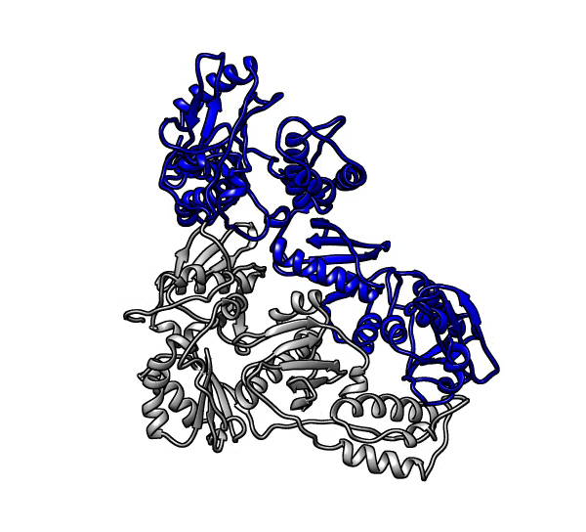
Reverse Transcription
Polymerase
p66
RNAse H
p51
HIV-1 Reverse Transcriptase, PDB ID 1dlo, 2hmi
RT polymerase is sloppy → many mutations → HIV quasi-species → Drug resistance
Notes:
Once the viral material have entered the cell, the RNA genome is converted into DNA by the viral enzyme Reverse Transcriptase (RT). The RT molecule is composed of 2 chains – P66 and P51 both of which are made from the same gene, but the latter has a domain (with Rnase H activity) missing. The enzyme has 2 active sites in P66 – polymerase and Rnase H. Watch the molecular movie

Slide 9
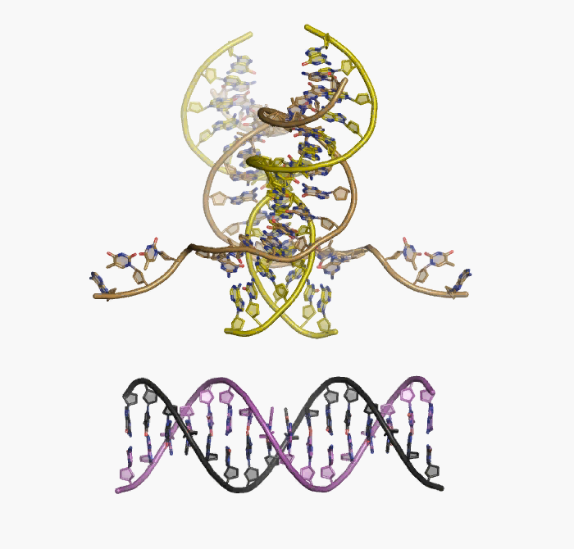
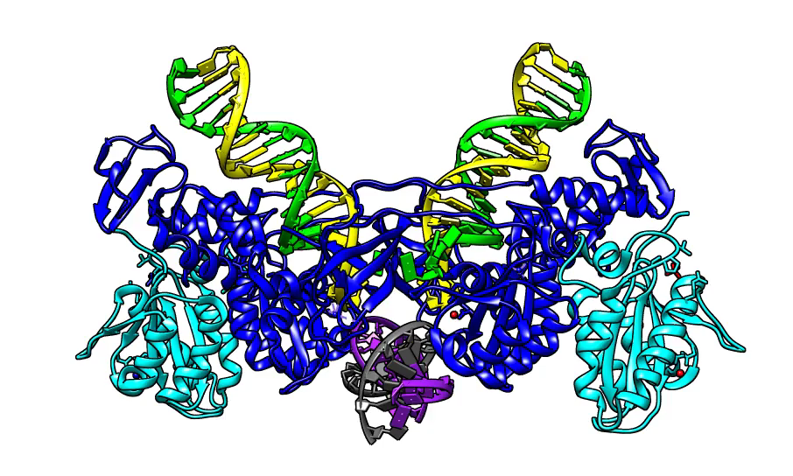
Proviral Integration
PFV Integrase: DNA complex, PDB ID 3os1
http://www.ncbi.nlm.nih.gov/pmc/articles/PMC2999894/bin/NIHMS32130-supplement-5.mov
Life-long (permanent) infection of host cell → may remain dormant for many years
Notes:
Integrase incorporates the viral DNA in the cellular genome. Watch the molecular movie

Slide 10
Making new HIV RNA and Protein
Accessory Proteins
Vif: Viral infectivity factor
    Prevents host APOBEC3G from mutating viral genome
Vpr: Viral Protein R
    Guides viral genome into nucleus, cell cycle arrest, apoptosis
Vpu: Viral Protein U
    Degrades CD4, role in budding of new viral particles
Nef: Negative Regulatory Factor
    Down regulates CD4, promotes greater infectivity of HIV
Regulatory Proteins
TAT: Transactivator of Transcription
    Facilitates long transcripts
REV: Regulator of Virion Expression
    Supports export of unspliced or partially spliced mRNA’s from nucleus
Transcription and Translation using host cell machinery
Env protein gp160 synthesized in ER, cleaved by Furin to form gp120 and gp41
Notes:
The accessory proteins work mostly to prevent the host cell to raise an alarm that it has been infected, so that the virus can continue to manipulate the host cell machinery for replication.

Slide 11
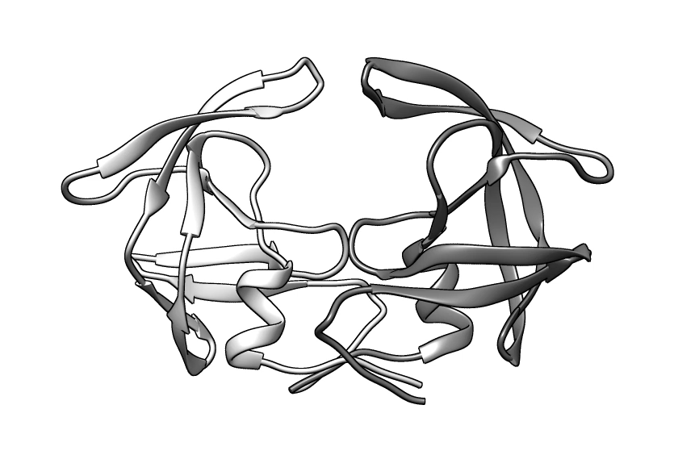
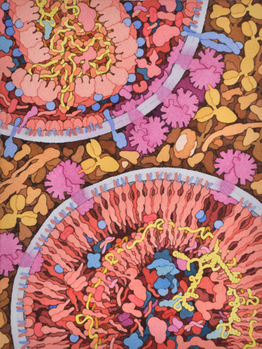
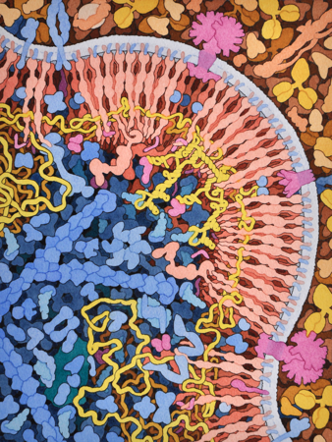
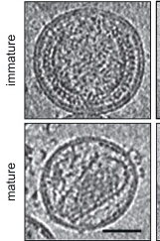
Budding and Maturation
HIV Protease, PDB ID 3oxc, 3hvp
http://hive.scripps.edu/images/8-maturation.jpg
http://hive.scripps.edu/images/7-budding.jpg
http://www.sciencedirect.com/science/article/pii/S0042682215001579
HIV Protease cleaves → GAG polyprotein
Matrix-Capsid-sp1-NucleoCapsid-sp2-p6
Notes:
The HIV Protease can cleave the poly protein to help with the maturation of HIV after budding and release. Watch the molecular movie

Slide 12
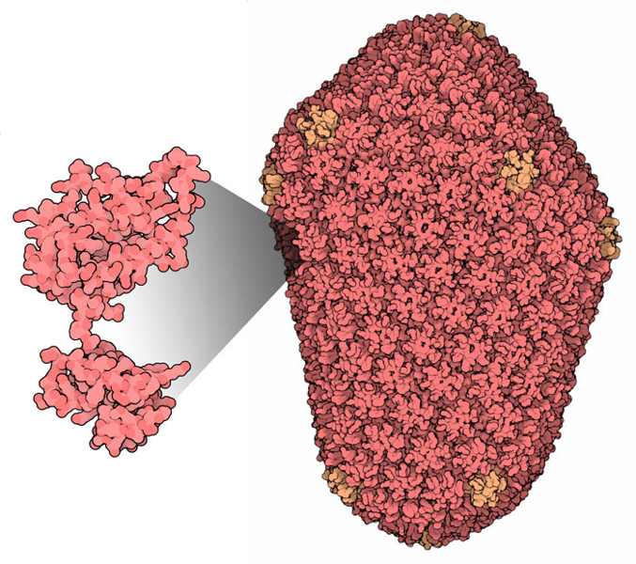
Mature Virus Capsid
HIV Capsid, PDB ID 3j3q
p24 forms the mature capsid by forming pentamers and hexamers
Notes:
In the mature capsid the P24 forms a casing for HIV’s RNA genome

Slide 13
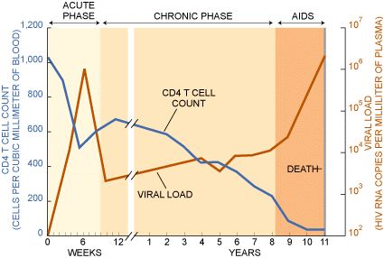
HIV Infection: Untreated
http://www.scientificamerican.com/article/can-you-explain-aids-and/
Notes:
In the beginning of the infection (few weeks into it) the host immune system tries to recover but if untreated HIV infects and destroys most of the CD4 positive T cells over several years, finally leading to AIDS and death

Slide 14
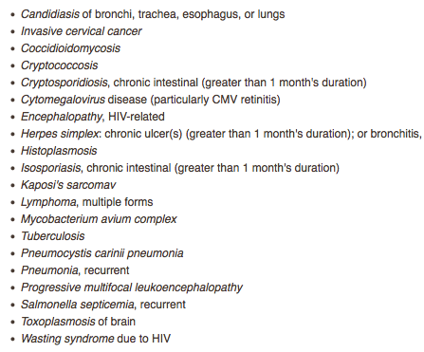
Acquired Immunodeficiency Syndrome
(AIDS)
Recognized by
AIDS Defining Conditions
Helper T-Cell depletion CD4 count <200 cells/µL
(CD4 percentage <14%)
Presence of one or more opportunistic infections
Neurological complications
Nephropathy
https://www.aids.gov/hiv-aids-basics/staying-healthy-with-hiv-aids/potential-related-health-problems/opportunistic-infections/
Notes:
Symptoms of AIDS

Slide 15
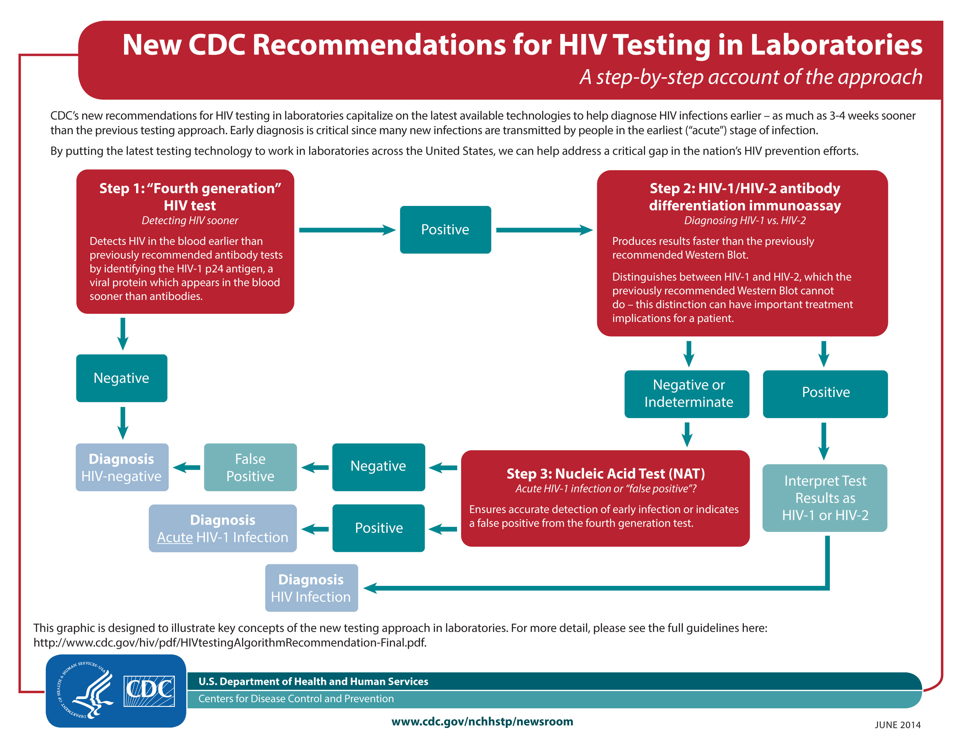

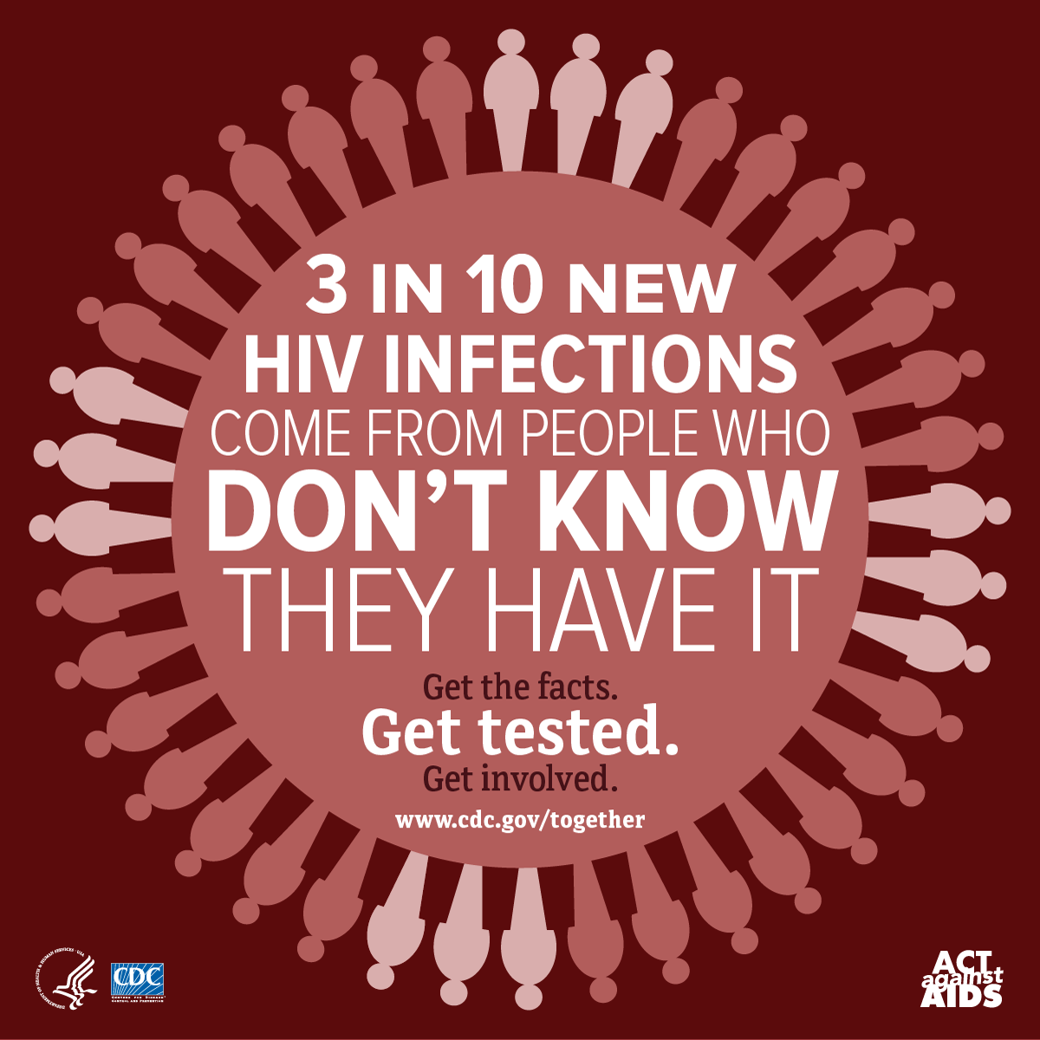
Testing for HIV
http://www.cdc.gov/nchhstp/newsroom/images/2014/HIV-testing-Labs-Flowchart-FullRes.jpg
Notes:
What is done to test for HIV infections?

Slide 16
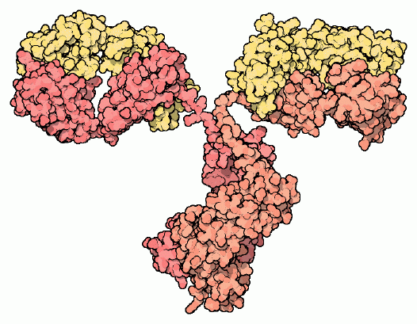
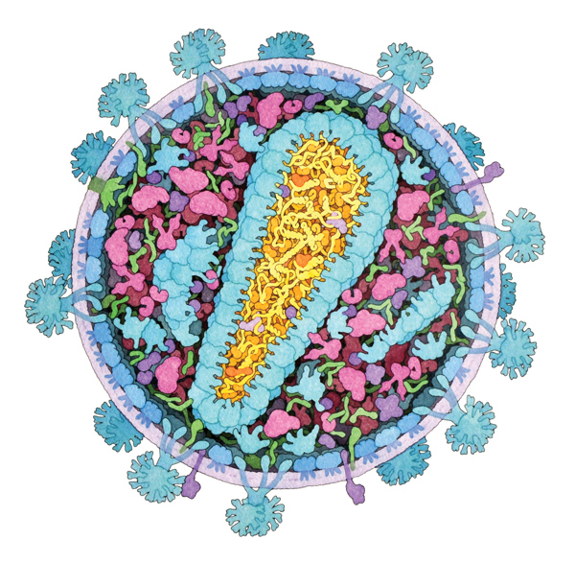
What do HIV tests look for?
Antibodies against HIV spike proteins (gp41 and gp120)
      Anti-gp41 and –gp120 Abs detected
HIV Antigens (p24)
      Used to detect HIV in early stages of
      infection (before Abs are present)
HIV RNA
      HIV-specific sequences of RNA can be detected by nucleic acid testing
      To assess viral load
HIV-1 versus HIV-2
      HIV-1 more pathogenic than HIV-2
Notes:
Testing for P24 antigen allows for detection earlier since the antibodies against gp41 and gp120 are produced after a few weeks. Another sure way to identify HIV in a host is by identifying and amplifying the viral RNA. This is also used to differentiate between HIV-1 (severely pathogenic) and HIV-2 (not as pathogenic)

Slide 17
Drugs Target the Achilles’ Heels of HIV
Adapted from http://www.nature.com/nrmicro/journal/v12/n11/fig_tab/nrmicro3351_F1.html
Year | Milestone(s) | Treatment Strategy
1987 | FDA approves Retrovir (Zidovudine or AZT) as the first drug to treat HIV | First reverse transcriptase inhibitor (RTI)
1995 | FDA approves Invirase (Saquinavir) to treat HIV | First protease inhibitor
1996 | FDA approves Viramune (Nevirapine) | First Non-Nucleoside RTI
2003 | FDA approves Fuzeon (Enfuvirtide) | First HIV fusion inhibitor
2007 | FDA approves Isentress (Raltegravir); FDA approves CCR5 blocker Selzentry (Maraviroc) | First integrase inhibitor and first entry blocker
Notes:
Overview of the various approaches used to block the HIV life cycle with currently approved drugs

Slide 18
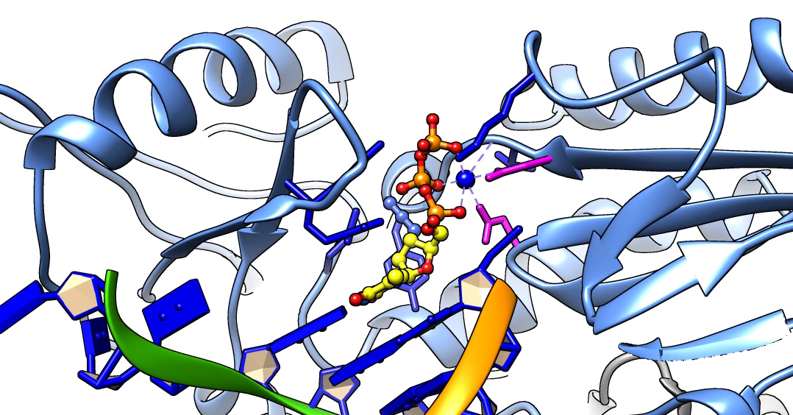
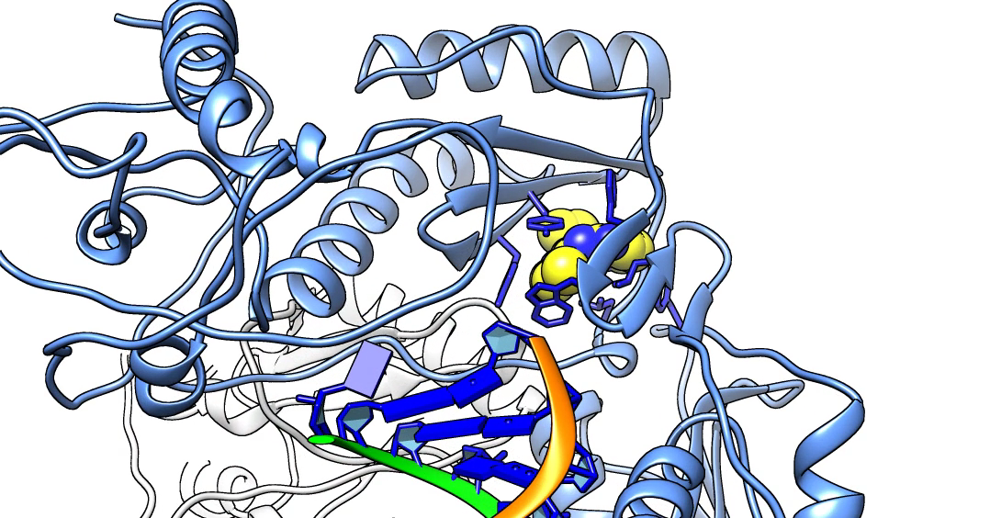
Reverse Transcriptase Inhibitors
Retrovir (NRTI)
  Nucleoside Reverse Transcriptase Inhibitor
  Binds to active site
Nevirapine (NNRTI)
  Non-Nucleoside Reverse Transcriptase Inhibitor
  Binds to a site away from active site
PDB ID 3v4i, Das et al., 2012
PDB ID 4puo, Das et al., 2014
Notes:
RT can be blocked by competitive (NRTIs) and non-competitive (NNRTIs) inhibitors. Watch the molecular movie

Slide 19
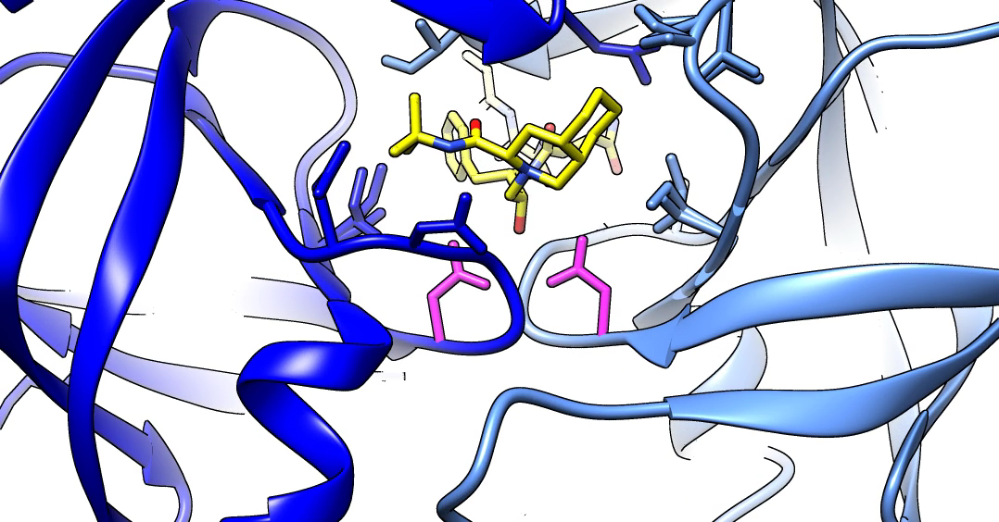
Protease Inhibitors
Saquinavir (HIV-1 PI)
  Binds to active site
  Inhibits protease action
  Prevents maturation of new viral particles
PDB ID 3oxc, Kovalevsky et al., 2007
Notes:
This and other protease inhibitors bind to the active site, usually by mimicking the natural substrate. Watch the molecular movie

Slide 20
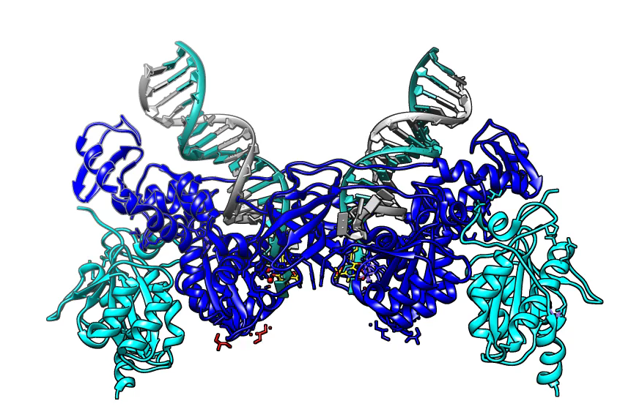
Integrase Inhibitor
Raltegravir – (IN STI)
  Strand transfer inhibitor
  Prevents integration
PDB ID 3oya, Hare et al., 2010
Notes:
The structure shown here is not that of an HIV protein but that from Prototype Foamy Virus (PFV). The drug blocks strand transfer, a critical step in the viral DNA integration process. Watch the molecular movie

Slide 21
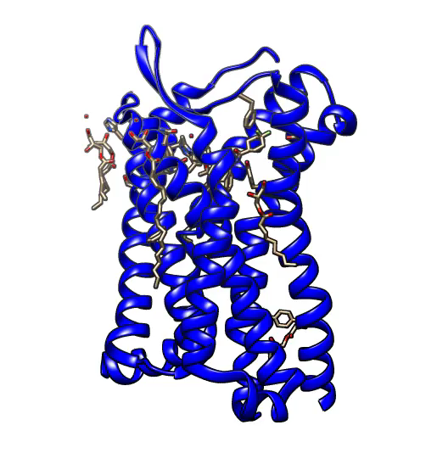
Entry Inhibitor
Maraviroc (Entry inhibitor)
  Co-receptor antagonist
  Prevents HIV Env:CD4 complex from binding to CCR5
PDB ID 4mbs, Tan et al., 2013
Notes:
The small molecule drug binds to the CCR5 molecule at the interface where the gp120-CD4 complex would bind, inhibiting the binding. Watch the molecular movie

Slide 22
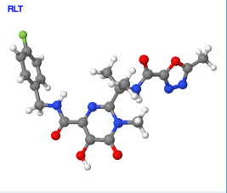
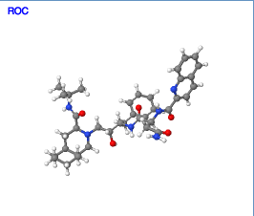
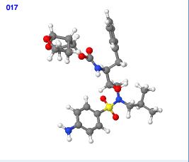
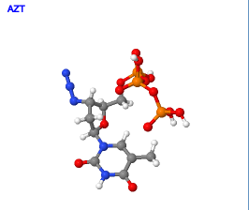
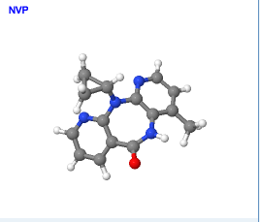
Multiple Drugs Against HIV
Blocks at multiple points in the HIV life cycle
Used in combinations
  Called Combination Anti-Retroviral Therapy (cART)
Multiple drugs are required to:
  Reduce viral load
  Increase CD4+ Cell counts → boost immune system
  Decrease likelihood of resistance

Slide 23
Current Use of Antiretrovirals (ARVs)
cART Treatment uses drug combinations of 3 different HIV ARVs from two different classes, e.g.
    2 NRTIs + 1 Protease Inhibitor
    2 NRTIs + 1 NNRTI
    2 NRTIs + 1 Integrase Inhibitor
Pre-Exposure Prophylaxis (PrEP) uses 2 specific ARVs daily to prevent HIV-infection in HIV-uninfected persons at high-risk
Post-Exposure Prophylaxis (PEP) uses 2-3 ARVs daily for 28 days after a high-risk exposure to HIV (both occupational and non-occupational exposures)

Slide 24
Drug Resistance
Inability of drugs to disrupt the HIV life cycle
Origins
  Variations in HIV genome from quasi-species infection
  Emergence of mutations under Rx selection pressure
    Lack of adherence (ART)
Example: Reverse Transcriptase M184V
    Most common resistance mutation in Africa (AIDS Rev. 2015;17(1):3-20)
    Context of M184V important in resistance

Slide 25
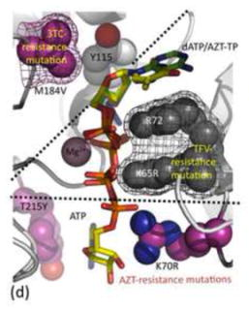
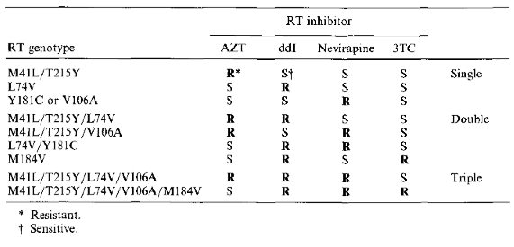
RT M184V Mutation Resistance
M184 near active site
V→ smaller residue, but branched at Cβ position → discriminates against NRTI (no room for unusual geometry of ribose of drug) and prefers dNTP over NRTI → resistance
Combinations of mutation → multi-drug resistance
http://www.ncbi.nlm.nih.gov/pmc/articles/PMC4097817/figure/F1/
http://jgv.sgmjournals.org/content/journal/jgv/10.1099/0022-1317-75-5-951
Notes:
Mechanism of drug resistance described in red letters in the slide. Broadly, the mutant does not bind the drug but prefers to bind to the natural substrate hence leading to drug resistance (i.e. the drug is not effective anymore).

Slide 26
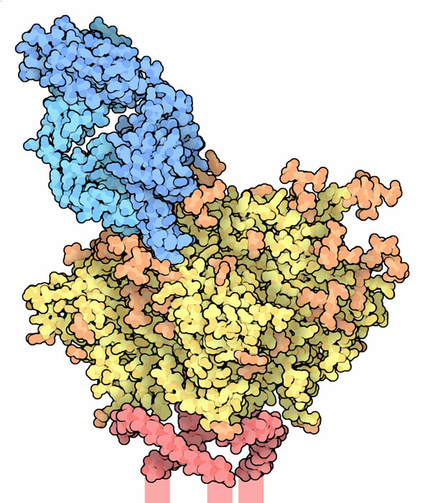
Designing Vaccines
Antibody Fragment
No approved vaccine
Challenges:
    HIV is an enveloped virus
    gp120 is sugar coated
    (glycosylated)
    Very few gp120 spikes
    gp120 varies among different
    HIV subtypes (clades)
Retro-Vaccinology Strategy:
    Study Broadly Neutralizing Abs
    Design right Immunogens→Abs
    Combine Immunogens→Vaccine
Sugars
gp120
Viral Envelope
Glycan shield and variable loops: Targets for broadly neutralizing antibodies
PDB ID 4nco, Julien et al., 2013
Notes:
The broadly neutralizing antibodies will hopefully tell us what the suitable immunogens of HIV are. This can help make a vaccine for HIV. There is a long way before anything useful is approved for clinical use.

Slide 27

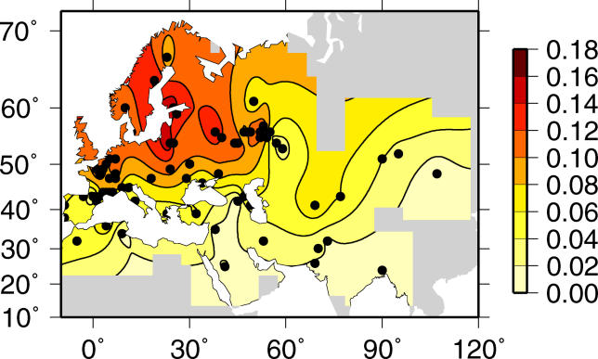
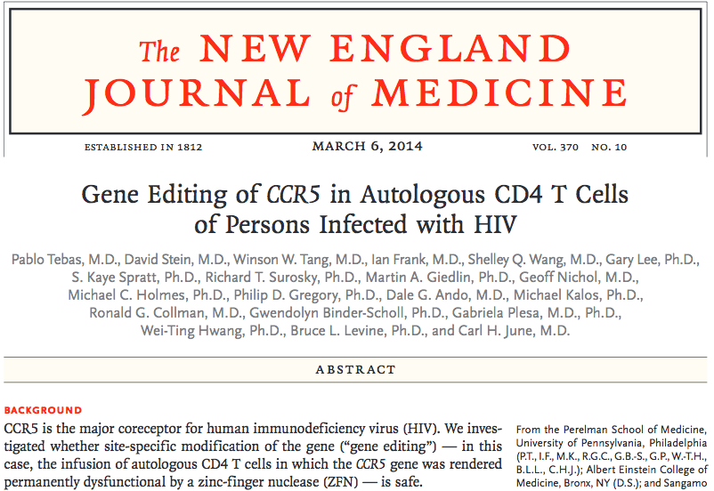
Upcoming Strategies – 1
Resistant Host Cells
  Idea: Berlin patient, Tim Brown
  CCR5 Δ32
    → deletion + frame shift
    → non functional
  Gene therapy
    CCR5 edited by Zinc
    Finger Nuclease
    (viral delivery)
    In Phase 2 clinical trials
Δ32 Allele Frequency Data
http://www.ncbi.nlm.nih.gov/pmc/articles/PMC1255740/figure/pbio-0030339-g001/
Notes:
Attempts to knock off the CCR5 gene in the lymphocytes of HIV infected individuals are being tested in clinical trials. The idea for this treatment strategy came from Timothy Brown – the Berlin Patient.

Slide 28
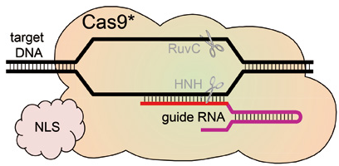
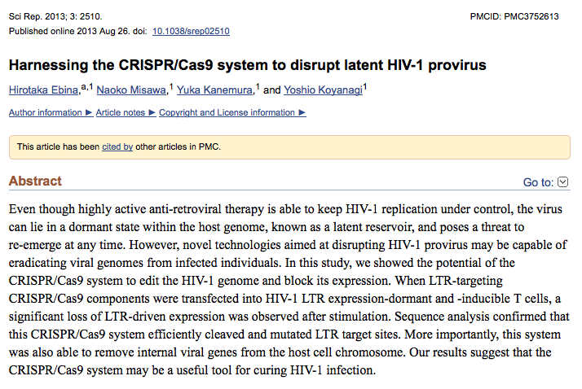
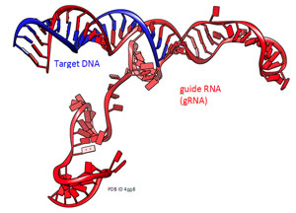
Upcoming Strategies - 2
Destroy Integrated Virus
    Use guide RNA/CRISPR CAS9
    Seek out integrated proviral DNA
    Make double stranded breaks
    Repair breaks – NH End Joining
Notes:
The ideas in using Crispers is to try and specifically excise out the viral genome that is integrated in the host cell genomes.

Slide 29
Summary
About HIV – proteins, life cycle, infection with no intervention
Testing for HIV infection
Treating HIV Infection
    HIV's Achilles' Heels: Current Treatment Approaches
    Drug Resistance
Current areas of research
    HIV Vaccine: A Status Report
    Upcoming Treatment Strategies

Slide 30
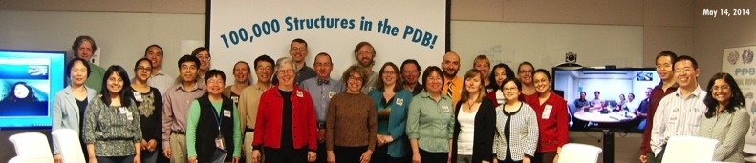



  Acknowledgements
The RCSB PDB is funded by a grant from the National Science Foundation,
the National Institutes of Health, and the US Department of Energy.

