Slide 1
Making Sense of
(DNA/RNA) Strands
Collaborative Curriculum Development Program
2020

Slide 2
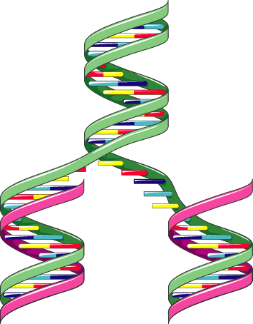
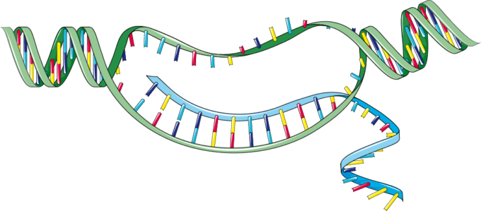
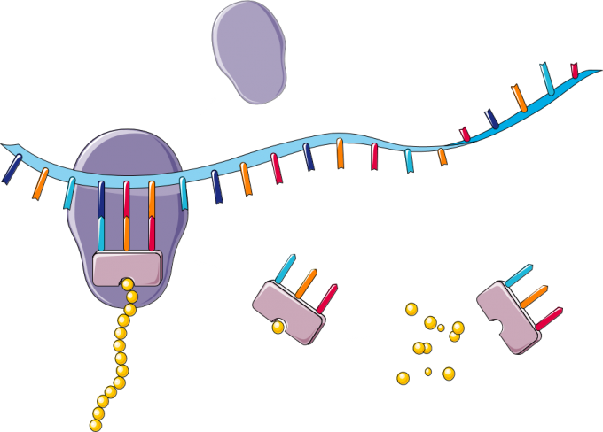
Central Dogma of Biology
+ Sense coding strand DNA
DNA
5’
Transcription
- antisense template non-coding strand DNA
3’
RNA
3’
+ mRNA
5’
Replication
Translation
Protein
tRNA
Notes:
The Central Dogma says DNA makes RNA, which in turn makes protein.
DNA can replicate itself by opening the double helix into 2 strands both of which become templates for making another copy. This function is often completed by a DNA dependent DNA polymerase.
The DNA is transcribed to RNA such that the RNA that will be translated (+ strand, colored light blue) reads off the - strand DNA (or non-coding DNA) and is translated to protein.

Slide 3
+/- Strands in DNA and RNA
Sequence | What is it? | What does it do?
3′GGCTATAGCGTTT 5′ | - DNA antisense strand (template/ noncoding) | Acts as template for transcription
5′CCGATATCGCAAA 3′ | + DNA sense strand (nontemplate/ coding) | Complementary to template strand; same sequence as mRNA (except uses T for U)
5′CCGAUAUCGCAAA 3′ | + RNA or mRNA (sense transcript) | RNA transcribed from the noncoding (template/ antisense) strand. This is what will bind to ribosomes and be translated. Has same sequence as coding strand DNA except uses U for T.
3′GGCUAUAGCGUUU 5′ | - RNA antisense transcript | RNA strand that would result if the coding (nontemplate/sense) strand is transcribed. Has same sequence as template strand except uses U for T. This is not shown in the previous slide
Notes:
This slide shows the DNA and RNA + and - strands. The colors are similar to the ones used in the previous slides.
Note the difference between the + strand DNA and RNA is the presence of T vs U in DNA vs RNA
The -DNA serves as the template for transcription - note the 5’ and 3’ ends and the complementary sequence (c.f. The +DNA and + RNA)
The -RNA has the same sequence as the non-coding/template strand (except uses U instead of T)

Slide 4
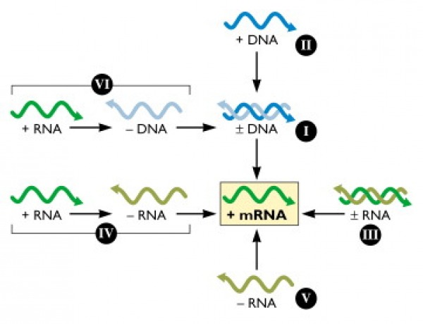
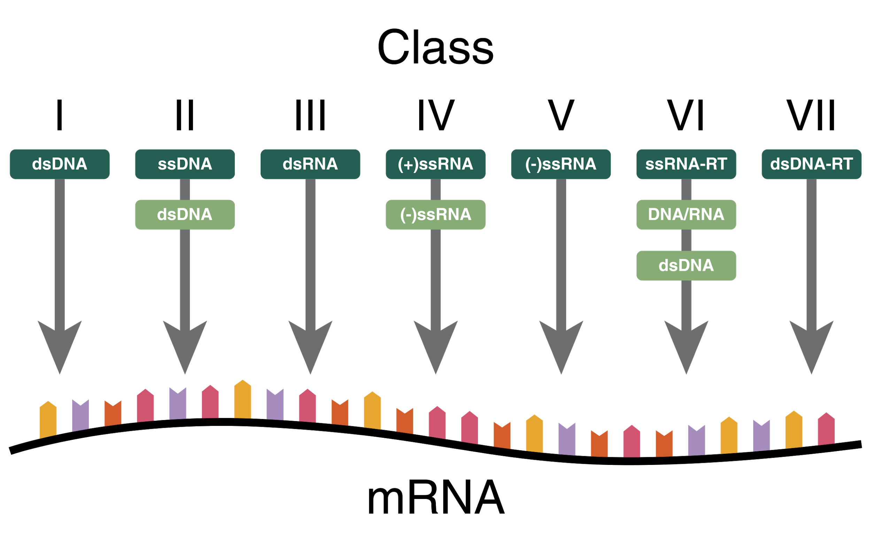
Baltimore Classification of Viral Genomes
http://www.virology.ws/wp-content/uploads/2009/08/baltimore-classification.jpg
Thomas Splettstoesser (www.scistyle.com) / CC BY-SA
Notes:
Viruses are classified by various physical and biological factors. The Baltimore system groups viruses in 7 classes based on their type of genome. Francis Crick proposed the central dogma of biology in which DNA codes for RNA that is translated into protein. (DNA---🡪RNA--🡪Protein). When it comes to viruses we see many variations of this due to the fact that many viruses contain RNA as their primary genome. Whatever the strategy viruses are using to replicate in hosts cells they have to produce RNA that can be replicated to supply new genomes and be translated using host ribosomes to make viral proteins.
Crick FH (1958). On protein synthesis. Symposia of the Society for Experimental Biology, 12, 138-63 PMID: 13580867
Baltimore D (1971). Expression of animal virus genomes. Bacteriological reviews, 35 (3), 235-41 PMID: 4329869
The above table illustrates the Baltimore System. The goal in all these types of viral genomes is to make (+)mRNA to make viral proteins.
I: dsDNA viruses (e.g. Adenoviruses, Herpesviruses, Poxviruses)
II: ssDNA viruses (+)sense DNA (e.g. Parvoviruses)
III: dsRNA viruses (e.g. Reoviruses)
IV: (+)ssRNA viruses (+)sense RNA (e.g. Picornaviruses, Togaviruses)
V: (−)ssRNA viruses (−)sense RNA (e.g. Orthomyxoviruses, Rhabdoviruses)
VI: ssRNA-RT viruses (+)sense RNA with DNA intermediate in life-cycle (e.g. Retroviruses)
VII: dsDNA-RT viruses (e.g. Hepadnaviruses)
https://bio.libretexts.org/Bookshelves/Microbiology/Book%3A_Microbiology_(Boundless)/9%3A_Viruses/9.3%3A_Classifying_Viruses/9.3B%3A_The_Baltimore_Virus_Classification

Slide 5
Bypassing the Central Dogma
Flavors of Viral Polymerases, Choi, 2016; doi: 10.1007/978-1-4614-0980-9_12
Notes:
The RNA-dependent RNA polymerase (RdRp), reverse transcriptase (rt) bypass the central dogma
https://www.ncbi.nlm.nih.gov/pmc/articles/PMC4711277/

Slide 6
SARS-CoV-2 Genome
Viral genome; + strand RNA
Non-structural Protein Products
Early translation of + genome
Produces enzymes needed for steps in the life cycle - 2 proteases, RdRp, Exonuclease, helicase etc.
Structural Proteins
Late translation of + subgenomic RNA
Produces Spike, Membrane, envelope, nucleocapsid proteins
Notes:
Corona Viruses are an example of Class IV. They are +sense single stranded RNA viruses. These viruses require RNA dependent RNA polymerase to copy the +sense RNA strand into a - antisense RNA strand which can then be replicated into +sense RNA strands to supply new virions with genome. These -antisense RNA strands can also be copied into various sense strands that can then be translated into multiple viral proteins.
Interestingly the host cell does not contain RdRp.
The viral genome itself acts like a mRNA which is translated by the host machinery. Once the virus gains entry into the cell and uncoats it components the +Sense single stranded RNA is translated into a polyprotein which is then cleaved by proteases to produce RdRp and other proteins. Thus this virus brings its own copy of the genetic message to make its RdRp.
The RdRp can then use the viral genome as a template to make new RNA copies and transcripts for protein synthesis. Class V RNA viruses contain single stranded -sense RNA. They carry with them , in the virus particle, RdRp. This enables the virus to copy their RNA into +sense mRNA which can be packaged into new virions and translated into viral proteins using host cell machinery.
Note - Reverse transcribing viruses , Class VI, e.g. HIV, are single stranded +sense RNA viruses which reverse transcribe their genome into a single stranded DNA. That single strand DNA is then copied into a Double stranded DNA and integrated into the host genome. This is then transcribed into mRNA and used to make viral proteins and viral genome.
The main genome of SARS-CoV-2 is a + Sense single stranded RNA virus. The genome is essentially a mRNA that is translated into polyprotein1a and polyprotein 1ab. These proteins are cleaved to produce the RdRp and other replication and transcription machinery.
The sense (+) RNA is then replicated by RdRp into antisense (-) RNA which then is replicated into multiple copies of sense (+) RNA. The sense RNA transcripts will be packaged into new viral particles.
The other product made during this process is subgenomic (-) RNA using a process called discontinuous transcription. This yields shorter RNA fragments that will be transcribed to form subgenomic (+) RNA which will in turn be translated to make different viral proteins - e.g., Spike, membrane, envelope, nucleocapsid.

Slide 7
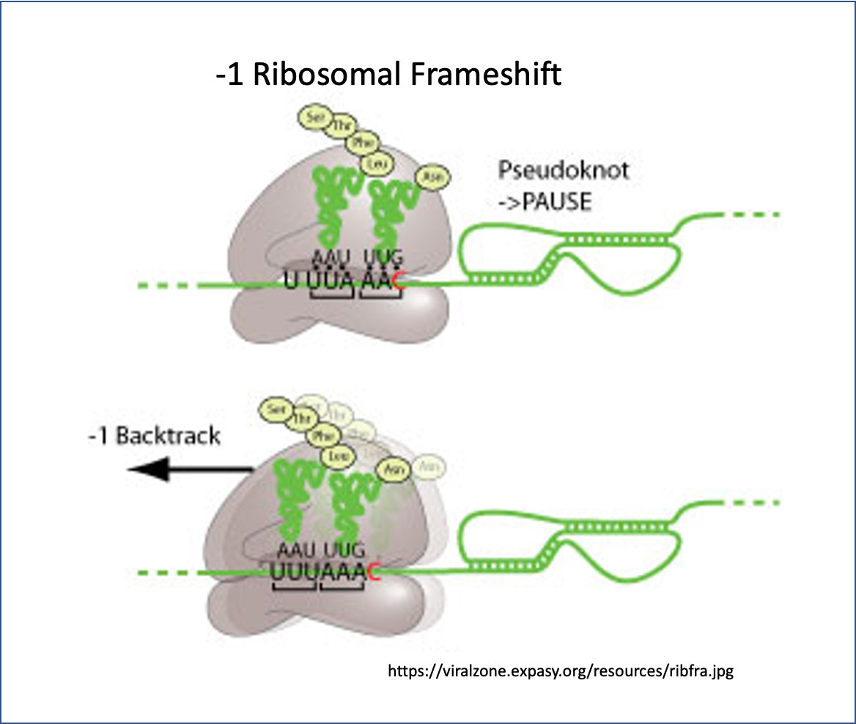
Ribosomal Frameshift to make Polyprotein 1ab
Sequences from UniProt
Pp1a: P0DTC1
pp1ab: P0DTD1
Notes:
During translation the ribosome is stalled by the presence of the pseudoknot structure
In the case of Coronavirus the ribosome slips back one base and that changes the frame of translation
In the new frame the stop codon present in the older frame is bypassed and a longer protein is made - see sequence of the end of the polyprotein 1a (pp1a) and how the pp1ab bypasses that.

