Slide 1
A Molecular View Of Immunology
Shuchismita Dutta, Ph.D.

Slide 2
Overview
The Human Immune System
Innate immunity
Barriers
Recognition
Pathogen Clearance
Adaptive Immunity
Humoral
Cell mediated

Slide 3
Human Immune System
Key players
Various lymphocytes
Lymphatics
Communications
M Prot: M Prot complex (e.g. MHC-TCR)
S Prot: M Prot complex (e.g. IL2-IL2R)
S Prot: S Prot complex (e.g. complement)
Types of immunity
Innate
Adaptive
© www.map.rcsb.org
Notes:
The immune system is composed of many different types of cells and specific molecules that play a role in the 2 types of immunity – innate and adaptive

Slide 4
Innate Immunity
Non-specific
Always working
Immediate
http://missinglink.ucsf.edu/lm/immunology_module/prologue/objectives/obj02.html
Notes:
Innate immunity properties and key players

Slide 5
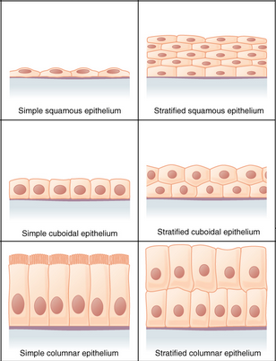
Barriers
Epithelial barriers prevent entry of pathogen
Antimicrobial proteins prevent infections
Defensin in mucous
Lysozyme in saliva, tears, urine etc.
PDB ID 2lzx
PDB ID 2zil
Notes:
The first level of protection against any pathogen is provided by the skin and epithelium followed by specific antimicrobial molecules such as defensin and lysozyme – which destroy pathogens like bacteria and prevent them from entering our body.

Slide 6
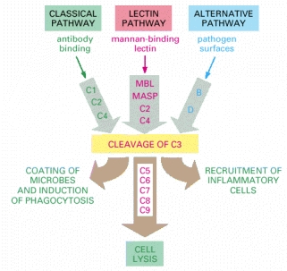
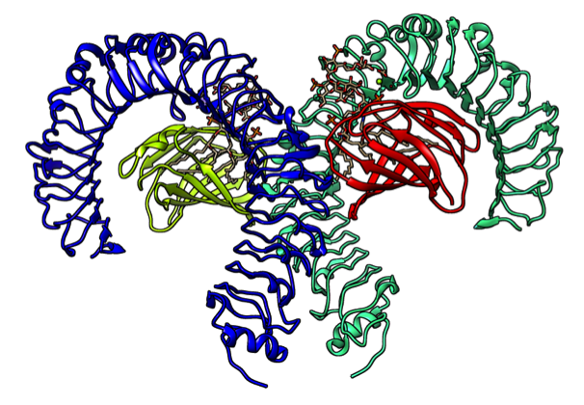
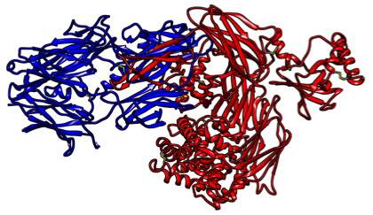
Recognizing Pathogens
Complement Activation
Toll Like Receptors
20 soluble proteins
Recognize pathogens or work with Ab action to activate various proenzymes.
Cell surface receptors
(Leu-rich repeats)
Recognize pathogen associated molecules
e.g. LPS, peptidoglycan, CpG DNA, bacterial flagella, etc.
PDB ID 2a73
LPS recognition by Human TLR-4, PDB ID 3fxi
C3b
C3a
Notes:
If the skin and antimicrobial molecules fail to prevent pathogen entry, the innate immune system takes over.
The first task at hand is to recognize the pathogen and alert the immune system. Many of the immune cells such as macrophages, dendritic cells, have special receptor proteins(called Toll-like Receptors) that can recognize common molecular patterns present in pathogenic (e.g. lipopolysaccharides, double or single stranded RNA etc.)
Another way to recognize and mark pathogens is through the complement system. This can be triggered in a number of different ways, all leading to the cleavage of a protein called C3. This protein is cleaved into two – C3a and C3b, one signaling the immune system to bring in more immune cells and the other coating pathogens for destruction.

Slide 7
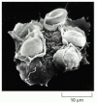
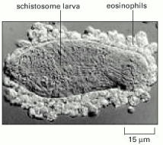
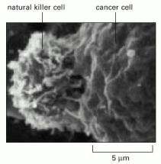
Pathogen Destruction
Phagocytosis
Macrophages engulf pathogens/infected cells
Neutrophils also play a role
Inflamation
Recruit additional cells to deal with large pathogens
Recruitment signaled by cytokines
Induced killing
Recognize infected cells and trigger cell death
Critical for virally infected cells
Images from http://www.ncbi.nlm.nih.gov/books/NBK26846/
Notes:
Once the pathogen has been recognized it is engulfed by macrophages or killed by specialized cells (Natural Killer or Cytotoxic cells). If the pathogen is too large for phagocytosis, additional cells are recruited to the site by cytokine signaling for clearing the pathogen

Slide 8
Adaptive Immunity
Specific
Needs priming
Delayed response
Types
Humoral
Extracellular pathogens
Cell mediated
Intracellular pathogens
http://missinglink.ucsf.edu/lm/immunology_module/prologue/objectives/obj02.html
Notes:
Adaptive Immunity properties and key players

Slide 9
Humoral (Antibody, Ab) Response
Antigen Recognition
Bone marrow lymphocytes (B cells) make
Cell-surface Abs and secreted Abs.
Ab specific to Antigen (Ag)
Ab or immunoglobulin (Ig)
Bind to pathogen/toxin to inactivate
Coat pathogens to activate complement pathway
Classes of Ab – IgA, IgG, IgM, IgE
Typical Ig (IgG)
Y shaped molecule
2 Ag binding sites
2 Fab and 1 Fc regions
Clonal Expansion
Differentiation
Antigen Elimination
Memory
Notes:
Humoral response – B-cells make antibodies in response to specific antigens. Immature B-cells initially produce Immunoglobulin M (IgM) molecules. Once the B-cells are primed by a specific antigen IgG molecules are made and released into the plasma.

Slide 10
Antibody Structure (IgG)
Fab region
Light chain
Light chain
Variable region
Variable region
Constant region
Heavy chain
Heavy chain
Fc region
Papain cleavage sites
PDB IDs 1igt, 3hfm
Notes:
Note this slide has a short animation.
IgG is made of 4 protein chains – 2 heavy and 2 light chains. All these chains have specific domains made up of beta barrel structures (called immunoglobulin domains) – 4 each in the heavy chain and 2 each in the light chains. Each immnoglobulin domain is stabilized by a disulfide bridge. The 4 chains are held together by covalent linkages – also disulfide bonds. The tips of the variable domains (marked with circles) is where the antigen binds. The Antibody structure can be cleaved by a protease called Papain at the points marked by the blue dots. For research and diagnostics many, often the Fab region is used for binding to and recognition of antigen. The Fc region is conserved and stabilized by saccharides. This region (Fc) is important for binding to Fc receptors initiating antibody effector functions.

Slide 11
Cell Mediated Responses
Antigen Presenting Cells activate T Cells (e.g., macrophages, dendritic cells)
Helper T Cells (CD4+)
Secrete Cytokines
Stimulate B-cells
Promote inflamation
Cytotoxic T Cells (CD8+)
Use Perforin, and/or caspases to kill infected cells
T Cells recognize antigens bound to MHC
Antigen Recognition
Clonal Expansion
Differentiation
Antigen Elimination
Memory
Notes:
Cell mediated response properties and key players. While many different T cell types are formed, the two discussed here are Helper and cytotoxic T-cells

Slide 12
Major Histocompatibility Complex (MHC)
MHC I, PDB ID 1hsa
Antigen
Antigen
MHC II, PDB ID 1dlh
β2 micro-globulin
α chain
α chain
β chain
Notes:
Note this slide has short animations
MHC structure:
MHCI: Antigen binding site made of 1 protein (dark blue chain)
MHCII: Antigen binding site made of 2 protein chains (dark and light blue)
Overall structure of MHC I and MHC II very similar

Slide 13
MHC-TCR Interaction
MHC II – TCR complex, PDB ID 1fyt
TCR β chain
TCR α chain
α chain
β chain
Notes:
Note this slide has a short animation
Specific T-cells recognize the antigen bound MHC to either signal release of specific cytokines (Helper T cells) or mediate cell death (Cytotoxic T cells). In the complex shown here MHC chains are shown in blue, antigen is shown in pink/blue/red balls and the TCR is shown in yellow and orange chains.

Slide 14
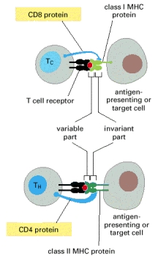
Role of CD4 and CD8
MHC I–CD8 dimer complex,
PDB ID 1akj
MHC II–TCR–CD4 complex,
PDB ID 3t0e
Notes:
Note this slide has short animations
Recognition of MHC and TCR is accompanied by recognition by other proteins – e.g. CD4 (pink/magenta chains) and CD8.
Note that the position of CD4/CD8 interaction is distant from the antigen recognition region.

Slide 15
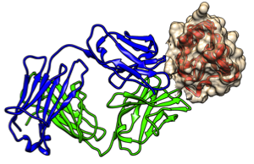
Adaptive Immunity
Humoral Response
Cell Mediated Response
Epitopes are displayed on surface
Antigen not processed
Ab - May be membrane bound or secreted
Epitopes are usually buried
Antigen processed
Broken down to peptide (bacterial)
Internal peptide (viral)
TCR - Membrane bound (not secreted)
Notes:
Compare and contrast the interaction of antigen in humoral (through antibodies) and cellular (through MHC/TCR) interactions.

Slide 16
Immune System Summary
Barriers
Non-specific pathogen recognition and destruction
Specific recognition and clearance of pathogens/toxins by
Antibodies
Activated T-cells
Role of CD4 (Helper T Cells) in connecting innate immunity to both types of adaptive immune responses

