Slide 1
Protein Synthesis and Sorting: A Molecular View
Shuchismita Dutta, Ph.D.

Slide 2
Learning Objectives
Central Dogma of Biology
Secretory Proteins: Synthesis and Sorting

Slide 3
Learning Objectives
Central Dogma of Biology
Secretory Proteins: Synthesis and Sorting

Slide 4
Central Dogma of Biology
DNA → RNA → Protein
Transcription Translation
Specific regions of DNA (genes) encode message for making proteins
Genes have start and stop sites as well as a direction (5’→3’)
Transcription - RNA pol makes mRNA
https://www.youtube.com/watch?v=SMtWvDbfHLo (advanced)
https://www.youtube.com/watch?v=5MfSYnItYvg (basic)
Translation – Ribosome and tRNA make protein
https://www.youtube.com/watch?v=TfYf_rPWUdY (advanced)
Notes:
Note the video links can be used to present a short molecular movie describing the key steps in each of these processes.

Slide 5
Transcription
DNA → RNA
RNA Polymerase
Eukaryotic polymerase complex machinery
Eukaryotic transcript may be processed
Types of RNA:
DNA
RNA polymerase
mRNAs | messenger RNAs, code for proteins
rRNAs | ribosomal RNAs, form basic structure of ribosome; catalyze protein synthesis
tRNAs | transfer RNAs, adaptors between mRNA and amino acids
snRNAs | small nuclear RNAs, function in nuclear processes,
RNA
http://pdb101.rcsb.org/motm/40
Notes:
To learn more about RNA Polymerase read http://pdb101.rcsb.org/motm/40

Slide 6
Translation
RNA → Protein
At the interface of Ribosomal subunits
Assisted by various Ribosomal factors
tRNAs recognize triplet codon → add appropriate amino acid to growing peptide
Ribosome
made of RNA and Proteins
http://pdb101.rcsb.org/motm/10
Notes:
Learn more about Ribosomal subunits at http://pdb101.rcsb.org/motm/10

Slide 7
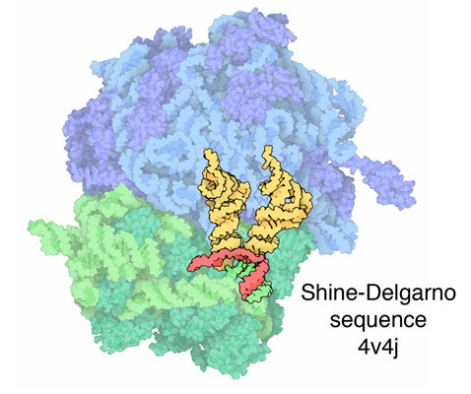
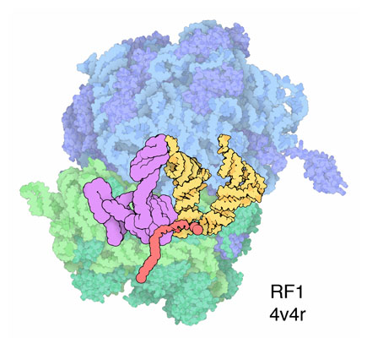
Translation on Ribosome
2. Delivery of tRNA-aa
3. Peptide bond formation
1. Initiate Translation
4. Push peptide bound tRNA
End. Terminate Protein Synthesis
http://pdb101.rcsb.org/motm/121
Notes:
Learn more about Ribosomes and Protein Synthesis at http://pdb101.rcsb.org/motm/121

Slide 8
Learning Objectives
Central Dogma of Biology
Secretory Proteins: Synthesis and Sorting

Slide 9
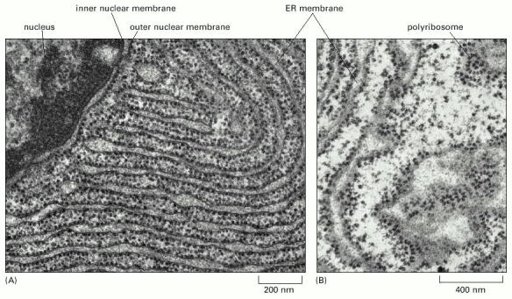
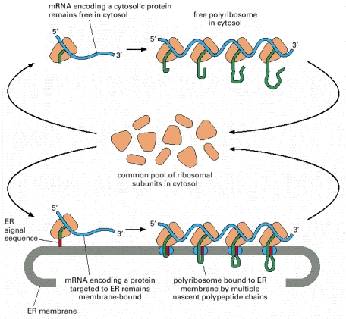
Secretory Proteins
Proteins → correct subcellular destination
Deliver new lipid/protein for cell expansion
Common ribosomal pool for cytosol and rER
http://www.ncbi.nlm.nih.gov/books/NBK26841/

Slide 10
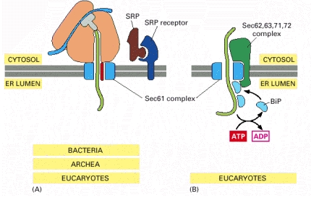
Entering the rER
Co-translational
Signal peptide and SRP bind SRP receptor
Protein transported via Sec61
Signal peptide cleaved
Post-translational
Protein translated in cytoplasm, binds Sec62 and Sec63
Transported to ER via Sec61
Co-translational
Post-translational
http://www.ncbi.nlm.nih.gov/books/NBK26841/figure/A2220

Slide 11
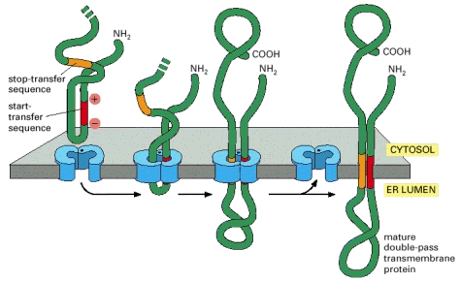
Trans-membrane Proteins
Internal ER signal sequence keeps protein in membrane
Start- and Stop-transfer sequences determine topology of multi-pass membrane proteins
http://www.ncbi.nlm.nih.gov/books/NBK26841/
Notes:
Learn more about transmembrane proteins and related topics at https://www.ncbi.nlm.nih.gov/books/NBK26841/

Slide 12
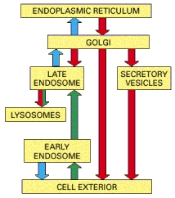
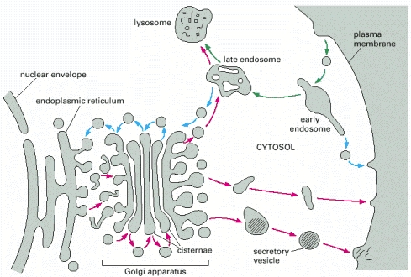
To Golgi and Beyond …
http://www.ncbi.nlm.nih.gov/books/NBK21045/
Notes:
For a comprehensive summary of Protein Sorting see https://www.ncbi.nlm.nih.gov/books/NBK21480/figure/A4668/

Slide 13
Post-translational Processing
In rER
In Golgi
Protein Disulfide Isomerase (PDI): Oxidation of free (SH) on Cys to form disulfide (S-S) bonds
Transfer of common N-linked Oligosaccharide
Trimming of Oligosaccharide(s)
Proteolytic processing of pro-peptides
Further processing of N-linked Oligosaccharides
O-linked glycosylation of proteins
Phosphorylation, sulfation of sugars and proteins
Synthesis and addition of lipids → glycolipids
Notes:
Description of types of post-translational processing that happen in ER and Golgi.
Note that these steps play key roles in proper folding and sorting of the proteins to their final destination. These modifications have important roles to play in the function of these proteins too.

Slide 14
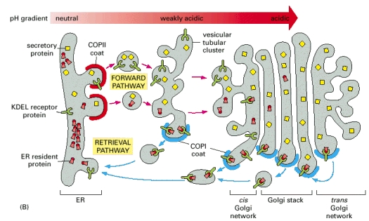
Sorting Proteins
Regulating transport
Signal sequences
COP protein coats
Fates:
Endosome → Lysosome
Secretory vesicle
Membrane protein
Recycle to ER
https://www.ncbi.nlm.nih.gov/books/NBK26941/figure/A2343
Notes:
Proteins transport between rER and Golgi is regulated by coat proteins (COPI And COPII)
Vesicles coated with COPII transport proteins from rER to Golgi and beyond
Proteins with exit signals are concentrated in vesicles coated with COPII
Vesicles coated with COPI transport proteins back from Golgi or Lysosomes to rER
Proteins which are ER resident proteins have the KDEL (Lys-Asp-Glu-Leu) sequence, which binds to the KDEL receptor. This in turn binds to COPI. The COPI coated vesicles are transported back to ER.

Slide 15
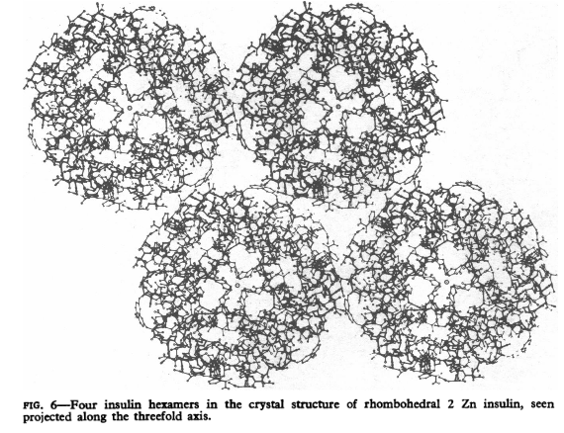
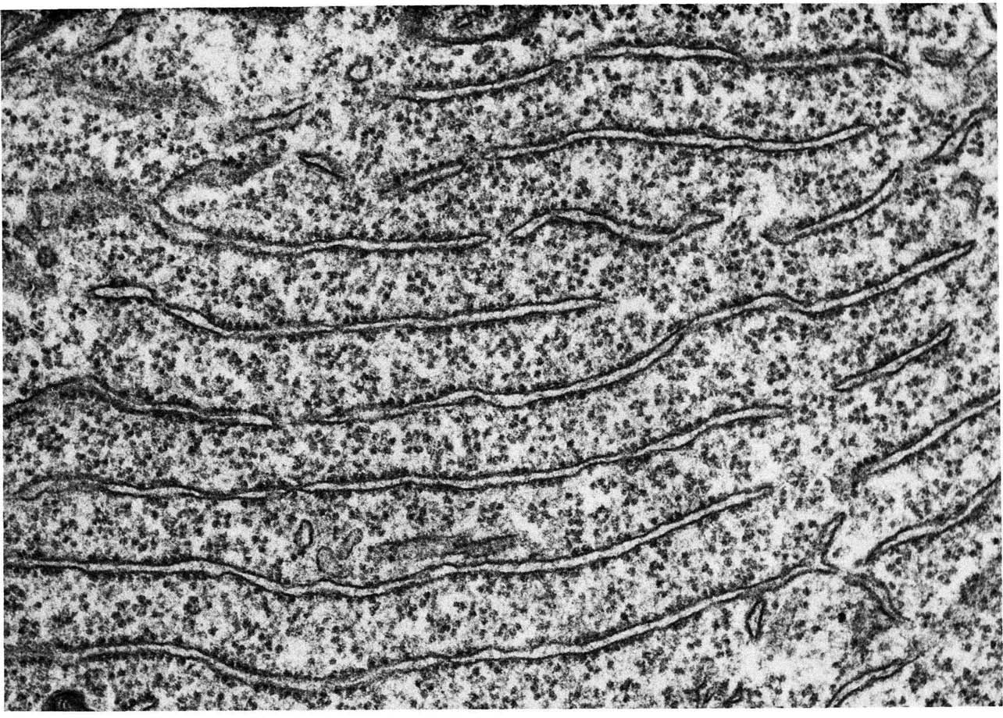
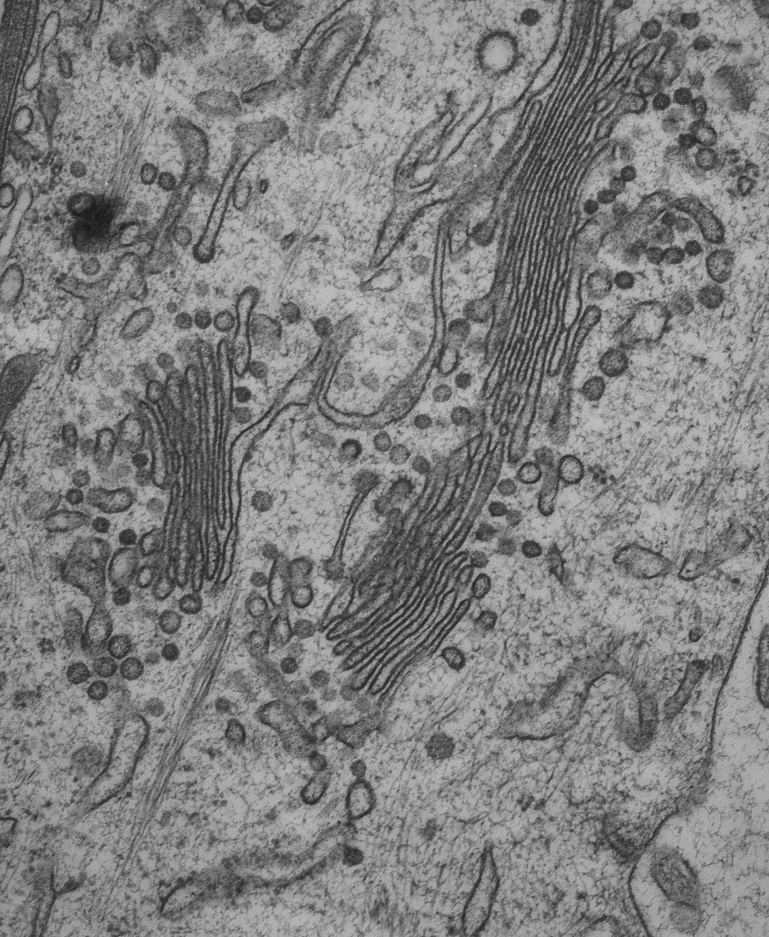
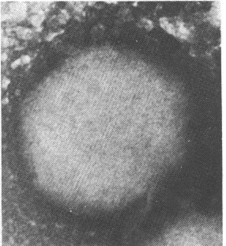
Insulin: Biosynthesis and Storage
Pancreatic β-cells
Cleave C-peptide with Prohormone Convertase 1 & 2 + Carboxypeptidase E
Secretory granules
Cleave 24 residues and localize to rER
Fold protein
Form 3 disulfide bonds
PDB ID 2kqp
PDB ID 1trz
Preproinsulin
Proinsulin
Insulin
D. Hodgkin, British Medical Journal, 1971, 4, 447-451
Rough ER CIL:10771
Golgi CIL:7743
Notes:
Cleave 31 residues (C-peptide) in golgi-network by cellular peptidases (prohormone convertases, and carboxypeptidase E)
Mature insulin molecule → has two short peptides
N-terminal 30 residues (referred to as chain B)
C-terminal 21 residues (referred to as chain A)
Secretion
In responses to incretin hormones or increased levels of Ca++ ions
Secretory vesicles released
CIL:10771:: Rough ER - Fig 172, Chap 5 of 'The Cell, 2nd Ed.’ by Don W. Fawcett M.D.
CIL:7743:: Golgi – TEM image by Mary Morphew, J. Richard McIntosh, Mark Ladinsky

Slide 16
Summary
Central Dogma of Biology
DNA → RNA → Protein
Protein Sorting
Extracellular and membrane proteins
Processed in rER, Golgi
Packaged/stored in vesicles

