Slide 1
SARS-CoV-2 Life Cycle
(Advanced)
Collaborative Curriculum Development Program
2020

Slide 2
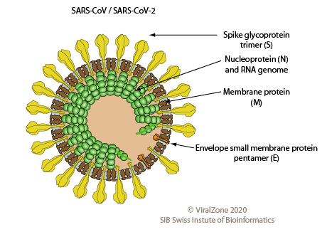
What does SARS-CoV-2 look like?
Severe acute Respiratory Syndrome -Coronavirus-2
Large (~30Kb)
+RNA genome
https://viralzone.expasy.org/764?outline=all_by_species

Slide 3
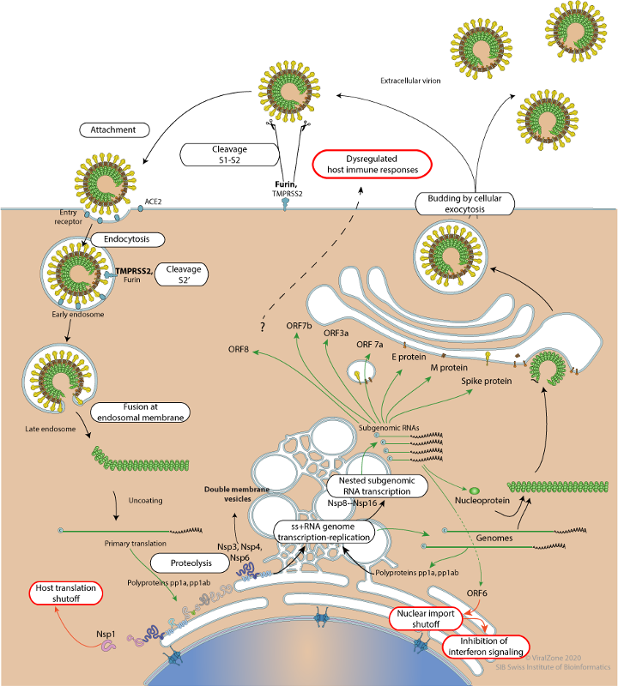
July 2020
Life Cycle of SARS-CoV-2
LYTIC
1. Attachment and
Entry
3. Viral Assembly and
Release
2. Replication and Synthesis
https://viralzone.expasy.org/resources/Coronavirus_cycle.png
Notes:
There are 3 main step of the life cycle shown in red, black and blue outlined boxes.

Slide 4
SARS-CoV-2 Life Cycle: Overview
Viral Attachment and Entry
Virus spike protein interacts with cell surface protein to enter the host (Human) cell
The viral genomic RNA acts like an mRNA - it can directly make proteins.
Replication and Synthesis
The genomic RNA produces proteins and new RNA necessary for viral reproduction, hijack the host cell machinery and prevent it from carrying out it own functions
Three important proteins produced by the virus are PL Proteinase, 3CL proteinase and RdRP.
Much of the RNA and protein synthesis happens in the double membrane vesicles budding off from the ER
Viral Assembly and Release
The structural proteins (Spike, Envelope, Matrix, and Nucleocapsid) and newly formed RNA are modified and packaged and assembled before release from the host cell by exocytosis

Slide 5
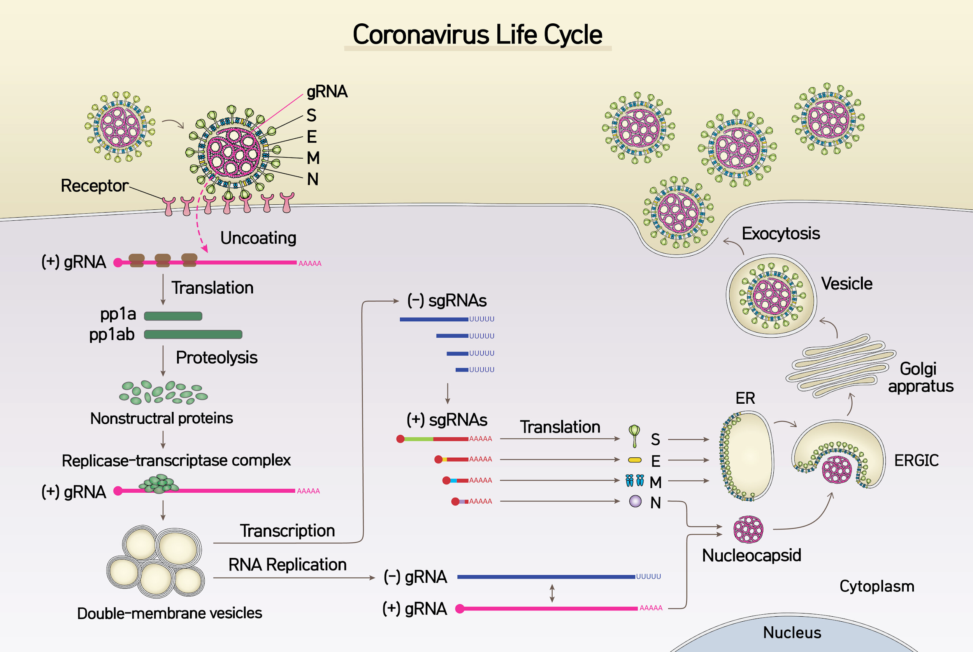
An Alternate View
Attachment and
Entry
Viral Assembly and
Release
https://phys.org/news/2020-04-coronavirus-sars-cov-.html
Replication and Synthesis
Notes:
Spike protein on the viral envelope attaches to the ACE2 receptor on the human epithelial mucosa cell (on the lungs, digestive system etc.)
A Protease enzyme on the host cell surface cuts off the spike head allowing the fusion machinery to spring into action. The virus can now enter the host cell in one of two different ways: The fusion machinery of the spike allows the virus and host cell membranes to come close enough so that they fuse together forming a channel that allows the virus genetic material to enter the host cell.
Another method that is reported in the research is that the virus is also capable of entering the host cell by receptor mediated endocytosis. After the virus enters the cell, the spike within the endosome is cleaved. The fusion machinery in the stem now joins the viral and host membranes to create a channel for the RNA to enter the cytosol of the host cell.

Slide 6
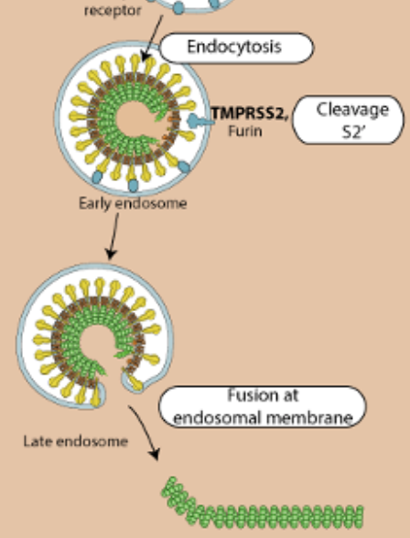
SARS-CoV-2 Life Cycle: Viral Attachment & Entry
Attachment
Entry
Spike protein on the viral envelope attaches to ACE-2 receptor on the human epithelial mucosa cell (on the lungs, digestive system etc.)
The virus can enter the cell in two steps
Receptor mediated endocytosis forming an endosome. A host enzyme cleaving the spike exposing the fusion protein.
Fusion of virus envelope and host cell
https://www.scientificamerican.com/article/a-visual-guide-to-the-sars-cov-2-coronavirus/

Slide 7
Notes:
Primary translation:
After entry into the host cell, the viral RNA translates the section ORF1a, also known as pp1a (polyprotein 1a). In order to form polypeptide 1ab, translation begins at the 5’ end of ORF1a, and a ribosomal frameshift around the middle (see diagram above) enables a change in the reading frame to form pp1ab. The protein made by this method are important in replication and transcription of the viral genome and are therefore known as “Replicase/transcriptase proteins”
Two proteases, PL proteinase and 3CL proteinase self cleave the polyprotein in the sections indicated in the diagram above. PL proteinase cleaves at sections indicated by the dark blue arrows which releases the proteins nsp 1, 2 and the PL proteinase itself. The 3CL proteinase cleaves at the section indicated by the light blue arrows. Once these proteases have been created, they can function in cleaving the polyprotein during subsequent translation events.
Another important protein that is made by this process is RNA dependent RNA polymerase (RdRp). This enzyme allows for the transcription of the original (+) RNA to make a complementary strand (-) RNA.

Slide 8
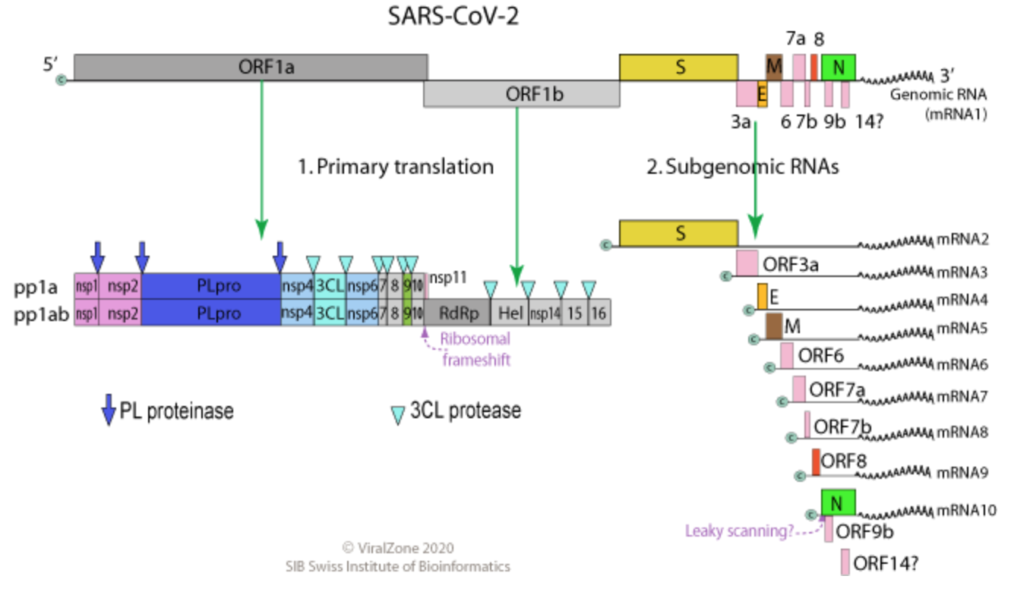
SARS-CoV-2 Life Cycle: Replication & Synthesis
Viral RNA from the section ORF1a translated as one long polypeptide known as pp1a (polyprotein 1a)
Polyprotein 1ab, translation begins at the 5’ end of ORF1a, and continues beyond the end of 1a due to a ribosomal frameshift (see diagram) and change in the reading frame to form pp1ab.
These proteins are known as “Replicase/transcriptase proteins” or Nsp (nonstructural proteins)
These proteins are used to make more viral particles, dampen the host’s response to infection and and hijack host proteins.
RdRP
Ribosomal frameshift
Notes:
The viral RNA is the sense or (+) strand that can immediately begin translation to make the viral proteins. All the proteins needed for the viral reproduction are coded for on the single (+) RNA .
ORF = Open Reading Frame. Denotes the section of the RNA from the start to the stop codon that translates to a protein. Here the ORF codes for a series of proteins consecutively and have to be cut out before they can function. (Analogy:Like a long ribbon that needs to be cut in specific places to allow a section to be made into a bow and another section to be used to wrap a present etc).
Protein synthesis begins from the 5’ end of the (+) RNA. This produces all the proteins in pp1a and pp1b (as shown in diagram above). PL and 3CL are two proteases that immediately cut themselves out. They in turn will begin to cut the other proteins from the long polypeptide.
A stop codon at then end of nsp 11 stops the translation to produce up to that point. In order to produce the proteins nsp 12 -16, a ribosomal frameshift occurs. Just before it get to the stop codon, the ribosome shifts one base backwards (to the left or 5’ end) and then continues on its way - going towards the 3’ end. This results in a change in the reading frame and the stop codon is changed to a amino acid. Thus the ribosome can continue translation till the end of the orf 1ab and so produces the rest of the non structural proteins needed for the virus. The pp1ab translation produces an important enzyme, RNA dependent RNA polymerase (RdRp). This enzyme will be used to produce the (-) RNA strand through complementary base pairing. This strand will then be used to produce many copies of the (+) RNA strand using the same enzyme.
Double membrane vesicle is the compartment where the subgenomic RNA are produced. The purpose of this is to protect the double stranded RNAs from getting degraded by the host enzymes.
The full length (+) RNA and the proteins needed for membrane formation are then transported to the Golgi bodies to be modified and packaged.

Slide 9
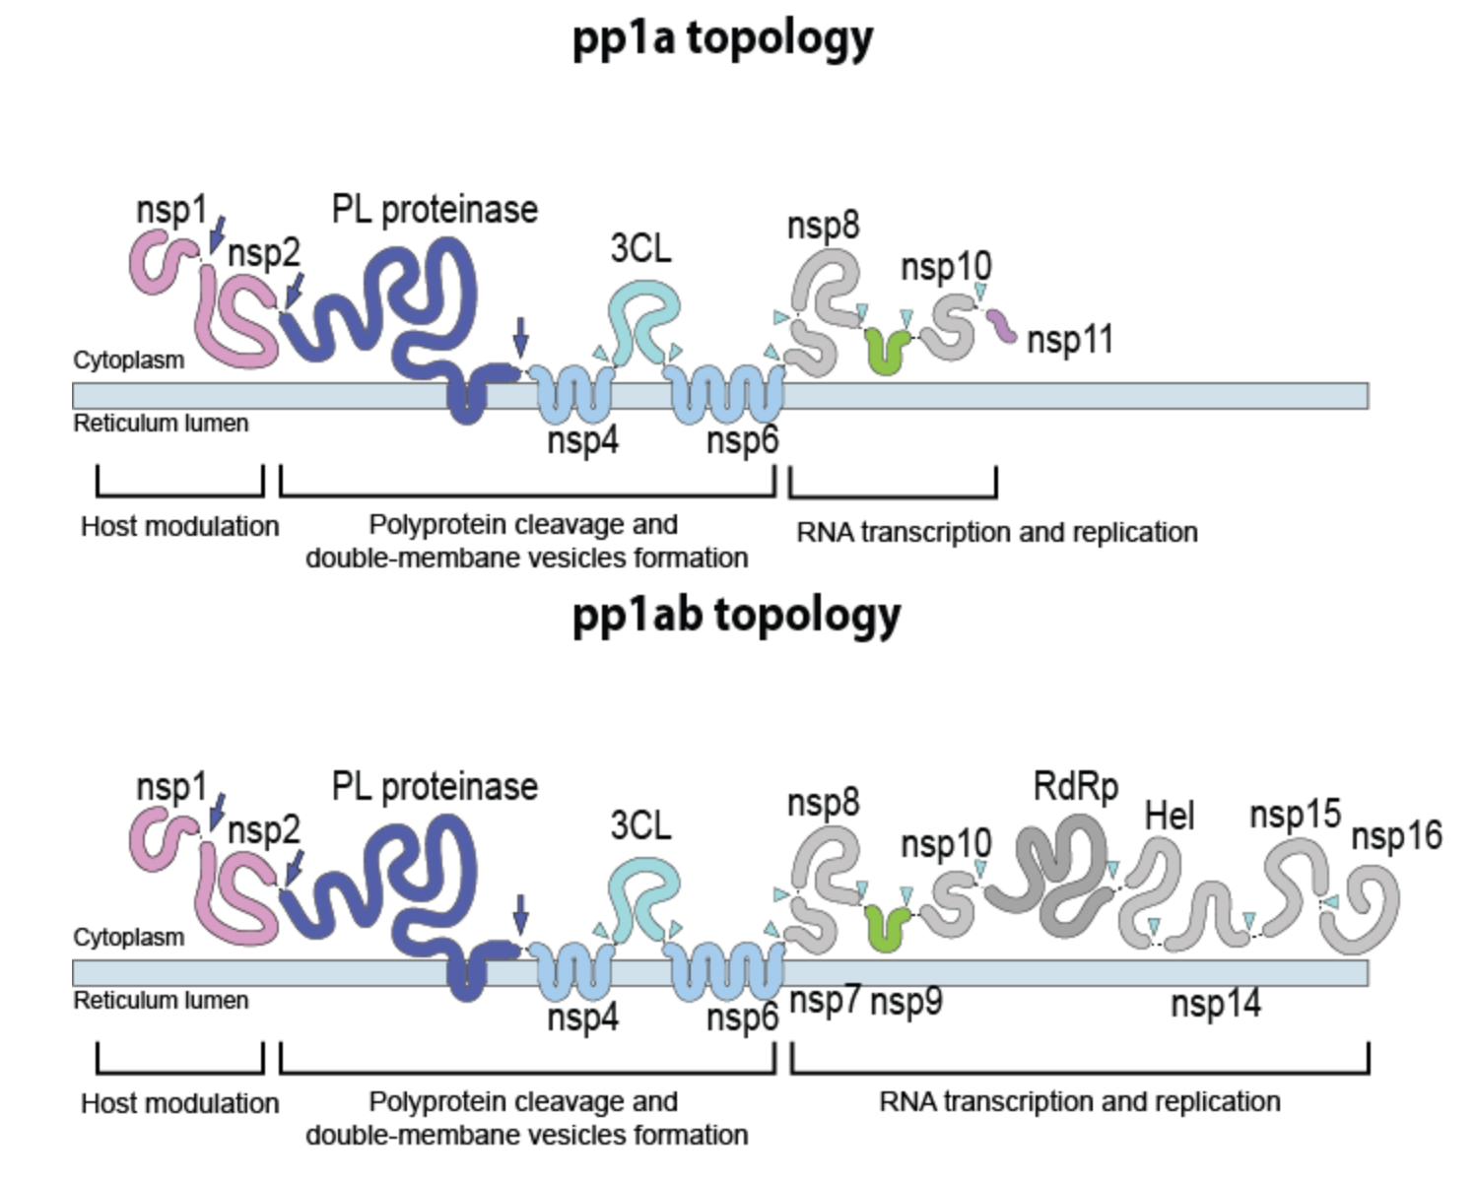
https://viralzone.expasy.org/9076
Notes:
Primary translation:
After entry into the host cell, the viral RNA translates the section ORF1a, also known as pp1a (polyprotein 1a). In order to form polypeptide 1ab, translation begins at the 5’ end of ORF1a, and a ribosomal frameshift around the middle (see diagram above) enables a change in the reading frame to form pp1ab. The protein made by this method are important in replication and transcription of the viral genome and are therefore known as “Replicase/transcriptase proteins”
Two proteases, PL and 3CL self cleave the polyprotein in the sections indicated in the diagram above. PL Proteinase cleaves at sections indicated by the dark blue arrows which releases the proteins nsp 1, 2 and the PL proteinase itself. The 3CL proteinase cleaves at the section indicated by the light blue arrows. Once these proteases have been created, they can function in cleaving the polyprotein during subsequent translation events.
Another important protein that is made by this process is RNA dependent RNA polymerase (RdRp). This enzyme allows for the transcription of the original (+) RNA to make a complementary strand (-) RNA.

Slide 10
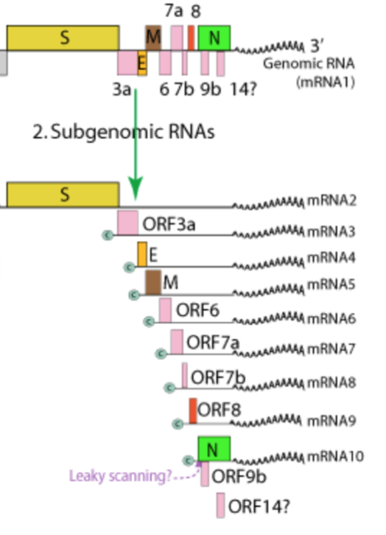
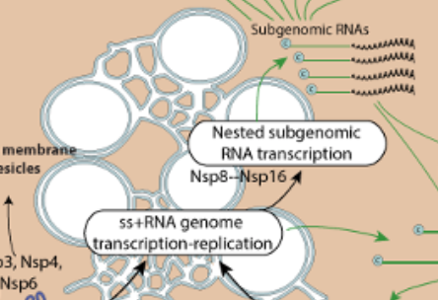
SARS-CoV-2 Life Cycle: Replication & Synthesis
Structural and accessory proteins
RdRp make 2 types of RNA
Full length genomic RNA for packaging to new viral particles
Shorter subgenomic RNAs - Small partial lengths of RNA needed for the translation of individual structural proteins e.g., (E)nvelope, (S)pike, (N)ucleocapsid and (M)embrane.
Double stranded RNAs produced during RNA replication “hide” in double membranes vesicles around the ER called membrane transcription complexes RTC (to avoid host cell endonucleases)

Slide 11
https://viralzone.expasy.org/9076
Notes:
29.9 KB long, 16 ORFs (open reading frames)
The SARS-Cov-2 genome consists of one stand of (+) RNA consisting of 29000 bases. This contains all the proteins and enzymes needed for the virus to enter the host cell, translate its genome to make new viral particles as well as prevent the host cell from carrying out its own activities.
Note that the ORF1a and 1ab produce many proteins including several enzymes e.g., the main protease and RdRP (required for duplicating the viral RNA genome)
The Structural Proteins S, E, M, N etc. are closer to the 3’ end of the genome. The other proteins in the subgenomic region are known as the accessory proteins.
Primary translation:
After entry into the host cell, the viral RNA translates the section ORF1a, also known as pp1a (polyprotein 1a). In order to form polypeptide 1ab, translation begins at the 5’ end of ORF1a, and a ribosomal frameshift around the middle (see diagram above) enables a change in the reading frame to form pp1ab. The protein made by this method are important in replication and transcription of the viral genome and are therefore known as “Replicase/transcriptase proteins”
Two proteases, PL and 3CL proteinases self cleave the polyprotein in the sections indicated in the diagram above. PL Proteinase cleaves at sections indicated by the dark blue arrows which releases the proteins nsp 1, 2 and the PL proteinase itself. The 3CL proteinase cleaves at the section indicated by the light blue arrows. Once these proteases have been created, they can function in cleaving the polyprotein during subsequent translation events.
Another important protein that is made by this process is RNA dependent RNA polymerase (RdRp). This enzyme allows for the transcription of the original (+) RNA to make a complementary strand (-) RNA.

Slide 12
Notes:
Subgenomic RNAs
The original (+) RNA now becomes the template for the production of the subgenomic RNAs by discontinuous transcription that will be translated into the various structural proteins. These are the spike proteins (S) membrane proteins (M), envelope proteins (E) and nucleocapsid proteins (N). See the diagram at “2. Subgenomic RNA” above.
The translation of these subgenomic short stranded RNAs take place in the Rough endoplasmic reticulum. Proteins made here can be transported to the Golgi apparatus for modification and packaging. The ER expands to form vesicles thereby protecting the RNA from degradation by the host enzymes.

Slide 13
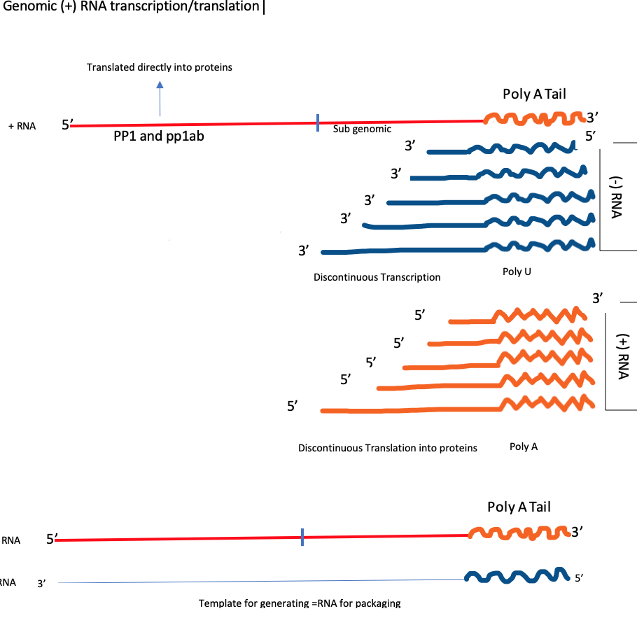
Notes:
Subgenomic RNAs are made by the RdRp jumping from one ORF to the beginning of the RNA or extreme 5’ end. For example as the enzyme is copying the first orf from the 3’ end of the genomic RNA (first blue line), it gets to the beginning of this ORF, then jumps over to the 5’ end of the genomic RNA without transcribing the sections in the middle. This gives rise to an - RNA that contains the complementary sequence of that ORF. A complementary strand is then generated by normal transcription to make the + RNA needed for ORF translation.

Slide 14
Notes:
Vesicles with newly formed virus bud out of the host cell by exocytosis.

Slide 15
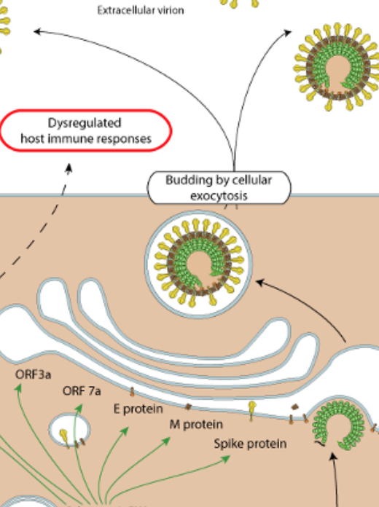
SARS-CoV-2 Life Cycle: Assembly & Release
Viral structural proteins are translated from the Subgenomic RNA
The ones that are embedded in the viral membrane are transported to the Golgi for modification - forming disulfide bonds, glycosylation etc.
The nucleocapsid protein is translated in the cytoplasm and binds to the full length genomic RNA
The viral particles are assembled packaged in and around the golgi
Fully formed viral particles exit the cell through exocytosis.

