Slide 1
SARS-CoV-2 Life Cycle
(Introductory)
Collaborative Curriculum Development Program
2020

Slide 2
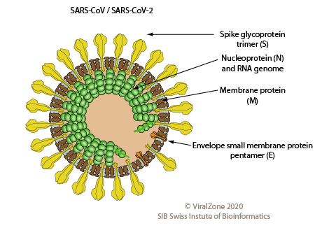
What does SARS-CoV-2 look like?
Severe acute Respiratory Syndrome -Coronavirus-2
Large (~30Kb)
+RNA genome
https://viralzone.expasy.org/764?outline=all_by_species

Slide 3
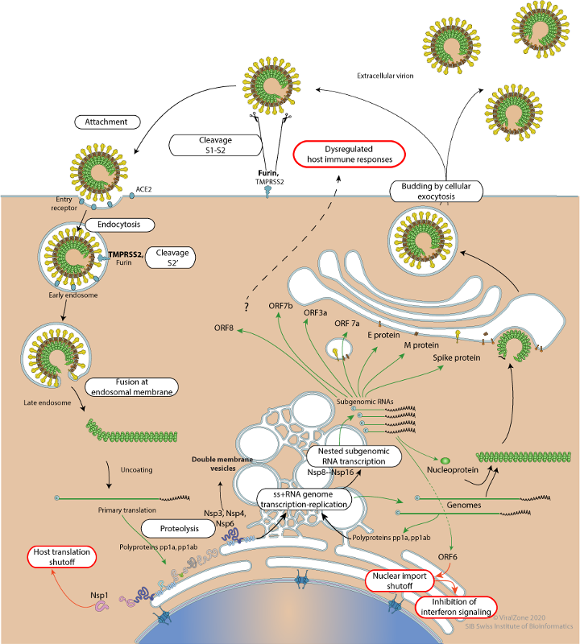
July 2020
Life Cycle of SARS-CoV-2
LYTIC
1. Attachment and
Entry
3. Viral Assembly and
Release
2. Replication and Synthesis
https://viralzone.expasy.org/resources/Coronavirus_cycle.png
Notes:
There are 3 main step of the life cycle shown in red, black and blue outlined boxes.

Slide 4
SARS-CoV-2 Life Cycle: Overview
Viral Attachment and Entry
Virus spike protein interacts with cell surface protein to enter the host (Human) cell
The viral genomic RNA acts like an mRNA - it can directly make proteins.
Replication and Synthesis
The genomic RNA produces proteins and new RNA necessary for viral reproduction, hijack the host cell machinery and prevent it from carrying out it own functions
Three important proteins produced by the virus are PL Proteinase, 3CL proteinase and RdRP.
Much of the RNA and protein synthesis happens in the double membrane vesicles budding off from the ER
Viral Assembly and Release
The structural proteins (Spike, Envelope, Matrix, and Nucleocapsid) and newly formed RNA are modified and packaged and assembled before release from the host cell by exocytosis

Slide 5
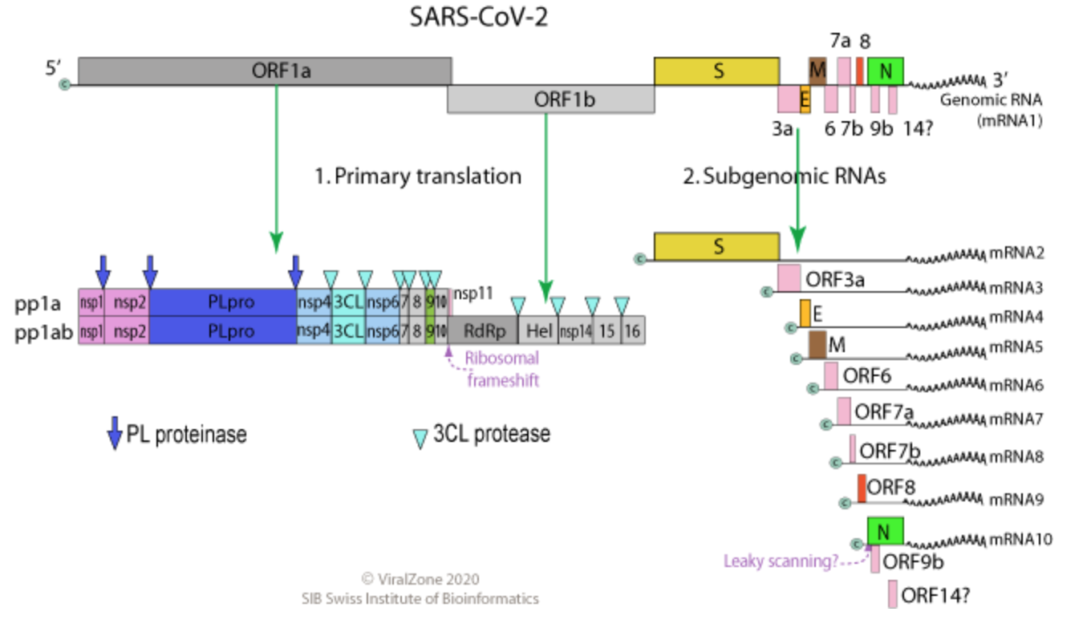
https://viralzone.expasy.org/9076
Notes:
Note that the ORF1a and 1ab produce many proteins including several enzymes e.g., the PL proteinase, main protease (or 3CL proteinase), and RdRP (required for duplicating the viral RNA genome)
The Structural Proteins S, E, M, N etc. are closer to the 3’ end of the genome

