Slide 1
SARS-CoV-2 Main Protease Also Called 3CL Proteinase
Collaborative Curriculum Development Program 2020

Slide 2
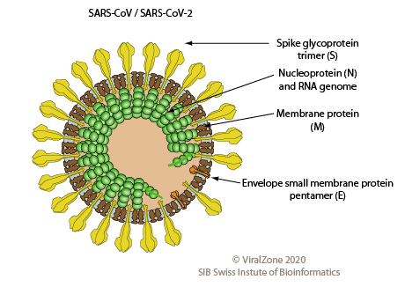
What does SARS-CoV-2 look like?
Severe acute Respiratory Syndrome -Coronavirus-2
Large (~30Kb)
+RNA genome
https://viralzone.expasy.org/764?outline=all_by_species

Slide 3
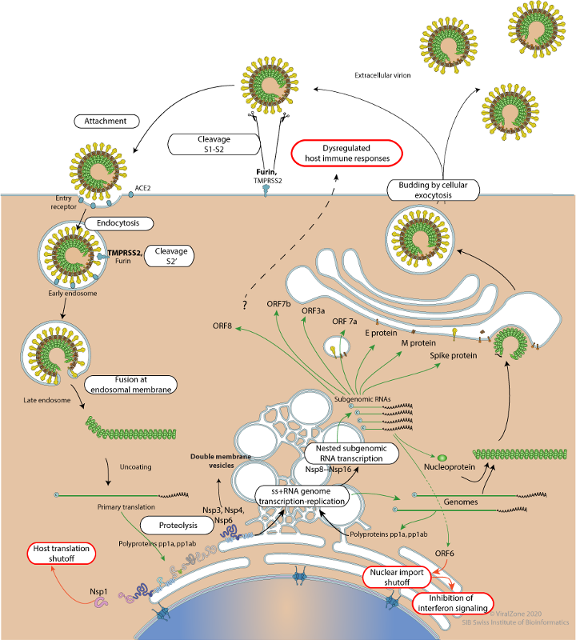
July 2020
Life Cycle of SARS-CoV-2
LYTIC
1. Attachment and
Entry
3. Viral Assembly and
Release
2. Replication and Synthesis
https://viralzone.expasy.org/resources/Coronavirus_cycle.png
Notes:
There are 3 main step of the life cycle shown in red, black and blue outlined boxes.

Slide 4
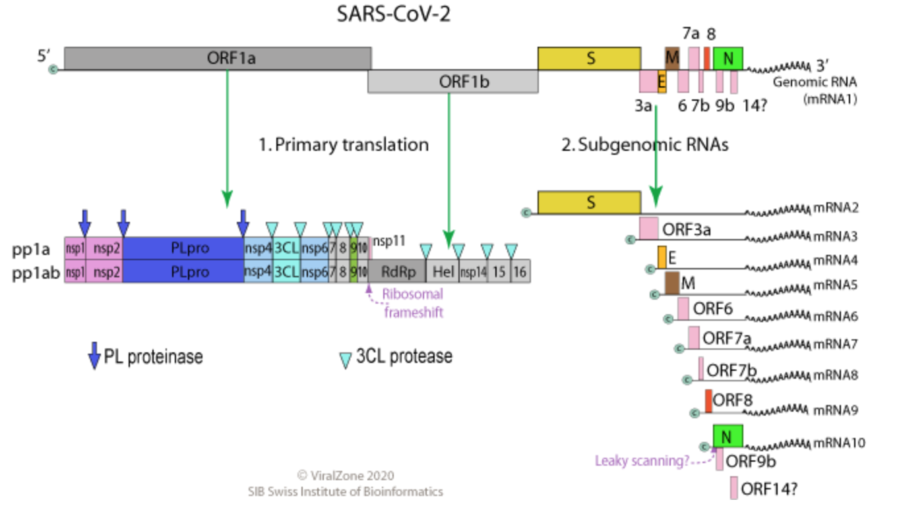
SARS-CoV-2 Life Cycle: Replication & Synthesis
Viral RNA from the section ORF1a translated as one long polypeptide known as pp1a (polyprotein 1a)
Polyprotein 1ab, translation begins at the 5’ end of ORF1a, and continues beyond the end of 1a due to a ribosomal frameshift (see diagram) and change in the reading frame to form pp1ab.
These proteins are known as “Replicase/transcriptase proteins” or Nsp (nonstructural proteins)
These proteins are used to make more viral particles, dampen the host’s response to infection and and hijack host proteins.
RdRP
Ribosomal frameshift
Notes:
The viral RNA is the sense or (+) strand that can immediately begin translation to make the viral proteins. All the proteins needed for the viral reproduction are coded for on the single (+) RNA .
ORF = Open reading frame. Denotes the section of the RNA from the start to the stop codon that translates to a protein. Here the ORF codes for a series of proteins consecutively and have to be cut out before they can function. (Analogy:Like a long ribbon that needs to be cut in specific places to allow a section to be made into a bow and another section to be used to wrap a present etc).
Protein synthesis begins from the 5’ end of the (+) RNA. This produces all the proteins in pp1a and pp1b (as shown in diagram above). PL and 3CL are two proteases that immediately cut themselves out. They in turn will begin to cut the other proteins from the long polypeptide.
A stop codon at then end of nsp 11 stops the translation to produce up to that point. In order to produce the proteins nsp 12 -16, a ribosomal frameshift occurs. Just before it get to the stop codon, the ribosome shifts one base backwards (to the left or 5’ end) and then continues on its way - going towards the 3’ end. This results in a change in the reading frame and the stop codon is changed to a amino acid. Thus the ribosome can continue translation till the end of the orf 1ab and so produces the rest of the non structural proteins needed for the virus. The pp1ab translation produces an important enzyme, RNA dependent RNA polymerase (RdRp). This enzyme will be used to produce the (-) RNA strand through complementary base pairing. This strand will then be used to produce many copies of the (+) RNA strand using the same enzyme.
the compartment where the subgenomic RNA and their proteins are produced. The purpose of this is to protect the double stranded RNAs from getting degraded by the host enzymes.
The full length (+) RNA and the proteins needed for membrane formation are then transported to the Golgi bodies to be modified and packaged.

Slide 5
Proteases
What is a Protease?
Enzyme that catalyzes breakdown of proteins - i.e., it cuts the protein polymer backbone by adding water (hydrolysis)
Involved in many biological functions - digestion, signaling, key steps in viral life cycles
Types: Based on where it cuts
Endopeptidase - cuts in the middle of the protein chain usually at a specific sequence
e.g. trypsin, chymotrypsin, pepsin, papain, elastase
Exopeptidase - cuts at the ends of the protein chain
Aminopeptidase - cuts the amino terminal residue
e.g., endoplasmic reticulum aminopeptidase 1 (or ERAP1)
Carboxypeptidase - cuts the carboxy terminal residue
e.g., Carboxypeptidase A

Slide 6
What is the function?
The proteins needed for virus to function is translated as one long protein or polyprotein (1a and 1ab) from Open reading frame or ORF (1a and 1ab)
After the translation - the individual proteins are separated by cleaving at specific sites within the polyprotein
Two enzymes produced by the virus is necessary for this function
PL (papain like) proteinase which cuts nsp 1, 2 and itself
3CL (chymotrypsin like or 3C like) proteinase which cuts nsp 4-16 and itself. Also called the main protease because it cleaves out more proteins than the PL proteinase

Slide 7
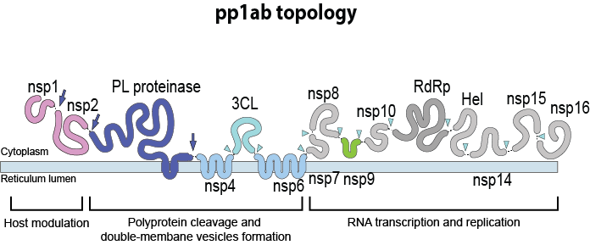
Why is it the “Main” Protease?
Also called Nsp5 or 3C-like proteinase
Acts at 11 cleavage sites on polyprotein 1ab (see light blue triangles)
Common recognition sequence is [ILMVF]-Q-|-[SGACN] (| cleavage site).
Drugs can be synthesized against this protein since no known human proteases has similar cleavage specificity
https://viralzone.expasy.org/resources/R1ab_topology.png
Notes:
Inhibiting the Nsp5 enzyme activity would block viral replication
Note that the Polyprotein codes for 2 proteases: In addition to the Main Protease, a Papain-like proteinase - also called Nsp3 or PL-Pro

Slide 8
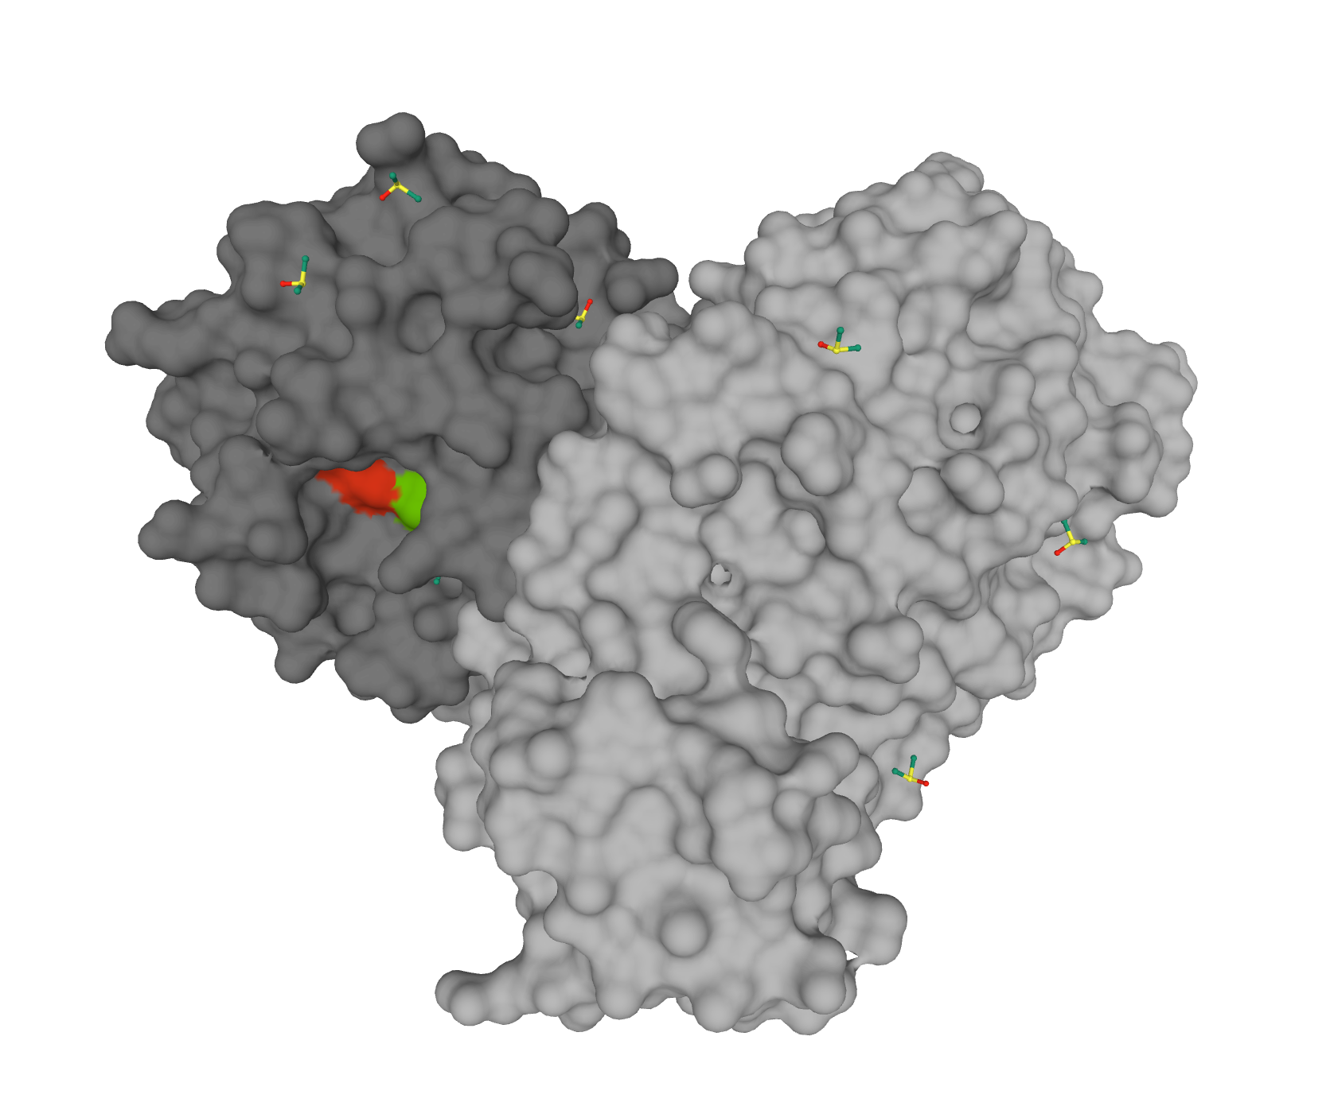
Enzyme: Structure and Function
The heart shaped enzyme functions as a homodimer (2 copies of the same protein)
Each protein chain has an active site
Overall structure very similar to SARS-CoV Main Protease
The catalytic residues (amino acids) H41 (41st amino acid Histidine) and C145 (145th amino acid Cysteine) are important for function
PDB ID 6yb7
Active site
Notes:
Original paper describing protease bound to substrate analog (PDB ID 6lu7) DOI: 10.1126/science.abb3405
https://science.sciencemag.org/content/368/6489/409

Slide 9
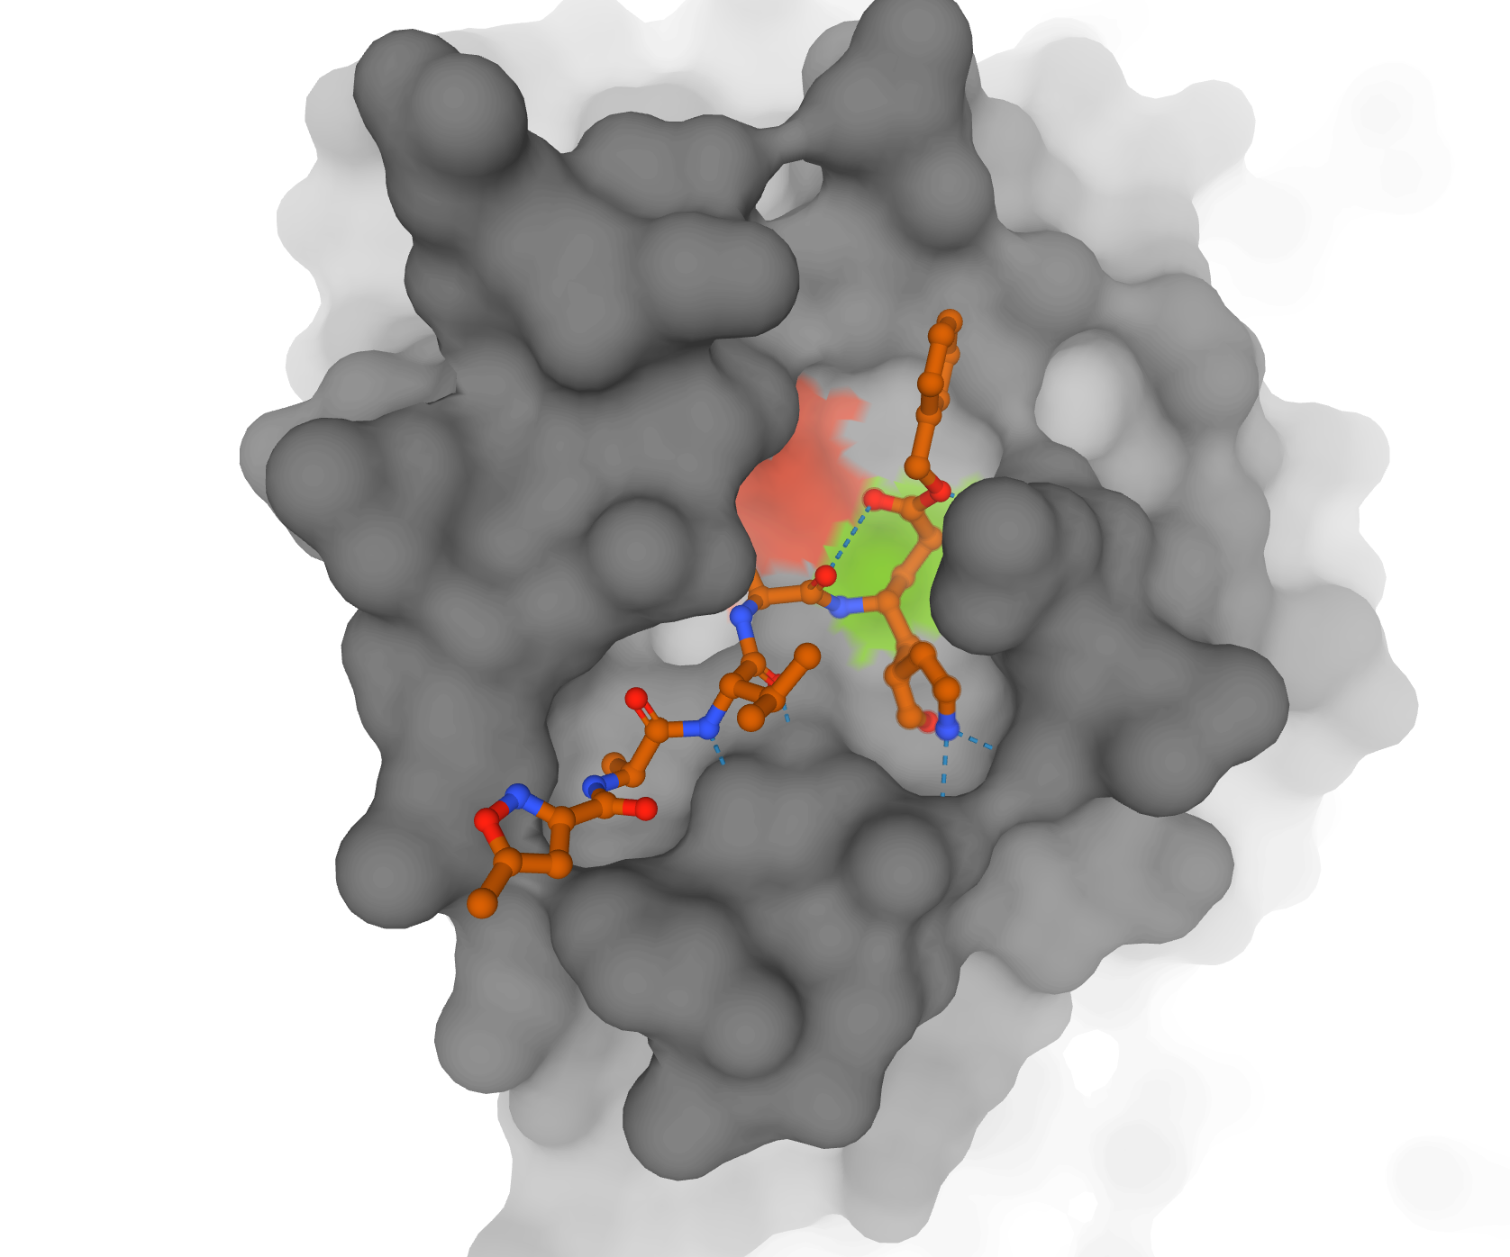
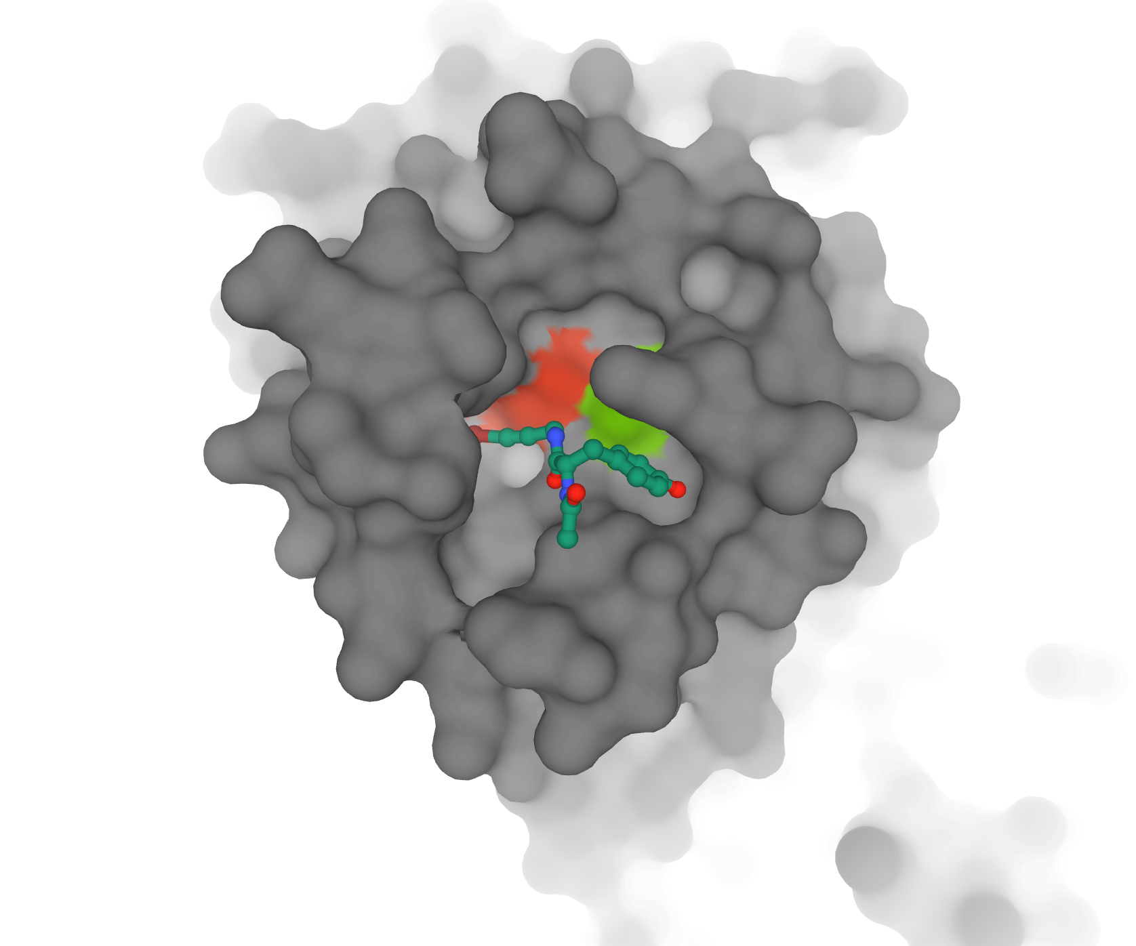
Enzyme: Substrates, Inhibitors, Drugs
Protease bound to substrate analog (PDB ID 6lu7, Liu et al., 2020)
Protease bound to inhibitor (PDB ID 5rg1, Fearon et al., 2020)
Notes:
Structures of enzyme bound to inhibitors provide insights into how the enzyme functions.
Any enzyme-substrate complex will rapidly be catalyzed so we will never be able to “see” the catalysis steps. To trap the enzyme with a substrate bound, substrate analogs are used. These molecules look like the substrate but are chemically or structurally slightly different so that the enzyme can not complete the reaction and gets “stuck”. These complexes show us how the substrate binds and how catalysis happens.
Some inhibitors are not substrate analogs but just block enzyme function by sitting in the catalytic site.
Some inhibitors can be designed to specifically bind the enzyme (and not to anything else) to interfere with a a critical function (e.g., lifecycle of the virus)

