Slide 1
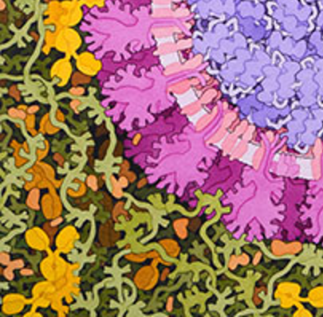
SARS-CoV-2
Spike Protein
Collaborative Curriculum Development Program
2020

Slide 2
Why Study the Spike Protein?
It specifically binds to the host receptor protein (ACE2)
It is similar to the SARS-CoV Spike protein
They are slightly different in sequence and structure
Can these differences explain why SARS-CoV was an epidemic, while SARS-CoV-2 became a pandemic (the virus is more infective)
It is the focus for vaccine development

Slide 3
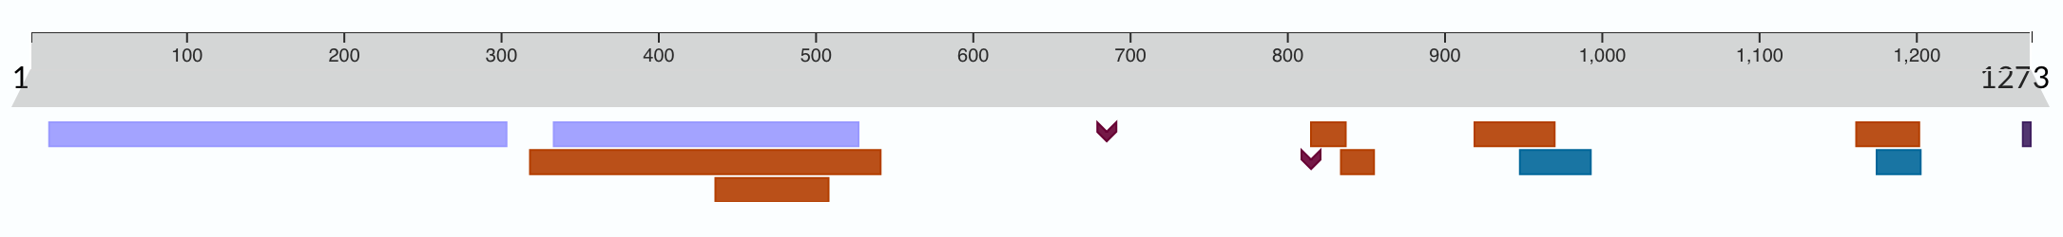
The Spike Protein Sequence
Cleavage; by TMPRSS2 or furin
S1-NTD
S1-CTD
S2’
TM
Cysm
Receptor-binding domain (RBD)
coiled-coil region
Fusion peptides
Receptor-binding motif; binding to human ACE2
Notes:
Over 1200 amino acids long
Cleaved into 2 pieces S1 and S2
RBD is in the S1 domain and the ACE2 binding piece is in S1 as well
S2 has fusion peptides that can insert itself into the host cell membrane and help the viral and host membranes fuse

Slide 4
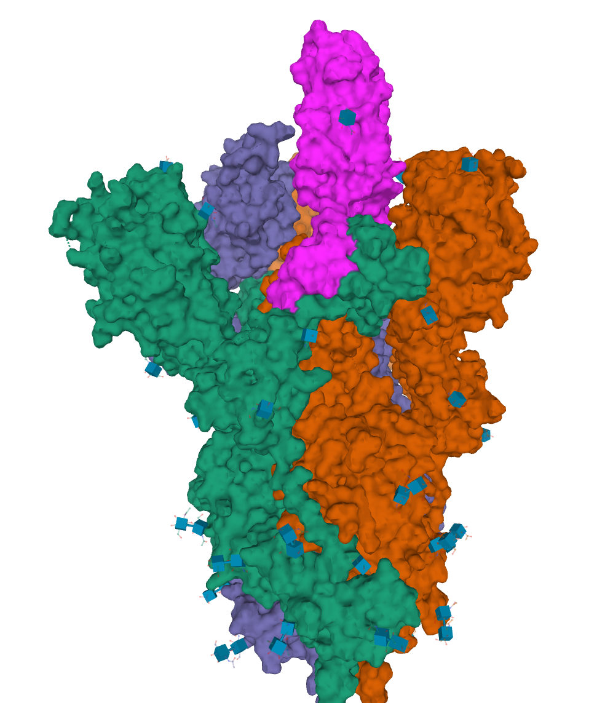
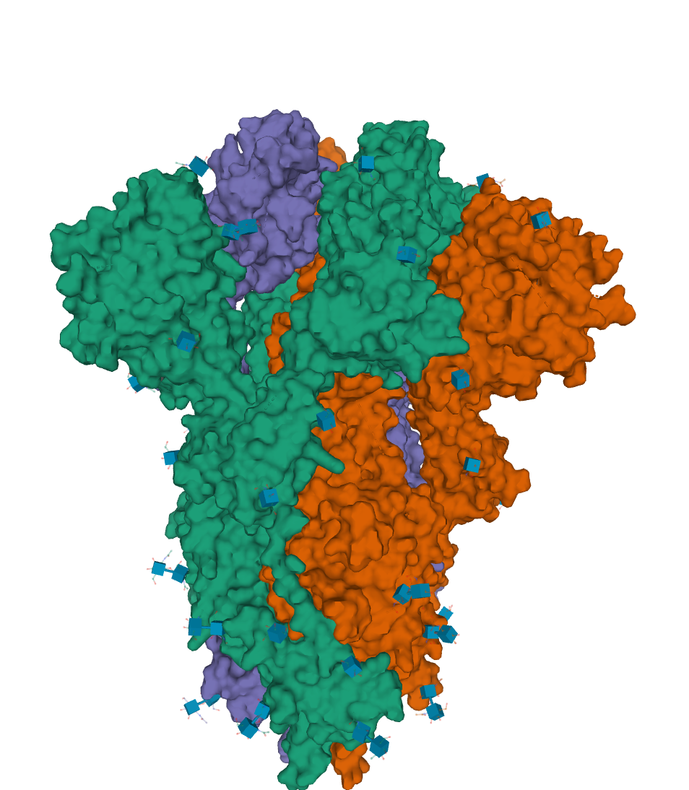
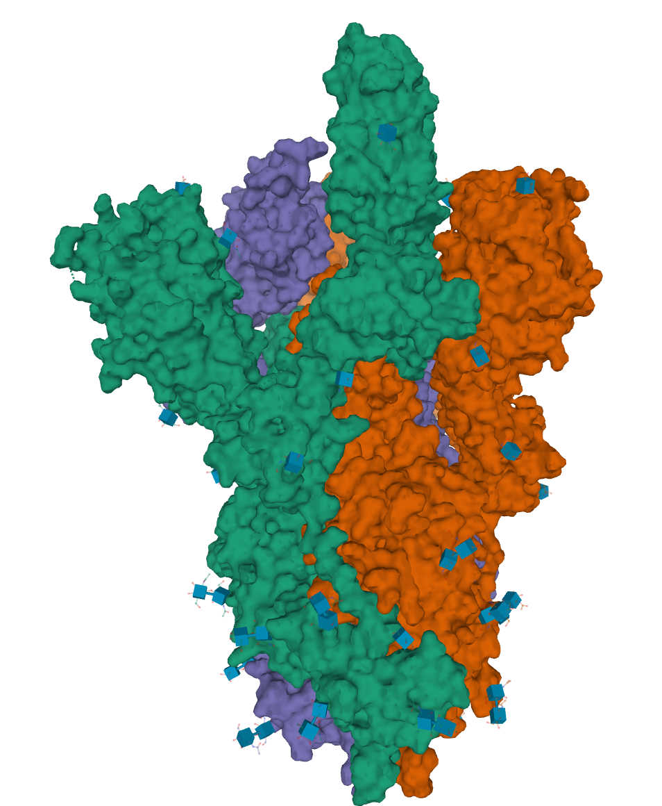
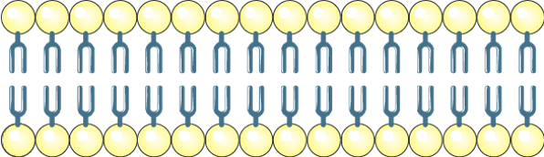
The Spike Protein Structure
SARS-CoV-2 spike (closed state)
PDB ID 6vxx
SARS-CoV-2 spike (a single receptor-binding domain up)
PDB ID 6vsb
RBD
Notes:
The spike protein is trimeric (see green, orange, and purple colored chains)
The closed form (left) the 3 spike proteins form a bulb like protrusion outside the viral membrane
In the open form note that one of the spike protein tip is raised above the other two - reaching out to bind the host target cell.
This tip is the receptor binding domain or RBD that binds to the ACE2 receptor on host cells. It is thus the target for many vaccines, where the goal is to help individuals mount an immune response so that they can produce antibodies that interfere (block) the binding of the Spike RBD to the ACE2 receptor.
Molecular structures shown here were drawn using date from the PDB and the visualization tool Mol*

Slide 5
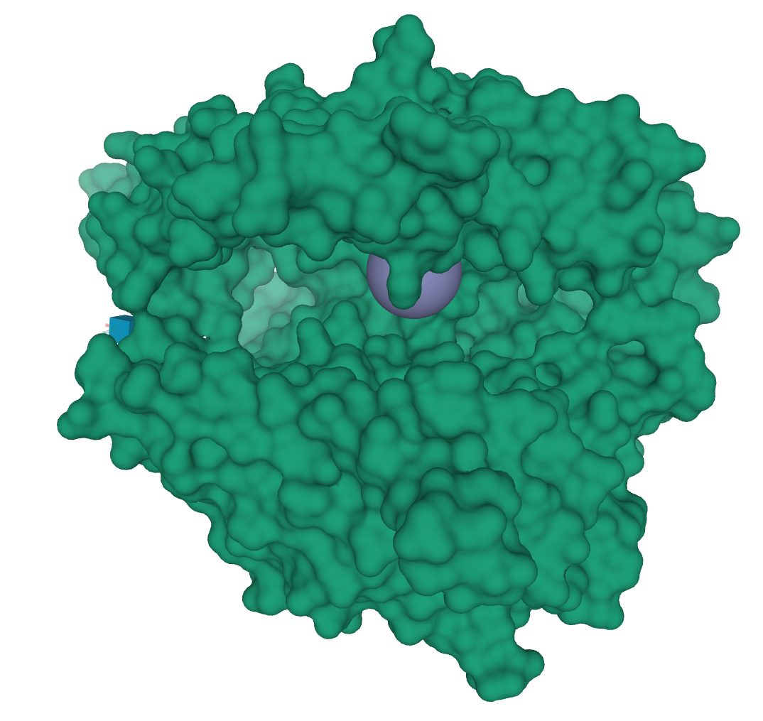
The ACE2 Receptor
Spike protein binding region
Angiotensin-converting enzyme 2
Carboxy-peptidase Enzyme
Has a Zinc bound to the active site
Converts:
Angiotensin I to angiotensin 1-9, a peptide with anti-hypertrophic effects and
Angiotensin II to angiotensin 1-7, a peptide with vasodilator and anti-proliferation effects
Overall, regulates heart function by regulating blood volume
Found on lung, GI tract mucosal cells
Receptor for SARS, and SARS-CoV-2 virus
Enzyme Active Site
ACE2 extracellular domain; PDB ID 1r42

Slide 6
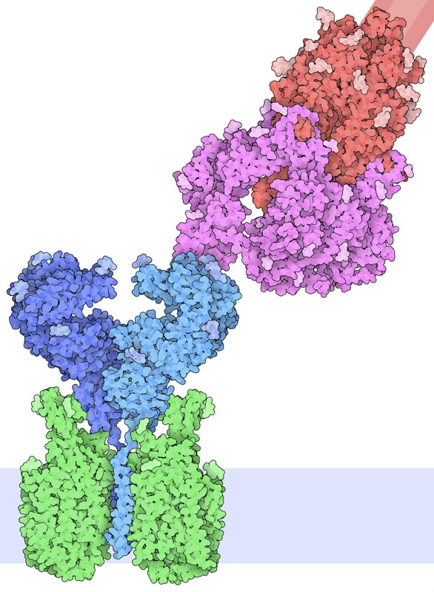
The Spike:ACE2 Binding
SARS-CoV-2 spike (a single receptor-binding domain up)
PDB ID 6vsb
The interaction of Spike protein and ACE2 is mediated by the Receptor Binding Domain (RBD) in Spike
Two different structures are shown here to provide insights into how the ACE2-RBD binding helps the Virus attach itself to host cells and how it brings the viral and host cell membranes close to each other
Spike Protein
RBD
ACE2
RBD/ACE2-Support Protein complex; PDB ID 6m17
http://pdb101.rcsb.org/motm/246

Slide 7
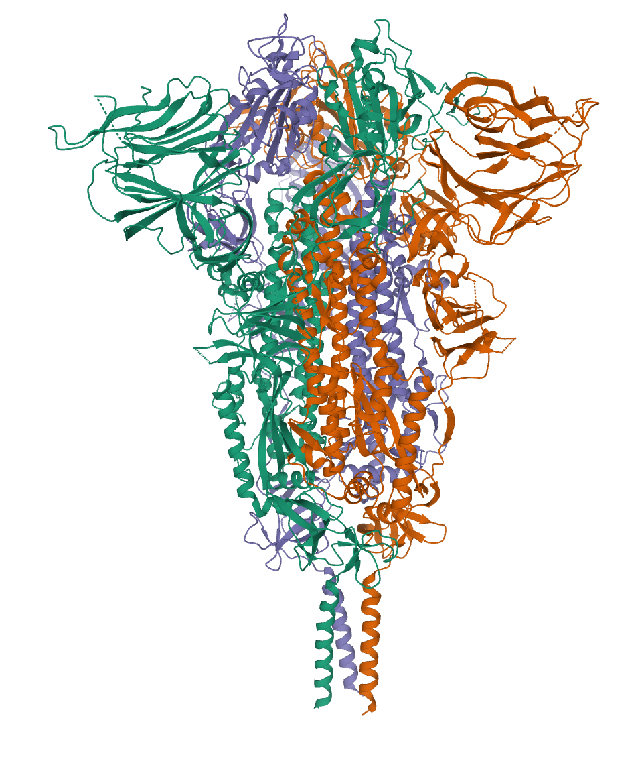
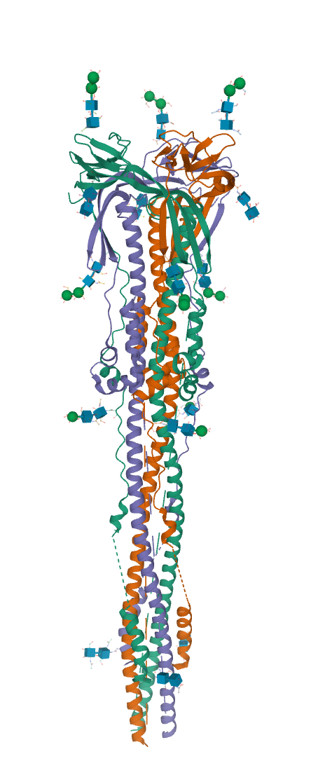
What Happens After Attachment?
N-terminal domain of the Spike protein is cleaved by host cell proteases
TMPRSS2 and Furin
SARS-CoV-2 spike protein; PDB ID 6xr8
Postfusion Spike S2 trimer; PDB ID 6xra
10.1126/science.abd4251
Notes:
Once the initial attachment has happened the host cell proteases (e.g., TMPRSS2 and Furin) cleave the N-terminal domain of Spike (S1)
The remaining part or S2 domain is still a trimer - it helps with the fusion of viarl membrane with the host cell cell membrane. See model in the next slide

Slide 8
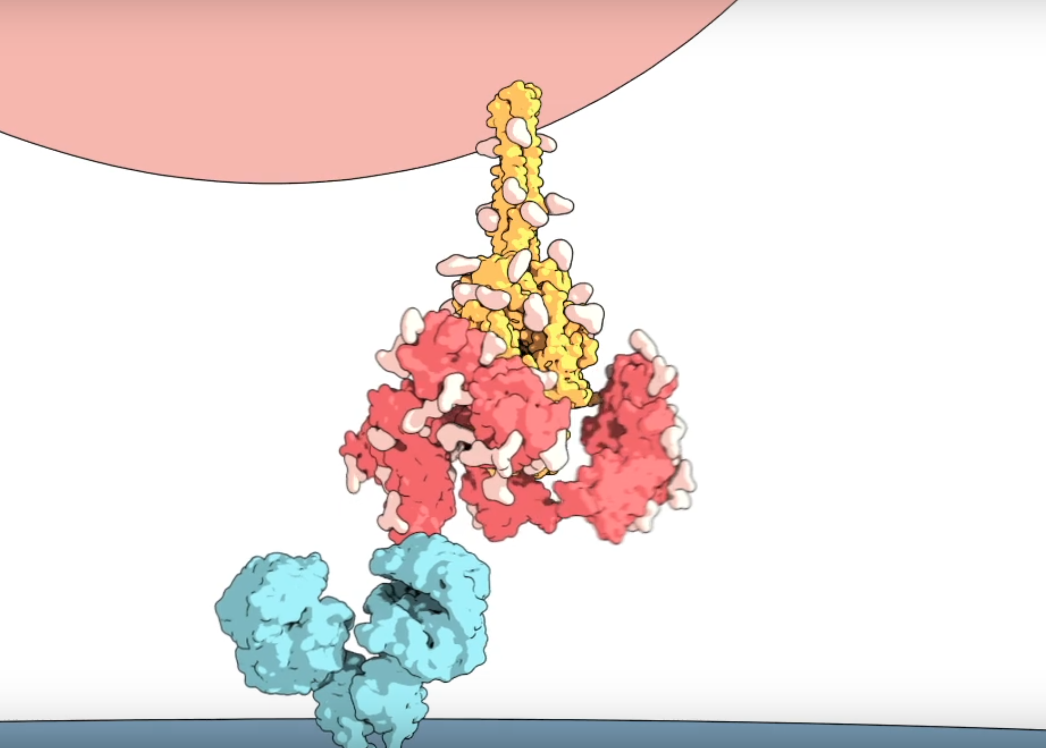
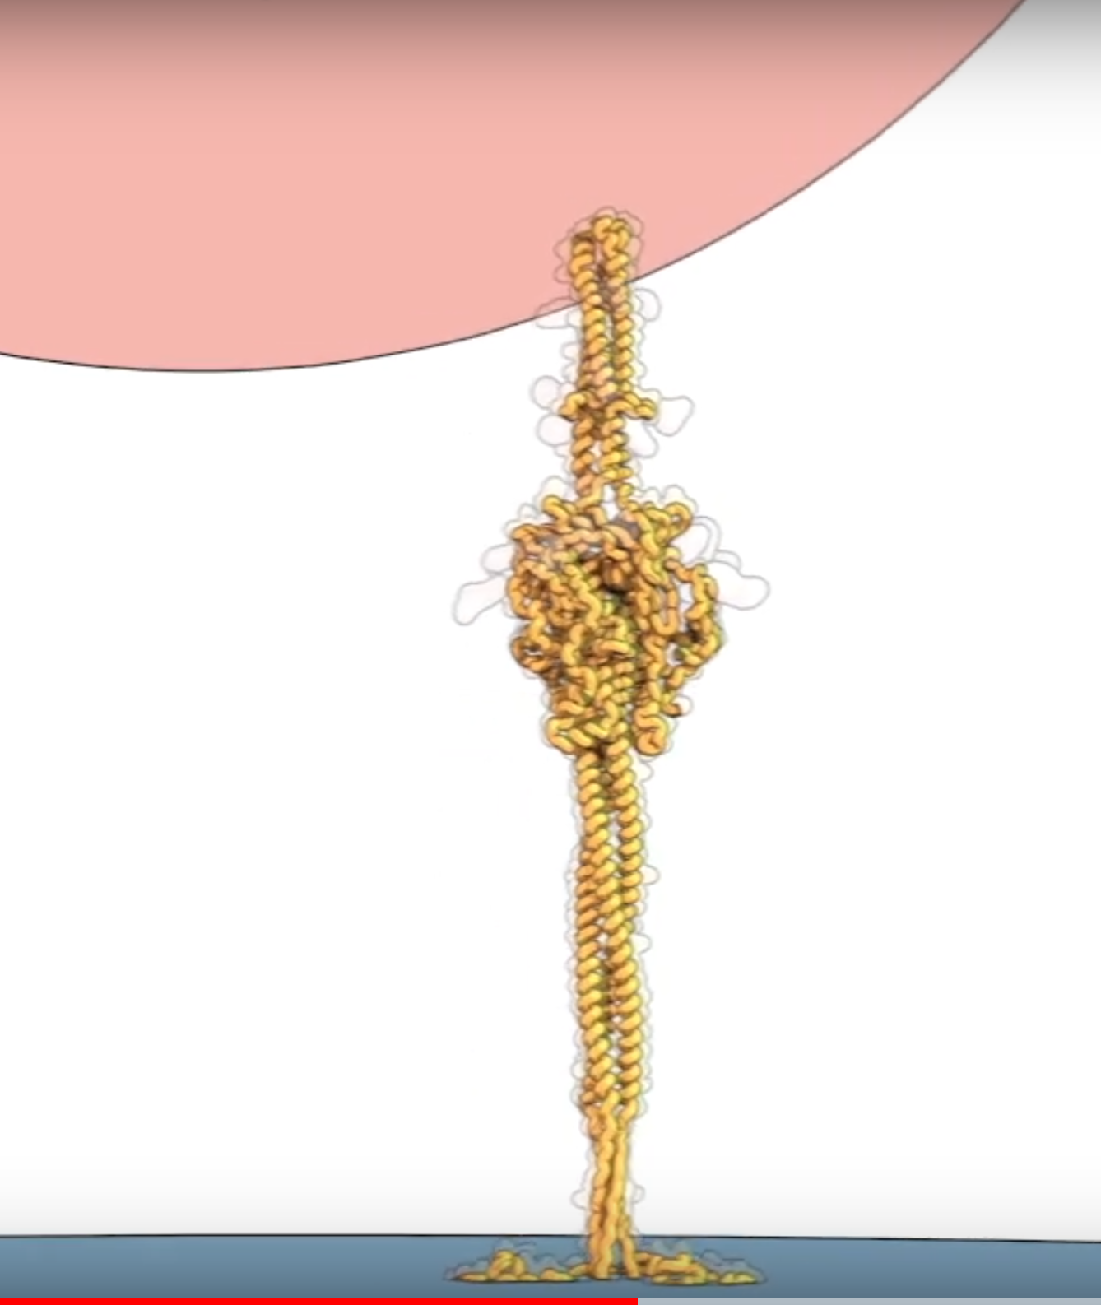
Fusion of Host cell and Viral membrarnes
Watch video https://youtu.be/e2Qi-hAXdJo
Notes:
Watch the video at the youtube link provided in the slide
The spikes bind to human cells via the ACE2 receptor and then dramatically change shape.
After cleaving the N-terminal domain or the Spike protein - the rod-like portion of the SARS-CoV-2 spike proteins are tips of the spear that will be inserted into host cells.
They jack-knife, folding in on themselves to fuse their own membrane with the membrane of host cells. And that opens the door to coronavirus infection.
See also https://discoveries.childrenshospital.org/sars-cov-2-spike-protein/

Slide 9
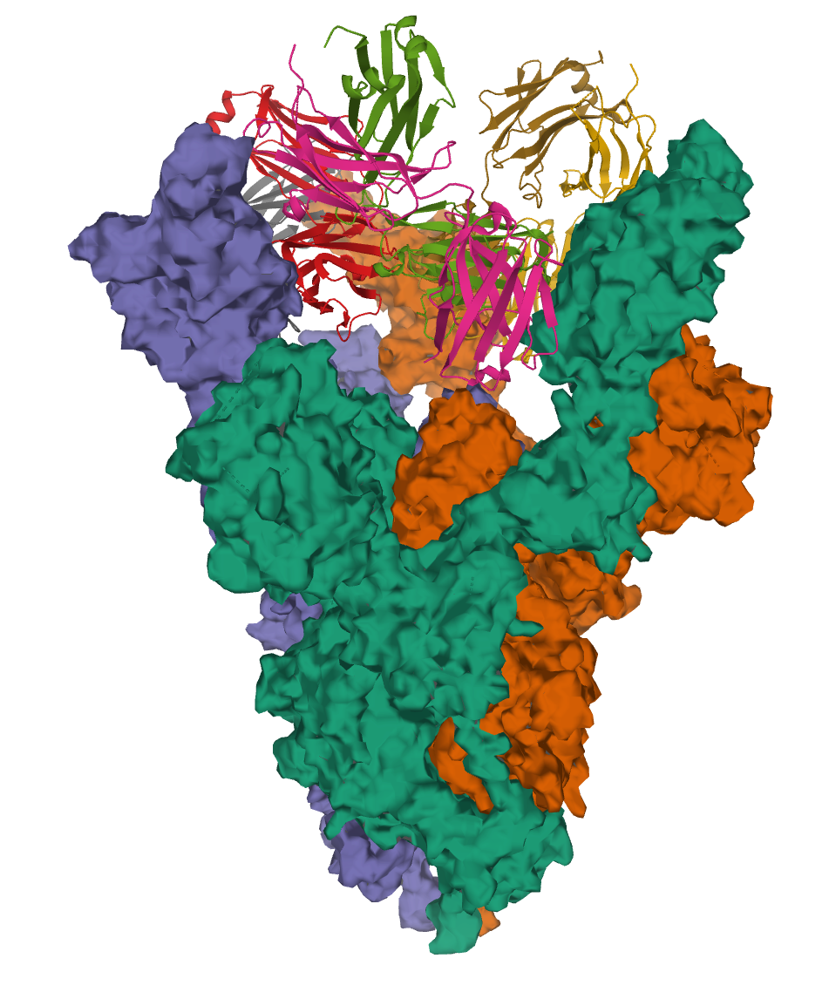
Binding Convalescent Antibody
Antibody, EY6A, isolated from an individual convalescing from COVID-19
Binds RBD of the viral spike protein tightly (KD of 2 nM)
Identifies the highly conserved epitope, away from the ACE2 receptor binding site.
Neutralizes SARS-CoV-2 and cross-reacts with SARS-CoV-1
candidate therapeutic for COVID-19
SARS-CoV-2 Spike glycoprotein in complex with a neutralizing antibody EY6A Fab; PDB ID 6zdh
Notes:
Studying the Spike protein is particularly important because our understanding the Spike protein structure is helping guide vaccine development.
Also antibody from convalescent plasma that is being tested as a therapeutic also containing antibodies against Spike protein.
For more details see 10.1038/s41594-020-0480-y

