Slide 1
Modeling tRNA’s Translator Function
An Extension of the tRNA Paper Modeling Activity

Slide 2
Contents
Background (pg 3)
Introduction and Resources
Instructions (pg 4-5)
Assembling the tRNA paper model
Exploring tRNA function
Questions (pg 6-9)
About the assembly and function of tRNA
Templates (pg 11-22)
For various tRNAs in color (pg 11-16) and black and white (pg 17-22)

Slide 3
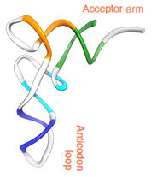
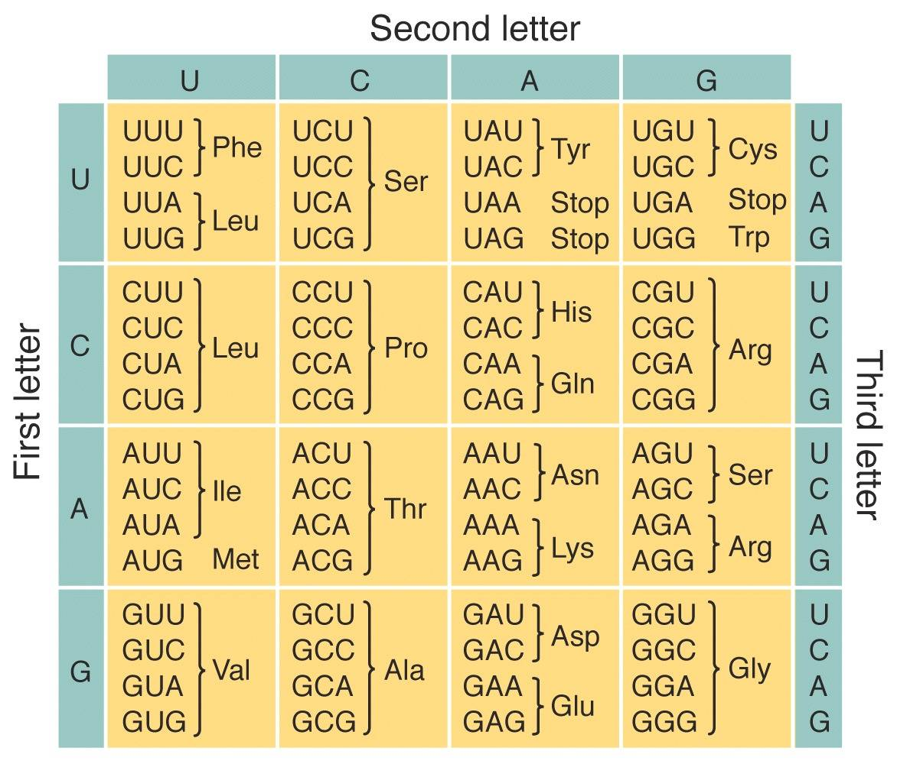
Introduction and Resources
To get started, read the Molecule of the Month articles on
tRNA: http://pdb101.rcsb.org/motm/15
Ribosome: http://pdb101.rcsb.org/motm/121
The Central Dogma
DNA → RNA → Protein
The Genetic Code
Structure of tRNA
Assumptions
Sequence of all tRNAs is not the same. Yet, in this activity only changes in anticodon sequences are considered
Overall structure of the different tRNAs is the same
Role of ribosomal subunits is not discussed here
tRNA
3

Slide 4
Instructions for Activity
Using provided templates build paper models for tRNAs (see instructions on pg 5)
Compare tRNA structures to experimentally determined model of tRNA-Phe (http://pdb101.rcsb.org/learn/resource/trna-activity-page)
Make a strand of mRNA that you can decode with the model tRNAs and write the sequence of its corresponding peptide.
Present your model for how tRNA functions
4

Slide 5
Assembling the tRNA Paper Model
5

Slide 6
Analyze the tRNA Model Structure
What is the function of tRNA?
_______________________________________________________________
How many bases are in anti-codon region of the model
_______________________________________________________________
Name of the amino acid attached to your tRNA model? _______________
What is meant by “Primary structure?” (See provided instructions)?
_______________________________________________________________
_______________________________________________________________
What is meant by “Secondary structure?” (See provided instructions)?
_______________________________________________________________
_______________________________________________________________
What is meant by “Tertiary structure?” (See provided instructions)?
_______________________________________________________________
_______________________________________________________________
6

Slide 7
Compare Paper and Interactive Models
Go to the tRNA activity page at http://pdb101.rcsb.org/learn/resource/trna-activity-page or search for “Paper Model of tRNA – RCSB Protein Data Bank”.
Scroll down to section #3 titled, “Explore Atomic Structure of tRNA” and select the “Model color scheme” option for coloring the interactive model. Can you locate the anticodon region and amino acid attachment sites? What color(s) are they?
_______________________________________________________________
_______________________________________________________________
What do the other colored regions in the models represent?
_______________________________________________________________
_______________________________________________________________
_______________________________________________________________
7

Slide 8
Modeling tRNA Function
In the group activity modeling tRNA function (with 6 tRNAs) answer the following questions.
What is the anticodon in your tRNA model? Write the sequence here.
_______________________________________________________________
Write the mRNA codon that matches your anti-codon?
_______________________________________________________________
Which amino acid is usually at the start of a synthesized peptide/protein? What is its codon?
_______________________________________________________________
What happens when the stop codon is read by the ribosome? (Hint: Read the Molecule of the Month article on Ribosomes for clues http://pdb101.rcsb.org/motm/121 )
_______________________________________________________________
_______________________________________________________________
8

Slide 9
RNA → Protein
Create a strand of mRNA that your tRNA’s can decode. Use each tRNA only once. Write down the mRNA sequence and the protein sequence below.
Final Reflection: How does the real tRNA structure (from the model and the webpage) compare to how RNA is explained in textbooks?
_______________________________________________________________
_______________________________________________________________
mRNA
sequence
_ _ _
_ _ _
_ _ _
_ _ _
_ _ _
_ _ _
U A A
Start
Stop
peptide
sequence
_ _ _
_ _ _
_ _ _
_ _ _
_ _ _
_ _ _
_ _ _
9

Slide 10
tRNA Paper Model Templates
Colored (pg 11-16)
Black and White (pg 17-22)

Slide 11
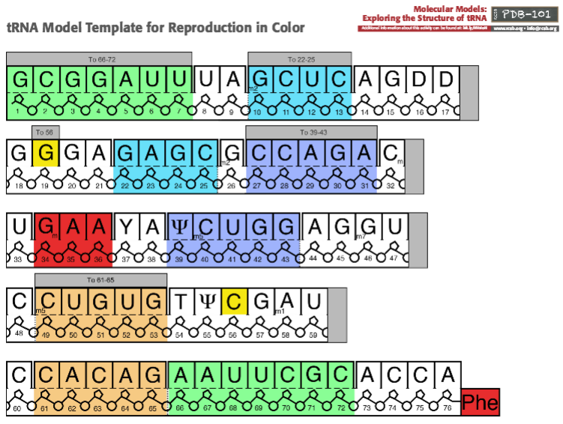
tRNA: Phe
G
A
A
Phe
11

Slide 12
tRNA: Arg
G
C
G
Arg
12

Slide 13
tRNA: Lys
C
U
U
Lys
13

Slide 14
tRNA: Pro
C
G
G
Pro
14

Slide 15
tRNA: Met (Start)
C
A
U
Met
15

Slide 16
tRNA: Leu
U
U
G
Leu
16

Slide 17
tRNA: Phe
G
A
A
Phe
17

Slide 18
tRNA: Arg
G
C
G
Arg
18

Slide 19
tRNA: Lys
C
U
U
Lys
19

Slide 20
tRNA: Pro
C
G
G
Pro
20

Slide 21
tRNA: Met (Start)
C
A
U
Met
21

Slide 22
tRNA: Leu
U
U
G
Leu
22

